Slide 1
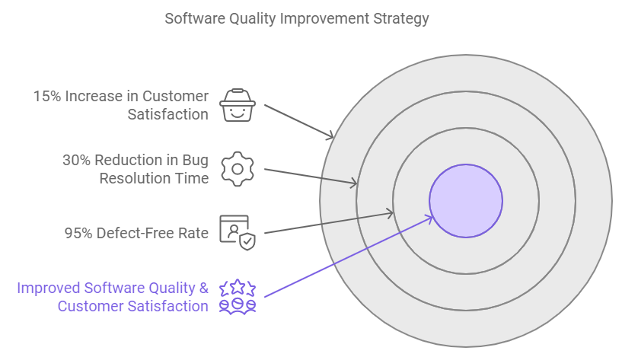
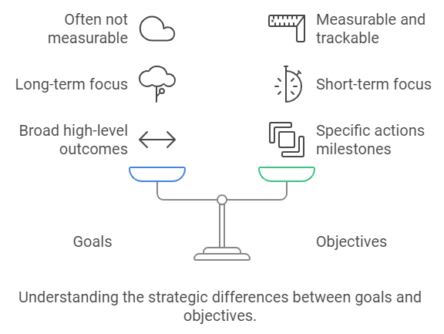
Goals vs Objective

Slide 2
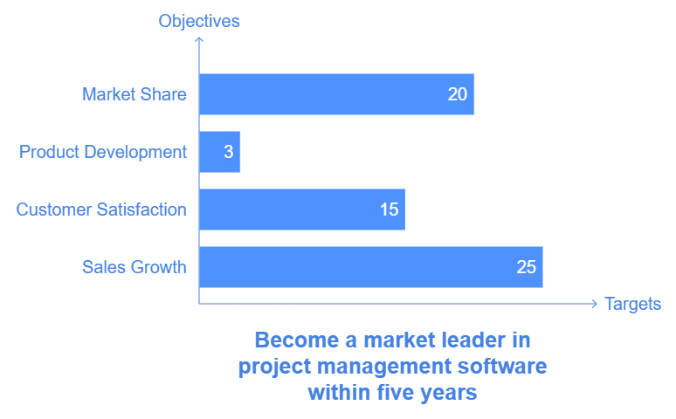

Slide 3
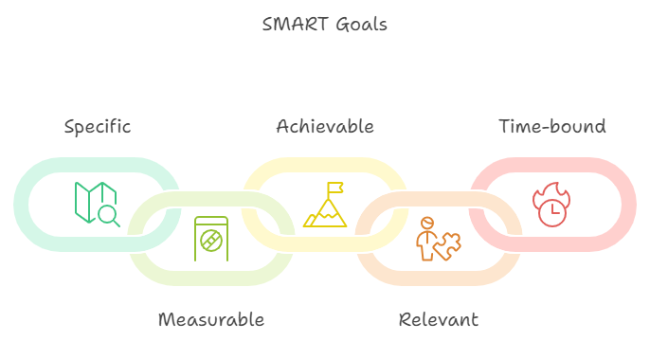
SMART Goals

Slide 4
SMART Goals
Goal: "Reduce production defects by 20% in the next six months by implementing stricter quality control checks and employee training programs."
Explanation:
Specific: Targets defect reduction.
Measurable: Goal is a 20% reduction.
Achievable: Feasible through quality control and training.
Relevant: Important for maintaining high product quality.
Time-bound: Six-month timeframe.
Goal: "Increase code coverage for all core modules from 60% to 85% by the end of Q3 by implementing automated testing practices and code reviews."
Explanation:
Specific: Focuses on improving code coverage.
Measurable: Target is 85% coverage.
Achievable: Attainable with resources and planned automation.
Relevant: Aligns with the team’s objective of improving software quality.
Time-bound: Set for completion by the end of Q3.

Slide 5
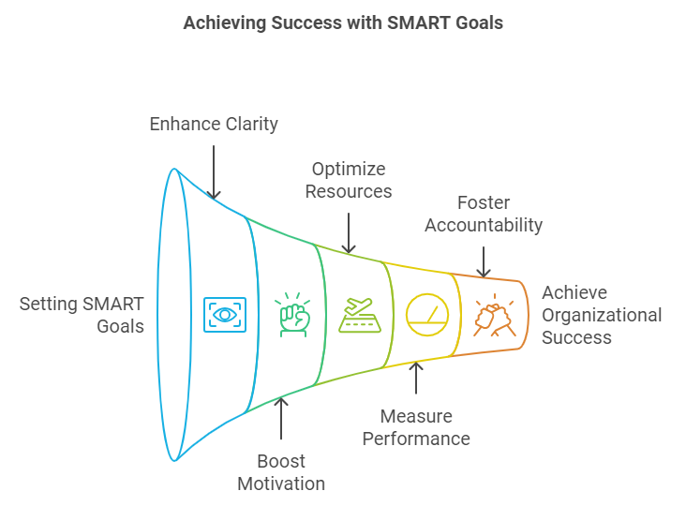
Benefits :SMART Goals
Benefits of SMART Goals
Clarity and Focus: SMART goals eliminate ambiguity, allowing teams to focus on concrete objectives.
Improved Motivation: Specific and achievable goals encourage motivation and commitment.
Better Resource Allocation: Knowing what is required helps in resource planning and avoiding wastage.
Enhanced Performance Measurement: SMART goals allow tracking progress, making it easier to adjust efforts as needed.
Greater Accountability: Time-bound goals encourage responsibility and foster accountability.

Slide 6
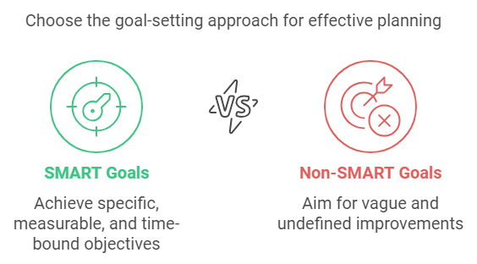
SMART vs NON-SMART
SMART Goal: "Increase website traffic by 25% in the next three months by publishing two SEO-optimized blog posts per week and promoting them on social media channels."
Non-SMART Goal: "Get more website visitors.
SMART Goal: "Complete the development of the new mobile app feature by March 30th, including thorough testing and code review to ensure a smooth release."
Non-SMART Goal: "Finish the mobile app update soon."
SMART Goal: "Improve customer satisfaction score from 80% to 90% over the next six months by implementing a new customer feedback process and resolving reported issues within 48 hours."
Non-SMART Goal: "Make customers happier."
SMART Goal: "Reduce product defects by 15% in the next quarter by enhancing quality control measures and conducting weekly training sessions for the production team."
Non-SMART Goal: "Make production quality better."
SMART Goal: "Increase sales revenue by 10% by the end of Q4 through targeted email marketing campaigns and upselling to existing customers."
Non-SMART Goal: "Boost sales."

Slide 7
Project program portfolio system
Project: A project is a temporary endeavor with a specific goal, such as creating a unique product, service, or result. Projects have defined start and end dates and are managed to achieve particular objectives within constraints like time, budget, and resources¹.
Program: A program is a collection of related projects managed in a coordinated way to obtain benefits and control not available from managing them individually. Programs focus on achieving strategic objectives and delivering outcomes that contribute to the organization’s goals¹.
Portfolio: A portfolio consists of a group of programs and projects that are managed together to achieve strategic business objectives. Portfolio management involves selecting and prioritizing projects and programs to ensure they align with the organization’s strategic goals and optimize resource use¹.
System: In the context of project management, a system refers to the set of processes, tools, and methodologies used to manage projects, programs, and portfolios. It encompasses the frameworks and standards that guide project management practices and ensure consistency and efficiency across the organization
Sure! Here are examples of a project, program, portfolio, and system in a software company:
Project: Developing a new mobile application for customer service. This project has a specific goal, timeline, and budget, and aims to create a unique product to enhance customer interactions.
Program: A digital transformation program that includes multiple related projects such as:
Developing the new mobile application.
Upgrading the company’s website.
Implementing a new Customer Relationship Management (CRM) system. These projects are managed together to achieve the broader goal of improving digital customer experiences.
Portfolio: The company’s innovation portfolio, which includes various programs and projects aimed at driving technological advancements and business growth. This portfolio might consist of:
The digital transformation program.
Research and development projects for new software products.
Initiatives to improve internal IT infrastructure. Portfolio management ensures these efforts align with the company’s strategic objectives and optimizes resource allocation.
System: The project management system used by the company, which includes tools and methodologies like Agile, Scrum, or Kanban. This system provides the framework for managing projects, programs, and portfolios, ensuring consistency, efficiency, and alignment with the company’s goals.

Slide 8
Aspect | Project | Program | Portfolio
Scope | Specific deliverable or outcome | Multiple related projects | Multiple programs and/or projects
Objective | Unique, defined end-product | Strategic benefit through synergy | Align with organizational strategy
Duration | Temporary | Often longer-term, until objectives met | Ongoing or adjusted over time
Structure | Managed by a project manager | Managed by a program manager | Managed by a portfolio manager
Example | Developing a new software application | Customer experience improvement program | Technology innovation portfolio

Slide 9
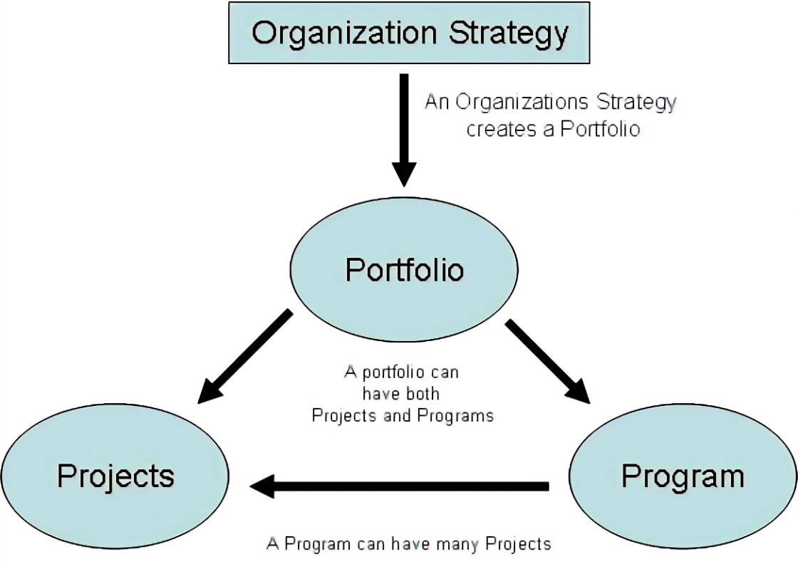
Example Scenario
Imagine a software company aiming to improve its market position:
Project: Develop a new AI-based feature for their project management software.
Program: A program to enhance user experience across all software products, including projects like the AI feature, UI redesign, and customer feedback integration.
Portfolio: The company’s entire set of initiatives, including the user experience program, new product development, and market expansion efforts.
System: The IT infrastructure and software tools that support the development, testing, and deployment of all these projects and programs.

Slide 10
Project Types
1. By Project Life Cycle
Predictive (Waterfall): Projects with well-defined requirements and scope, such as construction projects.
Iterative: Projects that evolve through repeated cycles, like software development with regular updates.
Incremental: Projects delivered in small, usable segments, such as phased rollouts of a new software feature.
Agile: Projects that adapt to changes quickly, often used in software development.
Hybrid: A combination of predictive and agile approaches, suitable for complex projects with both stable and evolving elements.
2. By Application Area
Construction: Building infrastructure like bridges or buildings.
IT and Software Development: Creating or upgrading software applications.
Healthcare: Implementing new healthcare systems or medical devices.
Marketing: Launching new marketing campaigns or branding initiatives.
3. By Complexity
Simple Projects: Projects with straightforward objectives and few dependencies, such as updating a website.
Moderately Complex Projects: Projects with multiple stakeholders and interdependencies, like developing a new software module.
Highly Complex Projects: Projects with high uncertainty and numerous interdependencies, such as launching a new product line.

Slide 11
Project Types
4. By Strategic Importance
Operational Projects: Focused on improving current operations, like process optimization.
Strategic Projects: Aligned with long-term goals, such as entering a new market.
Compliance Projects: Ensuring adherence to regulations, like implementing GDPR compliance.
5. By Resource Requirements
Capital Projects: Require significant financial investment, such as building a new data center.
Operational Projects: Utilize existing resources and focus on efficiency, like upgrading software systems.
6. By Duration
Short-term Projects: Completed within a few months, such as a marketing campaign.
Medium-term Projects: Lasting several months to a year, like developing a new software application.
Long-term Projects: Spanning multiple years, such as large infrastructure projects.

Slide 12
Project Types
4. By Strategic Importance
Operational Projects: Focused on improving current operations, like process optimization.
Strategic Projects: Aligned with long-term goals, such as entering a new market.
Compliance Projects: Ensuring adherence to regulations, like implementing GDPR compliance.
5. By Resource Requirements
Capital Projects: Require significant financial investment, such as building a new data center.
Operational Projects: Utilize existing resources and focus on efficiency, like upgrading software systems.
6. By Duration
Short-term Projects: Completed within a few months, such as a marketing campaign.
Medium-term Projects: Lasting several months to a year, like developing a new software application.
Long-term Projects: Spanning multiple years, such as large infrastructure projects.

Slide 13
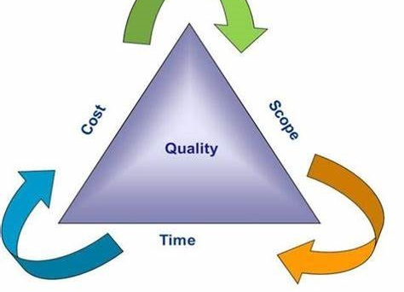
Project Constraints
Project constraints are the limitations that define the boundaries within which a project must operate. These constraints are crucial for project planning, execution, and control. The primary constraints are often referred to as the Triple Constraint or Iron Triangle, which includes.
1. Scope
Definition: The work required to deliver a product, service, or result with the specified features and functions.
Impact: Changes in scope can affect the project’s cost and schedule.
Example: Adding new features to a software project increases the scope.
2. Time
Definition: The schedule for completing the project, including deadlines for each phase and the final delivery.
Impact: Delays can increase costs and affect the quality of the deliverables.
Example: A project to develop a new software application must be completed in six months.
3. Cost
Definition: The budget allocated for the project, including all resources required.
Impact: Budget overruns can lead to project failure or require additional funding.
Example: The total budget for developing a new software application is $500,000.

Slide 14
Additional Constraints
4. Quality
Definition: The standards and criteria to which the project’s deliverables must adhere.
Impact: Compromising on quality can lead to stakeholder dissatisfaction and rework.
Example: Ensuring the software meets all user requirements and passes all quality assurance tests.
5. Risk
Definition: Potential events that could impact the project positively or negatively.
Impact: Risks need to be managed to minimize their impact on the project.
Example: The risk of a key team member leaving the project.
6. Resources
Definition: The people, equipment, materials, and facilities needed to complete the project.
Impact: Resource constraints can delay the project and increase costs.
Example: Limited availability of skilled developers for the software project.
7. Benefits
Definition: The value or benefits that the project is expected to deliver.
Impact: Projects must deliver sufficient benefits to justify the investment.
Example: The software project is expected to increase productivity by 20%.

Slide 15
Managing Constraints
Effective project management involves balancing these constraints to achieve project success. Here are some strategies:
Prioritize Constraints: Determine which constraints are most critical and focus on managing them.
Monitor and Control: Regularly track project performance against the constraints and make adjustments as needed.
Stakeholder Communication: Keep stakeholders informed about constraints and any changes to them.
Risk Management: Identify, assess, and mitigate risks that could impact the constraints.

Slide 16
Project
A project is a temporary endeavor undertaken to create a unique product, service, or result. It has a defined beginning and end, with specific objectives and constraints such as time, budget, and resources.
Key Characteristics:
Temporary: Defined start and end dates.
Unique Deliverables: Specific outcomes like a new product, service, or system.
Progressive Elaboration: Incremental refinement of project details.
Example:
Building a new website for an e-commerce company within six months.
Developing a mobile application for online banking.

Slide 17
Project Manager
A Project Manager (PM) is a professional responsible for planning, executing, and closing a project. The PM ensures that the project is completed on time, within budget, and meets its objectives.
Example:
A PM overseeing the development of a new marketing campaign coordinates with designers, writers, and clients to ensure timely delivery.

Slide 18
Project Management
Project Management is the application of knowledge, skills, tools, and techniques to project activities to meet the project requirements. It involves managing scope, schedule, cost, quality, resources, and risks.
Example:
Project management for launching a product includes:
Setting timelines.
Allocating team roles.
Managing risks like supply chain delays.

Slide 19
Advantages of Project Management
Clear Objectives:
Defines goals and deliverables.
Example: A PM sets a target to complete software development in 3 months.
Better Resource Management:
Ensures optimal use of resources (human, financial, technical).
Example: Allocating developers to high-priority features.
Risk Mitigation:
Identifies potential risks and plans mitigations.
Example: Creating backup plans for data loss during app testing.
Improved Communication:
Enhances collaboration and stakeholder engagement.
Example: Weekly meetings to review progress.
Enhanced Quality:
Focuses on meeting standards and delivering value.
Example: Quality assurance processes to ensure app reliability.

Slide 20
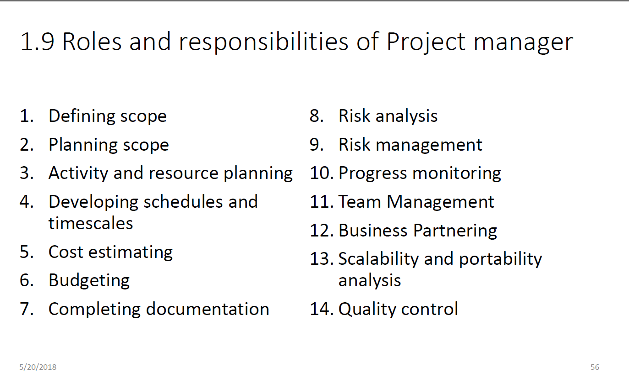

Slide 21
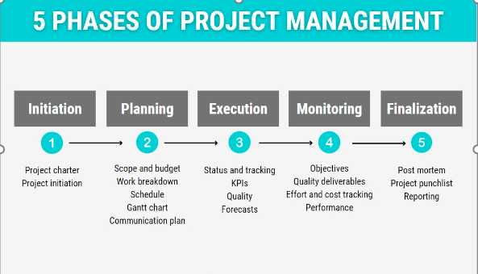
Project Management
Project management is the application of knowledge, skills, tools, and techniques to project activities to meet project requirements. It involves several key processes and phases, including:
Initiation: Defining the project and obtaining authorization.
Planning: Establishing the scope, objectives, and procedures.
Execution: Coordinating people and resources to carry out the plan.
Monitoring and Controlling: Tracking, reviewing, and regulating progress and performance.
Closing: Finalizing all activities to formally close the project.

Slide 22
Initiation
1. Initiation Phase
Purpose: Define the project at a high level and secure authorization to proceed.
Inputs:
Project Charter Template: Outlines goals, stakeholders, and constraints.
Business Case: Justifies the project and its value.
Stakeholder Register: Identifies key stakeholders and their interests.
Enterprise Environmental Factors (EEFs): External factors like industry standards or market conditions.
Organizational Process Assets (OPAs): Templates, lessons learned from past projects.

Slide 23
Initiation
Processes:
Develop Project Charter.
Identify Stakeholders.
Outputs:
Project Charter: Document authorizing the project, containing objectives and key requirements.
Stakeholder Register: List of stakeholders, their roles, and engagement levels.
Example:
A company wants to develop a mobile app for e-commerce.
Input: Market analysis report, proposal.
Output: Approved Project Charter with the app's scope (e.g., features like user login, payment integration).

Slide 24
Planning
Purpose: Create a roadmap to achieve the project goals.
Inputs:
Project Charter: Provides high-level project details.
Stakeholder Register: Guides stakeholder engagement plans.
Requirements Documentation: Details of stakeholder needs.
Risk Register: Identified risks to be mitigated.
Processes:
Define Scope.
Develop Project Management Plan.
Plan Resources, Budget, Schedule, and Risks.
WBS: Break down the software development process into tasks like design, coding, testing, and deployment.

Slide 25
Planning
Outputs:
Project Management Plan: Comprehensive plan covering scope, schedule, cost, quality, communication, and risk.
Baseline Plans: Approved versions of scope, schedule, and budget.
Risk Management Plan: Strategy for handling risks.
Resource Plan: Allocation of team and tools.
Example:
For the mobile app, the plan includes timelines for design (2 months), development (3 months), and testing (1 month).
Input: User requirements, team skills.
Output: Gantt chart, risk matrix, and project plan.

Slide 26
Execution
Purpose: Implement the project plan to produce deliverables.
Inputs:
Project Management Plan: Guides execution.
Approved Change Requests: Reflect any modifications.
Project Documents: Scope, schedules, and contracts.
Resource Assignments: Allocated team and tools.
Processes:
Manage Project Work.
Acquire Resources.
Execute Communication and Quality Plans.

Slide 27
Execution
Outputs:
Deliverables: Tangible or intangible outputs (e.g., app prototype).
Issue Log: Tracks problems during execution.
Performance Reports: Metrics on progress, quality, and cost.
Updated Project Plan: Reflecting ongoing changes.
Example:
Developing the e-commerce app:
Input: Project management plan, resource assignments.
Output: Functional app prototype, progress reports.

Slide 28
Monitoring and Control
Outputs:
Deliverables: Tangible or intangible outputs (e.g., app prototype).
Issue Log: Tracks problems during execution.
Performance Reports: Metrics on progress, quality, and cost.
Updated Project Plan: Reflecting ongoing changes.
Example:
Developing the e-commerce app:
Input: Project management plan, resource assignments.
Output: Functional app prototype, progress reports.

Slide 29
Monitoring and Control
Outputs:
Work Performance Reports: Consolidated progress data.
Change Requests: Approved modifications to the plan.
Corrective Actions: To address deviations.
Updated Documents: Logs, risk register, and plan.
Example:
If testing the app shows issues with payment integration, monitoring identifies delays, and corrective actions are taken to allocate more developers to fix the problem.
Input: Test reports, Gantt chart.
Output: Updated timeline, change request approval.

Slide 30
Closing
Purpose: Finalize the project and hand over deliverables.
Inputs:
Project Management Plan: For closure requirements.
Accepted Deliverables: From quality checks.
OPAs: Closure guidelines and templates.
Processes:
Close Project or Phase.
Finalize all Activities.

Slide 31
Closing
Outputs:
Final Product/Service: Handover of the deliverable.
Lessons Learned Register: Record of what worked and what didn’t.
Final Report: Summary of project performance.
Archived Documents: For future reference.
Example:
The mobile app is deployed to app stores.
Input: Testing reports, approved deliverables.
Output: Delivered app, project closure report, feedback.

Slide 32
Project Charter
A Project Charter is a formal document that authorizes the project and provides a high-level overview of the project objectives, key stakeholders, and resources. It serves as the foundational reference document.
Key Components:
Objectives: What the project aims to achieve.
Scope: High-level deliverables.
Stakeholders: Key individuals or groups.
Constraints: Time, budget, resources.
Example:
Project: Development of an E-commerce Platform.
Charter Highlights:
Objective: Build a mobile-friendly e-commerce platform within six months.
Sponsor: CEO of the company.
Budget: $500,000.
Milestones: Design (1 month), Development (3 months), Testing (1 month).

Slide 33
Project Charter
A project charter is an official document that outlines the objectives, scope, and participants of a project. It serves as a preliminary delineation of roles and responsibilities, identifies the main stakeholders, and defines the authority of the project manager.
Why is a Project Charter Needed?
A project charter is crucial because it:
Authorizes the Project: It formally initiates the project and grants the project manager the authority to use organizational resources.
Defines Objectives and Scope: It clearly outlines what the project aims to achieve and the boundaries within which it will operate, helping to prevent scope creep.
Aligns Stakeholders: It ensures that all stakeholders have a shared understanding of the project’s goals, scope, and deliverables.
Provides a High-Level Plan: It offers a broad overview of the project, including timelines, key milestones, and potential risk

Slide 34
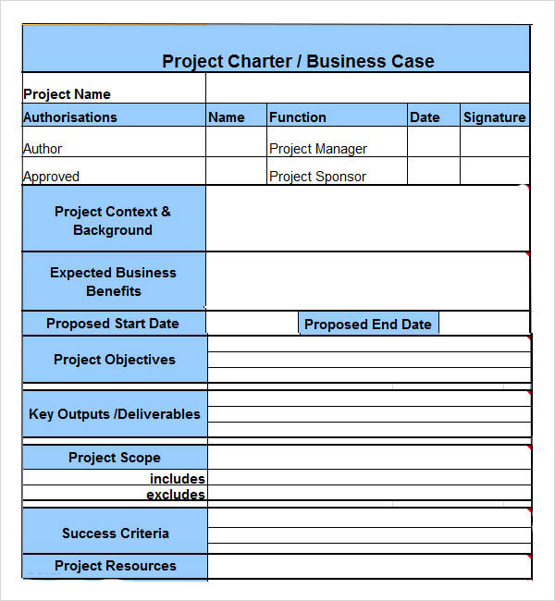
Project Charter

Slide 35
Stakeholder Register
A Stakeholder Register is a document that identifies all stakeholders involved in the project, their roles, and their influence or interest in the project.
Key Components:
Stakeholder Name.
Role/Responsibility.
Influence Level (High, Medium, Low).
Engagement Strategy.
Types:
Internal Stakeholders: Project team, managers, or executives.
External Stakeholders: Clients, vendors, regulatory agencies.

Slide 36
Stakeholder Register
Example:
Name | Role | Influence | Engagement Strategy
John Smith | Project Sponsor | High | Weekly progress reports
Jane Doe | Client | High | Bi-weekly updates
Sarah Johnson | QA Lead | Medium | Daily sync meetings

Slide 37
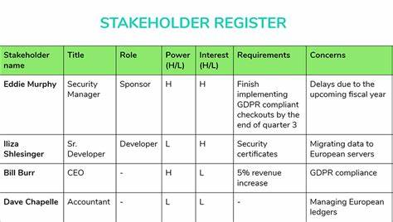
Stakeholder Register

Slide 38
EEF
EEFs are external or internal factors that influence a project's success but are outside the project manager's control.
Types:
Internal EEFs:
Organizational structure.
Company culture.
Resource availability.
External EEFs:
Market conditions.
Regulatory requirements.
Technological advancements.
Example:
Internal EEF: Limited skilled resources due to hiring freeze.
External EEF: A new data privacy law affecting app design.

Slide 39
EEF
Enterprise Environmental Factors (EEF)
EEF are external and internal factors that impact a project's success but are not under the control of the project team. These factors can include:
External EEF: Government regulations, market conditions, industry standards, and legal restrictions.
Internal EEF: Organizational culture, infrastructure, available resources, and internal political conditions.
Example of EEF: If a project is being executed in a country with strict environmental regulations, these regulations would be considered an EEF. The project team must comply with these regulations, which could affect project timelines and costs

Slide 40
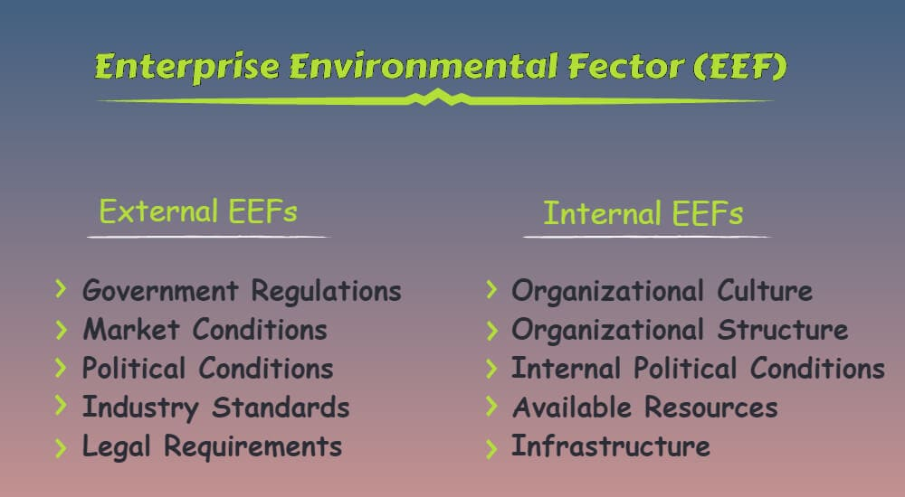
EEF

Slide 41
OPA
OPAs are resources and tools within an organization that help manage projects. These include templates, processes, policies, and historical data.
Types:
Processes and Procedures:
Risk management procedures.
Quality assurance policies.
Knowledge Repositories:
Lessons learned.
Historical project data.
Example:
OPA Resource: A risk management template from a previous project.
Knowledge Repository: Lessons learned from a past app development project.

Slide 42
OPA
Organizational Process Assets (OPA)
OPA are internal to the organization and include any processes, policies, procedures, and knowledge bases that the organization uses to manage projects. These assets help ensure consistency and efficiency in project execution.
OPA can be divided into two main categories:
Processes, Policies, and Procedures: These include project initiation processes, risk management policies, and change control procedures.
Organizational Knowledge Bases: These are repositories of historical information, lessons learned, and project documentation.
Example of OPA: A company might have a standardized project management template that all project managers use to create their project plans. This template ensures that all projects follow a consistent format and include all necessary information

Slide 43
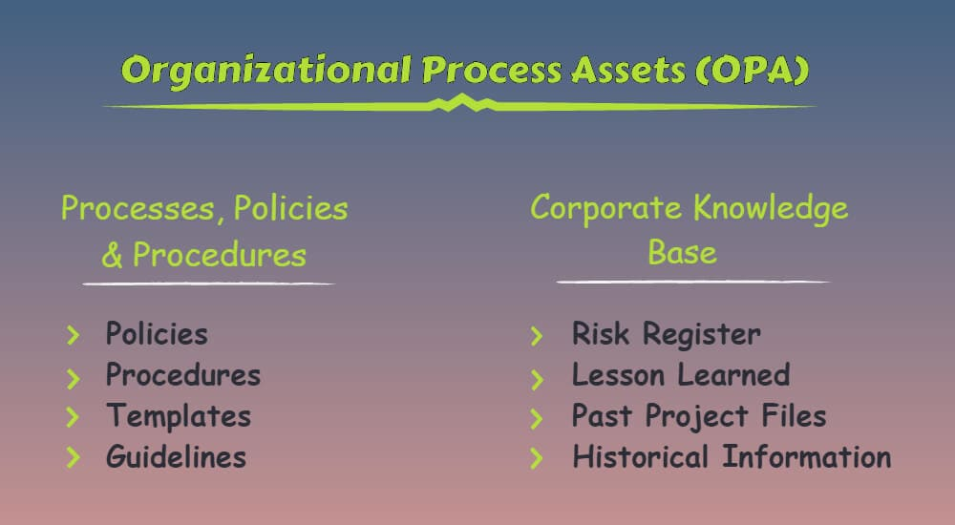
OPA

Slide 44
Risk Register
A Risk Register is a document that lists all identified risks, their potential impacts, and mitigation strategies.
Key Components:
Risk Description.
Likelihood: Probability of occurrence.
Impact: Severity on the project.
Owner: Person responsible for managing the risk.
Mitigation Plan: Actions to reduce risk.
Types:
Project Risks:
Technical Risks: Technology not performing as expected.
Schedule Risks: Delays in key milestones.
Operational Risks:
Resource Risks: Unavailability of key team members.
Budget Risks: Cost overruns.
External Risks:
Regulatory Risks: Compliance with new laws.
Environmental Risks: Natural disasters.

Slide 45
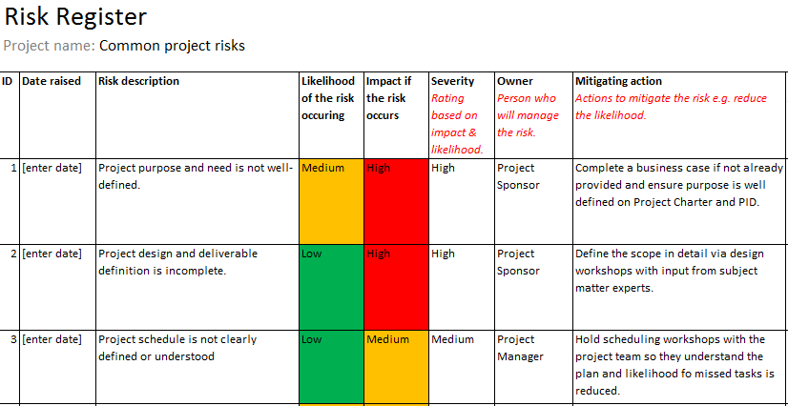
Risk Register

Slide 46
Risk Register
Example:
Risk | Likelihood | Impact | Owner | Mitigation Plan
Payment gateway failure | High | High | Tech Lead | Test backup gateways in advance
Developer availability | Medium | Medium | PM | Cross-train team members
Data privacy compliance | High | High | Legal Team | Regular audits and reviews

Slide 47
Summary
Term | Definition | Example
Project Charter | High-level document that authorizes the project. | Charter for developing a new app with objectives and budget.
Stakeholder Register | List of stakeholders, their roles, and strategies to manage them. | A table identifying the CEO, project team, and client as stakeholders with respective influence levels.
EEF | External and internal factors influencing the project. | Regulatory laws affecting app compliance, company culture, or resource availability.
OPA | Organizational resources like templates, processes, and lessons learned. | Risk management template from a previous project or a knowledge base for troubleshooting issues.
Risk Register | Document listing risks, their likelihood, impact, and mitigation strategies. | Risk of delayed project delivery due to team shortage, with a cross-training plan as mitigation.

Slide 48
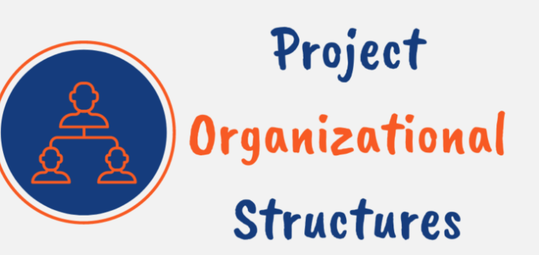
Organizational Structure
For a company, choosing the right organizational structure is crucial for project success.
And for a project manager, the organizational structure of the company you are working with largely determines your authority and how you manage projects.
Most companies use either a functional, matrix, or projectized organizational structure. Each has strengths and weaknesses depending on factors like company size, industry, and objectives.

Slide 49
Organizational Structure
The organizational structure defines how a company arranges its staff to achieve its objectives.
It establishes lines of authority and communication, allocates resources, and affects many aspects of business operations, including workflow, resource utilization, and project outcomes.
An organization’s structure directly impacts project success in a ton of ways. It determines:
How project resources are allocated
The level of authority granted to project managers
Efficiency of decision-making and governance
Collaboration and information flow
Project budget oversight and spending

Slide 50
Types of Organization
Basis for Categorizing Organizations
Organizations are categorized based on several factors:
Authority Distribution: How authority and decision-making power are distributed (e.g., centralized vs. decentralized).
Project Management Needs: The extent to which projects drive the organization’s operations.
Resource Allocation: How resources are allocated and managed across different functions and projects.
Operational Focus: Whether the focus is on functional efficiency or project outcomes.

Slide 51
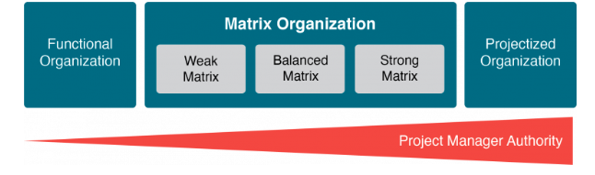

Slide 52
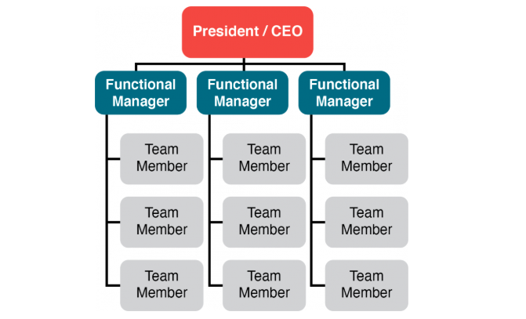
Functional Organization
Description: In this structure, the organization is divided into departments based on functions (e.g., marketing, finance, HR). Each department is managed independently.
Example: A company where the marketing team reports to the Marketing Manager, and the finance team reports to the Finance Manager.

Slide 53
Functional Organization
In a functional organization, the company is divided into different functional areas, such as IT, finance, marketing, sales, HR, etc.
It has tall hierarchies with narrow spans of control and communication moves vertically within siloed units.
Each department works independently and is led by a department manager who reports to the top management.
In this type of setup, projects are usually managed within the functional unit and project resources are likely to report to their functional manager who has the highest authority and decision-making power.
This structure is common in organizations where projects often serve the ongoing operations of the company.
Functional structures promote specialization as employees build expertise in their field by repeating similar tasks with their focus aligned with their department’s singular purpose.

Slide 54
When functional?
Here are some specific situations where functional organizational models thrive:
Organizations with little change in offerings or processes
Mature industries with established practices
Companies focused on efficiency and core expertise
Businesses with single or low variety products
Environments with low innovation and simple operations

Slide 55
Advantages and Disadvantages of Functional
Functional organizations have these key advantages:
Promotes skill development within functions
Achieves efficiencies from repetitive work
Clear structure with a single chain of command
Simpler coordination within functions
Functional managers control resources and budgets
Conversely, functional models present these disadvantages:
Communication limited across functional silos
Delayed responses to change
Limited collaboration across departments
Resource duplication across units
Constrained overview of organizational objectives
Project managers have little to no real authority

Slide 56
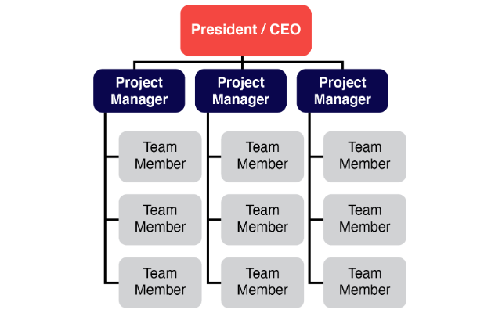
Projectized Organization
Projectized Organization:
Description: In this structure, the organization is structured around projects. Project managers have full authority over the project team.
Example: A construction company where each project (e.g., building a bridge) has its own dedicated team and project manager.

Slide 57
Projectized Organization
In a projectized organization, the organization is structured around projects. That means the team is assembled to complete a project.
In projectized models, the project manager has complete authority over the project. They make resource allocation decisions and manage the budget while the project team focuses solely on their project with no competing priorities.
Once projects end, resources are reassigned to new teams. Projectized organizations maintain a small support staff to handle functions like legal, HR, and facilities. However, most employees are dedicated to project work.
This structure is common in consultancies, construction, and other fields where a team comes together to accomplish a defined project and then moves on to different projects.

Slide 58
When Projectized?
Specific situations where projectized models excel include:
Organizations with primarily project-based work
Businesses that change objectives frequently
Short-term projects with a defined lifespan
Environments with many unique deliverables
Companies requiring cross-functional collaboration

Slide 59
Projectized organizations have these key advantages:
Strong alignment and focus on project objectives
Project managers have significant authority over resources
Adaptable to changing priorities
Facilitates cross-functional collaboration
Resources 100% dedicated to projects
On the other hand, projectized models have the following drawbacks:
Higher resource costs from dedicated staff
Resource redundancies across projects
Lack of long-term career development
Little skill specialization
Loss of knowledge when the project concludes
Need some non-projectized support functions

Slide 60
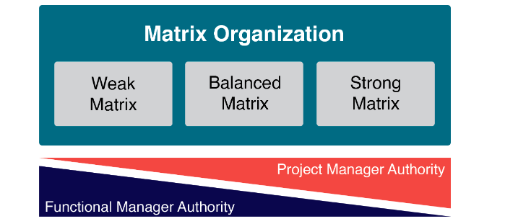
Matrix
Matrix Organization:
Description: This structure blends functional and projectized structures. Employees report to both functional managers and project managers.
Types:
Strong Matrix: Project managers have more authority.
Weak Matrix: Functional managers have more authority.
Balanced Matrix: Authority is shared equally.
Example: A tech company where software developers report to both the Head of Development and the Project Manager for specific projects.

Slide 61
Matrix
The matrix structure is a blend of functional and projectized structures. In a matrix organization, team members report to both a functional manager and one or more project managers.
Communication flows vertically and horizontally in this organizational structure as employees collaborate and share knowledge across functions and teams.
Since the team members basically report to more than 1 manager, the amount of authority divided between the two managers defines the type of matrix.
The weak matrix resembles functional structures where project managers act as coordinators with limited power while the strong matrix has features of projectized models with empowered project managers.
There are 3 types of matrix organizational structures:
Weak Matrix: The functional manager has the prime authority
Balanced Matrix: The authority shared equally
Strong Matrix: The project manager has the prime authority

Slide 62
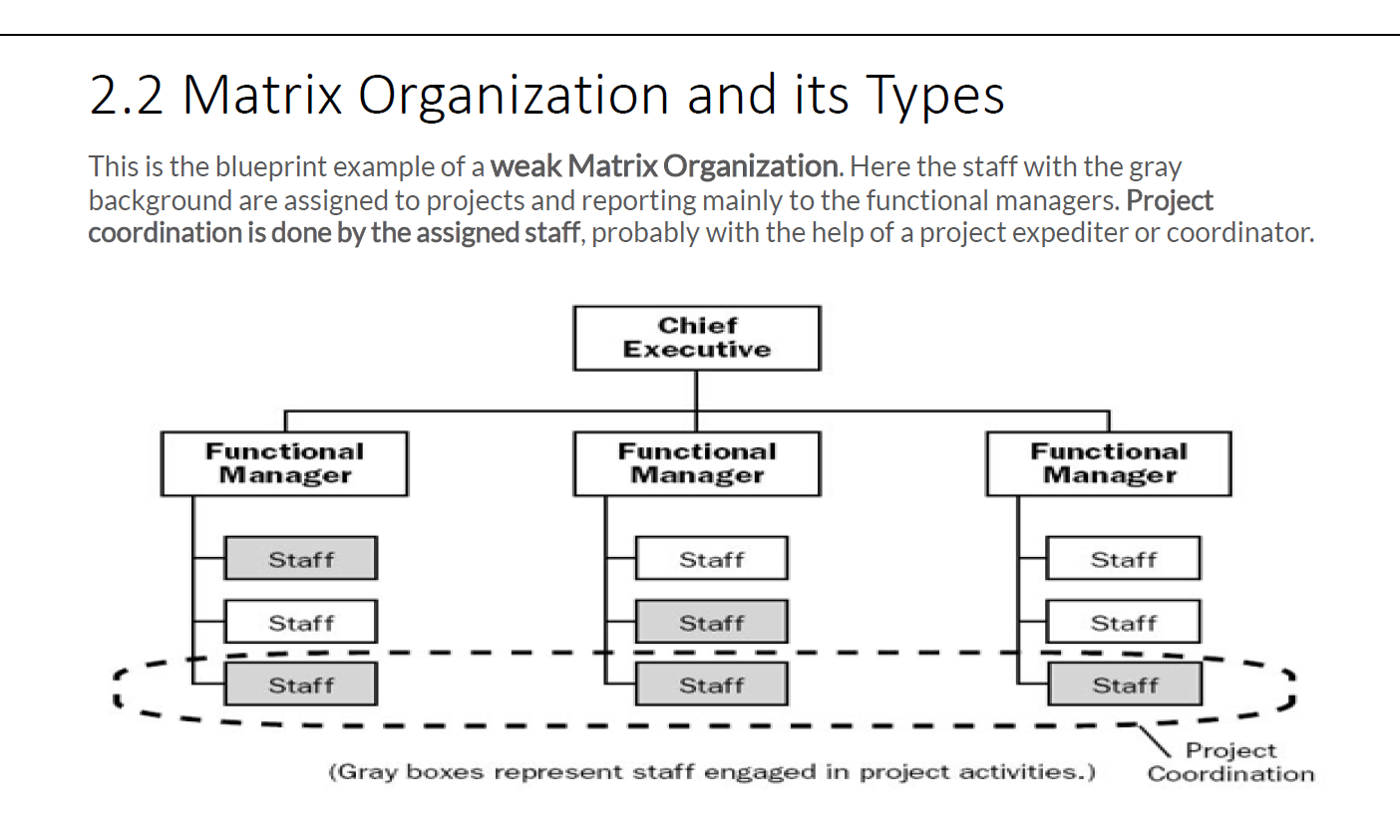

Slide 63
When Matrix?
Specific situations where a matrix structure may be best include:
Organizations requiring cross-functional collaboration
Businesses needing to quickly reprioritize resources
Large or complex projects requiring multiple skillsets
Companies with high volumes of varied projects
Dynamic industries needing responsiveness to change

Slide 64
Here are some key advantages of matrix organizations:
Flexibility to deploy resources across functions and projects
Ability to prioritize needs and share talent
Promotes cross-functional communication and collaboration
Project-specific focus while maintaining functional skills
Conversely, here are some drawbacks of matrix organizational structures:
Complex dual reporting relationships
Role confusion from multiple managers
Power struggles between functional and project managers
Resource conflict across departments and projects
Lack of ownership and accountability

Slide 65
Aspect | Functional Structure | Matrix Structure | Projectized Structure
Definition | Organized by functional areas such as development, testing, marketing, etc. | Combines functional and project structures, with employees reporting to both functional and project managers. | Organized entirely around projects, where the project manager has full authority over resources and tasks.
Key Characteristics | - Clear hierarchy within departments. | - Dual reporting lines (functional and project managers). | - Project manager is the central authority.
 | - Employees specialize in their functional expertise. | - Resources are shared across projects and functions. | - Teams are formed for specific projects and disbanded afterward.
 | - Decision-making is functional-manager centric. | - Balances functional expertise with project priorities. | - Focused on achieving project goals efficiently.
Advantages | - High specialization and efficiency within functions. | - Promotes collaboration across departments. | - High flexibility and focus on project delivery.
 | - Clear career growth within functions. | - Efficient resource utilization. | - Dedicated resources ensure quick decision-making.
Disadvantages | - Silo mentality; less collaboration between departments. | - Dual reporting can lead to conflicts and confusion. | - Limited focus on career development within specific functional areas.
 | - Slow decision-making across functions. | - Resource allocation conflicts between projects and departments. | - Resource downtime after project completion.

Slide 66
Authority | - Functional manager has full authority. | - Authority is shared between functional and project managers. | - Project manager has full authority over resources and tasks.
Team Composition | - Teams are grouped by department (e.g., development, testing). | - Teams include members from different functional areas working on the same project. | - Teams are dedicated to specific projects and consist of multidisciplinary members.
Focus | - Functional expertise and departmental goals. | - Balance between functional goals and project objectives. | - Achieving project-specific objectives.
Flexibility | - Low flexibility; changes are departmental. | - Moderate flexibility; shared resources can adapt to multiple priorities. | - High flexibility; team composition changes as projects start and end.
Examples | - IT Department: Developers report to the software development manager, QA team reports to QA lead. | - Tech Company: Developers work on multiple projects like an e-commerce app and CMS, reporting to functional and project managers. | - Consulting Firm: Teams formed for client-specific software projects, disbanded after project completion.

Slide 67
Summary
Functional: Best for organizations focusing on specialization and long-term functional goals.
Matrix: Ideal for companies managing multiple simultaneous projects while maintaining functional expertise.
Projectized: Suited for organizations heavily project-driven, like consulting firms or construction companies.

Slide 68
Project Management - Example
Example in a Software Company Context
Initiation Phase:
Project Charter: Authorize the development of a new software feature.
Stakeholder Analysis: Identify key stakeholders like product managers, developers, and end-users.
Planning Phase:
WBS: Break down the software development process into tasks like design, coding, testing, and deployment.
Risk Management Plan: Identify risks such as technical challenges or resource availability.
Execution Phase:
Project Management Software: Use Jira to track development tasks and progress.
Quality Assurance: Conduct regular code reviews and testing to ensure software quality.
Monitoring and Controlling Phase:
Performance Metrics: Track the number of completed tasks and bugs fixed.
Change Control Process: Manage any changes in software requirements or features.
Closing Phase:
Project Closure Report: Document the outcomes of the software development project.
Final Product Handover: Deliver the completed software feature to the product manager.

Slide 69
WBS
The Work Breakdown Structure (WBS) is a key project deliverable that organizes the team's work into manageable sections.
According to the PMBOK Guide, the WBS is a hierarchical decomposition of the total scope of work to be carried out by the project team to accomplish the project objectives and create the required deliverables.
Key Features of WBS:
Deliverable-Oriented: The WBS focuses on deliverables rather than tasks.
Levels of Decomposition: Work is divided into increasingly detailed levels, starting from major deliverables to smaller, manageable work packages.
Hierarchical Representation: The structure is depicted in a tree format or tabular format.
100% Rule: Ensures that the WBS includes all the work required for the project, with no overlap or omission.

Slide 70
WBS
Example of WBS (Building a Website)
Level 1: Project Name (Website Development)
Website Planning
1.1 Define Objectives
1.2 Identify Stakeholders
1.3 Develop Requirements
Design
2.1 Wireframes
2.2 Mockups
2.3 Final Design
Development
3.1 Front-End Development
3.1.1 HTML/CSS Structure
3.1.2 JavaScript Functionality
3.2 Back-End Development
3.2.1 Database Setup
3.2.2 API Integration

Slide 71
WBS
4. Testing and QA
4.1 Functional Testing
4.2 Usability Testing
4.3 Bug Fixing
5. Deployment and Launch
5.1 Hosting Setup
5.2 Domain Configuration
5.3 Go-Live

Slide 72
Benefits of WBS:
Clarifies project scope.
Facilitates resource allocation and scheduling.
Enhances risk identification and management.
Ensures comprehensive planning and control.

Slide 73
Project Team
A project team refers to a group of individuals who are responsible for performing project activities and achieving its objectives.
The composition, roles, and responsibilities of the project team vary depending on the project size, complexity, and organizational structure.

Slide 74
Project Team
Composition of the Project Team
The project team typically includes the following roles:
Role | Description
Project Manager | Responsible for leading the project, ensuring objectives are met, and balancing constraints like scope, time, and budget.
Core Team Members | Key individuals with specialized skills who contribute to project deliverables (e.g., developers, designers, analysts).
Subject Matter Experts (SMEs) | Provide expertise on specific aspects of the project (e.g., domain experts, technical specialists).
Stakeholders | May include customers, sponsors, and end-users who influence or are affected by the project.
Support Staff | Individuals providing administrative or logistical support (e.g., document controllers, coordinators).

Slide 75
Key Characteristics of a Project Team
Diversity of Skills: Team members possess the necessary expertise to perform their roles effectively.
Collaboration: Effective communication and teamwork are critical to achieve project goals.
Temporary Nature: The team is formed for the duration of the project and disbanded once objectives are met.
Adaptability: The team structure and roles may evolve based on project needs.

Slide 76
Roles and Responsibilities of the Project Team
Role | Responsibility
Project Manager | - Plan, execute, and monitor the project. - Manage the team, stakeholders, and constraints.
Team Members | - Execute assigned tasks. - Contribute to planning and risk identification.
SMEs | - Provide specialized knowledge. - Support decision-making and quality assurance.
Sponsors | - Provide resources and funding. - Approve key deliverables.
End-users/Customers | - Define requirements. - Validate project outcomes.

Slide 77
Types of Project Teams
Dedicated Team: Fully committed to the project, typically in a projectized organization. Example: A software team working exclusively on a product launch.
Part-Time Team: Members divide their time between project work and functional duties, common in functional or weak matrix structures. Example: A tester contributing to multiple ongoing projects.
Cross-Functional Team: Members come from different departments or disciplines to ensure diverse expertise. Example: A marketing analyst and a developer collaborating on a new e-commerce platform.
Virtual Team: Team members work remotely, often across different time zones. Example: Developers and designers collaborating from multiple countries on an app development project.

Slide 78
Project Team Development
Training: Providing team members with skills and knowledge required for the project.
Team Building: Encouraging collaboration and trust among team members.
Motivation: Recognizing contributions to boost morale and commitment.
Conflict Management: Resolving disputes to maintain a positive working environment.

Slide 79
Environment
Internal Environment
The internal environment includes factors within the organization that can influence the project. These factors are often within the control of the organization and include:
Characteristics:
Governed by organizational processes and resources.
Can be controlled or influenced by the project manager.
Organizational Culture, Structure, and Governance:
Example: A company with a hierarchical structure may have a formal decision-making process, which can affect project timelines.
Resource Availability:
Example: Availability of skilled personnel, equipment, and materials within the organization.
Infrastructure:
Example: IT systems, office space, and other physical resources available to the project team.
Organizational Process Assets (OPAs):
Example: Standardized guidelines, templates, and historical data from previous projects1
.

Slide 80
Environment
Task Environment
These are immediate factors related to the project, such as stakeholders, suppliers, competitors, and customers.
Characteristics:
Closely tied to the project's objectives and scope.
Typically involves external entities that directly interact with the project.
Examples:
Stakeholders: A key stakeholder may request changes to the project scope.
Suppliers: Delays in material supply impact project timelines.
Competitors: A rival company releases a similar product during your project.
Example in Context:
During the construction of a shopping mall, delays in vendor-supplied materials push the project timeline beyond the planned completion date.

Slide 81
Environment
External Environment
These are factors outside the organization's direct control but can still significantly influence the project. These include political, economic, legal, environmental, and technological factors.
Characteristics:
Broad and outside the control of the organization or project team.
Includes risks and opportunities.
External Environment
The external environment consists of factors outside the organization that can impact the project. These factors are typically beyond the control of the organization and include:
Market Conditions:
Example: Competitor actions, market trends, and economic conditions.
Social and Cultural Influences:
Example: Regional customs, public holidays, and societal attitudes.
Legal and Regulatory Environment:
Example: Compliance with local laws, industry standards, and regulations.
Physical Environment:
Example: Weather conditions, natural disasters, and geographical location

