Slide 1
Project Scope Management
Project scope refers to the work required to deliver a product, service, or result with the specified features and functions.
It encompasses all activities, deliverables, and boundaries of the project and includes what is within and outside the project's work.
Project scope is defined as:
All the work required to successfully complete a project.
Clear identification of objectives, deliverables, and work boundaries to meet project goals.

Slide 2
Key Elements of Project Scope
Project Objectives: The purpose and goals the project aims to achieve.
Deliverables: Tangible or intangible outputs of the project (e.g., products, services).
Requirements: Specifications or features the deliverables must satisfy.
Boundaries: Identifies what is in and out of the scope.
Constraints: Limits such as time, budget, or resources.
Assumptions: Hypotheses about the project work, stakeholders, or environment.
Acceptance Criteria: Conditions that must be met for deliverables to be approved.
Exclusions: Items or work explicitly not included in the project.

Slide 3
Product Scope
Product scope refers to the features and functions of a product, service, or result that a project aims to deliver.
It defines the "what" of the project—the characteristics, attributes, and functionality of the final output.
Focus:
Tangible deliverables (e.g., software, a building, or a physical product).
Functional and performance specifications.
User expectations and needs.
Example: In a mobile banking app project, the product scope includes functionalities like balance inquiry, fund transfers, and biometric login.

Slide 4
Project Scope
Project scope refers to the work required to deliver the product, service, or result with the specified features and functions.
It defines the "how" of the project—the work that must be performed to achieve the desired output.
Focus:
The processes, resources, and tasks involved in delivering the product.
Project deliverables, timelines, and exclusions.
Managing project constraints (time, cost, quality).
Example: In the same mobile banking app project, the project scope includes:
Gathering requirements.
Designing the user interface.
Coding and testing the application.
Deploying and maintaining the app.

Slide 5
Example: Project Scope
Project: Development of an E-Commerce Website
Objectives:
Launch an e-commerce website for selling fashion apparel within 6 months.
Deliverables:
Fully functional e-commerce platform.
User interface with product catalog, search functionality, and shopping cart.
Secure payment gateway integration.
Admin panel for inventory and order management.
Requirements:
Support for 1,000 concurrent users.
Responsive design for mobile and desktop users.
Compliance with GDPR and PCI DSS standards.
Boundaries:
In-scope:
Website development and testing.
Deployment on a cloud server.
Staff training for admin panel use.
Out-of-scope:
Marketing or advertising strategies.
Post-launch customer support.

Slide 6
Example: Project Scope
5. Constraints:
Budget: $50,000.
Deadline: 6 months.
Limited availability of senior developers.
6. Assumptions:
Third-party APIs for payment integration will be available on time.
Stakeholder feedback will be provided promptly during each sprint.
7. Acceptance Criteria:
All features work as per requirements with 99% uptime.
Approved by stakeholders during User Acceptance Testing (UAT).
8. Exclusions:
Data migration from an old system.
Development of a mobile application.

Slide 7
Example: Building a Hospital
Product Scope:
A fully functional hospital with 100 patient rooms, an emergency ward, an operating theatre, and diagnostic labs.
Project Scope:
Tasks required to construct the hospital, including:
Site surveys.
Architectural designs.
Procuring materials.
Construction and quality inspections.

Slide 8
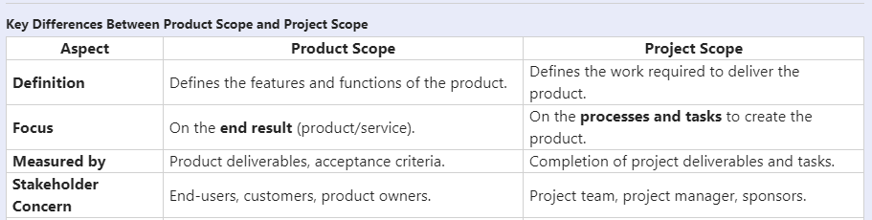

Slide 9
Project Scope Management Process
Project Scope Management, divided into two phases:
Planning Phase: Processes that establish scope.
Monitoring and Controlling Phase: Processes that ensure scope is adhered to.

Slide 10
Processes of Project Scope Management
1. Plan Scope Management
Purpose: Develop a plan to define, validate, and control project scope.
Inputs: Project charter, project management plan, enterprise environmental factors, organizational process assets.
Tools & Techniques: Expert judgment, meetings, and data analysis.
Outputs: Scope Management Plan, Requirements Management Plan.
Example: For an e-commerce website, the team creates a Scope Management Plan specifying:
How scope will be defined (e.g., using a Work Breakdown Structure).
How requirements will be gathered (e.g., user interviews).

Slide 11
Requirement Management Plan
A Requirements Management Plan in project management is a key component of the overall project management plan.
It outlines how the project team will gather, manage, and track requirements throughout the project's lifecycle.
The plan ensures that all requirements are properly defined, documented, and managed, and it establishes processes for communicating and addressing any changes to the requirements.

Slide 12
Requirement Management Plan
Key Elements of a Requirements Management Plan
Purpose and Scope of Requirements
Purpose: The plan outlines how requirements will be handled in the project and specifies the processes and tools to be used for managing them.
Scope: Defines the boundaries of what will and won’t be included in the requirements management process.
Requirements Identification Process
Describes how requirements will be gathered, documented, and classified (e.g., business, stakeholder, system, or functional requirements).
Roles and Responsibilities
Defines who is responsible for collecting, documenting, and verifying requirements (e.g., Business Analyst, Project Manager, stakeholders).

Slide 13
Requirement Management Plan
4. Requirements Traceability Matrix (RTM)
The RTM is a tool used to track the requirements from inception through to project completion, ensuring each requirement is addressed in the design, development, and testing phases.
5. Requirements Approval Process
This section outlines how requirements will be reviewed, approved, and formally signed off by stakeholders or sponsors.
6. Change Control Process for Requirements
A critical aspect of requirement management is how to handle changes to requirements. This section describes the process for evaluating, approving, and implementing changes to requirements.

Slide 14
Requirement Management Plan
7. Tools and Techniques for Requirements Management
Lists the tools (e.g., Jira, Microsoft Excel, etc.) and techniques (e.g., interviews, surveys, focus groups, workshops) used to manage and track requirements.
8. Communication Plan
Outlines how requirements will be communicated to all relevant stakeholders and how feedback will be incorporated.
9. Requirements Validation and Verification
Describes how requirements will be validated (to ensure they meet the business needs) and verified (to ensure the solution meets the requirements).

Slide 15
Requirement Gathering Process
Requirement gathering is a critical process in project management.
It ensures that stakeholders' needs and expectations are captured, documented, and aligned with project objectives.
Collect Requirements Process
The process of determining, documenting, and managing stakeholder needs and requirements to meet project objectives.
Key Inputs:
Project Charter: Provides high-level project objectives and initial stakeholder requirements.
Stakeholder Register: Identifies stakeholders who will provide requirements.
Project Management Plan: Includes the scope management plan and requirements management plan for guiding the process.

Slide 16
Requirement Gathering Process
Key Tools and Techniques:
Interviews: One-on-one discussions with stakeholders.
Focus Groups: Group sessions to gather diverse perspectives.
Workshops: Collaborative sessions to elaborate on requirements.
Questionnaires and Surveys: Useful for large audiences.
Observation: Watching users interact with systems or processes.
Prototypes: Early versions of a product for feedback.
Document Analysis: Reviewing existing documentation for requirements.
Brainstorming: Generating a broad list of ideas and requirements.
Outputs:
Requirements Documentation: A detailed description of stakeholder requirements.
Requirements Traceability Matrix (RTM): A grid linking requirements to project deliverables.

Slide 17
Steps in the Requirement Gathering Process
Identify Stakeholders
Engage stakeholders who will use or influence the project outcomes. Example: In a software development project, stakeholders include end-users, product owners, and IT teams.
Elicit Requirements
Use techniques such as interviews, surveys, or workshops to collect information. Example: Conduct interviews with end-users to understand their pain points with the current system.
Analyze Requirements
Organize and prioritize requirements based on feasibility, impact, and alignment with project goals. Example: A hospital IT system project may prioritize requirements for patient data security over additional reporting features.
Document Requirements
Capture requirements clearly in a structured format for validation and approval. Example: Documenting user stories for an Agile project or creating a detailed Functional Requirements Document (FRD) for a Waterfall project.
Validate Requirements
Ensure requirements are clear, complete, and agreed upon by stakeholders. Example: Review documented requirements with stakeholders during a workshop to address ambiguities or conflicts.
Establish Requirements Traceability
Link requirements to business objectives, deliverables, and test cases to ensure alignment throughout the project lifecycle. Example: Using an RTM to trace a requirement like "Add a search bar" to the corresponding UI prototype, implementation tasks, and test cases.

Slide 18
Tools used in Requirement Gathering
Interviews One-on-one or group discussions with stakeholders to understand their needs, expectations, and constraints.
When to Use:
To gather detailed, in-depth information.
For projects involving a limited number of stakeholders.
Example: In a software development project, interviews are conducted with end-users to understand pain points in the current system and desired functionalities.

Slide 19
Tools used in Requirement Gathering
Focus Groups A facilitated session where a group of stakeholders discusses and provides input on requirements.
When to Use:
To gain consensus among stakeholders.
For exploring different perspectives on a requirement.
Example: For a new e-commerce platform, a focus group of customers, marketing team members, and developers discuss desired features such as payment methods, product search capabilities, and user interface.

Slide 20
Tools used in Requirement Gathering
Workshops
Interactive sessions involving stakeholders to collaboratively define and refine requirements.
When to Use:
To resolve conflicting requirements.
To achieve consensus on complex requirements.
Example: During the planning of a healthcare system, workshops with doctors, nurses, and IT staff help define electronic health record functionalities.

Slide 21
Tools used in Requirement Gathering
Questionnaires and Surveys
Structured sets of questions distributed to stakeholders to gather requirements.
When to Use:
When there are a large number of stakeholders.
To gather quantitative data.
Example: For a new mobile banking app, a survey is distributed to bank customers to prioritize features like fund transfers, biometric login, and bill payments.

Slide 22
Tools used in Requirement Gathering
Observation
Watching stakeholders perform tasks to understand workflows and identify needs.
When to Use:
To capture implicit requirements.
When stakeholders are not articulate about their needs.
Example: Observing call center employees using an outdated system to identify inefficiencies and areas for improvement in a new software design.

Slide 23
Tools used in Requirement Gathering
Prototypes
Creating early versions of the product to gather feedback on requirements.
When to Use:
To visualize unclear requirements.
For iterative projects like Agile.
Example: A prototype of a travel booking website is shared with stakeholders to validate the navigation and booking process.

Slide 24
Tools used in Requirement Gathering
Prototypes
Creating early versions of the product to gather feedback on requirements.
When to Use:
To visualize unclear requirements.
For iterative projects like Agile.
Example: A prototype of a travel booking website is shared with stakeholders to validate the navigation and booking process.

Slide 25
Tools used in Requirement Gathering
Brainstorming
A group activity to generate a wide range of ideas and requirements.
When to Use:
During the initial stages of requirement gathering.
For innovation-focused projects.
Example: During the planning of a smart home system, brainstorming sessions are held to identify features like voice control, energy monitoring, and security alerts.

Slide 26
Tools used in Requirement Gathering
Group Decision-Making Techniques
Techniques like voting, multi-criteria decision analysis, or consensus building to finalize requirements.
When to Use:
To resolve conflicting priorities.
To prioritize requirements.
Example: Stakeholders vote on the top features for a retail website, such as inventory tracking, customer reviews, and order tracking

Slide 27
Tools used in Requirement Gathering
Context Diagrams
Graphical representation of the system and its interactions with external entities.
When to Use:
To clarify system boundaries.
For projects with complex interactions.
Example: A context diagram for an e-commerce platform shows interactions between the website, payment gateway, logistics provider, and customers.

Slide 28
Tools used in Requirement Gathering
Mind Mapping A visual technique to organize information and ideas around a central concept.
When to Use:
To brainstorm and structure requirements.
For identifying relationships between requirements.
Example: Creating a mind map for a new hotel booking app showing key features like room selection, payment, and customer support.

Slide 29
Context Diagram
A context diagram is a high-level graphical representation that defines the scope of the system and its interactions with external entities, such as users, systems, and organizations.
Key Features of a Context Diagram:
Shows the system as a single process or node in the center.
Displays external entities interacting with the system (e.g., users, third-party systems).
Focuses on inputs to the system and outputs from the system.
Avoids showing internal details of the system.

Slide 30
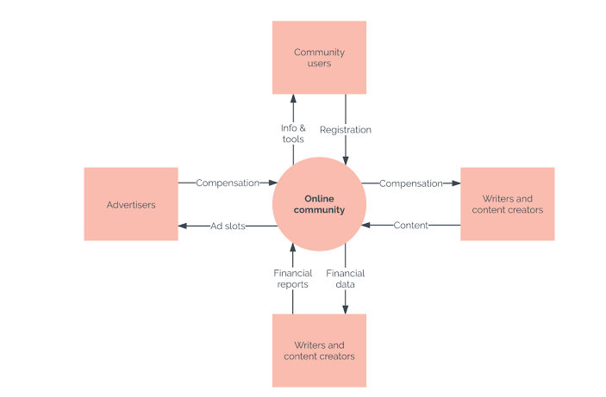

Slide 31
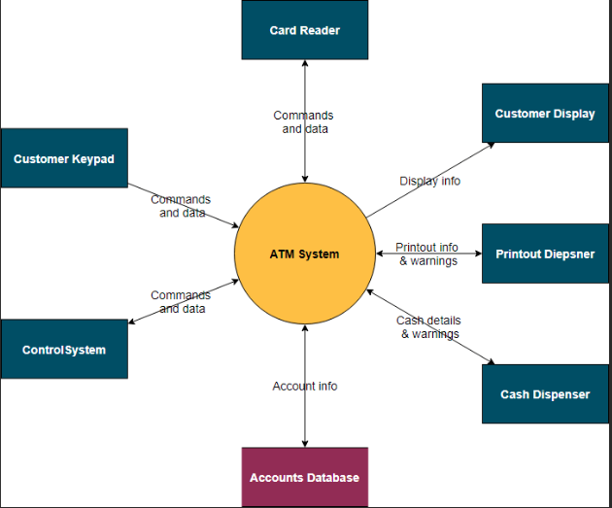

Slide 32
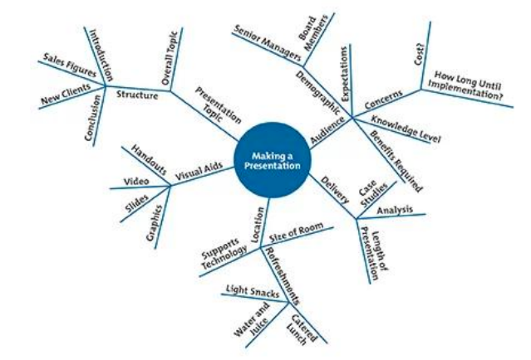

Slide 33
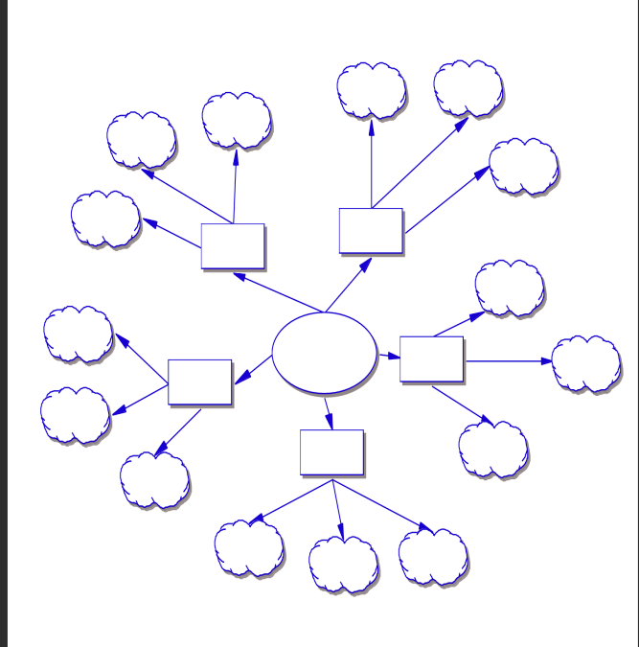

Slide 34
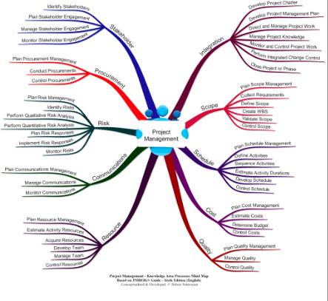
Mind Map

Slide 35
Mind Map Diagram
A mind map diagram in project management is a visual representation of ideas, tasks, or information structured around a central concept or theme.
It is used as a brainstorming and organizational tool to capture, structure, and visualize the relationships between various components of a project.
Mind maps help in breaking down complex information into manageable parts, making them particularly useful in project planning, requirement gathering, and problem-solving.
Key Characteristics of a Mind Map
Central Node: Represents the main topic or idea (e.g., project name or goal).
Branches: Extend from the central node, representing key themes or categories (e.g., phases, tasks, or resources).
Sub-branches: Break down each branch into finer details (e.g., sub-tasks or specific requirements).
Hierarchy: Maintains a clear structure from general to specific information.
Visual Elements: Often includes colors, images, icons, and keywords to enhance understanding and retention.

Slide 36
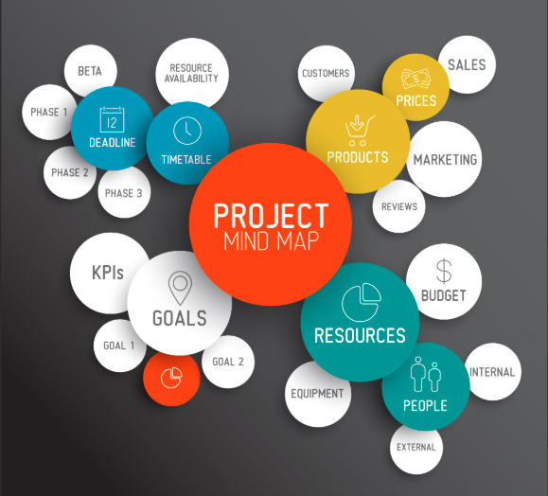

Slide 37
Processes of Project Scope Managment
2. Collect Requirements
Purpose: Determine and document stakeholder needs and expectations.
Inputs: Stakeholder register, Scope Management Plan, Project charter.
Tools & Techniques: Brainstorming, focus groups, interviews, surveys, prototyping.
Outputs: Requirements Documentation, Requirements Traceability Matrix.
Example: Stakeholders request features like a shopping cart, secure payment gateway, and responsive design. These are documented in the Requirements Traceability Matrix to track their implementation.

Slide 38
Requirements Traceability Matrix (RTM) in Project Management
A Requirements Traceability Matrix (RTM) is a crucial document in project management. It helps ensure that all project requirements are met by mapping the relationship between requirements and project deliverables.
Purpose: The RTM provides accountability by tracking the status of each requirement throughout the project lifecycle. It ensures that all requirements are tested and validated

Slide 39
Requirements Traceability Matrix (RTM) in Project Management
Components: An RTM typically includes:
Requirement ID: A unique identifier for each requirement.
Description: A detailed description of the requirement.
Source: The origin of the requirement (e.g., stakeholder, regulatory body).
Test Cases: Specific tests designed to verify the requirement.
Status: The current status of the requirement (e.g., pending, in progress, completed).
Comments: Additional notes or observations

Slide 40
Requirements Traceability Matrix (RTM) in Project Management
Benefits: Using an RTM helps in:
Ensuring all requirements are addressed.
Facilitating communication among stakeholders.
Providing a clear audit trail for compliance and quality assurance.
Identifying and managing changes to requirement

Slide 41
Processes of Project Scope Management
Define Scope
Purpose: Develop a detailed project and product description.
Inputs: Requirements Documentation, Scope Management Plan, Project charter.
Tools & Techniques: Expert judgment, alternatives analysis, product analysis.
Outputs: Project Scope Statement.
Example: The Project Scope Statement for the e-commerce project includes objectives, deliverables, constraints, assumptions, and exclusions (e.g., "mobile app development is out of scope").

Slide 42
Processes of Project Scope Management
Create Work Breakdown Structure (WBS)
Purpose: Break down the scope into smaller, manageable components.
Inputs: Scope Statement, Requirements Documentation.
Tools & Techniques: Decomposition, expert judgment.
Outputs: Scope Baseline (WBS, WBS Dictionary, Scope Statement).
Example: The e-commerce WBS might include:
Website Design:
Homepage.
Product catalog.
Backend Development:
Payment gateway.
Database integration.

Slide 43
WBS
A Work Breakdown Structure (WBS) is a hierarchical decomposition of the total scope of work to be carried out by the project team to accomplish the project objectives and create the deliverables.
It divides the project into smaller, manageable components, allowing for easier planning, scheduling, and control.
WBS Structure:
The WBS typically consists of multiple levels, where the top level represents the overall project, and subsequent levels break it down into progressively smaller and more detailed work packages.
WBS Structure Example:
Level 1: Project Name (e.g., CRM System Development)
Level 2: Major Deliverables (e.g., Requirements Gathering, System Design, Development, Testing, Deployment)
Level 3: Sub-deliverables or phases (e.g., for System Design: Database Design, UI/UX Design, System Architecture)
Level 4: Work Packages (e.g., for Database Design: Database Schema Design, Data Migration, Normalization)
Level 5: Tasks or Activities (e.g., for Database Schema Design: Create ERD, Define Tables, Create Views)

Slide 44
WBS – How to create?
Define the Project Scope: Understand the full scope of the project and the final deliverables. This can be obtained from project documentation like the project charter and scope statement.
Break the Work into Major Phases/Deliverables: Divide the project into large phases or deliverables. These could include major project stages such as design, development, testing, or deployment.
Decompose Deliverables into Sub-deliverables: Break down each major deliverable into smaller sub-deliverables. For example, if the deliverable is "System Design", break it down into smaller parts like database design, UI design, etc.
Break Sub-deliverables into Work Packages: Continue breaking down the sub-deliverables into work packages. Work packages should be the smallest units of work that can be assigned to individuals or teams. Ensure that each work package is clear, measurable, and manageable.
Define Activities and Tasks: For each work package, identify specific activities and tasks required to complete it. These tasks should be detailed enough to be tracked and managed effectively.
Ensure All Work is Included: Double-check that all required work is covered in the WBS, and nothing is left out. This is crucial to avoid scope creep later in the project.
Verify with Stakeholders: Ensure that the WBS aligns with stakeholder expectations. Review it with the project sponsor, team members, and other key stakeholders to confirm accuracy and completeness.

Slide 45
Guidelines for Creating a WBS:
Use the 100% Rule: The WBS should cover 100% of the project scope, including all deliverables and work required to meet the project objectives.
Focus on Deliverables: The WBS should focus on the deliverables (outcomes) rather than actions or activities. The work packages should be outcomes that contribute to the final product or service.
Work Packages Must Be Manageable: Break down the work until the work packages are small enough to be assigned and tracked effectively. They should be measurable in terms of time, cost, and scope.
Use a Consistent Level of Detail: Avoid over-detailing at some levels and under-detailing at others. Each level of the WBS should maintain a consistent level of detail.
Make the WBS Hierarchical: The WBS should be hierarchical, with a clear relationship between parent and child components. Each level should represent an increasingly detailed breakdown of the project.
Be Clear and Understandable: The WBS should be easily understood by all stakeholders. Use consistent naming conventions and avoid jargon or overly complex terms.
Review and Validate with Stakeholders: The WBS must be reviewed with stakeholders and validated to ensure it represents all necessary work and aligns with the project's goals.
Use Numbering System for Clarity: Each element in the WBS should have a unique identifier to facilitate tracking and reference. This numbering system helps when managing the project schedule, resources, and risks.

Slide 46
Things to Consider When Creating a WBS:
Scope Definition: Ensure that the WBS includes all work required to achieve the project objectives.
Work Packages: Work packages should be manageable and reflect deliverables.
Dependencies: Identify dependencies between tasks or deliverables within the WBS.
Team Input: Involve team members when creating the WBS to capture all technical and operational details.
Complexity and Size: Consider the size and complexity of the project. Larger projects may require multiple WBS levels, while smaller projects may require fewer levels.
Time and Cost Estimation: Ensure that each work package can be scheduled and costed for proper estimation and tracking.

Slide 47
Example 1: WBS for CRM System Development
CRM System Development (Level 1)
1.1 Requirements Gathering (Level 2)
1.1.1 Conduct Stakeholder Interviews (Level 3)
1.1.2 Review Existing Systems (Level 3)
1.2 System Design (Level 2)
1.2.1 Database Design (Level 3)
1.2.2 User Interface Design (Level 3)
1.3 Development (Level 2)
1.3.1 Front-end Development (Level 3)
1.3.2 Back-end Development (Level 3)
1.4 Testing (Level 2)
1.4.1 Unit Testing (Level 3)
1.4.2 User Acceptance Testing (Level 3)
1.5 Deployment (Level 2)
1.5.1 Data Migration (Level 3)
1.5.2 Go-Live Support (Level 3)

Slide 48
Example 2: WBS for a Construction Project
Construction Project (Level 1)
1.1 Site Preparation (Level 2)
1.1.1 Survey Land (Level 3)
1.1.2 Clear Site (Level 3)
1.2 Foundation Work (Level 2)
1.2.1 Digging Foundation (Level 3)
1.2.2 Pour Concrete (Level 3)
1.3 Structural Work (Level 2)
1.3.1 Build Walls (Level 3)
1.3.2 Roof Installation (Level 3)
1.4 Interior Work (Level 2)
1.4.1 Install Plumbing (Level 3)
1.4.2 Electrical Wiring (Level 3)
1.5 Final Inspection (Level 2)
1.5.1 Final Walkthrough (Level 3)
1.5.2 Approve Inspection (Level 3)

Slide 49
Processes of Project Scope Management
Validate Scope
Purpose: Obtain stakeholder acceptance of completed deliverables.
Inputs: Verified deliverables, Scope Baseline.
Tools & Techniques: Inspection, decision-making.
Outputs: Accepted deliverables, Change Requests.
Example: After UAT (User Acceptance Testing), stakeholders review the e-commerce website features. They approve the deliverables except for the search functionality, which needs modification.

Slide 50
Accepted Deliverables
Accepted deliverables are the outputs or results of the project work that have been reviewed and approved by the relevant stakeholders, typically the project sponsor or customer.
These deliverables have passed all criteria defined in the project scope and quality standards.
Examples:
Construction Project: In a construction project, after the building is completed, the deliverables (like a finished building) are reviewed and accepted by the client or stakeholders. If the building meets the project’s scope, it is considered an accepted deliverable.
Software Development Project: After completing a software application, the project team conducts testing, and the final version of the software, which meets the functional and non-functional requirements, is accepted by the client or end-user as an approved deliverable.

Slide 51
Change Requests
Change requests are formal proposals to alter the project’s scope, schedule, budget, or any other aspect of the project management plan.
Change requests arise due to unforeseen circumstances, new opportunities, stakeholder requests, or errors identified in the execution phase.
These requests are processed through formal review and approval processes.

Slide 52
Change Requests
Types of Change Requests:
Scope Change Requests: Modifications to the project scope (e.g., adding or removing features in a product).
Schedule Change Requests: Modifications to the project timeline (e.g., extending or reducing deadlines).
Cost Change Requests: Modifications to the project budget (e.g., reallocating or increasing funding).
Quality Change Requests: Modifications to quality standards, testing methods, or acceptance criteria.

Slide 53
Change Requests
Examples:
Product Development Project: The client requests additional features to be included in a software product after seeing a demo of the initial version. The project manager submits a change request to modify the scope, budget, and timeline to include the new features.
Construction Project: During the construction of a building, the client requests a change in the design of the building's exterior. The project manager creates a change request that impacts both the scope (design) and cost, which must be reviewed and approved by the stakeholders before proceeding.

Slide 54
Processes of Project Scope Managment
Control Scope
Purpose: Monitor and control changes to the project scope.
Inputs: Scope Baseline, Project management plan, Work performance data.
Tools & Techniques: Variance analysis, change control.
Outputs: Work performance information, Change Requests, Scope updates.
Example: A stakeholder requests adding a wish list feature post-scope approval. The Change Control Process evaluates its impact on time and budget before approval.

Slide 55
Example
Project: Develop an E-commerce Website
Plan Scope Management:
Scope and requirements will be documented using interviews and prototypes.
Collect Requirements:
Customers request user-friendly navigation, secure payments, and admin panel.
Define Scope:
Scope includes website features but excludes marketing strategies.
Create WBS:
Divide tasks: Design homepage, create product catalog, and integrate payment gateway.
Validate Scope:
Stakeholders approve most features except for minor design changes.
Control Scope:
A change request for adding a wish list is evaluated and incorporated after approval.

Slide 56
Gold Plating
Definition:
Gold plating refers to delivering more than what was agreed upon in the project scope, often by adding features or functionality not requested by the client or stakeholders.
Example: Adding extra design elements or functionalities in a software product that the client did not ask for.
Cause:
Often initiated by the project team or individual team members, believing the extra work will improve the client’s satisfaction or enhance the product's quality.
Impact:
Increased project costs, time overruns, or resource strain.
Potential dissatisfaction from clients if the extra features interfere with the product's functionality.

Slide 57
Scope Creep
Definition:
Scope creep is the uncontrolled expansion of the project scope due to unapproved changes or continuous addition of new requirements during the project lifecycle.
Example: Stakeholders requesting additional features after project work has commenced, without formally revising the scope.
Cause:
Often initiated by clients or stakeholders who request new requirements mid-project.
Poorly defined project scope, lack of scope control processes, or weak stakeholder management.
Impact:
Leads to delays, cost overruns, and compromised project quality.
Increased stress on resources and reduced team morale.

Slide 58
Key Difference
Aspect | Gold Plating | Scope Creep
Initiator | Internal (Project team or manager) | External (Client or stakeholder)
Intent | To exceed expectations and delight clients | To accommodate new requirements
Control | Often deliberate and within the team's control | Often uncontrolled and unplanned

