Slide 1
Information Systems
Surendra KC

Slide 2
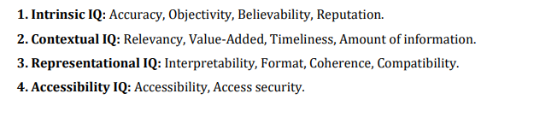
Qualities of Information System
Information systems possess several qualities that are essential for their effectiveness in supporting organizational operations, decision-making, and strategic goals.

Slide 3
IQ
Reliability: Information systems should be reliable, ensuring consistent and accurate performance under various conditions. Users must be able to depend on the system to provide reliable data and functionalities without unexpected failures or errors.
Accuracy: Information systems should produce accurate outputs, ensuring that data, reports, and analyses are correct and free from errors. Inaccurate information can lead to flawed decision-making and negative consequences for the organization.
Relevance: Information systems should deliver relevant information that is timely, contextually appropriate, and aligned with the needs of users and organizational objectives. Providing irrelevant or outdated information can diminish the system's usefulness and user satisfaction.
Accessibility: Information systems should be accessible to authorized users whenever and wherever needed. Accessibility encompasses factors such as user interface design, availability of mobile access, and compatibility with different devices and platforms.
Security: Information systems should incorporate robust security measures to protect sensitive data, prevent unauthorized access, and mitigate cybersecurity risks. Security features may include encryption, access controls, authentication mechanisms, and intrusion detection systems.

Slide 4
IQ
Scalability: Information systems should be scalable, capable of accommodating increasing volumes of data, users, and transactions as organizational needs grow. Scalability ensures that the system can support business growth and adapt to changing requirements over time.
Flexibility: Information systems should be flexible, allowing for customization, configuration, and adaptation to meet diverse user needs and business processes. Flexible systems can accommodate changes in organizational structure, workflows, and technology environments.
Usability: Information systems should be user-friendly and intuitive, with interfaces and functionalities designed to be easily understandable and navigable by users with varying levels of technical expertise. Usability promotes user adoption and productivity.
Integration: Information systems should support seamless integration with other systems, applications, and data sources within the organization's IT ecosystem. Integration enables data sharing, interoperability, and automation of processes across different systems.

Slide 5
IQ
Performance: Information systems should exhibit optimal performance, with fast response times, efficient processing capabilities, and minimal downtime. Performance optimization ensures that users can access and interact with the system efficiently to perform their tasks.
Compliance: Information systems should comply with relevant laws, regulations, industry standards, and organizational policies governing data privacy, security, and ethical practices. Compliance helps mitigate legal and regulatory risks and ensures ethical conduct in information management.
Innovation: Information systems should support innovation by enabling experimentation, exploration, and the adoption of emerging technologies to drive continuous improvement and competitive advantage for the organization

Slide 6
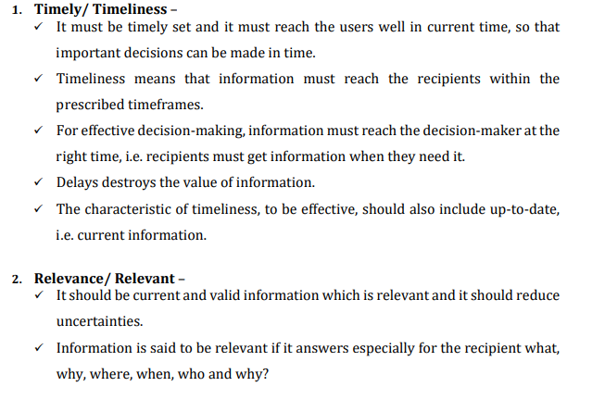
Features of IQ

Slide 7
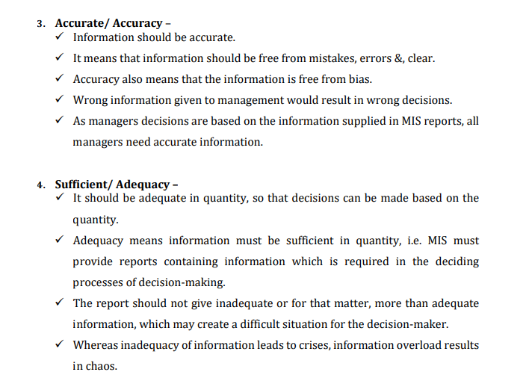
Features of IQ

Slide 8
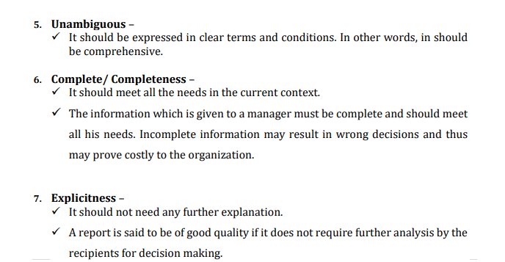
Features of IQ

Slide 9
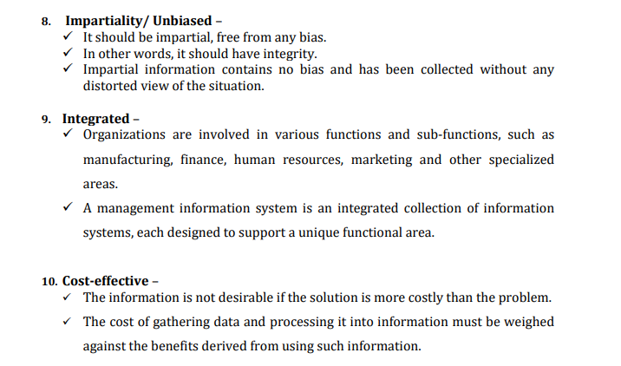
Features of IQ

Slide 10
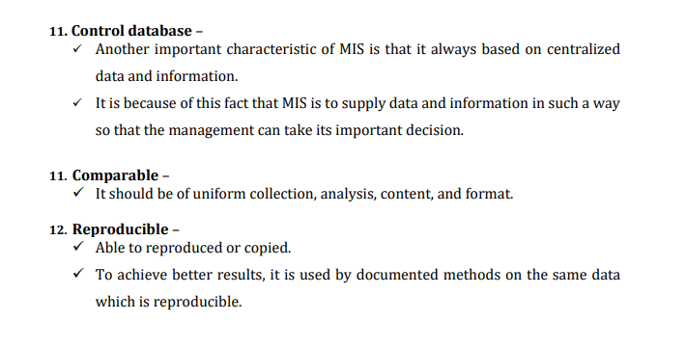
Features of IQ

Slide 11
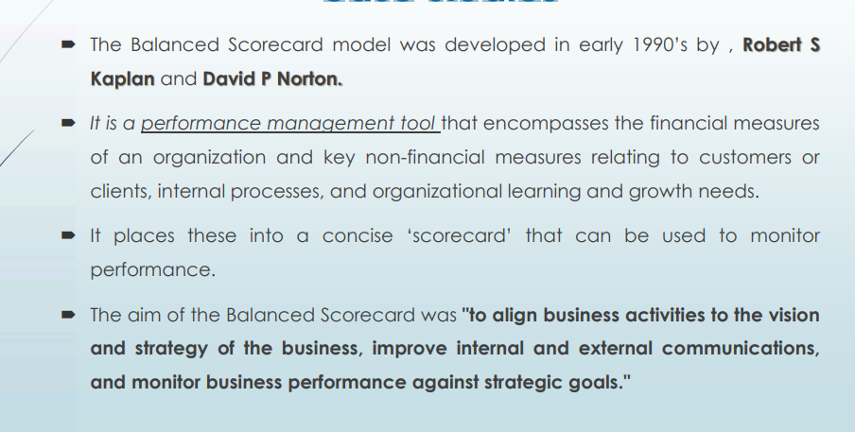
Balanced ScoreCard

Slide 12
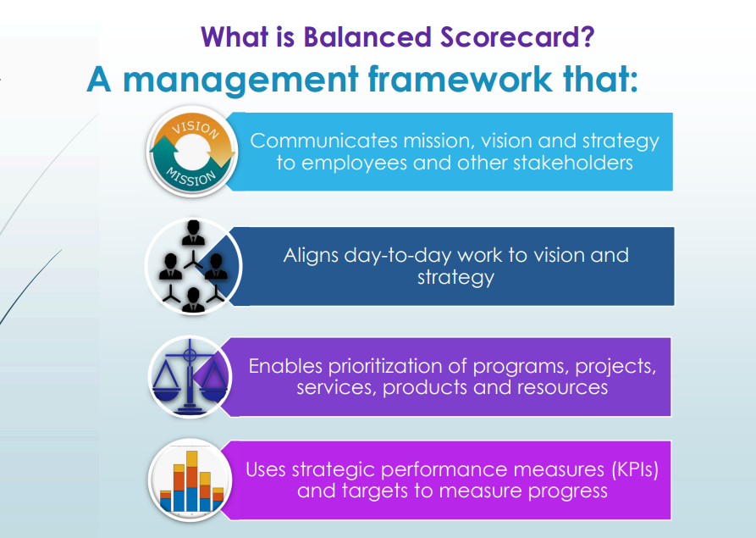
Balanced Scorecard

Slide 13
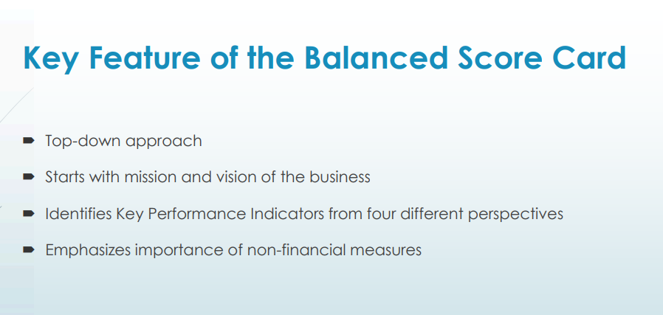
Balanced Scorecard

Slide 14
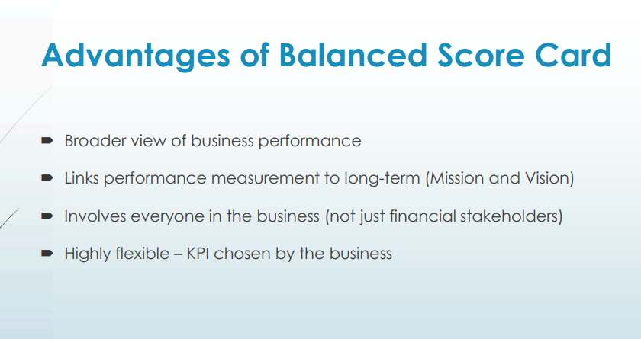
Balanced Scorecard

Slide 15
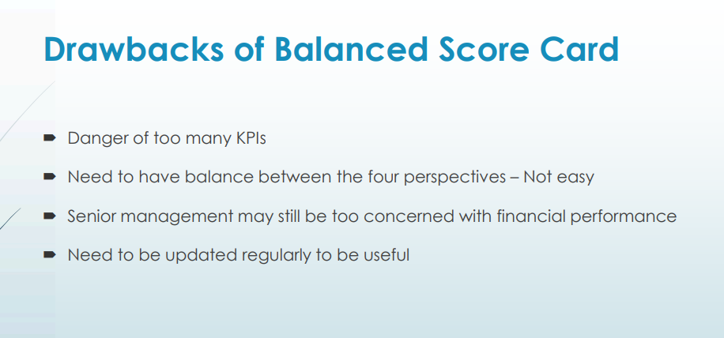
Balanced Scorecard

Slide 16
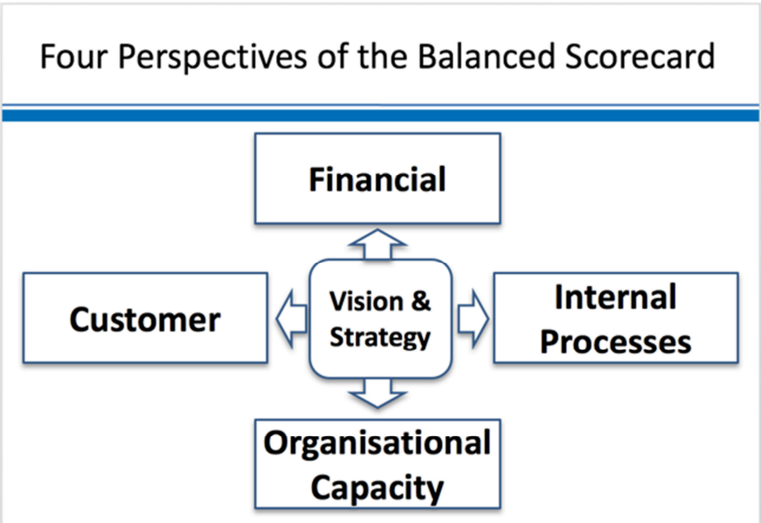
Balanced scorecard

Slide 17
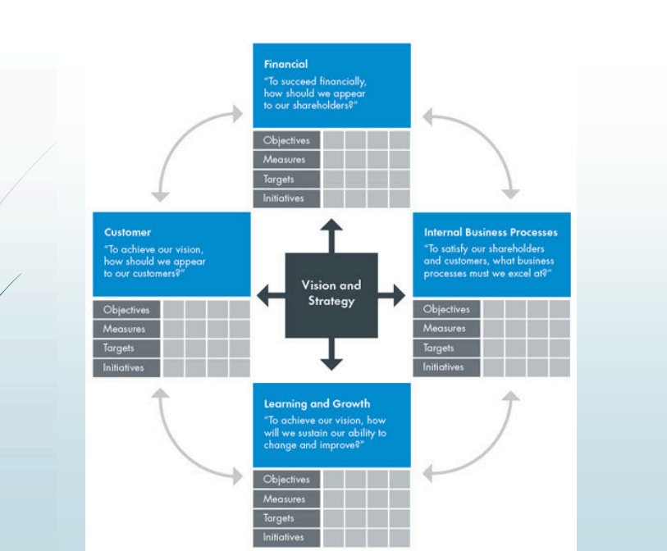
Balanced Scorecard

Slide 18
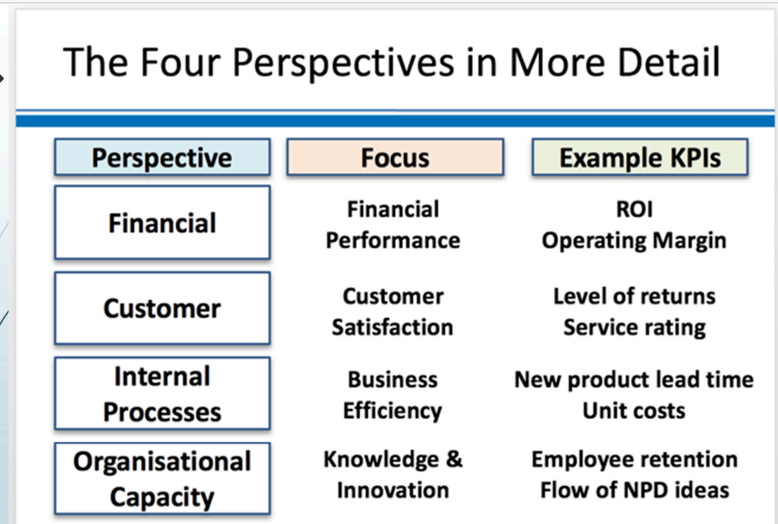
Balanced Scorecard

Slide 19
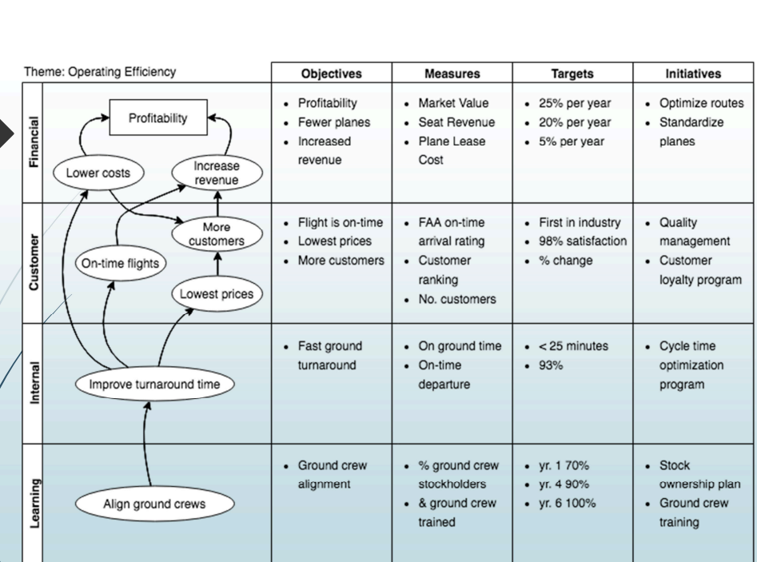
Balanced Scorecard

Slide 20
Balanced scorecard
The Balanced Scorecard (BSC) is a strategic management framework that translates an organization's strategic objectives into a set of performance measures across four key perspectives: financial, customer, internal business processes, and learning and growth.
By adopting the Balanced Scorecard framework in information systems, organizations can achieve a holistic view of IT performance and its alignment with overall strategic objectives.
The BSC enables organizations to measure, monitor, and manage IT performance across multiple dimensions, driving continuous improvement and value creation from IT investments.
Financial Perspective:
In the context of information systems, the financial perspective may focus on assessing the financial impact and return on investment (ROI) of IT initiatives and projects.
Key performance indicators (KPIs) in this perspective may include measures such as IT cost-effectiveness, IT spending as a percentage of revenue, cost savings achieved through IT initiatives, and revenue generated from IT-enabled products or services.
The financial perspective helps align IT investments with organizational objectives and ensures that IT resources are allocated effectively to maximize value creation and cost efficiency.

Slide 21
Balanced scorecard
Customer Perspective:
The customer perspective in information systems involves assessing how IT initiatives contribute to improving customer satisfaction, loyalty, and retention.
KPIs may include metrics such as customer satisfaction with IT services, response time for resolving IT issues, customer feedback on user experience with IT systems and applications, and Net Promoter Score (NPS) for IT services.
By focusing on the customer perspective, organizations can prioritize IT investments and initiatives that directly impact customer experience and drive business growth and competitive advantage.

Slide 22
Balanced scorecard
Internal Business Processes Perspective:
The internal business processes perspective in information systems evaluates the efficiency, effectiveness, and quality of IT-related processes and operations.
KPIs may include measures such as IT service delivery performance (e.g., service uptime, incident resolution time), IT project success rate, IT project delivery time, IT service level adherence, and IT process maturity levels (e.g., ITIL maturity).
By monitoring internal IT processes, organizations can identify opportunities for process improvement, automation, and optimization to enhance operational performance and service delivery quality.

Slide 23
Balanced scorecard
Learning and Growth Perspective:
The learning and growth perspective in information systems focuses on building and leveraging IT capabilities, skills, and knowledge to support organizational growth and innovation.
KPIs may include metrics such as employee IT skills development (e.g., training hours, certifications achieved), IT employee satisfaction and retention rates, innovation and creativity in IT solutions, and IT infrastructure and technology readiness.
By investing in employee training, skill development, and innovation initiatives, organizations can build a strong IT workforce and technological foundation to support future growth and adaptation to changing business needs.

Slide 24
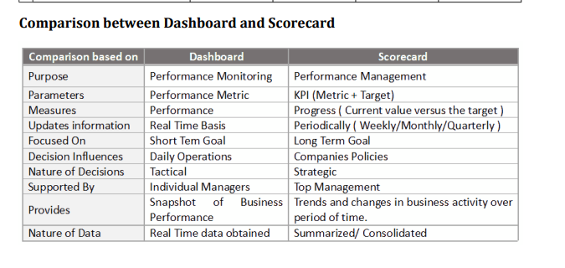

Slide 25
Casestudy
Let's consider the implementation of a Balanced Scorecard (BSC) in a hypothetical software company, “Everest Software":
Background: Everest Software is a mid-sized software development company that specializes in providing customized software solutions for clients across various industries. The company aims to enhance its strategic alignment, improve operational performance, and achieve sustainable growth through the implementation of a Balanced Scorecard framework.

Slide 26
Implementation of Balanced Scorecard:
Financial Perspective:
Objective: Increase profitability and revenue growth.
KPIs:
Annual revenue growth rate
Profit margins on software projects
Return on Investment (ROI) on R&D initiatives
Strategic Initiatives:
Focus on high-margin software projects and target industries.
Implement pricing strategies to optimize project profitability.
Invest in Research and Development (R&D) to develop innovative software solutions that can generate additional revenue streams.

Slide 27
Implementation of Balanced Scorecard:
Customer Perspective:
Objective: Enhance customer satisfaction and loyalty.
Key Performance Indicators (KPIs):
Customer satisfaction ratings from post-project surveys
Customer retention rate
Number of repeat customers
Strategic Initiatives:
Implement regular customer feedback mechanisms and surveys to assess satisfaction levels and identify areas for improvement.
Establish a dedicated customer support team to address client inquiries, concerns, and issues promptly.
Develop long-term relationships with key clients through personalized service and proactive communication.

Slide 28
Implementation of Balanced Scorecard:
Internal Business Processes Perspective:
Objective: Improve efficiency and quality in software development processes.
Key Performance Indicators (KPIs):
Project delivery time and adherence to deadlines
Defect density and software bug rates
Employee satisfaction with project management processes
Strategic Initiatives:
Implement Agile software development methodologies to enhance project flexibility, responsiveness, and delivery speed.
Conduct regular code reviews and quality assurance checks to reduce defects and ensure software quality.
Provide project managers and teams with training and resources to improve project planning, execution, and monitoring capabilities.

Slide 29
Implementation of Balanced Scorecard:
Learning and Growth Perspective:
Objective: Develop a skilled and motivated workforce.
Key Performance Indicators (KPIs):
Employee training hours and participation rates
Employee turnover rate
Innovation and creativity in software solutions
Strategic Initiatives:
Establish a comprehensive training program to enhance employees' technical skills, domain knowledge, and soft skills.
Implement employee recognition programs to reward and incentivize high-performing teams and individuals.
Foster a culture of innovation and knowledge sharing through internal workshops, hackathons, and idea generation initiatives.

Slide 30
ManufactureTech Inc.
Financial Perspective:
Objective: Increase profitability and financial performance.
KPIs:
Annual revenue growth rate
Gross profit margin
Return on investment (ROI)
Strategic Initiatives:
Increase market share in target segments by X% over the next fiscal year.
Reduce production costs by optimizing supply chain management and operational processes.
Increase revenue from new product launches by introducing X new products/services in the market.

Slide 31
ManufactureTech Inc.
Customer Perspective:
Objective: Enhance customer satisfaction and loyalty.
KPIs:
Customer satisfaction score (CSAT)
Net Promoter Score (NPS)
Customer retention rate
Strategic Initiatives:
Improve product quality and reliability to meet or exceed customer expectations.
Enhance after-sales service and support to ensure timely resolution of customer issues.
Conduct regular customer feedback surveys and implement actionable insights to drive product/service improvements.

Slide 32
ManufactureTech Inc.
Internal Business Processes Perspective:
Objective: Improve operational efficiency and effectiveness.
KPIs:
Manufacturing cycle time
Overall equipment effectiveness (OEE)
Defect rate
Strategic Initiatives:
Implement lean manufacturing principles to streamline production processes and reduce cycle times.
Invest in automation technologies to increase productivity and minimize downtime.
Implement a Total Quality Management (TQM) system to identify and address root causes of defects and quality issues.

Slide 33
ManufactureTech Inc.
Learning and Growth Perspective:
Objective: Develop a skilled and motivated workforce.
KPIs:
Employee training hours
Employee turnover rate
Innovation rate (number of new ideas generated)
Strategic Initiatives:
Provide ongoing training and development opportunities to employees to enhance technical skills and competencies.
Implement employee engagement initiatives to foster a positive work culture and reduce turnover.
Establish cross-functional teams to promote collaboration and innovation in product development and process improvement initiatives.

Slide 34
Why firms use balanced scorecard?
The Balanced Scorecard (BSC) is a strategic performance management tool used by organizations to monitor and manage their performance against strategic goals.
It was developed by Robert Kaplan and David Norton and offers a more comprehensive approach than traditional financial metrics
Why Firms Use the Balanced Scorecard
Holistic View of Performance:
Financial Metrics: While financial performance is crucial, it often reflects past performance rather than future potential.
Non-Financial Metrics: The BSC includes non-financial metrics like customer satisfaction, internal processes, and learning and growth, providing a balanced view of performance.

Slide 35
Holistic Performance View:
Comprehensive Metrics: Combines financial and non-financial metrics for a complete performance picture.
Balanced Perspectives: Includes financial, customer, internal processes, and learning and growth perspectives.
Strategic Alignment:
Aligns Activities: Ensures daily operations are aligned with long-term strategic goals.
Cascading Goals: Aligns goals across all organizational levels to support overall strategy.
Enhanced Performance Monitoring:
Feedback Loop: Provides mechanisms for continuous feedback and performance adjustments.
Proactive Management: Uses leading indicators to anticipate and address future challenges.

Slide 36
Improved Decision Making:
Data-Driven: Encourages data-driven decision-making by providing relevant performance metrics.
Strategic Insights: Offers insights into strategic areas that need attention or improvement.
Employee Engagement and Motivation:
Clear Objectives: Clarifies expectations, helping employees understand their roles in achieving strategic goals.
Recognition: Recognizes performance across multiple dimensions, not just financial outcomes, which can boost motivation.
Customer Focus:
Customer Satisfaction: Emphasizes customer-related metrics, fostering a customer-centric approach.
Market Responsiveness: Helps the firm respond effectively to customer needs and market changes.

Slide 37
Operational Efficiency:
Process Improvement: Identifies areas for improving internal processes and operational efficiencies.
Resource Allocation: Ensures resources are allocated effectively to support strategic objectives.
Learning and Growth:
Employee Development: Focuses on training and development, fostering a culture of continuous improvement.
Innovation: Encourages innovation and adaptation to changes in the business environment.
Performance Transparency:
Clear Reporting: Facilitates transparent reporting of performance to stakeholders.
Accountability: Enhances accountability by clearly linking performance metrics to strategic goals

Slide 38
Strategic Alignment:
Vision and Strategy: The BSC helps align daily operations with the long-term vision and strategy of the organization.
Cascading Goals: It ensures that goals at all levels of the organization are aligned with the overall strategy.
Performance Monitoring:
Feedback Loop: The BSC provides a mechanism for monitoring performance and receiving feedback, allowing for adjustments and continuous improvement.
Forward-Looking Indicators: It includes leading indicators that can predict future performance, helping firms to be proactive.
Employee Engagement:
Clear Objectives: By defining clear and measurable objectives, employees understand what is expected of them and how their work contributes to the organization’s goals.
Motivation: Recognition of performance across various dimensions motivates employees beyond financial incentives.

Slide 39
Example: A Retail Company
Financial Perspective:
Objective: Increase annual revenue by 10%.
Measure: Total sales revenue, profit margins.
Initiative: Implement a loyalty program to boost repeat purchases.
Customer Perspective:
Objective: Improve customer satisfaction.
Measure: Customer satisfaction scores, Net Promoter Score (NPS).
Initiative: Enhance customer service training and launch a new customer feedback system.
Internal Business Processes Perspective:
Objective: Streamline inventory management.
Measure: Inventory turnover rate, order fulfillment time.
Initiative: Upgrade the inventory management system and optimize supply chain logistics.
Learning and Growth Perspective:
Objective: Foster employee development.
Measure: Employee training hours, employee satisfaction scores.
Initiative: Implement continuous learning programs and career development workshops.

