Slide 1
Software Development Company

Slide 2
Strategic Information Planning
Responsible Party:
C-level executives (e.g., CEO, CTO, CIO)
Board of Directors

Slide 3
Strategic Information Planning
Objectives:
Align technology strategy with overall business goals.
Identify long-term technology trends and opportunities.
Establish a vision for the company’s technology landscape.
Ensure the company’s technological infrastructure supports its future growth.

Slide 4
Strategic Information Planning
Examples:
Deciding to invest in artificial intelligence (AI) and machine learning (ML) capabilities to enhance product offerings.
Planning to expand into new markets or industries with tailored software solutions.
Setting long-term goals for cloud migration and data center consolidation.

Slide 5
Strategic Information Planning
Challenges:
Predicting future technology trends and market needs.
Balancing innovation with the company’s core competencies.
Securing buy-in from stakeholders and ensuring alignment across departments.
Managing risks associated with large-scale technological changes.

Slide 6
Tactical Information Planning
Responsible Party:
Middle management (e.g., IT managers, project managers, product managers)

Slide 7
Tactical Information Planning
Responsible Party:
Middle management (e.g., IT managers, project managers, product managers)

Slide 8
Tactical Information Planning
Objectives:
Translate strategic goals into actionable projects and initiatives.
Develop medium-term plans to achieve strategic objectives.
Allocate resources efficiently to support strategic initiatives.
Ensure that projects are aligned with both strategic goals and operational capabilities.

Slide 9
Tactical Information Planning
Examples:
Developing a roadmap for implementing new AI and ML features into existing products over the next 1-2 years.
Planning the rollout of a new project management software across all teams.
Establishing a partnership with a cloud service provider to support the strategic goal of cloud migration.

Slide 10
Tactical Information Planning
Challenges:
Coordinating across different departments to ensure projects align with strategic objectives.
Managing resource constraints and budget limitations.
Handling unforeseen project delays or technical challenges.
Maintaining flexibility to adapt to changing priorities or market conditions.

Slide 11
Operational Information Planning
Responsible Party:
Operational managers (e.g., team leads, IT support, system administrators)

Slide 12
Operational Information Planning
Objectives:
Implement tactical plans through daily operations and activities.
Ensure the smooth and efficient functioning of IT systems and processes.
Monitor and maintain technology infrastructure and applications.
Provide support and training to staff to ensure effective use of technology.

Slide 13
Operational Information Planning
Examples:
Scheduling regular maintenance and updates for software and hardware.
Implementing a helpdesk system to support staff with IT issues.
Conducting training sessions on new project management software.
Monitoring system performance and addressing any issues promptly.

Slide 14
Operational Information Planning
Challenges:
Balancing day-to-day operational tasks with the implementation of new initiatives.
Ensuring high availability and reliability of IT systems.
Managing user expectations and providing timely support.
Keeping up with security updates and compliance requirements.

Slide 15
Summary
Strategic Planning
Responsible: C-level executives, Board of Directors
Objectives: Long-term vision, market positioning, innovation.
Challenges: Future trends, stakeholder alignment, risk management.
Tactical Planning
Responsible: Middle management
Objectives: Medium-term projects, resource allocation, project alignment.
Challenges: Coordination, resource management, project delays.
Operational Planning
Responsible: Operational managers
Objectives: Daily operations, system maintenance, user support.
Challenges: Task balancing, system reliability, user expectations.

Slide 16
Example Scenario:
Strategic:
Goal: Become a leader in AI-driven software solutions.
Objective: Invest in AI research and hire top talent in the field.
Tactical:
Goal: Integrate AI features into the flagship product within 2 years.
Objective: Develop a project plan, secure budget, and form a specialized AI development team.
Operational:
Goal: Ensure smooth integration and operation of AI features.
Objective: Conduct regular testing, provide staff training, and set up a dedicated support team for AI-related issues.

Slide 17
Example Scenario: Manufacturing
Strategic:
Goal: Achieve leadership in smart manufacturing.
Objective: Invest in Industry 4.0 technologies and sustainable practices.
Tactical:
Goal: Implement IoT sensors and AI-driven predictive maintenance.
Objective: Develop a project plan, secure budget, and form specialized teams.
Operational:
Goal: Ensure smooth integration and operation of new technologies.
Objective: Conduct regular equipment maintenance, provide staff training, and monitor system performance.

Slide 18
Example Scenario: Engineering College
Strategic Level:
Goal: Enhance digital learning and research capabilities.
Objective: Invest in a state-of-the-art Learning Management System (LMS) and establish a research center for AI and robotics.
Responsible Persons: Board of Trustees, College President, CIO.
Tactical Level:
Goal: Implement the LMS across all departments within 2 years and set up the research center.
Objective: Develop a detailed project plan, secure necessary budgets, and establish partnerships with technology providers.
Responsible Persons: Deans of Faculties, Department Heads, IT Managers.
Operational Level:
Goal: Ensure smooth integration and operation of the LMS and research center technologies.
Objective: Conduct regular system updates, provide training sessions, and monitor system performance.
Responsible Persons: Departmental Administrators, IT Support Staff, Faculty Members.

Slide 19
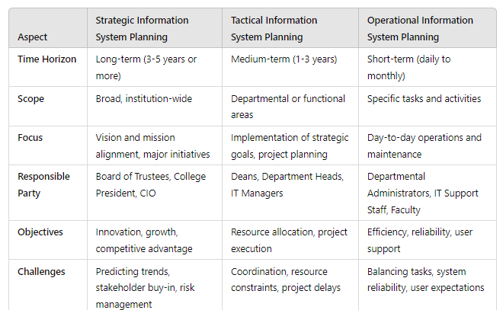
Key differences: Strategic, tactical, operational ISP

