Slide 1
Managing Information System Resources
Managing information system (IS) resources effectively is crucial for any organization to achieve its strategic goals, improve efficiency, and maintain a competitive edge.
Key Aspects of Managing Information System Resources
Hardware Management:
Inventory Control: Keep track of all hardware assets, including servers, computers, and networking equipment.
Maintenance and Upgrades: Regularly maintain and upgrade hardware to ensure optimal performance and prevent obsolescence.
Capacity Planning: Plan for future hardware needs based on expected growth and technological advancements.

Slide 2
Managing Information System Resources
2.Software Management:
Licensing and Compliance: Ensure all software is properly licensed and complies with vendor agreements and legal requirements.
Updates and Patches: Regularly update software to protect against vulnerabilities and improve functionality.
Application Portfolio Management: Evaluate and manage the portfolio of applications to align with business needs and eliminate redundancies.
3.Data Management:
Data Governance: Implement policies and procedures to ensure data accuracy, security, and accessibility.
Data Storage: Use efficient and scalable storage solutions, such as cloud storage, to manage growing data volumes.
Backup and Recovery: Regularly back up data and have a robust disaster recovery plan in place to mitigate data loss.

Slide 3
Managing Information System Resources
4.Network Management:
Network Infrastructure: Design and maintain a reliable and scalable network infrastructure to support business operations.
Security: Implement robust network security measures, including firewalls, intrusion detection systems, and encryption.
Performance Monitoring: Continuously monitor network performance to detect and resolve issues promptly.
5.Human Resources Management:
Skills Development: Invest in training and development programs to keep IT staff updated with the latest technologies and best practices.
Roles and Responsibilities: Clearly define roles and responsibilities to ensure efficient management and accountability.
Talent Acquisition: Recruit and retain skilled IT professionals to support and advance the organization's IS initiatives.

Slide 4
Example Scenario: Managing IS Resources in a Mid-Sized Company
Hardware:
They maintain an inventory of all hardware assets using an asset management system.
Regular maintenance schedules are followed, and aging equipment is replaced proactively.
Software:
All software licenses are tracked and managed to ensure compliance.
Regular software updates and patches are applied to keep systems secure and functional.
Data:
A data governance framework ensures that data is accurate, secure, and accessible to authorized users.
Data is backed up daily, and a disaster recovery plan is in place, with regular drills conducted to ensure readiness.
Network:
The company’s network infrastructure is designed for scalability and reliability, with redundant systems to prevent downtime.
Advanced security measures, including firewalls and intrusion detection systems, are implemented to protect against cyber threats.
Human Resources:
IT staff receive ongoing training and certifications to stay updated with the latest technologies.
Clear roles and responsibilities are defined, and regular performance reviews are conducted.

Slide 5
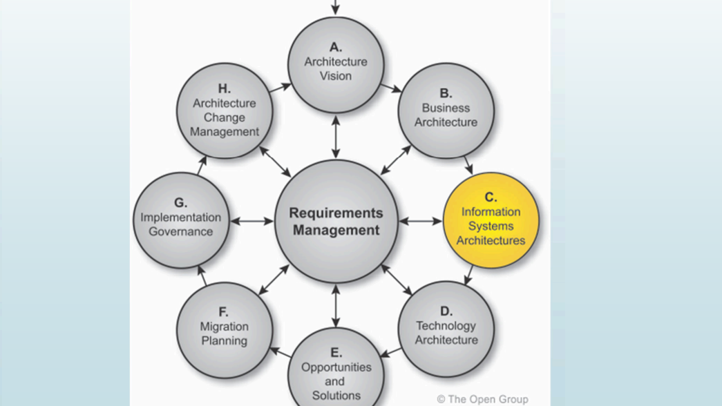

Slide 6
IS Architecture
Information system architecture is a comprehensive framework used to manage and align an organization’s IT infrastructure, data, applications, and processes with its business objectives. It serves as a blueprint for integrating and managing technology resources to effectively support business operations.
Information system architecture (ISA) is like a blueprint for how an organization's technology supports its goals and operations. It outlines how the different parts of the information system, such as hardware, software, data, and networks, work together to help the business run smoothly and efficiently.
Business Architecture:
Business Processes: Defines the core business processes, workflows, and functions.
Business Goals and Objectives: Aligns IT initiatives with strategic business goals.
Organizational Structure: Outlines roles, responsibilities, and relationships within the organization.

Slide 7
Components/ Domains of ISA
2.Data Architecture:
Data Models: Defines the structure of data, including entities, relationships, and data flow.
Data Management: Establishes data governance, quality, and lifecycle management practices.
Data Storage: Determines how and where data is stored, whether on-premises, in the cloud, or hybrid.
3.Application Architecture:
Application Portfolio: Catalogs all applications and their interactions.
Application Integration: Defines how different applications communicate and share data.
Development Standards: Sets standards for application development, including coding practices and tools.

Slide 8
Components/ Domains of ISA
4.Technology Architecture:
Infrastructure: Describes the hardware, software, networks, and facilities required to support applications and data.
Platforms: Identifies the operating systems, databases, and middleware used in the organization.
Security: Establishes security policies, controls, and technologies to protect the IT environment.
5.Security Architecture:
Security Policies: Defines the policies and procedures to safeguard information systems.
Access Controls: Specifies mechanisms for authentication, authorization, and auditing.
Risk Management: Identifies and mitigates potential security risks and vulnerabilities.

Slide 9
Components/ Domains of ISA
6.Integration Architecture:
Middleware: Uses middleware solutions for integrating disparate systems and applications.
APIs: Develops and manages APIs for seamless communication between systems.
Enterprise Service Bus (ESB): Implements ESB for routing and transforming messages between applications.

Slide 10
Phases of IS architecture
Preliminary Phase:
Establish the architecture framework and principles.
Set up the architecture team and define the architecture governance structure.
Activities:
Define the scope of the architecture.
Identify stakeholders and their concerns.
Establish the architecture governance structure.
2. Architecture Vision:
Develop a high-level vision of the architecture that aligns with company's business strategy.
Create an initial architecture roadmap outlining the transition from the current state to the desired future state.
Activities:
Create an initial architecture vision document.
Define key business requirements and constraints.
Develop a high-level roadmap.
3. Business Architecture:
1. Document the current business processes and identify areas for improvement.
2. Design the target business architecture to achieve strategic goal
Activities:
Document current business processes and capabilities.
Identify gaps and opportunities for improvement.
Design the target business architecture.

Slide 11
Phases of IS architecture
4. Information Systems Architectures (Data and Application):
Define the baseline and target data architecture, ensuring data quality and accessibility.
Develop the baseline and target application architecture, focusing on integration and alignment with business processes.
Data Activities:
Develop data models (conceptual, logical, and physical).
Establish data management policies and governance.
Plan for data storage and retrieval systems.
Application Activities:
Identify existing applications and their functionality.
Define application interfaces and integration points.
Design the target application architecture.
5. Technology Architecture:
Assess the current technology landscape and identify gaps.
Design the target technology architecture, considering scalability, security, and performance requirements.
Activities:
Document current technology infrastructure.
Identify technology standards and protocols.
Design the target technology infrastructure.
6. Opportunities and Solutions:
Identify potential solutions and opportunities to bridge the gaps between the baseline and target architectures.
Develop a detailed implementation and migration plan.
Activities:
Identify and evaluate solution options.
Develop a detailed implementation plan.
Define migration strategies and roadmaps.

Slide 12
Phases of IS architecture
7. Migration Planning:
Prioritize the implementation projects based on business value and dependencies.
Create a detailed roadmap for executing the migration plan.
Activities:
Prioritize projects and initiatives based on business value and dependencies.
Create a comprehensive migration roadmap.
Define change management and training requirements.
8. Implementation Governance:
Monitor the implementation to ensure alignment with the architecture vision and principles.
Adjust the plan as necessary based on feedback and changing business requirements.
Activities:
Monitor and control the implementation process.
Ensure compliance with architecture standards and principles.
Address any deviations from the plan.
9. Architecture Change Management:
Establish a process for managing changes to the architecture.
Continuously review and update the architecture to reflect new business needs and technological advancements.
Activities:
Establish a change management process.
Review and approve changes to the architecture.
Continuously update the architecture to reflect changes.

