Slide 2
Enterprise Engineering
Enterprise Engineering is a multidisciplinary approach to designing, implementing, and managing complex organizations, systems, and processes to achieve strategic objectives effectively and efficiently.
It involves applying engineering principles, methodologies, and tools to analyze, design, and optimize various aspects of an enterprise, including its structure, operations, technology, and culture.

Slide 3
Enterprise Engineering
Key Concepts of Enterprise Engineering:
Holistic View:
Enterprise Engineering takes a holistic view of organizations, considering their structure, processes, people, technology, and environment as interconnected components of a complex system.
Systems Thinking:
It applies systems thinking principles to understand the interactions and interdependencies among different elements of an enterprise, both internally and externally.
Alignment with Strategy:
Enterprise Engineering aligns organizational design and processes with strategic goals and objectives to ensure that the enterprise operates effectively and efficiently in pursuit of its mission.
Process Orientation:
It focuses on designing and optimizing business processes to improve efficiency, quality, and agility across the organization.

Slide 4
Enterprise Engineering
Interdisciplinary Approach:
Enterprise Engineering integrates concepts and methods from various disciplines, including engineering, management, information technology, economics, and sociology, to address complex organizational challenges.
Lifecycle Perspective:
It considers the entire lifecycle of an enterprise, from inception and design to implementation, operation, and evolution, emphasizing continuous improvement and adaptation to changing circumstances.
Enterprise Architecture:
Enterprise Engineering develops and maintains enterprise architecture frameworks, models, and standards to guide the design and evolution of organizational structures, processes, and systems.
Value Creation:
It focuses on creating value for stakeholders by optimizing resource allocation, improving operational performance, enhancing customer satisfaction, and fostering innovation and growth.
Change Management:
Enterprise Engineering addresses organizational change management to ensure successful implementation and adoption of new processes, technologies, and ways of working.

Slide 5
Methods in Enterprise Engineering
Business Process Reengineering (BPR):
BPR involves radical redesign and optimization of business processes to achieve dramatic improvements in performance, such as cost reduction, cycle time reduction, and quality enhancement.
Lean Enterprise:
Lean principles focus on eliminating waste, improving efficiency, and maximizing value delivery to customers by streamlining processes, reducing variation, and empowering employees.
Enterprise Architecture (EA):
EA provides a structured approach to designing and managing the architecture of an enterprise, including its business architecture, information architecture, application architecture, and technology architecture.
Agile and DevOps:
Agile and DevOps methodologies promote iterative and collaborative approaches to software development and operations, enabling organizations to respond quickly to changing requirements and market demands.
Six Sigma:
Six Sigma methodology aims to reduce defects and variation in processes through rigorous data analysis, statistical techniques, and continuous improvement initiatives.
Total Quality Management (TQM):
TQM focuses on continuous quality improvement by involving all employees in the pursuit of excellence, customer satisfaction, and process optimization.

Slide 6
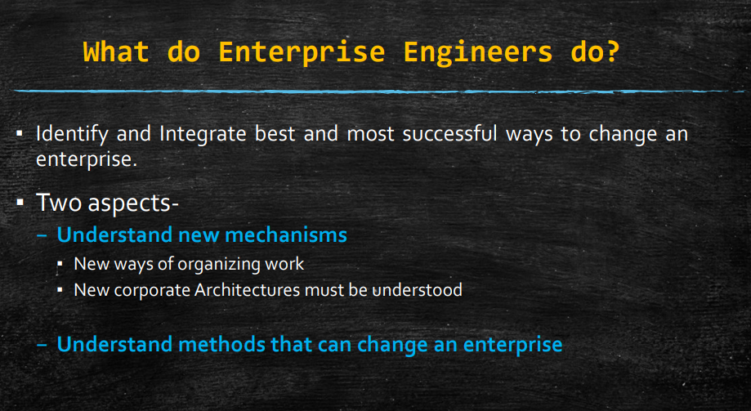

Slide 7
Digital/electronic Organism
An electronic or digital organism, also known as an artificial organism or digital creature, is an entity that exhibits characteristics of life, such as growth, reproduction, adaptation, and evolution, within a digital environment.
The concept of an electronic or digital organism is rooted in the field of artificial life (ALife), which explores how life-like behavior can emerge from non-biological systems, often using computational models and simulations.
So digital organism is a self – replicating computer program that mutates and evolves.

Slide 8
Digital organism – Key characteristics
Autonomy:
Electronic organisms have a degree of autonomy, meaning they can act and make decisions independently within their environment.
Self-Organization:
These organisms can self-organize, meaning they can spontaneously arrange themselves into complex structures or patterns without external intervention.
Adaptation and Learning:
Electronic organisms can adapt to changes in their environment over time. They may possess mechanisms for learning from experience and adjusting their behavior accordingly.
Reproduction:
Digital organisms can reproduce or replicate themselves, either through asexual division or sexual reproduction, producing offspring with variations.
Evolution:
Like biological organisms, electronic organisms can undergo evolutionary processes such as natural selection, mutation, and genetic drift, leading to the emergence of new traits and behaviors over generations.
Symbiosis and Interaction:
Electronic organisms may interact with each other and with their environment, forming symbiotic relationships or competing for resources.
Emergent Properties:
These organisms exhibit emergent properties, meaning that the behavior of the system as a whole cannot be predicted from the behavior of its individual components alone.

Slide 9
Examples
Artificial Life Simulations:
Computational models and simulations, such as cellular automata, genetic algorithms, and neural networks, can give rise to electronic organisms with life-like behavior.
Examples include virtual ecosystems where digital creatures interact, compete, and evolve, such as Tierra, Avida, and Polyworld.
Evolutionary Robotics:
Robotic systems equipped with artificial intelligence and evolutionary algorithms can exhibit behaviors analogous to those of living organisms.
These robots may evolve and adapt to their environment through simulated evolution or learning algorithms.

Slide 10
Enterprise Integration - need
Enterprises consist of multiple departments, systems, and processes that often operate in silos, leading to inefficiencies, data inconsistencies, and barriers to collaboration.
Enterprise integration aims to unify these disparate elements into a cohesive and interoperable whole, enabling seamless communication, coordination, and alignment across the organization.
Need for Enterprise Integration:
Efficiency and Productivity:
Integration streamlines business processes, eliminates duplicate efforts, and reduces manual data entry, leading to improved efficiency and productivity.
Data Consistency and Accuracy:
Integrating systems ensures that data is consistent and up-to-date across the organization, reducing errors and improving decision-making.
Real-time Information Sharing:
Integration enables real-time exchange of information between systems, departments, and stakeholders, facilitating faster decision-making and response to changing conditions.

Slide 11
Need for integration
Cost Reduction:
By rationalizing systems and eliminating redundant infrastructure, integration can reduce IT costs and operational expenses.
Enhanced Customer Experience:
Integration enables a holistic view of customer interactions and preferences, allowing organizations to deliver personalized and seamless customer experiences.
Agility and Innovation:
Integrated systems are more flexible and adaptable, allowing organizations to quickly respond to market changes, customer demands, and competitive threats.
Compliance and Risk Management:
Integration helps ensure compliance with regulations and industry standards by providing consistent data and audit trails. It also improves risk management by enabling better visibility and control over processes and transactions.

Slide 12
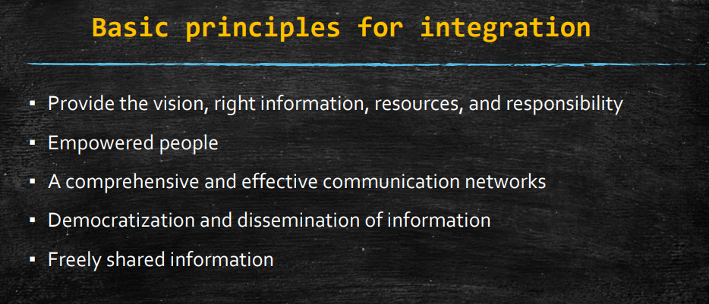

Slide 13
Loose Integration
In loose integration, systems or components are connected in a more flexible and less tightly coupled manner.
Data exchange often occurs through standardized interfaces or protocols, allowing systems to communicate without being directly dependent on each other.
This approach provides greater flexibility and agility but may require additional effort to maintain consistency and synchronization between systems.
Example: Integration between a CRM system and an email marketing platform. The CRM system exports customer data to the email marketing platform via a standardized CSV file format. While the systems are loosely integrated, changes in one system may require adjustments in the other to ensure data consistency.

Slide 14
Full Integration
In full integration, systems or components are tightly coupled and share data and functionality seamlessly.
Integration is achieved through direct connections, APIs, or shared databases, enabling real-time data exchange and synchronization.
This approach offers higher levels of automation, efficiency, and consistency but may require more upfront investment and effort to implement and maintain.
Example: Integration between an ERP system and a warehouse management system (WMS). The ERP system sends orders to the WMS in real-time via API calls, and the WMS updates inventory levels and order statuses back to the ERP system immediately upon fulfillment. This tight integration ensures accurate inventory management and order processing.

Slide 15
Horizontal Integration
Horizontal Integration:
Horizontal integration involves integrating systems, processes, or business units that operate at the same level or stage of the value chain.
It aims to consolidate similar or complementary functions to achieve economies of scale, improve efficiency, and enhance market competitiveness.
Horizontal integration can lead to broader product offerings, increased market share, and reduced competition.
Example: A retail chain acquires several competitors in the same industry to expand its market presence and increase its bargaining power with suppliers. By consolidating operations and resources, the retail chain achieves economies of scale and offers a wider range of products to customers.

Slide 16
Vertical Integration
Vertical integration involves integrating systems, processes, or business units that operate at different levels or stages of the value chain.
It aims to control or coordinate multiple stages of production, distribution, or sales to gain control over critical resources, reduce costs, and improve efficiency.
Vertical integration can lead to greater control over supply chains, improved quality assurance, and enhanced innovation.
Example: An automobile manufacturer acquires a supplier of key components, such as engines or transmissions, to ensure a stable supply of critical parts and reduce dependency on external suppliers. By vertically integrating backward, the manufacturer gains greater control over production quality and costs.

Slide 17
Intra-enterprise Integration:
Intra-enterprise Integration:
Intra-enterprise integration involves integrating systems, processes, or data within the boundaries of a single organization.
It aims to improve coordination, collaboration, and efficiency among different departments, functions, or business units within the organization.
Intra-enterprise integration focuses on optimizing internal operations, sharing resources, and aligning business objectives across the organization.
Example: Integration between finance, HR, and procurement systems within a large corporation. By connecting these systems, the organization streamlines processes such as budgeting, payroll, and purchasing, enabling better resource allocation and cost control.

Slide 18
Inter-enterprise Integration:
Inter-enterprise integration involves integrating systems, processes, or data across multiple organizations or business partners.
It aims to enable seamless communication, collaboration, and information sharing between different entities in a value chain or ecosystem.
Inter-enterprise integration focuses on optimizing supply chains, partner relationships, and customer interactions across organizational boundaries.
Example: Integration between a manufacturer and its suppliers in a supply chain network. By sharing demand forecasts, production schedules, and inventory levels, the manufacturer and its suppliers can coordinate production and inventory management more effectively, reducing lead times and costs.

Slide 19
System Integration:
System integration involves integrating hardware, software, and infrastructure components to ensure they work together as a unified system.
It focuses on connecting and synchronizing disparate systems, databases, and devices to enable seamless data exchange and communication.
System integration enables automation, interoperability, and scalability across IT infrastructure and applications.
Example: Integration between an ERP system, a CRM system, and an e-commerce platform. By connecting these systems, the organization can automate order processing, synchronize customer data, and provide a seamless omnichannel experience for customers.

Slide 20
Application Integration:
Application integration involves integrating software applications, services, or APIs to enable them to work together and share data or functionality.
It focuses on creating seamless workflows and user experiences by connecting and orchestrating different applications and services.
Application integration enables organizations to leverage best-of-breed solutions while ensuring interoperability and data consistency.
Example: Integration between a customer support ticketing system and a knowledge base platform. When a customer submits a support ticket, the integration automatically searches the knowledge base for relevant articles and suggests solutions to the support agent, speeding up resolution times and improving customer satisfaction.

Slide 21
Business Integration:
Business integration involves integrating business processes, rules, and workflows to align organizational objectives and optimize performance.
It focuses on streamlining end-to-end business processes, such as order-to-cash or procure-to-pay, to improve efficiency, agility, and customer satisfaction.
Business integration enables organizations to standardize processes, automate repetitive tasks, and adapt quickly to changing market conditions.
Example: Integration between sales, marketing, and customer service processes within a CRM system. By aligning these processes, the organization can provide a seamless customer journey from lead generation to post-sale support, resulting in higher customer retention and lifetime value.

Slide 22
Process Alignment
Process alignment in enterprise systems refers to the synchronization and harmonization of business processes with the capabilities and functionalities of enterprise systems, such as ERP (Enterprise Resource Planning), CRM (Customer Relationship Management), or SCM (Supply Chain Management) systems.
The goal is to ensure that the software solutions support and enhance the organization's workflows, goals, and objectives.

Slide 23
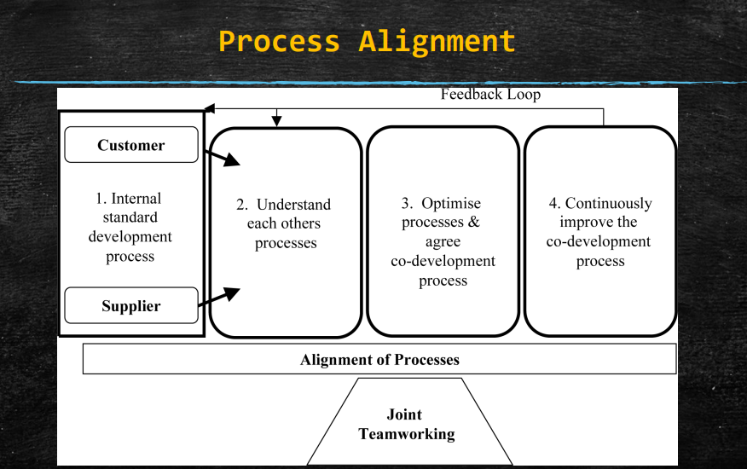
Process alignment

Slide 24
Examples
Examples of Process Alignment:
Order-to-Cash Process: Aligning the order-to-cash process with the CRM and ERP systems to ensure seamless flow of information from sales lead generation to order fulfillment, billing, and payment processing.
Procure-to-Pay Process: Aligning the procure-to-pay process with the ERP and SCM systems to automate procurement, inventory management, and accounts payable processes while maintaining compliance and cost control.
Customer Service Process: Aligning the customer service process with the CRM system to provide a unified view of customer interactions, enable case management, and track service requests from initiation to resolution.
Manufacturing Process: Aligning the manufacturing process with the ERP system to optimize production scheduling, resource allocation, and inventory management while ensuring quality control and traceability.

Slide 25
Enterprise change management
Integrated change management in the enterprise refers to the systematic approach of managing and implementing organizational changes in a coordinated and holistic manner, ensuring alignment with business objectives, stakeholder needs, and the overall organizational culture.
Key Components of Integrated Change Management:
Strategic Alignment: Ensure that proposed changes are aligned with the organization's strategic goals, vision, and values. Communicate the rationale behind the changes to gain buy-in from stakeholders and foster a sense of purpose and direction.
Change Governance: Establish a governance structure to oversee and guide the change management process. Define roles, responsibilities, and decision-making authority for stakeholders involved in planning, executing, and monitoring the changes.
Change Readiness Assessment: Assess the organization's readiness for change by evaluating factors such as leadership support, employee engagement, organizational culture, and capacity for change. Identify potential barriers and risks that may impede the change process.

Slide 26
Enterprise Change Management
Stakeholder Engagement: Engage key stakeholders throughout the change journey to solicit their input, address concerns, and build support for the proposed changes. Develop tailored communication and engagement strategies to effectively reach different stakeholder groups.
Change Planning and Execution: Develop a comprehensive change management plan that outlines the objectives, scope, timeline, and resources required for implementing the changes. Define clear milestones, metrics, and success criteria to measure progress and outcomes.
Training and Development: Provide targeted training, coaching, and skill-building programs to equip employees with the knowledge, skills, and competencies needed to adapt to new processes, systems, and ways of working. Offer ongoing support and reinforcement to sustain change adoption.
Communication and Transparency: Establish open and transparent communication channels to keep employees informed about the change initiative, its impact, and progress. Encourage two-way communication to foster dialogue, address concerns, and gather feedback from employees.
Change Integration with Business Processes: Embed change management practices into existing business processes, systems, and workflows to ensure that change management activities are seamlessly integrated with day-to-day operations. Align change initiatives with other organizational initiatives to maximize synergies and minimize disruptions.
Performance Measurement and Continuous Improvement: Establish metrics and KPIs to track the effectiveness of change management efforts and evaluate the impact of changes on business performance, employee engagement, and customer satisfaction. Use feedback and lessons learned to iteratively improve change management practices.

Slide 27
