Slide 1
Information Systems
Surendra KC

Slide 2
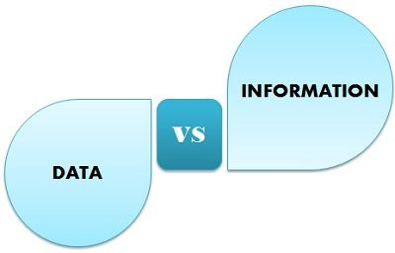

Slide 3
In summary, data is the raw material, while information is the processed, organized, and contextualized version of that data that provides meaning and usefulness.
Data:
Data refers to raw facts, figures, symbols, or statistics that have no inherent meaning on their own.
It's the basic unit of information, often lacking context or organization.
Example: A list of numbers - 5, 10, 15, 20, 25. Without any context or explanation, this is just data. It could represent anything from temperatures to test scores to ages.
Information:
Information is data that has been processed, organized, structured, or presented in a meaningful context.
It provides understanding, answers questions, or influences decisions.
Example: If we take the list of numbers mentioned earlier (5, 10, 15, 20, 25) and provide context by saying "These numbers represent the ages of students in a classroom," it becomes information. Now it can help someone understand the age distribution within that classroom.

Slide 4
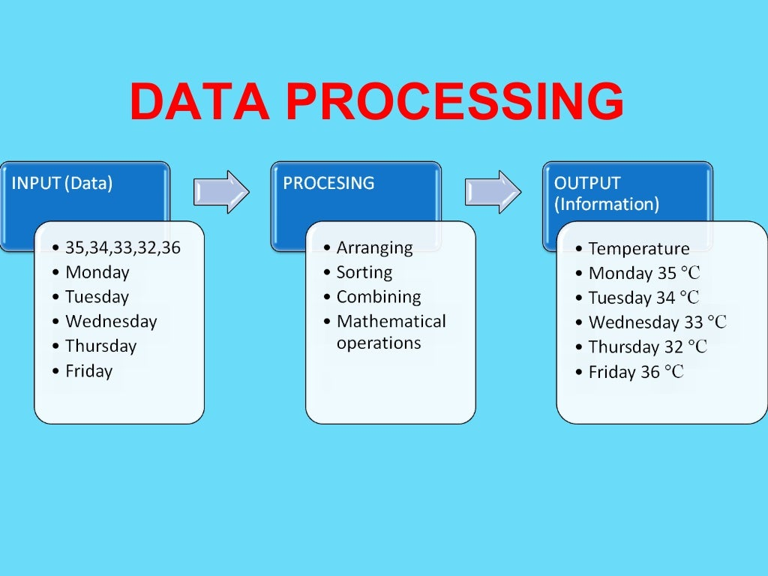
Data Processing Cycle

Slide 5
Data Processing Cycle
Data Collection: This is the initial stage where raw data is gathered from various sources, such as sensors, forms, databases, or external systems. The data collected may be structured (in databases) or unstructured (such as text files).
Data Input: In this stage, the collected data is entered into the information system. This can be manual entry by users, automated through devices, or imported from external sources.
Data Processing: Once the data is inputted into the system, it undergoes processing to convert it into a more useful form. Processing can involve various operations such as sorting, filtering, summarizing, calculations, and transformation of data.
Data Storage: Processed data is then stored in databases, files, or other data storage systems for future use. Proper data storage ensures that information is readily accessible when needed.
Data Output: In this stage, the processed data is presented in a format that is understandable and useful to users. Output can take various forms such as reports, charts, graphs, dashboards, or alerts.
Data Retrieval: Users may need to retrieve specific data from storage for analysis or decision-making purposes. Retrieval involves searching for and accessing the relevant data from storage.
Data Analysis: Analyzing data involves examining, interpreting, and deriving insights from the processed information. This stage often involves statistical analysis, data mining, or other analytical techniques to uncover patterns, trends, or relationships within the data.
Information Presentation: Finally, the analyzed information is presented to users in a meaningful and comprehensible manner. This presentation may involve visualizations, summaries, recommendations, or interactive interfaces tailored to the needs of the users.

Slide 6
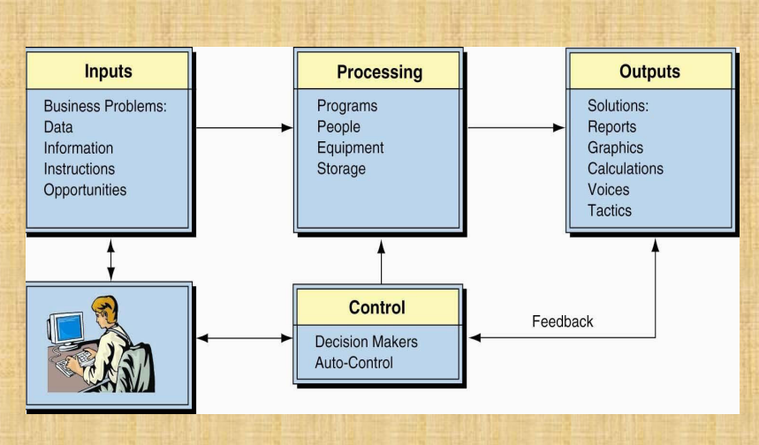

Slide 7
Information Systems
An information system is a coordinated system of people, processes, data, and technology designed to collect, process, store, and distribute information to support decision-making, coordination, control, analysis, and visualization in an organization.
Here's a breakdown of the components of an information system:
People: Users who interact with the system, including employees, managers, customers, and other stakeholders.
Processes: Procedures, workflows, and activities that define how data is collected, processed, and transformed into information within the system.
Data: Raw facts, figures, symbols, or statistics that are inputted into the system. Data can be structured (organized in databases) or unstructured (e.g., text documents, multimedia files).
Technology: Hardware, software, networks, and infrastructure that enable the collection, processing, storage, and dissemination of data and information within the system.

Slide 8
Information Systems
Product Development System:
People: Software developers, testers, product managers, and project managers.
Processes: Agile or Scrum methodologies for software development, including sprint planning, coding, testing, and deployment.
Data: Requirements documents, user stories, code repositories (e.g., Git), bug tracking systems (e.g., Jira), test results, and feedback from users.
Technology: Integrated development environments (IDEs) like Visual Studio Code or IntelliJ IDEA, version control systems (e.g., Git), continuous integration/continuous deployment (CI/CD) pipelines (e.g., Jenkins, GitLab CI), collaboration tools (e.g., Slack, Microsoft Teams), and project management software (e.g., Jira, Trello).
A software company is developing a new mobile application. The development team uses Jira to manage tasks and sprints, Git for version control, and Jenkins for automated testing and deployment. Developers use IDEs like Visual Studio Code to write code collaboratively, and Slack for communication and sharing updates.

Slide 9
Information Systems
Customer Support System:
People: Support agents, technical specialists, and customers.
Processes: Ticketing system for logging, prioritizing, and resolving customer issues, knowledge base management for storing solutions to common problems, and escalation procedures.
Data: Customer inquiries, tickets, support history, knowledge base articles, and customer feedback.
Technology: Help desk software (e.g., Zendesk, Freshdesk), customer relationship management (CRM) software (e.g., Salesforce), knowledge base platforms (e.g., Confluence), and communication tools (e.g., email, live chat).

Slide 10
Information Systems
Sales and Marketing System:
People: Sales representatives, marketing specialists, and customers.
Processes: Lead management, customer relationship management (CRM), marketing campaigns, and sales forecasting.
Data: Leads, contacts, accounts, sales opportunities, marketing analytics, and customer feedback.
Technology: CRM software (e.g., Salesforce, HubSpot), marketing automation platforms (e.g., Marketo, Mailchimp), analytics tools (e.g., Google Analytics, HubSpot Analytics), and social media management tools (e.g., Hootsuite, Buffer).

Slide 11
Classification of Management Hierarchy
Management hierarchy, also known as organizational hierarchy or managerial hierarchy, refers to the structure of authority and responsibility within an organization. It typically consists of different levels of management, each with its own set of roles, responsibilities, and decision-making powers.
Top-Level Management:
Description: Also known as executive management or senior management, top-level management consists of the highest-ranking executives in the organization. They are responsible for setting the overall direction, goals, and policies of the organization.
Roles and Responsibilities: Top-level managers focus on long-term strategic planning, making major decisions, and representing the organization to external stakeholders such as shareholders, government agencies, and the public.
Examples: Chief Executive Officer (CEO), President, Chief Operating Officer (COO), Chief Financial Officer (CFO), Chief Information Officer (CIO), and other C-level executives.

Slide 12
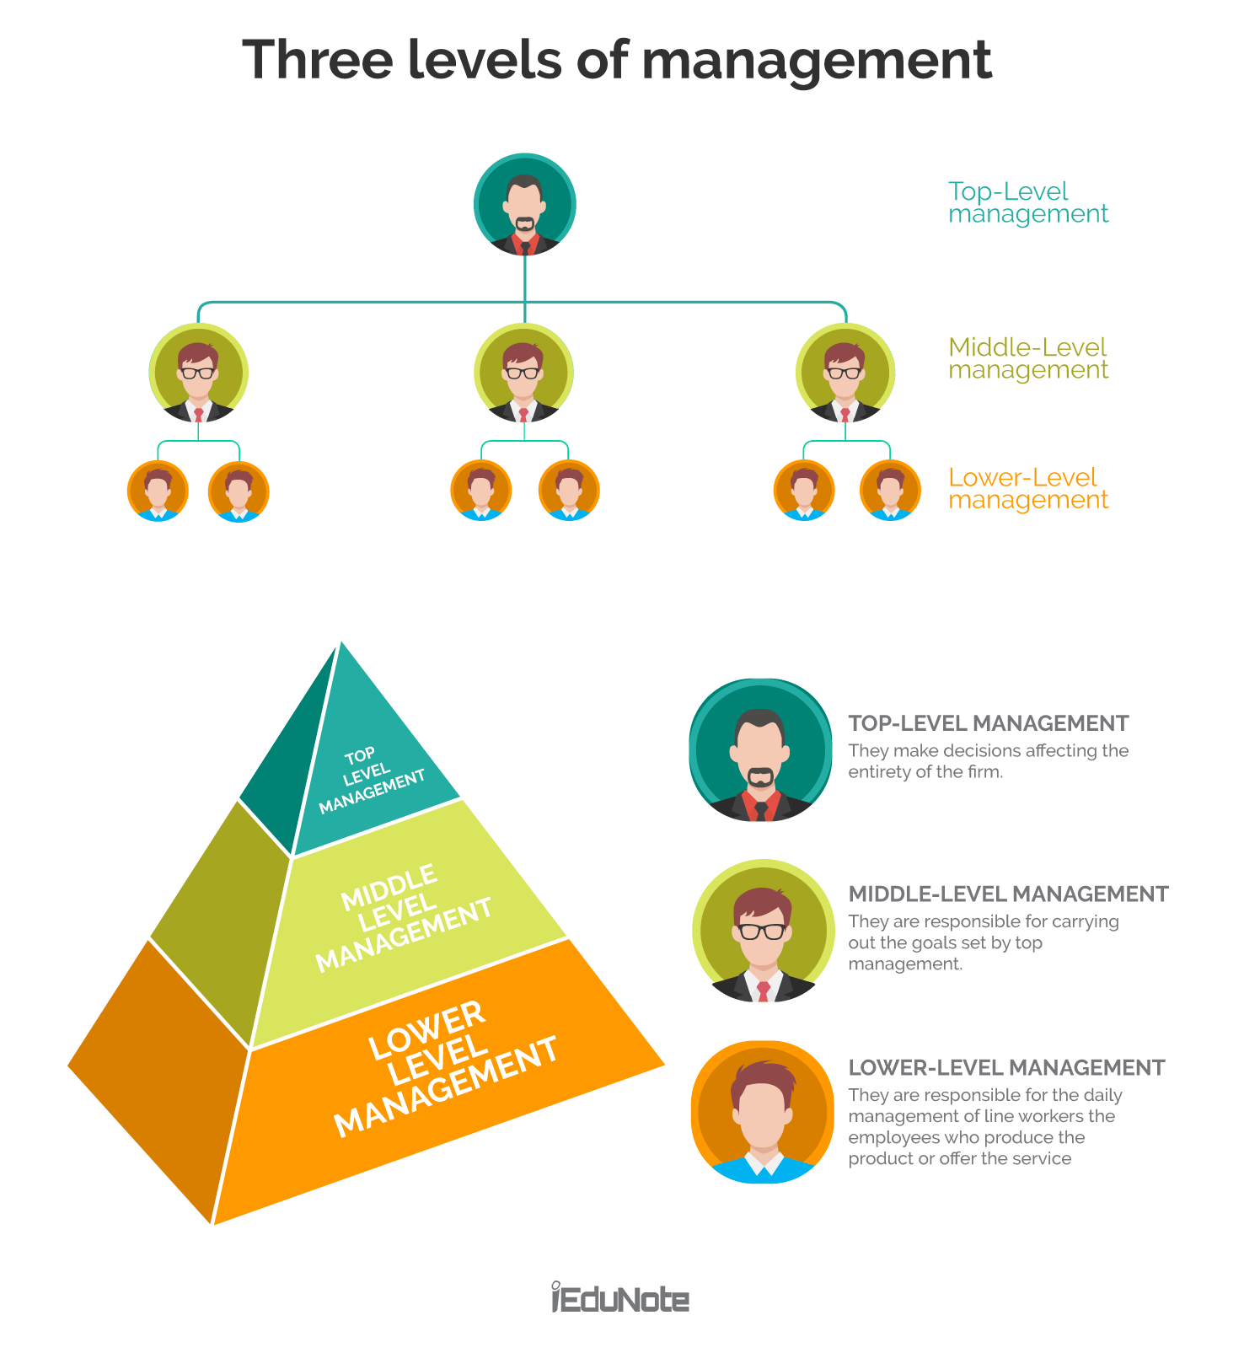
Management Hierarchy

Slide 13
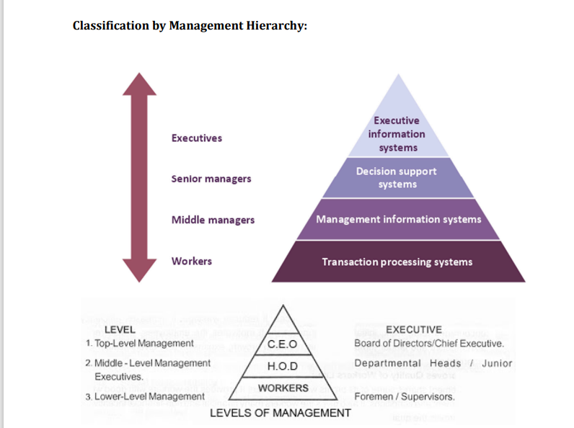

Slide 14
Classification of Management Hierarchy
Middle-Level Management:
Description: Middle-level management, also known as middle management or operational management, acts as a bridge between top-level management and lower-level employees. They translate the strategic goals set by top management into actionable plans and oversee day-to-day operations.
Roles and Responsibilities: Middle managers are responsible for implementing strategies, coordinating activities within their departments, managing resources, and ensuring that organizational goals are met.
Examples: Department managers, division heads, regional managers, branch managers, and project managers.

Slide 15
Classification of Management Hierarchy
First-Level Management:
Description: First-level management, also known as front-line management or supervisory management, directly oversees the work of non-managerial employees. They are responsible for translating the plans and policies set by top and middle management into specific tasks and actions.
Roles and Responsibilities: First-line managers focus on day-to-day operations, assigning tasks, supervising employees, providing training and guidance, and ensuring that work is completed efficiently and according to standards.
Examples: Team leaders, supervisors, shift supervisors, foremen, and coordinators.

Slide 16
Classification of Management Hierarchy
Non-Managerial Employees:
Description: Non-managerial employees, also known as staff or line employees, are individuals who do not hold formal management positions within the organization. They perform specific tasks or functions related to the organization's products, services, or operations.
Roles and Responsibilities: Non-managerial employees carry out the day-to-day tasks required to produce goods or deliver services, following instructions provided by managers and adhering to organizational policies and procedures.
Examples: Sales associates, production workers, customer service representatives, administrative assistants, and technical staf

Slide 17
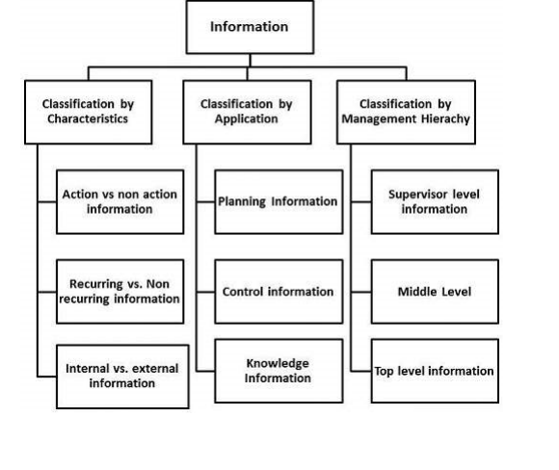
Classification of Information

Slide 18
Action vs. Non-action Information
Action Information: Information that prompts or requires a specific action to be taken. It often includes directives, requests, or notifications that necessitate a response or decision.
Example: An email from a client requesting a product demonstration would be considered action information, as it requires the sales team to schedule and conduct the demo.
Example: - when the attendance of the student for a particular subject suddenly falls down 40% calls for immediate action
Non-action Information: Information that provides knowledge or updates without necessitating an immediate response or action. It may include reports, updates, or general information.
Example: A monthly sales report detailing performance metrics and trends would be non-action information, as it provides insights for analysis but does not require an immediate response.
Example: - While watching the live cricket match you understand that India's Current Run rate is 4 per over whereas its required run rate is 7 Per over. You have this information but this is non-action information

Slide 19
Recurring v/s Non-recurring Informatio
Recurring Information: Information that repeats at regular intervals or is generated periodically. It often includes routine reports, updates, or data that follows a predictable schedule.
Example: Weekly sales reports, monthly financial statements, and quarterly performance reviews are examples of recurring information.
Non-recurring Information: Information that is one-time or irregular, not following a predictable pattern. It may include ad-hoc reports, special announcements, or unique data.
Example: A special market analysis report commissioned for a specific project or a one-time event evaluation would be non-recurring information.

Slide 20
Internal v/s External Information
Internal Information: Information generated or circulated within the organization, pertaining to its operations, employees, or resources. It is used for internal decision-making, communication, and coordination.
Example: Internal memos, company policies, employee performance reviews, and departmental budgets are examples of internal information.
For Example: - The Everest Engineering College announces the date of final examination schedule
External Information: Information obtained from sources outside the organization, such as customers, suppliers, competitors, or industry reports. It provides insights into external factors that may impact the organization.
Example: Market research reports, customer feedback surveys, industry benchmarks, and competitor analysis are examples of external information.
Example: - The Pokhara University announces the date of final examination schedule

Slide 21
Planning Information
Planning information within an information system typically refers to data and insights used to support the planning process within an organization. This includes information related to strategic, tactical, and operational planning activities.
Strategic Planning Information
Description: Strategic planning information is used by top-level executives to set long-term goals, define organizational objectives, and formulate strategies for achieving them.
Examples:
Market Analysis Reports: Provide insights into market trends, customer preferences, and competitive dynamics to inform strategic direction.
SWOT Analysis: Evaluate the organization's strengths, weaknesses, opportunities, and threats to identify strategic priorities and areas for improvement.
Industry Benchmarks: Compare the organization's performance against industry standards and benchmarks to identify areas of competitive advantage or areas needing improvement.

Slide 22
Planning Information
Description: Tactical planning information is used by middle managers to translate strategic goals into specific action plans and initiatives for achieving them.
Examples:
Departmental Budgets: Allocate resources and funds to support departmental objectives and initiatives in alignment with overall strategic goals.
Sales Forecasts: Predict future sales trends and demand patterns to guide inventory management, production planning, and resource allocation.
Project Plans: Outline the scope, schedule, budget, and deliverables of specific projects or initiatives to ensure successful implementation.

Slide 23
Planning Information
Description: Operational planning information is used by front-line managers and supervisors to coordinate day-to-day activities, allocate resources, and ensure operational efficiency.
Examples:
Work Schedules: Assign tasks, shifts, and responsibilities to employees to ensure adequate coverage and efficient use of labor resources.
Production Plans: Schedule production activities, allocate equipment and materials, and coordinate workflow to meet production targets and customer demands.
Inventory Reports: Monitor inventory levels, track stock movements, and reorder materials as needed to maintain optimal inventory levels and avoid stockouts
An operational plan addresses four questions: • Where are we now? • Where do we want to be? • How do we get there? • How do we measure our progress?

Slide 24
Planning Information
Description: Financial planning information is used to manage financial resources, forecast revenues and expenses, and ensure financial stability and sustainability.
Examples:
Financial Statements: Provide an overview of the organization's financial performance, including income statements, balance sheets, and cash flow statements.
Budget Variance Analysis: Compare actual financial results against budgeted figures to identify variances and take corrective actions as needed.
Cost-Benefit Analysis: Evaluate the costs and benefits of proposed projects or investments to determine their financial viability and return on investment (ROI).

Slide 25
Control Information
Control information within an information system refers to data and insights used to monitor, evaluate, and regulate organizational activities and processes. It enables managers to ensure that operations are running smoothly, goals are being achieved, and resources are being utilized effectively.
Control information encompasses various metrics, Key Performance Indicators (KPIs), reports, and feedback mechanisms that help managers assess performance, identify deviations from standards or targets, and take corrective actions as needed.
It provides insights into whether organizational objectives are being met and helps in maintaining operational efficiency and effectiveness
Example: The CRM system tracks and manages customer interactions, sales activities, and pipeline progress. Control information within the CRM system enables sales managers to monitor sales performance, identify areas for improvement, and ensure that sales targets are being met.

Slide 26
Control Information
Project Management Tools: The project management tool, such as Jira or Trello, is used to track tasks, assign responsibilities, and monitor progress. Control information includes:
Task status (e.g., to-do, in progress, done)
Task assignments and deadlines
Burndown charts showing progress over time
Issue logs capturing bugs and blockers
Version Control System (VCS): A version control system like Git is used to manage code changes, track revisions, and facilitate collaboration among team members. Control information includes:
Commit history showing changes made to the codebase over time
Branches and merges indicating the evolution of features and bug fixes
Code review comments and approvals
Code Quality Metrics: Automated code analysis tools like SonarQube or ESLint are used to assess code quality and adherence to coding standards. Control information includes:
Code coverage metrics showing the percentage of code covered by automated tests
Code complexity scores indicating the readability and maintainability of code
Static code analysis findings highlighting potential issues and violations
Testing and Quality Assurance (QA): Testing tools and frameworks like Selenium or Cypress are used to automate testing and ensure software quality. Control information includes:
Test case execution results showing pass/fail status
Defect tracking reports documenting issues found during testing
Test coverage reports indicating the percentage of code exercised by tests

Slide 27
Control Information
Purpose: The control information in software development serves several purposes:
Progress Monitoring: It allows project managers to monitor progress against project timelines and milestones, ensuring that the project stays on track.
Risk Management: It helps identify potential risks, such as missed deadlines, scope creep, or quality issues, allowing proactive mitigation measures to be taken.
Quality Assurance: It facilitates the assessment of code quality, adherence to standards, and the effectiveness of testing efforts, ensuring that the software meets quality requirements.
Decision-making: It provides stakeholders with actionable insights and data-driven recommendations, enabling informed decision-making and course corrections as needed.

Slide 28
Knowledge Information
Knowledge information within information systems refers to data and insights that have been processed and organized to create actionable knowledge. It goes beyond raw data to provide context, understanding, and insights that can be used to support decision-making, problem-solving, and innovation within an organization.
Consider a CRM system used by a sales and marketing team to manage customer relationships, track sales activities, and analyze customer data. Within this system, knowledge information is derived from various sources of data and transformed into actionable insights that drive sales strategies and improve customer engagement.
Purpose: The knowledge information within the CRM system serves several purposes:
Informed Decision-making: It provides sales and marketing teams with actionable insights and recommendations to guide strategic decision-making and resource allocation.
Improved Customer Engagement: It enables personalized and targeted marketing efforts, leading to enhanced customer satisfaction, loyalty, and retention.
Optimized Sales Performance: It empowers sales teams to identify and capitalize on opportunities, optimize sales processes, and achieve sales targets more effectively.
Continuous Learning and Improvement: It fosters a culture of continuous learning and improvement by capturing and sharing knowledge, best practices, and success stories across the organization.
In summary, knowledge information within a CRM system transforms raw data into valuable insights that drive sales effectiveness, customer satisfaction, and business growth.

Slide 29
Organizational Information
Organizational information within information systems refers to data and insights that are relevant to the functioning and management of an organization as a whole. This includes information about organizational structure, processes, policies, resources, and performance
Organizational Structure
Department, roles, job description, employee profile, contact etc
Financial Management
Salary , balance sheet, budget
Human Resources Management
Supply Chain Management: Vendor, pricing, shipping , logistics, etc

Slide 30
Database Information
Database information within information systems refers to structured data stored in databases, which is organized, managed, and retrieved to support various business processes and decision-making activities

Slide 31
Functional/Operational Information
Functional or operational information within information systems refers to data and insights that support day-to-day operational activities and processes within an organization. It encompasses information related to routine transactions, tasks, and operations that are essential for the functioning of the business
Employee Information
Payroll Processing
Leave Management
Performance Evaluations

Slide 32
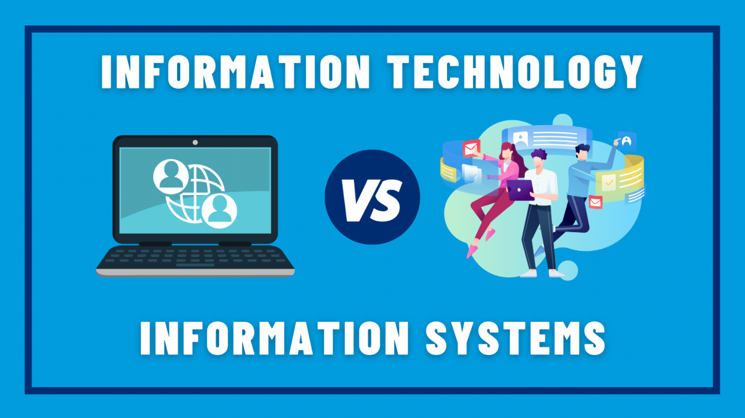

Slide 33
IS vs IT
Information Systems (IS):
Information systems refer to the broader framework of processes, people, and technology used to gather, process, store, and disseminate data within an organization.
IS encompass the entire ecosystem of hardware, software, data, procedures, and people that work together to support organizational goals and decision-making.
IS focus on how technology is utilized to support business processes, enhance communication, and facilitate decision-making.
Examples of information systems include enterprise resource planning (ERP) systems, customer relationship management (CRM) systems, and knowledge management systems (KMS)
Information Technology (IT):
Information technology refers specifically to the hardware, software, and networks used to manage and process data.
IT focuses on the technology infrastructure and tools that enable the storage, retrieval, transmission, and manipulation of data.
IT encompasses a wide range of technologies, including computers, servers, networks, databases, software applications, and communication systems.
Examples of information technology include hardware components like servers and routers, software applications like databases and operating systems, and networking technologies like the internet and intranets.

Slide 34
IS vs IT
Description: AgileTech Project Management System (ATPMS) is an information system used by the software company to plan, track, and manage their software development projects.
Components:
Software Application: ATPMS includes a web-based project management software application accessible to all team members. This application allows project managers to create project plans, assign tasks, set deadlines, and track progress.
Database: ATPMS stores project-related data such as task assignments, project timelines, resource allocation, and project documentation in a centralized database.
People: Team members including developers, testers, project managers, and stakeholders interact with ATPMS to collaborate on project tasks, provide status updates, and monitor project progress.

Slide 35
IS vs IT
Description: CodeCraft Development Environment (CCDE) is the information technology infrastructure used by the software company to develop, test, and deploy software applications.
Components:
Development Tools: CCDE includes integrated development environments (IDEs) such as Visual Studio Code or JetBrains IntelliJ IDEA, which developers use to write, debug, and test code.
Version Control System: CCDE integrates with a version control system like Git, allowing developers to collaborate on code changes, track revisions, and manage code repositories.
Testing Frameworks: CCDE includes testing frameworks and automation tools like JUnit or Selenium for automated testing of software applications.
Deployment Pipeline: CCDE includes CI/CD (Continuous Integration/Continuous Deployment) tools such as Jenkins or GitLab CI/CD, enabling automated builds, testing, and deployment of software releases.

Slide 36
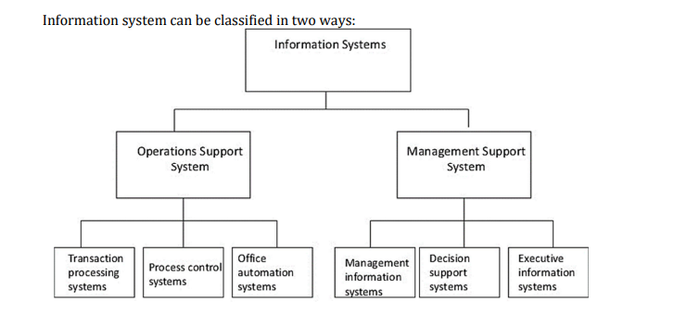
Classification of Information Systems

Slide 37
OSS vs MSS
Description: OSS are information systems designed to support the day-to-day operational activities and processes of an organization. They focus on automating routine tasks, managing transactions, and ensuring the smooth functioning of operational processes.
Purpose: OSS help organizations automate repetitive tasks, improve operational efficiency, reduce manual errors, and ensure the smooth flow of business processes.
Description: MSS are information systems designed to support managerial decision-making, planning, and control activities within an organization. They provide managers with the necessary data, tools, and analytical capabilities to make informed decisions and monitor performance.
Purpose: MSS help managers at different levels of the organization make informed decisions, allocate resources effectively, monitor performance against objectives, and align organizational activities with strategic goals.

Slide 38
OSS vs MSS
Key Differences:
Focus: OSS focus on supporting operational activities and processes, while MSS focus on supporting managerial decision-making and control.
Users: OSS are primarily used by operational staff and employees involved in day-to-day tasks, while MSS are used by managers and executives responsible for planning and strategic decision-making.
Data and Information: OSS deal with transactional data and real-time operational information, while MSS deal with summarized, aggregated, and analytical information used for decision-making and planning.
Scope: OSS typically cover a wide range of operational functions and processes, while MSS are more focused on specific managerial functions and activities.

Slide 39
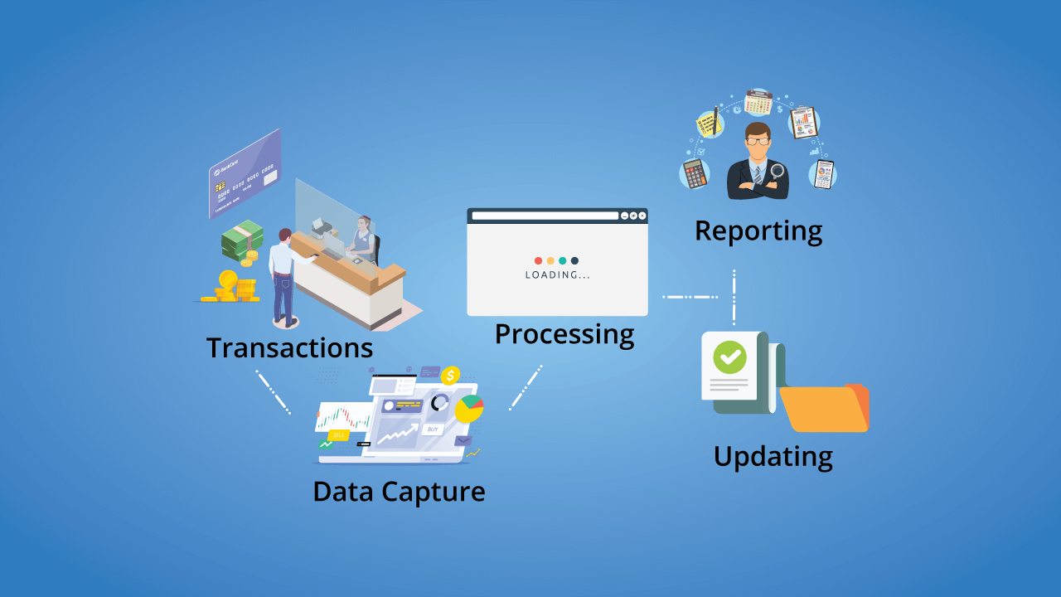
Transaction Processing System

Slide 40
TPS
Transaction Processing Systems (TPS) are information systems designed to process and manage transactions within an organization.
Transactions refer to any business activity that involves the exchange of goods, services, or money and typically result in some form of record-keeping.
TPS automate and streamline these transactional processes to ensure accuracy, efficiency, and reliability.
Example: Point of Sale (POS) System
A Point of Sale (POS) system is a common example of a Transaction Processing System used in retail businesses to process sales transactions. It automates the process of recording sales, processing payments, updating inventory levels, and generating receipts.

Slide 41
TPS
Data Entry:
Description: This stage involves capturing transaction data and entering it into the system. Data entry methods may include manual data entry, barcode scanning, or electronic data interchange (EDI) for automated data exchange with external systems.
Example: In a retail environment, a cashier scans the barcodes of items purchased by a customer at the point of sale (POS) terminal, entering transaction details such as item codes, quantities, and prices into the system.
Validation and Verification:
Description: Once transaction data is entered, it undergoes validation and verification checks to ensure accuracy, completeness, and consistency. This stage involves checking for errors, validating data formats, and verifying the integrity of transaction information.
Example: The POS system verifies that the scanned item codes correspond to valid products in the inventory database and that the prices charged align with the current pricing structure.
3. Transaction Processing:
Description: In this stage, the system processes the transaction according to predefined business rules and logic. This may involve calculating totals, applying discounts or taxes, updating inventory records, and generating transaction identifiers.
Example: The POS system calculates the total amount due based on the prices of scanned items, applies any applicable discounts or taxes, processes payment transactions, and updates inventory levels to reflect the items sold.

Slide 42
TPS
4. Transaction Recording:
Description: After processing, the transaction data is recorded and stored in the system's database for future reference and reporting purposes. This stage ensures that transaction records are securely stored and easily retrievable.
Example: The POS system records transaction details such as the date and time of the sale, the items purchased, payment method, and customer information in the transaction log or database.
5. Transaction Reporting and Analysis:
Description: Transaction data may be used for generating reports, analyzing trends, and gaining insights into business performance. This stage involves generating reports, dashboards, or analytics to monitor transaction volumes, sales trends, revenue, and other key metrics.
Example: Management can use transaction data from the POS system to generate daily, weekly, or monthly sales reports, track inventory turnover rates, identify popular products, and analyze customer buying patterns.
6. Transaction Maintenance and Archiving:
Description: Transaction records may need to be maintained, archived, or purged based on organizational policies and regulatory requirements. This stage involves managing transaction data over its lifecycle, including archiving historical data and purging outdated records.
Example: Old transaction records may be archived periodically to free up database space, while retaining them for compliance purposes or historical analysis. Archived data may be stored in long-term storage systems or offline backups.

Slide 43
Process Control System
In information systems, a Process Control System (PCS) is a set of tools, procedures, and protocols used to monitor, manage, and optimize processes within an organization. These systems ensure that workflows are executed efficiently, adhere to predefined standards, and achieve desired outcomes.
Example: Workflow Management System
A Workflow Management System (WMS) is an example of a Process Control System used in information systems to automate, monitor, and streamline business processes. It facilitates the coordination of tasks, resources, and information across departments, improving efficiency, transparency, and accountability.

Slide 44
PCS
Components:
Process Modeling: In a WMS, processes are modeled using graphical representations, such as flowcharts or process diagrams. These models define the sequence of activities, decision points, and dependencies within a process.
Task Assignment and Routing: Once a process is defined, tasks are automatically assigned to individuals or teams based on predefined rules and criteria. Tasks may be routed to specific users or groups based on their roles, skills, availability, or workload.
Automated Workflows: The WMS orchestrates the flow of work through predefined workflows, ensuring that tasks are executed in the correct sequence and routed to the appropriate stakeholders for review, approval, or action.
Notifications and Alerts: The system sends notifications and alerts to users to inform them of new tasks, pending approvals, deadlines, or status updates. These notifications can be delivered via email, mobile notifications, or within the system's interface.
Monitoring and Reporting: The WMS provides real-time visibility into process performance through dashboards, reports, and analytics. Managers can track the status of workflows, monitor key performance indicators (KPIs), and identify bottlenecks or inefficiencies.
Integration with Other Systems: The WMS integrates with other systems and applications within the organization's IT ecosystem, such as enterprise resource planning (ERP) systems, customer relationship management (CRM) systems, and document management systems. This integration ensures seamless data exchange and interoperability across systems.

Slide 45
PCS
Purpose: The Workflow Management System serves several purposes within an information system:
Process Automation: It automates repetitive tasks, standardizes workflows, and reduces manual effort, leading to increased efficiency and productivity.
Process Standardization: It enforces consistency and compliance with predefined business rules, policies, and regulations, ensuring that processes are executed according to best practices.
Process Visibility and Transparency: It provides stakeholders with visibility into process status, progress, and performance, fostering transparency, accountability, and informed decision-making.
Process Optimization: It identifies bottlenecks, inefficiencies, and opportunities for improvement within processes, enabling organizations to optimize workflows and resource allocation.

Slide 46
Office Automation System
An Office Automation System (OAS) is a type of information system designed to automate and streamline routine office tasks and workflows. It aims to improve efficiency, productivity, and communication within an organization by reducing manual effort and optimizing the use of resources.
Example: Microsoft Office 365
Microsoft Office 365 is a comprehensive suite of cloud-based productivity tools and services that serves as an Office Automation System for businesses and individuals. It includes a wide range of applications and features designed to streamline office tasks, facilitate collaboration, and enhance productivity.

Slide 47
OAS
Email and Calendar: Office 365 provides an email service (Outlook) with advanced features such as email management, calendaring, scheduling, and integration with other Office applications. Users can schedule meetings, share calendars, and collaborate on appointments seamlessly.
Document Creation and Collaboration: Office 365 includes popular applications such as Microsoft Word, Excel, and PowerPoint for creating, editing, and sharing documents, spreadsheets, and presentations. These applications support real-time collaboration, allowing multiple users to work on the same document simultaneously.
File Storage and Sharing: Office 365 offers OneDrive for Business, a cloud-based file storage and sharing platform, where users can store, sync, and access files from any device. It enables secure sharing of documents and folders with colleagues, clients, and external partners.
Team Collaboration: Office 365 includes Microsoft Teams, a collaboration hub that integrates chat, video conferencing, file sharing, and project management tools into a single platform. Teams enables teams to communicate, collaborate, and coordinate tasks effectively, regardless of their location.
Workflow Automation: Office 365 offers Power Automate, a workflow automation tool that allows users to automate repetitive tasks and business processes across different applications and services. Users can create automated workflows (flows) without writing code, streamlining approvals, notifications, and data collection processes.
Business Intelligence: Office 365 includes Power BI, a business analytics tool that enables users to visualize and analyze data from various sources, create interactive reports and dashboards, and gain insights into key performance metrics and trends.

Slide 48
OAS
These activities can be divided into clerical and managerial activities.
Clerical activities performed with the help of office automation system include data entry, answering phone calls, sorting and filing documents, preparing written communication, typesetting, printing, mailing, scheduling meetings, calendar keeping etc
Under managerial activities, office automation system helps in conferencing, creating reports and messages, and controlling performance of organization. Many applications like word processing, electronic filing and e-mail are integrated in office automation system.

Slide 49
OAS
Purpose: Microsoft Office 365 serves several purposes as an Office Automation System:
Enhanced Productivity: It provides users with powerful tools and features to streamline office tasks, automate repetitive processes, and accomplish more in less time.
Improved Collaboration: It facilitates collaboration and communication among team members, enabling them to work together efficiently, share information, and coordinate tasks seamlessly.
Anywhere Access: It allows users to access their files, emails, and applications from anywhere, using any device with an internet connection, enabling flexible work arrangements and remote collaboration.
Scalability and Cost-effectiveness: It offers scalable solutions tailored to the needs of businesses of all sizes, with flexible pricing plans and pay-as-you-go options, reducing upfront costs and IT overhead.

Slide 50
Management Information System
A Management Information System (MIS) is a type of information system that provides managers with the tools and information they need to make informed decisions and manage organizational resources effectively.
MIS typically collects, processes, stores, and disseminates data to support managerial decision-making at various levels of an organization.
Example: Sales Reporting System
A Sales Reporting System is an example of a Management Information System used by organizations to track, analyze, and report on sales-related data to support managerial decision-making in sales and marketing departments

Slide 51
MIS
Purpose: A Sales Reporting System serves several purposes as a Management Information System:
Performance Monitoring: It allows managers to monitor sales performance in real-time, track progress towards sales targets, and identify areas for improvement.
Decision Support: It provides managers with timely and accurate sales data to support decision-making, such as resource allocation, pricing strategies, and product promotions.
Strategic Planning: It helps managers formulate sales strategies, set goals, and prioritize initiatives based on data-driven insights into market trends, customer preferences, and competitive analysis.
Evaluation and Control: It enables managers to evaluate the effectiveness of sales initiatives, assess the impact of marketing campaigns, and implement corrective actions as needed to achieve sales objectives.

Slide 52
MIS
A Project Management Dashboard is an MIS tool used by software companies to monitor and manage various aspects of software development projects. It provides managers with real-time visibility into project progress, resource utilization, and key performance indicators (KPIs) to facilitate decision-making and ensure project success.
Components:
Project Overview: The dashboard provides an overview of ongoing software development projects, including project names, timelines, and current status (e.g., in progress, on hold, completed).
Task Tracking: It tracks individual tasks and milestones within each project, displaying task status, deadlines, assigned team members, and dependencies. Tasks may be categorized by priority, complexity, or functional area.
Resource Allocation: The dashboard visualizes resource allocation across projects, showing the availability and utilization of developers, designers, testers, and other team members. It helps managers identify resource constraints and allocate resources efficiently.
Budget and Cost Management: It monitors project budgets, expenditures, and financial metrics, such as project costs, expenses, and profitability. Managers can track budget vs. actual spending and identify cost-saving opportunities or budget overruns.
Quality Assurance and Testing: The dashboard provides insights into software quality and testing activities, including test coverage, defect density, bug backlog, and test execution status. It helps ensure that software meets quality standards and release criteria.
Client Communication: It facilitates communication with clients by providing updates on project progress, milestones achieved, and any issues or risks that may impact project delivery. Clients can access the dashboard to view project status and provide feedback.

Slide 53
MIS
Purpose: A Project Management Dashboard serves several purposes within a software company as part of the MIS:
Decision Support: It provides managers with actionable insights and data-driven decision-making tools to identify project risks, allocate resources effectively, and prioritize tasks based on project goals and objectives.
Performance Monitoring: It enables managers to monitor project progress, track key performance indicators (KPIs), and identify bottlenecks or areas for improvement in the software development process.
Client Satisfaction: It enhances client satisfaction by providing transparency into project activities, fostering collaboration, and ensuring that client expectations are met or exceeded.
Resource Optimization: It helps optimize resource allocation, streamline workflows, and improve team productivity by identifying underutilized resources, reallocating workloads, and resolving resource conflicts.

Slide 54
Decision Support System
A Decision Support System (DSS) is an information system designed to assist managers and decision-makers in making informed decisions by providing relevant data, analysis tools, and interactive interfaces
Purpose:
A Resource Allocation and Project Planning Tool serves several purposes as a Decision Support System in a software company:
Optimized Resource Utilization: It helps managers allocate resources effectively, ensuring that the right skills are available for each project and maximizing resource productivity.
Improved Project Performance: It enables managers to identify potential resource constraints, risks, and bottlenecks early in the project lifecycle, allowing for timely interventions to keep projects on track.
Enhanced Decision-making: It provides managers with data-driven insights and scenario analysis tools to make informed decisions about resource allocation, project prioritization, and strategic investments.
Increased Operational Efficiency: It streamlines project planning processes, reduces manual effort, and minimizes administrative overhead, allowing teams to focus on delivering high-quality software products efficiently.

Slide 55
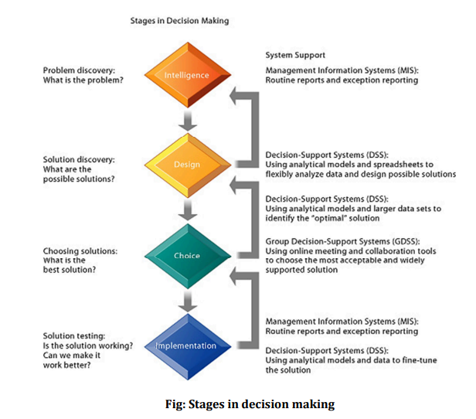
DSS

Slide 56
DSS
Intelligence Phase:
Definition: In this initial stage, the decision-makers identify and define the problem or opportunity that requires a decision. They gather relevant information, data, and knowledge related to the issue at hand.
Activities:
Problem Identification: Recognizing the need for a decision and defining the problem statement.
Data Collection: Gathering relevant data from internal and external sources.
Environmental Scanning: Assessing the internal and external business environment to understand factors influencing the decision.
Design Phase:
Definition: In this stage, decision-makers determine the criteria and objectives that will guide the decision-making process. They establish decision criteria, priorities, and performance measures.
Activities:
Goal Setting: Defining the objectives and desired outcomes of the decision.
Criteria Specification: Identifying the factors or criteria that will be used to evaluate alternative solutions.
Constraints Identification: Recognizing any limitations, constraints, or restrictions that may impact decision options.

Slide 57
DSS
3. Choice Phase:
Definition: In this stage, decision-makers generate and evaluate alternative courses of action based on the established criteria and objectives. They analyze the potential outcomes, risks, and benefits associated with each alternative.
Activities:
Alternative Generation: Generating a range of possible solutions or decision options.
Alternative Evaluation: Assessing the strengths, weaknesses, opportunities, and threats (SWOT analysis) of each alternative.
Trade-off Analysis: Comparing alternatives against decision criteria and priorities to identify the most suitable option.
4. Implementation Phase:
Definition: In this stage, decision-makers implement the chosen alternative and put the decision into action. They develop an action plan, allocate resources, and execute the decision effectively.
Activities:
Action Planning: Developing a detailed plan outlining the steps, timelines, and responsibilities for implementing the decision.
Resource Allocation: Allocating human, financial, and other resources necessary to execute the decision.
Monitoring and Control: Monitoring the implementation process, tracking progress, and adjusting plans as needed to ensure successful execution.

Slide 58
DSS
5. Review Phase:
Definition: In this final stage, decision-makers evaluate the outcomes and consequences of the decision. They assess whether the decision achieved the desired objectives and analyze lessons learned for future decision-making.
Activities:
Outcome Evaluation: Assessing the actual results and outcomes of the decision against the expected or desired outcomes.
Feedback Collection: Gathering feedback from stakeholders and participants involved in the decision-making process.
Lessons Learned: Identifying successes, failures, and areas for improvement in the decision-making process and organizational performance.
These stages in the decision-making process within a Decision Support System help guide managers and stakeholders through a structured approach to problem-solving, analysis, and action, ultimately leading to better-informed and more effective decisions.

Slide 59
Executive Information System
An Executive Information System (EIS) is a specialized type of Management Information System (MIS) designed to support the informational needs of top executives and senior management within an organization.
EIS provides executives with easy access to summarized, high-level information from various sources, enabling them to monitor organizational performance, identify trends, and make strategic decisions effectively.

Slide 60
EIS
Functions of Executive Information Systems:
Strategic Planning: EIS supports strategic planning by providing executives with insights into market trends, competitive intelligence, and industry benchmarks to formulate long-term strategies and business goals.
Performance Monitoring: Executives use EIS to monitor organizational performance against key performance indicators (KPIs), goals, and targets to identify areas of strength and areas needing improvement.
Decision Making: EIS aids executives in decision-making by providing relevant information, analysis, and decision support tools to evaluate alternatives, assess risks, and make informed decisions.
Communication and Collaboration: EIS facilitates communication and collaboration among executives and stakeholders by providing a common platform for sharing information, discussing strategies, and aligning goals.

Slide 61
Expert System
An Expert System (ES) is a type of artificial intelligence (AI) system that emulates the decision-making abilities of a human expert in a specific domain or field.
Expert Systems are designed to solve complex problems, provide advice, and make decisions by leveraging domain knowledge, rules, and inference mechanisms.

Slide 62
ES
Components of Expert Systems:
Knowledge Base: The Knowledge Base (KB) is the central component of an Expert System, containing domain-specific knowledge, facts, rules, and heuristics acquired from human experts or existing sources. It represents the expertise required to solve problems in the target domain.
Inference Engine: The Inference Engine (IE) is responsible for reasoning and making deductions based on the information stored in the Knowledge Base. It applies rules, algorithms, and logical reasoning techniques to infer new facts, draw conclusions, and generate recommendations or solutions.
User Interface: The User Interface (UI) allows users to interact with the Expert System, input problem descriptions, provide data, and receive responses. The UI may include text-based interfaces, graphical user interfaces (GUIs), or conversational interfaces (chatbots).
Explanation Facility: An Explanation Facility provides users with explanations of the system's reasoning process, justification for recommendations, and insights into how conclusions were reached. It enhances transparency and user trust in the system's outputs.
Knowledge Acquisition System: The Knowledge Acquisition System (KAS) facilitates the acquisition, representation, and maintenance of knowledge in the Expert System. It allows human experts to input new knowledge, update existing rules, and refine the system's performance over time.

Slide 63
ES
Example:
Consider a medical diagnosis Expert System used in a healthcare organization. The system incorporates the knowledge of experienced physicians, medical textbooks, and research papers to assist doctors in diagnosing diseases and recommending treatment plans for patients. Doctors input patient symptoms, medical history, and test results into the system, which then analyzes the data, applies diagnostic rules, and generates potential diagnoses along with supporting evidence. The system may also provide explanations for its recommendations, including references to relevant medical literature and case studies.

Slide 64
Integrated information System
An Integrated Information System (IIS) refers to a comprehensive and interconnected system that consolidates various components of an organization's information technology infrastructure into a unified framework.
It aims to streamline operations, enhance collaboration, and improve decision-making by integrating disparate systems, data sources, and processes.

Slide 65
IIS
Components of Integrated Information Systems:
Enterprise Resource Planning (ERP) Systems: ERP systems integrate core business functions such as finance, human resources, procurement, inventory management, and supply chain management into a single, unified platform. They facilitate data sharing and process automation across departments, improving efficiency and productivity.
Customer Relationship Management (CRM) Systems: CRM systems centralize customer data and interactions, enabling organizations to manage customer relationships, sales pipelines, marketing campaigns, and customer service activities effectively. They provide insights into customer preferences, behaviors, and buying patterns to drive sales and marketing strategies.
Supply Chain Management (SCM) Systems: SCM systems coordinate the flow of goods, services, and information across the entire supply chain, from suppliers to manufacturers to distributors to customers. They optimize inventory levels, streamline procurement processes, and enhance visibility and collaboration among supply chain partners.
Business Intelligence (BI) and Analytics Tools: BI and analytics tools collect, analyze, and visualize data from various sources to provide actionable insights and decision support. They enable organizations to monitor performance, identify trends, forecast demand, and make data-driven decisions across all levels of the organization.
Document Management Systems (DMS): DMS systems digitize and manage documents, files, and records within an organization, facilitating document creation, storage, retrieval, and sharing. They improve document security, version control, and compliance with regulatory requirements.
Collaboration and Communication Tools: Collaboration and communication tools such as email, instant messaging, video conferencing, and project management platforms enable real-time communication and collaboration among employees, teams, and stakeholders, regardless of location or time zone.

Slide 66
Communication and Collaboration System
A Communication and Collaboration System (CCS) is a set of tools and platforms designed to facilitate communication, information sharing, and collaboration among individuals and groups within an organization.
These systems integrate various communication channels and collaboration tools to enable seamless interaction, regardless of geographical location or time zone.

Slide 67
CCS
Key Components of Communication and Collaboration Systems:
Email: Email remains a fundamental component of CCS, allowing users to send and receive messages, attachments, and notifications. Modern email systems often include features such as calendaring, task management, and integration with other collaboration tools.
Instant Messaging (IM) and Chat: IM and chat platforms enable real-time text-based communication between individuals or groups. They support one-on-one conversations, group chats, file sharing, and multimedia content sharing, fostering quick and informal communication within teams.
Video Conferencing: Video conferencing systems facilitate face-to-face communication and virtual meetings among remote or distributed teams. They support audio and video calls, screen sharing, and collaborative document editing, enabling effective collaboration and decision-making in real time.
Audio Conferencing: Audio conferencing systems allow participants to join conference calls using telephone lines or VoIP (Voice over Internet Protocol) services. They provide a convenient way to conduct meetings, discussions, and presentations remotely, especially for participants unable to attend in person.
Document Collaboration: Document collaboration platforms enable multiple users to create, edit, and collaborate on documents, spreadsheets, presentations, and other files in real time. They support version control, commenting, and co-authoring features, ensuring that everyone works on the latest version of documents.
Project Management: Project management tools help teams plan, organize, and track project tasks, milestones, and deadlines. They provide features such as task assignment, progress tracking, Gantt charts, and resource allocation, facilitating effective project collaboration and coordination.
Social Intranet: Social intranet platforms combine traditional intranet features with social networking capabilities, allowing employees to connect, share knowledge, and collaborate within the organization. They include features such as news feeds, discussion forums, employee directories, and team spaces.

Slide 68
knowledge Management System (KMS)
A Knowledge Management System (KMS) is a software platform or framework designed to facilitate the creation, organization, sharing, and utilization of knowledge within an organization.
KMS aims to capture, store, retrieve, and disseminate both explicit and tacit knowledge, enabling employees to access relevant information, expertise, and insights to support decision-making, problem-solving, and innovation

Slide 69
KMS
Key Components of Knowledge Management Systems:
Knowledge Repositories: KMS typically includes repositories or databases for storing knowledge assets such as documents, manuals, reports, best practices, case studies, and lessons learned. These repositories may be organized by categories, tags, or metadata to facilitate easy search and retrieval.
Collaboration Tools: KMS provides collaboration tools such as discussion forums, wikis, blogs, and social networking features to encourage knowledge sharing and collaboration among employees. These tools facilitate asynchronous communication, idea exchange, and collective problem-solving.
Expertise Location: Expertise location features help users identify subject matter experts (SMEs) within the organization based on their skills, experience, and knowledge domains. This enables employees to connect with experts, seek advice, and tap into specialized knowledge resources when needed.
Document Management: Document management functionalities allow users to create, edit, version control, and share documents and files within the organization. Document management systems (DMS) ensure that knowledge assets are properly managed, archived, and accessible to authorized users.
Search and Retrieval: KMS provides robust search capabilities to help users quickly locate relevant information and knowledge resources. Advanced search features, including full-text search, faceted search, and natural language processing (NLP), enable users to find answers to their queries effectively.
Knowledge Capture: Knowledge capture tools facilitate the capture and codification of tacit knowledge, insights, and expertise from employees' experiences, interactions, and observations. This may include techniques such as storytelling, interviews, knowledge elicitation, and knowledge mapping.
Analytics and Insights: KMS may incorporate analytics and reporting features to analyze usage patterns, content effectiveness, and knowledge gaps. Analytics dashboards provide insights into knowledge consumption, contribution trends, and areas where additional knowledge management efforts are needed.

Slide 70
IS in functional areas
Information systems play a crucial role in supporting various functional areas within organizations by providing the necessary tools and technologies to streamline operations, enhance decision-making, and improve overall efficiency
Information systems are integral to supporting functional areas within organizations by providing tailored solutions and platforms to address specific needs and challenges, ultimately contributing to improved efficiency, effectiveness, and competitiveness.

Slide 71
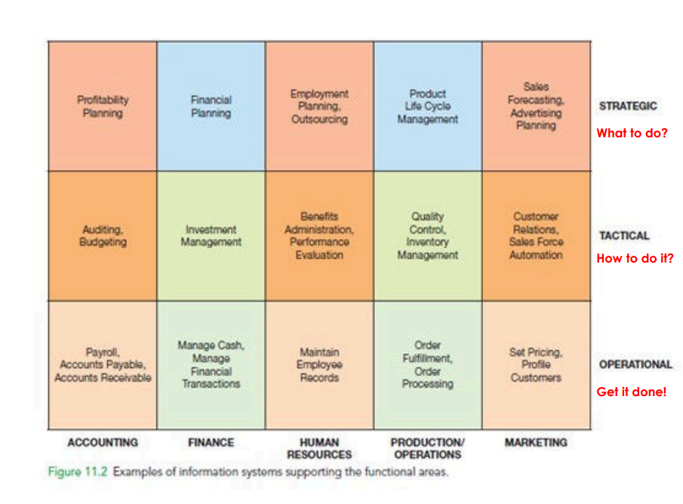

Slide 72
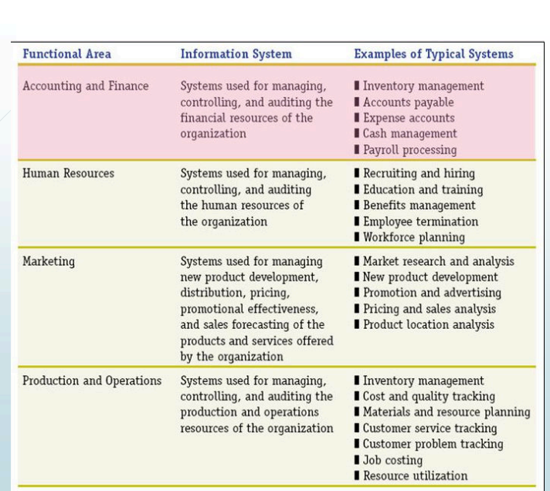

Slide 73
Operations Management:
Inventory Management Systems: These systems track inventory levels, monitor stock movements, and automate replenishment processes to ensure optimal inventory levels and minimize stockouts or overstocking.
Production Planning and Control Systems: These systems assist in scheduling production activities, allocating resources, managing workflows, and optimizing production processes to meet demand while minimizing costs and maximizing efficiency.
Quality Management Systems: Quality management systems facilitate monitoring, measurement, and improvement of product and service quality by tracking quality metrics, managing corrective actions, and ensuring compliance with quality standards and regulations.
Marketing:
Customer Relationship Management (CRM) Systems: CRM systems manage customer interactions, track customer preferences, and analyze customer data to enhance customer satisfaction, loyalty, and retention. They support targeted marketing campaigns, sales forecasting, and lead management.
Market Research and Analytics: Information systems provide tools for conducting market research, analyzing market trends, and gathering competitive intelligence to identify market opportunities, assess customer needs, and develop effective marketing strategies.

Slide 74
3. Finance and Accounting:
Enterprise Resource Planning (ERP) Systems: ERP systems integrate financial modules such as accounts payable, accounts receivable, general ledger, and financial reporting to streamline financial processes, ensure regulatory compliance, and provide real-time visibility into financial performance.
Financial Planning and Analysis (FP&A) Systems: FP&A systems support budgeting, forecasting, financial modeling, and variance analysis to assist in strategic financial planning, resource allocation, and performance evaluation.
4. Human Resources:
Human Resource Information Systems (HRIS): HRIS systems manage employee data, payroll processing, benefits administration, recruitment, performance management, and training and development activities to support HR functions and improve workforce management.
Talent Management Systems: Talent management systems help organizations attract, retain, and develop talent by identifying high-potential employees, tracking career progression, and facilitating succession planning and skill development initiatives.

Slide 75
5. Supply Chain Management:
Supply Chain Management (SCM) Systems: SCM systems optimize the flow of materials, information, and finances across the entire supply chain, from suppliers to manufacturers to distributors to customers. They support demand forecasting, procurement, logistics, inventory management, and supplier relationship management.
6. Research and Development:
Research Collaboration Platforms: These platforms facilitate collaboration among researchers, scientists, and engineers by providing tools for sharing research data, collaborating on experiments, and managing research projects.
Product Lifecycle Management (PLM) Systems: PLM systems support the entire product development lifecycle, from concept to retirement, by managing product design, engineering changes, version control, and regulatory compliance.

