Slide 1
Stakeholder
A stakeholder is any individual, group, or organization that can affect, or is affected by, a project, product, or service.
Types of Stakeholders in an IT Company
Internal Stakeholders
Project Manager
Developers / QA Engineers
UX/UI Designers
Product Owner
Senior Management
DevOps / IT Support

Slide 2
Stakeholders
External Stakeholders
Clients / Customers
Vendors / Cloud Service Providers (AWS, Azure)
Regulatory Bodies
End Users
Third-party API providers
Example
In a banking software development project:
Client bank = stakeholder
Developers building the app = stakeholders
End users (bank customers) = stakeholders
Security compliance team = stakeholder

Slide 3
Stakeholder Register
A stakeholder register is a document that records all identified stakeholders along with their interests, influence, expectations, and communication requirements.
Key Fields
Interest: How much the stakeholder cares about the project outcome
Influence / Power: Ability to impact project decisions
Expectations: What the stakeholder wants from the project
Engagement Strategy: How the project team plans to manage them
Communication Mode: Channel used for interaction
Frequency: How often communication occurs
Why Stakeholder Register is Important
Helps prioritize stakeholders
Improves communication planning
Prevents conflicts
Ensures right people are engaged at the right time

Slide 4
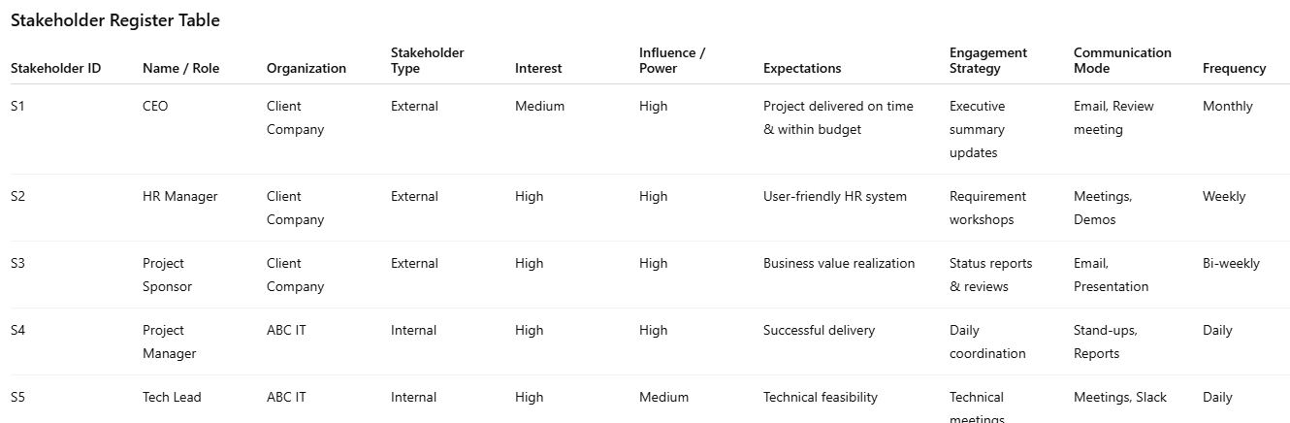

Slide 5
Stakeholder Management
Stakeholder Management is the process of identifying, analyzing, engaging, and managing stakeholders throughout the project lifecycle to ensure project success.
Basic Concepts of Stakeholder Management
Stakeholder Identification
Identify all stakeholders early.
Example: During requirement gathering for an ERP system:
Finance team
HR team
IT admin
CEO (final approval)

Slide 6
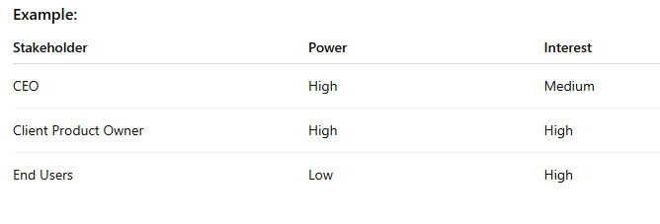
Basic Concepts of Stakeholder Management
Stakeholder Analysis
Understand:
Interest level
Power / influence
Expectations
Tools Used:
Power–Interest Grid
Stakeholder Register

Slide 7
Power – Interest Grid
A Power–Interest Grid is a stakeholder analysis tool used to classify stakeholders based on:
Power → ability to influence project decisions
Interest → level of concern or involvement in the project
It helps the project manager decide how to engage and communicate with each stakeholder.
Components of Power–Interest Grid
Power
Authority to influence project outcomes
Control over budget, approvals, or resources
IT Example: Client Sponsor who approves funding → High Power
Interest
Level of involvement or concern about project results
IT Example: End users who will use the software daily → High Interest

Slide 8
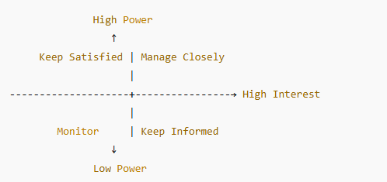
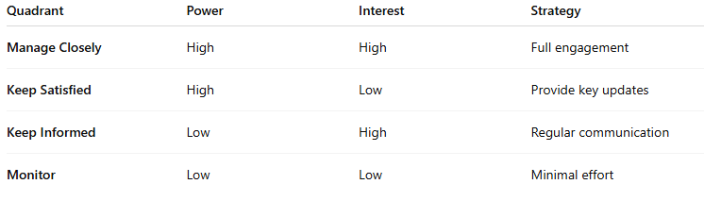
Power – Interest Grid

Slide 9
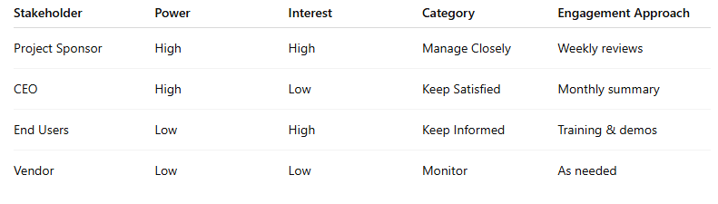
Power – Interest Grid

Slide 10
Basic Concepts of Stakeholder Management
Stakeholder Engagement
Actively involve stakeholders at the right time.
Example:
Weekly sprint review with client
Demo to users before UAT

Slide 11
Basic Concepts of Stakeholder Management
Right Team Composition
Selecting the right mix of skills, experience, and roles required for the project.
Importance
Avoid skill gaps
Reduce rework
Faster delivery
IT Company Example
For a mobile app development project:
Frontend developer (React Native)
Backend developer (Node.js)
QA tester
UI/UX designer
DevOps engineer
Project Manager
Wrong composition → delays, bugs, unhappy client.

Slide 12
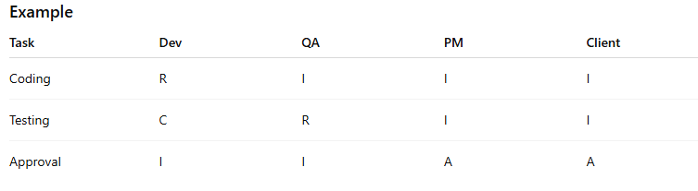
Basic Concepts of Stakeholder Management
Defining Clear Roles and Responsibilities
Clearly defining who does what, who decides, and who is accountable.
Tool Used
RACI Matrix
R – Responsible
A – Accountable
C – Consulted
I – Informed
Benefits
Avoid confusion
Prevent work duplication
Faster decision-making

Slide 13
RACI
A RACI Matrix is a roles and responsibilities assignment tool that clearly defines who is responsible, accountable, consulted, and informed for each project activity or deliverable.
RACI stands for:
R – Responsible: Person who actually does the work
A – Accountable: Person who owns the task and gives final approval
C – Consulted: People who provide inputs or expertise
I – Informed: People who need updates but don’t work on it
Rule: Every task should have only one Accountable (A).

Slide 14
RACI
Avoids Confusion
Prevents situations like “I thought someone else was doing it.”
Clear Ownership
Everyone knows their role and responsibility.
Faster Decision-Making
No delays due to unclear authority.
Improves Communication
Right people are consulted and informed.
Reduces Conflict
Eliminates overlap and blame in teams.
When to Use RACI Matrix
Large software projects
Cross-functional teams
Multiple stakeholders
Outsourced or distributed teams

Slide 15
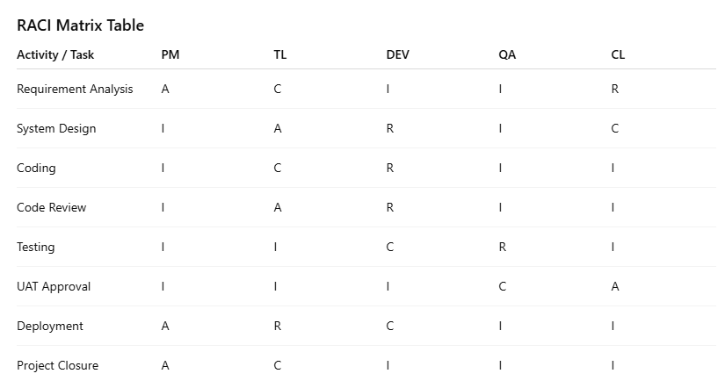
RACI

Slide 16
Basic Concepts of Stakeholder Management
Setting Expectations
Clearly communicating deliverables, timelines, quality standards, and constraints.
Example in IT Project
Delivery date: 30 June
Performance: App should handle 10,000 users
Scope: Payment gateway only (no wallet)
Why Important
Prevents scope creep
Reduces conflicts
Improves trust

Slide 17
Managing Stakeholder Expectations
Stakeholder expectation management is the process of understanding, aligning, communicating, and controlling what stakeholders expect from a project so that expectations remain realistic and achievable.
Why Managing Stakeholder Expectations is Important
Prevents dissatisfaction
Reduces scope creep
Avoids conflict
Improves trust and project success
Ensures alignment between business and technical teams
Many IT projects fail not because of poor coding, but because expectations were not managed.

Slide 18
Managing Stakeholder Expectations
Identify Stakeholders Early
Tool: Stakeholder Register
What to Do:
List all internal and external stakeholders
Identify decision-makers and influencers
IT Example: In a CRM project:
Client Sponsor
Sales Head
End users
Development team

Slide 19
Managing Stakeholder Expectations
Understand Stakeholder Needs & Expectations
Tools:
Interviews
Workshops
Requirement-gathering sessions
What to Capture:
Deliverables
Timelines
Quality standards
Constraints
Example: Client expects:
System live in 3 months
Mobile-friendly UI
99.9% uptime

Slide 20
Managing Stakeholder Expectations
Analyze Stakeholder Power & Interest
Tool: Power–Interest Grid
Purpose:
Identify whose expectations need priority
Decide level of engagement
IT Example:
Product Owner → High power, high interest
End users → Low power, high interest

Slide 21
Managing Stakeholder Expectations
Define Clear Scope & Boundaries
Tools:
Project Charter
Scope Statement
Product Backlog
What to Do:
Clearly document what is included and excluded
Get stakeholder sign-off
Example: Payment gateway integration included Wallet feature excluded (future phase)

Slide 22
Managing Stakeholder Expectations
Set Realistic Timelines & Deliverables
Tools:
Work Breakdown Structure (WBS)
Project Schedule (Gantt Chart)
Sprint plan (Agile)
Example: Instead of “Full app in 2 months” → Deliver:
Login module in Sprint 1
Payments in Sprint 2

Slide 23
Managing Stakeholder Expectations
Define Roles & Responsibilities
Tool: RACI Matrix
Why Important:
Avoids confusion about ownership
Clarifies decision authority
Example:
Feature priority → Product Owner
Technical design → Tech Lead

Slide 24
Managing Stakeholder Expectations
Create a Communication Plan
Tool: Communication Management Plan
Includes:
What to communicate
To whom
How often
Through which channel

Slide 25
Managing Stakeholder Expectations
Manage Changes Effectively
Tool: Change Control Process
What to Do:
Document change requests
Analyze impact on cost/time
Get approval before implementation
IT Example: Client requests new reporting dashboard → Impact analyzed → Timeline extended → Approved

Slide 26
Managing Stakeholder Expectations
Manage Changes Effectively
Tool: Change Control Process
What to Do:
Document change requests
Analyze impact on cost/time
Get approval before implementation
IT Example: Client requests new reporting dashboard → Impact analyzed → Timeline extended → Approved

Slide 27
Managing Stakeholder Expectations
Continuous Engagement & Feedback
Tools:
Sprint reviews
Demos
Feedback sessions
Example: Bi-weekly demo to client to validate expectations early.

Slide 28
Managing Stakeholder Expectations
Monitor & Adjust Expectations
Tools:
Status reports
KPIs
Stakeholder feedback surveys
What to Do:
Identify dissatisfaction early
Correct misunderstandings

Slide 29
Basic Concepts of Stakeholder Management
Decision Making
The process of choosing the best option among alternatives.
Types in IT Projects
Technical decisions (architecture, tools)
Business decisions (features, priorities)
Decision Authority Example
Architecture → Tech Lead
Budget → Senior Management
Feature priority → Product Owner
Good Practices
Data-driven decisions
Clear escalation path
Stakeholder involvement when required

Slide 30
Basic Concepts of Stakeholder Management
Coordination & Dependencies
Managing inter-related tasks and teams so work flows smoothly.
Types of Dependencies
Finish-to-start
Start-to-start
IT Example
Backend API must be ready before frontend integration
Database schema approval before development
Why Important
Avoid bottlenecks
Prevent idle resources
Maintain schedule

Slide 31
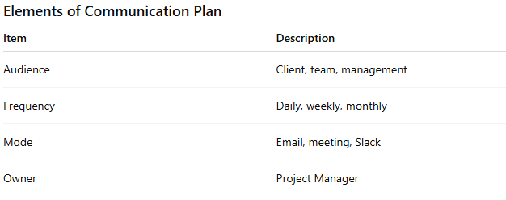
Basic Concepts of Stakeholder Management
Communication Plan
A document that defines what, when, how, and to whom communication will happen.
Elements of Communication Plan

Slide 32
Importance of Communication Plan
Why Critical in IT Projects
Distributed teams
Rapid changes
Complex technical details
Benefits
Avoids misunderstandings
Ensures transparency
Improves stakeholder satisfaction
Example
Weekly status email to client:
Progress
Risks
Next steps

Slide 33
Communication Management
The systematic process of planning, executing, monitoring, and controlling communication.
Processes in Communication Management
1. Plan Communications
Identify stakeholder needs and communication methods.
2. Manage Communications
Sharing information, conducting meetings, reporting status.
3. Monitor Communications
Ensure communication is effective and timely.
IT Example
Daily stand-up (team)
Sprint review (client)
Monthly steering committee meeting

Slide 34
Why?
Why Necessary
Projects fail due to poor communication
Stakeholder dissatisfaction leads to rework
Clear communication reduces risks
How to Do It Effectively
Identify stakeholders early
Analyze influence & expectations
Define roles clearly
Build right team
Create communication plan
Maintain continuous engagement
Monitor feedback and adjust

Slide 35
Real-World IT Company Scenario
Project: CRM System Development Issues without Proper Management:
Client unhappy due to lack of updates
Developers unclear about requirements
Missed deadlines
With Proper Stakeholder & Communication Management:
Weekly demos
Clear ownership
Regular status reports
Timely delivery
High client satisfaction

Slide 36
Scope Creep
Scope creep is the uncontrolled expansion of project scope by adding new features, requirements, or work without adjusting time, cost, or resources.
Scope creep occurs when extra work is added to a project without proper approval or planning.
Project: E-commerce Website Development
Original Scope:
Product listing
Shopping cart
Payment gateway
Scope Creep Examples:
Adding product recommendation engine
Multi-language support
Admin analytics dashboard
👉 Added without changing deadline or budget = scope creep.

Slide 37
Scope Creep – Why Important”
Importance in IT Projects
Software projects are highly change-prone
Clients often request new features mid-project
Uncontrolled changes lead to failure
Why Project Managers Care
Affects schedule
Increases cost
Reduces quality
Demotivates teams

Slide 38
Scope Creep – Benefits!
⚠️ Scope creep is usually negative, but controlled scope changes can have benefits.
When It Can Be Beneficial
Improves product quality
Adds business value
Adapts to market or regulatory changes
Enhances user satisfaction
Example
Client requests security enhancement due to new compliance rule → beneficial change if managed properly.

Slide 39
Scope Creep - Challenges
Challenge | Impact
Schedule delays | Missed deadlines
Budget overrun | Increased costs
Quality issues | Rushed testing
Team burnout | Low morale
Client dissatisfaction | Unrealistic expectations

Slide 40
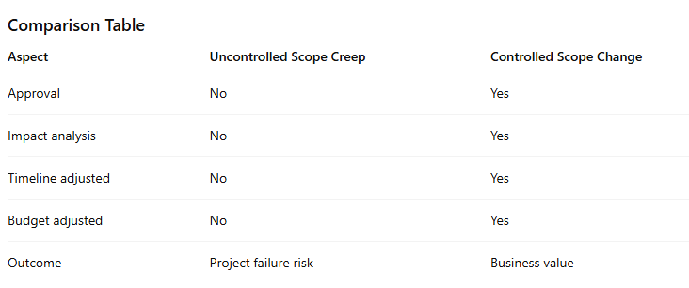
Is Scope Creep Good or Bad?
Uncontrolled scope creep is bad. Controlled scope change is acceptable.

Slide 41
Why Scope Creep Happens (IT Context)
Poor requirement analysis
Vague scope definition
Lack of stakeholder involvement
Weak change control
“Just one small change” requests
Agile misunderstanding (“Agile means unlimited changes”)

Slide 42
How to Manage Scope Creep
Define Clear Scope
Tools:
Project Charter
Scope Statement
Product Backlog
Example: Document what is in scope and out of scope.
Get Stakeholder Sign-Off
Ensure all key stakeholders approve scope.

Slide 43
How to Manage Scope Creep
Use Change Control Process
Tool: Change Request Log
Steps:
Submit change request
Analyze impact (time, cost, resources)
Approve/reject change
Update plans
Set Expectations Early
What changes mean for cost and timeline
Trade-offs involved

Slide 44
How to Manage Scope Creep
Strong Communication Plan
Regular updates reduce surprise requests.
Prioritize Requirements
Tools:
MoSCoW technique
Product backlog refinement
Agile Approach (Controlled Changes)
Freeze sprint scope
Add new requests to backlog
Reprioritize for future sprints
Use RACI Matrix
Clarify who can approve changes.

