Slide 1
nORMALIZATION

Slide 2
NORMALIZATION
Normalization is a process of organizing the data in the database.
It is a systematic approach of decomposing tables to eliminate data redundancy.
It was developed by E. F. Codd.
Normalization is a multi-step process that puts the data into a tabular form by removing the duplicate data from the relation tables.
It is a step by step decomposition of complex records into simple records.
“Normalization is a process of designing a consistent database by minimizing redundancy and ensuring data integrity through decomposition WHICH IS LOSSLESS”

Slide 3
FEATURES OF NORMALLIZATION
Normalization avoids the data redundancy (ROWLEVEL, COLUMNLEVEL).
It is a formal process of developing data structures.
It promotes the data integrity.
It ensures data dependencies make sense that means data is logically stored.
It eliminates the undesirable characteristics like Insertion, Updation and Deletion Anomalies.

Slide 4

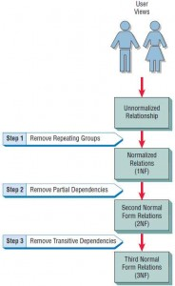
Normalization steps

Slide 5

The Problem of redundancy in Database insert anomaly delete anomaly update anomaly
emp_id | emp_name | emp_address | emp_dept
101 | Rick | Delhi | D001
101 | Rick | Delhi | D002
123 | Maggie | Agra | D890
166 | Glenn | Chennai | D900
166 | Glenn | Chennai | D004

Slide 6
Insert anomaly: Suppose a new employee joins the company, who is under training and currently not assigned to any department then we would not be able to insert the data into the table if emp_dept field doesn’t allow nulls.
Delete anomaly: Suppose, if at a point of time the company closes the department D890 then deleting the rows that are having emp_dept as D890 would also delete the information of employee Maggie since she is assigned only to this department.
Update anomaly: In the above table we have two rows for employee Rick as he belongs to two departments of the company. If we want to update the address of Rick then we have to update the same in two rows or the data will become inconsistent. If somehow, the correct address gets updated in one department but not in other then as per the database, Rick would be having two different addresses, which is not correct and would lead to inconsistent data.
To overcome these anomalies we need to normalize the data.
Anomalies are problems that can occur in poorly planned, un-normalised databases where all the data is stored in one table

Slide 7
Activity: Anomalies
What information do we lose if 9901 stops skiing?

Slide 8
DELETE ANOMALY: WE WILL LOSE THE PRICE OF SKIING AS WELL AS THE FACT THAT STUDENT 9901 WAS TAKING SKIING. INSERT ANOMALY: IF WE WANT TO RECORD A NEW ACITIVITY, BUT, NO ONE HAS YET TAKEN IT, WE CAN’T DO SO. WE NEED A STUDENT ID BECAUSE A STUDENT ID IS A PRIMARY KEY, THEREFORE CAN’T BE NULL. THIS IS AN INSERT ANOMALY. UPDATE ANOMALY: IF WE WANTED TO CHANGE THE COST OF SWIMMING TO 75. WE WOULD HAVE TO DO IT FOR EVERY TUPLE WHERE SOMEONE WAS TAKING SWIMMING. IN A RELATIONAL DATABASE, DOING SUCH REPETITIVE UPDATES SHOULD NOT BE NECESSARY. THE PROBLEM WITH THIS RELATION IS THAT IT CONTAINS DETAILS ABOUT TWO SEPARATE FACTS –WHO IS TAKING ACTIVITY, AND HOW MUCH THE ACTIVITY COSTS. THE SOLUTION IS TO SPLIT THE TABLES.

Slide 9
Splitting the Relation
Student_activity
Activity_cost

Slide 10
First Normal Form (1NF)
A given relation is called in First Normal Form (1NF) if each cell of the table contains only an atomic value. (Atomic values:- The Single cell have only single value)
Each Record needs to be unique and there are no repeating groups.
Repeating Groups:- Repeating group means a table contains 2 or more values of columns that are closely related.

Slide 11
ECode | Employee_Name | Department_Name
1 | ABC | Sales
1 | ABC | Production
2 | PQR | Human Resource
3 | XYZ | Quality Assurance
3 | XYZ | Marketing
ECode | Employee_Name | Department_Name
1 | ABC | Sales, Production
2 | PQR | Human Resource
3 | XYZ | Quality Assurance, Marketing

Slide 12
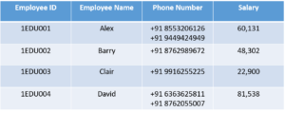
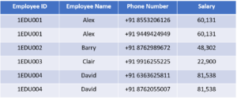
MULTIVALUED

Slide 13
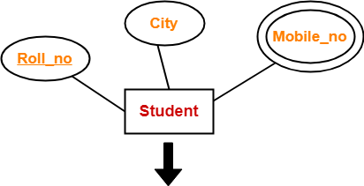
Roll_no | City
Roll_no | Mobile_no

Slide 14
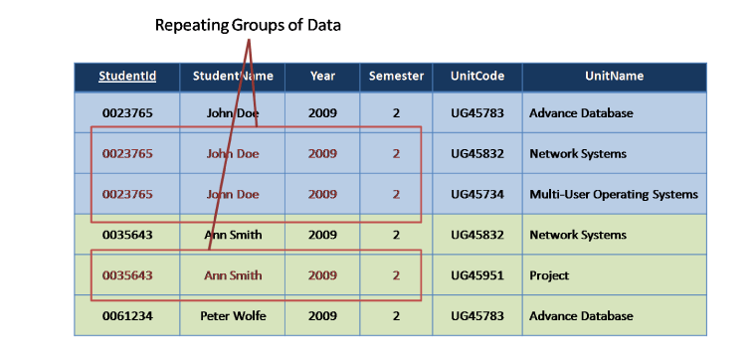

Slide 15
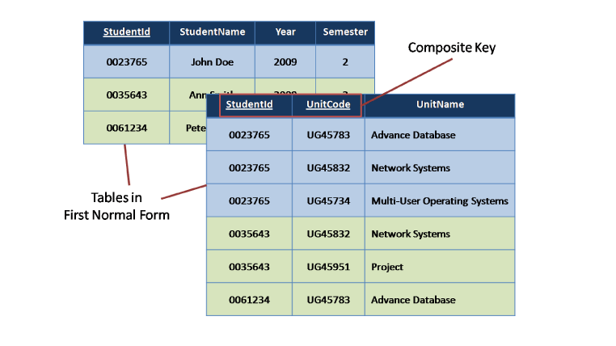

Slide 16
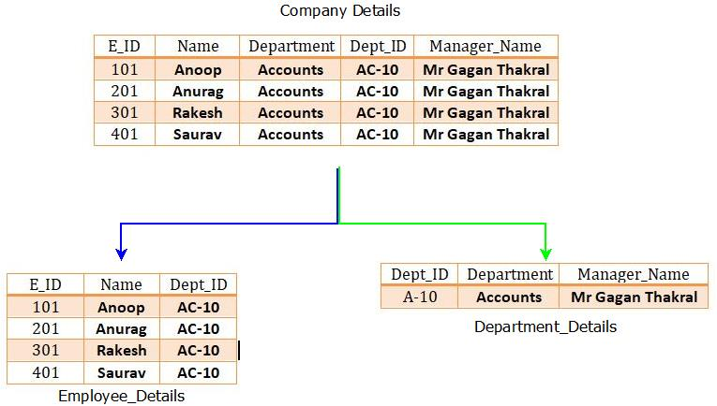

Slide 17
SECOND NORMAL FORM -2NF
A given relation is called in Second Normal Form (2NF) if and only if-
Relation already exists in 1NF.
No partial dependency exists in the relation.
A relation is in 2NF if it has No Partial Dependency, i.e., no non-prime attribute (attributes which are not part of any candidate key) is dependent on any proper subset of any candidate key of the table.
Partial Dependency – If the proper subset of candidate key determines non-prime attribute, it is called partial dependency.

Slide 18
Consider a relation R(X,Y,Z,T) with following functional dependencies :
FD1 : XY ->T, FD2 : Y ->Z
The closure will be, {X}⁺ = {X},{Y}⁺ = {Y,Z}, {XY}⁺ = {X,Y,Z,T}, {T}⁺ = {T}
Here, Candidate key will be “XY”.
Now, have a look at the FD2,
Y-> Z
In the above FD2, “Z” is a non-prime attribute which is dependent upon “Y”, which is a partial part of candidate key “XY”. This is called as partial dependency.
To remove partial dependency, decompose the whole relation R(X,Y,Z,T) into R1(X,Y,T) and R2(Y,Z).
Therefore, R1 : XY T (“XY” will be the candidate key) and R2 : Y Z (“Y” will be the candidate key)
Hence in relation R2, “Z” will be fully dependent upon “Y” as it is the candidate key for relation R2.

Slide 19
STUD_NO COURSE_NO COURSE_FEE
1 C1 1000
2 C2 1500
1 C4 2000
4 C3 1000
4 C1 1000
2 C5 2000
candidate key {STUD_NO, COURSE_NO} ;
Table 1 Table 2
STUD_NO COURSE_NO COURSE_NO COURSE_FEE
1 C1 C1 1000
2 C2 C2 1500
1 C4 C3 1000
4 C3 C4 2000
4 C1 C5 2000
But, COURSE_NO -> COURSE_FEE
Non-prime attribute COURSE_FEE is dependent on a proper subset of the candidate key, which is a partial dependency and so this relation is not in 2NF.

Slide 20
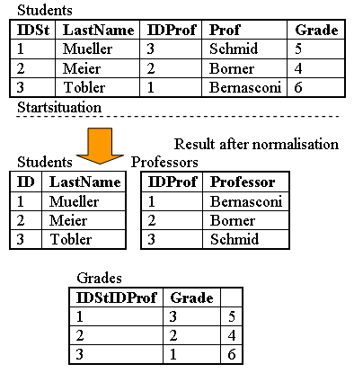
student_id | subject_id | marks | teacher
10 | 1 | 70 | Java Teacher
10 | 2 | 75 | C++ Teacher
11 | 1 | 80 | Java Teacher

Slide 21
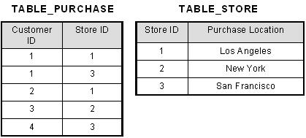
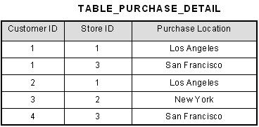

Slide 22
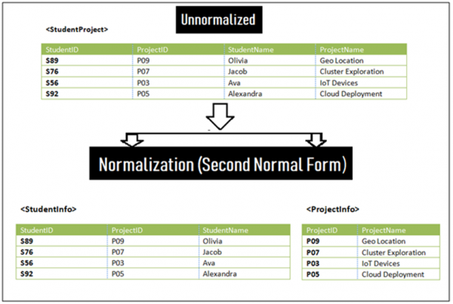

Slide 23
Employee No | Department No | Employee Name | Department
1 | 101 | Ram | ORACLE
2 | 102 | Rajiv | SQL
3 | 101 | Shiva | PL SQL
Employee No | Department No | Employee Name
1 | 101 | Ram
2 | 102 | Rajiv
3 | 101 | Shiva
Department No | Department
101 | ORACLE
102 | SQL

Slide 24
Third Normal Form (3NF)
A table is said to be in the Third Normal Form when,
It is in the Second Normal form.
And, it doesn't have Transitive Dependency.
Transitive dependency – If A->B and B->C are two FDs then A->C is called transitive dependency.
This is Transitive Dependency. When a non-prime attribute depends on other non-prime attributes rather than depending upon the prime attributes or primary key.

Slide 25
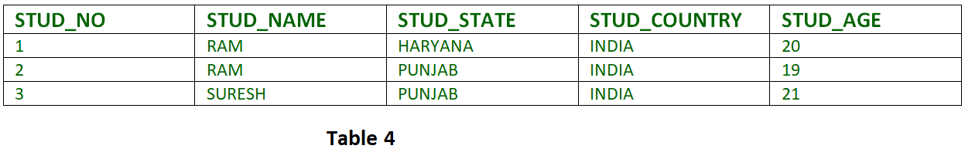
FD set: {STUD_NO -> STUD_NAME, STUD_NO -> STUD_STATE, STUD_STATE -> STUD_COUNTRY, STUD_NO -> STUD_AGE}
Candidate Key: {STUD_NO}
STUD_NO -> STUD_STATE and STUD_STATE -> STUD_COUNTRY are true
So STUD_COUNTRY is transitively dependent on STUD_NO. It violates the third normal form
To convert it in third normal form, we will decompose the relation STUDENT
STUDENT (STUD_NO, STUD_NAME, STUD_PHONE, STUD_STATE, STUD_AGE) STATE_COUNTRY (STATE, COUNTRY)
A table is in 3NF if it is in 2NF and for each functional dependency X-> Y at least one of the following conditions hold:
X is a super key of table
Y is a prime attribute of table

Slide 26
EId | Ename | DOB | City | State | Zip
001 | ABC | 10/05/1990 | Pune | Maharashtra | 411038
002 | XYZ | 11/05/1988 | Mumbai | Maharashtra | 400007
In the above <Employee> table, EId is a primary key but City, State depends upon Zip code.
The dependency between Zip and other fields is called Transitive Dependency.
Therefore we apply 3NF. So, we need to move the city and state to the new <Employee_Table2> table, with Zip as a Primary key.
EId | Ename | DOB | Zip
001 | ABC | 10/05/1990 | 411038
002 | XYZ | 11/05/1988 | 400007
City | State | Zip
Pune | Maharashtra | 411038
Mumbai | Maharashtra | 400007

Slide 27
The Document

Slide 28
Specify repeating group information

Slide 29
1NF
- Remove Repeating Group Information

Slide 30
2NF
For 2nf, we need to examine the functional dependencies that exist when there is a candidate key that is made up of more than one attributes.
Examine each non-key attribute to see if it is fully dependent on the whole candidate key.
Result: yes, result is for particular student in a particular module.
Result code: yes, same.
Grade: grade is given for particular student in particular module.
No of credits: no, nothing to do with student. Dependent on only module code.
Module title: no. module title is dependent only on module code.
Next steps:
The identified attributes that are only dependent on part of candidate key, we separate them out. We take out the part of candidate key, on which they are dependent. This becomes a foreign key.

Slide 31
2NF
- Remove Partial Key Dependencies

Slide 32
3nf
Go through each attribute to see if it is dependent on primary key directly.
There are two examples where this is not so here.
Course title is dependent on the course code.
Transitive : if we know the student number, we can no the course title via course code.
Course code is separated out with course title. Course code is left as foreign key in the student relation.
Second example is result code and result. Result is transitively dependent on the student number/module code primary key and so separated out.

Slide 33
3NF
- Remove Non-Key Dependencies

Slide 34
Student
Course
Student Module
Result Type
Module

Slide 35
0...*
1
Course
Student
A foreign key means we attach a ‘many’ end on an entity relationship diagram...

Slide 36
Customer Order Sheet for Art Supply Shop

Slide 37
First Step
Un-normalised Form. Identify repeating groups

Slide 38
First Normal Form (1NF)

Slide 39
2nf
Let us examine each non-key attributes if they are fully dependent on the whole primary key.
Item name: no, dependent on item number only.
Supplier id: no, only on item number. It indicates which supplier provides that item.
Price: no, it the the price of the item
Supplier name: no, it show name of the supplier who provided particular item.
Quantity: yes, it is about how many of this item, was ordered by this customer.

Slide 40
Second Normal Form (2NF)

Slide 41
Third Normal Form (3NF)

Slide 42
Third Normal Form (3NF) to Deriving Entities
Customer
CustomerItem
Item
Supplier

Slide 43
The Entity Relationship Diagram
Customer
1
0...*
CustomerItem
0...*
1
Item
0...*
1
Supplier

