Slide 1
Analysis Zomato restaurants dataset in the city of Gurgaon

Slide 2
Introduction
Gurgaon is the capital city of Haryana. Gurgaon is a city just southwest of New Delhi in northern India. It’s known as a financial and technology hub. The city itself has a population of 8.77 lakhs. The official language of Gurgaon and the one that is most widely spoken is Hindi. Gurgaon would be incomplete without a taste of its delicious street food
With its diverse culture , comes diverse food items. There are many restaurants in Gurgaon City, each belonging to different categories like Indian , Chinese , Italian etc.
So as part of this project , we will list and visualize all major parts of Gurgaon City .

Slide 3
Objectives
Questions that can be asked using the above mentioned datasets
What is best location in Gurgaon City for Chinese food ?
Which areas have large number of Chinese Restaurant Market ?
Which all areas have less number of restaurant ?
Which is the best place to stay if I prefer Chinese Cuisine ?
What places are have best restaurant in Gurgaon?

Slide 4
Data
For this project we need the following data :
Gurgaon Restaurants data that contains list Locality, Restaurant name, Rating along with their latitude and longitude.
Data source : Zomato kaggel dataset
Description : This data set contains the required information. And we will use this data set to explore various locality of Gurgaon city.
Nearby places in each locality of Gurgaon city.
Data source : Fousquare API
Description : By using this api we will get all the venues in each neighborhood.

Slide 5
Approach
Collect the Gurgaon city data from Zomato kaggel dataset
Using FourSquare API we will find all venues for each neighborhood.
Filter out all venues that are nearby by locality.
Using aggregative rating for each restaurant to find the best places.
Visualize the Ranking of neighborhoods using folium library(python)

Slide 6
Results

Slide 7
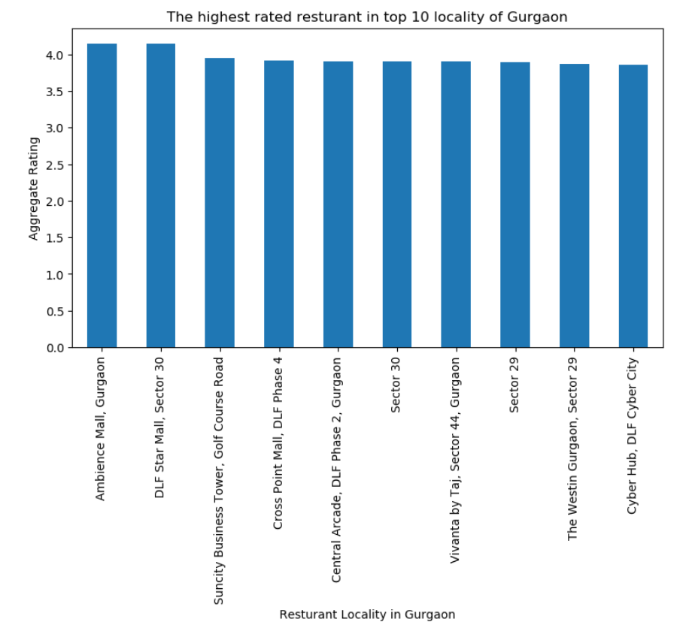

Slide 8
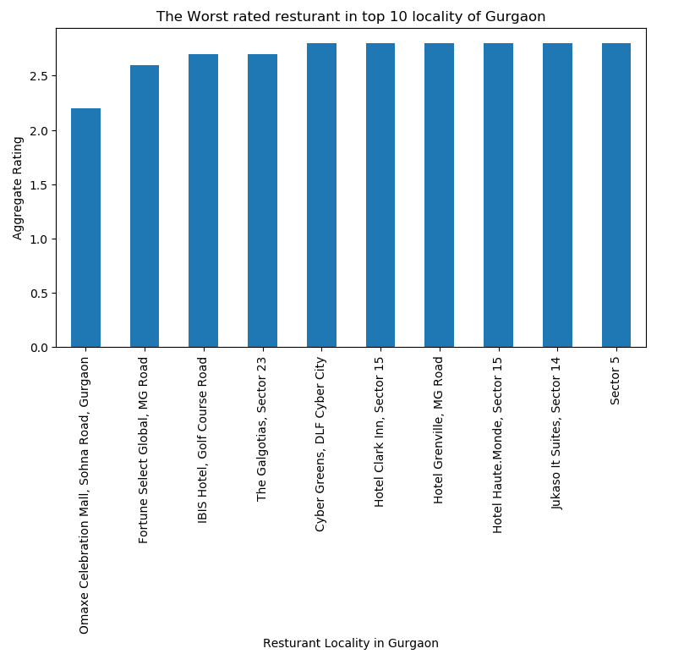

Slide 9
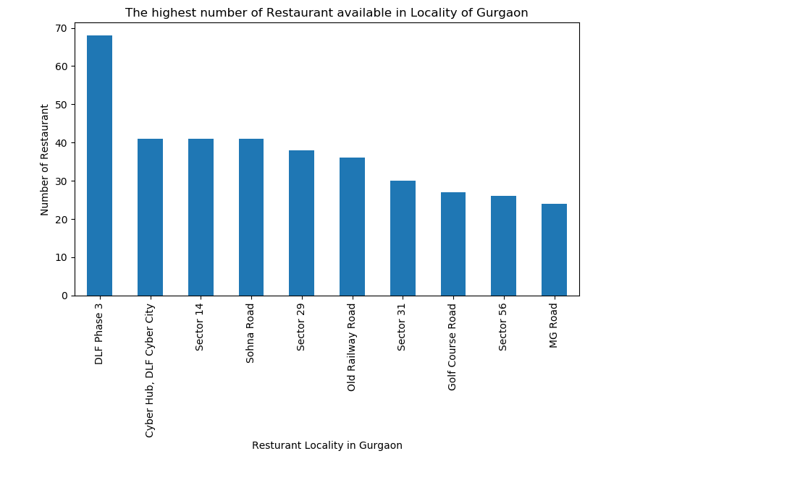

Slide 10
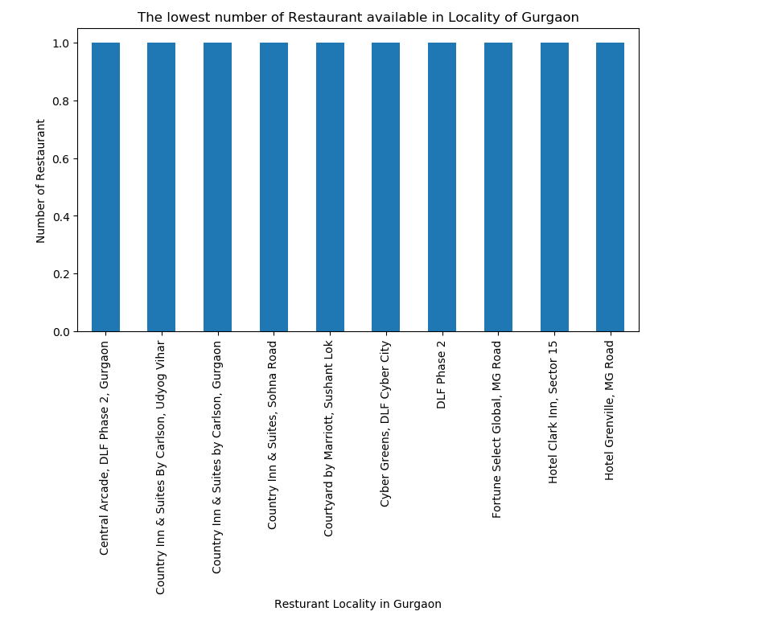

Slide 11
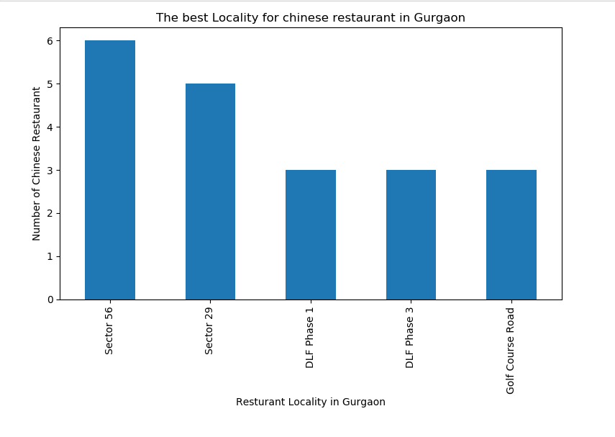

Slide 12
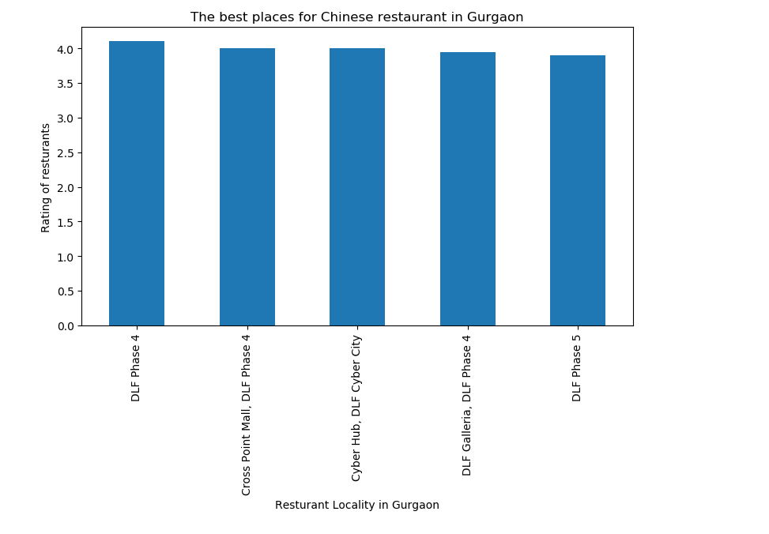

Slide 13
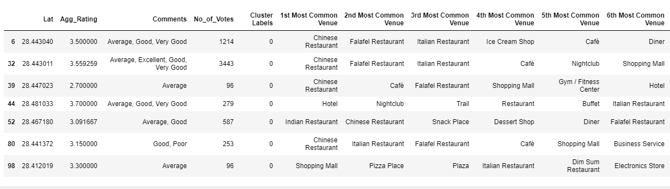
Cluster 1:
The Chinese restaurants are most recommended venues nearby the locations.

Slide 14
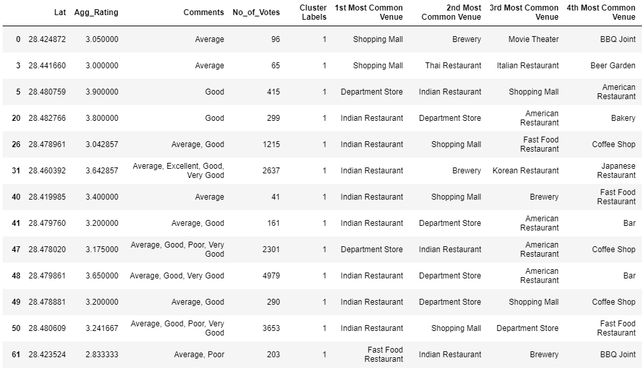
Cluster 2:
It is recommended for the Indian Restaurant venues areas:

Slide 15
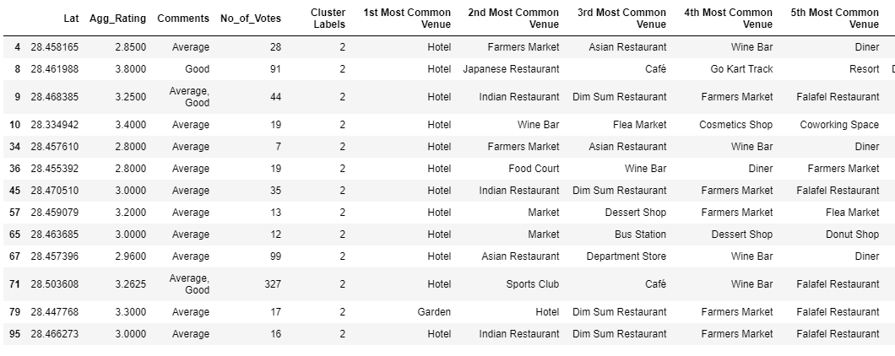
Cluster 3:
It is recommended for the Hotel venues areas:

Slide 16
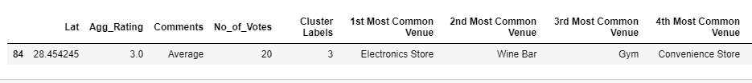
Cluster 4:
It seems to be electronics stores

Slide 17
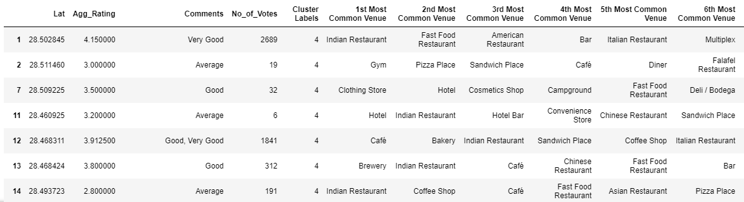
Cluster 5:
Fast food, cafes are the most recommended venues

Slide 18
Conclusion
Sector 56 and Sector 29 are some of the best neighborhoods for Chinese cuisine.
DLF phase 4, Cross point mall , Cyber Hub have the best Chinese Restaurant.
DLF phase 3 , Cyber hub , Sector 14 , Sohna Road are the best places for edible person.
Ambience Mall , DLF Star Mall , Suncity Business Tower have best rated restaurants in Gurgaon.

