Slide 1
NATIONAL INSTITUTE OF TECHNOLOGY,
TIRUCHIRAPPALLI TAMILNADU 620015 Department of Computer Applications
Project Work-2020
Final Review
Title: Machine Learning Algorithms for Defect Analysis
in Thermographic Images
Guide/Mentor Submitted by
Dr. U. Srinivasulu Reddy Surendra Lodhi
205117066

Slide 2
Content
Introduction
Motivation
Problem Statement
Platform
Literature Survey
Methodologies
Design and Development
Results and Discussions
Conclusion and Future Work
References
2

Slide 3
Introduction
Thermal Imaging:
Remote sensing technique
Capable in daytime and night-time
Machine Learning:
Predictive Analysis
Classification Analysis
Clustering Analysis
3

Slide 4
Motivation
Potholes on road pose a great danger to lives.
The root cause of potholes formation is water logging and due to presence of water in cracks and crevices.
The temperature of potholes is normally expected to be less than the surrounding road.
Thus it is easy to differentiate between potholes and non potholes using thermal imaging technique.
4

Slide 5
Problem Statement
Finding the defects in thermographic images and identifying the defect type and predicting the depth of defects using Machine Learning Algorithm.
5

Slide 6
Platform
Hardware:
FLIR Camera
Processor I3 or higher
64 bit machine with min 4GB RAM
Software:
Matlab
Python(2.7 or 3.7)
Anaconda(Jupyter Notebook, Tensorflow)
6

Slide 7
Literature Survey
Artificial neural networks based quantitative evaluation of subsurface anomalies in quadratic frequency modulated thermal wave imaging
Link
Artificial Neural Network Application for Damages Classification in Fibre glass Pre-impregnated Laminated Composites (FGLC) from Ultrasonic Signal
Link
7

Slide 8
Methodologies
Convolution Neural Network(CNN)
To classifying the images as defected and non
defected
Artificial Neural Network(ANN)
To predict the depth of defects.
Multinomial Logistic Regression
To predict the depth of defects.
8

Slide 9
Design and Development
Data acquisition
Pre-processing data
Training CNN model
Prediction of defect
Prediction of depth of defect
Analysis of results
9

Slide 10
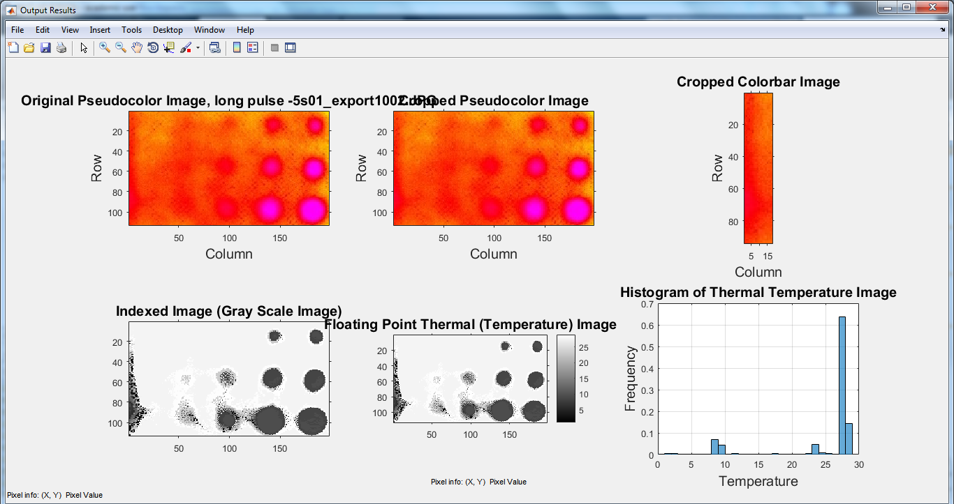
Results and Discussions
Features analysis of thermographic images
10

Slide 11
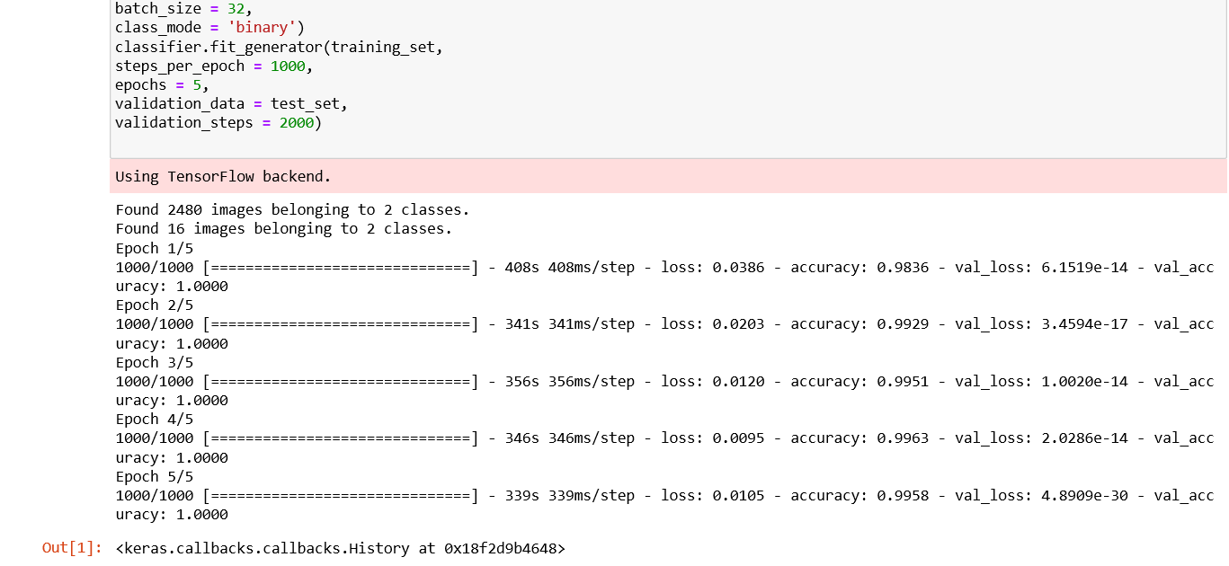
Results and Discussions
Training CNN Model
11

Slide 12
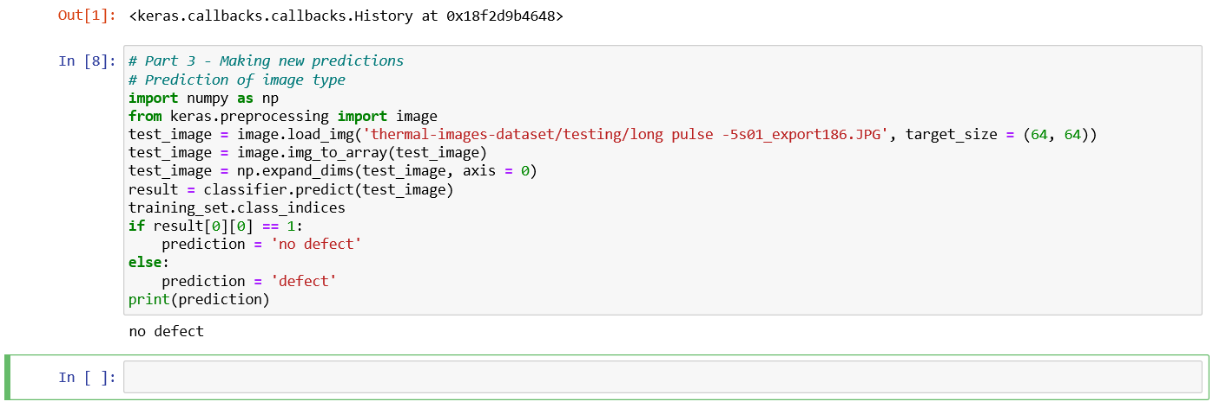
Results and Discussions continue...
Prediction of defect using CNN
12

Slide 13
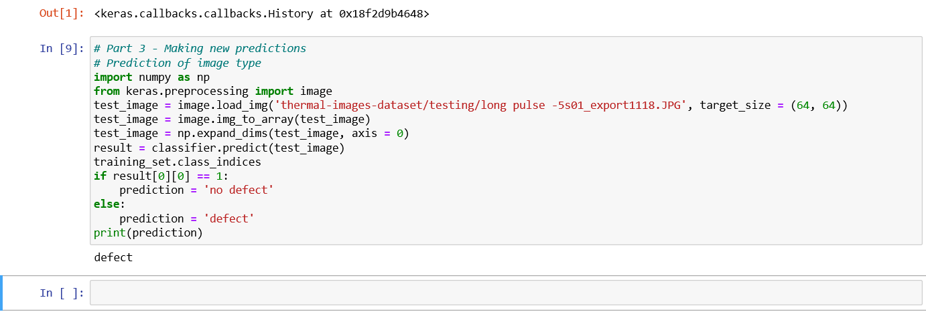
Results and Discussions continue...
Prediction of defect using CNN
13

Slide 14
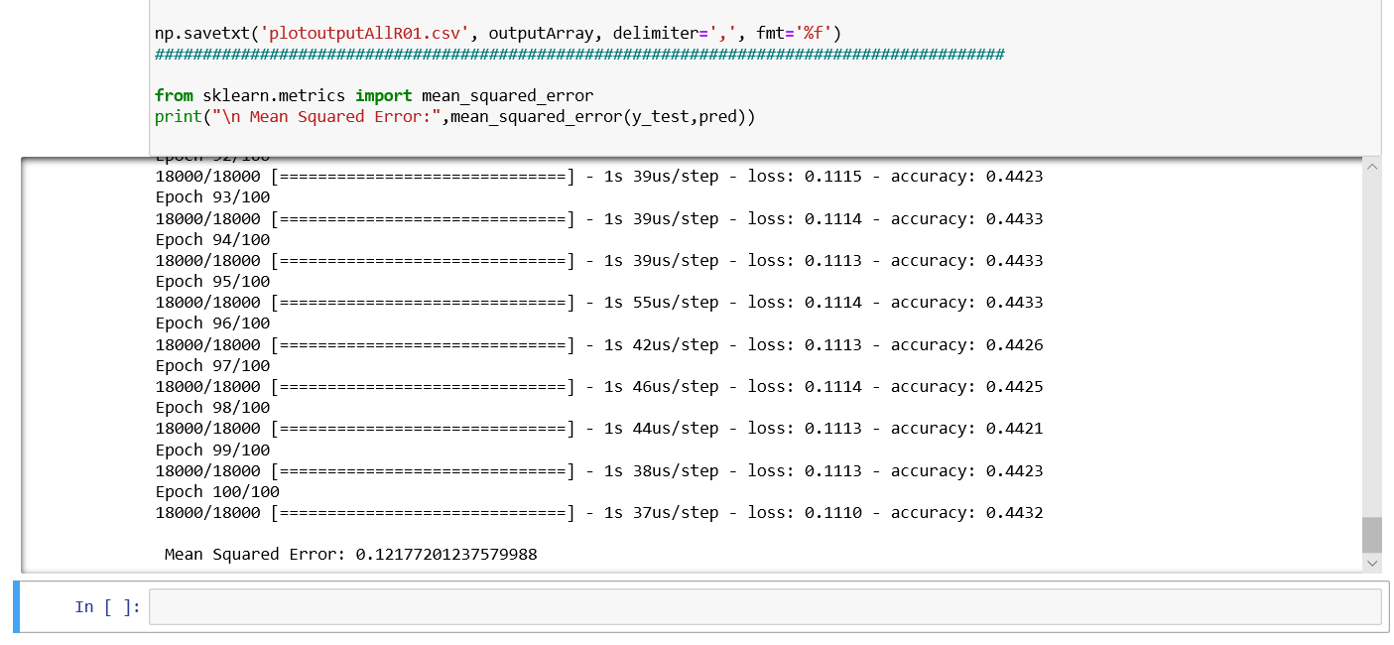
Results and Discussions continue...
Training ANN model
14

Slide 15
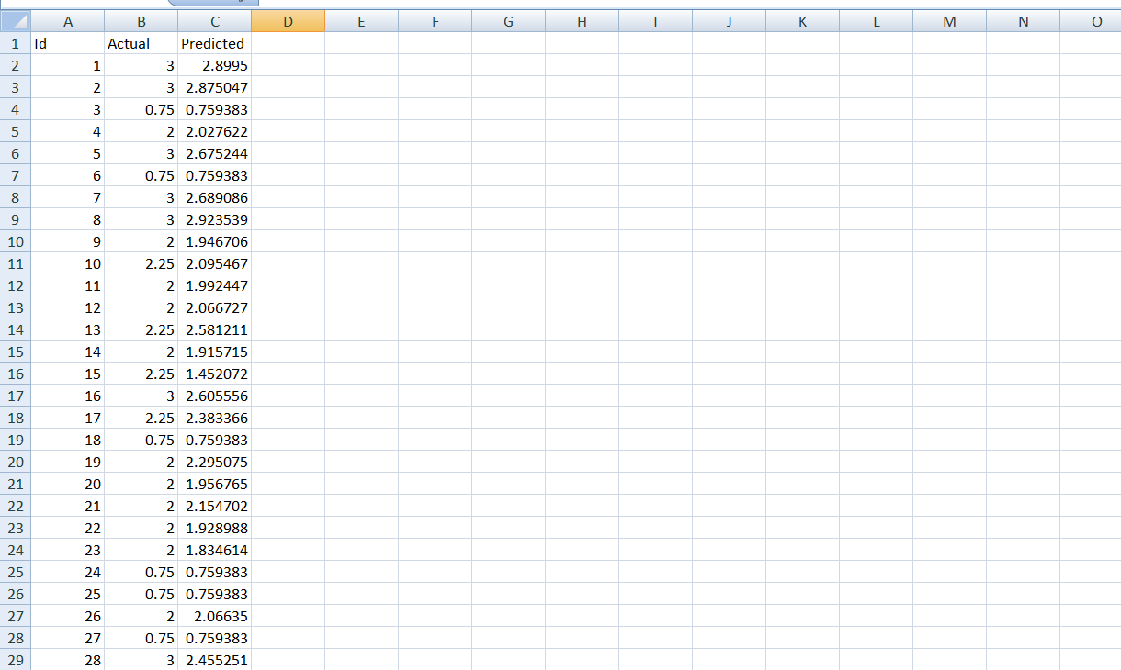
Results and Discussions continue...
Predicted depth of defects using ANN
15

Slide 16
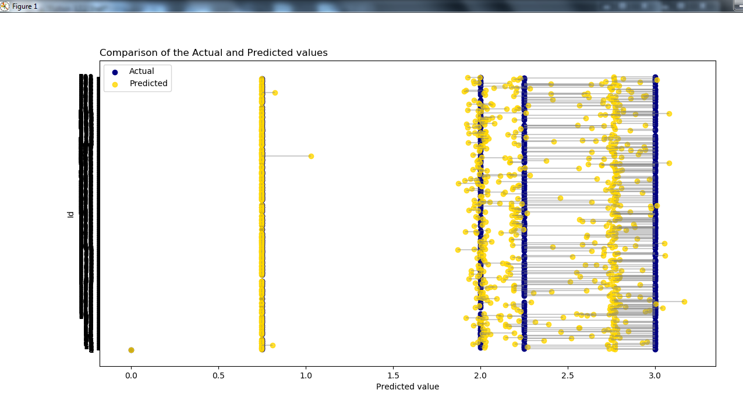
Results and Discussions continue...
Comparison graph of actual and predicted depth using(ANN)
16

Slide 17
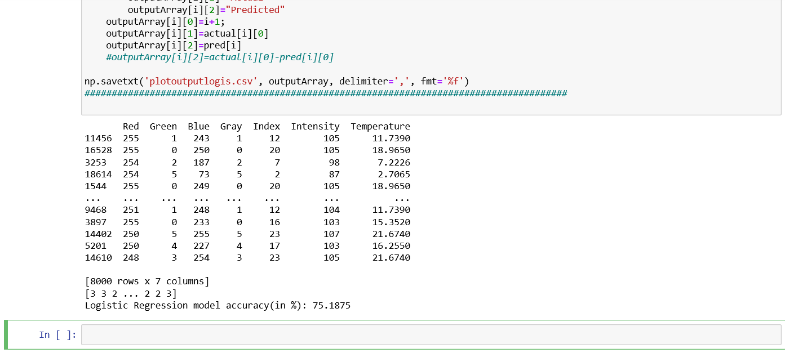
Results and Discussions continue...
Training Multinomial Regression Model
17

Slide 18
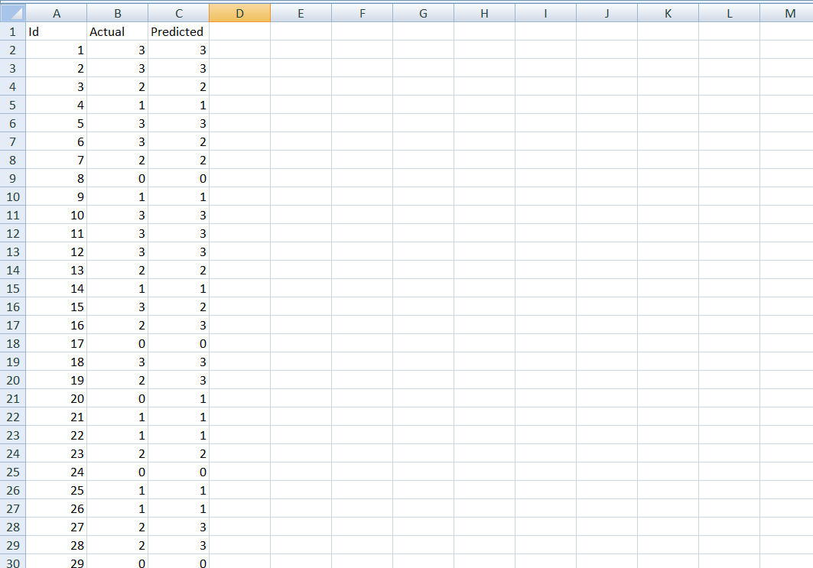
Results and Discussions continue...
Predicted depth of defects using Multinomial Logistic Regression
18

Slide 19
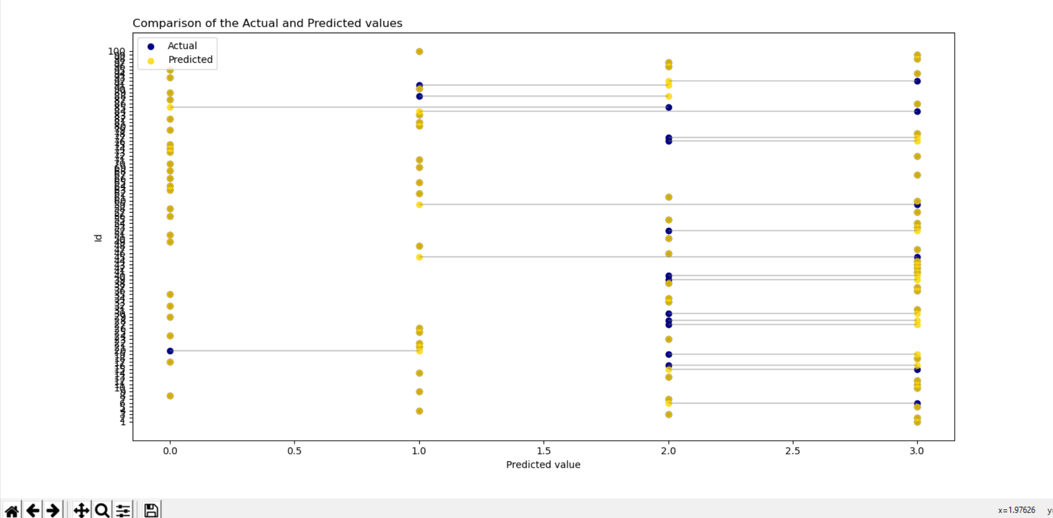
Results and Discussions continue...
Comparison graph of actual and predicted depth(Multinomial Logistic Regression)
19

Slide 20
Results and Discussions continue...
Table 1 Classification results of thermographic images
Epoch | Loss | Accuracy | Val_loss | Val_accuray
1/1000 | 0.0386 | 0.9836 | 6.1519e-14 | 1.0000
2/1000 | 0.0203 | 0.9929 | 3.4599e-17 | 1.0000
3/1000 | 0.0120 | 0.9951 | 1.0020e-14 | 1.0000
4/1000 | 0.0095 | 0.9963 | 2.0286e-14 | 1.0000
5/1000 | 0.0105 | 0.9958 | 4.8909e-30 | 1.0000
Table 2 Comparison of results of different ML Algorithms
Defects | a | b | c | d
Actual size(cm) | 0.75 | 2.0 | 2.25 | 3.0
ANN Regression | 0.753164 | 2.08 | 2.240417 | 3.003
Logistic Regression | 0.75 | 2.01 | 2.30 | 3.0
20

Slide 21
Conclusion and Future Work
Conclusion:
Thermal imaging and Machine Learning is used for defect analysis in thermographic images.
We used CNN for image classification as defected and non defected image.
ANN and Multinomial Logistic Regression are used for predicting the depth of defects.
Accuracy of Multinomial Logistic Regression is better than Artificial Neural Network.
21

Slide 22
Conclusion and Future Work continue…
Future Work:
We can combine above mentioned ML algorithms in a single program so that it can be used for real life problem.
This project is general demonstration of how Thermal Imaging and Machine Learning are used for defect analysis.
Project can be extended and might be used in various fields like Healthcare, Aerospace, Machine Health Monitoring etc.
22

Slide 23
References
https://www.sciencedirect.com/science/article
https://www.researchgate.net/publication
http://qirt.org/archives/qirt2016/papers/057.pdf
https://www.ndt.net/article/qirt2014/papers
https://towardsdatascience.com/
https://medium.com/
23

Slide 24
Thank you
24

