Slide 1
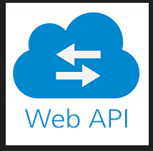
Modules :
Pip.vendor.requests()
Pyodbc.connect()
conn.cursor()
Pandas()
Json()
time
PYTHON APPLICATION
VS CODE
MSSQL
CONNECTOR PYTHON
MS SQL
DATABASE
.CSV FILE

