Slide 1
Agentic Rag Chat_Bot
Retrieval-Augmented Generation (RAG) chatbot built with a multi-agent architecture using MCP

Slide 2
About This Project
This project is a Retrieval-Augmented Generation (RAG) chatbot built with a multi-agent architecture. It is designed to answer user queries based on uploaded documents of various formats. The system uses a structured message-passing protocol (Model Context Protocol - MCP) between the agents to maintain modularity and traceability.
Upload and parse diverse document formats: PDF, DOCX, PPTX, CSV, TXT, and Markdown
Embedding and retrieval of document chunks using HuggingFace MiniLM and FAISS
Uses Gemini API (Google) to generate context-aware answers
Agentic design with clear separation of responsibilities
Multi-turn chat history support to handle follow-up questions
Built-in session management using Streamlit's native state
Simple and intuitive user interface

Slide 3
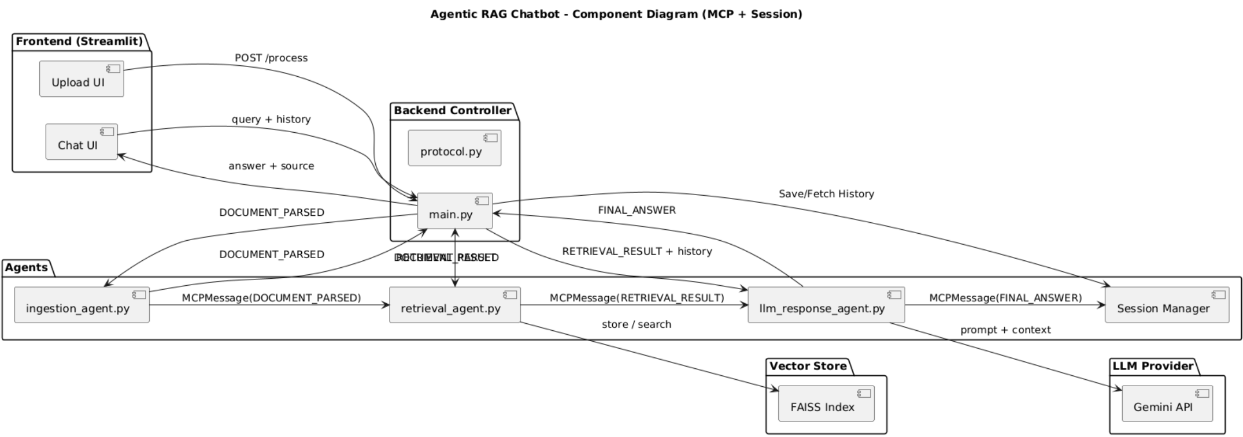
Component Diagram

Slide 4
Tech Stack Used In Project
Layer | Tech Used | Purpose
Frontend | Streamlit | Simple UI for document upload and chatbot
API Backend | FastAPI + Uvicorn | Handles routes and connects agents
Agents | Python Modules (Ingestion, Retrieval, LLM Response) | Modular logic for parsing, searching, and response
Protocol | MCP (Model Context Protocol) | Manages message flow between agents
LLM Provider | Gemini API (via google.generativeai) | Generates answers using contextual prompts
Vector Store | FAISS + HuggingFace Embeddings | Stores and retrieves semantic document chunks
Session Mgmt | In-memory / file-based Python logic | Tracks multi-turn chat history
Supported Docs | PDF, DOCX, PPTX, TXT, CSV, MD | Multi-format input parsing
Other Tools | Git, GitHub, .gitignore, PlantUML | Versioning, ignored files, and architecture diagrams

Slide 5
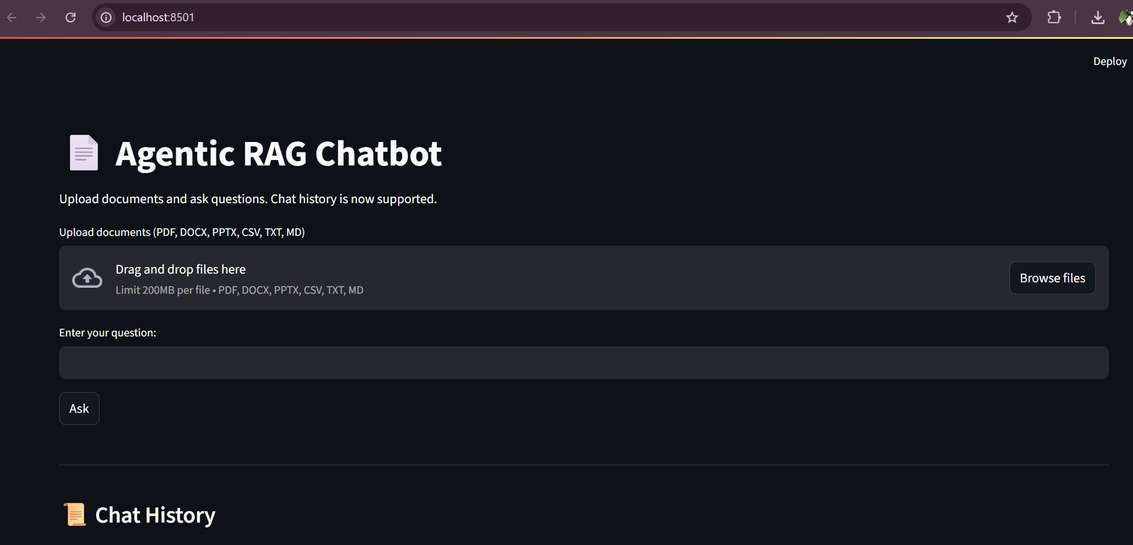
Images Of UI→ index page

Slide 6
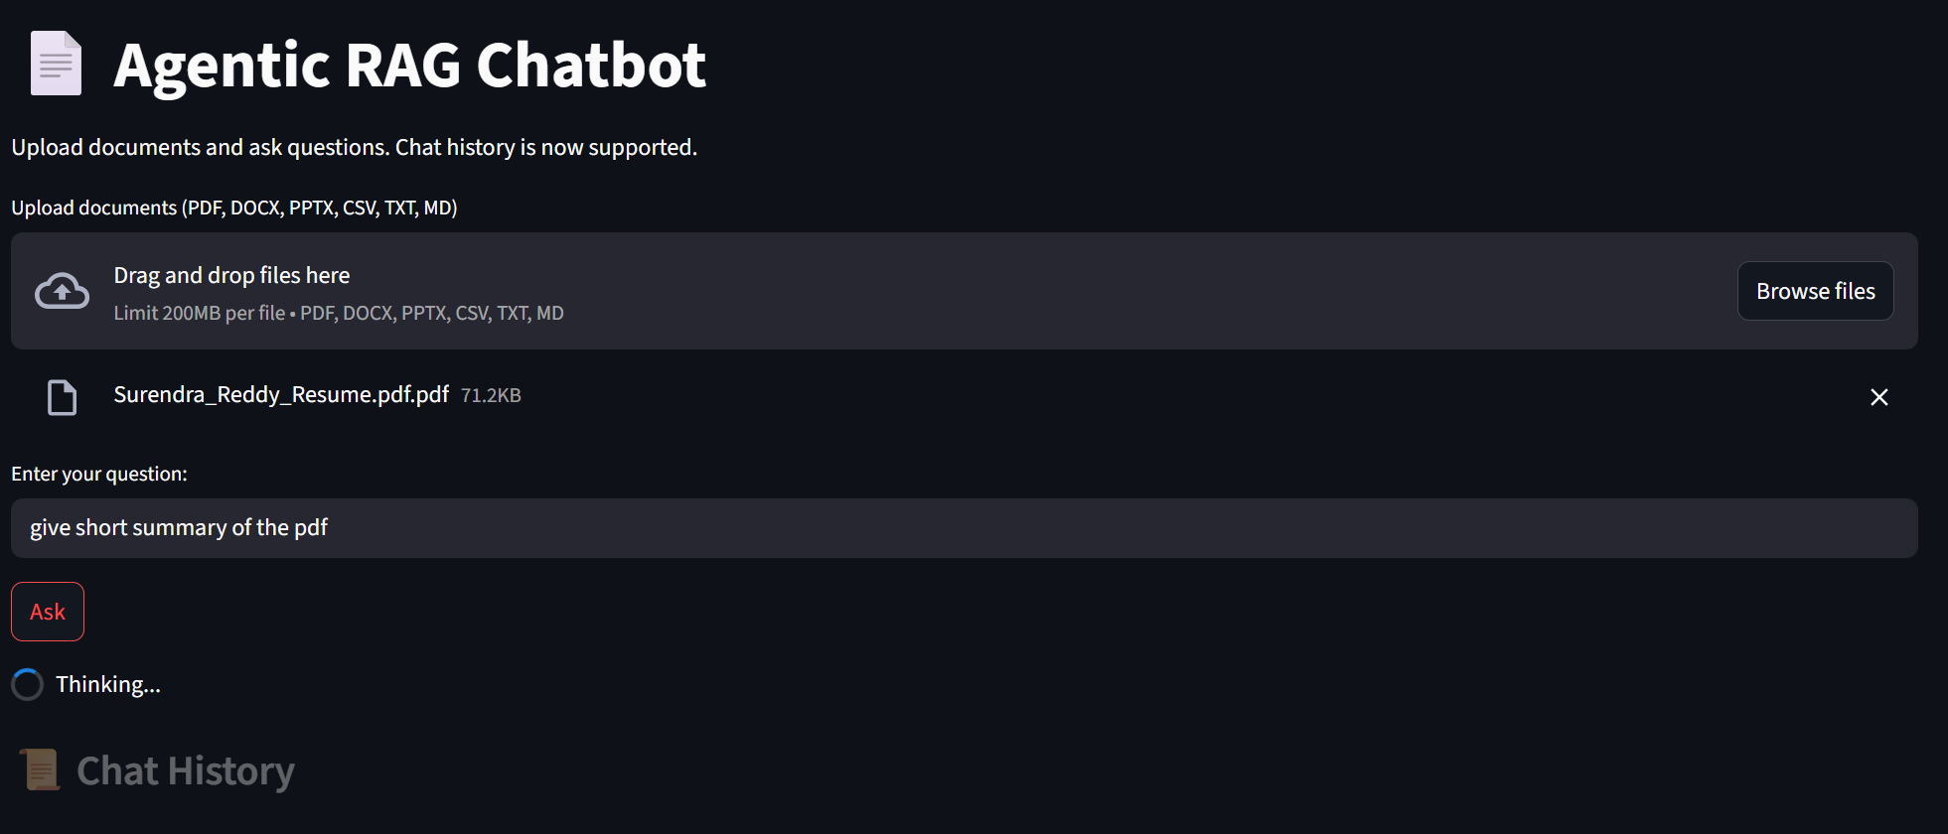
Images 3 → While Thinking

Slide 7
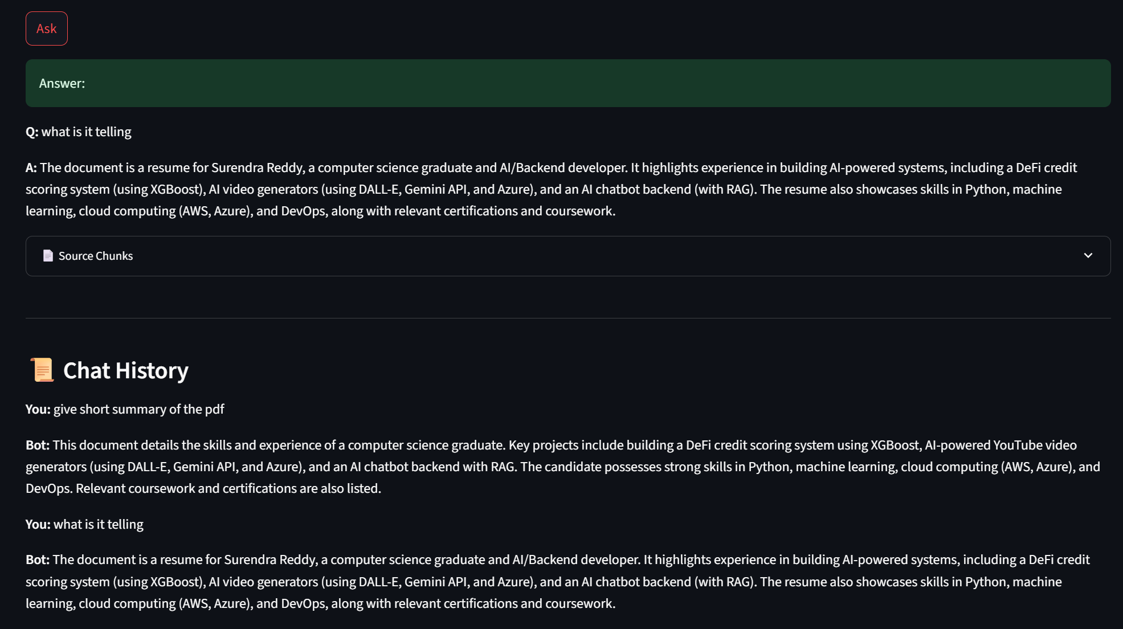
Images2 → Chat History

Slide 8
Challenges Faced/Future Improvements
Handling multiple file formats required different parsing logic and careful text extraction handling.
Chat history integration while maintaining stateless backend calls involved clever usage of Streamlit’s session state.
Gemini’s API output can vary in format, which required prompt engineering and response validation.
Coordinating three agents with proper traceability using MCP structure added complexity but made debugging much easier.
Future Improvements
Add persistent database support for user sessions and documents
Add support for real-time streaming responses from Gemini
Build admin interface to view all uploaded documents and chat sessions
Deploy the backend as a containerized service with production-ready settings
Extend support to OCR-based image input and audio transcription

Slide 9
Thank YOU…..!

