Slide 1
ECMA 2015(ES6)
const and let
Template Literals
Modules
Arrow Functions
Destructuring Assignment
Object Assembly Shorthand
Spread operator
promises

Slide 2
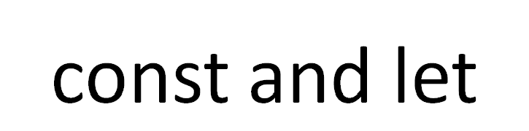
 | Var | Const | let
Scope | Global or Local | Block | block
Re declare | Yes | No | No
Re assign | Yes | No | Yes
Hoisted | Yes | No | no

Slide 3


Slide 4
Modules
Importing and Exporting

Slide 5

Arrow functions

Slide 6
Destructuring Assignment
const person = {
name : “surendra”,
job: “Software Engineer”
}
let { name} = person
Console.log(name ) //output surendra

