Slide 1
Predicting Anxiety, Depression and Stress in modern life using SVM Classifier
Project Guide:
Dr. K. Sudha Rani
Associate professor, Dept. of EIE
VNRVJIET
Presented by:
CH. Sai Anvesh (17071A1070)
D. Mrunal Varma (17071A1072)
V. Surendar (17071A10B3)

Slide 2
Presentation Outline
Introduction
Objective
Literature survey
Block Diagram
Flow Diagram
Methodology
Results
References

Slide 3
Introduction
A study reported in WHO, conducted for the NCMH (National Care Of Medical Health), states that at least 6.5 per cent of the Indian population suffers from some form of the serious mental disorder, with no discernible rural-urban differences.
Though there are effective measures and treatments, there is an extreme shortage of mental health workers like psychologists, psychiatrists, and doctors. As reported latest in 2014, it was as low as ''one in 100,000 people''.
The average suicide rate in India is 10.9 for every lakh people and the majority of people who commit suicide are below 44 years of age.

Slide 4
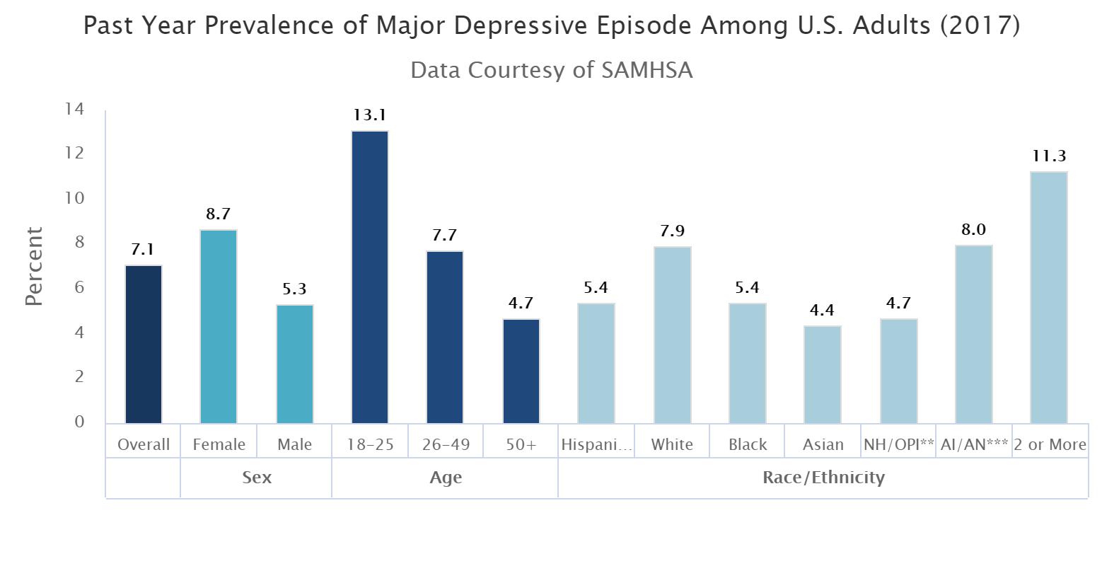
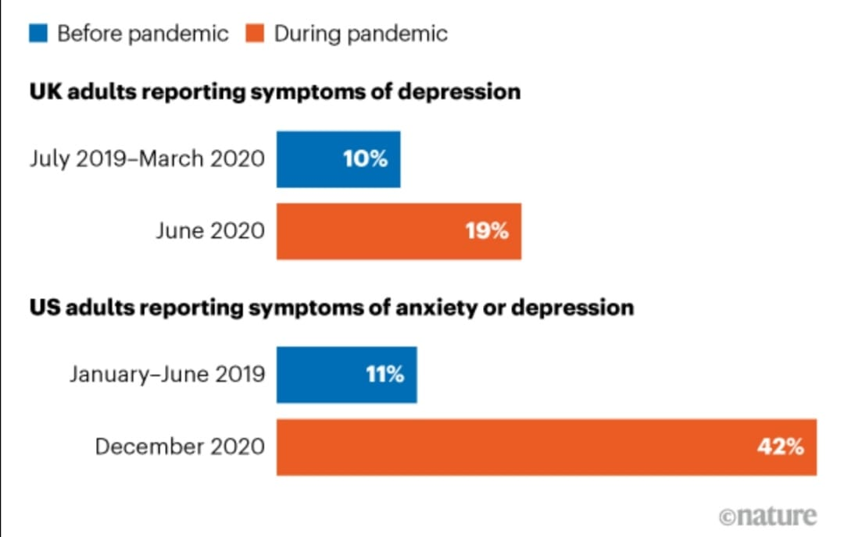
Introduction
https://www.nimh.nih.gov/health/statistics/major-depression https://nature.com/articles/d41586-021-00175-z

Slide 5
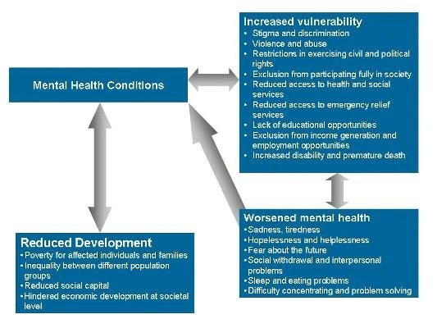
Introduction
Causes of Anxiety, Depression and Stress.

Slide 6
Objective
In the modern world, psychological health issues like depression, anxiety and stress have become very common in daily life.
We have proposed a SVM Classifier model to predict the depression , anxiety and stress levels in the human being.
In this model , we are going to take the trained data from different datasets and we are going to extract the depression , anxiety and stress levels in different human beings.

Slide 7
LITERATURE SURVEY
Anu Priya[1]: A Machine learning model for depicting Depression , Anxiety and Stress is being created .In this project, the data from the employed and unemployed workers are collected and created 5 different models for 5 levels with a high accuracy and depicting many other Psychological problems. Using these 5 models, get the confusion table where it depicts the most important in the different scales.
Hao Peng[2]:A Machine learning model for implementing federated learning to analyse and diagnose depression. In this model , General multi-view federated learning framework using multi - scource data is proposed , which can extend any machine leaning model to support federated learning. And based on the model we depict the depression levels of a person.
Pengfei Zhou [3]:A Deep learning – based integrated Psychological activity monitoring system is developed for depicting depression and anxiety. In this project , the data has been pre-processed using correlation – based filtering approach and essentials are selected . By calculating the dice coefficient ratio , the obtained labels from the result of classification . These cluster labels were used to depict the axiety and depression levels in a human.

Slide 8
LITERATURE SURVEY
Alexander Kautzky[4]:A prediction model for treatment-Resistant Depression using Machine learning is Generated. 552 patients were diagnosed with Major depressive disorder between 2011 to 2016 and TRD is defined , characterised by Montgomery-As berg Depression rating scale score below 22 after at least 2 antidepressant trials . Random Forest was used to depict the outcome of the treatment in 10-fold cross validation. Full model with 47 predictors yielded an accuracy of 71.0%. When the number is reduced to 15 the accuracy is in the range of 67% to 70%.
Ahmed Khodayari- Kostamabad [5]:The performance of the proposed Machine learning methodology for depicting the response of treatment suffering from major depression disorders been investigated. A small number of most discriminating features are selected for the procedure . The selected features are fed into a classifier which is a mixture of factor analysis model ,whose output is the predicted response of livelihood value . This method is evaluated using a “leave-n-out” randomized permutation cross- validation procedure . The specificity of the proposed method is 80.9% while the sensitivity is 94.9% and an overall accuracy of 87.9% is achieved.

Slide 9
LITERATURE SURVEY
Neha prerana tigga.[6]: The machine learning algorithms were applied in R programming language using RStudio version 3.5. The dataset was divided into the ratio 70:30, representing the training and test sets, respectively. The dataset used for this project is DASS21.the data is collected from 348 participants aged between 20-60 years from google form. Questionaries are the people who gives DASS 21 comprises 21 questions, with 7 questions allocated to each of the scales of Stress, Anxiety and Depression. The application in the five methods gives the values in the 5x5 matrix. The number of columns and rows shows the normal, mild, moderate, severe, extremely severe cases respectively.
Dr. D. Venkataraman.[7]
A system is being used with frontal face videos recorded or live extracts facial expressions and analyse and detect depression in the people.
Training phase.
Face detection and facial feature extraction.
Feature set creation
Creation of dataset for testing
After these 4 steps the sets of images will be created and shows the depression, anxiety and stress

Slide 10
LITERATURE SURVEY
Rohizah Abd Rahman[8]:-This project is working on the comparison principle of data analysis method, comparison, challenges and limitations. The data extracted from the dataset is examined by statical analysis or machine learning.
Finding and selecting studies
Description of selected studies
Data set
Feature extraction
Shahrul Azman Mohd Noah[9]:-An automated system is trained with the facial features of positive and negative facial emotions. Classifications is done by using SVM classifier. The level of depression is calculated from no.of negative facial expressions and sends notification. This system works up to 64.38%.

Slide 11
LITERATURE SURVEY
Jeffrey F. Cohn, [10]:-Manual faces are taken and reads the face expression. Active appearance models(AAM) are used because it reads the unseen lines in the facial expression. Accuracy for AAM and vocal prosody was 79%; for manual FACS coding accuracy was 89%.
Neha s,Nivya,pooja HS Shekar[11]:-There are 3 different modules used in design Data pre-processing, Model definition, Real time emotion detector. Data augmentation, kernel register, batch normalisation, global average pooling, depth wise separable convolution. The convolution network using Kaggle database. It includes seven emotions with 48x48 pixels and converted to grayscale image. It has accuracy of 64% for emotion recognition.
Devakunchari Ramalingam,Vaibhav Sharma[12]:-SNMDD (Social Network Mental Disorder Detection)
Detecting depression stigma on social media
In-Time perception in depression
Filtering
Classification
The method employed by these systems uses the tactic of detection via analysing the posts on social media,doing syntax and semantic analysis for emotion detection of the person, so as to predict Depression levels among various age groups.

Slide 12
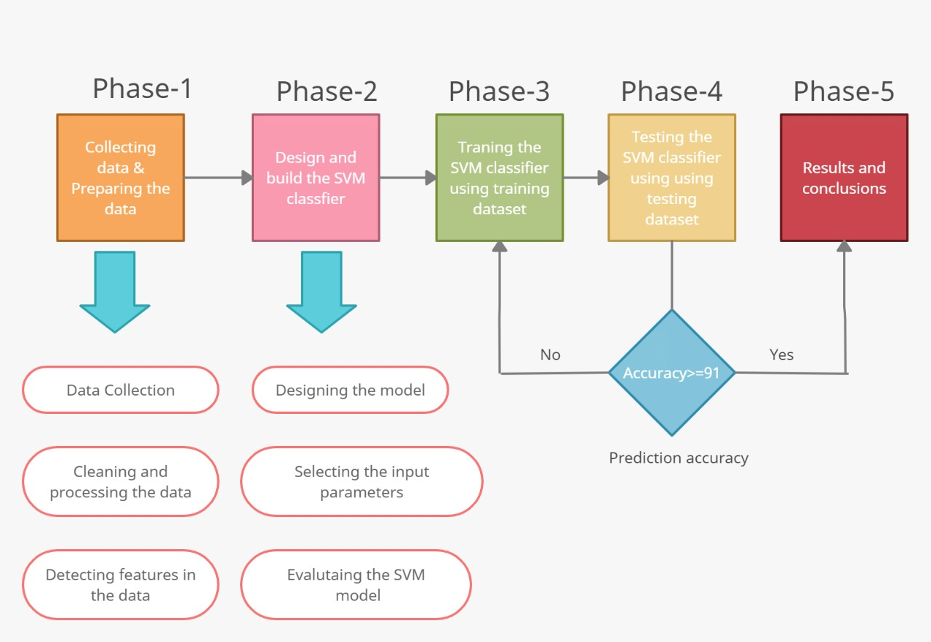
Block Diagram:

Slide 13
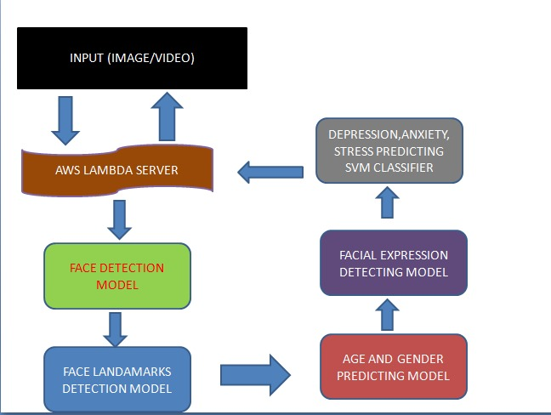
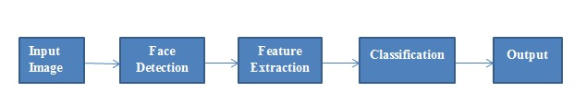
Flow Diagram

Slide 14
Methodology
In the first phase we collect the images and then we are processing the image to retrieve the information from the image and to do so we are using HAAR classifier.
In the second phase we are designing the mathematical model using unsupervised learning(SVM classifier).
In phase three we are sending the training data as an input to the mathematical model and retrieve the values of input variable.
After phase three we are sending testing data in to trained mathematical model and evaluate it. while evaluating it will create a confusion matrix and compare testing data with trained data.
If the accuracy is above 91% then it is the final result otherwise we need to train the model again.

Slide 15
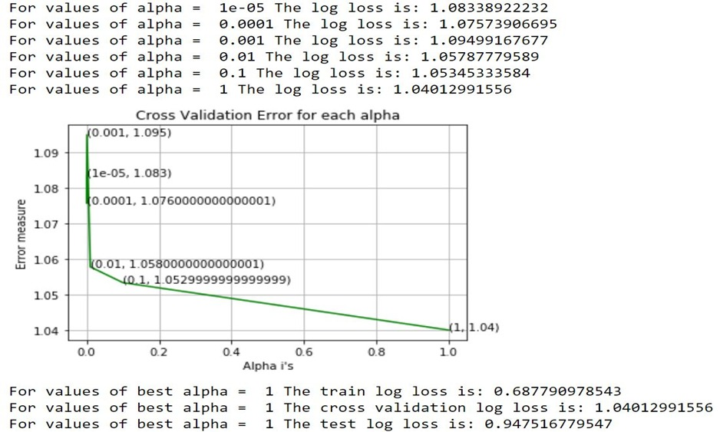
Learning Rate and Error Log

Slide 16
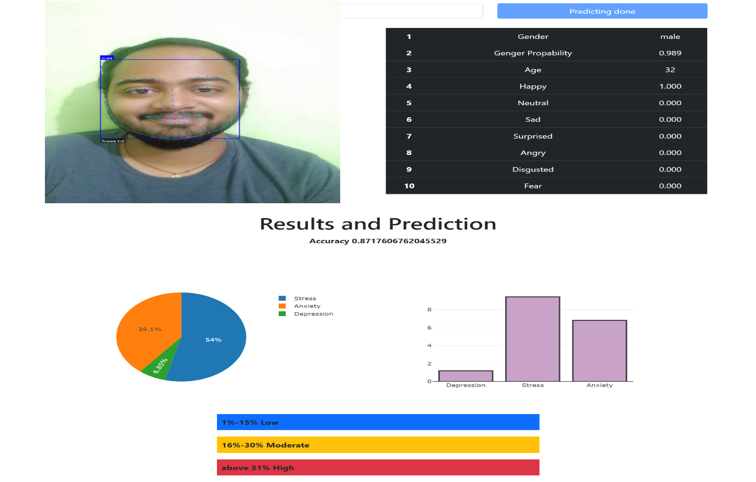
RESULTS
Results of Anxiety, Depression and Stress levels in Age 18-30 years.

Slide 17
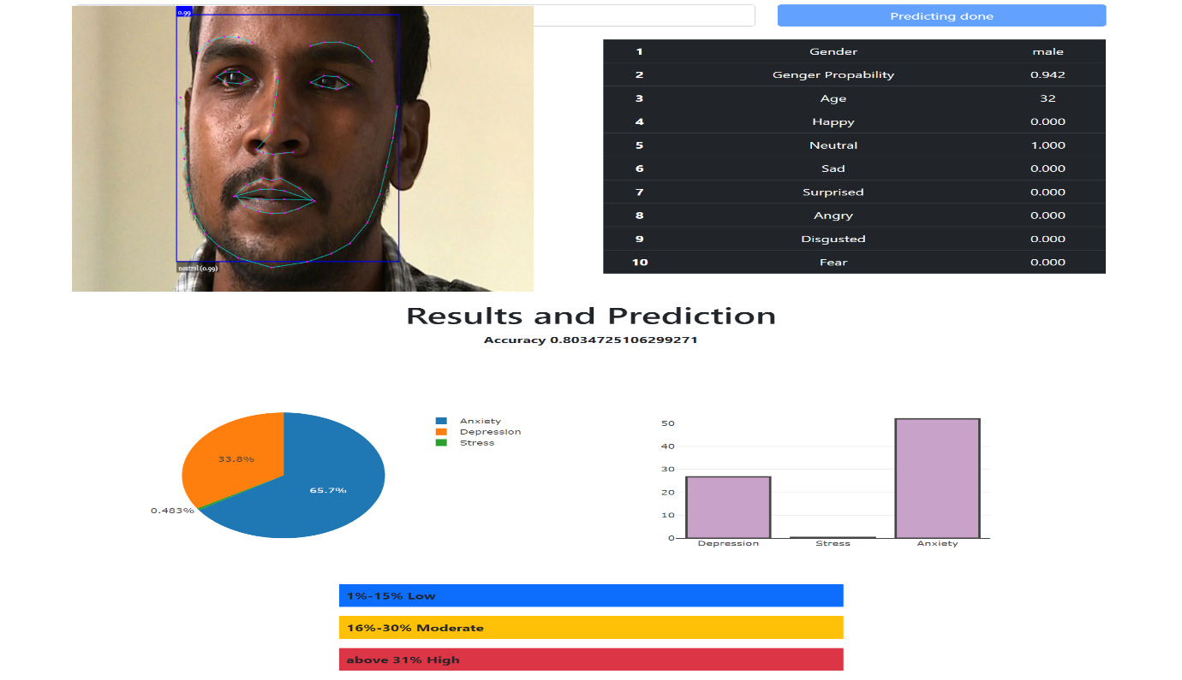
RESULTS
Results of Anxiety, Depression and Stress levels in Age 30-50 years.

Slide 18
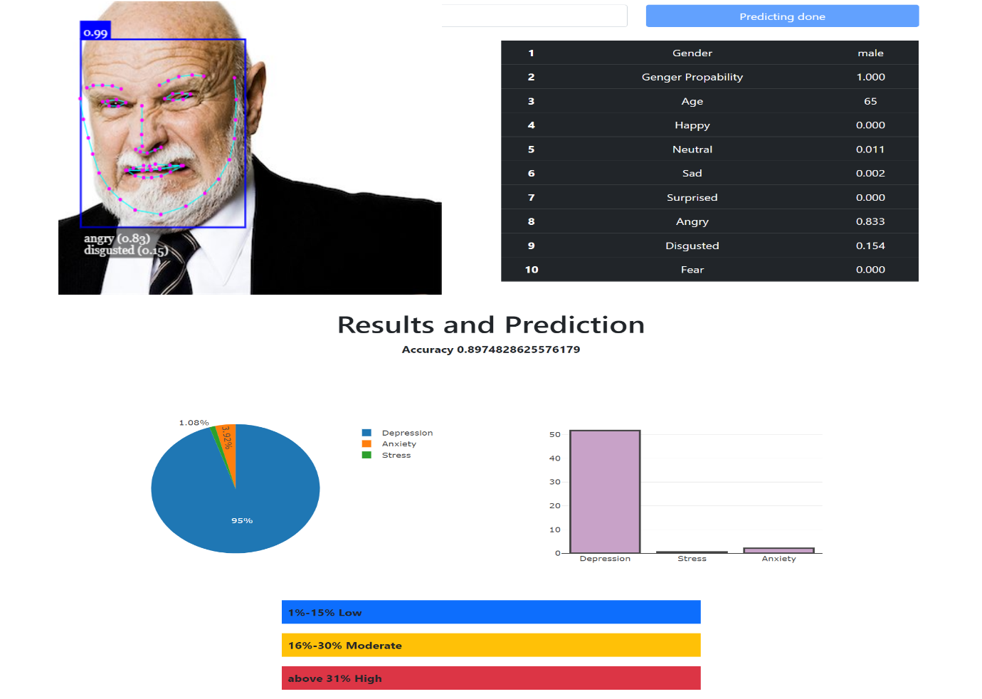
RESULTS
Results of Anxiety, Depression and Stress levels in Age 50-80 years.

Slide 19
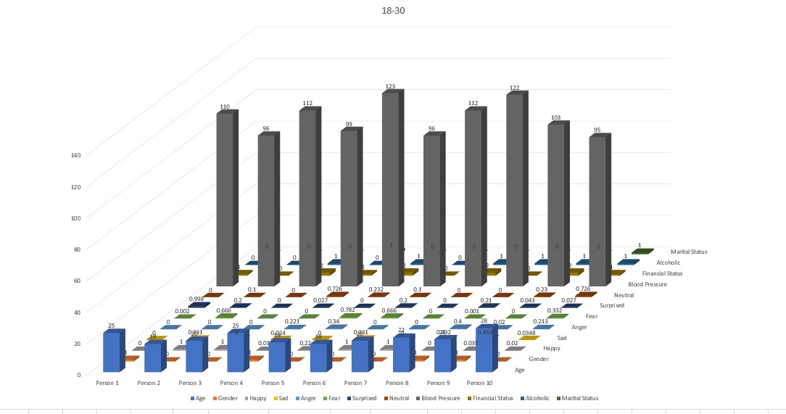
RESULTS
Features outputs for age 18-30 years:

Slide 20
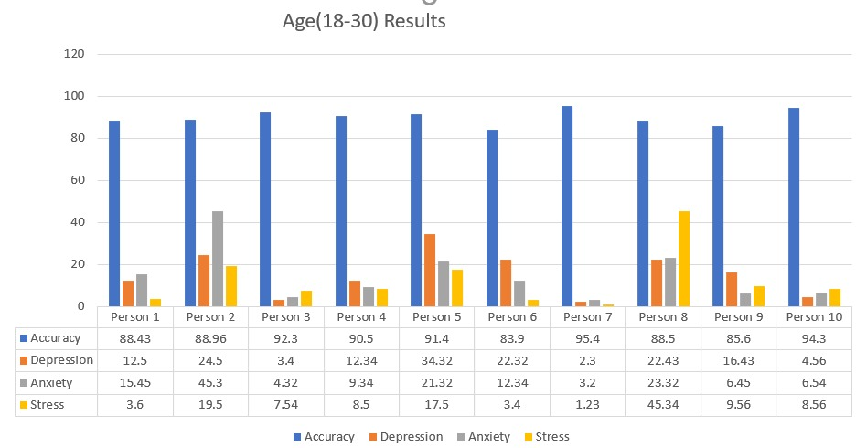
RESULTS
Predicted outputs Results:

Slide 21
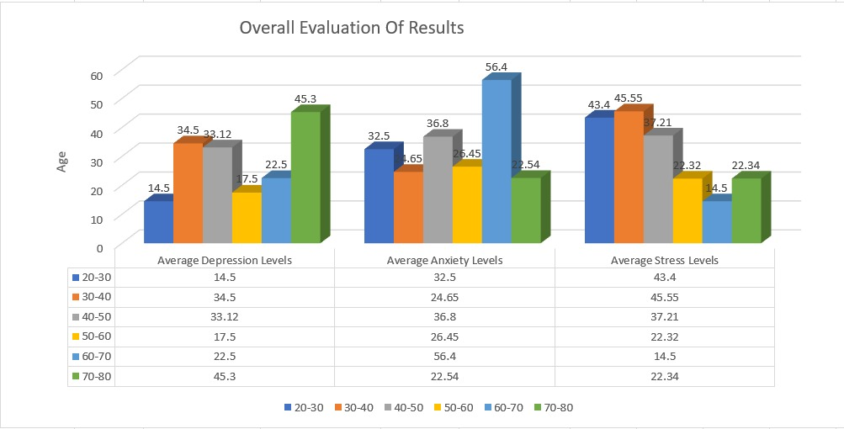
RESULTS
Overall Evaluation of Results:

Slide 22
Conclusion
We have attempted to build an outfit to foresee the Anxiety, Depression and Stress levels in human beings from their photographs. By using Machine learning it gave us more accurate results which can be used for prediction of Anxiety, Depression and Stress levels. As the mental Health problems is growing everywhere over the world this model gives us the better prediction of mental health and their level so that they can be treated well.

Slide 23
References
Anu Priya, Shruti Garg, Neha prerna Tigga,(2020)"Predicting Anxiety, Depression and Stress in modern life using Machine Learning Algorithm", Procedia Computer science 167 (2020) 1258-1267
Hao Peng ∗, Lichao Sun, Md Zakirul Alam Bhuiyan (2021)” FedMood: Federated Learning on Mobile Health Data for Mood Detection”, Department of Computer Science and Engineering, Lehigh University, Bethlehem, PA 18015 USA
Alexander Kautzky, Dold M (2019) “Clinical factors predicting treatment resistant depression: affirmative results from the European multicenter study”, Acta Psychiatr Scand. 2019 Jan; 139(1): 78–88.
Ahmed Khodayari- Kostamabad, Jame P.Reilly, ” A machine learning approach using EEG data to predict response to SSRI treatment for major depressive disorder”, Dept. of Electrical and Computer Engineering, McMaster University, Hamilton, ON, Canada L8S 4K1, 5 April, 2013.
Neha prerana tigga,” Predicting Anxiety, Depression and Stress in modern life using Machine Learning Algorithm", Procedia Computer science 167 (2020) 1258-1267.
Dr. D. Venkataraman , Namboodiri Sandhya Parameswaran,” Extraction of facial features for depression detection among students”, 2020 4th International Conference on Intelligent Computing and Control Systems (ICICCS), IEEE, 13-15 May 2020, 10.1109/ICICCS48265.2020.9120909.

Slide 24
References
7. Rohizah Abd Rahman,” Application of Machine Learning Methods in Mental Health Detection: A Systematic Review”, 2020, Universiti Kebangsaan Malaysia under Grant GGPP-2019-004.
8. Shahrul Azman Mohd Noah,” Application of machine Learning Methods in Mental Health Detection: A Systemic Review”, 2020, Universiti Kebangsaan Malaysia under Grant GGPP-2019-004.
9. Jeffrey F. Cohn,” Detecting Depression from Facial Actions and Vocal Prosody”, DOI: 10.1109/ACII.2009.5349358, 2019, Disney Research, Pittsburgh, PA, USA.
10. Neha s, Nivya, pooja, HS Shekar,” Emotion Detection and Depression Detection using Deep Learning”, Volume: 07 Issue: 08, Dept.of Computer Science, Jyothy Institute of Technology, Bangalore, India, Aug 2020.
11. Devakunchari Ramalingam, Vaibhav Sharma,” Study of Depression Analysis using Machine Learning Techniques”, International Journal of Innovative Technology and Exploring Engineering (IJITEE) ISSN: 2278-3075,Volume-8, Issue-7C2, May 2019.
12. https://www.nimh.nih.gov/health/statistics/major-depression.

