Slide 1

PICTRE – THE PHOTO SHARING WEB APP
Presented by: Group 10
Kajaruban Surendran
Shitij Vasist
Jaspreet Singh Sambee
Brindha Guruswami
Enlil Tom

Slide 2
Introduction
Connect with friends and Share Photos
Capture and share your life moments in photos
See friend photos and show off your Check-Ins

Slide 3

Demo!

Slide 4
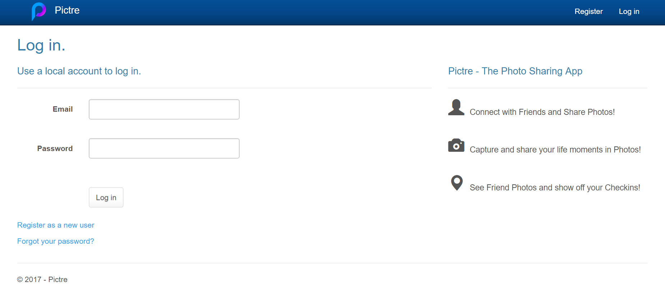
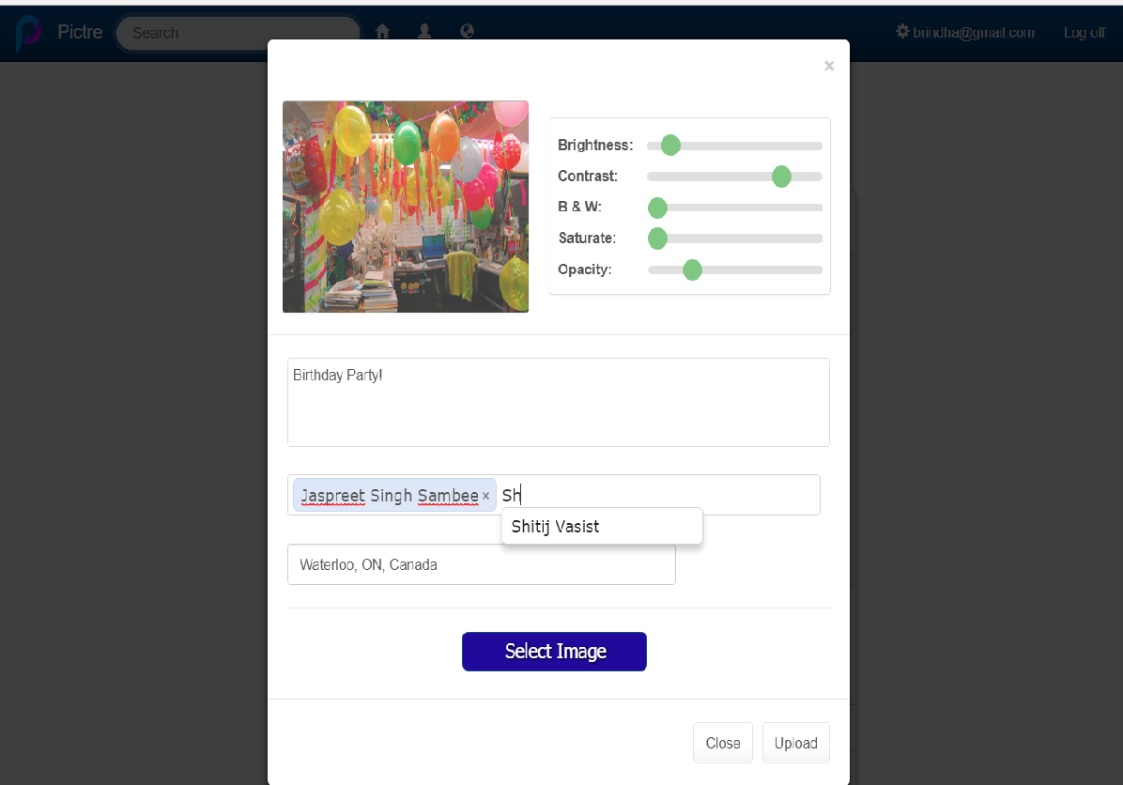
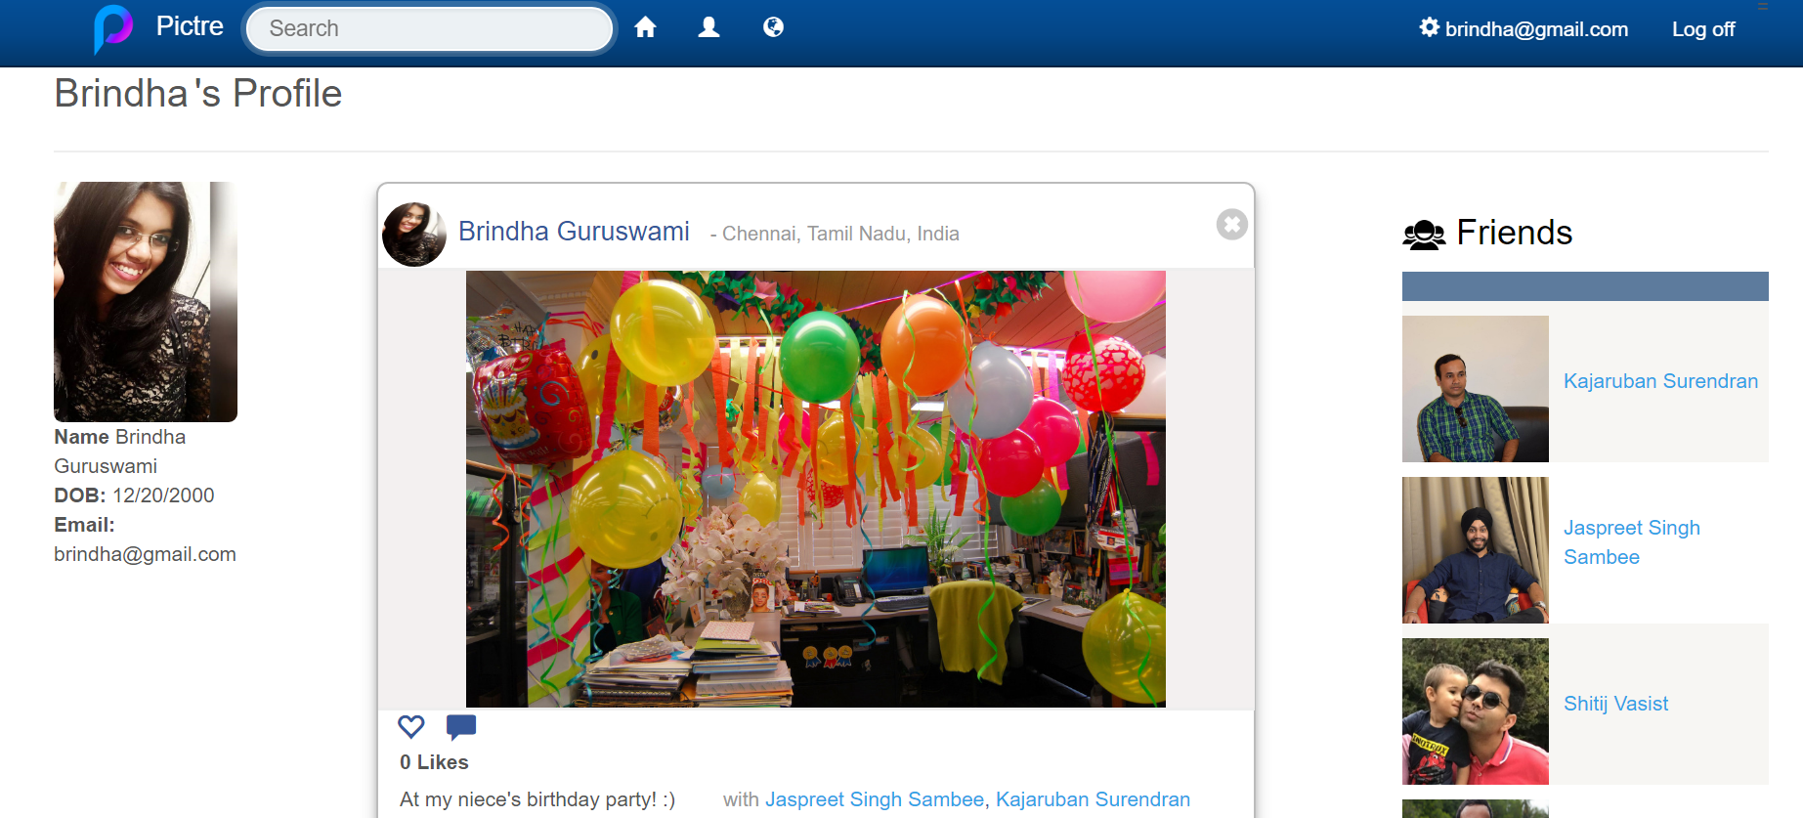
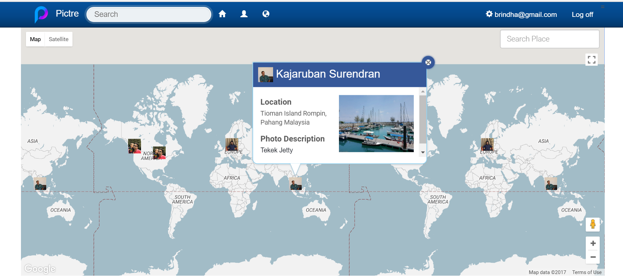

Slide 5
Functional Properties

Slide 6
User Management
Registration
Login
Forgot Password
Edit Profile
Friend Map
Search Friends
Homepage
Upload Photo
Check In
Friend Tagging
Likes
Comments
View Friend Photos
User Profile
Profile Details
Friend List
View Own Photos
Add Friends

Slide 7
Non-Functional Properties
Maintainability
Portability

Slide 8
Technologies and Frameworks

Slide 9
ASP.NET Web Form
C#
WCF
ADO.NET
MS SQL server 2016
JavaScript, JQuery
Bootstrap, CSS, HTML
Windows Azure

Slide 10
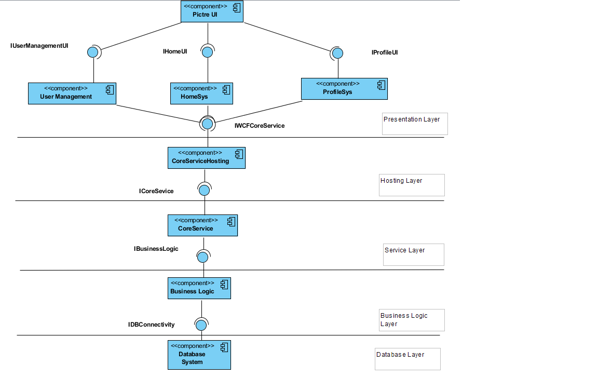
Component Diagram

Slide 11
Architectural Styles
5 Layers
Client - Server
Object Oriented
N - Tier
REST Architecture
Event - Based

Slide 12
Enterprise Styles
Business Delegate
Session Facade
Coarse Grained Interface

Slide 13
Design Patterns
Abstract Factory
Factory
Singleton
Observer
Facade
Data Transfer Object

Slide 14

Challenges
Learning Curve
SignalR for Notifications
Azure Deployment

Slide 15

Thanks!
Any questions?

