Slide 1



KONGU ENGINEERING COLLEGE
PERUNDURAI ERODE-638060
Master of Computer Applications
PODCAST CONTENT MANAGEMENT
SYSTEM
Team Members:
NAVEEN.S (24MCR073)
SURENDER.V.G (24MCR112)
THIRU SELVAM.P (24MCR118)
Guided By:
Ms.S.HEMALATHA
TEAM NO: 29

Slide 2
CONTENTS
Team no: 29
Objective
Existing System
Proposed System
Module Description
Use case Diagram
Data flow diagram
Class diagram
Database Design
Conclusion and Future Enhancement
References
24.12.2024
Slide no: 2

Slide 3
OBJECTIVE
Team no: 29
Design a user-friendly website for hosting and promoting podcasts, featuring intuitive navigation and episode streaming for a seamless experience.
Enable admins to upload podcasts with metadata (title, description, tags) and organize them into categories by genre or topic for easy discovery.
24.12.2024
Slide no: 3

Slide 4
EXISTING SYSTEM
Team no: 29
Simple login and registration functionality, often limited to email and password.
Most of the websites puts limit to listen audio files.
Basic recommendations based on trending podcasts or user-selected genres.
Listeners struggles to find new podcasts or relevant episodes.
24.12.2024
Slide no: 4

Slide 5
PROPOSED SYSTEM
Team no: 29
Options for social media login (like Google).
Allows listeners to listen and download the audios for free.
Highlight popular episodes in real-time.
Personalization and enhanced browsing help users find content relevant to their tastes.
Taking the project as educational basis.
24.12.2024
Slide no: 5

Slide 6
MODULE DESCRIPTION
Team no: 29
The project contains five modules
Dashboard
Upload Module
Profile Module
Episodes List
24.12.2024
Slide no: 6

Slide 7
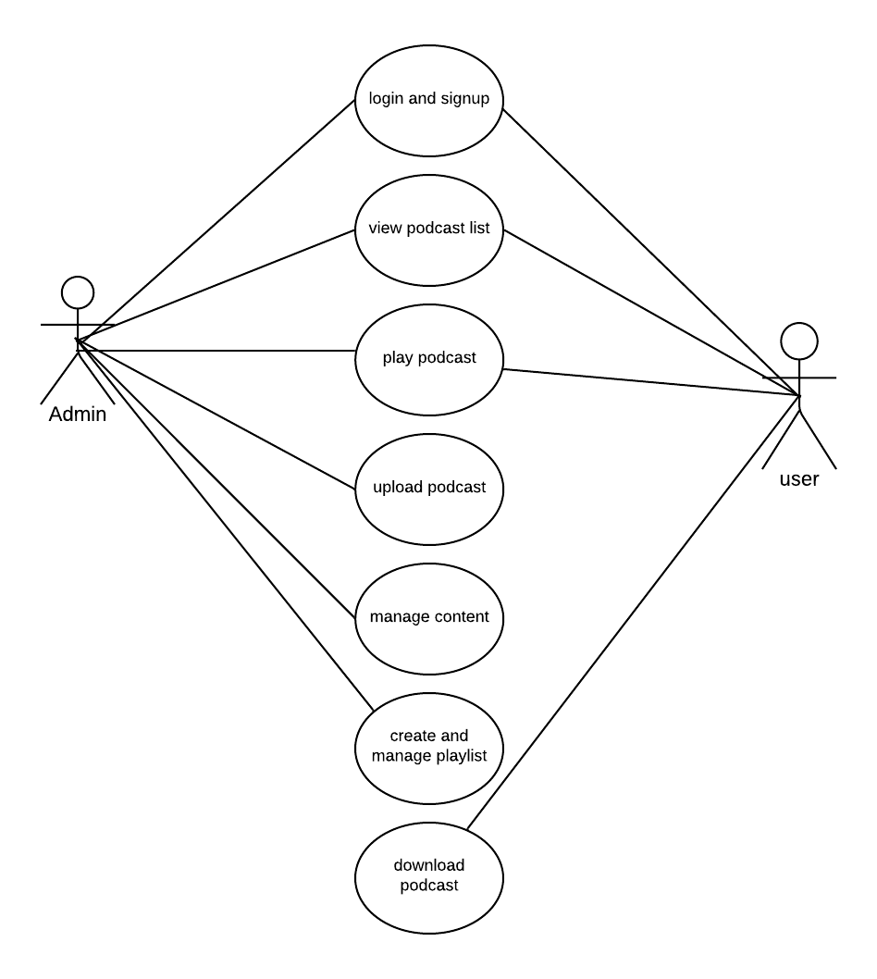
USE CASE DIAGRAM
Team no: 29
24.12.2024
Slide no: 7

Slide 8
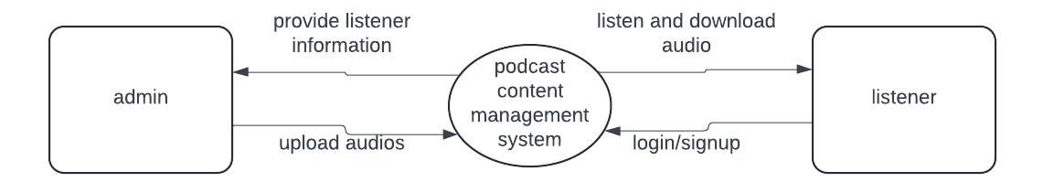
DATA FLOW DIAGRAM: Level 0
Team no: 29
24.12.2024
Slide no: 8

Slide 9
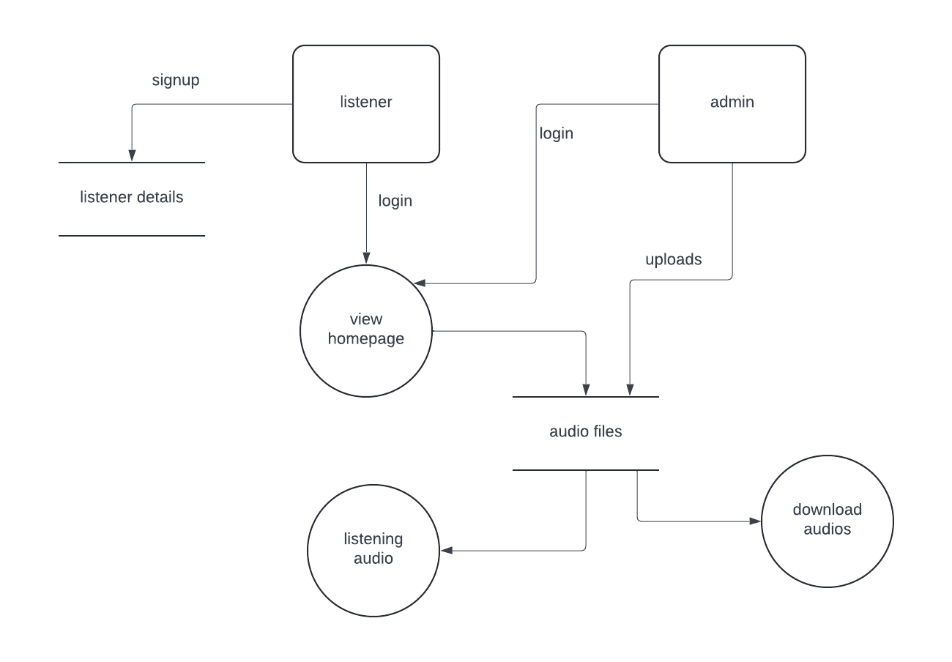
DATA FLOW DIAGRAM: LEVEL 1
Team no: 29
24.12.2024
Slide no: 9

Slide 10
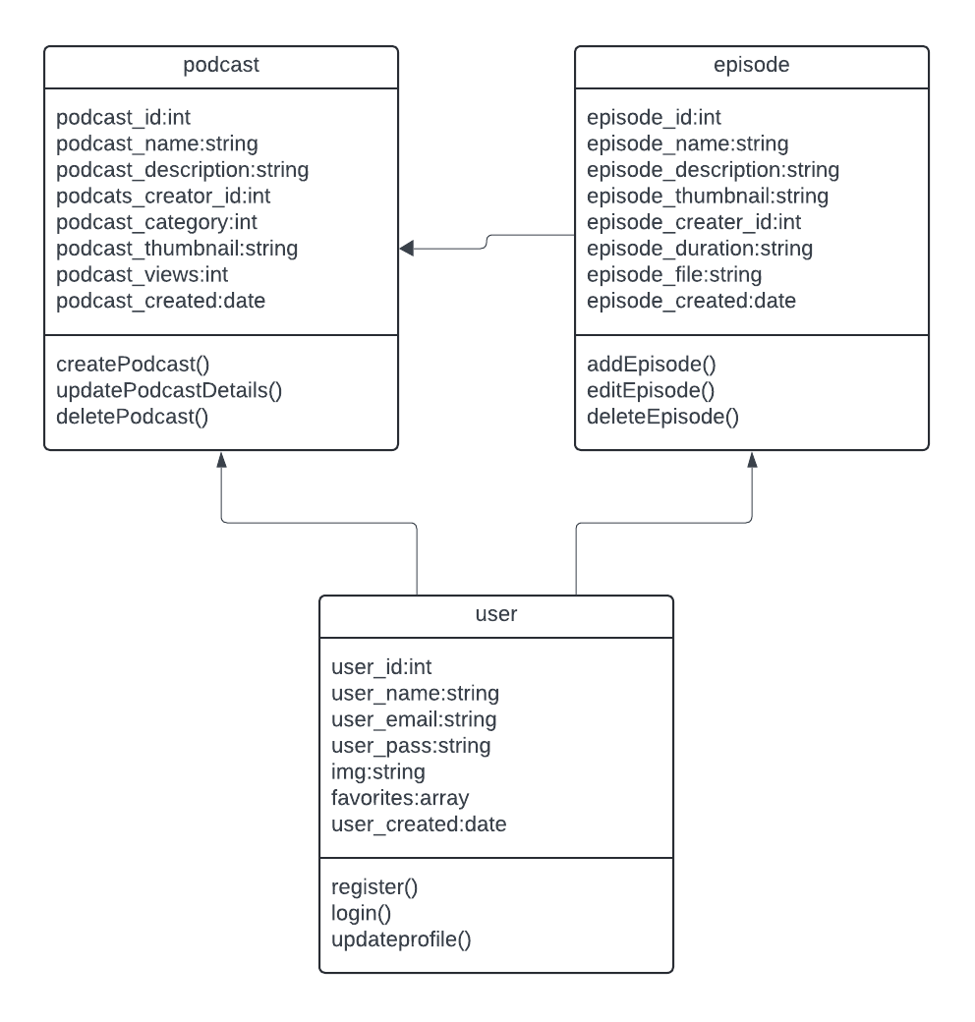
CLASS DIAGRAM
Team no: 29
24.12.2024
Slide no: 10

Slide 11
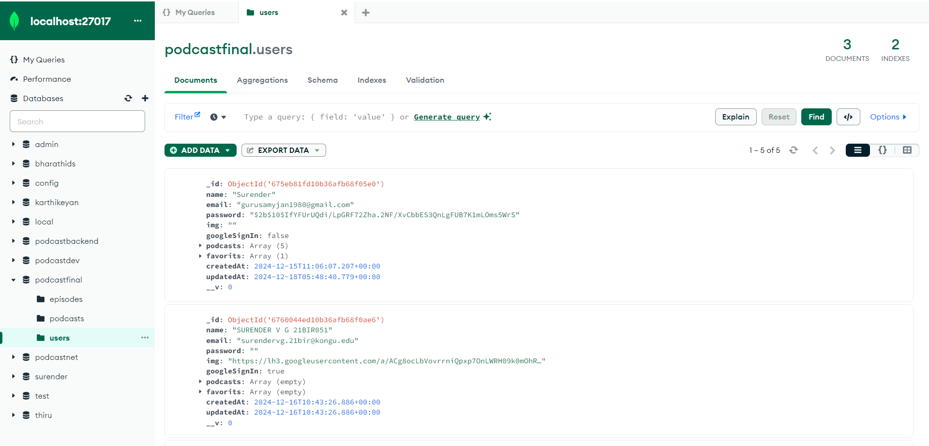
DATABASE DESIGN
Team no: 29
User details:
24.12.2024
Slide no: 11

Slide 12
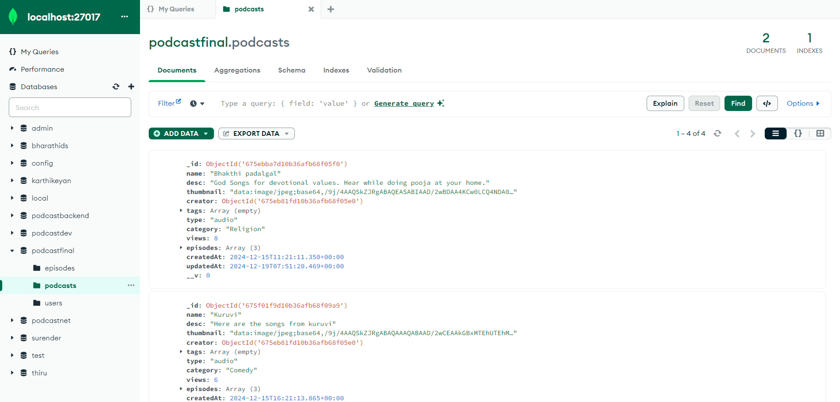
Team no: 29
Podcast details:
24.12.2024
Slide no: 12

Slide 13
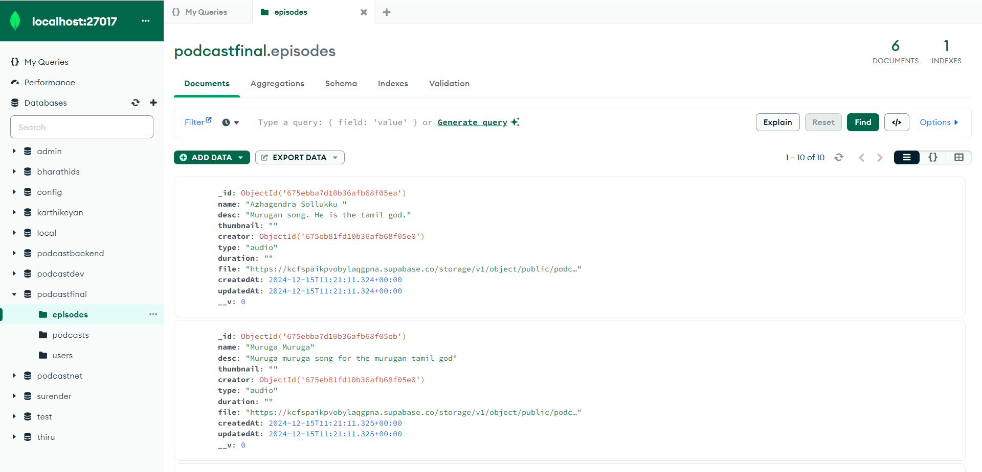
Team no: 29
Episode details:
24.12.2024
Slide no: 13

Slide 14
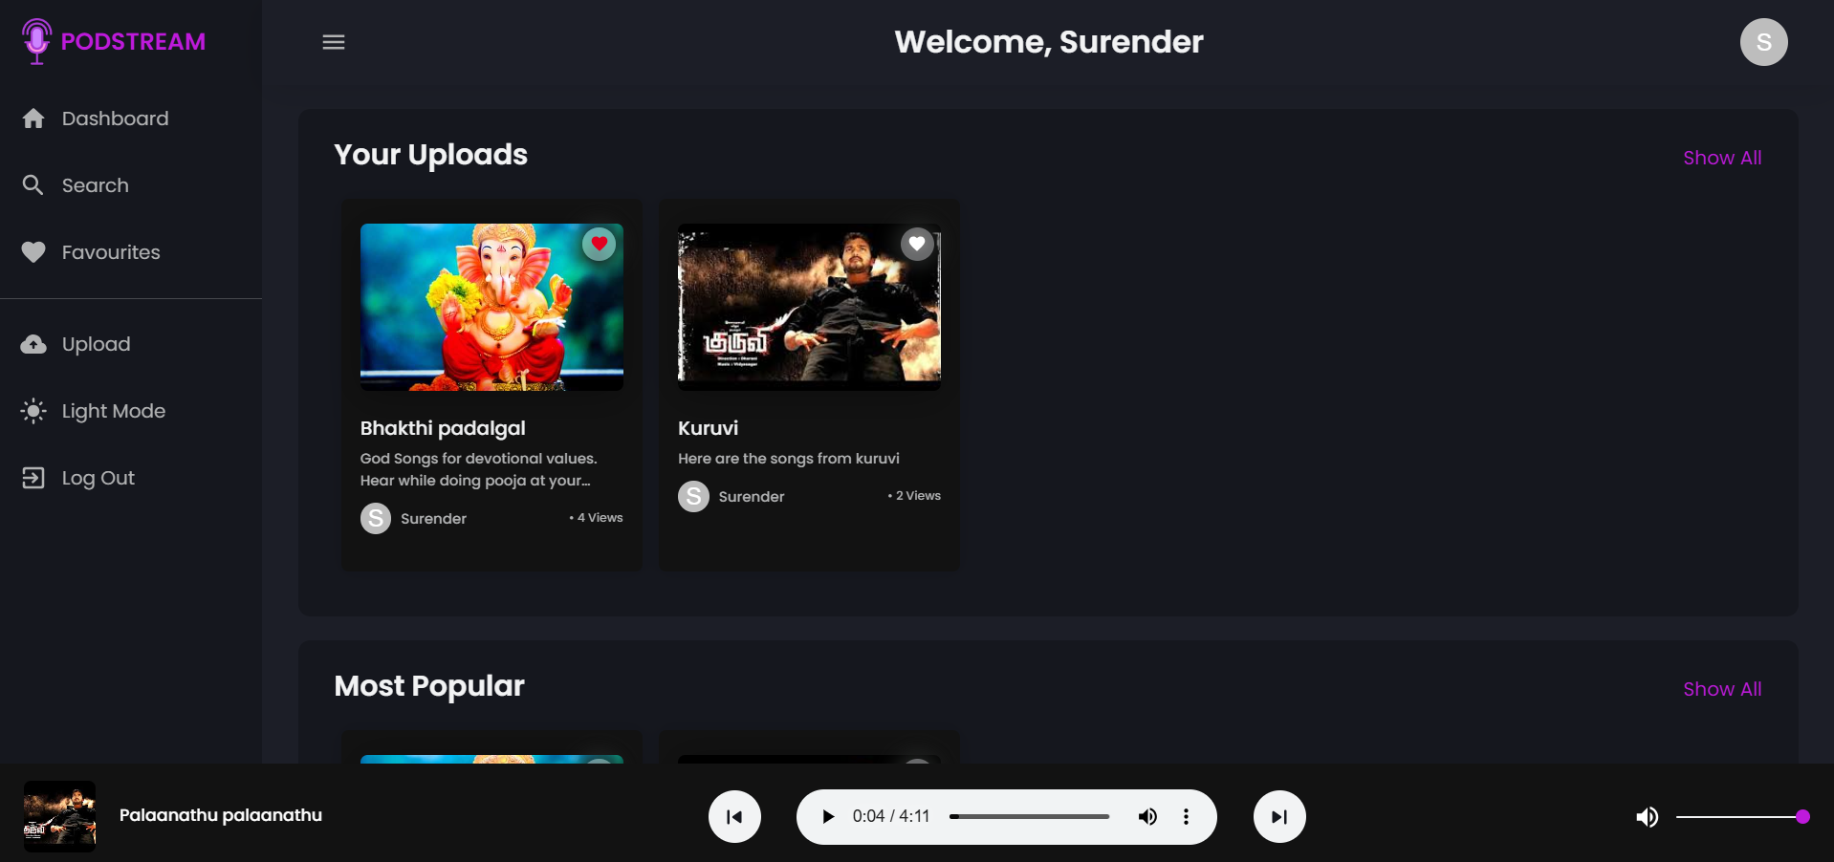
HOME PAGE
Team no: 29
24.12.2024
Slide no: 14

Slide 15
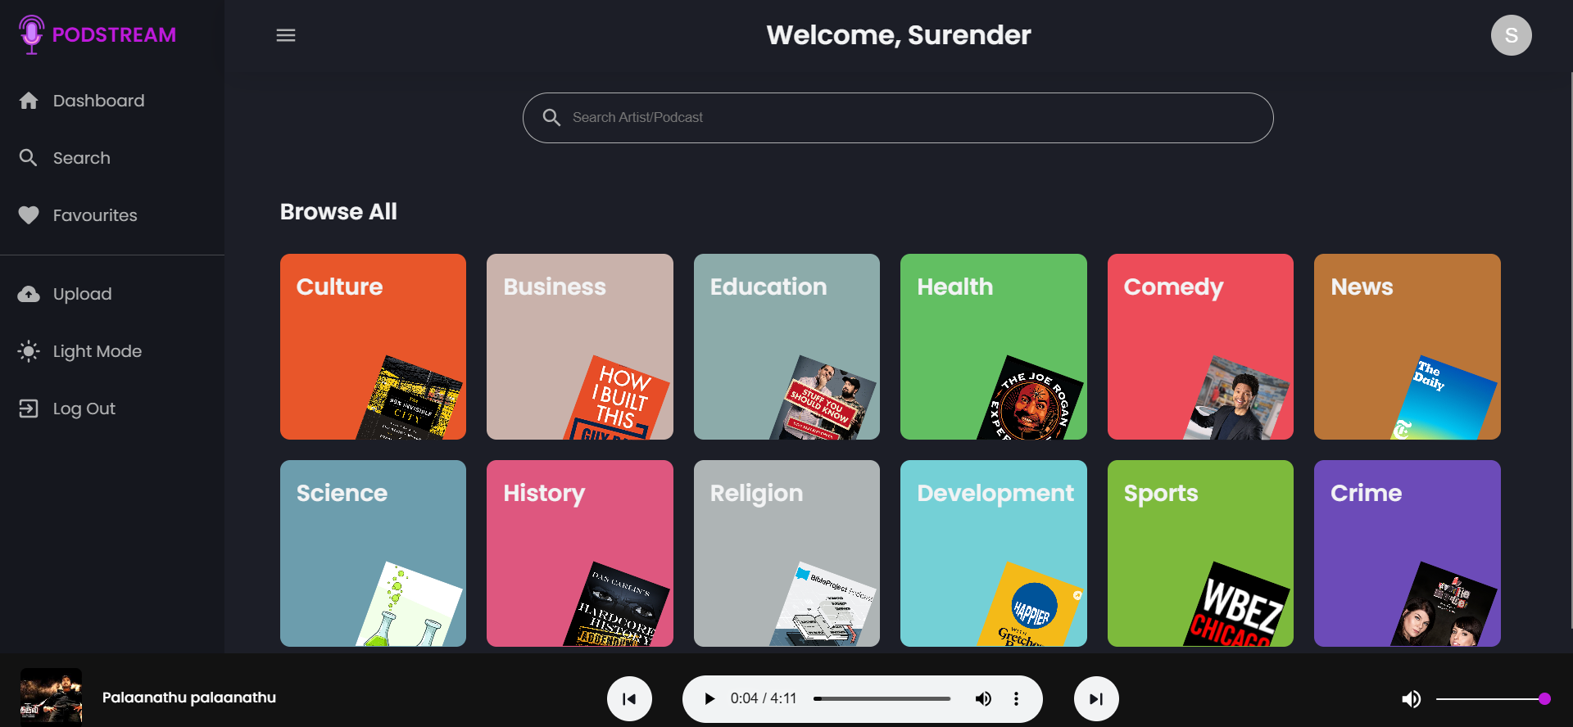
SEARCH MODULE
Team no: 29
24.12.2024
Slide no: 15

Slide 16
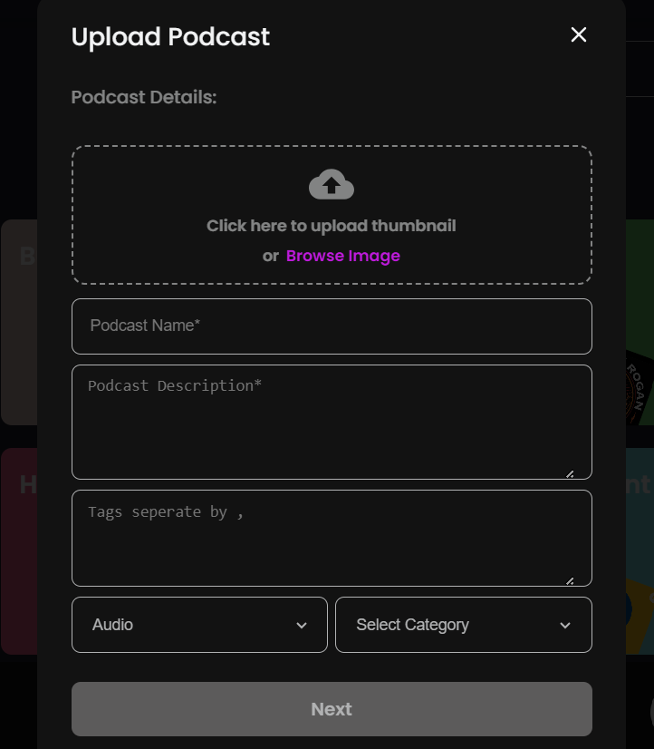
UPLOAD MODULE
Team no: 29
24.12.2024
Slide no: 16

Slide 17
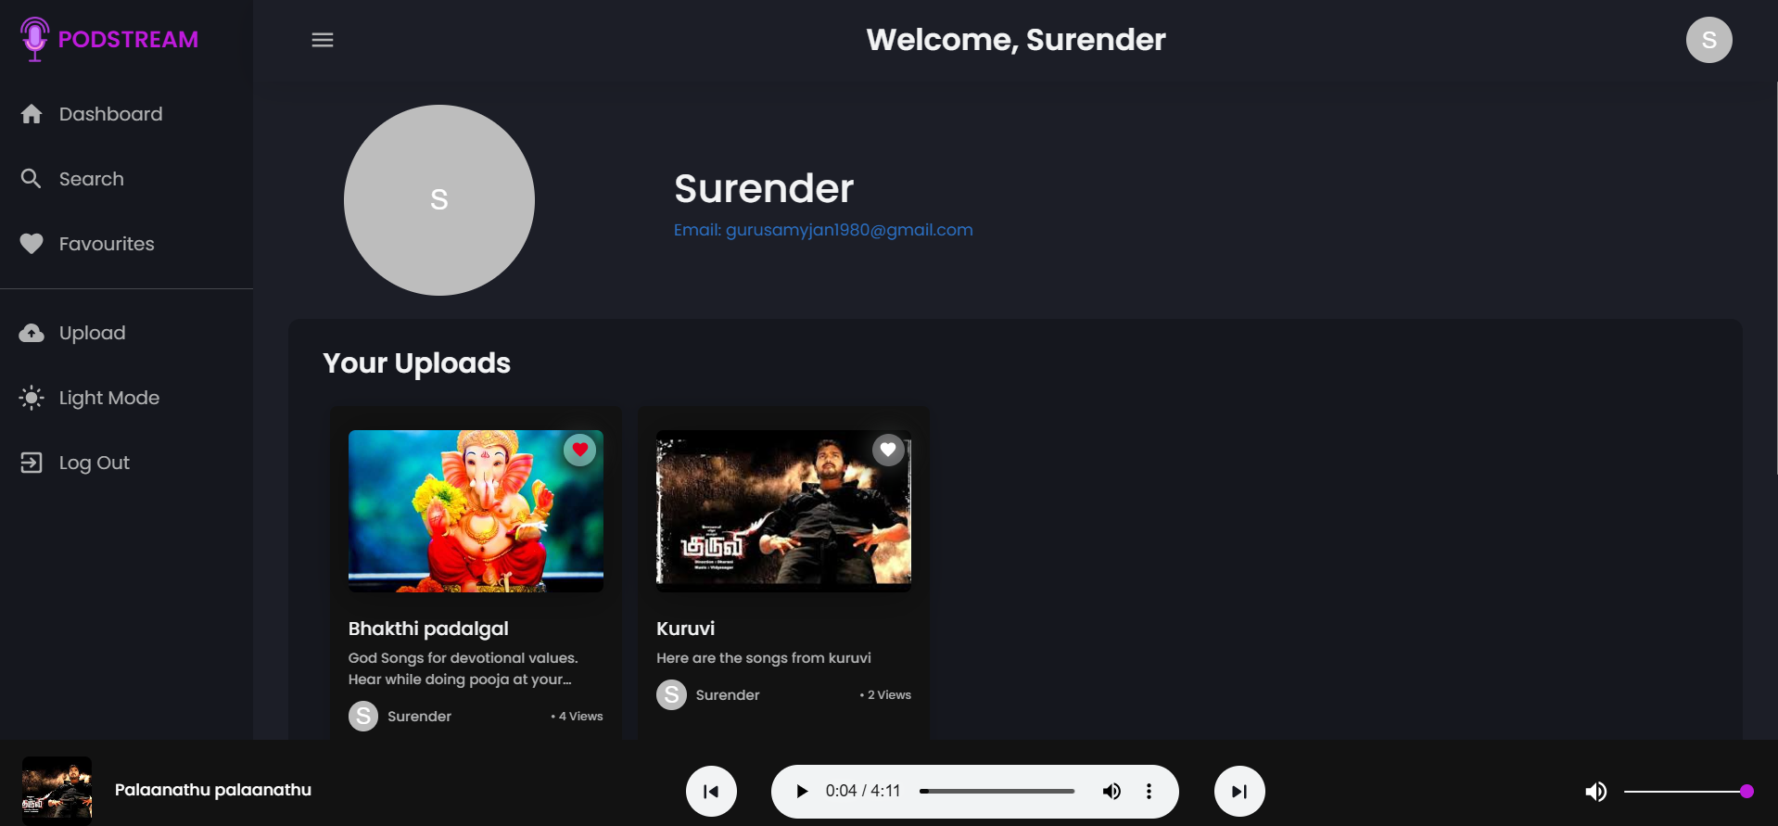
LISTENER PROFILE
Team no: 29
24.12.2024
Slide no: 17

Slide 18
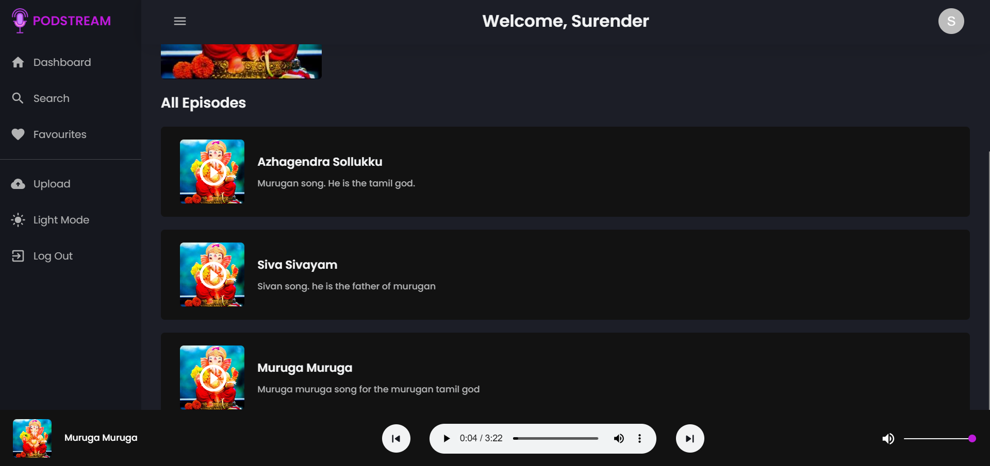
EPISODE LIST
Team no: 29
24.12.2024
Slide no: 18

Slide 19
CONCLUSION
Team no: 29
The project work entitled “PODCAST CONTENT MANAGEMENT” so far been tested and documented completely.
The Podcast Content Management System provides an efficient, centralized platform for managing and distributing podcast content.
By integrating technologies like ReactJS, MongoDB, and Firebase, the system ensures seamless functionality for both creators and listeners.
The platform addresses the limitations of existing systems by offering a streamlined, user-friendly experience.
FUTURE ENHANCEMENT
Live Streaming Support
Mobile App Development
24.12.2024
Slide no: 19

Slide 20
Team no: 29
REFERENCES
Ryan Foster, "MERN Stack Development: A Practical Guide", 1st Edition, 2022.
Christopher Rodriguez, "The Art of NoSQL: MongoDB in Action", 3rd Edition, 2017.
https://www.geeksforgeeks.org/reactjs/
https://www.mongodb.com/
24.12.2024
Slide no: 20

Slide 21
Thank You !!

