Slide 1
Health care analytics – using logistic regression
CAPSTONE PROJECT
Presented By:
SURE SAI AKSHAY - VELLORE INSTITUTE OF TECHNOLOGY A.P – CSE
- 2nd year – STU65b7cc8b52f1f1706544267

Slide 2
OUTLINE
Problem Statement (Should not include solution)
Proposed System/Solution
System Development Approach (Technology Used)
Algorithm & Deployment
Result
Conclusion
Future Scope
References

Slide 3
Problem Statement
Example:
The given scenario is to accurately predict the Length of Stay (LOS) for each patient on a case-by-case basis. LOS is a critical parameter in healthcare management as it helps hospitals identify patients with high LOS risk at the time of admission. By predicting LOS, hospitals can optimize treatment plans to minimize LOS, lower the chance of staff/visitor infection, and allocate resources such as rooms and beds more efficiently.
The task is to develop a predictive model to accurately forecast the Length of Stay (LOS) for patients in hospitals. The model aims to classify patients into one of eleven LOS categories, aiding in resource allocation and healthcare management optimization..

Slide 4
Proposed Solution
The proposed system aims to address the challenge of predicting the Length of Stay(LOS) for each patient on case by case basis . This involves leveraging data analytics and machine learning techniques to forecast LOS patterns accurately. The solution will consist of the following components:
Data Collection:
Gather historical data related to patients and hospitals, including hospital code, city code, patient id, and other relevant factors.
Utilize data sources, such as severity of illness, age, and visitors with patient, to enhance prediction accuracy.
Data Preprocessing:
Clean and preprocess the collected data to handle missing values and some columns like Hospital code, City Code Hospital. Bed Grade etc.. Should be converted to string or integer type as required
Feature engineering to extract relevant features from the data that might impact severity of illness, type of admission.
Machine Learning Algorithm:
Implement a machine learning algorithm, such as logistic regression, support vector machine(SVM), Random Forest etc.. to predict the Severity of illness.
Consider incorporating other factors like Age, visitors with patient etc.. to improve prediction accuracy.
Deployment:
A User-friendly application or interface is developed to predict the real time predictions for length of stay .
The solution will be deployed on a scalable and reliable platform to ensure optimal performance and Reliability.
The interface will be designed to accept the input parameters such as the patient and hospital information
Evaluation:
Assess the model's performance using appropriate metrics such as Mean Absolute Error (MAE), Root Mean Squared Error (RMSE), or other relevant metrics.
Fine-tune the model based on feedback and continuous monitoring of prediction accuracy, Hyper parameters techniques should be employed to optimize model performance.
Result: This solution helps to predict the length of stay in the hospitals for the patients based on their conditions, this helps to improve patient care.

Slide 5
System Approach
The "System Approach" section outlines the overall strategy and methodology for developing and implementing the Health care prediction system. Here's a suggested structure for this section:
System requirements:
Hard Ware:
A computer with power, internet and multi cores for fast training of machine learning tools. RAM is used to
handle the size of the data set
Soft Ware:
An operating system with compatible machine learning tools
Library required to build the model:
The Libraries required for this model are : NumPy, Pandas, matplotlib, seaborn, scipy, scikit-learn(sklearn)

Slide 6
Algorithm & Deployment
ALGORITHM SELECTION
Data Exploration:
Explore the Health care analysis data sets structure, feature and the target variables
identifying the outliers and relations
Problem Formulation:
Define the problem: predicting the length of stay in the hospital based on the relevant factors and the data provided
Algorithm Selection:
Considering the linear regression, logistic regression and decision trees

Slide 7
Algorithm & Deployment
DATA INPUT
Data Collection:
Gathering the historical data from the Kaggle such as the patient name, Age, Severity, type of disease, and relevant patient details.
Data Cleaning:
Handling the missing values, outliers, and any inconsistancies in the data set
Convert the categorical variables into the numerical values by using some encoding techniques.

Slide 8
Algorithm & Deployment
TRAINING PROCESS
As my data set consists of train and test files there is no need of dividing the data
Feature Scaling:
Standardize and normalize the numerical features to ensure that they have the consistent value
Model Training:
Use the selected algorithm to train the model on the dataset
Adjust the hyperparameters to optimize the model performance
Model Evaluation:
Evaluate the model on the testing dataset using appropriate metrics
Fun tune the model if necessary

Slide 9
Algorithm & Deployment
PREDICTION PROCESS
New Data Input:
Collect new data or existing data to make the predictions
Processing Steps:
Apply the same Data processing Steps
Model inference:
Use the trained model to make the predictions on the new data
Results and interpretation:
Interpret the model’s predictions in the context of the problem at hand.

Slide 10
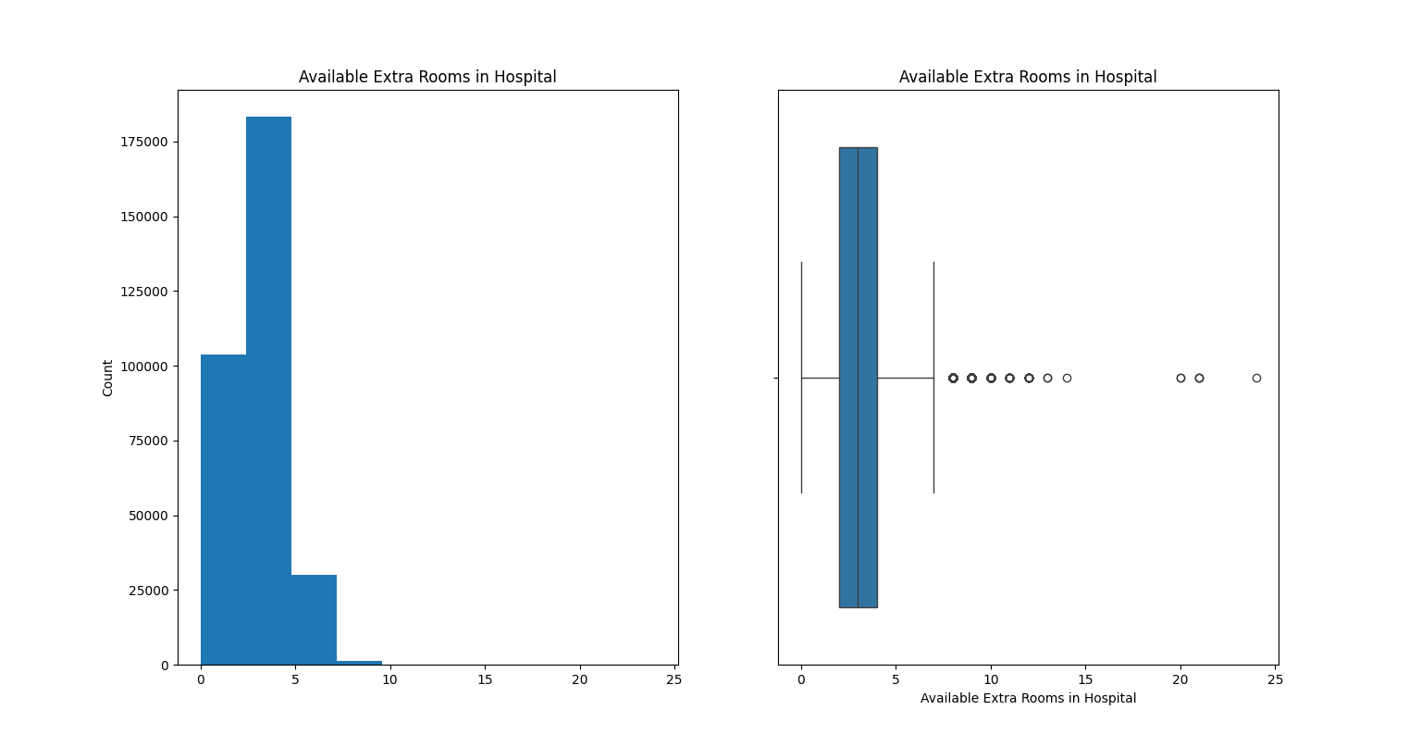
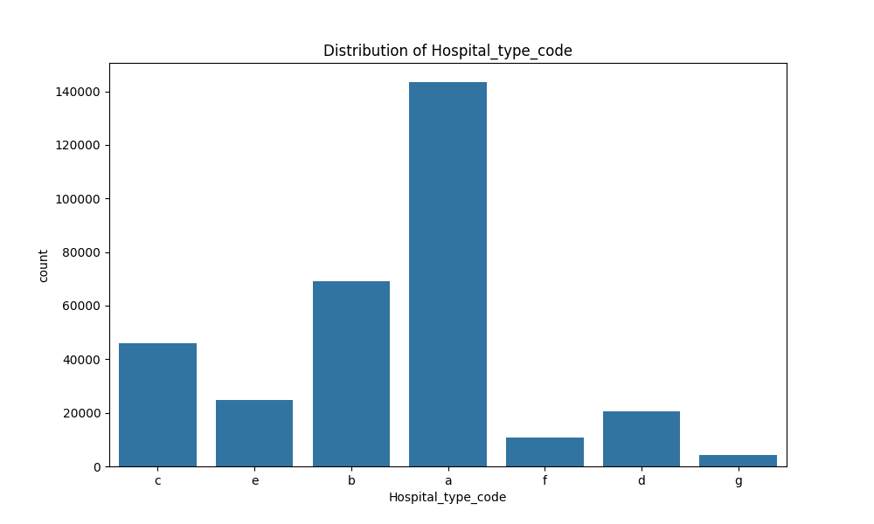
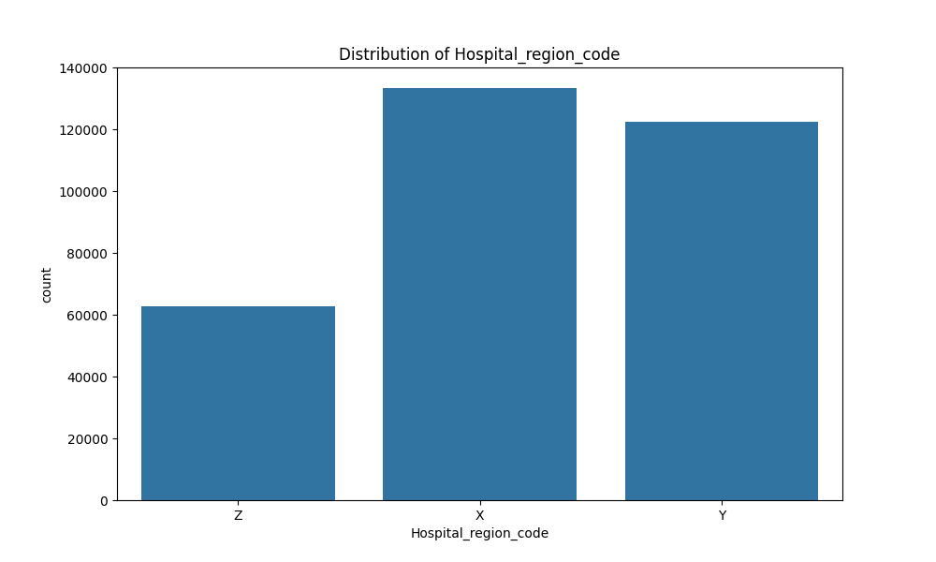
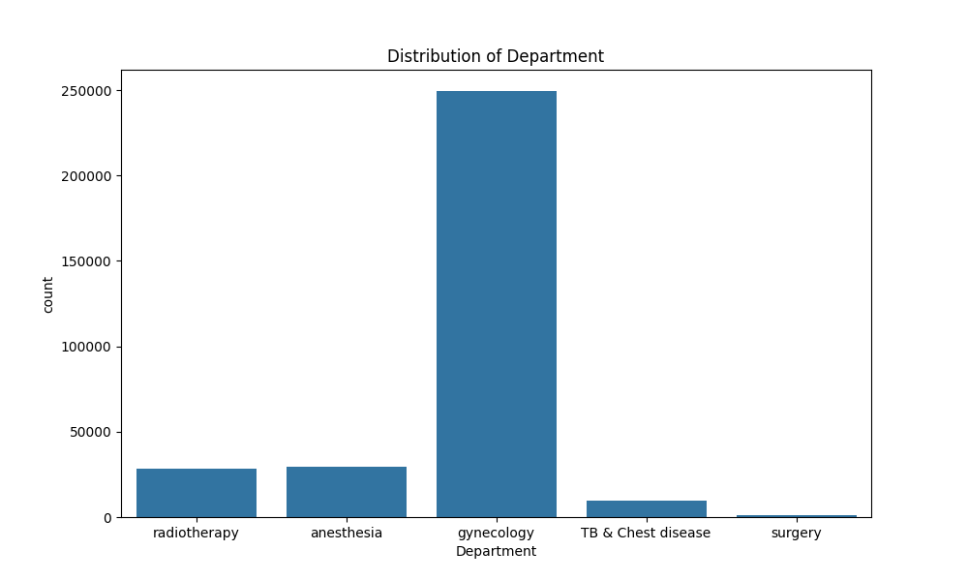
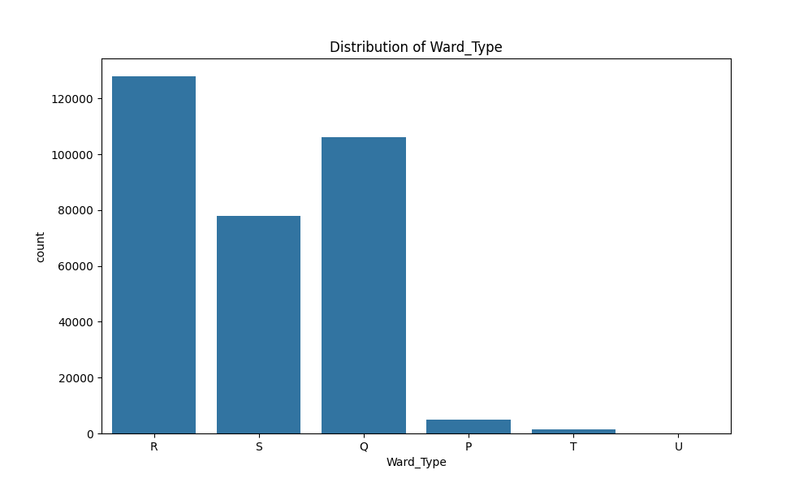
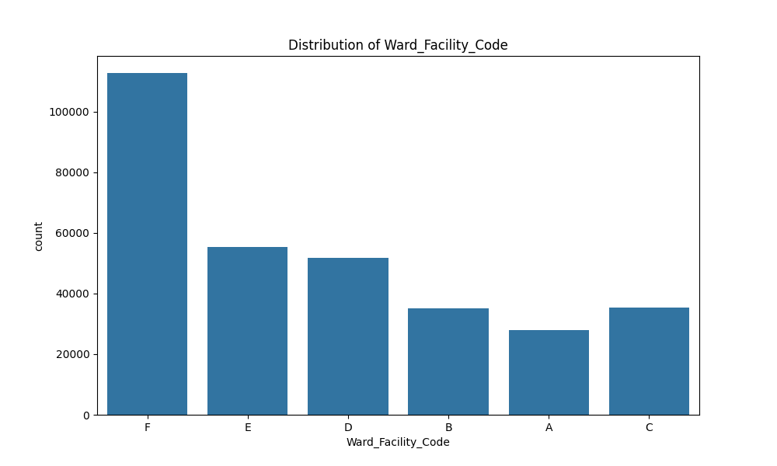
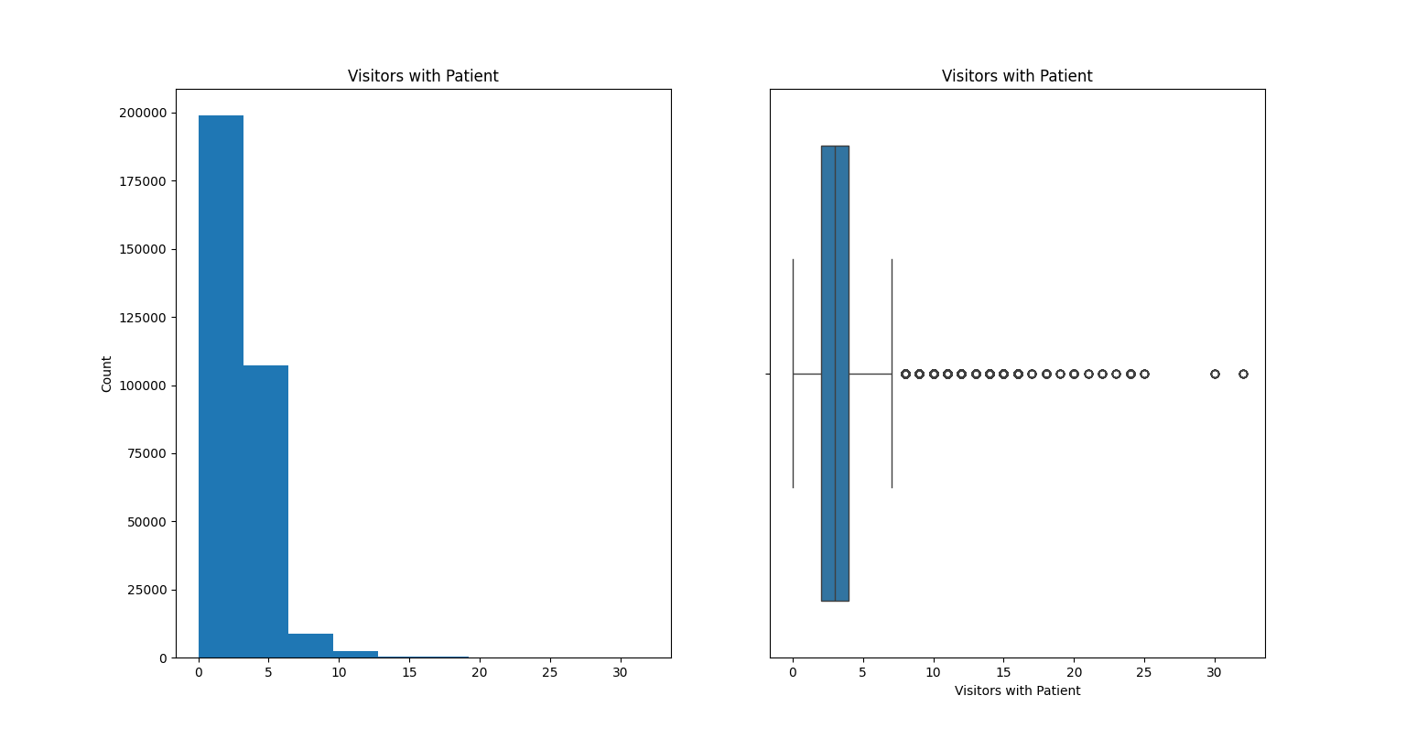
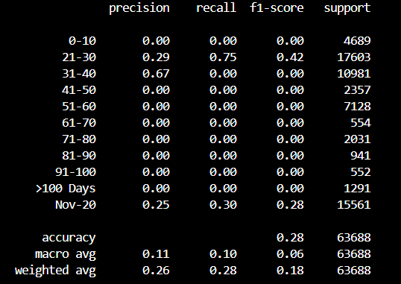
Result

Slide 11
Conclusion
In conclusion that, our proposed solution uses the machine learning techniques to the health care into advanced level by predicting the length of stay in the hospital when we are effected with a disease. By analyzing the data of the patient like age, severity of the disease, type of the disease etc.… we can predict the length of stay in hospital. It also helps to store the required resources for the patient before hand what they required.

Slide 12
Future scope
The proposed Solution lays the foundation for the Advancement in the health care analysis . Here are the keys for the future exploration and enhancement :
Real Time predictions:
Move the real time predictive models that account for the instant changes in demand, develop new diagnostic tests to predict the outcomes of the patient, to identify the risk of the patient of developing the disease
to personalize the treatment plans

Slide 13
References
https://www.kaggle.com/datasets
https://pandas.pydata.org/
https://numpy.org/
https://scikit-learn.org/

Slide 14
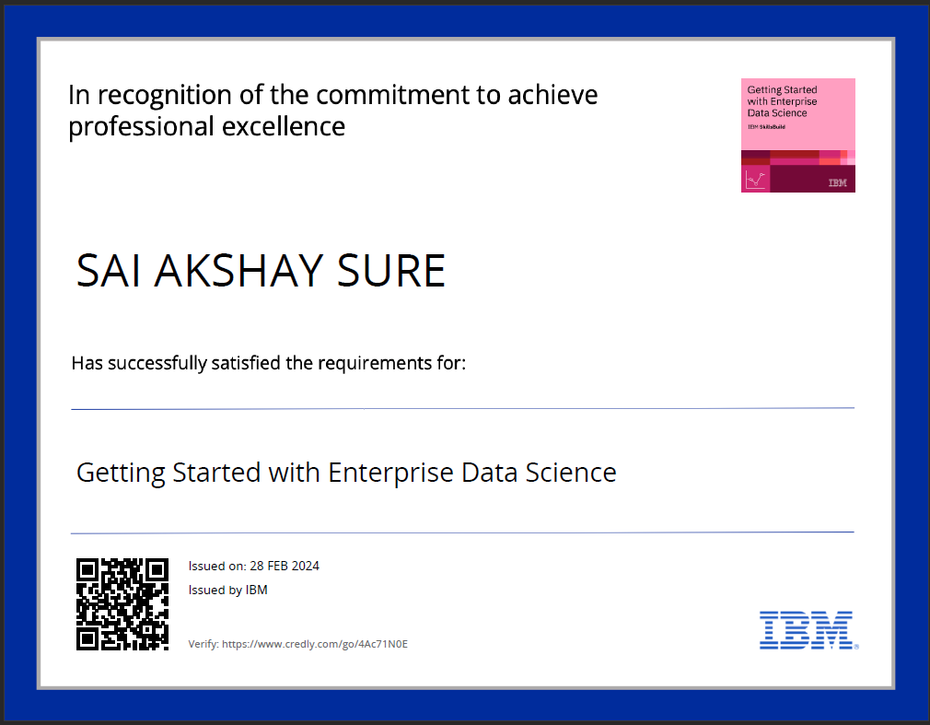
course certificate 1

Slide 15
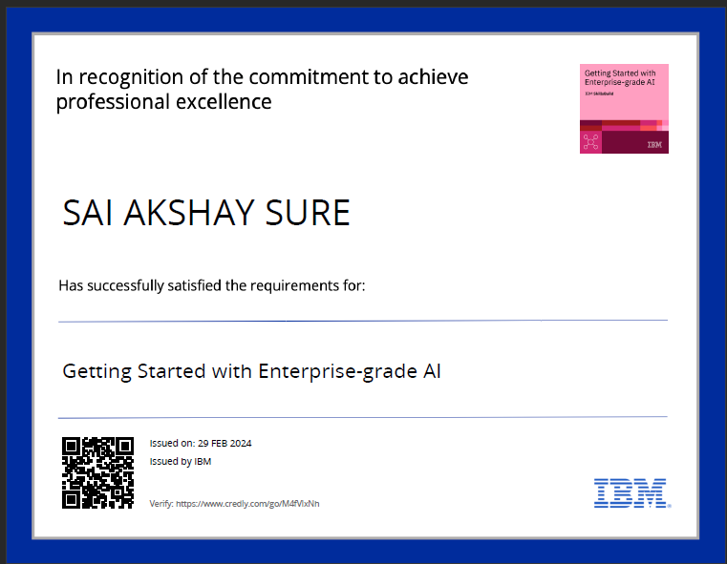
course certificate 2

Slide 16
THANK YOU

