Slide 1


Calibo
Advertising Sales Prediction
Multiple Linear Regression
M Suresh
ID: 2300030390

Slide 2



Advertising Sales Prediction
MULTIPLE LINEAR REGRESSION
TV
Radio
Business objective: understand how TV, Radio, and Newspaper advertising influence Sales.
Newspaper
Build a predictive model using historical advertising data.
Predict Sales for a planned advertising budget.
→ Sales
Dataset: Advertising Dataset (200 records, 4 columns).

Slide 3
Business Problem
1
How do different advertising channels together influence product Sales?
2
Can Sales be predicted from planned advertising expenditure?
3
Which advertising medium has the strongest estimated impact?
4
Which medium has the least estimated impact?
5
How accurate is the predictive model?

Slide 4
Dataset and Variables
200
4
0
float64
Rows
Columns
Missing values in all columns
All variables numerical
INPUT FEATURES (X)
TARGET VARIABLE (y)
TV
Radio
Newspaper
Sales

Slide 5
Machine Learning Workflow
01
02
03
04
Load and inspect the dataset
Define X and y
Split data into 80% training and 20% testing
Build Multiple Linear Regression model
05
06
07
08
Train the model on historical data
Predict unseen test data
Evaluate using MSE, RMSE, MAE, and R²
Predict Sales for the planned advertising budget

Slide 6
Multiple Linear Regression Model
The model learns the relationship between the three advertising channels and Sales.
REGRESSION EQUATION
Sales = 4.7141 + 0.0545(TV) + 0.1009(Radio) + 0.0043(Newspaper)
Intercept
TV coefficient
Radio coefficient
Newspaper coefficient
4.7141
0.0545
0.1009
0.0043

Slide 7
Model Coefficients
TV
0.0545
Radio
0.1009
Newspaper
0.0043
Radio has the strongest estimated positive impact.
Newspaper has the weakest estimated impact.

Slide 8
Prediction for Planned Budget
Planned TV budget
Planned Radio budget
Planned Newspaper budget
150
20
30
15.04
Predicted Sales = 15.0395
Approximately 15.04 units of Sales are predicted.
PREDICTED SALES

Slide 9

Model Evaluation
Mean Squared Error (MSE)
Root Mean Squared Error (RMSE)
Mean Absolute Error (MAE)
R² Score
2.9078
1.7052
1.2748
0.9059
90.59%
The model explains approximately 90.59% of the variation in Sales in the test dataset.
Average absolute prediction error is approximately 1.27 Sales units.

Slide 10
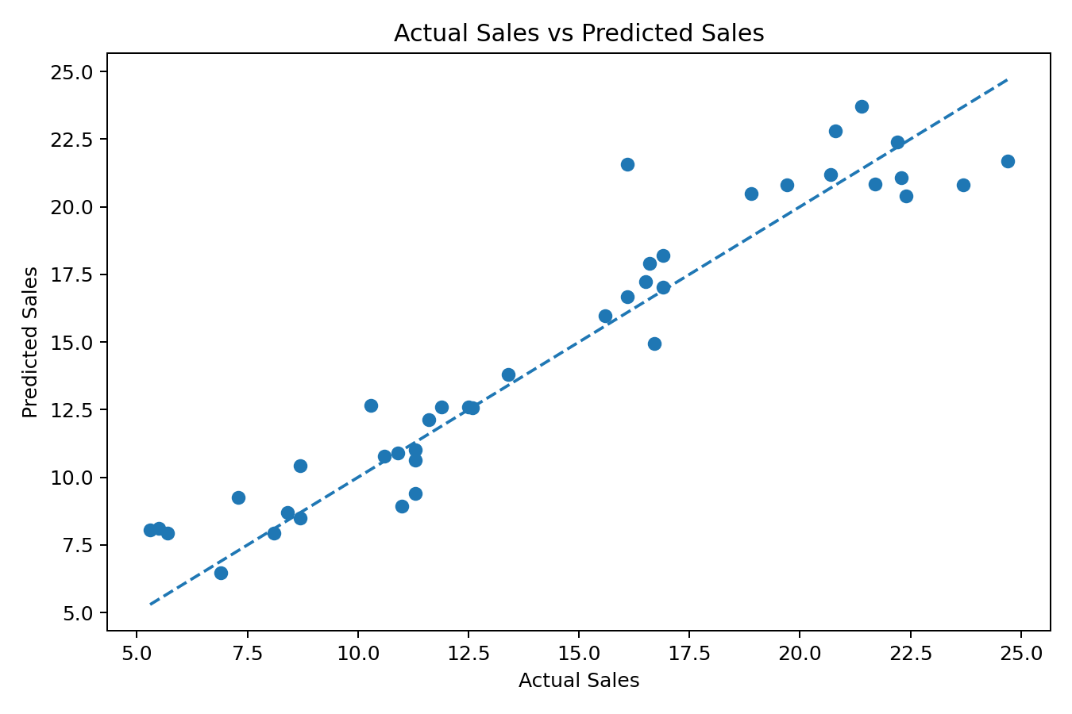

Actual Sales vs Predicted Sales
Points closer to the diagonal reference line indicate more accurate predictions.
Most points are reasonably close to the line.
This supports the strong R² score of 0.9059.

Slide 11


Business Recommendation
Prioritize Radio
Validate first
Decision support
Consider prioritizing Radio advertising because it has the highest estimated regression coefficient (0.1009).
Continue evaluating advertising cost, audience reach, campaign performance, and return on investment before changing the final budget.
Use the model as a decision-support tool rather than the only basis for budget allocation.

Slide 12




Technical Recommendation
Cross-validate
Compare models
Use cross-validation instead of relying on only one train-test split.
Compare alternative models such as Ridge Regression, Lasso Regression, and Polynomial Regression.
Tune settings
Select the best
Tune model settings and compare validation performance.
Select the model that generalizes best to unseen data.

Slide 13

Conclusion
A Multiple Linear Regression model was successfully developed for Sales prediction.
Radio has the strongest estimated impact, while Newspaper has the weakest.
For TV = 150, Radio = 20, and Newspaper = 30, predicted Sales = 15.04.
The model achieved R² = 0.9059 with MAE = 1.2748.
The analysis can support advertising budget planning and sales forecasting.

Slide 14
Key Results at a Glance
Dataset
Model
Strongest medium
Weakest medium
200 records
Multiple Linear Regression
Radio (0.1009)
Newspaper (0.0043)
Planned-budget prediction
MAE
RMSE
R²
15.04 Sales units
1.2748
1.7052
0.9059

