Slide 1

STRESS AT WORKPLACE
STRESSOLOGY:A Study of Stress.
(Organizational)

Slide 2
WHAT IS STRESS ?
“A state of affair involving demand on physical or mental energy”. - OXFORD DICTIONARY
“Non-specific response of the body to any demands made upon it”. - HANS SELYE
Stress is psychological reaction to problems , threats , opportunities and challenges faced by an individual when the outcome is both important and uncertain.

Slide 3
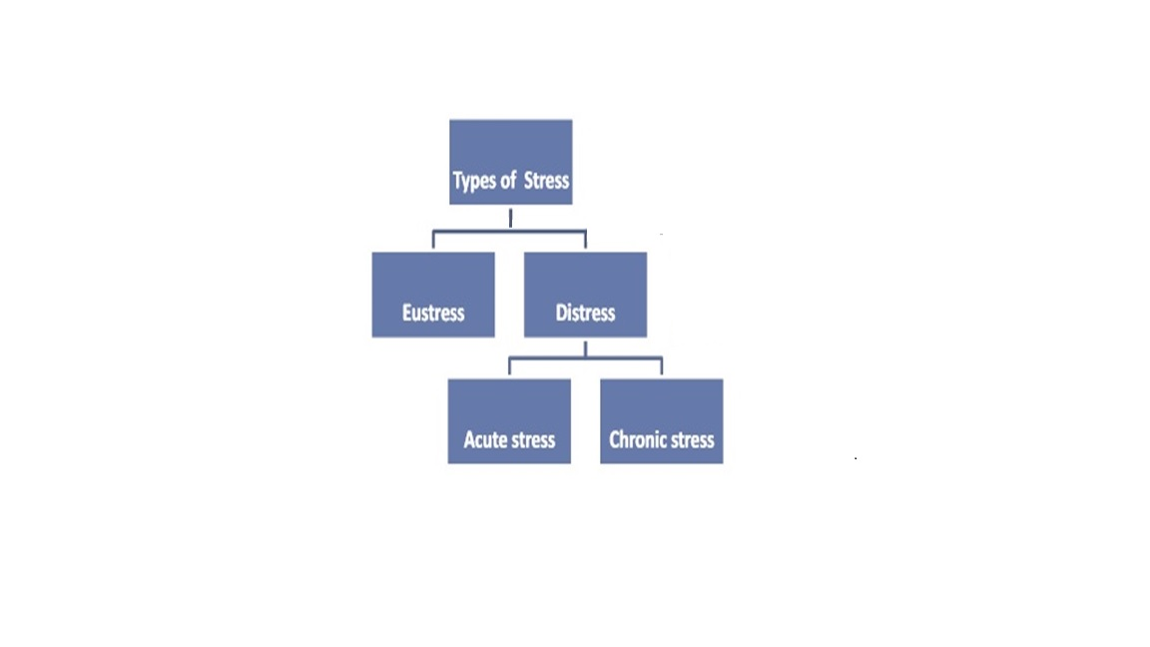
1. Eustress : Eustress or positive stress occurs when your level of stress is high enough to motive you to move into action to get things accomplished. 2. Distress : Distress or negative stress occurs when your level of stress is either too high or too low. It causes physical psychological behavioral problems. There are two types of distress : a) Acute stress is usually for a short time and may be due to work pressure, meeting deadlines etc. b) Chronic stress is prolonged stress that exists for weeks, months or even years. Someone who is constantly relocating or changing jobs may experience distress.
TYPES OF STRESS
1. Eustress : Eustress or positive stress occurs when your level of stress is high enough to motive you to move into action to get things accomplished.

Slide 4
WORK STRESS
Work stress is a dynamic condition in which an individual confronts with an opportunity , constraint and demand related to what he or she desires and for which the outcome is perceived to be both certain and important .
“ A challenging and fulfilling job in a good workplace can be great, but if work starts to take over and we lose the balance, it gets stressful. The ability to have some control over your own workload definitely contributes to the impact work has on your life.”
-Andrea

Slide 5
OBJECTIVES
To examine the association between demographic factors and stress.
To identify the most common factors that causes stress at workplace.
To identify the ill-effects of stress on job performance.
To summarize the findings of the study and recommend some valuable suggestions.

Slide 6
METHODOLOGY
Keeping our objective in mind and techniques to be used, we designed our questionnaire.
Initially we conducted a pilot survey with a sample size of 100 after which there were some modifications introduced in the questionnaire.

Slide 7



DATA COLLECTION
+
50
750
=
800
798

Slide 9
SAMPLING TECHNIQUE USED
Convenience sampling
It is a non probability sampling technique.
It is the most common and easiest sampling technique.
It is fast, inexpensive and the subjects are readily available.
The relative cost and time required to carry out a convenience sampling are small in comparison to probability sampling techniques

Slide 10

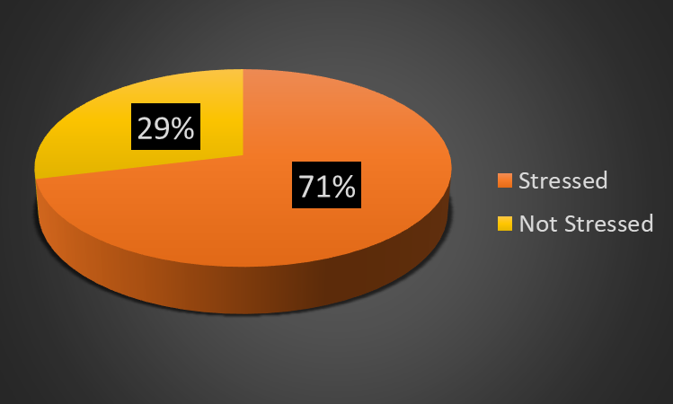
According to our survey 71% of the respondent are stressed and rest 29% of the respondents are not stressed.

Slide 11
GRAPHICAL REPRESENTATION
GENDER
MARITAL STATUS

Slide 12
To examine the association between demographic factors and stress.
Cross tabulation is used to examine if the two variables are statistically associated with each other.
Ho: There is no association between demographic factors and stress.
V/S
H1: There is association between demographic factors and stress.

Slide 13
Rejection criterion: Reject Ho when p-value <0.05
Demographic factor v/s Stress | p-value | Decision criteria
Gender | 0.499602 | Do not reject Ho
Salary | 0.834561 | Do not reject Ho
Travelling time | 0.004536 | Reject Ho
Family type | 0.016017 | Reject Ho
Job experience | 0.772037 | Do not reject Ho
Marital status | 0.794424 | Do not reject Ho
CONCLUSION: From the above table we conclude that there is an association between travelling time and stress & family type and stress.

Slide 14
To examine the effects of demographic factors on stress.
Binary Logistic Regression is a method where the response variable is dichotomous i.e categorical and the independent variable may be continuous or categories.
It is widely used statistical technique.
Assumptions:
Adequate sample size
No outliers
Absence of multicollinearity

Slide 15
Binary Logistic Regression
∏(X)= e^{β0 + ∑ βiXi} / 1+ e^{(β0 + ∑ βiXi )}
Where,
∏(X)=conditional probability that the outcome
is present. i.e. Pr (Y=1/X=x) Y : response variable,
X : vector of independent variables.

Slide 16
Independent Variables
Response Variable
Y = 1 ; if the person is stressed
Y = 0 ; if the person is not stressed
X₁ : Age
X₂ : Gender
X₃ : Job position
X₄ : Salary (per annum)
X₅ : Total Years of Job Experience
X₆ : Working Hours per day (in hrs)
X₇ :Travelling hours per day(in hrs)
X₈ : No. of Dependent members in the Family

Slide 17
Summary of Stepwise Procedure
SUMMARY OF STEPWISE PROCEDURE
Sr.No | EFFECTS | ESTIMATES | Pr >(|Z|)
1 | Age | 0.02787 | 0.04525
2 | Job Position | 0.13565 | 0.04672
3 | Working Hours | 0.30875 | 0.00362
4 | Travelling Time | 0.25248 | 0.00129
5 | Dependent Members | 0.15016 | 0.00307

Slide 18
Test for multicollinearity :
Effects | VIF
Age | 1.59225
Job Experience | 1.538609
No of Working Hours | 1.032759
Total Travelling Time | 1.00908
No of Dependent members in the family | 1.01149
Since , VIF<5 , Multicollinearity is absent.

Slide 19
GLOBAL TESTING
Wald’s test:
H₀: β_{i} = 0 ; i = 1,2,3,4,5
H₁: Not H₀
Variables | p-value
Age | 0.0456
Job Position | 0.0489
Working Hours | 0.00372
Travelling Hours | 0.00134
Dependent Members | 0.00316
Since, p-value <0.05, we reject H₀ and conclude that all the variables are significant.

Slide 20
Thus the fitted model is :
g(x) = -1.93419 + 0.02787*X₁ + 0.13565*X₃ + 0.30875*X₆ + 0.25248*X₇ + 0.15016*X₈
Therefore, age, job position, working hours, travelling hours and dependent members are significant and hence included in the model.

Slide 21
HOSMER AND LEMESHOW GOODNESS OF FIT TEST
H₀ : Model is a good fit
v/s
H₁ : Not H₀
Hosmer and Lemeshow Goodness of Fit Test
Chi-square | DF | P-value
3.9814 | 8 | .8588
Conclusion :
Since p-value is greater than 0.05, we accept H₀ & we conclude that our model is a good fit.

Slide 22
Training set = 598 Test set = 200
Confusion Matrix
Predicted Values
Actual Values |  | 0 | 1
 | 0 | 2 | 56
 | 1 | 4 | 138
ACCURACY = 0.7

Slide 23
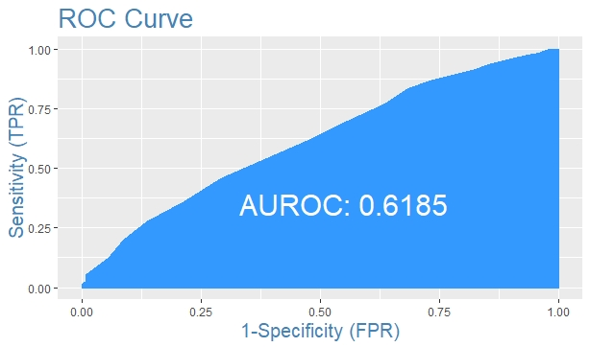
From the above ROC curve we can observe that our model is fair.

Slide 24
To identify the most common factors that causes stress at workplace.
Factor Analysis is a technique that is used to reduce a large number of variables into fewer number of factors.
It helps in identifying groups of interrelated variables to see how they are related to each other.

Slide 25
Validation Tests for proceeding with Factor Analysis
Kaiser-Meyer-Olkin Measure of Sampling Adequacy
This measure varies between 0 and 1, and values closer to 1 are better. A value of 0.5 is a suggested minimum.
Bartlett's Test of Sphericity
This tests the null hypothesis that the correlation matrix is an identity matrix. You want to reject this null hypothesis.

Slide 26
Hypothesis to be tested:
H₀: Population correlation matrix is identity matrix.
H₁: Population correlation matrix is not identity matrix.
Decision Criteria
Reject H₀ if
KMO > 0.5
Large value of Bartlett’s Test of Sphericity
P-value <0.05

Slide 27
KMO and BARTLETT’S TEST
Kaiser-Meyer-Olkin Measure of Sampling Adequacy | 0.91
Bartlett’s Test of Sphericity | Chi-Sq value(app) | 5927.418
 | Degrees of freedom | 253
 | P-value | 0.000

Slide 28
Total Variance Explained
Component | Initial eigen values
 | Total | % of variance | Cumulative %
1 | 8.0167 | 34.855480 | 34.85548
2 | 2.3147 | 10.063960 | 44.91943
3 | 1.6688 | 7.255906 | 52.17534
4 | 1.3490 | 5.865563 | 58.04090
5 | 0.9685 | 4.211056 | 62.25196
6 | 0.8771 | 3.813445 | 66.06540
7 | 0.7594 | 3.301767 | 69.36717
8 | 0.7214 | 3.136492 | 72.50366
9 | 0.6245 | 2.715118 | 75.21878
10 | 0.6062 | 2.635588 | 77.85437
11 | 0.5712 | 2.483374 | 80.33774
12 | 0.5236 | 2.276581 | 82.61432
13 | 0.5081 | 2.209337 | 84.82366
14 | 0.4571 | 1.987589 | 86.81125
15 | 0.4331 | 1.883042 | 88.69429
16 | 0.3977 | 1.729369 | 90.42366
17 | 0.3769 | 1.638729 | 92.06239
18 | 0.3661 | 1.591882 | 93.65427
19 | 0.3447 | 1.498926 | 95.15319
20 | 0.3257 | 1.416303 | 96.56950
21 | 0.2931 | 1.274334 | 97.84383
22 | 0.2527 | 1.098930 | 98.94276
23 | 0.2432 | 1.057237 | 100.00000

Slide 29
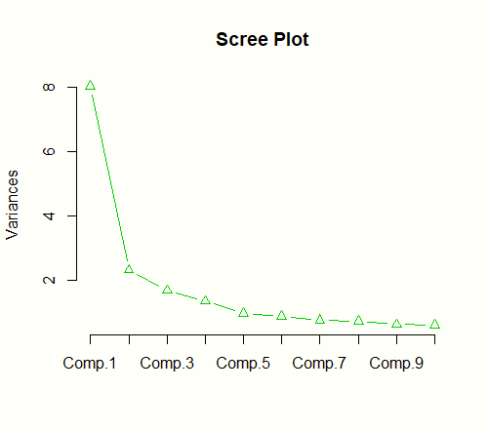
Scree Plot
This scree plot shows that the first four factors account for most of the total variability in data (given by the eigenvalues).
The eigenvalues for the first four factors are all greater than 1.

Slide 30
Communalities
 | Initial | Extraction
Work Conditions | 1.000 | 0.384
Emotional well being | 1.000 | 0.630
Unreasonable Deadlines | 1.000 | 0.646
Opinions about Job Conditions | 1.000 | 0.635
Job pressures interfere with personal life | 1.000 | 0.571
Adequate control over work | 1.000 | 0.524
Appropriate recognition for performance | 1.000 | 0.610
Utilize skills at the fullest extent | 1.000 | 0.624
Variation in shift timing | 1.000 | 0.484
Change in Job Process | 1.000 | 0.671
Change in Management technique | 1.000 | 0.650
Monotonous/Repetitive work | 1.000 | 0.602
Long working hours | 1.000 | 0.582
Inadequate break times | 1.000 | 0.532
Job insecurity | 1.000 | 0.588
Lack of training | 1.000 | 0.537
Poor relationship with seniors/colleagues | 1.000 | 0.627
Constant nagging of boss/senior | 1.000 | 0.643
Bullying / Harassment | 1.000 | 0.568
Underpaid | 1.000 | 0.596
Problems with Family/Relationships affect your professional life | 1.000 | 0.577
Monetary issues | 1.000 | 0.627
Daily commute to work | 1.000 | 0.466
Conclusion : Percent of variance extraction for each of the variables is considerably high

Slide 31
Component Matrix (Unrotated)
 | Components
 | 1 | 2 | 3 | 4
Work Conditions |  | 0.518
Emotional well being | 0.446 | 0.647
Unreasonable Deadlines | 0.482 | 0.602
Opinions about Job Conditions | 0.484 | 0.622
Job pressures interfere with personal life | 0.447 | 0.548
Adequate control over work |  |  | 0.679
Appropriate recognition for performance |  |  | 0.683
Utilize skills at the fullest extent |  |  | 0.727
Variation in shift timing | 0.524 |  |  | -0.477
Change in Job Process | 0.660 |  |  | -0.447
Change in Management technique | 0.670
Monotonous/Repetitive work | 0.682
Long working hours | 0.710
Inadequate break times | 0.677
Job insecurity | 0.735
Lack of training | 0.701
Poor relationship with seniors/colleagues | 0.736
Constant nagging of boss/senior | 0.777
Bullying / Harassment | 0.676
Underpaid | 0.730
Problems with Family/Relationships affect your professional life | 0.610
Monetary issues | 0.703
Daily commute to work | 0.636
Component matrix :
The higher the absolute value of the loading,
the more the factor contributes to the variable.
We suppressed all loadings less than 0.40.

Slide 32
Rotated Component Matrix
 | Components
 | 1 | 2 | 3 | 4
Work Conditions |  |  | 0.602
Emotional well being |  |  | 0.773
Unreasonable Deadlines |  |  | 0.771
Opinions about Job Conditions |  |  | 0.768
Job pressures interfere with personal life |  |  | 0.726
Adequate control over work |  |  |  | 0.696
Appropriate recognition for performance |  |  |  | 0.764
Utilize skills at the fullest extent |  |  |  | 0.784
Variation in shift timing |  | 0.651
Change in Job Process |  | 0.774
Change in Management technique |  | 0.738
Monotonous/Repetitive work |  | 0.690
Long working hours |  | 0.631
Inadequate break times |  | 0.583
Job insecurity | 0.659
Lack of training | 0.614
Poor relationship with seniors/colleagues | 0.733
Constant nagging of boss/senior | 0.671
Bullying / Harassment | 0.719
Underpaid | 0.693
Problems with Family/Relationships affect your professional life | 0.751
Monetary issues | 0.760
Daily commute to work | 0.613
Rotation : Varimax

Slide 33
Conclusion
On the basis of the factor loadings obtained from the rotated component matrix we can classify the variables and name the following factors as follows
Employment condition
Role ambiguity/work load
Job satisfaction
Promotion and Control
Job insecurity
Lack of training
Poor relationship with seniors/colleagues
Constant nagging of boss/senior
Bullying / Harassment
Underpaid
Problems with Family/Relationships affect your professional life
Monetary issues
Daily commute to work
Variation in shift timing
Change in Job Process
Change in Management technique
Monotonous /Repetitive work
Long working hours
Inadequate break times
Work Conditions
Emotional well being
Unreasonable Deadlines
Opinions about Job Conditions
Job pressures interfere with personal life
Adequate control over work
Appropriate recognition for performance
Utilize skills at the fullest extent

Slide 34
Cronbach’s alpha
Cronbach’s alpha is a measure of internal consistency, that is, how closely related a set of items area as a group. It is considered to be a measure of scale reliability.
Cronbach’s alpha | Internal Consistency
α ≥ 0.9 | Excellent
0.9 > α ≥ 0.8 | Good
0.8 > α ≥ 0.7 | Acceptable
0.7 > α ≥ 0.6 | Questionable
0.6 > α ≥ 0.5 | Poor
0.5 > α | Unacceptable

Slide 35
RELIABILITY OF FACTORS
EMPLOYMENT CONDITION JOB SATISFACTION
ROLE AMBIGUITY/WORK LOAD
Cronbach's Alpha | N of Items
.904 | 9
Cronbach's Alpha | N of Items
.812 | 5
PROMOTION AND CONTROL
Cronbach's Alpha | N of Items
.851 | 6
Cronbach's Alpha | N of Items
.726 | 3

Slide 36
Factors | Eigen values | % of variance | Cumulative %
Employment condition | 8.0167 | 34.855480 | 34.85548
Role ambiguity/work load | 2.3147 | 10.063960 | 44.91943
Job satisfaction | 1.6688 | 7.255906 | 52.17534
Promotion and Control | 1.3490 | 5.865563 | 58.04090
From the eigen values, we can say that employment condition is the most important factor for stress.

Slide 37
To identify the ill-effects of stress on job performance.
Pareto analysis is a statistical technique in decision making that is used for the selection of a limited number of tasks that produce significant overall effect
It uses the Pareto Principle. It is also known as 80/20 rule.
The idea is that by doing 20% of the work you can generate 80% of the benefit of doing whole job.

Slide 38
Sr.no | ill effects of stress on job performance | Frequency | Percentage | Cumulative frequency
1 | Lack of concentration | 161 | 28% | 28%
2 | Can't complete your work within specific time | 110 | 19% | 48%
3 | Low morale | 98 | 17% | 65%
4 | Losing patience while dealing with customers or clients | 91 | 16% | 81%
5 | Committing more errors | 81 | 14% | 95%
6 | Increased Absenteeism | 27 | 5% | 100%
 | Grand Total | 568

Slide 39
Graph of ill effects of stress on job performance.

Slide 40
INTERPRETATION:
The ill effects of stress on job performance are:
Lack of concentration
Can’t complete your work within specific time.
Low morale
Losing patience while dealing with customers or clients.

Slide 41
From the graph we come to a conclusion that
-the most common physiological problem faced by population are headache and back pain.
-the most common psychological problems faced by population are tension, restlessness and depression.

Slide 42
The most common behavioral changes faced by the population due to stress are under/over eating and poor performance in job .

Slide 43
To determine the coping methods that best relieve stress for the working class.
Hypothesis to be tested:
H₀: Population correlation matrix is identity matrix.
H₁: Population correlation matrix is not identity matrix.
Decision Criteria:
Reject H₀ if
KMO > 0.5
Large value of Bartlett’s Test of Sphericity
P-value <0.05

Slide 44
KMO and BARTLETT’s TEST
Kaiser-Meyer-Olkin Measure of Sampling Adequacy | .765
Bartlett’s Test of Sphericity | Chi – Sq Value(app) | 761.956
 | Degrees of freedom | 66
 | P-value | .000

Slide 45
Total Variance Explained
Component | Initial Eigen Values
 | Total | % of variance | Cumulative %
1 | 4.0532 | 35.119 | 35.119
2 | 1.7222 | 14.171 | 49.29
3 | 1.4124 | 11.471 | 60.761
4 | 0.9464 | 7.637 | 68.398
5 | 0.8212 | 6.778 | 75.176
6 | 0.6985 | 5.71 | 80.886
7 | 0.6168 | 5.027 | 85.913
8 | 0.4682 | 3.825 | 89.738
9 | 0.4016 | 3.265 | 93.003
10 | 0.3436 | 2.782 | 95.785
11 | 0.2661 | 2.17 | 97.955
12 | 0.249 | 2.045 | 100
Extraction Method : Principal Component Analysis

Slide 46
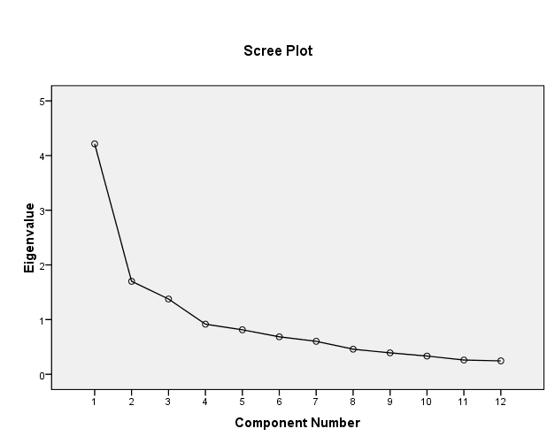
SCREE PLOT
This scree plot shows that the first three factors account for most of the total variability in data (given by the eigenvalues).
The eigenvalues for the first three factors are all greater than 1.

Slide 47
Communalities
 | Initial | Extraction
Yoga/Meditation | 1.000 | 0.8026
Physical exercise | 1.000 | 0.7538
Watching movies | 1.000 | 0.6496
Listening music | 1.000 | 0.6793
Playing Games | 1.000 | 0.5234
Talking to the close friend | 1.000 | 0.5229
Medication | 1.000 | 0.4289
Spending time with family | 1.000 | 0.6501
Sleep | 1.000 | 0.6684
Going for a tour/trip | 1.000 | 0.5171
Going for a walk | 1.000 | 0.4858
Spending time on mobile | 1.000 | 0.5058
Conclusion : Percent of variance extraction for each of the variables is considerably high.

Slide 48
Component Matrix
 | Components
 | 1 | 2 | 3
Yoga/Meditation | .443 | .777
Physical exercise | .516 | .695
Watching movies | .578 |  | .554
Listening music | .702 |  | .403
Playing Games | .551 |  | .457
Talking to the close friend | .656
Medication | .494 | .411
Spending time with family | .581 |  | -.522
Sleep | .642 |  | -.479
Going for a tour/trip | .718
Going for a walk | .697
Spending time on mobile | .441 | -.510
Component matrix :
The higher the absolute value of the loading,
the more the factor contributes to the variable.
We suppressed all loadings less than 0.40.

Slide 49
Rotated Component Matrix
 | Components
 | 1 | 2 | 3
Yoga/Meditation |  |  | .894
Physical exercise |  |  | .853
Medication |  |  | .575
Listening music |  | .771
Playing Games |  | .709
Spending time on mobile |  | .605
Watching movies |  | .793
Spending time with family | .811
Sleep | .816
Going for a tour/trip | .591
Going for a walk | .568
Talking to the close friend | .683
Rotation Method: Varimax

Slide 50
Conclusion :
On the basis of the factor loadings obtained from the rotated component matrix we can classify the coping methods and name the following factors as follows:
SELF RELAXATION METHOD
DISTRACTION METHOD
EMOTIONAL RELIEF
Talking to the close friend
Spending time with family
Sleep
Going for a tour/trip
Going for a walk
Yoga/Meditation
Physical exercise
Medication
Watching movies
Listening music
Playing Games
Spending time on mobile

Slide 51
RELIABILITY OF COPING FACTORS
SELF CARE
EMOTIONAL RELIEF
Cronbach's Alpha | N of Items
.739 | 3
Cronbach's Alpha | N of Items
.801 | 5
DISTRACTION METHOD
Cronbach's Alpha | N of Items
.724 | 4

Slide 52
Factors | Eigen values | % of variance | Cumulative %
EMOTIONAL RELIEF | 4.0532 | 35.119 | 35.119
DISTRACTION METHOD | 1.7222 | 14.171 | 49.29
SELF RELAXATION METHOD | 1.4124 | 11.471 | 60.761
From the eigen values, we can say that emotional relief is the most important coping method for reducing stress.

Slide 53
EMPLOYEE NEEDS AND EXPECTATIONS
These are the most required steps that should be conducted by the organization for the employees in order to reduce stress at working place.

Slide 54
CONCLUSION
The following socio-demographic factors age, job position, working hours, travelling hours and dependent members are significant to stress i.e. they are likely to cause stress.
According to survey, out of the four factors Employment condition is likely to cause stress.
The ill effects of stress on job performance are lack of concentration, can’t complete your work within specific time, low morale and losing patience while dealing with customers or clients.
As claimed by the respondents, the most effective coping methods is Emotional relief.
According to 60% of our data, employees feel that the organization can take more measures to manage stress.
The most effective steps to be conducted by the organization for the employees in order to reduce stress at working place are health club and effective training & development program.

Slide 55
TEAM MEMBERS
AISHWARYA ASHOKAN
ANSHIKA YADAV
AKASH KADGE
SHEETAL GORDE
SURESH KONAR

Slide 56
THANK YOU

