Slide 1
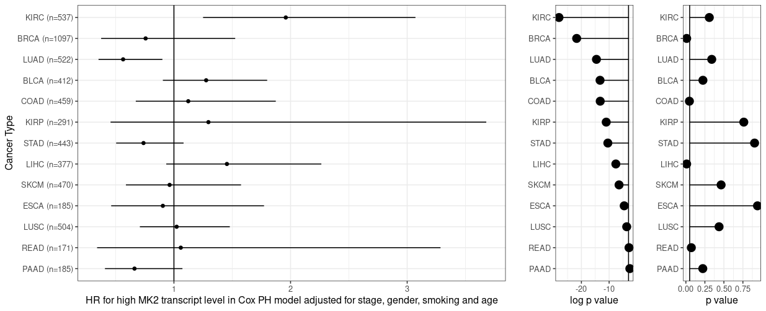
Model results
Model metrics
Model: h(time to death | covariates) ~ high MK2 levelª + cancer stage^{b}+gender+smoking+age
Overall model goodness of fit
MK2 covariate PH violation assumption testing
Better fit
Does not violate PH
Left: Plot showing HR estimates and 95% CI results for a cox proportional hazards modelª assessing the effect of high MK2 expressionª on overall survival at 2 years. Horizontal line represents HR of 1. Right: Lollipop plot showing Cox PH model metrics by cancer type. Horizontal line represents p value of 0.05. Red dots represents results of proportionality hazard testing p value (p > 0.05 represents no violation of PH assumption) and teal dots represent the log p value for goodness of fit (Wald test) for each Cox PH model (p < 0.05 represents significant).
ª MK2_level defined dichotomously as 0: Bottom 2/3rd of log normalized MK2 transcript levels for that cancer type; 1: Top 1/3
^{b} Cancer stage defined as: Early Stage (Stage I, Stage II) vs. late stage (Stage III, Stage IV)

Slide 2
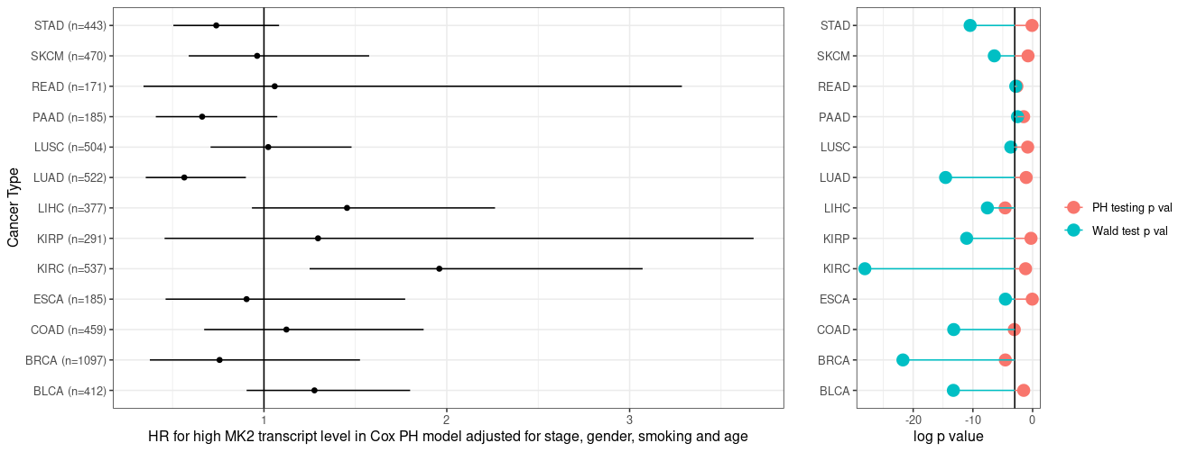
Model results
Model metrics
Model: h(time to death | covariates) ~ high MK2 levelª + cancer stage^{b}+gender+smoking+age
Overall model goodness of fit
MK2_level variable does not violate PH assumption
Left: Plot showing HR estimates and 95% CI results for a cox proportional hazards modelª assessing the effect of high MK2 expressionª on overall survival at 2 years. Horizontal line represents HR of 1. Right: Lollipop plot showing Cox PH model metrics by cancer type. Horizontal line represents p value of 0.05. Red dots represents results of proportionality hazard testing p value (p > 0.05 represents no violation of PH assumption) and teal dots represent the log p value for goodness of fit (Wald test) for each Cox PH model (p < 0.05 represents significant).
ª MK2_level defined dichotomously as 0: Bottom 2/3rd of log normalized MK2 transcript levels for that cancer type; 1: Top 1/3
^{b}
Cancer stage defined as: Early Stage (Stage I, Stage II) vs. late stage (Stage III, Stage IV)

Slide 3
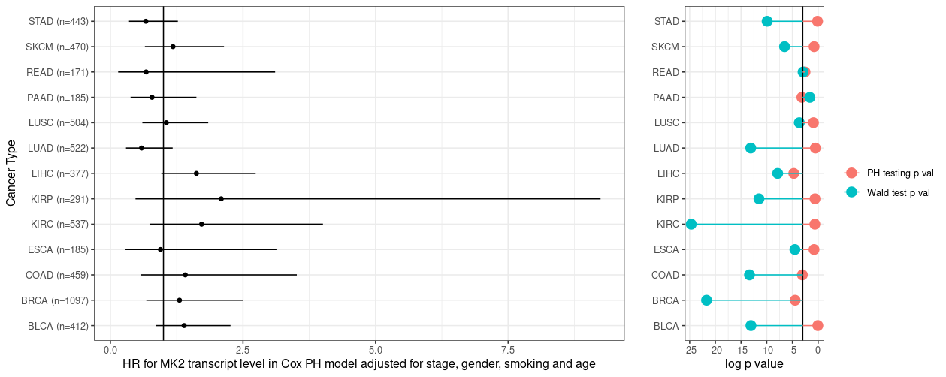
Model results
Model metrics
Model: h(time to death | covariates) ~ log(MK2 transcript level)ª + cancer stage^{b}+gender+smoking+age
Overall model goodness of fit
MK2 transcript level variable does not violate PH assumption
Left: Plot showing HR estimates and 95% CI results for a cox proportional hazards modelª assessing the effect of high MK2 expressionª on overall survival at 2 years. Horizontal line represents HR of 1. Right: Lollipop plot showing Cox PH model metrics by cancer type. Horizontal line represents p value of 0.05. Red dots represents results of proportionality hazard testing p value (p > 0.05 represents no violation of PH assumption) and teal dots represent the wald test p value for each Cox PH model (p < 0.05 represents significant
ª MK2_level defined as a continuous variable, log-transformed
^{b}
Cancer stage defined as: Early Stage (Stage I, Stage II) vs. late stage (Stage III, Stage IV)

Slide 4
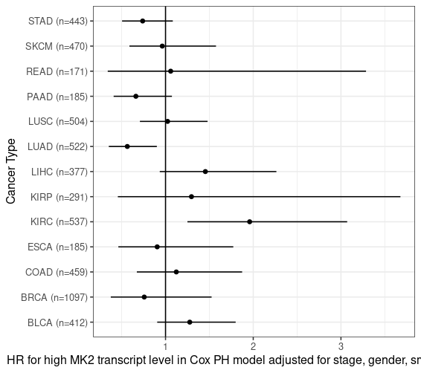
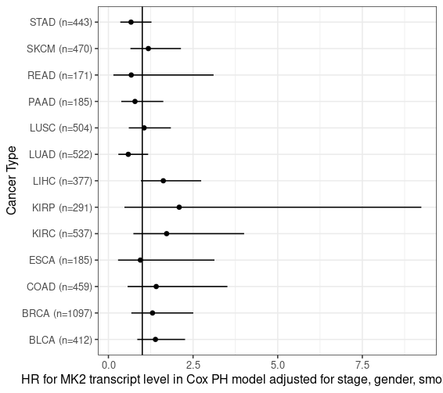
Dichotomous
Continuous

Slide 5
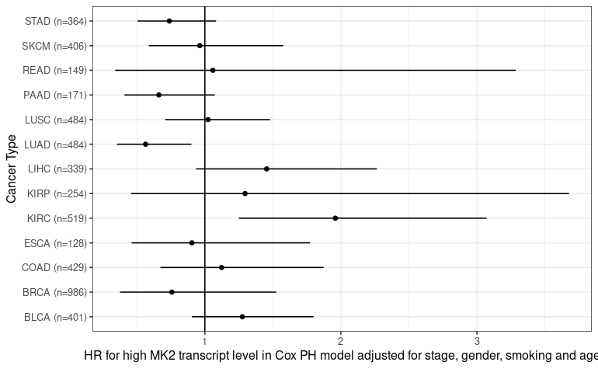
Plot showing HR estimates and 95% CI results for a cox proportional hazards model* assessing the effect of high MK2 expression** on overall survival at 2 years.
* Cox PH model: Death at 2 years ~ MK2_level*+cancer_stage+gender+smoking+age
** MK2_level defined as 0: Bottom 2/3rd of MK2 transcript levels for that cancer type; 1: Top 1/3

Slide 6
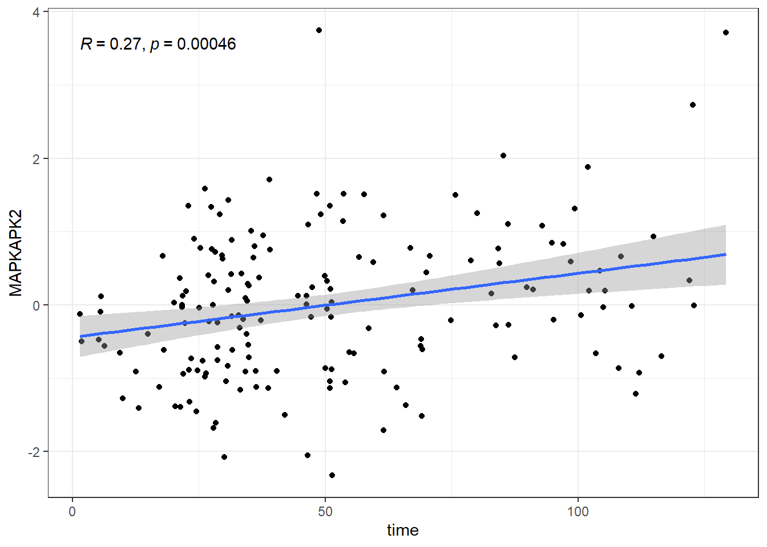
Relationship between MK2 transcript level at time of death across the entire validation cohort

Slide 7
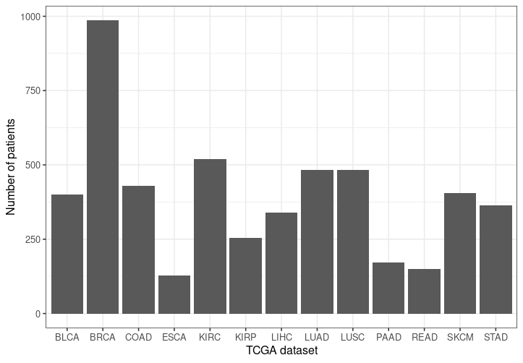

Slide 8
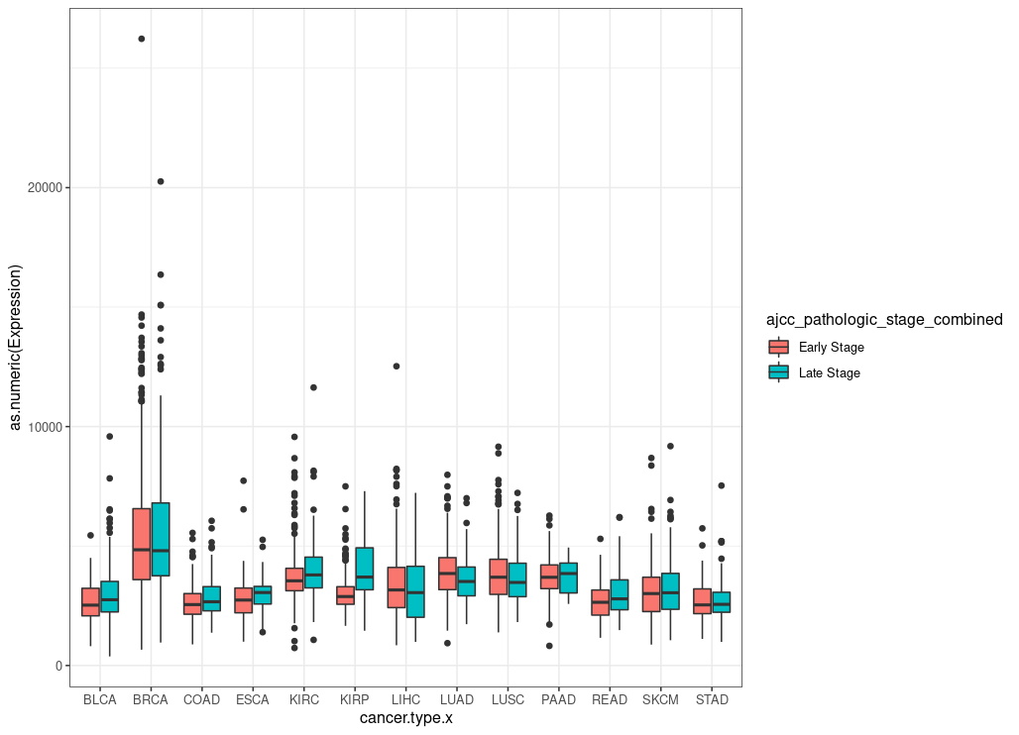

Slide 9
