Slide 1

COURIER MANAGEMENT SYSTEM
DBMS Cornerstone Project
Department of CSE
Team Members:
26B21CS086 Y.J.P.SARADHI
25B11CS272 G.H.D.V.S.SURESH
25B11CS228 D.M.S.P.SIDDHU SRI
25B11CS401 K.BHUVANA HASINI
Academic Year: 2026

Slide 2


Outline Of The Talk
BACKGROUND AND PROBLEM STATEMENT
OBJECTIVES
REQUIREMENT ANALYSIS
END USERS
SYSTEM MODULES
ER DIAGRAM – ENTITIES,KEYS AND RELATIONSHIPS
RELATIONAL SCHEMA
EXPECTED OUTCOME AND ADVANTAGES
CONCLUSION

Slide 3
Background & Problem Statement
Courier companies handle a large number of parcels and customer records every day.
Manual or separate record keeping is time-consuming and can lead to errors and duplicate data.
Customer, booking, delivery, tracking and payment information needs to be organized in one place.
Our system uses a centralized DBMS to store, retrieve and update courier information efficiently.
DBMS Cornerstone Project | Courier Management System

Slide 4
Objectives
Maintain customer information in a structured database.
Manage courier bookings and parcel details.
Store sender, receiver, source and destination information.
Track courier status using a unique Tracking ID.
Manage delivery-agent assignments and delivery updates.
Maintain payment details and payment status.
Reduce manual work and improve data accuracy and consistency.
DBMS Cornerstone Project | Courier Management System 3

Slide 5
Requirement Analysis
Functional Requirements
Non-Functional Requirements
Customer registration and management
Courier booking and parcel entry
Store sender/receiver details
Generate/store Tracking ID
Update shipment status and location
Assign delivery personnel
Record payments and payment status
View basic reports
Security and authorized access
Data accuracy and consistency
Simple and user-friendly interface
Fast data retrieval
Reliable database storage
Easy maintenance and updates
DBMS Cornerstone Project | Courier Management System 4

Slide 6
End Users
Admin — manages customers, couriers, delivery agents, payments and reports.
Courier Staff — registers bookings, enters parcel information and updates status.
Delivery Agent — receives assigned parcels and updates delivery information.
Customer — registers, books a courier, views shipment details and tracks the parcel.
DBMS Cornerstone Project | Courier Management System 5

Slide 7
System Modules
Core Modules
Administrative Functions
Admin Module
Customer and employee management
Courier and payment record management
Basic booking, delivery and pending-shipment reports
Customer Module
Courier Management Module
Delivery Module
Payment Module
DBMS Cornerstone Project | Courier Management System 6

Slide 8
Relational Schema
CUSTOMER
(Customer_ID [PK], Name, Email, Phone, Address)
COURIER
(Courier_ID [PK], Customer_ID [FK], Tracking_ID, Pickup_Address, Delivery_Address, Booking_Date, Weight, Status)
DELIVERY_AGENT
(Agent_ID [PK], Name, Phone, Address, Vehicle_No)
PAYMENT
(Payment_ID [PK], Courier_ID [FK], Amount, Payment_Date, Payment_Method, Payment_Status)
TRACKING
(Tracking_ID [PK], Courier_ID [FK], Location, Status, Updated_date)

Slide 9
Expected Outcome & Advantages
Advantages
Expected Outcome
Centralized courier database
Easy booking and record management
Simple shipment tracking
Accurate customer and payment records
Faster retrieval of information
Less manual work
Reduced data redundancy
Improved consistency
Better organization of records
User-friendly operation
DBMS Cornerstone Project | Courier Management System 12

Slide 10
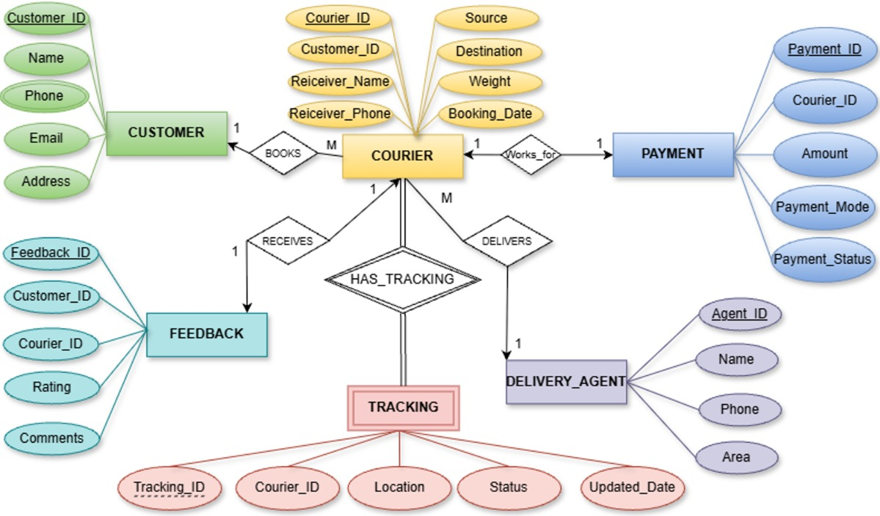
ER Diagram

Slide 11
Entities, Keys & Relationship Justification
Entity 1
Relationships
Entity 2
Cardinality
Meaning
CUSTOMER
Books
Courier
1 : M
One customer can book many couriers.
COURIER
Works_for
Payment
1 : 1
One courier is associated with one payment record.
COURIER
Receives
Feedback
1 : M
One courier receives one feedback record.
COURIER
Has_Tracking
Tracking
1 : 1
One courier can have multiple tracking updates.
Delivery Agent
Delivers
Courier
1 : M
One delivery agent can deliver multiple couriers.
DBMS Cornerstone Project | Courier Management System

Slide 12
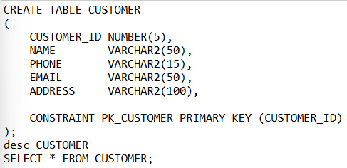
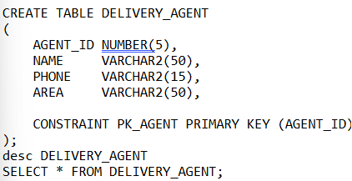
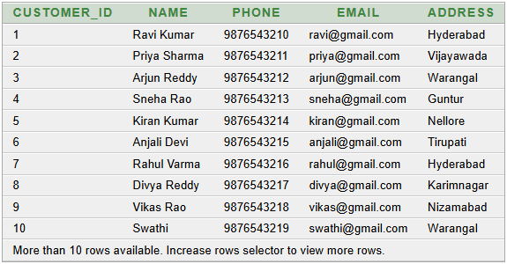
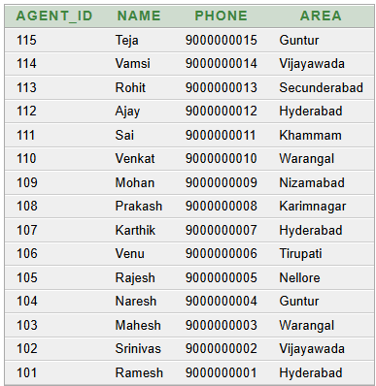
ENTITY SETS TO TABLES
1.CUSTOMER TABLE
2.DELIVERY AGENT TABLE

Slide 13
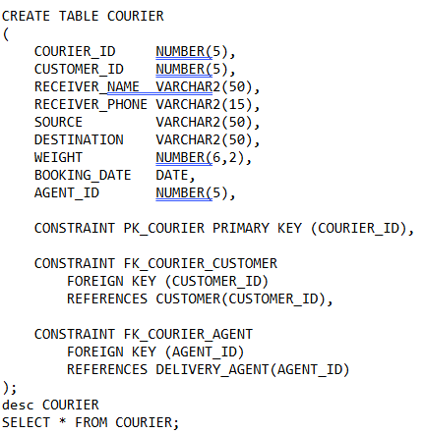
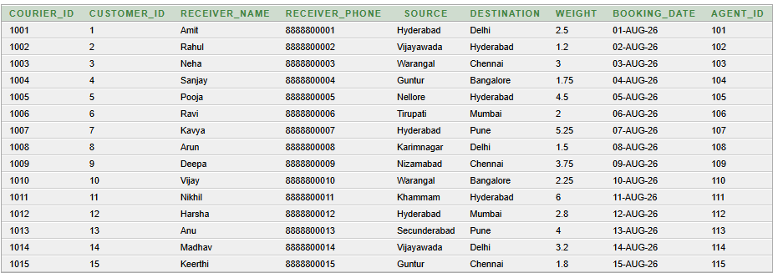
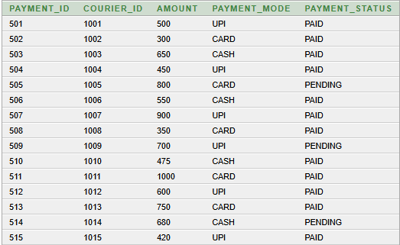
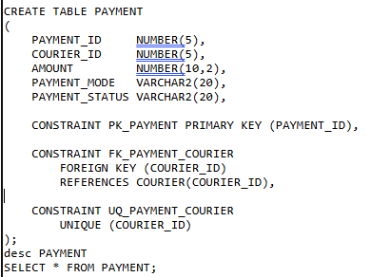
3. COURIER TABLE
4.PAYMENT TABLE

Slide 14
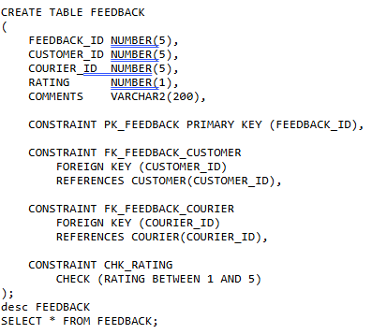
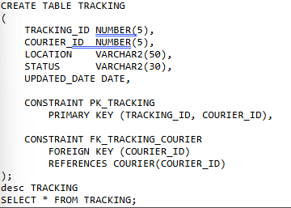
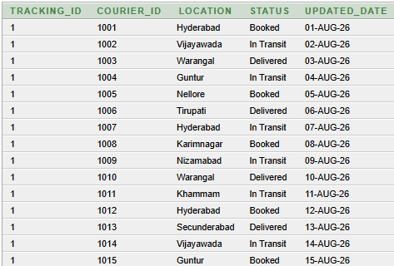
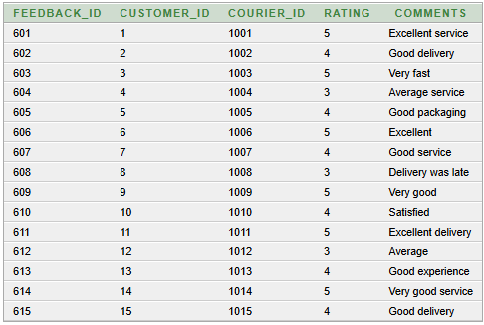
5.FEEDBACK TABLE
6.TRACKING TABLE

Slide 15
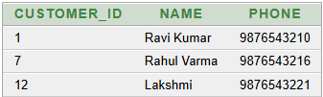
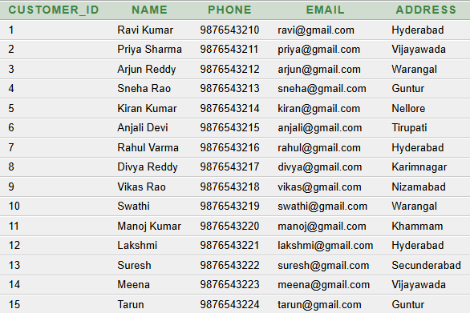
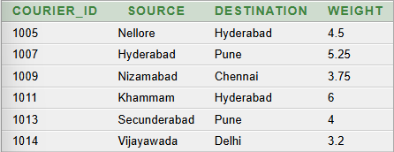
QUERIES
1. Display all customer details
2. Find all customers whose address is Hyderabad
SELECT CUSTOMER_ID, NAME, PHONE
FROM CUSTOMER
WHERE ADDRESS = 'Hyderabad';
SELECT *FROM CUSTOMER;
3. Display couriers weighing more than 3 kg
SELECT COURIER_ID, SOURCE, DESTINATION, WEIGHT
FROM COURIER
WHERE WEIGHT > 3;

Slide 16
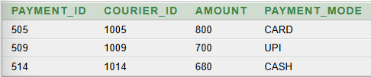
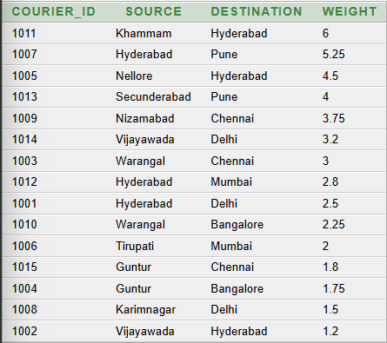
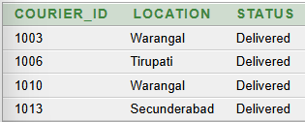
4. Display all pending payments
SELECT PAYMENT_ID, COURIER_ID, AMOUNT, PAYMENT_MODE
FROM PAYMENT
WHERE PAYMENT_STATUS = 'PENDING';
5. Display couriers in descending order of weight
SELECT COURIER_ID, SOURCE, DESTINATION, WEIGHT
FROM COURIER
ORDER BY WEIGHT DESC;
6. Display all delivered couriers
SELECT COURIER_ID, LOCATION, STATUS
FROM TRACKING
WHERE STATUS = 'Delivered';

Slide 17

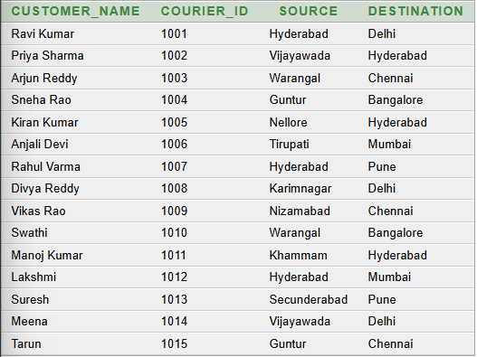

7. Find the total number of couriers
8. Display customer name along with courier details
SELECT COUNT(*) AS TOTAL_COURIERS
FROM COURIER;
SELECT C.NAME AS CUSTOMER_NAME,
CR.COURIER_ID,
CR.SOURCE,
CR.DESTINATION
FROM CUSTOMER C
JOIN COURIER CR
ON C.CUSTOMER_ID = CR.CUSTOMER_ID;
9. Count couriers according to tracking status
SELECT STATUS,
COUNT(*) AS TOTAL_COURIERS
FROM TRACKING
GROUP BY STATUS;

Slide 18
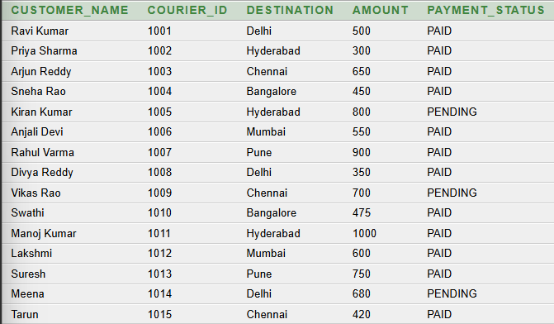
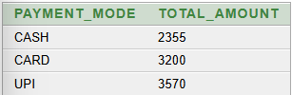
10.Display customer, courier and payment details
SELECT C.NAME AS CUSTOMER_NAME,
CR.COURIER_ID,
CR.DESTINATION,
P.AMOUNT,
P.PAYMENT_STATUS
FROM CUSTOMER C
JOIN COURIER CR
ON C.CUSTOMER_ID = CR.CUSTOMER_ID
JOIN PAYMENT P
ON CR.COURIER_ID = P.COURIER_ID;
11. Find total payment amount for each payment mode
SELECT PAYMENT_MODE,
SUM(AMOUNT) AS TOTAL_AMOUNT
FROM PAYMENT
GROUP BY PAYMENT_MODE;

Slide 19
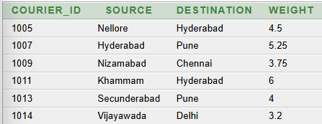
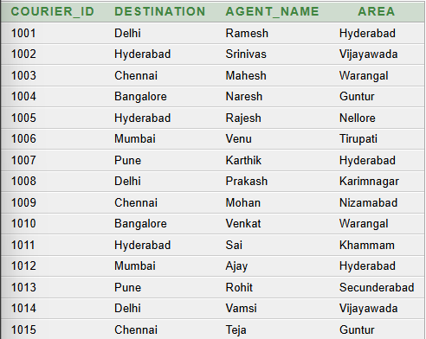

12. Find couriers whose weight is greater than average weight
13. Display courier and delivery agent details
SELECT CR.COURIER_ID,
CR.DESTINATION,
A.NAME AS AGENT_NAME,
A.AREA
FROM COURIER CR
JOIN DELIVERY_AGENT A
ON CR.AGENT_ID = A.AGENT_ID;
SELECT COURIER_ID,
SOURCE,
DESTINATION,
WEIGHT
FROM COURIER
WHERE WEIGHT > (
SELECT AVG(WEIGHT)
FROM COURIER
);
14. Find delivery agents handling more than one courier
SELECT A.AGENT_ID,
A.NAME,
COUNT(CR.COURIER_ID) AS TOTAL_COURIERS
FROM DELIVERY_AGENT A
JOIN COURIER CR
ON A.AGENT_ID = CR.AGENT_ID
GROUP BY A.AGENT_ID, A.NAME
HAVING COUNT(CR.COURIER_ID) > 1;

Slide 20
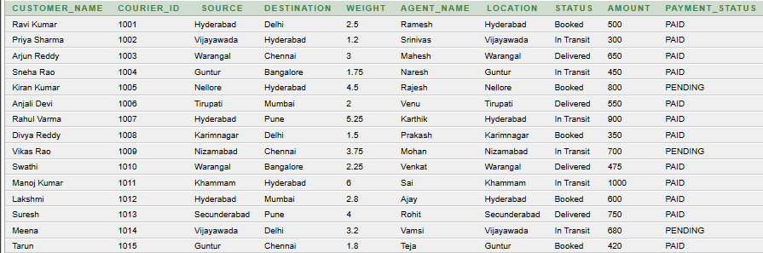
15. Display complete courier information
SELECT C.NAME AS CUSTOMER_NAME,
CR.COURIER_ID,
CR.SOURCE,
CR.DESTINATION,
CR.WEIGHT,
A.NAME AS AGENT_NAME,
T.LOCATION,
T.STATUS,
P.AMOUNT,
P.PAYMENT_STATUS
FROM CUSTOMER C
JOIN COURIER CR
ON C.CUSTOMER_ID = CR.CUSTOMER_ID
JOIN DELIVERY_AGENT A
ON CR.AGENT_ID = A.AGENT_ID
JOIN TRACKING T
ON CR.COURIER_ID = T.COURIER_ID
JOIN PAYMENT P
ON CR.COURIER_ID = P.COURIER_ID;

Slide 21
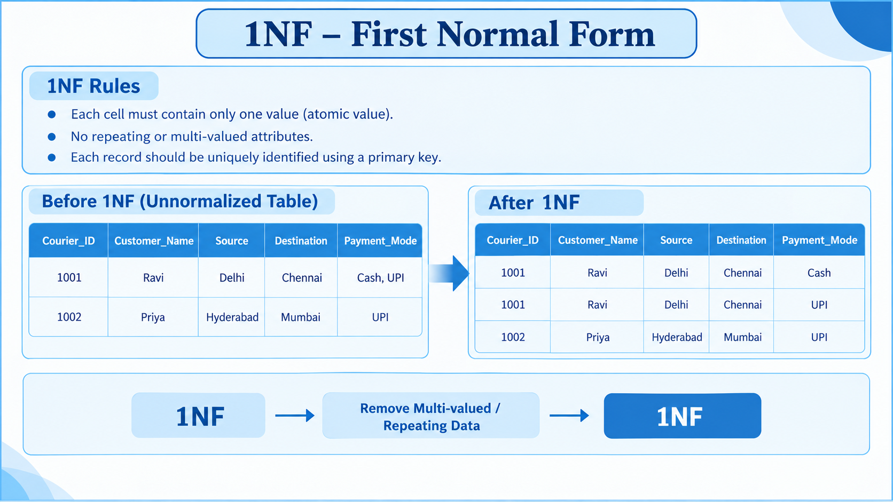

Slide 22
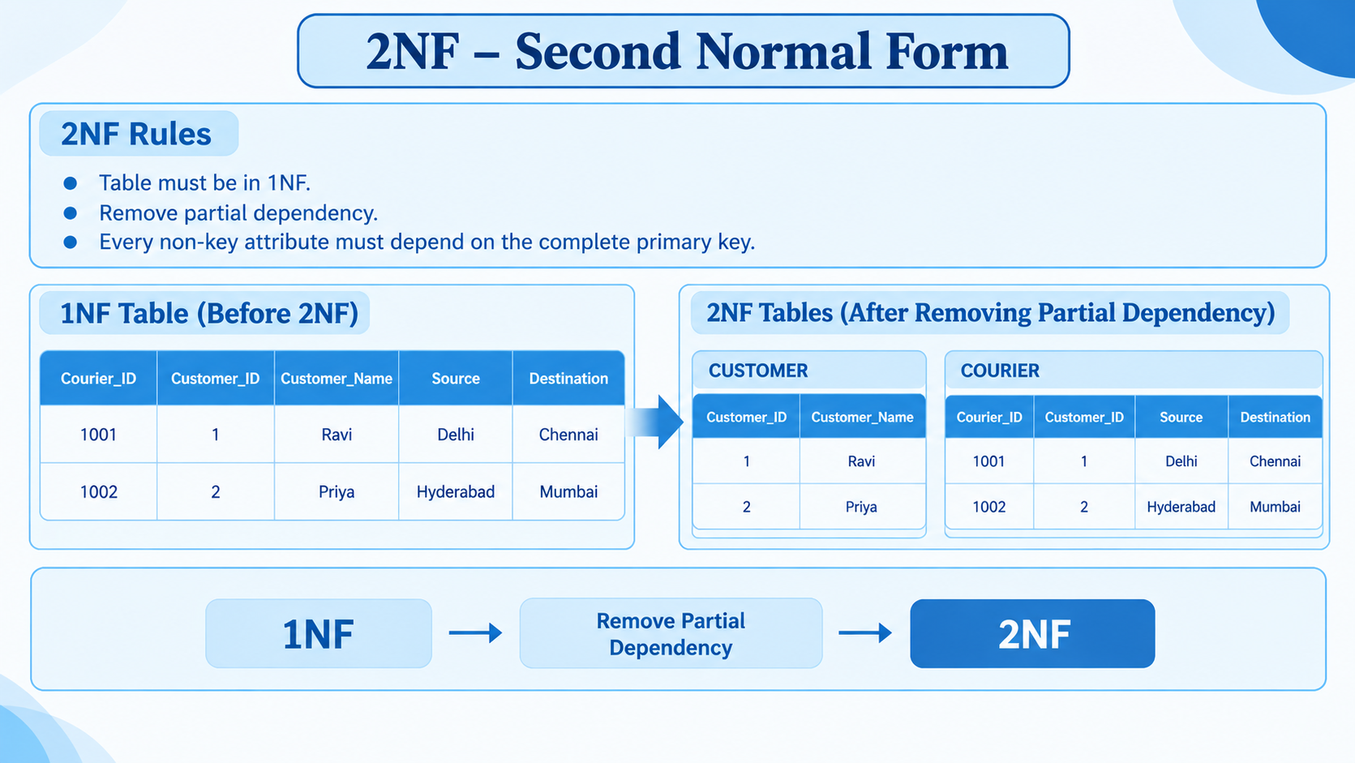

Slide 23
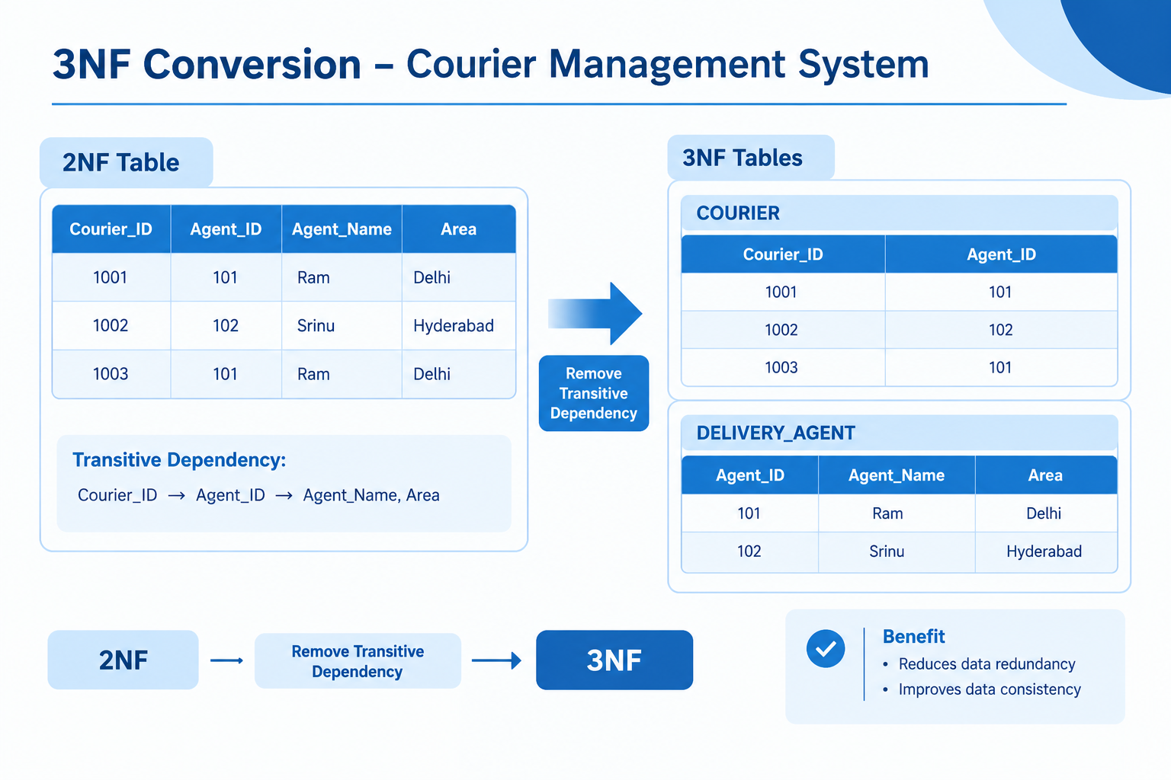

Slide 24
Conclusion
The Courier Management System provides a simple DBMS-based solution for managing courier operations.
It integrates customer, courier, delivery, tracking and payment information in one database.
Authorized access improves security of customer and payment information.
SQL supports retrieval, insertion, deletion and modification of courier records.
The ER design clearly represents entities, keys, relationships and cardinalities.
The project demonstrates practical DBMS concepts including relational design, SQL and data integrity.
Future work can include online notifications, route optimization and advanced reporting.
DBMS Cornerstone Project | Courier Management System 13

Slide 25
THANK YOU

