Slide 1
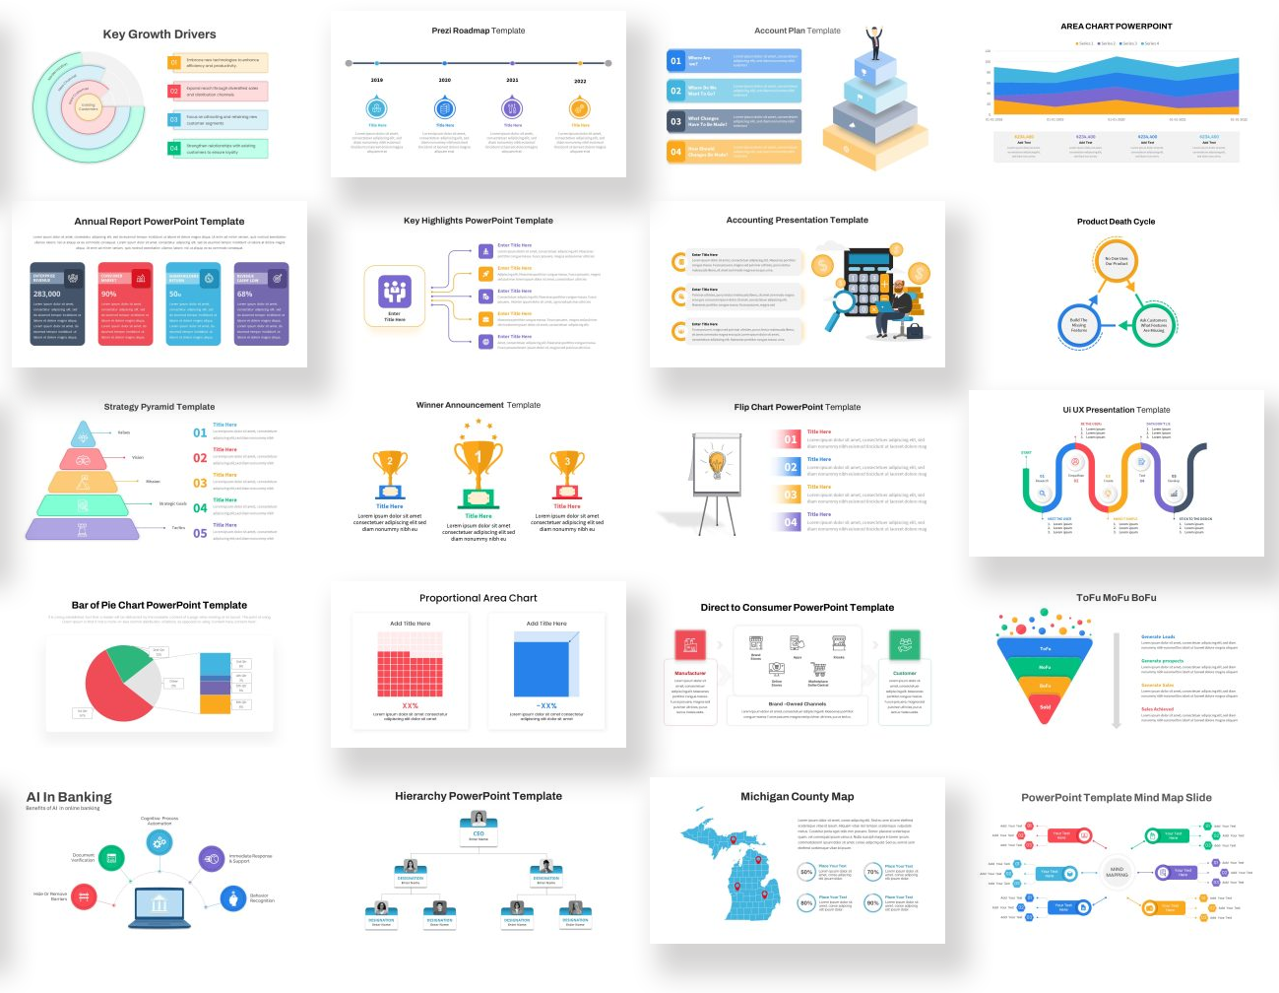

Never Get Stuck on a Blank Slide Again!
Check out SlideBazaar.com to access thousands of PowerPoint themes, templates and useful resources for your next presentation!

Slide 2
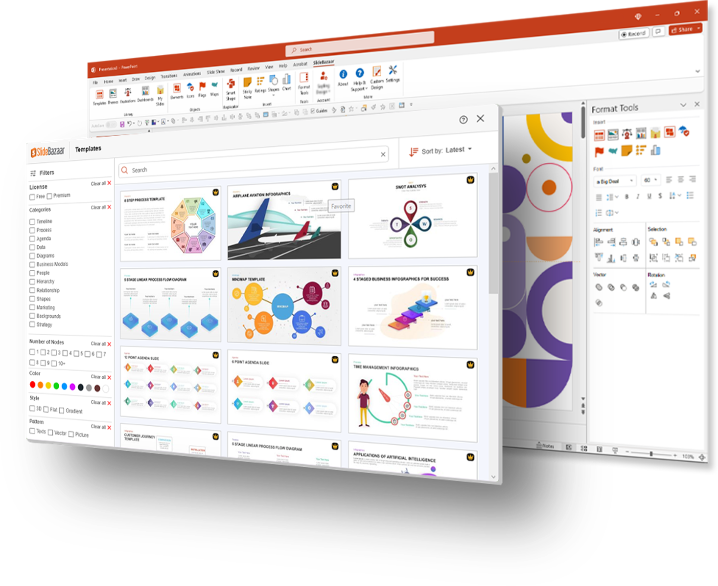
Now Get
SlideBazaar Inside
PowerPoint!
Design Slides 2x faster with SlideBazaar's new Add-in; featuring AI-powered capabilities, templates, shape-builder and a whole lot more!
Download for Free

Slide 3
DA Billing Roadmap 2026
Static Setups / Data Ingestion
Invoice Generation / Payments
UAT / Release Prep
5th JAN
16th FEB
27th APR
25th MAY
6th JUL
24th JUL
Fee Calculation
Receivable Managements
PROD deployment

Slide 4
Timeline Infographics
Consequat
Dolor Sit
Consectetur
Sed ut unde perspiciatis iste
Natus error sit totam ccusantium
Eaque ipsa quae ab illo inventore
2018
2019
2020
2021
2022
2023
Adipiscing
Eiusmod Sed
Tempor Elit
inventore veritatis vitae et quasi
Nemo enim ipsam voluptatem quia
voluptas aut odit aspernatur aut

Slide 5


