Slide 1
Spring Framework
Spring Introduction
Spring EcoSystem
Spring Modules
Creating SpringApplication

Slide 2
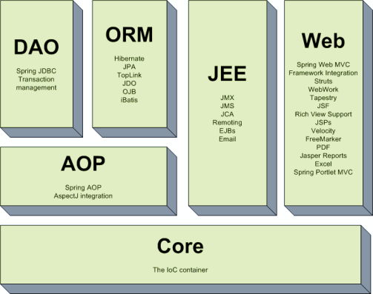
Spring Modules

Slide 3
Spring Core Module
Beans
Core
Context
SpEl

Slide 4
Spring First Application
1 . JDK 1.7 or JDK1.8
2 . Spring Core Module Jars
3 . Eclipse

