Slide 1

CC ANALYTICS
Credit Card Portfolio Analytics
DAX Measures for Power BI — Utilization, Growth, Retention & Delinquency Risk
Prepared by Suresh Deuja · Data Analytics Portfolio · 2026

Slide 2




OVERVIEW
What This Report Covers
15 DAX-driven measures grouped into four analytical themes, built for a client-level credit card dataset in Power BI.
Transaction Trends
Problems 1–4
Running totals, moving averages, MoM/WoW growth and acquisition cost ratio
Utilization & Revenue
Problems 5–8
Utilization ratios, interest yield, top clients and high-usage flags
Risk & Retention
Problems 9–12
Churn detection, delinquency rate, composite risk score and correlation
Segmentation Insights
Problems 13–15
Satisfaction by card tier, loan behaviour and a combined high-risk flag
02

Slide 3

DATA MODEL
Assumptions Behind the Measures
Assumed tables
Formatting convention
CC — the client-level fact/dimension table: CLIENTNUM, creditLimit, Income, Avg_Utilization_Ratio, Total_Revolving_Bal, Total_Trans_Amt, Interest_Earned, Delinquent_Acc, Card_Category, Personal_loan, Cust_Satisfaction_Score.
Date — a standard CALENDAR() date table, marked as the active date table and related to a transaction-date column, needed for the running total, moving average, MoM/WoW growth and churn measures.
Acquisition_Cost — assumed present for the CAC measure; substitute your actual cost field if named differently.
Ratios use Power BI's built-in Percentage format directly on the measure, so DIVIDE results stay as decimals (0–1) and display with the % symbol — no manual ×100 needed. The Credit Risk Score (a 0–100 point score, not a ratio) is the one exception and keeps its ×100 scaling with Decimal Number formatting.
If the source file is a single client-level snapshot (no transaction dates), treat measures 1, 2, 3 and 9 as the standard time-intelligence pattern to apply once a dated fact table is loaded.
03

Slide 4
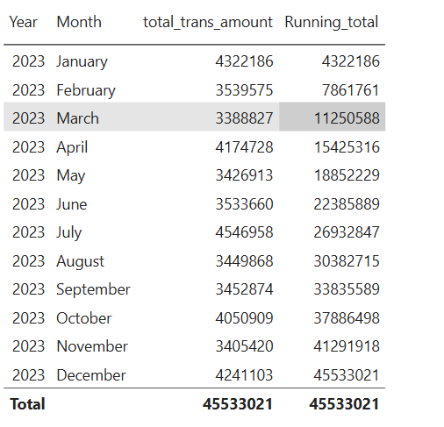
TRANSACTION TRENDS · PROBLEM 1
Running Total of Credit Card Transactions
CONCEPT
DAX
A cumulative sum of transaction amount up to the current date in context — each point on the trend shows everything spent so far, not just that period.
Running_total = CALCULATE([total_trans_amount],
FILTER(ALL(Calender[Date]),Calender[Date]
<=MAX(Calender[Date])))
BUSINESS READ
Plot on a line chart by date to reveal acceleration or plateaus in overall spend.
04

Slide 5

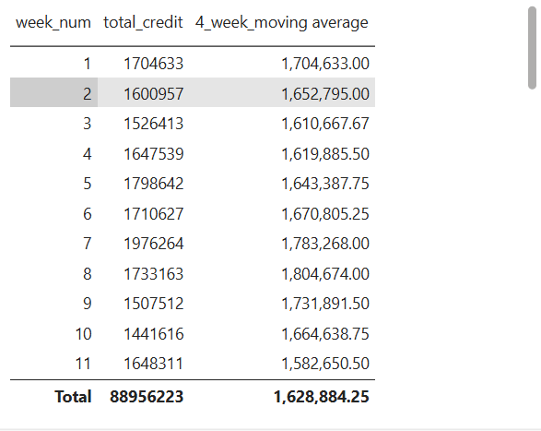
TRANSACTION TRENDS · PROBLEM 2
4-Week Moving Average of Credit Limit
CONCEPT
DAX
Smooths short-term noise by averaging creditLimit over the trailing 28 days for each client, so limit-policy trends read clearly.
4_week_moving average =
var time_period=FILTER(ALL(Calender),Calender[week_num]>=MAX
(Calender[week_num])-3 && Calender[week_num]<=MAX(Calender[week_num]))
var rev_per_period=CALCULATE(SUM(credit_card[Credit_Limit]),time_period)
var week_time_period= CALCULATE(DISTINCTCOUNT(Calender[week_num]),time_period)
RETURN DIVIDE(rev_per_period,week_time_period,0)
BUSINESS READ
A widening gap between the raw value and this average signals a recent limit change.
05

Slide 6

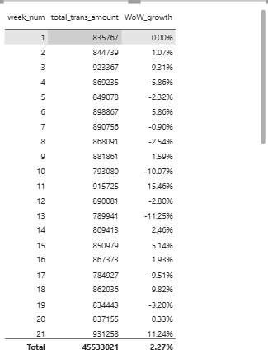
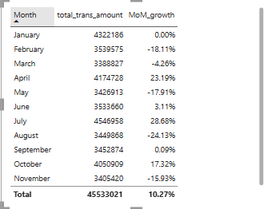
TRANSACTION TRENDS · PROBLEM 3
MoM % and WoW % Growth on Transaction Amount
CONCEPT
Compares current transaction amount against the same measure one month, and one week, earlier — the two standard growth-rate lenses.
DAX
MoM % Growth =
var MoM_pre=CALCULATE([total_trans_amount],
DATEADD(Calender[Date],-1,MONTH))
RETURN DIVIDE([total_trans_amount]-MoM_pre,MoM_pre,0)
DAX
WOW % Growth =
var pre_week=CALCULATE([total_trans_amount],DATEADD(Calender[Date],-7,DAY))
RETURN DIVIDE([total_trans_amount]-pre_week,pre_week,0)
BUSINESS READ
Use WoW for operational alerts and MoM for board-level trend reporting.
06

Slide 7

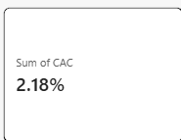
TRANSACTION TRENDS · PROBLEM 4
Customer Acquisition Cost as a Ratio of Transaction Amount
CONCEPT
DAX
Expresses what was spent to acquire clients as a percentage of the transaction revenue those clients generate — an efficiency check on acquisition spend.
CAC to Trans Amt % =
DIVIDE(SUM(credit_card[Customer_Acq_Cost]),[total_trans_amount])
BUSINESS READ
A rising ratio over time means acquisition spend is outpacing the revenue it produces.
07

Slide 8

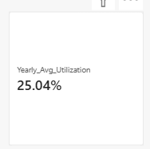
UTILIZATION & REVENUE · PROBLEM 5
Yearly Average of Avg_Utilization_Ratio
CONCEPT
DAX
Rolls up every client’s utilization ratio into one portfolio-level figure per year, the headline number for overall credit-line usage.
Yearly Avg Utilization =
CALCULATE (
AVERAGE ( credit_card[Avg_Utilization_Ratio] ),
ALLEXCEPT ( credit_card, credit_card[current_year] )
)
BUSINESS READ
Trend this by year to spot whether the book is drifting toward heavier utilization.
08

Slide 9
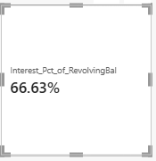
UTILIZATION & REVENUE · PROBLEM 6
Interest Earned as a % of Total Revolving Balance
CONCEPT
DAX
Shows how much interest yield is being generated per client relative to the balance they are carrying — a proxy for revolving-book profitability.
Interest % of Revolving Bal =
DIVIDE(SUM(credit_card[Interest_Earned]),SUM(credit_card[Total_Revolving_Bal]))
BUSINESS READ
Compare this against the delinquency rate for the same client — high yield with high delinquency is a red flag, not a win.
09

Slide 10

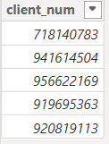
UTILIZATION & REVENUE · PROBLEM 7
Top 5 Clients by Total Transaction Amount
CONCEPT
DAX
Ranks clients dynamically within whatever filter context is active, so the leaderboard updates as the user slices the report.
Top 5 Trans Amt =
SELECTCOLUMNS(
TOPN(5,
SUMMARIZE(credit_card,credit_card[Client_Num],
"total_transt",SUM(credit_card[Total_Trans_Amt])),
[total_transt],DESC),"client_num",credit_card
[Client_Num])
BUSINESS READ
Pair with RANKX as a visual-level filter to build a self-updating Top 5 table.
10

Slide 11

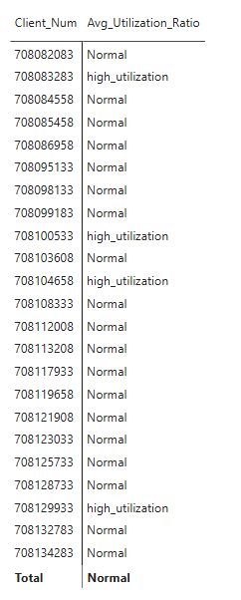
UTILIZATION & REVENUE · PROBLEM 8
Clients Whose Avg_Utilization_Ratio Exceeds 80%
CONCEPT
DAX
Counts and isolates the clients running their credit lines hot — the pool most likely to need a limit review or proactive outreach.
High Utilization Clients =
IF( AVERAGE(credit_card[Avg_Utilization_Ratio])>0.8,"high_utilization","Normal")
BUSINESS READ
Feed this count into a card visual alongside the total client count for an instant exposure ratio.
11

Slide 12

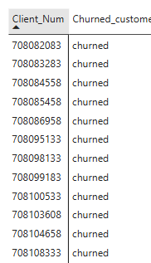
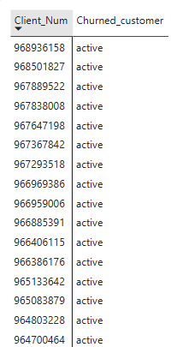
RISK & RETENTION · PROBLEM 9
Customer Churn Indicator
CONCEPT
DAX
Flags any client with zero transaction amount across the trailing six months — a simple, fast proxy for disengagement.
Churn Flag =
var client_last_date=MAX(credit_card[Week_Start_Date])
VAR dataset_last_date= CALCULATE(MAX(credit_card[Week_Start_Date]),ALL(credit_card))
RETURN IF(DATEDIFF(client_last_date,dataset_last_date,DAY)>180,"churned","active")
BUSINESS READ
Surface this as a KPI tile so retention teams can prioritise outreach before an account lapses further.
12

Slide 13

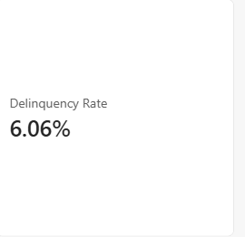
RISK & RETENTION · PROBLEM 10
Delinquency Rate
CONCEPT
DAX
The share of the client base carrying at least one delinquent account — the single most-watched credit-quality metric.
Delinquency Rate % =
var total_customer=DISTINCTCOUNT(credit_card[Client_Num])
var delinquency=CALCULATE(DISTINCTCOUNT(credit_card[Client_Num]),FILTER(credit_card,credit_card
[Delinquent_Acc]>0))
RETURN DIVIDE(delinquency,total_customer,0)
BUSINESS READ
Break this out by Card_Category to see whether risk concentrates in a specific tier.
13

Slide 14
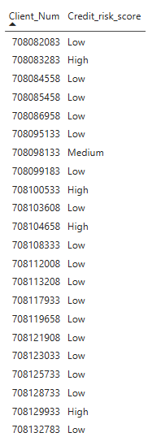
RISK & RETENTION · PROBLEM 11
Credit Risk Score
DAX
CONCEPT
Credit Risk Score =
var avg_utilization=AVERAGE(credit_card[Avg_Utilization_Ratio])*50
var Delinquent_Acc=AVERAGE(credit_card[Delinquent_Acc])*15
var revolv_ratio=DIVIDE(AVERAGE(credit_card[Total_Revolving_Bal]),
AVERAGE(credit_card[Credit_Limit]))
var revolv_score=revolv_ratio*35
var summ= avg_utilization+Delinquent_Acc+revolv_score
VAR score = summ
RETURN
SWITCH (
TRUE (),
score < 30, "Low",
score < 60, "Medium",
"High"
)
A weighted composite of utilization, delinquency and revolving balance, so each client gets one comparable 0–100 risk figure instead of three separate ones.
BUSINESS READ
Weights (40/35/25) are a starting point — recalibrate them once you can validate the score against actual write-offs.
14

Slide 15

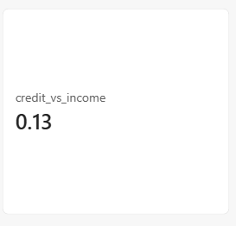
RISK & RETENTION · PROBLEM 12
Income vs Credit Limit Correlation
DAX
Income-CreditLimit Correlation =
var client_table = SUMMARIZE(credit_card,credit_card[Client_Num],"average_income",AVERAGE(customer[Income])
,"average_credit",AVERAGE(credit_card[Credit_Limit]))
var N=COUNTROWS(client_table)
var Xsum=SUMX(client_table,[average_income])
var Ysum=SUMX(client_table,[average_credit])
var XYsum=SUMX(client_table,[average_credit]*[average_income])
VAR Xsum2=SUMX(client_table,[average_income]^2)
var Ysum2=SUMX(client_table,[average_credit]^2)
var numerator=(n*XYsum)-(Xsum*Ysum)
var denomerator=SQRT(((n*Xsum2)-(Xsum^2))*
((n*Ysum2)-(Ysum^2)))
RETURN DIVIDE( numerator,denomerator,0)
CONCEPT
DAX has no built-in CORREL, so the Pearson coefficient is built by hand from its five summed components across all clients.
BUSINESS READ
A coefficient near 1 supports income-based limit setting; near 0 suggests other factors drive limit decisions.
15

Slide 16
SEGMENTATION INSIGHTS · PROBLEM 13
Average Customer Satisfaction Score by Card Category
CONCEPT
DAX
One reusable measure that recalculates automatically for whichever Card_Category the visual is sliced by.
Avg Satisfaction Score =
AVERAGE(CC[Cust_Satisfaction_Score])
BUSINESS READ
Place on a clustered bar by Card_Category — a satisfaction gap between tiers usually points to a benefits or service issue.
16

Slide 17

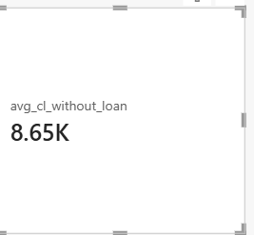

SEGMENTATION INSIGHTS · PROBLEM 14
Loan Approval vs Credit Limit
CONCEPT
DAX
Splits average credit limit between clients who hold a personal loan and those who don’t, to see whether loan status tracks with limit size.
Avg CL - With Loan =
CALCULATE(
AVERAGE(CC[creditLimit]),
CC[Personal_loan] = "Yes"
)
Avg CL - No Loan =
CALCULATE(
AVERAGE(CC[creditLimit]),
CC[Personal_loan] = "No"
)
BUSINESS READ
A wide gap suggests credit limit is a meaningful input — or an output — of the loan approval decision.
17

Slide 18

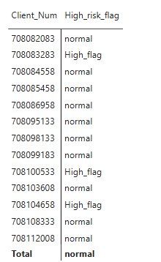
SEGMENTATION INSIGHTS · PROBLEM 15
High Risk Clients Flag
CONCEPT
DAX
Combines two conditions — revolving balance above 90% of the limit, and utilization above 80% — into a single actionable flag.
High Risk Flag =
var revolvingratio=DIVIDE(AVERAGE(credit_card[Total_Revolving_Bal]),
AVERAGE(credit_card[Credit_Limit]),0)
var utilization_ratio= AVERAGE(credit_card[Avg_Utilization_Ratio])
RETURN if(revolvingratio<0.9 && utilization_ratio>0.7,"High_flag","normal")
BUSINESS READ
This is the tightest of the three risk lenses — use it to prioritise the shortlist for manual review.
18

Slide 19

KEY TAKEAWAYS
How These Measures Work Together
01
Growth measures (1–4) tell you if the portfolio is expanding — utilization and revenue measures (5–8) tell you at what cost.
02
Churn and delinquency (9–10) catch clients drifting away; the risk score and correlation (11–12) explain why.
03
High-utilization, high-risk-flag and loan-vs-limit views (8, 14, 15) triangulate the same clients from three angles — use them together, not alone.
04
Satisfaction by card tier (13) turns a risk-focused report into a retention one — pair it with the churn flag before acting.
19

Slide 20

Thank You
Credit Card Portfolio Analytics — DAX Measures for Power BI
Suresh Deuja
linkedin.com/in/suresh-deuja-209305391

