Slide 1
TATA POWER
EV Charging Infrastructure Analysis
Performance, Profitability & Expansion Strategy
Bengaluru District Analysis | Aug – Nov 2024
5 Datasets • 114,000 Sessions • 65 Stations • 8,000 Customers • 98 ROI Projects
Data Analytics Report | Milestone Project 1

Slide 2
Executive Summary
Network Scale
65 stations across 18 districts serving 8,000 customers with 390 charging plugs. 114,000 sessions generated ₹497 Lakh revenue over 3 months.
Critical Gap
677-plug shortfall across the network. Jayanagar (79), Rajajinagar (73), and HSR Layout (70) are the most stressed districts needing immediate capacity expansion.
Investment Opportunity
54 High-priority projects with avg 2.8yr payback and 93% ROI. AC Level-2 chargers dominate returns. DC Ultra-Fast (150kW) shows ~10yr payback — not viable in 5yr horizon.
Customer Insight
All income tiers charge equally often (~14 sessions/customer). Revenue gap driven by energy per visit, not frequency. Low-Mid is the largest segment (3,990) but lowest revenue/customer (₹4,109).

Slide 3
Data Overview
5 interconnected datasets forming a complete view of the EV charging ecosystem
Charging Sessions
Session-level data with timestamps, energy, cost, station and customer IDs
114,000 rows
Charging Stations
Station details: location, district, operator, plug count across 18 districts
65 stations
Customers
Customer profiles: income tier, car model, battery capacity
8,000 customers
Districts
District-level projections: projected EVs, projected plugs, income tier
18 districts
ROI Bengaluru
Financial analysis: CAPEX, revenue, EBITDA, payback, 5yr ROI, priority tier
98 projects

Slide 4
Methodology & Tools
01
Data Loading
Imported 5 CSV files into Excel via Power Query. Validated all 114,000+ rows — zero missing values confirmed.
02
Data Modelling
Built relationships in Power Pivot Data Model: sessions→stations, sessions→customers, stations→districts. Created DAX measures.
03
Analysis
26 DAX measures created covering sessions, revenue, energy, utilization, customer metrics, and ROI calculations.
04
Visualization
15 PivotCharts across 4 interactive dashboard pages with slicers for month, income tier, priority, and charger type filtering.
05
Validation
Verified all dictionary formula claims (CAPEX, EBITDA, payback, ROI). Cross-checked join integrity across all tables.

Slide 5
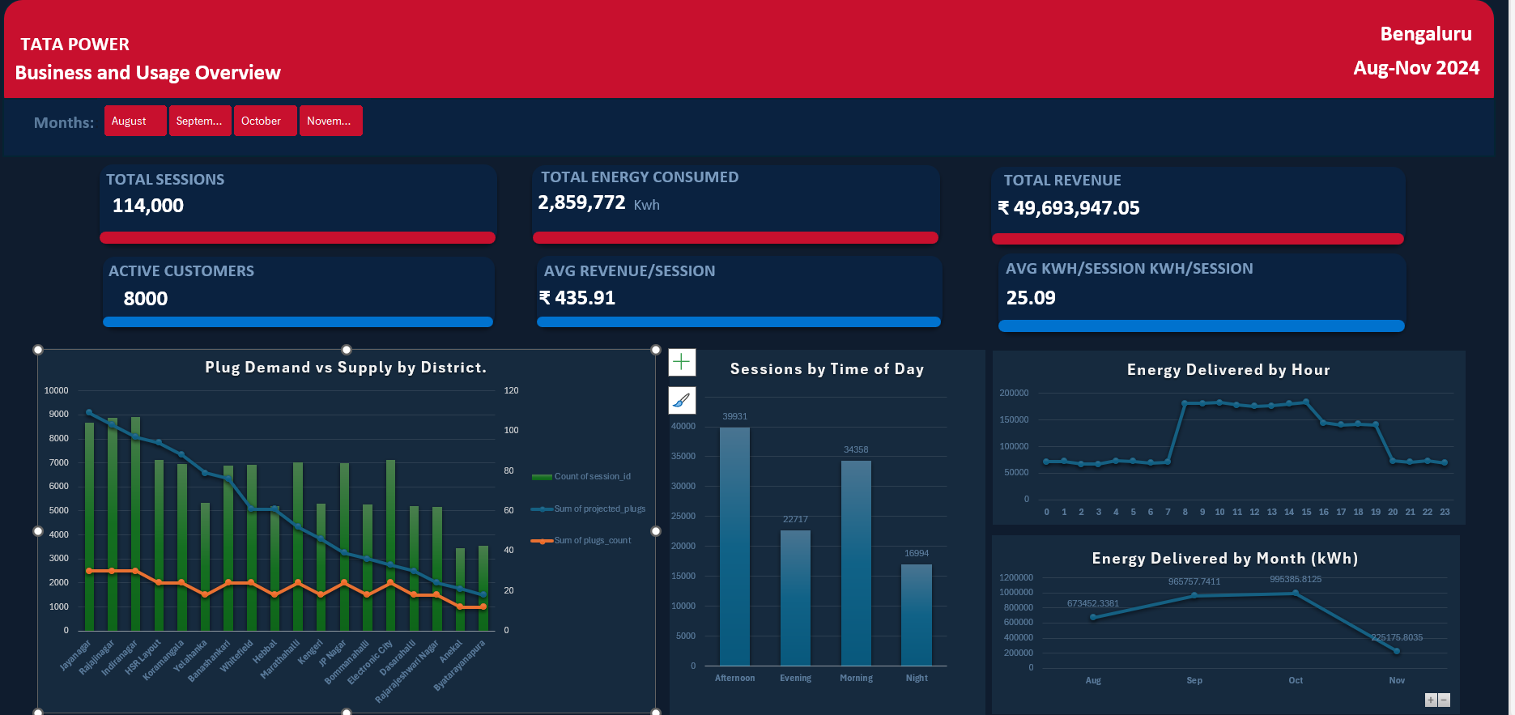
Page 1: Business and Usage Overview

Slide 6
Page 1 — Key Findings
TOTAL SESSIONS
TOTAL ENERGY
TOTAL REVENUE
114,000
2,859,772 kWh
₹497 Lakh
ACTIVE CUSTOMERS
AVG REV/SESSION
AVG KWH/SESSION
8,000
₹435.91
25.09
Questions Answered:
Demand grew 48% from Aug to Oct (673K → 995K kWh). Nov is partial data (to 8th), not a decline.
677-plug shortfall across the network — stations cannot handle projected demand.
Afternoon (39,931) and Morning (34,358) are peak charging windows — 65% of daily load.
Tata Power holds ~20% market share with 13 of 65 stations.

Slide 7
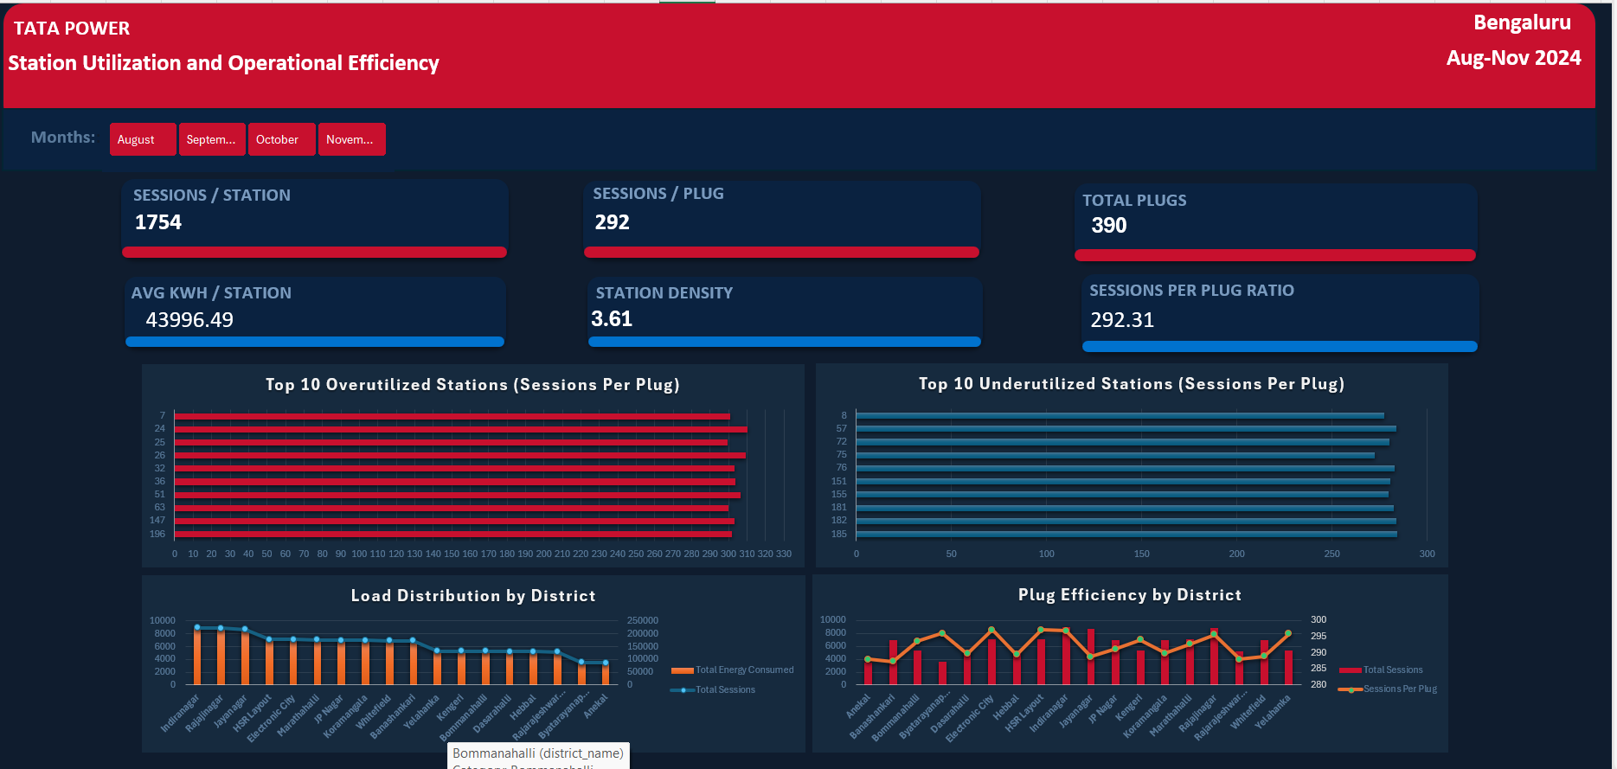
Page 2: Station Utilization and Operational Efficiency

Slide 8
Page 2 — Key Findings
SESSIONS/STATION
SESSIONS/PLUG
TOTAL PLUGS
1,754
292
390
AVG KWH/STATION
STATION DENSITY
TOTAL STATIONS
43,996
3.61/district
65
Questions Answered:
Top 10 overutilized stations identified — need capacity expansion (stations 7, 24, 51 lead).
Top 10 underutilized stations identified — need operational improvement (stations 8, 57, 72).
Indiranagar, Rajajinagar, Jayanagar carry heaviest load across the network.
plugs_count is uniform (6) per station — variation reflects session volume, not actual plug differences.

Slide 9
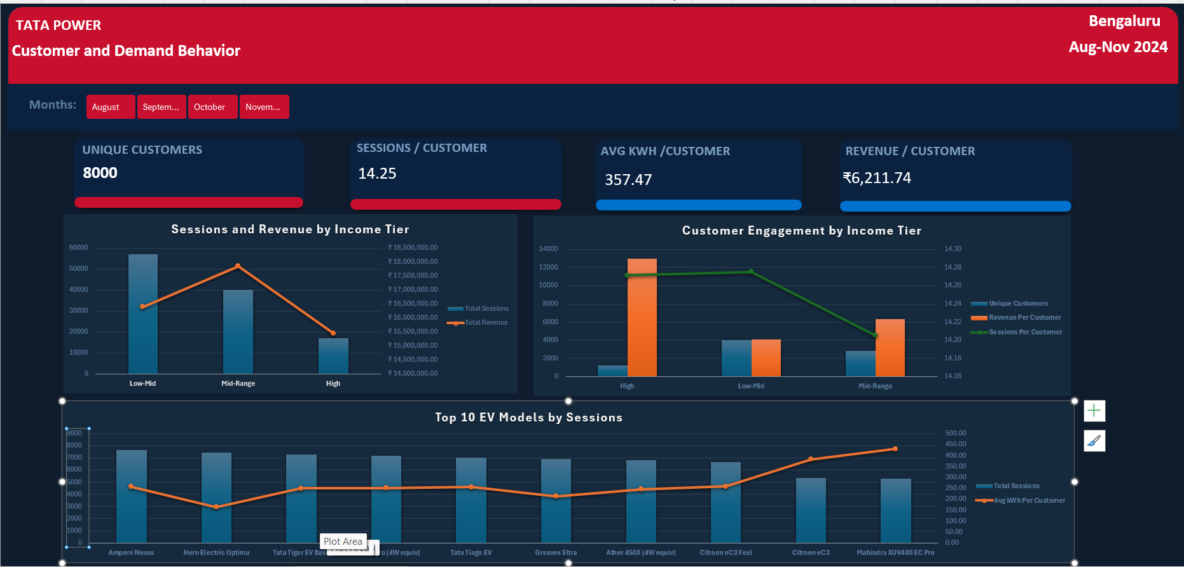
Page 3: Customer and Demand Behavior

Slide 10
Page 3 — Key Findings
Income Tier | Customers | Sessions | Revenue | Rev/Customer | Sess/Cust
Low-Mid | 3,990 | 56,958 | ₹164 L | ₹4,109 | 14.28
Mid-Range | 2,820 | 40,059 | ₹179 L | ₹6,331 | 14.21
High | 1,190 | 16,983 | ₹154 L | ₹12,979 | 14.27
Key Findings:
All income tiers charge with equal frequency (~14 sessions/customer). Revenue gap is energy-driven.
Low-Mid: largest segment (3,990) but lowest rev/customer (₹4,109) — highest growth potential.
High tier: fewest customers (1,190) but 3x revenue per customer (₹12,979) — already captured.
Two-wheelers (Ampere Nexus, Hero Optima) lead sessions; four-wheelers drive higher kWh/session.
Top 10 EV models account for ~59% of all sessions — Ampere Nexus leads with 7,635 sessions.

Slide 11
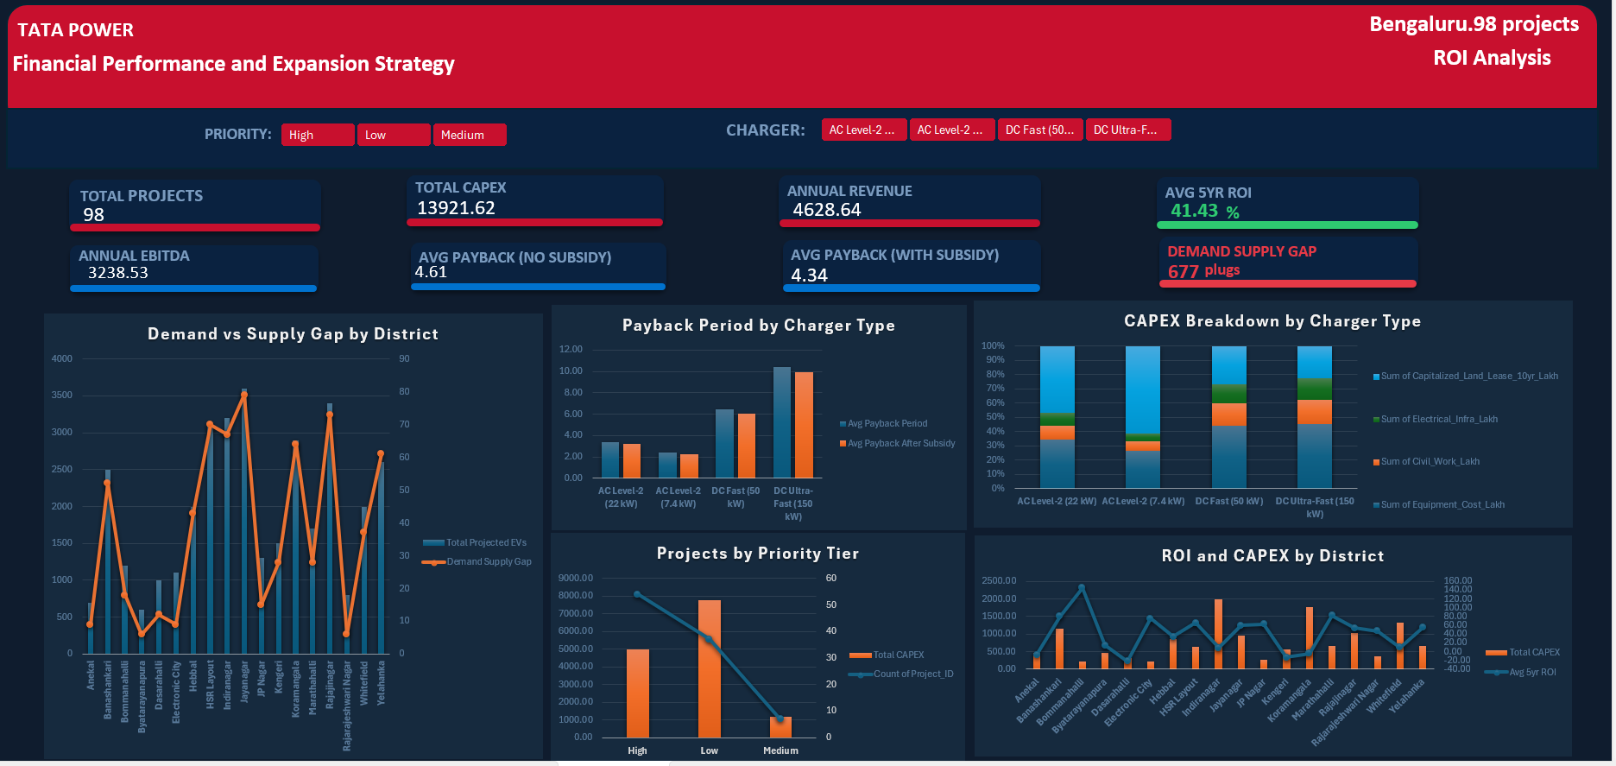
Page 4: Financial Performance and Expansion Strategy

Slide 12
Page 4 — Key Findings
TOTAL PROJECTS
TOTAL CAPEX
ANNUAL EBITDA
AVG 5YR ROI
98
₹13,922 L
₹3,239 L
41.4%
PAYBACK (NO SUB)
PAYBACK (W/ SUB)
PROJECTED EVs
PLUG GAP
4.61 yrs
4.34 yrs
35,200
677
Key Findings:
AC Level-2 chargers (7.4kW, 22kW): 2.5–3.1yr payback, 90%+ ROI — best investment choice.
DC Ultra-Fast (150kW): ~10yr payback even with subsidy — not viable at current utilization.
54 High-priority projects (55%) with avg 2.8yr payback and 93% ROI — immediate deployment targets.
Top 5 gap districts (Jayanagar, Rajajinagar, HSR Layout, Indiranagar, Koramangala) = 53% of total gap.
Government subsidy reduces avg payback from 4.61 to 4.34 years — modest but helpful impact.

Slide 13
Strategic Recommendations
Prioritize AC Level-2 Expansion
1
Deploy AC chargers (7.4kW and 22kW) in the top 5 gap districts. These offer 2.5–3yr payback with 90%+ ROI.
Defer DC Ultra-Fast Investment
2
DC 150kW chargers show ~10yr payback even with subsidy. Wait until utilization justifies the ₹60+ Lakh CAPEX per project.
Target Low-Mid Customer Segment
3
3,990 customers generating only ₹4,109/each. Same visit frequency (14x) but lower energy/visit. Incentivize longer sessions.
Optimize for Peak Hours
4
Afternoon and Morning = 65% of daily load. Deploy time-of-use pricing to shift demand to Evening/Night.
Close the 677-Plug Gap
5
54 High-priority projects (₹4,980L CAPEX) would address the most critical gaps with avg 2.8yr payback.

Slide 14
TATA POWER
EV Charging Infrastructure — Conclusion
Dashboard Deliverables
4 interactive dashboard pages: Business Overview, Station Utilization, Customer Behavior, Financial ROI
26 DAX measures tracking every KPI specified in the project brief
15 PivotCharts with dark navy professional theme across all pages
Interactive slicers: Month, Income Tier, Priority Tier, Charger Type
16 business questions answered with data-driven visualizations
Complete data validation: zero missing values, all formulas verified
The Bengaluru EV charging network is growing rapidly with strong ROI potential in AC infrastructure. Immediate action on the 677-plug gap in high-demand districts will capture market share ahead of the projected 35,200 EVs.
Data Analytics Report | Milestone Project 1

Slide 15
TATA POWER
Thank You
Suresh Deuja
Data Analyst
Milestone Project 1 | Tata Power EV Charging Infrastructure Analysis

