Slide 1

taxi trip duration
A Beginner approach on machine learning algorithms

Slide 2
Introduction
The Data
Exploratory Analysis
Regression Modelling
Results & Conclusion

Slide 3

Introduction : New Yorkers take thousands of Taxi ride every day. Yellow Taxi’s are dominating the market though they get strong competition from Uber and Lyft in the market. However ridesharing apps gaining popularity now days with convenient apps on mobile phones. It is increasingly important for taxi companies to provide visibility to their estimated ride duration, since the competing apps provide these metrics upfront. Machine Learning algorithms are answer to this problem. We have used supervised learning and since it’s a time prediction, we are using regression techniques. This problem was posted by “NYC Taxi and Limousine Commission” as competition in Kaggle.com challenging us to build a model that predicts the total ride duration of taxi trips in New York City.

Slide 4
The Data : Primary data for this analysis was released by the NYC Taxi and Limousine Commission, which includes pickup time, geo-coordinates, number of passengers, and several other variables. Training dataset has close to 1.5 Million and 630k records in test dataset. Each row contains one taxi trip.
We have used two data sets primarily for our modelling.
Train -> This data set provided by NYC Taxi and Limousine Commission for modelling. We have taken subset of 400k records and used for our modelling. This dataset contains, Trip ID, Trip Duration, Trip Data/Time and Pickup/Dropoff coordinates.
OSRM -> As part of EDA we have identified Distance calculated between Pickup/Dropoff coordinates using Geosphere was positively correlated with Trip Duration. So we have introduced external Data set created using OSRM which contains accurate Distance calculation, Duration of the taxi trips based on coordinates. We have used these features primarily in our modeling.

Slide 5
The Data continued …
Glimpse of Input Data
Trip Id is unique identiﬁcation of a trip
vendor_id ﬁeld has only 2 values “1” or “2” asuming two taxi companies
pickup/dropoﬀ_datetime - holds date and time of pickup and dropoﬀ. we need to mutate the ﬁelds to get date and time separately.
pickup/dropoﬀ_longitute/latitute - hold values of geographical coordinates where the meter was activate/deactivated.
store_and_fwd_ﬂag is a ﬂag that indicates whether the trip data was sent immediately to the vendor (“N”) or held in the memory of the taxi because there was no connection to the server (“Y”). Maybe there could be a correlation with certain geographical areas with bad reception?
trip_duration hold the duration in seconds and its our target prediction of this project.

Slide 6
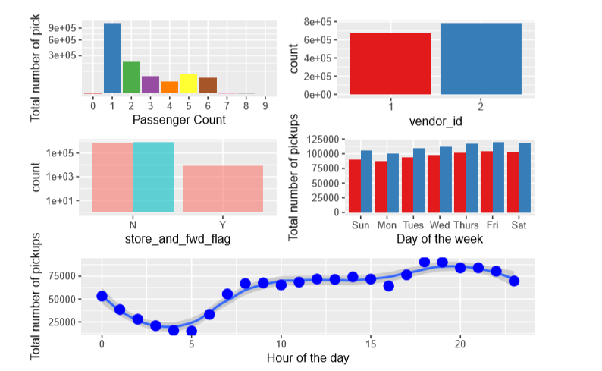
EDA
A view of trends in our data. Where we see Monday is the quietest day and Fridays are busiest days. Also evening are busiest hours. Considering the facts, we have used Weekday and Hours as independent variables.

Slide 7
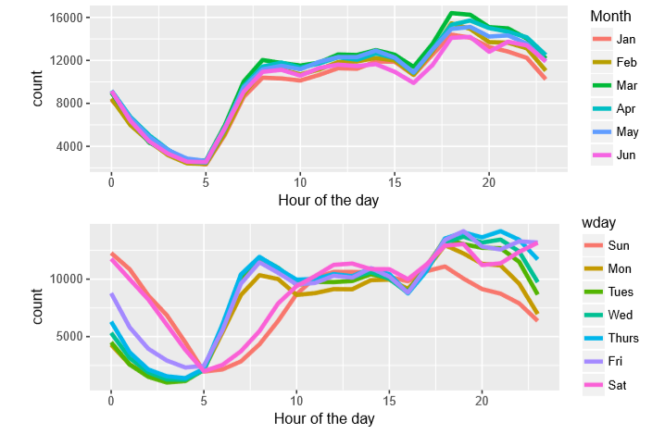
EDA cont ….
Below plot shows high volume of trips are taken during evening times and we see high number of trip in early morning during weekends.

Slide 8
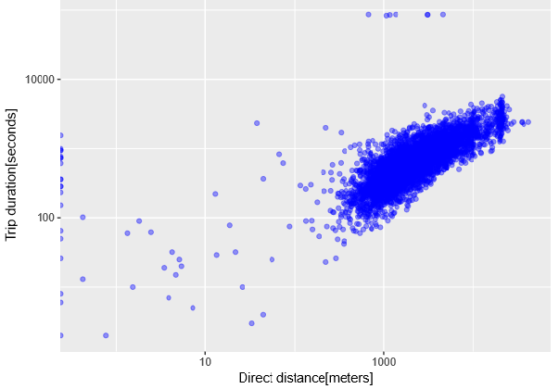
Its clear observation, that distance increases trip duration. Distant from Geosphere and Distance from OSRM were are main important predictor variables.

Slide 9
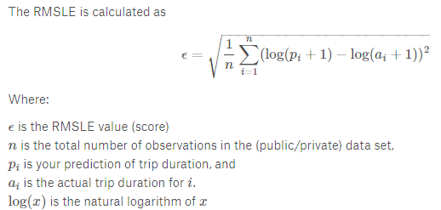
Regression Modelling
We have used Linear Regression, Random Forest and XG Boost algorithms for prediction. Among those, Random Forest algorithm performed well based on and Pseudo R2.
We have evaluated model performance by RMSLE & Pseudo R2
PseudoR2 = 1− MSE /Var(y)

Slide 10
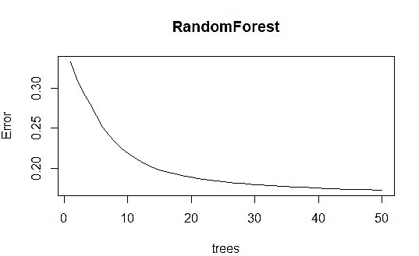
Random Forest
The tree regression model is capable of representing complex decision boundaries, thus complementing our other chosen models. Random Forest is chosen since it prevents overﬁtting and robust against outliers. Since we have limited computing resource, we have run algorithm with just 50 trees. Results are based on the same.
Results -> RMSLE : 0.3995 and Pseudo Rˆ2 : 0.7452
Due to memory issue, we have ran model with only 50 trees and 12 variables ( which is 4 ntry) . Below charts shows error trend.

Slide 11
XG Boost
XG Boost is an advanced gradient boosting algorithm. It is a highly sophisticated algorithm, powerful enough to deal with all sorts of irregularities of data. The tool is extremely ﬂexible, which allows users to customize a wide range of hyper-parameters while training the mode, and ultimately to reach the optimal solution.
Results -> RMSLE : 0.4078 and Pseudo Rˆ2 : 0.7345
Linear Regression
We are using Linear Regression as our baseline model. The multiple-linear regression model allows us to exploit linear patterns in the data set. This model is an appealing ﬁrst choice because feature weights are easily interpretable and because it runs eﬃciently on large datasets.
Results -> RMSLE : 0.5321 and Pseudo Rˆ2 : 0.5480

Slide 12
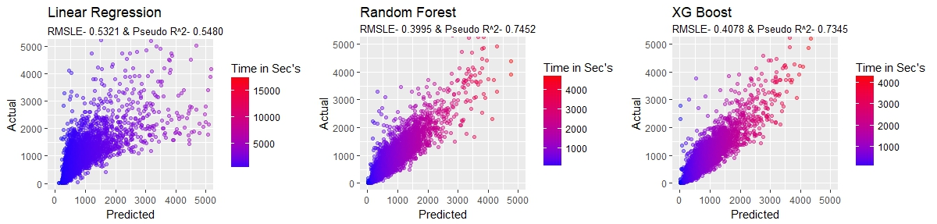
Results & Conclusion
The results of all the models are compared in the below table. The plots in the ﬁgure suggest that both Random Forest and XG Boost models perform well on the test set. Most predictions are almost close to the true values. Random Forest achieved the lowest RMSLE of 0.3995 and Pseudo R2 of 0.7452 in duration prediction. Though we cannot claim this as best model by looking at the results. This can be still used as tool to ﬁnd approximate estimate.
Algorithm | RMLSE | Pseudo Rˆ2
Linear Regression | 0.5321 | 0.5480
Random Forest | 0.3995 | 0.7452
XG Boost | 0.4078 | 0.7345

