Slide 1
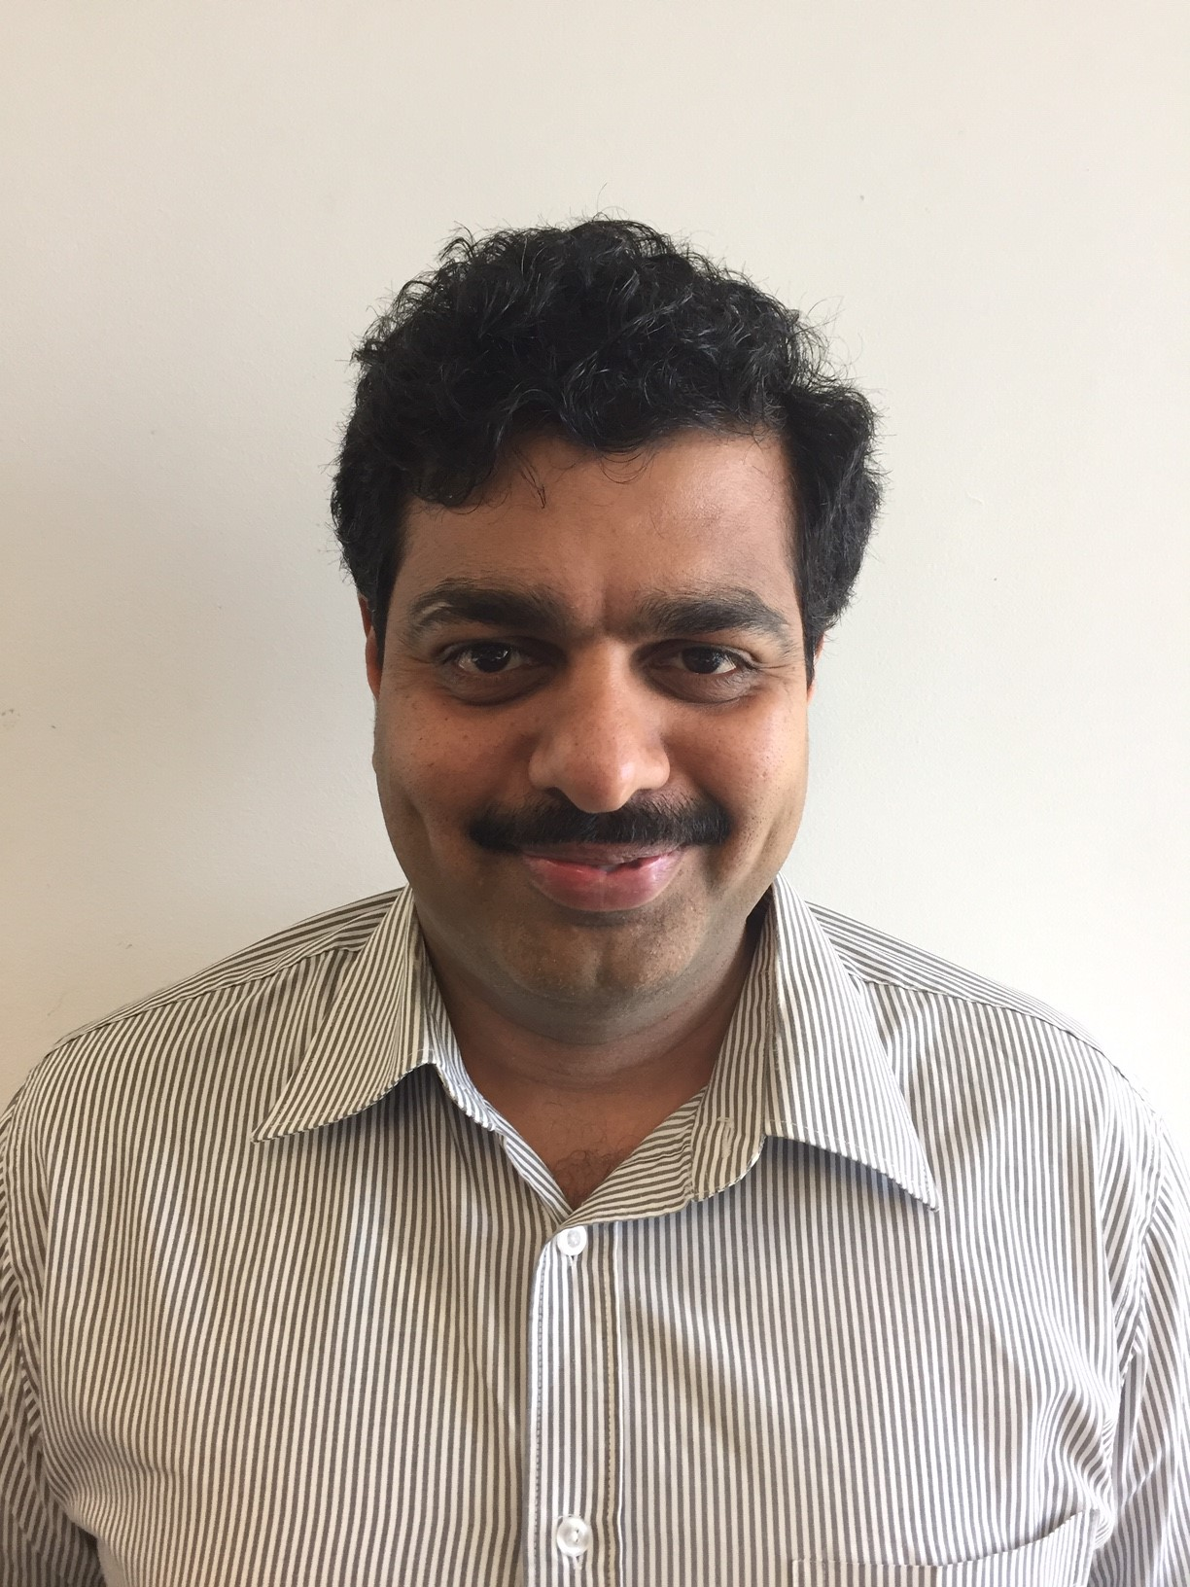
Competencies
Professional experience
Microsoft C#.Net, ASP .Net Core, Entity framework Core, Microsoft Azure, Azure Storage, AWS Lex, Lambda Functions, Docker, Angular 6, Web API, MVC, Typescript, Kendo Grid, Mongo DB, Raven DB, LINQ, HTML 5, Bootstrap, CSS Style Sheets, Windows Services
Micro Services with Domain Driven Design, Event Sourcing, CQRS, RabbitMQ
AWS Lex, Lambda Functions, AWS Chatbot Integration with customized Lambda Functions, AWS Assets Discovery & Billing, Azure App Services, Azure Active Directory
Design Patterns, UML, Visual Studio Online, Github, SVN, CI/CD, Octopus, TFS, Agile Scrum Methodologies
SQL Server, SQL, Stored Procedures, Triggers, Indexes
Performance Tuning for database, Caching Techniques
BetEasy – Senior Developer
Responsible for analysis and reverse engineering of Bet API, Settlement engine, Events , Liability including analysis of Intrabet and Breeze database. for RWWA B2B discovery
Enterprise Cloud Backup
Senior .net developer for a product implementation that allows to configure and enable cloud backup for various types of backup including file system, SQL and other VM images and metering for the
clients depending on usage & features selected
Cloud Micro Service for Microsoft (MCSfM)
Senior .net developer for a portal implementation to facilitate configuration and management of Microsoft Skype for Business for users either on-prem or cloud. It also supports provisioning Office 365 to users, moving users from on-prem to O365 and vice-versa. It also supports provisioning of various features audio/video and managing conferencing policies. The users can be automatically provisioned into the system when users are created in Active Directory
Payments Platform
Senior .net developer for online payment processing implementation. It allows through direct debit and credit card, paypal for real estate agents and child care centers. This is a green field project to design and develop the complete functionality of payment processing raging from one-off payment to recurring payments, reconciliation, administration and reporting etc. This project is developed to fully run in Windows Azure Cloud environment.
Senior .net developer for Starcard Application Forms implementation: These are application forms available in internet for users to apply credit/debit fuel cards offered by Caltex. These application forms gather the required information to process the application about the business for companies and personal details for individual applicants.
Senior Software Engineer for Risk Agility Project: This Project focuses on analysis on risk for Insurance companies based on risk factors, catastrophe perils and various other calibrations. It deals with various calculations involved in the analysis, produces a deep analysis on various combination of data.
Suresh Natarajan
Senior .Net Lead Developer
Profile
15+ years of experience in IT Industry working with Microsoft Technologies, Strong Design and technical skills developing enterprise applications using C#.Net, .Net Core, Micro services, MVC, SQL Server, Web API, Windows Services
Solution provider for complex projects & issues with scalable architecture and better performance
Interact with client & business to better understand the requirements, Leverage work to team members and successful delivery of projects
Extensive involvement in all stages of application development life cycle including logical and physical architecture modeling, design using design patterns & UML diagrams, agile environment, development, implementation and support activities
Education/Certification
Master of Computer Applications (M.C.A)
Bachelor of Mathematics

