Slide 1
JavaFX Periodic Table Controller Explanation
1. Dependencies and Setup
To include JavaFX libraries in your project, add the JavaFX dependency in your 'pom.xml'.
This makes sure that the necessary libraries are available when you compile and run your project.
< dependencies >
<dependency>
<groupId>org.openjfx</groupId>
<artifactId>javafx-controls</artifactId>
<version>17.0.1 </version>
</dependency>
< /dependencies >

Slide 2
JavaFX Periodic Table Controller Explanation
2. Main Class Definition
The 'PeriodicTableApp' class extends 'Application', which is the base class for JavaFX applications.
The 'main' method calls 'launch(args)', which initializes and launches the JavaFX application.

Slide 3
JavaFX Periodic Table Controller Explanation
3. Elements Array
The 'ELEMENTS' array is a 2D array representing the periodic table. Each element is represented by its chemical symbol, while empty strings represent gaps in the table layout. This array defines the structure and layout of the periodic table in the application.
private static final String[][] ELEMENTS = {
{"H
H MM MM MM MM MM MM MM MM MM MM MM MM MM MM MM MM MM MM
"He"},
{^{M}|_j^{M} "Be" 1,11 1,11 1,11 MM MM MM MM MM MM MM "B" "0" "N" "0" "p" "Ne"} // (other rows omitted for brevity)
} ;

Slide 4
JavaFX Periodic Table Controller Explanation
4. GridPane Layout
'GridPane' is used to create a grid layout that aligns elements in rows and columns, similar to the actual periodic table.
This layout is suitable for the tabular structure of the periodic table.

Slide 5
JavaFX Periodic Table Controller Explanation
5. Creating Buttons for Elements
For each non-empty cell in the 'ELEMENTS' array, a 'Button' is created. The button represents an element and is added to the 'GridPane' at the corresponding position.
Each button has a minimum size set for uniformity and an action handler that displays element details when clicked.
for (int row = 0; row < ELEMENTS.length; row++) { for (int col = 0; col < ELEMENTS[row].length; col++) {
String element = ELEMENTS[row][col]; if (!element.isEmpty()) {
Button button = new Button(element); button.setMinSize(50, 50); button.setOnAction(e ->
showElementDetails(element)); grid.add(button, col,
row);
}
}
}
6 . Displaying the Grid
A 'Scene' is created using the 'GridPane', and the primary stage is set up with this scene.
The 'primaryStage.show()' method displays the application window.

Slide 6
JavaFX Periodic Table Controller Explanation
Scene scene = new Scene(grid, 900, 600); primaryStage.setTitle("Periodic Table"); primaryStage.setScene(scene); primaryStage.show();

Slide 7
JavaFX Periodic Table Controller Explanation
7 . Showing Element Details
The 'showElementDetails' method displays an 'Alert' dialog with information about the clicked element.
This information is retrieved from the 'ELEMENT_DETAILS' map, which contains detailed descriptions for each element.
If no details are available for an element, a default message is shown.
private void showElementDetails(String element) {
String details = ELEMENT_DETAILS.getOrDefault(element, "Details not available.”);
Alert alert = new Alert(Alert.AlertType.INFORMATION); alert.setTitle("Element Details"); alert.setHeaderText("Details for " + element); alert.setContentText(details); alert.showAndWait();
}
8 . Example Data Structure for Element Details

Slide 8
JavaFX Periodic Table Controller Explanation
The 'ELEMENT_DETAILS' map holds detailed information for each element. This can be expanded to include more elements and additional properties such as electron configuration, state at room temperature, and discovery history.
private static final Map<String, String> ELEMENT_DETAILS = new HashMap<>(); static {
ELEMENT_DETAILS.put("H", "Hydrogen\nAtomic Number: 1\nAtomic Mass: 1.008\nNonmetal");
ELEMENT_DETAILS.put("He", "Helium\nAtomic Number: 2\nAtomic Mass: 4.0026\nNoble Gas");
ELEMENT_DETAILS.put("Li", "Lithium\nAtomic Number: 3\nAtomic Mass: 6.94\nAlkali Metal");
ELEMENT_DETAILS.put("Be", "Beryllium\nAtomic Number: 4\nAtomic Mass: 9.0122\nAlkaline Earth Metal");
ELEMENT_DETAILS.put("B", "Boron\nAtomic Number: 5\nAtomic Mass: 10.81\nMetalloid");
ELEMENT_DETAILS.put("C", "Carbon\nAtomic Number: 6\nAtomic Mass: 12.011\nNonmetal");
ELEMENT_DETAILS.put("N", "Nitrogen\nAtomic Number: 7\nAtomic Mass: 14.007\nNonmetal");
ELEMENT_DETAILS.put("O", "Oxygen\nAtomic Number: 8\nAtomic Mass: 15.999\nNonmetal");
ELEMENT_DETAILS.put("F", "Fluorine\nAtomic Number: 9\nAtomic Mass: 18.998\nHalogen");
ELEMENT_DETAILS.put("Ne", "Neon\nAtomic Number: 10\nAtomic Mass: 20.180\nNoble Gas"); // Add details for other elements as needed
}

Slide 9
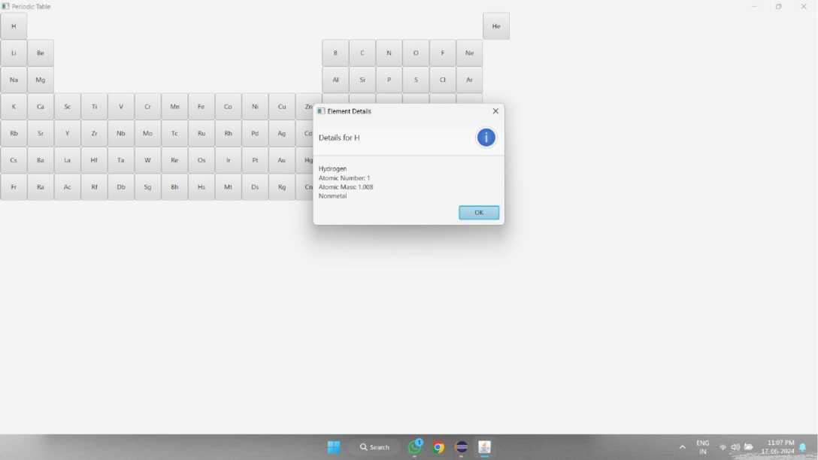
JavaFX Periodic Table Controller Explanation
OUTPUT

Slide 10
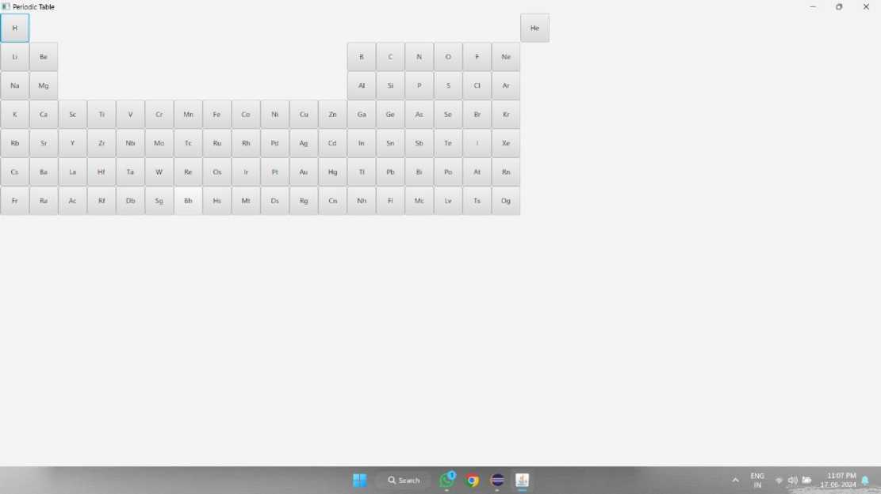
JavaFX Periodic Table Controller Explanation

Slide 11
JavaFX Periodic Table Controller Explanation
The square brackets around the atomic masses for certain elements (like Polonium, Astatine, etc.) indicate that these values are not based on stable, naturally occurring isotopes. Instead, they are based on the most stable isotopes or are estimates due to the elements' radioactive nature and short half-lives. For these elements, the atomic mass is an approximate value rather than a precise measurement.

