Slide 1
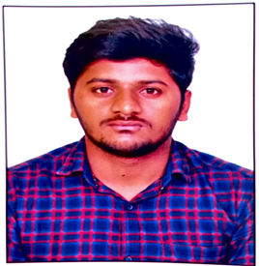


Suresh Kumar Vipparla
Analyst/Software Engineer
Bachelor of Technlogy, Computer Science Engineering : 2015 - 2019
Skills
Bangalore
Java 8 /J2EE | Java Basics, OOPS, Generics, Collections, Arrays, Jdbc , Servlets
C# | C#Basics, OOPS, Generics, Collections, Arrays.
.NET | ADO.NET,ASP.NET with MVC5 and WEB API, Entity Framework
Version Control Tool | Git, GitHub, Branches, Merging
Angular | Components, Services, Modules, Routing, Forms & Validation.
UI | HTML 5 & CSS 3,JavaScript, ES6 & TypeScript ,Bootstrap
Data base | Micrpsoft Sql Server
Tools | Git, SSMS, Visual Studio, Visual Studio Code
Add On Skills | Self Learning
suresh-kumar.vipparla@capgemini.com
+91 7659950594
A4
Full Stack Developer
Hands on experience on C#,ADO.NET, LINQ, Entity framework, Sql Server, ASP.NET MVC5 with WEB API
Knowledge on creating Single page Web Application in Angular .
Knowledge on creating databases in SSMS
Having Knowledge on Git And GitHub
Certifications
Az-900 (Azure Fundamentals)
Az-104 (Azure Administration)
Agile Software Development
RPA Developer Foundation
Online Hotel Management System [ Video Profile]
Case study of Online Hotel Management System along with API Gateway, Swagger, and payment , responsive UI with HTML5, CSS, Bootstrap and Angular used as User Interface.
Degreed :
Successfully completed the degreed training in git, Sql
C#, .Net Core, Angular.
Check out my work on GitHub

