Slide 1
TechCon-2026
AiPERF
AI-Native Performance Engineering Intelligence Platform
From Performance Testing to Performance Intelligence

Slide 2
Problem Statement
Current Challenges: Organizations execute performance tests across multiple releases, environments, and production validation cycles. Over time, thousands of performance test results are generated, but extracting meaningful intelligence remains difficult.
Performance Monitoring tools provide metrics but do not offer performance test intelligence, release risk prediction, or automated optimization recommendations.
Performance reports are analysed manually and in isolation.
Difficult to identify long-term performance trends across releases.
Limited visibility into performance degradation or improvement patterns.
Root Cause Analysis (RCA) consumes significant effort and expert time.
Anomalies often go unnoticed until production impact occurs.
Go/No-Go decisions rely heavily on manual interpretation.
Performance knowledge is lost across teams and projects.
Current Pain Points
Primary Users
Performance Engineers
QE Leads
Test Managers
Secondary Users
Developers
DevOps Teams
SRE Teams
Business Stakeholders
Product Owners
Delivery Managers
Program Managers
Strategic Stakeholders
Enterprise Architects
CIO/CTO Office
Engineering Leadership
Key Stakeholders :

Slide 3
Solution
AiPERF transforms raw test results into actionable AI-driven insights, enabling organizations to predict risks, identify root cause, optimize performance, and help make confident release decisions.
Data Collection
AI Intelligence Layer
Automated Trend Analysis
Release-over-Release Comparison
Anomaly Detection
AI-Powered RCA Identification
Performance Risk Prediction
Impact Assessment
Intelligent Recommendations
Business Insights Dashboard
Go / No-Go Recommendation
Release Readiness Score
Top Performance Risks
Functional Areas Requiring Optimization
Executive Performance Summary
Performance Test Results
APM Metrics
Infrastructure Metrics
Historical Results
AiPERF acts as an intelligent layer on top of existing performance testing results
AI Capabilities
✅ Performance Trend Forecasting
✅ Intelligent RCA Generation
✅ Anomaly Detection & Alerting
✅ Automated Report Insights
✅ Predictive Release Risk Assessment
✅ Self-Learning Knowledge Repository

Slide 4
Business Outcome
Faster Decision Making
AI-driven Go/No-Go recommendations
Instant performance health assessment
Reduced dependency on manual analysis
Improved Quality
Early detection of degradation trends
Prevention of performance regressions
Improved release confidence
Reduced Cost & Effort
60-70% reduction in result analysis effort
Faster RCA identification
Reduced performance engineering cycle time
Better Business Outcomes
Improved application stability
Faster release velocity
Reduced production incidents
Enhanced customer experience
Executive Insights
Release Readiness Score
Performance Risk Heat Map
Capacity Growth Trends
Business Impact Prediction
The Release Readiness Scorecard based on data-driven assessment of application readiness for production deployment. It analyzes key performance indicators such as SLA compliance, performance trends, anomaly detection, error rates, and infrastructure health to calculate an overall readiness score based on various weight. Based on the score and identified risks, AiPERF generates a Go / No-Go recommendation, helping stakeholders make faster and more confident release decisions.

Slide 5

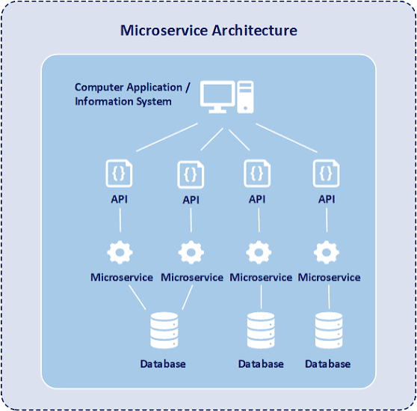
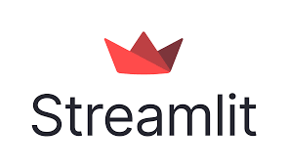

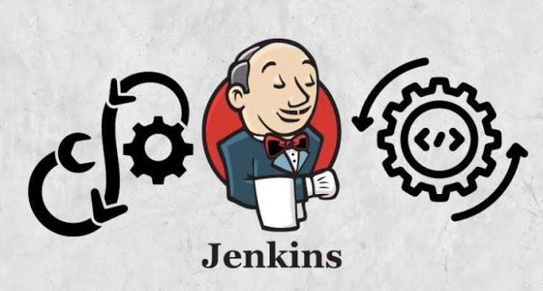

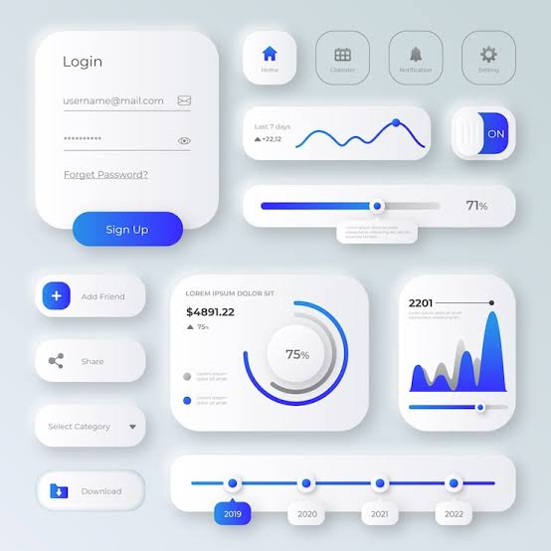
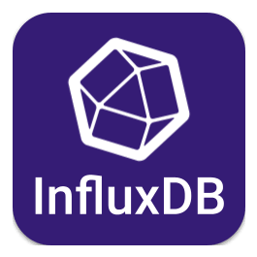
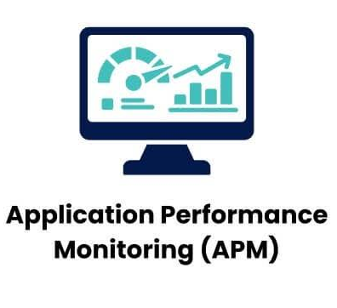

Solution Architecture
Data Management Layer
User/Stockholders
Performance Engineer
Dev / DevOps / QA user
Application Under Test
Business User
AI Layer:
Trend Engine,
Anomaly Engine,
RCA Engine,
Recommendation Engine
Coforge
AI Studio GPT-5
Lib Kats/ StatsModels
Architecture Design
User Experience Layer
Dashboard &
Reporting Layer
AI Intelligence Layer

Slide 6
Capability Matrix
Capability | APM Tools | AiPERF
Monitoring | Yes | Yes
Historical Trend Analysis | Limited | Yes
Anomaly Detection | Partial | Yes
Automated RCA | Partial | Yes
Recommendation Engine | Limited | Yes
Release Readiness Scoring | No | Yes
Go/No-Go Recommendation | No | Yes
Knowledge Repository | No | Yes
AiPERF does not replace APM tools. AiPERF leverages APM data to generate actionable intelligence.

Slide 7
Success Metrics
KPIs
Reduction in analysis effort
Reduction in RCA effort
Accuracy of AI recommendations
Release decision turnaround time
User adoption rate
ROI Approach
ROI to be established through pilot implementation by measuring:
Time savings
Faster RCA
Reduced release delays
Reduction in performance defects

Slide 8
AiPERF Product Roadmap
AiPERF continuously learns from historical execution data, analyzes performance trends, identifies recurring patterns and anomalies, and applies intelligence from similar executions. Leveraging Coforge AI Studio, it transforms complex performance metrics into actionable insights that help organizations predict risks, accelerate root cause analysis, optimize application performance, and make confident release readiness decisions.
Phase 1: Foundation MVP
JMeter/LR Report Ingestion
Centralized Test Results Repository
Trend Visualization Dashboard
Basic AI Recommendations
Release-over-Release Comparison
Phase 2: Predictive Intelligence
Automated RCA Generation
Performance Anomaly Detection
Release Risk Prediction
Intelligent Alerting
Capacity Trend Analysis
Phase 3: Future Road Map - Long Term
Self-Learning Intelligence Engine
Cross-Project Benchmarking
Recommendation Learning
Autonomous Optimization Suggestions
Continuous Performance Governance

Slide 9
Assumptions/Risks/Dependencies
Assumptions
Historical performance data is available.
Existing test results are accessible for ingestion.
Performance reports follow standardized formats.
Monitoring tool integrations are available.
Risks
AI-generated recommendations may require human validation.
Insufficient historical data may reduce prediction accuracy.
Data quality issues can impact AI outcomes.
Tool integration complexity may affect timelines.
Dependencies
Access to performance test repositories.
JMeter and/or LoadRunner integration.
Monitoring platform connectivity.
Enterprise LLM platform availability.
Appropriate security and compliance approvals.

Slide 10

AiPERF – Solution Setup
Layer | Technology | Primary responsibility
Execution | Apache JMeter 5.6.3 | Generate controlled workload and JTL evidence.
Orchestration | Jenkins | Validate environment, execute the pipeline, publish evidence.
Telemetry store | InfluxDB OSS 1.8.10 / jmeter | Persist execution, service, comparison, anomaly, findings, and outcome evidence.
Runtime telemetry | Spring Boot Actuator (Optional) | Expose CPU, process, JVM, threads, and HTTP request counters.
Intelligence | Python 3.12 + scikit-learn | Extract, compare, reconcile, detect, correlate, package findings, and govern release.
LLM reasoning | Coforge GPT-5 primary/failover | Explain the deterministic Findings Package and answer bounded questions.
Command Center | Streamlit | Present selected-run evidence and grounded Copilot interaction.
Visualization | Grafana | Operational dashboards over validated InfluxDB measurements.
Steps to setup –
1. Checkout the code from git repo - sureshpittala/AiPERF
2. Build any JMeter scripts for any application
3. Setup Jenkins. Use the Jenkins attached file or prepare Jenkins pipeline to run the JMeter script. Note – change the path to your checkout code
4. Grafana (optional)
5. Run the actuator setup (only if you are using inhouse microservices else you can use any application for which JMeter scripts are developed. Note – Microservices are provided in the repo
6. Setup Streamlit
7. Get the API keys for LLM from Coforge AI Studio. Use GPT-5.2 Chat (Primary) and GPT-5.2 (Failover). Note – You can use any model as per the requirement
Checkout the complete code from below public git repo
sureshpittala/AiPERF
Use the Jenkins file for orchestration

Slide 11
Let’s Engage

