Slide 1
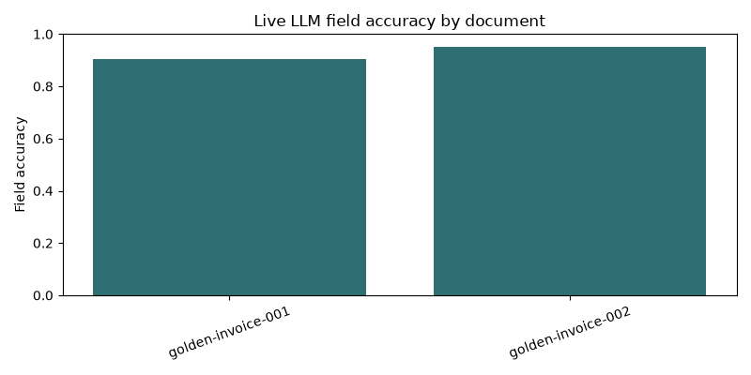
MILESTONE 2 INVOICE APP
LLMOps upgrade overview
Milestone 2 added contract, measurement, and CI enforcement around invoice extraction.
01
Versioned contract
Prompt registry, invoice_v2 schema, and golden dataset now define extraction behavior and scoring.
02
Live pipeline
OpenAI-compatible runner writes JSON, HTML, PNG, and DAG artifacts from golden OCR examples.
03
Runtime metadata
Backend records prompt version, schema version, fallback reason, latency, and usage-cost details.
04
CI enforcement
GitHub Actions uploads offline and live reports, and missing live secret now fails gate loudly.
Current live run meets threshold with 0 invalid documents and 0 fallback documents.
v2
4
23
Prompt/schema
Change areas
LLMOps tests
Sources: README.md, docs/llmops.md, outputs/llmops/live_eval_report.json, .github/workflows/llmops-ci.yml

Slide 2
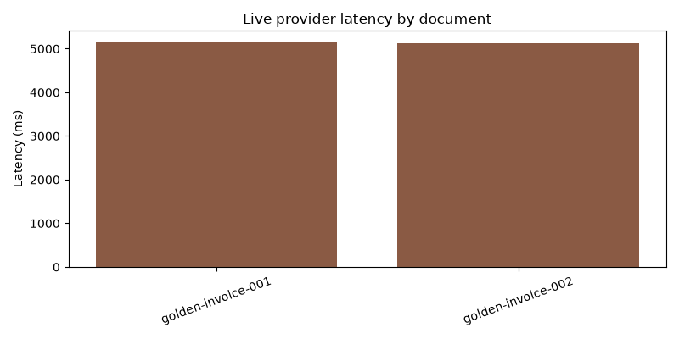
MILESTONE 2 INVOICE APP
Pipeline and code changes
LLMOps moved from thin helpers to reusable modules around provider calls, reporting, and telemetry.
01
Registry and schema
llmops/registry.py and llmops/schema.py load prompt/schema versions instead of hardcoding extraction contract.
02
Live provider path
llmops/live_provider.py and llmops/pipeline.py run per-document live eval and score every result row.
03
Reporting and telemetry
llmops/reporting.py and telemetry.py add charts, HTML output, token-cost totals, and Pushgateway rollups.
04
Backend integration
app_backend.py now attaches LLMOps metadata to JPG, PDF, and DOCX extraction responses.
Live pipeline now exposes per-document provider timing instead of opaque provider calls.
7
2
3
Core helpers
Eval modes
Upload types
Sources: README.md, docs/llmops.md, app_backend.py, llmops/*.py, scripts/run_llmops_pipeline.py

Slide 3
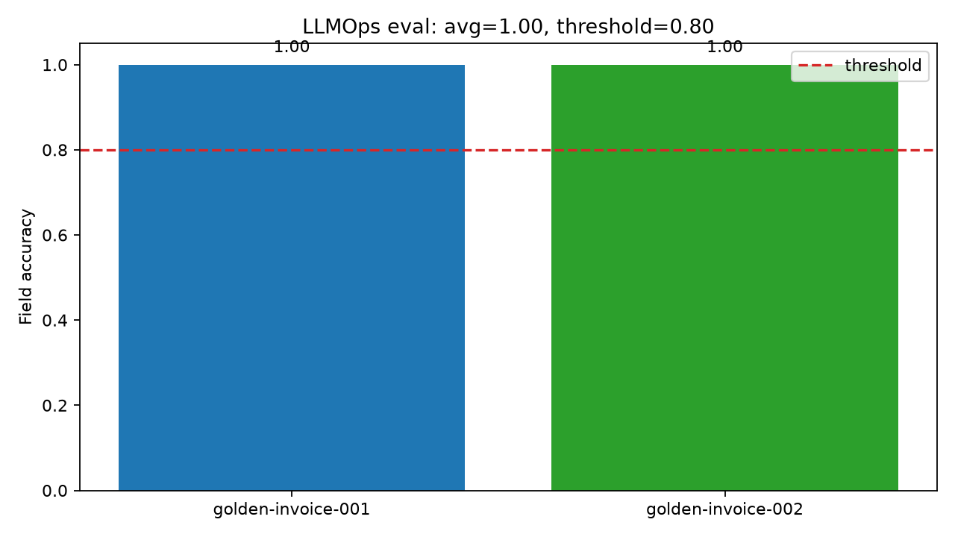
MILESTONE 2 INVOICE APP
Quality gates and contract hardening
Offline eval, live eval, and shared normalization now catch schema drift before release.
01
Golden dataset
OCR-text fixtures in data/golden keep regressions reviewable without live model dependency.
02
Nested line items
v2 contract scores scalar fields and order_items separately so line-item drift stays visible.
03
Normalization fix
Shared coercion converts model numeric values to schema-safe strings before validation runs.
04
Artifact proof
CI publishes llmops-eval-report and live-llmops-report so failures are inspectable from artifacts.
Offline golden eval remains deterministic and currently passes at 1.00 average field accuracy.
1.00
0.80
23
Offline avg
Gate threshold
LLMOps tests
Sources: docs/llmops.md, outputs/llmops_eval_report.json, tests/unit/test_llmops_*.py

Slide 4
MILESTONE 2 INVOICE APP
Live performance and operations
Latest live run meets target and feeds monitoring path used for operational visibility.
01
Provider config
Live pipeline uses OPENAI_API_KEY, optional OPENAI_API_BASE, pricing config, and optional Pushgateway URL.
02
Observability stack
docker-compose.yml exposes app metrics, Prometheus, Pushgateway, and Grafana for pipeline monitoring.
03
Fallback discipline
Live evaluator does not count local fallback as provider success, keeping report quality honest.
04
Operational benefit
Same contract now shows up in app runtime, CI artifacts, and live performance reporting.
Current live report: 92.9% average accuracy, 5.14s average latency, 0 invalid documents.
92.9%
5.14s
0
Live accuracy
Avg latency
Invalid docs
Sources: outputs/llmops/live_eval_report.json, docs/llmops.md, docker-compose.yml

