Slide 1
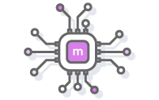


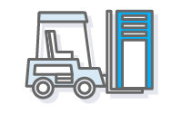





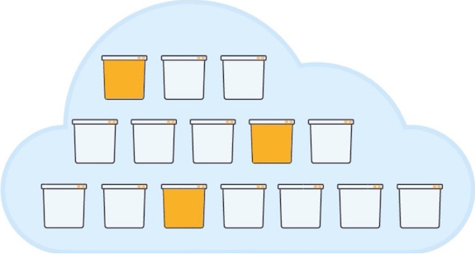









Amazon Web Services
Serving Tier
Data Science Workbench
Caching Layer
Relational Database
Data Warehouse
ETL
ElastiCache
Aurora/RDS
Redshift
Snowflake
Glue
Ab Inito
EMR
Container Platform
NoSQL Database
DynamoDB
Batch Analytics
Serverless SQL
Data Sources
Amazon S3
Data Lake
Snowflake
Athena
Streaming &
Data Loads
Processing & Preparation
Kafka
Ab Inito
Kinesis
Streaming/Real-time Analytics
Spark
Container Platform
Machine Learning
Visualization / Reporting
Data Science Workbench
Streaming Analytics Tools
Amazon Elasticsearch Service
Amazon Kinesis Analytics
Spark Streaming
AWS Lambda

