Slide 1

Chapter 4 Network Layer:
Data Plane
A note on the use of these PowerPoint slides:
We’re making these slides freely available to all (faculty, students, readers). They’re in PowerPoint form so you see the animations; and can add, modify, and delete slides (including this one) and slide content to suit your needs. They obviously represent a lot of work on our part. In return for use, we only ask the following:
If you use these slides (e.g., in a class) that you mention their source (after all, we’d like people to use our book!)
If you post any slides on a www site, that you note that they are adapted from (or perhaps identical to) our slides, and note our copyright of this material.
For a revision history, see the slide note for this page.
Thanks and enjoy! JFK/KWR
All material copyright 1996-2020
J.F Kurose and K.W. Ross, All Rights Reserved
Computer Networking: A Top-Down Approach 8th edition Jim Kurose, Keith Ross Pearson, 2020
Notes:
Version History
8.0 (May 2020)
All slides reformatted for 16:9 aspect ratio
All slides updated to 8th edition material
Use of Calibri font, rather that Gill Sans MT
Add LOTS more animation throughout
added new 8th edition material on middleboxes (and Internet arch), Net neutrality, buffering …
lighter header font
8.2 (July 2023), changes from 8.0:
some minor updates (e.g., IPv6 stats updated) but not much has changed.

Slide 2
Network layer: our goals
understand principles behind network layer services, focusing on data plane:
network layer service models
forwarding versus routing
how a router works
addressing
generalized forwarding
Internet architecture
instantiation, implementation in the Internet
IP protocol
NAT, middleboxes

Slide 3

Network layer: “data plane” roadmap
Network layer: overview
data plane
control plane
What’s inside a router
input ports, switching, output ports
buffer management, scheduling
IP: the Internet Protocol
datagram format
addressing
network address translation
IPv6
Generalized Forwarding, SDN
Match+action
OpenFlow: match+action in action
Middleboxes

Slide 4








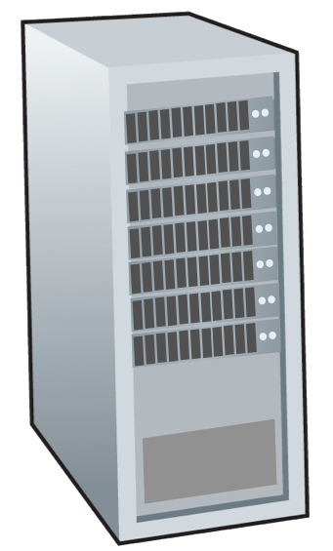







Network-layer services and protocols
transport segment from sending to receiving host
sender: encapsulates segments into datagrams, passes to link layer
receiver: delivers segments to transport layer protocol
network layer protocols in every Internet device: hosts, routers
routers:
examines header fields in all IP datagrams passing through it
moves datagrams from input ports to output ports to transfer datagrams along end-end path
mobile network
national or global ISP
application
transport
network
link
physical
network
link
physical
network
link
physical
network
link
physical
network
link
physical
network
link
physical
datacenter
network
application
transport
network
link
physical
enterprise
network

Slide 5
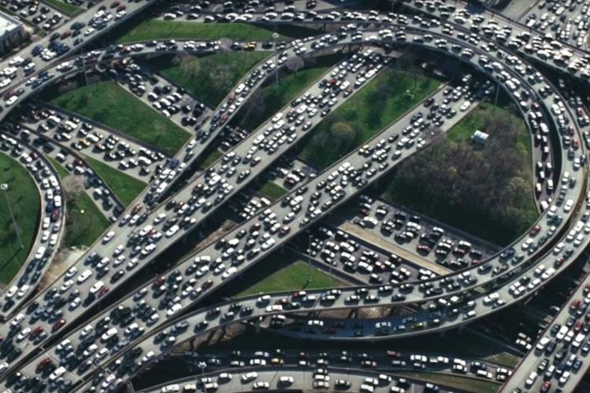
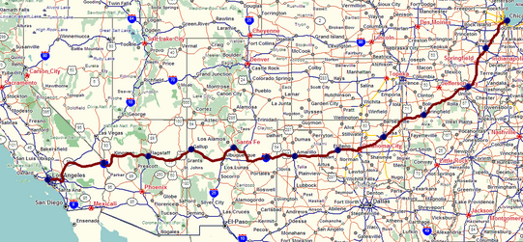
Two key network-layer functions
network-layer functions:
forwarding: move packets from a router’s input link to appropriate router output link
analogy: taking a trip
forwarding: process of getting through single interchange
routing: process of planning trip from source to destination
routing: determine route taken by packets from source to destination
routing algorithms
forwarding
routing

Slide 6
Network layer: data plane, control plane
Data plane:
local, per-router function
determines how datagram arriving on router input port is forwarded to router output port
Control plane
network-wide logic
determines how datagram is routed among routers along end-end path from source host to destination host
values in arriving
packet header
two control-plane approaches:
traditional routing algorithms: implemented in routers
software-defined networking (SDN): implemented in (remote) servers
0111
1
3
2

Slide 7

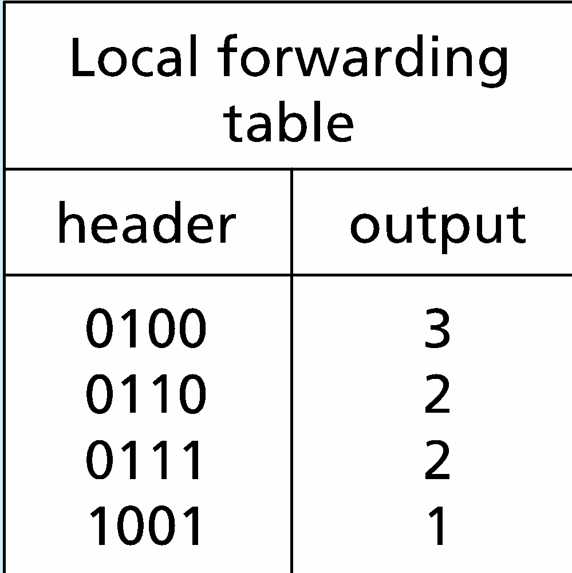
Per-router control plane
Individual routing algorithm components in each and every router interact in the control plane
Routing
Algorithm
control
plane
data
plane
values in arriving
packet header
0111
1
3
2

Slide 8
Software-Defined Networking (SDN) control plane
Remote controller computes, installs forwarding tables in routers
Remote Controller
control
plane
data
plane
CA
CA
CA
CA
CA
values in arriving
packet header
0111
1
3
2

Slide 9
Network service model
Q: What service model for “channel” transporting datagrams from sender to receiver?
example services for individual datagrams:
guaranteed delivery
guaranteed delivery with less than 40 msec delay
example services for a flow of datagrams:
in-order datagram delivery
guaranteed minimum bandwidth to flow
restrictions on changes in inter-packet spacing

Slide 10
Network-layer service model
Quality of Service (QoS) Guarantees ?
Network
Architecture
Internet
ATM
ATM
Internet
Internet
Service
Model
best effort
Constant Bit Rate
Available Bit Rate
Intserv Guaranteed
(RFC 1633)
Diffserv (RFC 2475)
Bandwidth
none
Constant rate
Guaranteed min
yes
possible
Loss
no
yes
no
yes
possibly
Order
no
yes
yes
yes
possibly
Timing
no
yes
no
yes
no
Internet “best effort” service model
No guarantees on:
successful datagram delivery to destination
timing or order of delivery
bandwidth available to end-end flow

Slide 11
Network-layer service model
Quality of Service (QoS) Guarantees ?
Network
Architecture
Internet
ATM
ATM
Internet
Internet
Service
Model
best effort
Constant Bit Rate
Available Bit Rate
Intserv Guaranteed
(RFC 1633)
Diffserv (RFC 2475)
Bandwidth
none
Constant rate
Guaranteed min
yes
possible
Loss
no
yes
no
yes
possibly
Order
no
yes
yes
yes
possibly
Timing
no
yes
no
yes
no

Slide 12
Reflections on best-effort service:
simplicity of mechanism has allowed Internet to be widely deployed adopted
sufficient provisioning of bandwidth allows performance of real-time applications (e.g., interactive voice, video) to be “good enough” for “most of the time”
replicated, application-layer distributed services (datacenters, content distribution networks) connecting close to clients’ networks, allow services to be provided from multiple locations
congestion control of “elastic” services helps
It’s hard to argue with success of best-effort service model

Slide 13
Network layer: “data plane” roadmap
Network layer: overview
data plane
control plane
What’s inside a router
input ports, switching, output ports
buffer management, scheduling
IP: the Internet Protocol
datagram format
addressing
network address translation
IPv6
Generalized Forwarding, SDN
Match+action
OpenFlow: match+action in action
Middleboxes

Slide 14
Router architecture overview
high-level view of generic router architecture:
routing, management
control plane (software)
operates in millisecond
time frame
routing
processor
forwarding data plane (hardware) operates in nanosecond timeframe
high-speed
switching
fabric
router input ports
router output ports

Slide 15



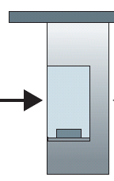

Router architecture overview
analogy view of generic router architecture:
routing, management
control plane (software)
operates in millisecond
time frame
Station manager
forwarding data plane (hardware) operates in nanosecond timeframe
roundabout
entry stations
exit roads
Notes:
We can easily recognize the principal router components in Figure 4.4 in this analogy—the entry road and entry station correspond to the input port (with a lookup function to determine to local outgoing port); the roundabout corresponds to the switch fabric; and the roundabout exit road corresponds to the output port. With this analogy, it’s instructive to consider where bottlenecks might occur. What happens if cars arrive blazingly fast (for example, the roundabout is in Germany or Italy!) but the station attendant is slow? How fast must the attendant work to ensure there’s no backup on an entry road? Even with a blazingly fast attendant, what happens if cars traverse the roundabout slowly—can backups still occur? And what happens if most of the cars entering at all of the roundabout’s entrance ramps all want to leave the roundabout at the same exit ramp—can backups occur at the exit ramp or elsewhere? How should the roundabout operate if we want to assign priorities to different cars, or block certain cars from entering the roundabout in the first place? These are all analogous to critical questions faced by router and switch designers.

Slide 16


Input port functions
lookup,
forwarding
queueing
line
termination
link
layer
protocol
(receive)
switch
fabric
physical layer:
bit-level reception
Datagram
decentralized switching:
using header field values, lookup output port using forwarding table in input port memory (“match plus action”)
goal: complete input port processing at ‘line speed’
input port queuing: if datagrams arrive faster than forwarding rate into switch fabric
link layer:
e.g., Ethernet
(chapter 6)
Frame
Notes:
Green box is a physical layer responsible for receiving bit level transmission. Copper, fiber wireless.
Link layer in blue – bit assemble into Ethernet frame. We will discuss this in details in chapter 6.
But most critical one, is here. Lookup, forwarding function. Lookup and forward is “Match plus action” behavior.
GOAL – processing at “line speed”, otherwise, buffer will be full and packet will be lost

Slide 17
Input port functions
lookup,
forwarding
queueing
line
termination
link
layer
protocol
(receive)
switch
fabric
physical layer:
bit-level reception
decentralized switching:
using header field values, lookup output port using forwarding table in input port memory (“match plus action”)
destination-based forwarding: forward based only on destination IP address (traditional)
generalized forwarding: forward based on any set of header field values
link layer:
e.g., Ethernet
(chapter 6)

Slide 18
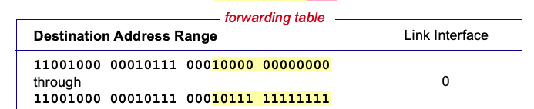

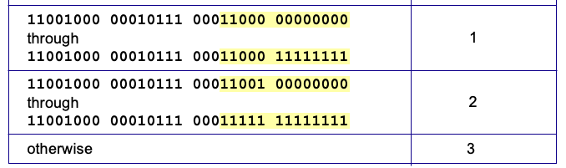
Destination-based forwarding
3
Q: but what happens if ranges don’t divide up so nicely?
Notes:
Text for this animation:
This all works out pretty nice and looks pretty simple!
But of course the devil is in the details, as the saying goes.
What happens, for example, when a subset of addresses say in this first range should go to say interface 3, rather than interface 0. Well, of course we could split the first address range into multiple pieces, and add in this new subrange with its new destination output port. But it turns out there’s a much simpler and elegant way to do this. Known as longest prefix matching.

Slide 19
Longest prefix matching
longest prefix match
when looking for forwarding table entry for given destination address, use longest address prefix that matches destination address.
Destination Address Range
11001000 00010111 00010
11001000 00010111 00011000
11001000 00010111 00011
otherwise
Link interface
0
1
2
3
***
********
********
***
********
examples:
11001000 00010111 00010110 10100001
which interface?
11001000 00010111 00011000 10101010
which interface?

Slide 20
Longest prefix matching
longest prefix match
when looking for forwarding table entry for given destination address, use longest address prefix that matches destination address.
Destination Address Range
11001000 00010111 00010
11001000 00010111 00011000
11001000 00010111 00011
otherwise
Link interface
0
1
2
3
***
********
********
match!
***
********
examples:
11001000 00010111 00010110 10100001
which interface?
11001000 00010111 00011000 10101010
which interface?

Slide 21
Longest prefix matching
longest prefix match
when looking for forwarding table entry for given destination address, use longest address prefix that matches destination address.
Destination Address Range
11001000 00010111 00010
11001000 00010111 00011000
11001000 00010111 00011
otherwise
Link interface
0
1
2
3
***
********
********
***
********
match!
examples:
11001000 00010111 00010110 10100001
which interface?
11001000 00010111 00011000 10101010
which interface?

Slide 22
Longest prefix matching
longest prefix match
when looking for forwarding table entry for given destination address, use longest address prefix that matches destination address.
Destination Address Range
11001000 00010111 00010
11001000 00010111 00011000
11001000 00010111 00011
otherwise
Link interface
0
1
2
3
***
********
********
***
********
match!
examples:
11001000 00010111 00010110 10100001
which interface?
11001000 00010111 00011000 10101010
which interface?

Slide 23
Longest prefix matching
we’ll see why longest prefix matching is used shortly, when we study addressing
longest prefix matching: often performed using ternary content addressable memories (TCAMs)
content addressable: present address to TCAM: retrieve address in one clock cycle, regardless of table size
Cisco Catalyst: ~1M routing table entries in TCAM

Slide 24
Switching fabrics
transfer packet from input link to appropriate output link
switching rate: rate at which packets can be transfer from inputs to outputs
often measured as multiple of input/output line rate
N inputs: switching rate N times line rate desirable
R
(rate: NR, ideally)
R
. . .
high-speed
switching
fabric
. . .
N input ports
N output ports
R
R

Slide 25
Switching fabrics
transfer packet from input link to appropriate output link
switching rate: rate at which packets can be transfer from inputs to outputs
often measured as multiple of input/output line rate
N inputs: switching rate N times line rate desirable
three major types of switching fabrics:
memory
memory
bus
interconnection
network

Slide 26
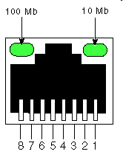
Switching via memory
first generation routers:
traditional computers with switching under direct control of CPU
packet copied to system’s memory
speed limited by memory bandwidth (2 bus crossings per datagram)
input
port
(e.g.,
Ethernet)
output
port
(e.g.,
Ethernet)
memory
system bus

Slide 27
Switching via a bus
datagram from input port memory to output port memory via a shared bus
bus contention: switching speed limited by bus bandwidth
32 Gbps bus, Cisco 5600: sufficient speed for access routers

Slide 28
Switching via interconnection network
Crossbar, Clos networks, other interconnection nets initially developed to connect processors in multiprocessor
multistage switch: nxn switch from multiple stages of smaller switches
3x3 crossbar
3x3 crossbar
exploiting parallelism:
fragment datagram into fixed length cells on entry
switch cells through the fabric, reassemble datagram at exit
8x8 multistage switch
built from smaller-sized switches

Slide 29
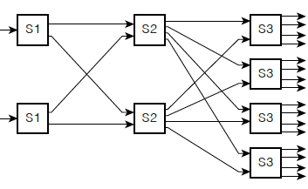
Switching via interconnection network
scaling, using multiple switching “planes” in parallel:
speedup, scaleup via parallelism
Cisco CRS router:
basic unit: 8 switching planes
each plane: 3-stage interconnection network
up to 100’s Tbps switching capacity
fabric plane 0
fabric plane 1
fabric plane 2
. . .
. . .
fabric plane 3
. . .
. . .
fabric plane 4
. . .
. . .
fabric plane 5
. . .
. . .
fabric plane 6
. . .
. . .
fabric plane 7
. . .
. . .
. . .
. . .
. . .
. . .
Notes:
Carrier Routing System

Slide 30
Input port queuing
If switch fabric slower than input ports combined -> queueing may occur at input queues
queueing delay and loss due to input buffer overflow!
Head-of-the-Line (HOL) blocking: queued datagram at front of queue prevents others in queue from moving forward
switch
fabric
switch
fabric
output port contention: only one red datagram can be transferred. lower red packet is blocked
one packet time later: green packet experiences HOL blocking

Slide 31

Output port queuing
datagram
buffer
queueing
This is a really important slide
switch
fabric
(rate: NR)
link
layer
protocol
(send)
line
termination
R
Buffering required when datagrams arrive from fabric faster than link transmission rate. Drop policy: which datagrams to drop if no free buffers?
Datagrams can be lost due to congestion, lack of buffers
Scheduling discipline chooses among queued datagrams for transmission
Priority scheduling – who gets best performance, network neutrality

Slide 32
Output port queuing
switch
fabric
switch
fabric
at t, packets more
from input to output
one packet time later
buffering when arrival rate via switch exceeds output line speed
queueing (delay) and loss due to output port buffer overflow!

Slide 33
How much buffering?
RFC 3439 rule of thumb: average buffering equal to “typical” RTT (say 250 msec) times link capacity C
e.g., C = 10 Gbps link: 2.5 Gbit buffer
more recent recommendation: with N flows, buffering equal to
.
RTT C
N
but too much buffering can increase delays (particularly in home routers)
long RTTs: poor performance for real-time apps, sluggish TCP response
recall delay-based congestion control: “keep bottleneck link just full enough (busy) but no fuller”
Notes:
You might think that more buffering is a good thing. Buffering is a bit like salt—just the right amount of salt makes food better, but too much makes it inedible!

Slide 34
Buffer Management
buffer management:
drop: which packet to add, drop when buffers are full
tail drop: drop arriving packet
priority: drop/remove on priority basis
datagram
buffer
queueing
scheduling
switch
fabric
link
layer
protocol
(send)
line
termination
R
Abstraction: queue
marking: which packets to mark to signal congestion (ECN, RED)
R
packet
departures
packet
arrivals
queue
(waiting area)
link
(server)

Slide 35
Packet Scheduling: FCFS
packet scheduling: deciding which packet to send next on link
first come, first served
priority
round robin
weighted fair queueing
FCFS: packets transmitted in order of arrival to output port
also known as: First-in-first-out (FIFO)
real world examples?
Abstraction: queue
R
packet
departures
packet
arrivals
queue
(waiting area)
link
(server)

Slide 36
Scheduling policies: priority
Priority scheduling:
arriving traffic classified, queued by class
any header fields can be used for classification
high priority queue
arrivals
classify
link
departures
low priority queue
2
send packet from highest priority queue that has buffered packets
FCFS within priority class
1
3
4
5
arrivals
packet in service
1
3
2
4
5
departures
1
3
2
4
5

Slide 37
Scheduling policies: round robin
Round Robin (RR) scheduling:
arriving traffic classified, queued by class
any header fields can be used for classification
server cyclically, repeatedly scans class queues, sending one complete packet from each class (if available) in turn
R
classify
arrivals
link
departures

Slide 38
Scheduling policies: weighted fair queueing
Weighted Fair Queuing (WFQ):
generalized Round Robin
each class, i, has weight, w_{i}, and gets weighted amount of service in each cycle:
w₁
w₂
R
w_{i}
Σ_{j}w_{j}
classify
arrivals
link
departures
w₃
minimum bandwidth guarantee (per-traffic-class)

Slide 39
Sidebar: Network Neutrality
What is network neutrality?
technical: how an ISP should share/allocation its resources
packet scheduling, buffer management are the mechanisms
social, economic principles
protecting free speech
encouraging innovation, competition
enforced legal rules and policies
Different countries have different “takes” on network neutrality

Slide 40
Sidebar: Network Neutrality
2015 US FCC Order on Protecting and Promoting an Open Internet: three “clear, bright line” rules:
no blocking … “shall not block lawful content, applications, services, or non-harmful devices, subject to reasonable network management.”
no throttling … “shall not impair or degrade lawful Internet traffic on the basis of Internet content, application, or service, or use of a non-harmful device, subject to reasonable network management.”
no paid prioritization. … “shall not engage in paid prioritization”

Slide 41
ISP: telecommunications or information service?
Is an ISP a “telecommunications service” or an “information service” provider?
the answer really matters from a regulatory standpoint!
US Telecommunication Act of 1934 and 1996:
Title II: imposes “common carrier duties” on telecommunications services: reasonable rates, non-discrimination and requires regulation
Title I: applies to information services:
no common carrier duties (not regulated)
but grants FCC authority “… as may be necessary in the execution of its functions”4

Slide 42
Network layer: “data plane” roadmap
Network layer: overview
data plane
control plane
What’s inside a router
input ports, switching, output ports
buffer management, scheduling
IP: the Internet Protocol
datagram format
addressing
network address translation
IPv6
Generalized Forwarding, SDN
match+action
OpenFlow: match+action in action
Middleboxes

Slide 43
Network Layer: Internet
host, router network layer functions:
transport layer: TCP, UDP
IP protocol
datagram format
addressing
packet handling conventions
Path-selection algorithms: implemented in
routing protocols (OSPF, BGP)
SDN controller
network
layer
forwarding
table
ICMP protocol
error reporting
router “signaling”
link layer
physical layer

Slide 44
IP Datagram format
32 bits
IP protocol version number
head.
len
type of
service
total datagram
length (bytes)
ver
length
header length(bytes)
“type” of service:
diffserv (0:5)
ECN (6:7)
flgs
fragment
offset
fragmentation/
reassembly
16-bit identifier
time to
live
upper
layer
header
checksum
header checksum
TTL: remaining max hops
(decremented at each router)
source IP address
32-bit source IP address
destination IP address
Maximum length: 64K bytes
Typically: 1500 bytes or less
upper layer protocol (e.g., TCP or UDP)
32-bit destination IP address
overhead
options (if any)
e.g., timestamp, record route taken
20 bytes of TCP
20 bytes of IP
= 40 bytes + app layer overhead for TCP+IP
payload data
(variable length,
typically a TCP
or UDP segment)

Slide 45

IP addressing: introduction
223.1.1.1
IP address: 32-bit identifier associated with each host or router interface
interface: connection between host/router and physical link
router’s typically have multiple interfaces
host typically has one or two interfaces (e.g., wired Ethernet, wireless 802.11)
223.1.2.1
223.1.1.2
223.1.1.4
223.1.2.9
223.1.1.3
223.1.3.27
223.1.2.2
223.1.3.1
223.1.3.2
dotted-decimal IP address notation:
223.1.1.1 = 11011111 00000001 00000001 00000001
223
1
1
1
Notes:
Network ip
Broadcast ip

Slide 46
IP addressing: introduction
223.1.1.1
IP address: 32-bit identifier associated with each host or router interface
interface: connection between host/router and physical link
router’s typically have multiple interfaces
host typically has one or two interfaces (e.g., wired Ethernet, wireless 802.11)
223.1.2.1
223.1.1.2
223.1.1.4
223.1.2.9
223.1.1.3
223.1.3.27
223.1.2.2
223.1.3.1
223.1.3.2
dotted-decimal IP address notation:
223.1.1.1 = 11011111 00000001 00000001 00000001
223
1
1
1

Slide 47
IP addressing: introduction
223.1.1.1
Q: how are interfaces actually connected?
223.1.2.1
223.1.1.2
A: we’ll learn about that in chapters 6, 7
A: wired
Ethernet interfaces connected by Ethernet switches
223.1.1.4
223.1.2.9
223.1.1.3
223.1.3.27
223.1.2.2
223.1.3.1
223.1.3.2
For now: don’t need to worry about how one interface is connected to another (with no intervening router)
A: wireless WiFi interfaces connected by WiFi base station

Slide 48
Subnets
223.1.1.1
What’s a subnet ?
device interfaces that can physically reach each other without passing through an intervening router
223.1.2.1
223.1.1.2
223.1.1.4
223.1.2.9
223.1.1.3
223.1.3.27
223.1.2.2
IP addresses have structure:
subnet part: devices in same subnet have common high order bits
host part: remaining low order bits
223.1.3.1
223.1.3.2
network consisting of 3 subnets

Slide 49
Subnets
subnet 223.1.1.0/24
223.1.1.1
subnet 223.1.2.0/24
Recipe for defining subnets:
detach each interface from its host or router, creating “islands” of isolated networks
each isolated network is called a subnet
223.1.2.1
223.1.1.2
223.1.1.4
223.1.2.9
223.1.1.3
223.1.3.27
223.1.2.2
subnet
223.1.3.0/24
223.1.3.1
223.1.3.2
subnet mask: /24
(high-order 24 bits: subnet part of IP address)

Slide 50
Subnets
223.1.1.2
subnet 223.1.1/24
where are the subnets?
what are the /24 subnet addresses?
223.1.1.1
223.1.1.4
223.1.1.3
223.1.9.2
223.1.7.0
subnet 223.1.7/24
subnet 223.1.9/24
223.1.9.1
223.1.7.1
223.1.8.1
223.1.8.0
subnet 223.1.2/24
223.1.2.6
subnet 223.1.8/24
223.1.3.27
subnet 223.1.3/24
223.1.2.1
223.1.2.2
223.1.3.1
223.1.3.2

Slide 51
IP addressing: CIDR
CIDR: Classless InterDomain Routing (pronounced “cider”)
subnet portion of address of arbitrary length
address format: a.b.c.d/x, where x is # bits in subnet portion of address
subnet
part
host
part
11001000 00010111 00010000 00000000
200.23.16.0/23

Slide 52
IP addresses: how to get one?
That’s actually two questions:
Q: How does a host get IP address within its network (host part of address)?
Q: How does a network get IP address for itself (network part of address)
How does host get IP address?
hard-coded by sysadmin in config file (e.g., /etc/rc.config in UNIX)
DHCP: Dynamic Host Configuration Protocol: dynamically get address from as server
“plug-and-play”

Slide 53
DHCP: Dynamic Host Configuration Protocol
goal: host dynamically obtains IP address from network server when it “joins” network
can renew its lease on address in use
allows reuse of addresses (only hold address while connected/on)
support for mobile users who join/leave network
DHCP overview:
host broadcasts DHCP discover msg [optional]
DHCP server responds with DHCP offer msg [optional]
host requests IP address: DHCP request msg
DHCP server sends address: DHCP ack msg

Slide 54
DHCP client-server scenario
Typically, DHCP server will be co-located in router, serving all subnets to which router is attached
DHCP server
223.1.1.1
223.1.2.1
223.1.2.5
223.1.1.2
223.1.1.4
223.1.2.9
223.1.1.3
223.1.3.27
arriving DHCP client needs
address in this network
223.1.2.2
223.1.3.1
223.1.3.2

Slide 55


DHCP client-server scenario
DHCP server: 223.1.2.5
DHCP discover
Arriving client
src : 0.0.0.0, 68
dest.: 255.255.255.255,67
yiaddr: 0.0.0.0
transaction ID: 654
Broadcast: is there a DHCP server out there?
DHCP offer
src: 223.1.2.5, 67
dest: 255.255.255.255, 68
yiaddr: 223.1.2.4
transaction ID: 654
lifetime: 3600 secs
Broadcast: I’m a DHCP server! Here’s an IP address you can use
The two steps above can be skipped “if a client remembers and wishes to reuse a previously allocated network address” [RFC 2131]
DHCP request
src: 0.0.0.0, 68
dest:: 255.255.255.255, 67
yiaddr: 223.1.2.4
transaction ID: 655
lifetime: 3600 secs
Broadcast: OK. I would like to use this IP address!
DHCP ACK
src: 223.1.2.5, 67
dest: 255.255.255.255, 68
yiaddr: 223.1.2.4
transaction ID: 655
lifetime: 3600 secs
Broadcast: OK. You’ve got that IP address!

Slide 56
DHCP: more than IP addresses
DHCP can return more than just allocated IP address on subnet:
address of first-hop router for client
name and IP address of DNS sever
network mask (indicating network versus host portion of address)

Slide 57


DHCP: example
DHCP
DHCP
UDP
IP
Eth
Phy
Connecting laptop will use DHCP to get IP address, address of first-hop router, address of DNS server.
DHCP
DHCP
DHCP
DHCP
DHCP REQUEST message encapsulated in UDP, encapsulated in IP, encapsulated in Ethernet
DHCP
DHCP
UDP
IP
Eth
Phy
168.1.1.1
DHCP
DHCP
DHCP
Ethernet frame broadcast (dest: FFFFFFFFFFFF) on LAN, received at router running DHCP server
DHCP
router with DHCP
server built into
router
Ethernet de-mux’ed to IP de-mux’ed, UDP de-mux’ed to DHCP

Slide 58
DHCP: example
DHCP
UDP
IP
Eth
Phy
DCP server formulates DHCP ACK containing client’s IP address, IP address of first-hop router for client, name & IP address of DNS server
DHCP
DHCP
DHCP
DHCP
encapsulated DHCP server reply forwarded to client, de-muxing up to DHCP at client
DHCP
DHCP
UDP
IP
Eth
Phy
DHCP
DHCP
DHCP
router with DHCP
server built into
router
client now knows its IP address, name and IP address of DNS server, IP address of its first-hop router
DHCP

Slide 59
IP addresses: how to get one?
Q: how does network get subnet part of IP address?
A: gets allocated portion of its provider ISP’s address space
ISP's block 11001000 00010111 00010000 00000000 200.23.16.0/20
ISP can then allocate out its address space in 8 blocks:
Organization 0 11001000 00010111 00010000 00000000 200.23.16.0/23
Organization 1 11001000 00010111 00010010 00000000 200.23.18.0/23
Organization 2 11001000 00010111 00010100 00000000 200.23.20.0/23
... ….. …. ….
Organization 7 11001000 00010111 00011110 00000000 200.23.30.0/23

Slide 60
Hierarchical addressing: route aggregation
hierarchical addressing allows efficient advertisement of routing information:
Organization 0
200.23.16.0/23
Organization 1
200.23.18.0/23
“Send me anything
with addresses
beginning
200.23.16.0/20”
Organization 2
200.23.20.0/23
.
Fly-By-Night-ISP
.
.
.
.
Internet
Organization 7
.
200.23.30.0/23
ISPs-R-Us
“Send me anything
with addresses
beginning
199.31.0.0/16”

Slide 61
Hierarchical addressing: more specific routes
Organization 1 moves from Fly-By-Night-ISP to ISPs-R-Us
ISPs-R-Us now advertises a more specific route to Organization 1
Organization 0
200.23.16.0/23
Organization 1
200.23.18.0/23
“Send me anything
with addresses
beginning
200.23.16.0/20”
Organization 2
200.23.20.0/23
.
Fly-By-Night-ISP
.
.
.
.
Internet
Organization 7
.
200.23.30.0/23
ISPs-R-Us
“Send me anything
with addresses
beginning
199.31.0.0/16”
Organization 1
200.23.18.0/23
“or 200.23.18.0/23”

Slide 62
Hierarchical addressing: more specific routes
Organization 1 moves from Fly-By-Night-ISP to ISPs-R-Us
ISPs-R-Us now advertises a more specific route to Organization 1
Organization 0
200.23.16.0/23
“Send me anything
with addresses
beginning
200.23.16.0/20”
Organization 2
200.23.20.0/23
.
Fly-By-Night-ISP
.
.
.
.
Internet
Organization 7
.
200.23.30.0/23
ISPs-R-Us
“Send me anything
with addresses
beginning
199.31.0.0/16”
Organization 1
200.23.18.0/23
“or 200.23.18.0/23”

Slide 63
IP addressing: last words ...
Q: how does an ISP get block of addresses?
A: ICANN: Internet Corporation for Assigned Names and Numbers http://www.icann.org/
allocates IP addresses, through 5 regional registries (RRs) (who may then allocate to local registries)
manages DNS root zone, including delegation of individual TLD (.com, .edu , …) management
Q: are there enough 32-bit IP addresses?
ICANN allocated last chunk of IPv4 addresses to RRs in 2011
NAT (next) helps IPv4 address space exhaustion
IPv6 has 128-bit address space
"Who the hell knew how much address space we needed?" Vint Cerf (reflecting on decision to make IPv4 address 32 bits long)

Slide 64
Network layer: “data plane” roadmap
Network layer: overview
data plane
control plane
What’s inside a router
input ports, switching, output ports
buffer management, scheduling
IP: the Internet Protocol
datagram format
addressing
network address translation
IPv6
Generalized Forwarding, SDN
match+action
OpenFlow: match+action in action
Middleboxes

Slide 65
NAT: network address translation
NAT: all devices in local network share just one IPv4 address as far as outside world is concerned
rest of
Internet
local network (e.g., home network) 10.0.0/24
10.0.0.1
138.76.29.7
10.0.0.4
10.0.0.2
10.0.0.3
all datagrams leaving local network have same source NAT IP address: 138.76.29.7, but different source port numbers
datagrams with source or destination in this network have 10.0.0/24 address for source, destination (as usual)

Slide 66
NAT: network address translation
all devices in local network have 32-bit addresses in a “private” IP address space (10/8, 172.16/12, 192.168/16 prefixes) that can only be used in local network
advantages:
just one IP address needed from provider ISP for all devices
can change addresses of host in local network without notifying outside world
can change ISP without changing addresses of devices in local network
security: devices inside local net not directly addressable, visible by outside world

Slide 67
NAT: network address translation
implementation: NAT router must (transparently):
outgoing datagrams: replace (source IP address, port #) of every outgoing datagram to (NAT IP address, new port #)
remote clients/servers will respond using (NAT IP address, new port #) as destination address
remember (in NAT translation table) every (source IP address, port #) to (NAT IP address, new port #) translation pair
incoming datagrams: replace (NAT IP address, new port #) in destination fields of every incoming datagram with corresponding (source IP address, port #) stored in NAT table

Slide 68
NAT: network address translation
NAT translation table
WAN side addr LAN side addr
2: NAT router changes datagram source address from 10.0.0.1, 3345 to 138.76.29.7, 5001,
updates table
1: host 10.0.0.1 sends datagram to 128.119.40.186, 80
138.76.29.7, 5001 10.0.0.1, 3345
…… ……
S: 10.0.0.1, 3345
D: 128.119.40.186, 80
10.0.0.1
1
2
S: 138.76.29.7, 5001
D: 128.119.40.186, 80
10.0.0.4
10.0.0.2
138.76.29.7
S: 128.119.40.186, 80
D: 10.0.0.1, 3345
4
S: 128.119.40.186, 80
D: 138.76.29.7, 5001
3
10.0.0.3
3: reply arrives, destination address: 138.76.29.7, 5001

Slide 69
NAT: network address translation
NAT has been controversial:
routers “should” only process up to layer 3
address “shortage” should be solved by IPv6
violates end-to-end argument (port # manipulation by network-layer device)
NAT traversal: what if client wants to connect to server behind NAT?
but NAT is here to stay:
extensively used in home and institutional nets, 4G/5G cellular nets

Slide 70
IPv6: motivation
initial motivation: 32-bit IPv4 address space would be completely allocated
additional motivation:
speed processing/forwarding: 40-byte fixed length header
enable different network-layer treatment of “flows”

Slide 71
IPv6 datagram format
flow label: identify datagrams in same "flow.” (concept of “flow” not well defined).
32 bits
priority: identify priority among datagrams in flow
ver
pri
flow label
payload len
next hdr
hop limit
source address
(128 bits)
128-bit
IPv6 addresses
destination address
(128 bits)
payload (data)
What’s missing (compared with IPv4):
no checksum (to speed processing at routers)
no fragmentation/reassembly
no options (available as upper-layer, next-header protocol at router)

Slide 72
Transition from IPv4 to IPv6
not all routers can be upgraded simultaneously
no “flag days”
how will network operate with mixed IPv4 and IPv6 routers?
tunneling: IPv6 datagram carried as payload in IPv4 datagram among IPv4 routers (“packet within a packet”)
tunneling used extensively in other contexts (4G/5G)
IPv4 header fields
IPv6 header fields
IPv4 payload
IPv4 source, dest addr
IPv6 source dest addr
UDP/TCP payload
IPv6 datagram
IPv4 datagram

Slide 73
Tunneling and encapsulation
Ethernet connecting two IPv6 routers:
A
B
Ethernet connects two IPv6 routers
E
F
IPv6
IPv6
IPv6
IPv6
IPv6 datagram
Link-layer frame
The usual: datagram as payload in link-layer frame
IPv4 network connecting two IPv6 routers
A
B
E
F
IPv6
IPv6/v4
IPv6/v4
IPv6
IPv4 network

Slide 74
Tunneling and encapsulation
Ethernet connecting two IPv6 routers:
A
B
Ethernet connects two IPv6 routers
E
F
IPv6
IPv6
IPv6
IPv6
IPv6 datagram
Link-layer frame
The usual: datagram as payload in link-layer frame
IPv4 tunnel connecting two IPv6 routers
A
B
IPv4 tunnel
connecting IPv6 routers
E
F
IPv6
IPv6/v4
IPv6/v4
IPv6
IPv6 datagram
IPv4 datagram
tunneling: IPv6 datagram as payload in a IPv4 datagram

Slide 75
Tunneling
A
B
IPv4 tunnel
connecting IPv6 routers
E
F
logical view:
IPv6
IPv6/v4
IPv6/v4
IPv6
A
B
C
D
E
F
physical view:
IPv6
IPv6/v4
IPv4
IPv4
IPv6/v4
IPv6
flow: X
src: A
dest: F
data
src:B
dest: E
src:B
dest: E
src:B
dest: E
flow: X
src: A
dest: F
data
Flow: X
Src: A
Dest: F
data
Flow: X
Src: A
Dest: F
data
Flow: X
Src: A
Dest: F
data
Note source and destination addresses!
A-to-B:
IPv6
B-to-C:
IPv6 inside
IPv4
B-to-C:
IPv6 inside
IPv4
B-to-C:
IPv6 inside
IPv4
E-to-F:
IPv6

Slide 76
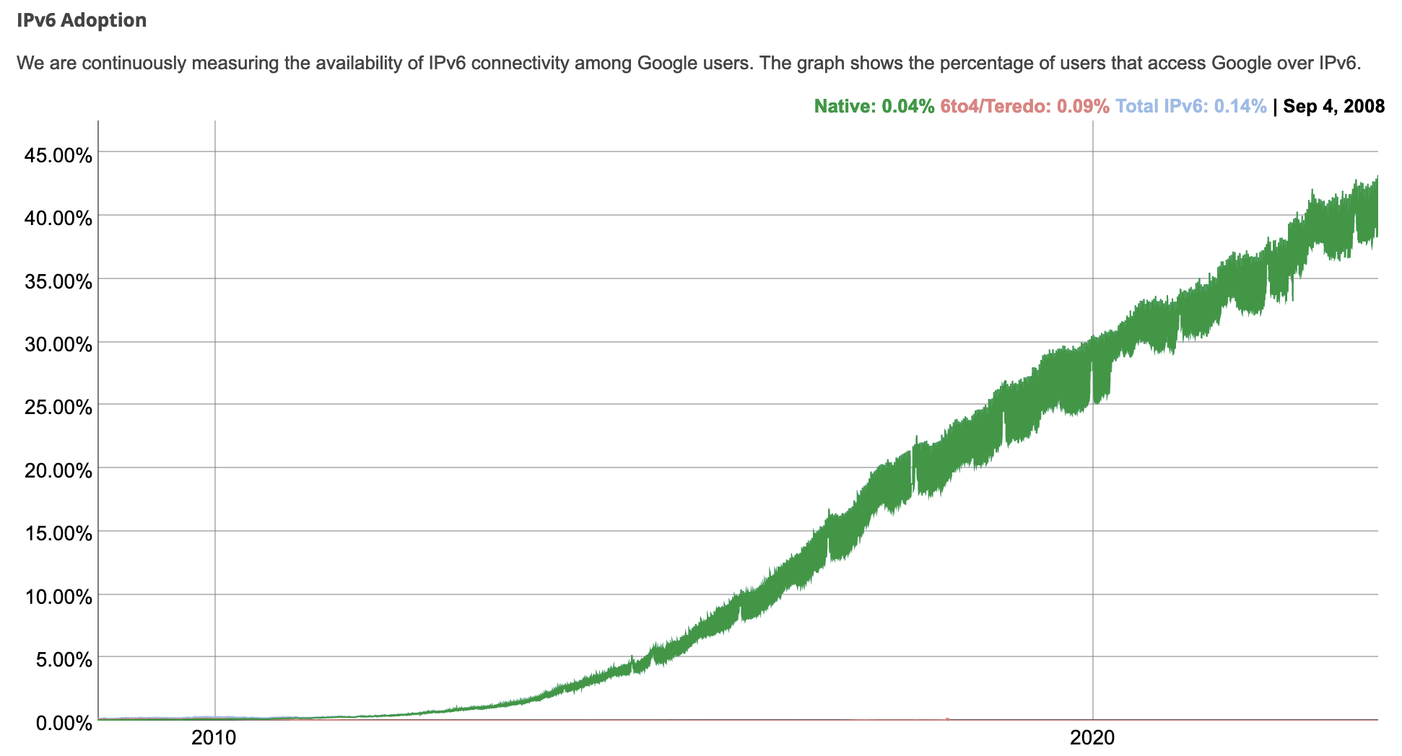
IPv6: adoption
Google¹: ~ 40% of clients access services via IPv6 (2023)
NIST: 1/3 of all US government domains are IPv6 capable

Slide 77
IPv6: adoption
Google¹: ~ 40% of clients access services via IPv6 (2023)
NIST: 1/3 of all US government domains are IPv6 capable
Long (long!) time for deployment, use
25 years and counting!
think of application-level changes in last 25 years: WWW, social media, streaming media, gaming, telepresence, …
Why?
¹ https://www.google.com/intl/en/ipv6/statistics.html

Slide 78
Network layer: “data plane” roadmap
Network layer: overview
data plane
control plane
What’s inside a router
input ports, switching, output ports
buffer management, scheduling
IP: the Internet Protocol
datagram format
addressing
network address translation
IPv6
Generalized Forwarding, SDN
Match+action
OpenFlow: match+action in action
Middleboxes

Slide 79
Generalized forwarding: match plus action
Review: each router contains a forwarding table
“match plus action” abstraction: match bits in arriving packet, take action
(aka: flow table)
destination-based forwarding: forward based on dest. IP address
values in arriving
packet header
generalized forwarding:
many header fields can determine action
many action possible: drop/copy/modify/log packet
0111
1
3
2
forwarding table
(aka: flow table)

Slide 80
Flow table abstraction
flow: defined by header field values (in link-, network-, transport-layer fields)
generalized forwarding: simple packet-handling rules
match: pattern values in packet header fields
actions: for matched packet: drop, forward, modify, matched packet or send matched packet to controller
priority: disambiguate overlapping patterns
counters: #bytes and #packets
Flow table
Router’s flow table define router’s match+action rules
match
action

Slide 81
Flow table abstraction
flow: defined by header fields
generalized forwarding: simple packet-handling rules
match: pattern values in packet header fields
actions: for matched packet: drop, forward, modify, matched packet or send matched packet to controller
priority: disambiguate overlapping patterns
counters: #bytes and #packets
src = *.*.*.*, dest=3.4.*.* forward(2)
Flow table
match
action
src=1.2.*.*, dest=*.*.*.* drop
src=10.1.2.3, dest=*.*.*.* send to controller
* : wildcard
1
4
3
2

Slide 82
OpenFlow: flow table entries
Match
Action
Stats
Packet + byte counters
Forward packet to port(s)
Drop packet
Modify fields in header(s)
Encapsulate and forward to controller
Header fields to match:
Ingress Port
Src MAC
Dst MAC
Eth Type
VLAN
ID
VLAN
Pri
IP Src
IP Dst
IP Proto
IP
ToS
TCP/UDP Src Port
TCP/UDP Dst Port
Link layer
Network layer
Transport layer

Slide 83
OpenFlow: examples
Destination-based forwarding:
Switch
Port
MAC
src
MAC
dst
Eth
type
VLAN
ID
VLAN
Pri
IP
Src
IP
Dst
IP
Prot
IP
ToS
TCP
s-port
TCP
d-port
Action
*
*
*
*
*
*
*
51.6.0.8
*
*
*
*
port6
IP datagrams destined to IP address 51.6.0.8 should be forwarded to router output port 6
Firewall:
Switch
Port
MAC
src
MAC
dst
Eth
type
VLAN
ID
VLAN
Pri
IP
Src
IP
Dst
IP
Prot
IP
ToS
TCP
s-port
TCP
d-port
Action
*
*
*
*
*
*
*
*
*
*
*
22
drop
Block (do not forward) all datagrams destined to TCP port 22 (ssh port #)
Switch
Port
MAC
src
MAC
dst
Eth
type
VLAN
ID
VLAN
Pri
IP
Src
IP
Dst
IP
Prot
IP
ToS
TCP
s-port
TCP
d-port
Action
*
*
*
*
*
*
128.119.1.1
*
*
*
*
*
drop
Block (do not forward) all datagrams sent by host 128.119.1.1

Slide 84
OpenFlow: examples
Layer 2 destination-based forwarding:
Switch
Port
MAC
src
MAC
dst
Eth
type
VLAN
ID
VLAN
Pri
IP
Src
IP
Dst
IP
Prot
IP
ToS
TCP
s-port
TCP
d-port
Action
*
*
22:A7:23:
11:E1:02
*
*
*
*
*
*
*
*
*
port3
layer 2 frames with destination MAC address 22:A7:23:11:E1:02 should be forwarded to output port 3

Slide 85
OpenFlow abstraction
match+action: abstraction unifies different kinds of devices
Router
match: longest destination IP prefix
action: forward out a link
Switch
match: destination MAC address
action: forward or flood
Firewall
match: IP addresses and TCP/UDP port numbers
action: permit or deny
NAT
match: IP address and port
action: rewrite address and port

Slide 86


OpenFlow example
Orchestrated tables can create network-wide behavior, e.g.,:
datagrams from hosts h5 and h6 should be sent to h3 or h4, via s1 and from there to s2
Host h6
10.3.0.6
1
s3
controller
2
3
4
Host h5
10.3.0.5
1
s1
s2
Host h1
10.1.0.1
1
2
Host h4
10.2.0.4
4
2
4
3
3
Host h2
10.1.0.2
Host h3
10.2.0.3

Slide 87
OpenFlow example
match
action
Orchestrated tables can create network-wide behavior, e.g.,:
datagrams from hosts h5 and h6 should be sent to h3 or h4, via s1 and from there to s2
IP Src = 10.3.*.*
IP Dst = 10.2.*.*
Host h6
10.3.0.6
forward(3)
1
s3
controller
2
3
4
Host h5
10.3.0.5
1
s1
s2
Host h1
10.1.0.1
1
2
Host h4
10.2.0.4
4
2
4
3
3
match
action
match
action
Host h2
10.1.0.2
Host h3
10.2.0.3
ingress port = 2
IP Dst = 10.2.0.3
ingress port = 2
IP Dst = 10.2.0.4
ingress port = 1
IP Src = 10.3.*.*
IP Dst = 10.2.*.*
forward(3)
forward(4)
forward(4)

Slide 88
Generalized forwarding: summary
“match plus action” abstraction: match bits in arriving packet header(s) in any layers, take action
matching over many fields (link-, network-, transport-layer)
local actions: drop, forward, modify, or send matched packet to controller
“program” network-wide behaviors
simple form of “network programmability”
programmable, per-packet “processing”
historical roots: active networking
today: more generalized programming:
P4 (see p4.org).

Slide 89
Network layer: “data plane” roadmap
Network layer: overview
What’s inside a router
IP: the Internet Protocol
Generalized Forwarding
Middleboxes
middlebox functions
evolution, architectural principles of the Internet

Slide 90
Middleboxes
Middlebox (RFC 3234)
“any intermediary box performing functions apart from normal, standard functions of an IP router on the data path between a source host and destination host”

Slide 91
Middleboxes everywhere!
Firewalls, IDS: corporate, institutional, service providers, ISPs
national or global ISP
NAT: home, cellular, institutional
Load balancers: corporate, service provider, data center, mobile nets
Application-specific: service providers, institutional, CDN
datacenter
network
Caches: service provider, mobile, CDNs
enterprise
network

Slide 92
Middleboxes
initially: proprietary (closed) hardware solutions
move towards “whitebox” hardware implementing open API
move away from proprietary hardware solutions
programmable local actions via match+action
move towards innovation/differentiation in software
SDN: (logically) centralized control and configuration management often in private/public cloud
network functions virtualization (NFV): programmable services over white box networking, computation, storage

Slide 93
The IP hourglass
HTTP
SMTP
RTP
…
Internet’s “thin waist”:
one network layer protocol: IP
must be implemented by every (billions) of Internet-connected devices
QUIC
DASH
many protocols in physical, link, transport, and application layers
TCP
UDP
IP
Ethernet
…
PPP
PDCP
WiFi
Bluetooth
copper radio fiber

Slide 94
The IP hourglass, at middle age
HTTP
SMTP
RTP
…
QUIC
DASH
Internet’s middle age “love handles”?
middleboxes, operating inside the network
TCP
UDP
caching
NAT
IP
NFV
Firewalls
Ethernet
…
PPP
PDCP
WiFi
Bluetooth
copper radio fiber

Slide 95
Architectural Principles of the Internet
RFC 1958
“Many members of the Internet community would argue that there is no architecture, but only a tradition, which was not written down for the first 25 years (or at least not by the IAB). However, in very general terms, the community believes that
the goal is connectivity, the tool is the Internet Protocol, and the intelligence is end to end rather than hidden in the network.”
Three cornerstone beliefs:
simple connectivity
IP protocol: that narrow waist
intelligence, complexity at network edge

Slide 96
The end-end argument
some network functionality (e.g., reliable data transfer, congestion) can be implemented in network, or at network edge
application
transport
network
data link
physical
end-end implementation of reliable data transfer
application
transport
network
data link
physical
application
transport
network
data link
physical
application
transport
network
data link
physical
hop-by-hop (in-network) implementation of reliable data transfer
network
link
physical
network
link
physical
network
link
physical
network
link
physical
network
link
physical
network
link
physical

Slide 97
The end-end argument
some network functionality (e.g., reliable data transfer, congestion) can be implemented in network, or at network edge
“The function in question can completely and correctly be implemented only with the knowledge and help of the application standing at the end points of the communication system. Therefore, providing that questioned function as a feature of the communication system itself is not possible. (Sometimes an incomplete version of the function provided by the communication system may be useful as a performance enhancement.)
We call this line of reasoning against low-level function implementation the “end-to-end argument.”
Saltzer, Reed, Clark 1981

Slide 98




Where’s the intelligence?
20th century phone net:
intelligence/computing at network switches
Internet (pre-2005)
intelligence, computing at edge
Internet (post-2005)
programmable network devices
intelligence, computing, massive application-level infrastructure at edge
Notes:
The 20th century phone network had dumb network endpoints, really by definition. The end points were rotary phones that maybe only your parents and grandparents remember; they weren’t computers. They really were dumb devices, and therefore the phone network had programmable switches that were quite smart. All functionality – well, all of the intelligence - was implemented within the network. It HAD to be. The end systems could not do anything more than send digits and send audio signals.
When the Internet came along, the endpoints and the switches were both programmable computers. So where to put the complexity? RFC 1958 – the architectural principles of the Internet RFC - that says “intelligence is end to end rather than hidden in the network.” That puts the intelligence clearly at the edge, like we see here. And that’s possible because the edge devices are smart; they’re programmable. Well that’s the diagram as I remember it 20 years ago.
And in the 20 years since, as we see the rise of middleboxes and SDN, we’re now seeing intelligence (in software) layered on top of “dumb” whiteboxes within the network. So I might add a brain here today. And with datacenters and content distribution networks, we see even smarter and more sophisticated application-level infrastructure being connected at points within the network. So now there are clearly much much bigger, much more computationally intensive and complex, endpoints if you will in today’s Internet

Slide 99
Chapter 4: done!
Network layer: overview
What’s inside a router
IP: the Internet Protocol
Generalized Forwarding, SDN
Middleboxes
Question: how are forwarding tables (destination-based forwarding) or flow tables (generalized forwarding) computed?
Answer: by the control plane (next chapter)

Slide 100
Additional Chapter 4 slides

Slide 101
IP fragmentation/reassembly
network links have MTU (max. transfer size) - largest possible link-level frame
different link types, different MTUs
large IP datagram divided (“fragmented”) within net
one datagram becomes several datagrams
“reassembled” only at destination
IP header bits used to identify, order related fragments
…
fragmentation:
in: one large datagram
out: 3 smaller datagrams
reassembly
…

Slide 102
IP fragmentation/reassembly
example:
4000 byte datagram
MTU = 1500 bytes
length
=4000
ID
=x
fragflag
=0
offset
=0
one large datagram becomes
several smaller datagrams
1480 bytes in data field
length
=1500
ID
=x
fragflag
=1
offset
=0
offset =
1480/8
length
=1500
ID
=x
fragflag
=1
offset
=185
length
=1040
ID
=x
fragflag
=0
offset
=370

Slide 103
DHCP: Wireshark output (home LAN)
Message type: Boot Request (1)
Hardware type: Ethernet
Hardware address length: 6
Hops: 0
Transaction ID: 0x6b3a11b7
Seconds elapsed: 0
Bootp flags: 0x0000 (Unicast)
Client IP address: 0.0.0.0 (0.0.0.0)
Your (client) IP address: 0.0.0.0 (0.0.0.0)
Next server IP address: 0.0.0.0 (0.0.0.0)
Relay agent IP address: 0.0.0.0 (0.0.0.0)
Client MAC address: Wistron_23:68:8a (00:16:d3:23:68:8a)
Server host name not given
Boot file name not given
Magic cookie: (OK)
Option: (t=53,l=1) DHCP Message Type = DHCP Request
Option: (61) Client identifier
Length: 7; Value: 010016D323688A;
Hardware type: Ethernet
Client MAC address: Wistron_23:68:8a (00:16:d3:23:68:8a)
Option: (t=50,l=4) Requested IP Address = 192.168.1.101
Option: (t=12,l=5) Host Name = "nomad"
Option: (55) Parameter Request List
Length: 11; Value: 010F03062C2E2F1F21F92B
1 = Subnet Mask; 15 = Domain Name
3 = Router; 6 = Domain Name Server
44 = NetBIOS over TCP/IP Name Server
……
Message type: Boot Reply (2)
Hardware type: Ethernet
Hardware address length: 6
Hops: 0
Transaction ID: 0x6b3a11b7
Seconds elapsed: 0
Bootp flags: 0x0000 (Unicast)
Client IP address: 192.168.1.101 (192.168.1.101)
Your (client) IP address: 0.0.0.0 (0.0.0.0)
Next server IP address: 192.168.1.1 (192.168.1.1)
Relay agent IP address: 0.0.0.0 (0.0.0.0)
Client MAC address: Wistron_23:68:8a (00:16:d3:23:68:8a)
Server host name not given
Boot file name not given
Magic cookie: (OK)
Option: (t=53,l=1) DHCP Message Type = DHCP ACK
Option: (t=54,l=4) Server Identifier = 192.168.1.1
Option: (t=1,l=4) Subnet Mask = 255.255.255.0
Option: (t=3,l=4) Router = 192.168.1.1
Option: (6) Domain Name Server
Length: 12; Value: 445747E2445749F244574092;
IP Address: 68.87.71.226;
IP Address: 68.87.73.242;
IP Address: 68.87.64.146
Option: (t=15,l=20) Domain Name = "hsd1.ma.comcast.net."
request
reply

