Slide 1

Chapter 5 Network Layer:
Control Plane
A note on the use of these PowerPoint slides:
We’re making these slides freely available to all (faculty, students, readers). They’re in PowerPoint form so you see the animations; and can add, modify, and delete slides (including this one) and slide content to suit your needs. They obviously represent a lot of work on our part. In return for use, we only ask the following:
If you use these slides (e.g., in a class) that you mention their source (after all, we’d like people to use our book!)
If you post any slides on a www site, that you note that they are adapted from (or perhaps identical to) our slides, and note our copyright of this material.
For a revision history, see the slide note for this page.
Thanks and enjoy! JFK/KWR
All material copyright 1996-2023
J.F Kurose and K.W. Ross, All Rights Reserved
Computer Networking: A Top-Down Approach 8th edition Jim Kurose, Keith Ross Pearson, 2020
Notes:
Version History
8.0 (May 2020)
All slides reformatted for 16:9 aspect ratio
All slides updated to 8th edition material
Use of Calibri font, rather that Gill Sans MT
Add LOTS more animation throughout
lighter header font
Re-do of network management slides; redo of Bellman-Ford slides
8.2 (changes over 8.0)
improved animations of Dijkstra’s algorithm and Bellman Ford
various improvements to BGP
SDN: added Google Orion (2021 Google network SDN control plane)

Slide 2
Network layer control plane: our goals
understand principles behind network control plane:
traditional routing algorithms
SDN controllers

Slide 3

Network layer: “control plane” roadmap
introduction
routing protocols
link state
distance vector
intra-ISP routing: OSPF
routing among ISPs: BGP
SDN control plane

Slide 4
Network-layer functions
forwarding: move packets from router’s input to appropriate router output
data plane
routing: determine route taken by packets from source to destination
control plane
Two approaches to structuring network control plane:
per-router control (traditional)
logically centralized control (software defined networking)

Slide 5

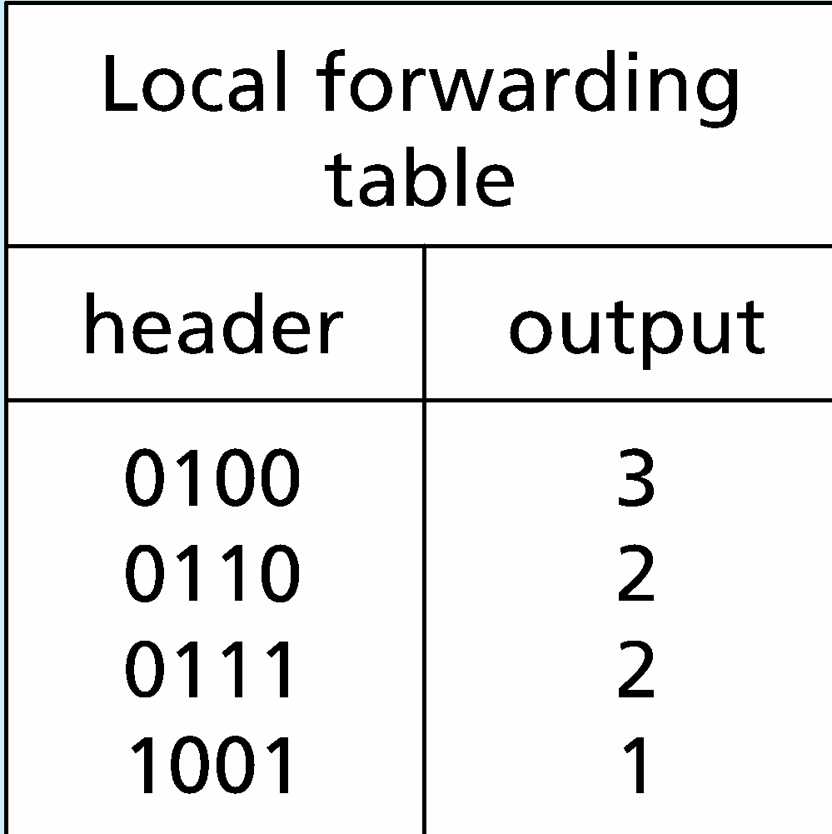
Per-router control plane
Individual routing algorithm components in each and every router interact in the control plane
Routing
Algorithm
control
plane
data
plane
values in arriving
packet header
0111
1
3
2

Slide 6
Software-Defined Networking (SDN) control plane
Remote controller computes, installs forwarding tables in routers
Remote Controller
control
plane
data
plane
CA
CA
CA
CA
CA
values in arriving
packet header
0111
1
3
2

Slide 7
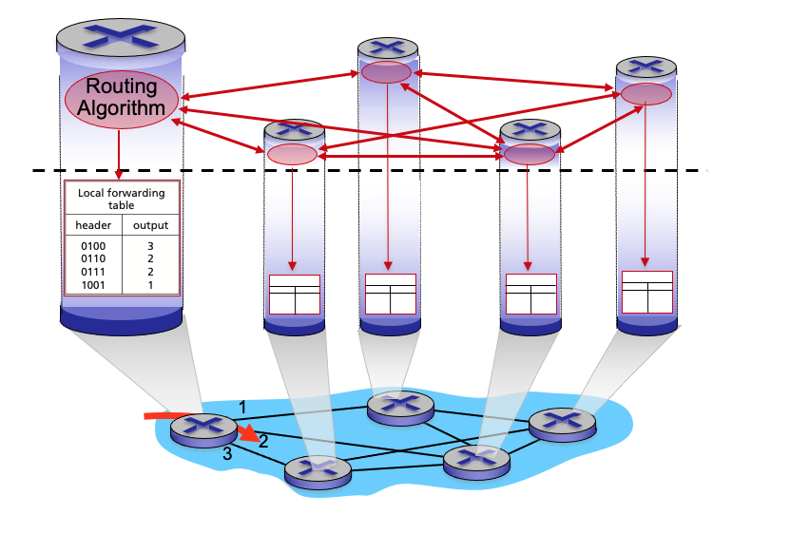
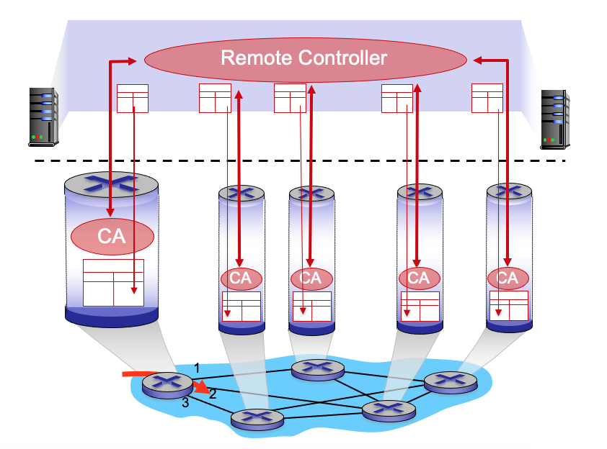
Per-router control plane
SDN control plane

Slide 8
Network layer: “control plane” roadmap
introduction
routing protocols
link state
distance vector
intra-ISP routing: OSPF
routing among ISPs: BGP
SDN control plane
Internet Control Message Protocol
network management, configuration
SNMP
NETCONF/YANG

Slide 9








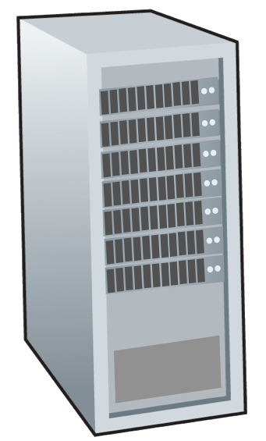







Routing protocols
mobile network
Routing protocol goal: determine “good” paths (equivalently, routes), from sending hosts to receiving host, through network of routers
path: sequence of routers packets traverse from given initial source host to final destination host
“good”: least “cost”, “fastest”, “least congested”
routing: a “top-10” networking challenge!
national or global ISP
application
transport
network
link
physical
network
link
physical
network
link
physical
network
link
physical
network
link
physical
network
link
physical
datacenter
network
application
transport
network
link
physical
enterprise
network

Slide 10
Graph abstraction: link costs
5
c_{a,b}: cost of direct link connecting a and b
e.g., c_{w,z} = 5, c_{u,z} = ∞
cost defined by network operator: could always be 1, or inversely related to bandwidth, or inversely related to congestion
v
3
w
2
5
u
2
1
z
3
1
2
x
y
1
graph: G = (N,E)
N: set of routers = { u, v, w, x, y, z }
E: set of links ={ (u,v), (u,x), (v,x), (v,w), (x,w), (x,y), (w,y), (w,z), (y,z) }

Slide 11
Routing algorithm classification
global: all routers have complete topology, link cost info
“link state” algorithms
dynamic: routes change more quickly
periodic updates or in response to link cost changes
How fast do routes change?
static: routes change slowly over time
decentralized: iterative process of computation, exchange of info with neighbors
routers initially only know link costs to attached neighbors
“distance vector” algorithms
global or decentralized information?

Slide 12
Network layer: “control plane” roadmap
introduction
routing protocols
link state
distance vector
intra-ISP routing: OSPF
routing among ISPs: BGP
SDN control plane
Internet Control Message Protocol
network management, configuration
SNMP
NETCONF/YANG

Slide 13
Dijkstra’s link-state routing algorithm
centralized: network topology, link costs known to all nodes
accomplished via “link state broadcast”
all nodes have same info
computes least cost paths from one node (“source”) to all other nodes
gives forwarding table for that node
iterative: after k iterations, know least cost path to k destinations
notation
c_{x,y}: direct link cost from node x to y; = ∞ if not direct neighbors
D(v): current estimate of cost of least-cost-path from source to destination v
p(v): predecessor node along path from source to v
N': set of nodes whose least-cost-path definitively known

Slide 14
Dijkstra’s link-state routing algorithm
1 Initialization:
2 N' = {u} /* compute least cost path from u to all other nodes */
3 for all nodes v
4 if v adjacent to u /* u initially knows direct-path-cost only to direct neighbors */
5 then D(v) = c_{u,v} /* but may not be minimum cost! */
6 else D(v) = ∞
7
8 Loop
9
10
11
12
13
14
15 until all nodes in N'
find w not in N' such that D(w) is a minimum
add w to N'
update D(v) for all v adjacent to w and not in N' :
D(v) = min ( D(v), D(w) + c_{w,v} )
/* new least-path-cost to v is either old least-cost-path to v or known
least-cost-path to w plus direct-cost from w to v */

Slide 15
Dijkstra’s algorithm: an example
v
w
x
y
z
Step
0
1
2
3
4
5
N'
D(v),p(v)
D(w),p(w)
D(x),p(x)
D(y),p(y)
D(z),p(z)
u
2,u
5,u
1,u
∞
∞
D(w),p(w)
5,u
4,x
3,y
3,y
5
Initialization (step 0):
For all a: if a adjacent to u then D(a) = c_{u,a}
v
3
w
2
5
u
2
1
z
3
1
2
x
y
1

Slide 16
Dijkstra’s algorithm: an example
v
w
x
y
z
Step
0
1
2
3
4
5
N'
D(v),p(v)
D(w),p(w)
D(x),p(x)
D(y),p(y)
D(z),p(z)
u
2,u
5,u
1,u
∞
∞
ux
D(w),p(w)
5,u
4,x
3,y
3,y
8 Loop
9
10
find a not in N' such that D(a) is a minimum
add a to N'
5
v
3
w
2
5
u
2
1
z
3
1
2
x
y
1

Slide 17

Dijkstra’s algorithm: an example
v
w
x
y
z
Step
0
1
2
3
4
5
N'
D(v),p(v)
D(w),p(w)
D(x),p(x)
D(y),p(y)
D(z),p(z)
u
2,u
5,u
1,u
∞
∞
ux
2,u
4,x
2,x
∞
D(w),p(w)
5,u
4,x
3,y
3,y
8 Loop
9
10
11
find a not in N' such that D(a) is a minimum
add a to N'
5
v
3
w
2
5
update D(b) for all b adjacent to a and not in N' :
D(b) = min ( D(b), D(a) + c_{a,b} )
u
2
1
z
3
1
2
D(v) = min ( D(v), D(x) + c_{x,v} ) = min(2, 1+2) = 2
x
y
1
D(w) = min ( D(w), D(x) + c_{x,w} ) = min (5, 1+3) = 4
D(y) = min ( D(y), D(x) + c_{x,y} ) = min(inf,1+1) = 2

Slide 18
Dijkstra’s algorithm: an example
v
w
x
y
z
Step
0
1
2
3
4
5
N'
D(v),p(v)
D(w),p(w)
D(x),p(x)
D(y),p(y)
D(z),p(z)
u
2,u
5,u
1,u
∞
∞
ux
2,u
4,x
2,x
∞
uxy
D(w),p(w)
5,u
4,x
3,y
3,y
8 Loop
9
10
find a not in N' such that D(a) is a minimum
add a to N'
5
v
3
w
2
5
u
2
1
z
3
1
2
x
y
1

Slide 19
Dijkstra’s algorithm: an example
v
w
x
y
z
Step
0
1
2
3
4
5
N'
D(v),p(v)
D(w),p(w)
D(x),p(x)
D(y),p(y)
D(z),p(z)
u
2,u
5,u
1,u
∞
∞
ux
2,u
4,x
2,x
∞
uxy
2,u
3,y
4,y
8 Loop
9
10
11
find a not in N' such that D(a) is a minimum
add a to N'
5
v
3
w
2
5
update D(b) for all b adjacent to a and not in N' :
D(b) = min ( D(b), D(a) + c_{a,b} )
u
2
1
z
3
1
2
D(w) = min ( D(w), D(y) + c_{y,w} ) = min (4, 2+1) = 3
x
y
1
D(z) = min ( D(z), D(y) + c_{y,z} ) = min(inf,2+2) = 4

Slide 20
Dijkstra’s algorithm: an example
v
w
x
y
z
Step
0
1
2
3
4
5
N'
D(v),p(v)
D(w),p(w)
D(x),p(x)
D(y),p(y)
D(z),p(z)
u
2,u
5,u
1,u
∞
∞
ux
2,u
4,x
2,x
∞
uxy
2,u
3,y
4,y
uxyv
8 Loop
9
10
find a not in N' such that D(a) is a minimum
add a to N'
5
v
3
w
2
5
u
2
1
z
3
1
2
x
y
1

Slide 21
Dijkstra’s algorithm: an example
v
w
x
y
z
Step
0
1
2
3
4
5
N'
D(v),p(v)
D(w),p(w)
D(x),p(x)
D(y),p(y)
D(z),p(z)
u
2,u
5,u
1,u
∞
∞
ux
2,u
4,x
2,x
∞
uxy
2,u
3,y
4,y
uxyv
3,y
4,y
8 Loop
9
10
11
find a not in N' such that D(a) is a minimum
add a to N'
5
v
3
w
2
5
update D(b) for all b adjacent to a and not in N' :
D(b) = min ( D(b), D(a) + c_{a,b} )
u
2
1
z
3
1
2
D(w) = min ( D(w), D(v) + c_{v,w} ) = min (3, 2+3) = 3
x
y
1

Slide 22
Dijkstra’s algorithm: an example
v
w
x
y
z
Step
0
1
2
3
4
5
N'
D(v),p(v)
D(w),p(w)
D(x),p(x)
D(y),p(y)
D(z),p(z)
u
2,u
5,u
1,u
∞
∞
ux
2,u
4,x
2,x
∞
uxy
2,u
3,y
4,y
uxyv
3,y
4,y
uxyvw
8 Loop
9
10
find a not in N' such that D(a) is a minimum
add a to N'
5
v
3
w
2
5
u
2
1
z
3
1
2
x
y
1

Slide 23
Dijkstra’s algorithm: an example
v
w
x
y
z
Step
0
1
2
3
4
5
N'
D(v),p(v)
D(w),p(w)
D(x),p(x)
D(y),p(y)
D(z),p(z)
u
2,u
5,u
1,u
∞
∞
ux
2,u
4,x
2,x
∞
uxy
2,u
3,y
4,y
uxyv
3,y
4,y
uxyvw
4,y
8 Loop
9
10
11
find a not in N' such that D(a) is a minimum
add a to N'
5
v
3
w
2
5
update D(b) for all b adjacent to a and not in N' :
D(b) = min ( D(b), D(a) + c_{a,b} )
u
2
1
z
3
1
2
D(z) = min ( D(z), D(w) + c_{w,z} ) = min (4, 3+5) = 4
x
y
1

Slide 24
Dijkstra’s algorithm: an example
v
w
x
y
z
Step
0
1
2
3
4
5
N'
D(v),p(v)
D(w),p(w)
D(x),p(x)
D(y),p(y)
D(z),p(z)
u
2,u
5,u
1,u
∞
∞
ux
2,u
4,x
2,x
∞
uxy
2,u
3,y
4,y
uxyv
3,y
4,y
uxyvw
4,y
uxyvwz
8 Loop
9
10
find a not in N' such that D(a) is a minimum
add a to N'
5
v
3
w
2
5
u
2
1
z
3
1
2
x
y
1

Slide 25
Dijkstra’s algorithm: an example
v
w
x
y
z
Step
0
1
2
3
4
5
N'
D(v),p(v)
D(w),p(w)
D(x),p(x)
D(y),p(y)
D(z),p(z)
u
2,u
5,u
1,u
∞
∞
ux
2,u
4,x
2,x
∞
uxy
2,u
3,y
4,y
uxyv
3,y
4,y
uxyvw
4,y
uxyvwz
8 Loop
9
10
11
find a not in N' such that D(a) is a minimum
add a to N'
5
v
3
w
2
5
update D(b) for all b adjacent to a and not in N' :
D(b) = min ( D(b), D(a) + c_{a,b} )
u
2
1
z
3
1
2
x
y
1

Slide 26
Dijkstra’s algorithm: an example
v
w
x
y
z
Step
0
1
2
3
4
5
N'
D(v),p(v)
D(w),p(w)
D(x),p(x)
D(y),p(y)
D(z),p(z)
u
2,u
5,u
1,u
∞
∞
ux
2,u
4,x
2,x
∞
uxy
2,u
3,y
4,y
uxyv
3,y
4,y
D(w),p(w)
5,u
4,x
3,y
3,y
uxyvw
4,y
uxyvwz
Initialization (step 0): For all a: if a adjacent to then D(a) = c_{u,a}
5
find a not in N' such that D(a) is a minimum
add a to N'
update D(b) for all b adjacent to a and not in N' :
D(b) = min ( D(b), D(a) + c_{a,b} )
v
3
w
2
5
u
2
1
z
3
1
2
x
y
1

Slide 27
Dijkstra’s algorithm: an example
5
v
3
w
2
5
u
2
1
z
3
1
2
D(w),p(w)
5,u
4,x
3,y
3,y
x
y
1
resulting least-cost-path tree from u:
resulting forwarding table in u:
v
w
destination
outgoing link
v
x
y
w
x
(u,v)
(u,x)
(u,x)
(u,x)
(u,x)
route from u to v directly
u
z
x
route from u to all other destinations via x
y

Slide 28
Dijkstra’s algorithm: another example
v
w
x
y
z
x
D(v),
p(v)
D(w),
p(w)
D(x),
p(x)
D(y),
p(y)
D(z),
p(z)
9
Step
N'
0
u
7,u
3,u
5,u
∞
∞
5
7
4
1
uw
6,w
5,u
11,w
∞
8
2
uwx
6,w
11,w
14,x
u
3
w
y
z
2
3
uwxv
10,v
14,x
3
4
uwxvy
12,y
7
4
5
uwxvyz
v
notes:
construct least-cost-path tree by tracing predecessor nodes
ties can exist (can be broken arbitrarily)

Slide 29
Dijkstra’s algorithm: discussion
algorithm complexity: n nodes
each of n iteration: need to check all nodes, w, not in N
n(n+1)/2 comparisons: O(n²) complexity
more efficient implementations possible: O(nlogn)
message complexity:
each router must broadcast its link state information to other n routers
efficient (and interesting!) broadcast algorithms: O(n) link crossings to disseminate a broadcast message from one source
each router’s message crosses O(n) links: overall message complexity: O(n²)

Slide 30
Dijkstra’s algorithm: oscillations possible
when link costs depend on traffic volume, route oscillations possible
sample scenario:
routing to destination a, traffic entering at d, c, e with rates 1, e (<1), 1
link costs are directional, and volume-dependent
a
a
a
a
1
1+e
2+e
0
0
2+e
2+e
0
d
b
d
1
b
d
b
d
b
0
0
1+e
0
0
1+e
1
1
0
e
1
0
c
0
1
1
1
c
1+e
1
1
0
0
1
c
1
c
e
e
e
e
given these costs,
find new routing….
resulting in new costs
given these costs,
find new routing….
resulting in new costs
given these costs,
find new routing….
resulting in new costs
initially

Slide 31
Network layer: “control plane” roadmap
introduction
routing protocols
link state
distance vector
intra-ISP routing: OSPF
routing among ISPs: BGP
SDN control plane
Internet Control Message Protocol
network management, configuration
SNMP
NETCONF/YANG

Slide 32
Distance vector algorithm
Based on Bellman-Ford (BF) equation (dynamic programming):
Bellman-Ford equation
Let D_{x}(y): cost of least-cost path from x to y.
Then:
D_{x}(y) = min_{v} { c_{x,v} + D_{v}(y) }
v’s estimated least-cost-path cost to y
min taken over all neighbors v of x
direct cost of link from x to v

Slide 33
Bellman-Ford Example
Suppose that u’s neighboring nodes, x,v,w, know that for destination z:
D_{v}(z) = 5
D_{w}(z) = 3
Bellman-Ford equation says:
5
D_{u}(z) = min { c_{u,v} + D_{v}(z),
c_{u,x} + D_{x}(z),
c_{u,w} + D_{w}(z) }
v
3
w
2
5
u
2
1
z
3
= min {2 + 5,
1 + 3,
5 + 3} = 4
1
2
x
y
1
D_{x}(z) = 3
node achieving minimum (x) is next hop on estimated least-cost path to destination (z)

Slide 34
Distance vector algorithm
key idea:
from time-to-time, each node sends its own distance vector estimate to neighbors
when x receives new DV estimate from any neighbor, it updates its own DV using B-F equation:
D_{x}(y) ← min_{v}{c_{x,v} + D_{v}(y)} for each node y ∊ N
under minor, natural conditions, the estimate D_{x}(y) converge to the actual least cost d_{x}(y)

Slide 35
Distance vector algorithm:
each node:
iterative, asynchronous: each local iteration caused by:
local link cost change
DV update message from neighbor
wait for (change in local link cost or msg from neighbor)
recompute DV estimates using DV received from neighbor
distributed, self-stopping: each node notifies neighbors only when its DV changes
neighbors then notify their neighbors – only if necessary
no notification received, no actions taken!
if DV to any destination has changed, notify neighbors

Slide 36
Distance vector: example
D_{x}()
cost to
cost to
x y z
x y z
x
0 2 7
x
0
2
3
y
y
2 0 1
from
∞
∞
∞
from
D_{x}(z) = min{c_{x,y}+ D_{y}(z), c_{x,z}+ D_{z}(z)}
= min{2+1 , 7+0} = 3
z
∞
∞
∞
z
7 1 0
cost to
y
D_{y}()
x y z
2
1
D_{x}(y) = min{c_{x,y} + D_{y}(y), c_{x,z}+ D_{z}(y)} = min{2+0 , 7+1} = 2
z
x
∞
∞
x
∞
2 0 1
7
from
y
z
∞
∞
∞
D_{z}()
cost to
x y z
x
∞ ∞ ∞
from
y
∞
∞
∞
z
7
1
0
time

Slide 37
Distance vector: another example
D_{x}()
cost to
cost to
cost to
x y z
x y z
x y z
x
0 2 7
x
0
2
3
x
0 2 3
y
y
2 0 1
from
∞
∞
∞
from
y
2 0 1
z
z
from
∞
∞
∞
7 1 0
z
3 1 0
cost to
cost to
cost to
y
D_{y}()
x y z
x y z
x y z
2
1
x
∞
∞
x
0 2 7
x
z
∞
2 0 1
x
0 2 3
7
from
y
y
2 0 1
y
from
from
2 0 1
z
∞
∞
∞
z
7 1 0
z
3 1 0
cost to
cost to
cost to
D_{z}()
x y z
x y z
x y z
x
∞ ∞ ∞
x
0 2 7
x
0 2 3
y
y
2 0 1
from
y
∞
∞
from
2 0 1
from
∞
z
z
3 1 0
z
3 1 0
7
1
0
time

Slide 38
node x
table
cost to
cost to
x y z
x y z
x
0 2 7
x
y
y
2 0 1
from
∞
∞
∞
from
z
∞
∞
∞
z
7 1 0
node y
table
cost to
x y z
y
2
1
x
∞
∞
z
∞
2 0 1
x
from
y
7
z
∞
∞
∞
node z
table
cost to
x y z
x
∞ ∞ ∞
from
y
∞
∞
∞
z
7
1
0
time

Slide 39
D_{x}(z) = min{c(x,y) + D_{y}(z), c(x,z) + D_{z}(z)}
= min{2+1 , 7+0} = 3
D_{x}(y) = min{c(x,y) + D_{y}(y), c(x,z) + D_{z}(y)} = min{2+0 , 7+1} = 2
node x
table
cost to
cost to
x y z
x y z
x
0 2 7
x
0
2
3
y
y
2 0 1
from
∞
∞
∞
from
z
∞
∞
∞
z
7 1 0
node y
table
cost to
x y z
y
2
1
x
∞
∞
z
∞
2 0 1
x
from
y
7
z
∞
∞
∞
node z
table
cost to
x y z
x
∞ ∞ ∞
from
y
∞
∞
∞
z
7
1
0
time

Slide 40
D_{x}(z) = min{c(x,y) + D_{y}(z), c(x,z) + D_{z}(z)}
= min{2+1 , 7+0} = 3
D_{x}(y) = min{c(x,y) + D_{y}(y), c(x,z) + D_{z}(y)} = min{2+0 , 7+1} = 2
node x
table
cost to
cost to
x y z
x y z
x
0 2 7
x
0
2
3
y
y
2 0 1
from
∞
∞
∞
from
z
∞
∞
∞
z
7 1 0
node y
table
cost to
cost to
x y z
x y z
x
∞
∞
x
0 2 7
y
∞
2 0 1
2
1
from
y
y
2 0 1
from
x
z
z
∞
∞
∞
z
7 1 0
7
node z
table
cost to
cost to
x y z
x y z
x
∞ ∞ ∞
x
0 2 7
y
from
y
∞
∞
from
2 0 1
∞
z
z
3 1 0
7
1
0
time
time
D_{z}(x) = min{c(z,x) + D_{x}(x), c(z,y) + D_{y}(x)}
= min{7+0 , 1+2} = 3
D_{z}(y) = min{c(x,z) + D_{x}(y), c(z,y) + D_{y}(y)} = min{7+2 , 1+0} = 1

Slide 41
D_{x}(z) = min{c(x,y) + D_{y}(z), c(x,z) + D_{z}(z)}
= min{2+1 , 7+0} = 3
D_{x}(y) = min{c(x,y) + D_{y}(y), c(x,z) + D_{z}(y)} = min{2+0 , 7+1} = 2
node x
table
cost to
cost to
cost to
x y z
x y z
x y z
x
0 2 7
x
0
2
3
x
0 2 3
y
y
2 0 1
from
∞
∞
∞
from
y
2 0 1
z
z
from
∞
∞
∞
7 1 0
z
3 1 0
node y
table
cost to
cost to
cost to
x y z
x y z
x y z
x
∞
∞
x
0 2 7
y
∞
2 0 1
x
0 2 3
2
1
from
y
y
2 0 1
y
from
from
2 0 1
x
z
z
∞
∞
∞
z
7 1 0
z
3 1 0
7
node z
table
cost to
cost to
cost to
x y z
x y z
x y z
x
∞ ∞ ∞
x
0 2 7
x
0 2 3
y
y
2 0 1
from
y
∞
∞
from
2 0 1
from
∞
z
z
3 1 0
z
3 1 0
7
1
0
time
time
D_{z}(x) = min{c(z,x) + D_{x}(x), c(z,y) + D_{y}(x)}
= min{7+0 , 1+2} = 3
D_{z}(y) = min{c(x,z) + D_{x}(y), c(z,y) + D_{y}(y)} = min{7+2 , 1+0} = 1

Slide 42
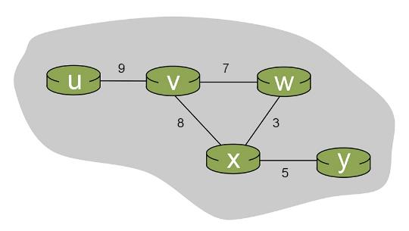
Class Exercise: Bellman Ford Equation
When the algorithm converges, what are the distance vectors in each of the routers.

Slide 43
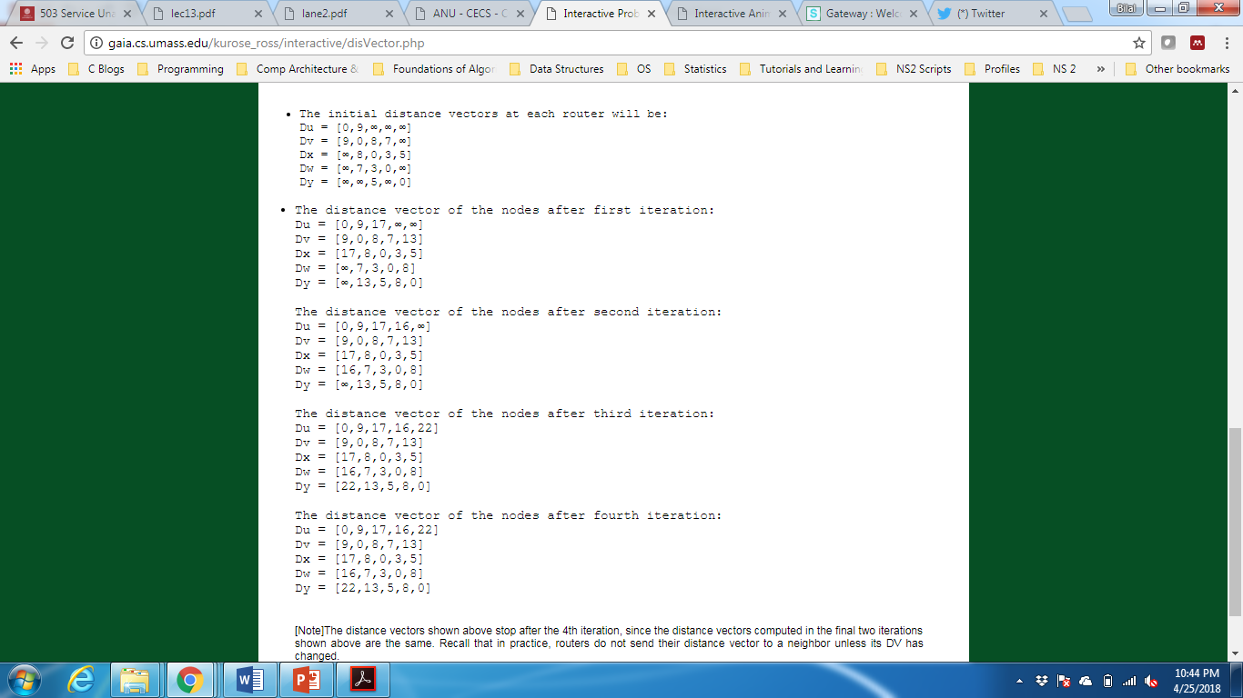
Class Exercise: Bellman Ford Equation
When the algorithm converges, what are the distance vectors in each of the routers.

Slide 44
Class Exercise: Bellman Ford Equation
When the algorithm converges, what are the distance vectors in each of the routers.

Slide 45
Distance vector: example
DV in a: D_{a}(a)=0
D_{a}(b) = 8
D_{a}(c) = ∞
D_{a}(d) = 1
D_{a}(e) = ∞
D_{a}(f) = ∞
D_{a}(g) = ∞
D_{a}(h) = ∞
D_{a}(i) = ∞
a
b
c
8
1
t=0
1
1
All nodes have distance estimates to nearest neighbors (only)
A few asymmetries:
missing link
larger cost
d
e
f
1
1
All nodes send their local distance vector to their neighbors
1
1
1
g
h
i
1
1

Slide 46
Distance vector example: iteration
a
b
c
8
1
t=1
1
1
All nodes:
receive distance vectors from neighbors
compute their new local distance vector
send their new local distance vector to neighbors
d
e
f
1
1
1
1
1
g
h
i
1
1

Slide 47
Distance vector example: iteration
a
compute
compute
compute
b
c
8
1
t=1
1
1
All nodes:
receive distance vectors from neighbors
compute their new local distance vector
send their new local distance vector to neighbors
d
compute
e
f
compute
compute
1
1
1
1
1
g
h
i
compute
compute
1
compute
1

Slide 48
Distance vector example: iteration
a
b
c
8
1
t=1
1
1
All nodes:
receive distance vectors from neighbors
compute their new local distance vector
send their new local distance vector to neighbors
d
e
f
1
1
1
1
1
g
h
i
1
1

Slide 49
Distance vector example: iteration
a
b
c
8
1
t=2
1
1
All nodes:
receive distance vectors from neighbors
compute their new local distance vector
send their new local distance vector to neighbors
d
e
f
1
1
1
1
1
g
h
i
1
1

Slide 50
Distance vector example: iteration
compute
compute
compute
a
b
c
2
1
t=2
1
1
All nodes:
receive distance vectors from neighbors
compute their new local distance vector
send their new local distance vector to neighbors
d
compute
compute
compute
e
f
1
1
1
1
1
g
compute
compute
compute
h
i
8
1

Slide 51
Distance vector example: iteration
a
b
c
8
1
t=2
1
1
All nodes:
receive distance vectors from neighbors
compute their new local distance vector
send their new local distance vector to neighbors
d
e
f
1
1
1
1
1
g
h
i
1
1

Slide 52
Distance vector example: iteration
…. and so on
Let’s next take a look at the iterative computations at nodes

Slide 53
Distance vector example: computation
DV in b:
DV in c:
D_{c}(a) = ∞
D_{c}(b) = 1
D_{c}(c) = 0
D_{c}(d) = ∞
D_{c}(e) = ∞
D_{c}(f) = ∞
D_{c}(g) = ∞
D_{c}(h) = ∞
D_{c}(i) = ∞
D_{b}(a) = 8
D_{b}(c) = 1
D_{b}(d) = ∞
D_{b}(e) = 1
D_{b}(f) = ∞
D_{b}(g) = ∞
D_{b}(h) = ∞
D_{b}(i) = ∞
DV in a: D_{a}(a)=0
D_{a}(b) = 8
D_{a}(c) = ∞
D_{a}(d) = 1
D_{a}(e) = ∞
D_{a}(f) = ∞
D_{a}(g) = ∞
D_{a}(h) = ∞
D_{a}(i) = ∞
a
b
c
8
1
t=1
1
1
b receives DVs from a, c, e
DV in e:
D_{e}(a) = ∞
D_{e}(b) = 1
D_{e}(c) = ∞
D_{e}(d) = 1
D_{e}(e) = 0
D_{e}(f) = 1
D_{e}(g) = ∞
D_{e}(h) = 1
D_{e}(i) = ∞
d
e
f
1
1
1
1
1
g
h
i
1
1

Slide 54
Distance vector example: computation
DV in b:
DV in c:
D_{c}(a) = ∞
D_{c}(b) = 1
D_{c}(c) = 0
D_{c}(d) = ∞
D_{c}(e) = ∞
D_{c}(f) = ∞
D_{c}(g) = ∞
D_{c}(h) = ∞
D_{c}(i) = ∞
D_{b}(a) = 8
D_{b}(c) = 1
D_{b}(d) = ∞
D_{b}(e) = 1
D_{b}(f) = ∞
D_{b}(g) = ∞
D_{b}(h) = ∞
D_{b}(i) = ∞
DV in a: D_{a}(a)=0
D_{a}(b) = 8
D_{a}(c) = ∞
D_{a}(d) = 1
D_{a}(e) = ∞
D_{a}(f) = ∞
D_{a}(g) = ∞
D_{a}(h) = ∞
D_{a}(i) = ∞
a
b
c
b
8
compute
1
t=1
1
1
b receives DVs from a, c, e, computes:
DV in e:
D_{e}(a) = ∞
D_{e}(b) = 1
D_{e}(c) = ∞
D_{e}(d) = 1
D_{e}(e) = 0
D_{e}(f) = 1
D_{e}(g) = ∞
D_{e}(h) = 1
D_{e}(i) = ∞
e
d
e
f
1
1
D_{b}(a) = min{c_{b,a}+D_{a}(a), c_{b,c} +D_{c}(a), c_{b,e}+D_{e}(a)} = min{8,∞,∞} = 8
D_{b}(c) = min{c_{b,a}+D_{a}(c), c_{b,c} +D_{c}(c), c _{b,e} +D_{e}(c)} = min{∞,1,∞} = 1
D_{b}(d) = min{c_{b,a}+D_{a}(d), c_{b,c} +D_{c}(d), c _{b,e} +D_{e}(d)} = min{9,2,∞} = 2
1
1
1
D_{b}(e) = min{c_{b,a}+D_{a}(e), c_{b,c} +D_{c}(e), c _{b,e} +D_{e}(e)} = min{∞,∞,1} = 1
DV in b:
D_{b}(f) = min{c_{b,a}+D_{a}(f), c_{b,c} +D_{c}(f), c _{b,e} +D_{e}(f)} = min{∞,∞,2} = 2
D_{b}(g) = min{c_{b,a}+D_{a}(g), c_{b,c} +D_{c}(g), c _{b,e}+D_{e}(g)} = min{∞, ∞, ∞} = ∞
D_{b}(a) = 8
D_{b}(c) = 1
D_{b}(d) = 2
D_{b}(e) = 1
D_{b}(f) =2
D_{b}(g) = ∞
D_{b}(h) = 2
D_{b}(i) = ∞
g
h
1
i
1
D_{b}(h) = min{c_{b,a}+D_{a}(h), c_{b,c} +D_{c}(h), c _{b,e}+D_{e}(h)} = min{∞, ∞, 2} = 2
D_{b}(i) = min{c_{b,a}+D_{a}(i), c_{b,c} +D_{c}(i), c _{b,e}+D_{e}(i)} = min{∞, ∞, ∞} = ∞

Slide 55
Distance vector example: computation
DV in b:
DV in c:
D_{c}(a) = ∞
D_{c}(b) = 1
D_{c}(c) = 0
D_{c}(d) = ∞
D_{c}(e) = ∞
D_{c}(f) = ∞
D_{c}(g) = ∞
D_{c}(h) = ∞
D_{c}(i) = ∞
D_{b}(a) = 8
D_{b}(c) = 1
D_{b}(d) = ∞
D_{b}(e) = 1
D_{b}(f) = ∞
D_{b}(g) = ∞
D_{b}(h) = ∞
D_{b}(i) = ∞
DV in a: D_{a}(a)=0
D_{a}(b) = 8
D_{a}(c) = ∞
D_{a}(d) = 1
D_{a}(e) = ∞
D_{a}(f) = ∞
D_{a}(g) = ∞
D_{a}(h) = ∞
D_{a}(i) = ∞
a
b
c
8
1
t=1
1
1
c receives DVs from b
DV in e:
D_{e}(a) = ∞
D_{e}(b) = 1
D_{e}(c) = ∞
D_{e}(d) = 1
D_{e}(e) = 0
D_{e}(f) = 1
D_{e}(g) = ∞
D_{e}(h) = 1
D_{e}(i) = ∞
d
e
f
1
1
1
1
1
g
h
i
1
1

Slide 56
Distance vector example: computation
DV in b:
DV in c:
D_{c}(a) = ∞
D_{c}(b) = 1
D_{c}(c) = 0
D_{c}(d) = ∞
D_{c}(e) = ∞
D_{c}(f) = ∞
D_{c}(g) = ∞
D_{c}(h) = ∞
D_{c}(i) = ∞
D_{b}(a) = 8
D_{b}(c) = 1
D_{b}(d) = ∞
D_{b}(e) = 1
D_{b}(f) = ∞
D_{b}(g) = ∞
D_{b}(h) = ∞
D_{b}(i) = ∞
a
b
c
1
compute
8
t=1
1
1
c receives DVs from b computes:
d
e
f
D_{c}(a) = min{c_{c,b}+D_{b}(a}} = 1 + 8 = 9
DV in c:
D_{c}(a) = 9
D_{c}(b) = 1
D_{c}(c) = 0
D_{c}(d) = 2
D_{c}(e) = ∞
D_{c}(f) = ∞
D_{c}(g) = ∞
D_{c}(h) = ∞
D_{c}(i) = ∞
D_{c}(b) = min{c_{c,b}+D_{b}(b)} = 1 + 0 = 1
D_{c}(d) = min{c_{c,b}+D_{b}(d)} = 1+ ∞ = ∞
D_{c}(e) = min{c_{c,b}+D_{b}(e)} = 1 + 1 = 2
D_{c}(f) = min{c_{c,b}+D_{b}(f)} = 1+ ∞ = ∞
D_{c}(g) = min{c_{c,b}+D_{b}(g)} = 1+ ∞ = ∞
* Check out the online interactive exercises for more examples: http://gaia.cs.umass.edu/kurose_ross/interactive/
g
h
i
D_{c}(h) = min{c_{bc,b}+D_{b}(h)} = 1+ ∞ = ∞
D_{c}(i) = min{c_{c,b}+D_{b}(i)} = 1+ ∞ = ∞

Slide 57
Distance vector example: computation
DV in b:
D_{b}(a) = 8
D_{b}(c) = 1
D_{b}(d) = ∞
D_{b}(e) = 1
D_{b}(f) = ∞
D_{b}(g) = ∞
D_{b}(h) = ∞
D_{b}(i) = ∞
DV in e:
D_{e}(a) = ∞
D_{e}(b) = 1
D_{e}(c) = ∞
D_{e}(d) = 1
D_{e}(e) = 0
D_{e}(f) = 1
D_{e}(g) = ∞
D_{e}(h) = 1
D_{e}(i) = ∞
DV in d:
D_{c}(a) = 1
D_{c}(b) = ∞
D_{c}(c) = ∞
D_{c}(d) = 0
D_{c}(e) = 1
D_{c}(f) = ∞ D_{c}(g) = 1
D_{c}(h) = ∞
D_{c}(i) = ∞
a
b
c
8
1
t=1
Q: what is new DV computed in e at t=1?
1
1
e receives DVs from b, d, f, h
d
compute
f
DV in f:
D_{c}(a) = ∞
D_{c}(b) = ∞
D_{c}(c) = ∞
D_{c}(d) = ∞
D_{c}(e) = 1
D_{c}(f) = 0
D_{c}(g) = ∞
D_{c}(h) = ∞
D_{c}(i) = 1
e
DV in h:
D_{c}(a) = ∞
D_{c}(b) = ∞
D_{c}(c) = ∞
D_{c}(d) = ∞
D_{c}(e) = 1
D_{c}(f) = ∞
D_{c}(g) = 1
D_{c}(h) = 0
D_{c}(i) = 1
1
1
1
1
1
g
h
i
1
1

Slide 58
Distance vector: state information diffusion
Iterative communication, computation steps diffuses information through network:
t=0
c’s state at t=0 is at c only
a
b
c
8
1
c’s state at t=0 has propagated to b, and may influence distance vector computations up to 1 hop away, i.e., at b
t=1
1
1
t=1
t=2
c’s state at t=0 may now influence distance vector computations up to 2 hops away, i.e., at b and now at a, e as well
t=2
d
e
f
1
1
t=3
c’s state at t=0 may influence distance vector computations up to 3 hops away, i.e., at d, f, h
1
1
1
t=3
c’s state at t=0 may influence distance vector computations up to 4 hops away, i.e., at g, i
t=4
g
h
i
1
1
t=4

Slide 59
Distance vector: link cost changes
link cost changes:
node detects local link cost change
updates routing info, recalculates local DV
if DV changes, notify neighbors
1
y
4
1
x
z
50
t₀ : y detects link-cost change, updates its DV, informs its neighbors.
“good news
travels fast”
t₁ : z receives update from y, updates its DV, computes new least cost to x , sends its neighbors its DV.
t₂ : y receives z’s update, updates its DV. y’s least costs do not change, so y does not send a message to z.

Slide 60
Distance vector: link cost changes
link cost changes:
node detects local link cost change
“bad news travels slow” – count-to-infinity problem:
60
y
4
1
x
z
50
y sees direct link to x has new cost 60, but z has said it has a path at cost of 5. So y computes “my new cost to x will be 6, via z); notifies z of new cost of 6 to x.
z learns that path to x via y has new cost 6, so z computes “my new cost to x will be 7 via y), notifies y of new cost of 7 to x.
y learns that path to x via z has new cost 7, so y computes “my new cost to x will be 8 via y), notifies z of new cost of 8 to x.
z learns that path to x via y has new cost 8, so z computes “my new cost to x will be 9 via y), notifies y of new cost of 9 to x.
…
see text for solutions. Distributed algorithms are tricky!

Slide 61
Comparison of LS and DV algorithms
message complexity
LS: n routers, O(n²) messages sent
DV: exchange between neighbors; convergence time varies
robustness: what happens if router malfunctions, or is compromised?
LS:
router can advertise incorrect link cost
each router computes only its own table
DV:
DV router can advertise incorrect path cost (“I have a really low-cost path to everywhere”): black-holing
each router’s DV is used by others: error propagate thru network
speed of convergence
LS: O(n²) algorithm, O(n²) messages
may have oscillations
DV: convergence time varies
may have routing loops
count-to-infinity problem

Slide 62
Network layer: “control plane” roadmap
introduction
routing protocols
intra-ISP routing: OSPF
routing among ISPs: BGP
SDN control plane
Internet Control Message Protocol
network management, configuration
SNMP
NETCONF/YANG

Slide 63
Making routing scalable
our routing study thus far - idealized
all routers identical
network “flat”
… not true in practice
scale: billions of destinations:
can’t store all destinations in routing tables!
routing table exchange would swamp links!
administrative autonomy:
Internet: a network of networks
each network admin may want to control routing in its own network

Slide 64
Internet approach to scalable routing
aggregate routers into regions known as “autonomous systems” (AS) (a.k.a. “domains”)
intra-AS (aka “intra-domain”): routing among routers within same AS (“network”)
all routers in AS must run same intra-domain protocol
routers in different AS can run different intra-domain routing protocols
gateway router: at “edge” of its own AS, has link(s) to router(s) in other AS’es
inter-AS (aka “inter-domain”): routing among AS’es
gateways perform inter-domain routing (as well as intra-domain routing)

Slide 65
Interconnected ASes
forwarding table configured by intra- and inter-AS routing algorithms
Intra-AS
Routing
Inter-AS
Routing
intra-AS routing determine entries for destinations within AS
forwarding
table
inter-AS & intra-AS determine entries for external destinations
intra-AS
routing
3c
3a
inter-AS routing
2c
3b
2a
intra-AS
routing
1c
2b
AS3
intra-AS
routing
1a
1b
AS2
1d
AS1

Slide 66

Inter-AS routing: a role in intradomain forwarding
suppose router in AS1 receives datagram destined outside of AS1:
AS1 inter-domain routing must:
learn which destinations reachable through AS2, which through AS3
propagate this reachability info to all routers in AS1
router should forward packet to gateway router in AS1, but which one?
3c
3a
2c
other
networks
3b
2a
1c
2b
AS3
other
networks
1a
1b
AS2
1d
AS1

Slide 67
Intra-AS routing: routing within an AS
most common intra-AS routing protocols:
RIP: Routing Information Protocol [RFC 1723]
classic DV: DVs exchanged every 30 secs
no longer widely used
EIGRP: Enhanced Interior Gateway Routing Protocol
DV based
formerly Cisco-proprietary for decades (became open in 2013 [RFC 7868])
OSPF: Open Shortest Path First [RFC 2328]
link-state routing
IS-IS protocol (ISO standard, not RFC standard) essentially same as OSPF

Slide 68
OSPF (Open Shortest Path First) routing
“open”: publicly available
classic link-state
each router floods OSPF link-state advertisements (directly over IP rather than using TCP/UDP) to all other routers in entire AS
multiple link costs metrics possible: bandwidth, delay
each router has full topology, uses Dijkstra’s algorithm to compute forwarding table
security: all OSPF messages authenticated (to prevent malicious intrusion)

Slide 69
Hierarchical OSPF
two-level hierarchy: local area, backbone.
link-state advertisements flooded only in area, or backbone
each node has detailed area topology; only knows direction to reach other destinations
area border routers: “summarize” distances to destinations in own area, advertise in backbone
boundary router: connects to other ASes
backbone
backbone router: runs OSPF limited to backbone
local routers:
flood LS in area only
compute routing within area
forward packets to outside via area border router
area 3
internal
routers
area 1
area 2

Slide 70
Network layer: “control plane” roadmap
introduction
routing protocols
intra-ISP routing: OSPF
routing among ISPs: BGP
SDN control plane
Internet Control Message Protocol
network management, configuration
SNMP
NETCONF/YANG

Slide 71

Interconnected ASes
intra-AS
routing
3c
3a
inter-AS routing
2c
3b
2a
intra-AS
routing
1c
2b
AS3
intra-AS
routing
1a
1b
AS2
1d
AS1
intra-AS (aka “intra-domain”): routing among routers within same AS (“network”)
inter-AS (aka “inter-domain”): routing among AS’es
Notes:
Each router then locally runs Dijkstra’s shortest-path algorithm to determine a shortest-path tree to all subnets, with itself as the root node.

Slide 72
Internet inter-AS routing: BGP
BGP (Border Gateway Protocol): the de facto inter-domain routing protocol
“glue that holds the Internet together”
allows subnet to advertise its existence, and the destinations it can reach, to rest of Internet: “I am here, here is who I can reach, and how”
BGP provides each AS a means to:
obtain destination network reachability info from neighboring ASes (eBGP)
determine routes to other networks based on reachability information and policy
propagate reachability information to all AS-internal routers (iBGP)
advertise (to neighboring networks) destination reachability info
Notes:
Since an inter-AS routing protocol involves coordination among multiple ASs, communicating ASs must run the same inter-AS routing protocol. In fact, in the Internet, all ASs run the same inter-AS routing protocol, called the Border Gateway Protocol, more commonly known as BGP

Slide 73
eBGP, iBGP connections
2b
∂
2a
2c
1b
3b
2d
∂
1a
1c
3a
3c
AS 2
1d
3d
AS 1
eBGP connectivity
AS 3
logical iBGP connectivity
1c
gateway routers run both eBGP and iBGP protocols

Slide 74
BGP basics
BGP session: two BGP routers (“peers”) exchange BGP messages over semi-permanent TCP connection:
advertising paths to different destination network prefixes (BGP is a “path vector” protocol)
when AS3 gateway 3a advertises path AS3,X to AS2 gateway 2c:
AS3 promises to AS2 it will forward datagrams towards X
AS 3
3b
AS 1
1b
3a
3c
1a
1c
AS 2
3d
2b
1d
2a
2c
BGP advertisement:
AS3, X
X
2d

Slide 75
BGP protocol messages
BGP messages exchanged between peers over TCP connection
BGP messages [RFC 4371]:
OPEN: opens TCP connection to remote BGP peer and authenticates sending BGP peer
UPDATE: advertises new path (or withdraws old)
KEEPALIVE: keeps connection alive in absence of UPDATES; also ACKs OPEN request
NOTIFICATION: reports errors in previous msg; also used to close connection

Slide 76
Path attributes and BGP routes
BGP advertised route: prefix + attributes
prefix: destination being advertised
two important attributes:
AS-PATH: list of ASes through which prefix advertisement has passed
NEXT-HOP: indicates specific internal-AS router to next-hop AS
policy-based routing:
gateway receiving route advertisement uses import policy to accept/decline path (e.g., never route through AS Y).
AS policy also determines whether to advertise path to other other neighboring ASes

Slide 77
BGP path advertisement
AS 3
3b
AS 1
1b
3a
3c
1a
1c
AS 2
3d
X
2b
1d
AS3, X
AS2,AS3,X
2a
2c
2d
AS2 router 2c receives path advertisement AS3,X (via eBGP) from AS3 router 3a
based on AS2 policy, AS2 router 2c accepts path AS3,X, propagates (via iBGP) to all AS2 routers
based on AS2 policy, AS2 router 2a advertises (via eBGP) path AS2, AS3, X to AS1 router 1c

Slide 78
BGP path advertisement: multiple paths
AS 3
3b
AS 1
1b
AS3,X
3a
3c
AS3,X
AS3,X
1a
1c
AS 2
3d
X
2b
AS3,X
1d
AS3, X
AS2,AS3,X
2a
2c
2d
gateway router may learn about multiple paths to destination:
AS1 gateway router 1c learns path AS2,AS3,X from 2a
AS1 gateway router 1c learns path AS3,X from 3a
based on policy, AS1 gateway router 1c chooses path AS3,X and advertises path within AS1 via iBGP

Slide 79
BGP: populating forwarding tables
AS 3
3b
AS 1
1b
AS3,X
3a
3c
1
AS3,X
1a
AS3,X
1c
AS 2
2b
3d
X
local link interfaces
at 1a, 1d
2
AS3,X
2
1d
1
AS3, X
AS2,AS3,X
2a
2c
2d
dest
interface
recall: 1a, 1b, 1d learn via iBGP from 1c: “path to X goes through 1c”
…
…
at 1d: OSPF intra-domain routing: to get to 1c, use interface 1
1c
1
X
1
at 1d: to get to X, use interface 1
…
…

Slide 80
BGP: populating forwarding tables
AS 3
3b
AS 1
1b
3a
3c
1
1a
1c
AS 2
3d
X
2
2b
1d
2a
2c
2d
dest
interface
…
…
recall: 1a, 1b, 1d learn via iBGP from 1c: “path to X goes through 1c”
1c
2
at 1d: OSPF intra-domain routing: to get to 1c, use interface 1
X
2
…
…
at 1d: to get to X, use interface 1
at 1a: OSPF intra-domain routing: to get to 1c, use interface 2
at 1a: to get to X, use interface 2

Slide 81
Hot potato routing
AS 3
3b
AS 1
1b
3a
3c
1a
1c
AS 2
3d
X
2b
112
1d
AS3,X
AS1,AS3,X
2a
2c
201
263
2d
OSPF link weights
2d learns (via iBGP) it can route to X via 2a or 2c
hot potato routing: choose local gateway that has least intra-domain cost (e.g., 2d chooses 2a, even though more AS hops to X): don’t worry about inter-domain cost!

Slide 82
BGP: achieving policy via advertisements
A,w
B
x
provider
w
A
network
legend:
C
customer
A,w
y
network:
ISP only wants to route traffic to/from its customer networks (does not want to carry transit traffic between other ISPs – a typical “real world” policy)
A advertises path Aw to B and to C
B chooses not to advertise BAw to C!
B gets no “revenue” for routing CBAw, since none of C, A, w are B’s customers
C does not learn about CBAw path
C will route CAw (not using B) to get to w

Slide 83
BGP: achieving policy via advertisements (more)
B
x
provider
w
A
network
legend:
C
customer
y
network:
ISP only wants to route traffic to/from its customer networks (does not want to carry transit traffic between other ISPs – a typical “real world” policy)
A,B,C are provider networks
x,w,y are customer (of provider networks)
x is dual-homed: attached to two networks
policy to enforce: x does not want to route from B to C via x
.. so x will not advertise to B a route to C

Slide 84
BGP route selection
router may learn about more than one route to destination AS, selects route based on:
local preference value attribute: policy decision
shortest AS-PATH
closest NEXT-HOP router: hot potato routing
additional criteria

Slide 85
Why different Intra-, Inter-AS routing ?
policy:
inter-AS: admin wants control over how its traffic routed, who routes through its network
intra-AS: single admin, so policy less of an issue
scale:
hierarchical routing saves table size, reduced update traffic
performance:
intra-AS: can focus on performance
inter-AS: policy dominates over performance

Slide 86
Network layer: “control plane” roadmap
introduction
routing protocols
intra-ISP routing: OSPF
routing among ISPs: BGP
SDN control plane
Internet Control Message Protocol
network management, configuration
SNMP
NETCONF/YANG

Slide 87
Software defined networking (SDN)
Internet network layer: historically implemented via distributed, per-router control approach:
monolithic router contains switching hardware, runs proprietary implementation of Internet standard protocols (IP, RIP, IS-IS, OSPF, BGP) in proprietary router OS (e.g., Cisco IOS)
different “middleboxes” for different network layer functions: firewalls, load balancers, NAT boxes, ..
~2005: renewed interest in rethinking network control plane

Slide 88
Per-router control plane
Individual routing algorithm components in each and every router interact in the control plane to computer forwarding tables
Routing
Algorithm
control
plane
data
plane
values in arriving
packet header
0111
1
3
2

Slide 89
Software-Defined Networking (SDN) control plane
Remote controller computes, installs forwarding tables in routers
Remote Controller
control
plane
data
plane
CA
CA
CA
CA
CA
values in arriving
packet header
0111
1
3
2

Slide 90
Software defined networking (SDN)
Why a logically centralized control plane?
easier network management: avoid router misconfigurations, greater flexibility of traffic flows
table-based forwarding (recall OpenFlow API) allows “programming” routers
centralized “programming” easier: compute tables centrally and distribute
distributed “programming” more difficult: compute tables as result of distributed algorithm (protocol) implemented in each-and-every router
open (non-proprietary) implementation of control plane
foster innovation: let 1000 flowers bloom

Slide 91





SDN analogy: mainframe to PC revolution
App
App
App
App
App
App
App
App
App
App
App
Specialized
Applications
Open Interface
Specialized
Operating
System
or
or
Windows
Linux
MAC OS
Specialized
Hardware
Open Interface
Microprocessor
Vertically integrated
Closed, proprietary
Slow innovation
Small industry
Horizontal
Open interfaces
Rapid innovation
Huge industry
* Slide courtesy: N. McKeown

Slide 92

Traffic engineering: difficult with traditional routing
5
3
v
w
5
2
u
2
1
z
3
1
2
x
y
1
Q: what if network operator wants u-to-z traffic to flow along uvwz, rather than uxyz?
A: need to re-define link weights so traffic routing algorithm computes routes accordingly (or need a new routing algorithm)!
link weights are only control “knobs”: not much control!

Slide 93
Traffic engineering: difficult with traditional routing
5
3
v
w
5
2
u
2
1
z
3
1
2
x
y
1
Q: what if network operator wants to split u-to-z traffic along uvwz and uxyz (load balancing)?
A: can’t do it (or need a new routing algorithm)

Slide 94
Traffic engineering: difficult with traditional routing
5
3
v
w
5
2
u
2
1
z
3
1
2
x
y
1
Q: what if w wants to route blue and red traffic differently from w to z?
A: can’t do it (with destination-based forwarding, and LS, DV routing)
We learned in Chapter 4 that generalized forwarding and SDN can be used to achieve any routing desired

Slide 95
Software defined networking (SDN)
…
3. control plane functions external to data-plane switches
4. programmable control applications
routing
access control
load
balance
Remote Controller
control
plane
data
plane
CA
2. control, data plane separation
CA
CA
CA
CA
1: generalized “flow-based” forwarding (e.g., OpenFlow)

Slide 96
Software defined networking (SDN)
Data-plane switches:
fast, simple, commodity switches implementing generalized data-plane forwarding (Section 4.4) in hardware
flow (forwarding) table computed, installed under controller supervision
API for table-based switch control (e.g., OpenFlow)
defines what is controllable, what is not
protocol for communicating with controller (e.g., OpenFlow)
network-control applications
…
routing
access
control
load
balance
control
plane
northbound API
SDN Controller
(network operating system)
southbound API
data
plane
SDN-controlled switches

Slide 97
Software defined networking (SDN)
SDN controller (network OS):
maintain network state information
interacts with network control applications “above” via northbound API
interacts with network switches “below” via southbound API
implemented as distributed system for performance, scalability, fault-tolerance, robustness
network-control applications
…
routing
access
control
load
balance
control
plane
northbound API
SDN Controller
(network operating system)
southbound API
data
plane
SDN-controlled switches

Slide 98
Software defined networking (SDN)
network-control apps:
“brains” of control: implement control functions using lower-level services, API provided by SDN controller
unbundled: can be provided by 3rd party: distinct from routing vendor, or SDN controller
network-control applications
…
routing
access
control
load
balance
control
plane
northbound API
SDN Controller
(network operating system)
southbound API
data
plane
SDN-controlled switches

Slide 99
Components of SDN controller
routing
access
control
load
balance
interface layer to network control apps: abstractions API
Interface, abstractions for network control apps
…
network graph
RESTful
API
intent
…
network-wide state management : state of networks links, switches, services: a distributed database
statistics
flow tables
SDN
controller
Network-wide distributed, robust state management
…
Link-state info
host info
switch info
…
communication: communicate between SDN controller and controlled switches
OpenFlow
SNMP
Communication to/from controlled devices

