Slide 1
Problem Statement
1. Predict whether to sanction the insurance or not?
2. Issuing of Credit Card/Loan ?
3. Identifying the fraud agency

Slide 2
Why solve this problem?
Minimize financial loss of the company
Improvement of company reputation in market
Identifying the product & destination beneficial for the company while issuing the travel insurance
Stakeholders - Risk Management, Underwriting and Product development teams.

Slide 3
Data
Dataset Info: The data consists of roughly 52310 records and 11 features with 10 predictors and 1 target that describes whether the customer will claim or not.
data would like to have:
Date of travel
Feature | Feature Type | Description
ID | numeric | ID of customer
Agency | categorical | Name of agency
Agency Type | categorical | Type of travel insurance agencies
Distribution Channel | categorical | Distribution channel of travel insurance agencies
Product Name | categorical | Name of the travel insurance products
Duration | numeric | Duration of travel
Destination | categorical | Destination of travel
Net Sales | numeric | Amount of sales of travel insurance policies
Commision (in value) | numeric | The commission received for travel insurance agency
Age | numeric | Age of insured
Claim | Binary | Claim Status

Slide 4
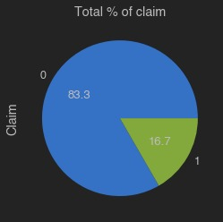
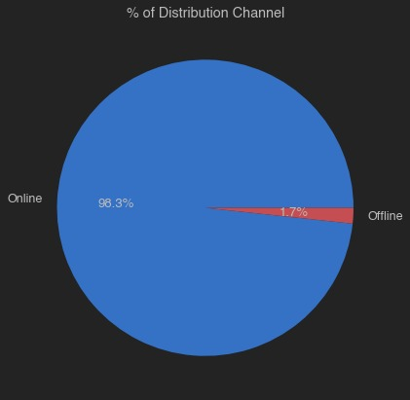
Exploratory Data Analysis
Claim %
Distribution Channel %

Slide 5
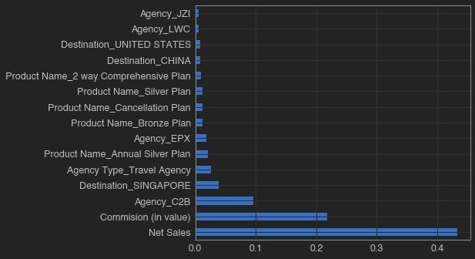
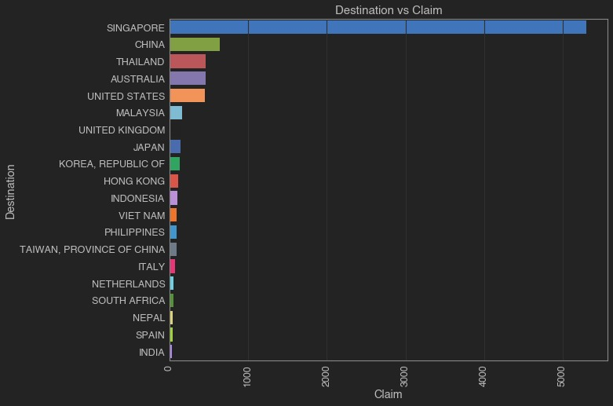
Feature Selection - Exploratory Data Analysis
Top 15 Best Features
Claim For Top 15 Countries

Slide 6
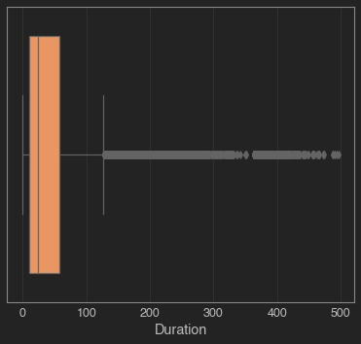
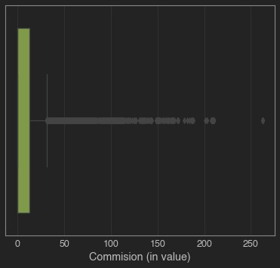
Exploratory Data Analysis
Outliers - Duration
Outliers – Commission (in value)

Slide 7
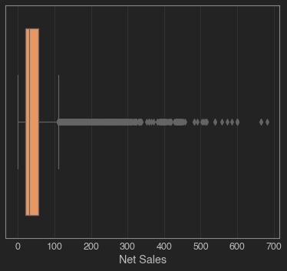
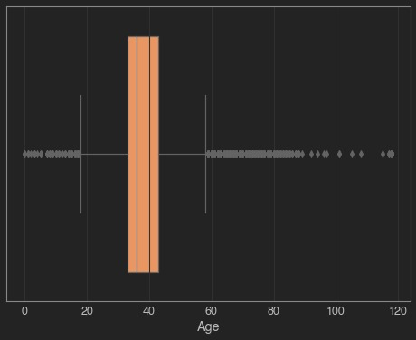
Exploratory Data Analysis
Outliers – Net Sales
Outliers - Age

Slide 8
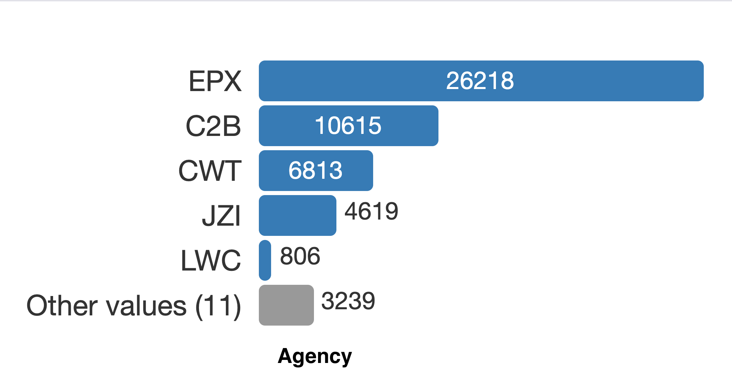
EDA

Slide 9
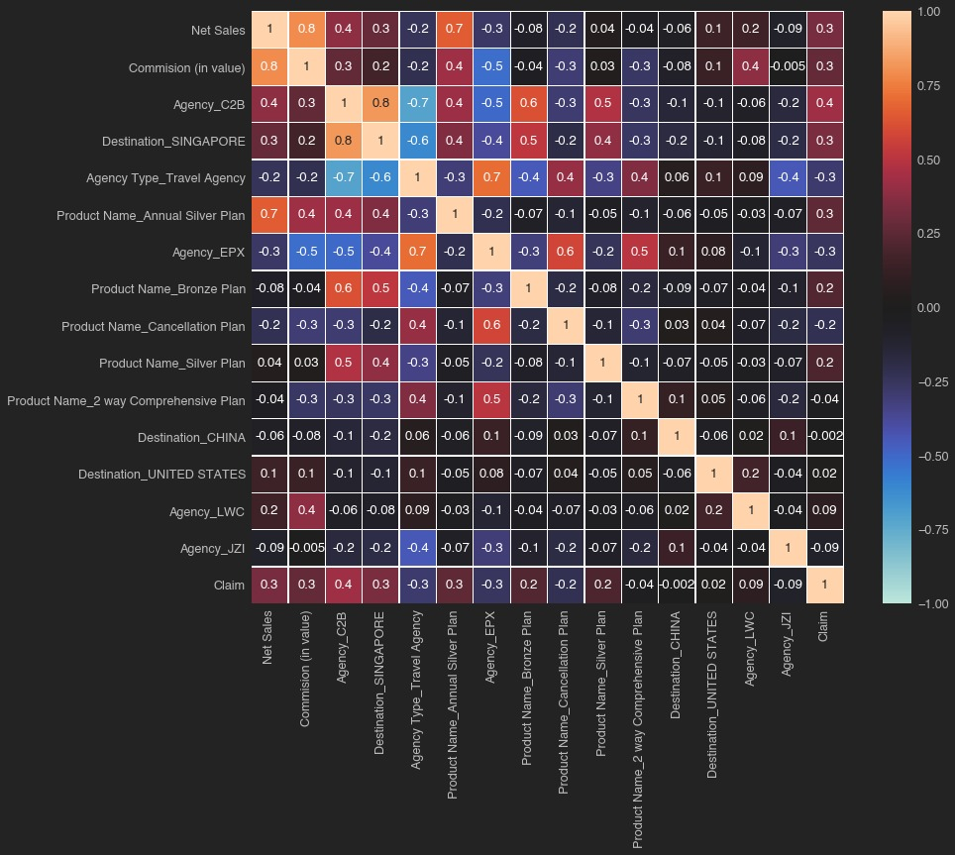
Features Correlation Matrix

Slide 10
Models and Approaches
Model Name | Precision
Random Forest Classifier | 0.7752
Decision Tree Classifier | 0.675
SGD Classifier | 0.6534
Kneighbors Classifier | 0.4729

Slide 11
Model Tuning
Model Parameters Used :
RandomForestClassifier(
n_estimators = 60,
max_depth = 40,
class_weight = {0:30,1:1}
)
Feature selection/ Feature engineering :
We have used ExtraTreeClassifier for best feature selection
Precision score after tuning RFC: 0.9779

Slide 12
Evaluation & Results
Evaluation matrix used :
Precision Score
Why precision score used ? :
Precision: It is implied as the measure of the correctly identified positive cases from all the predicted positive cases. Thus, it is useful when the costs of False Positives is high.
This will be helpful for not to loose out genuine customers and minimize the loss
Validation result Vs Test result:
Precision Score for train is : 0.99979983
Precision Score for test is : 0. 97791164

Slide 13
Final Results
From the above observations and plotting it can be inferred that the best performing model was Random Forest Classifier giving a precision score of 0.9779
Confusion Matrix :
Classification Report:
 | Predicted Positive | Predicted Negative
Actual Positive | 449 (TP) | 387 (FP)
Actual Negative | 9 (FN) | 4386 (TN)
 | precision | recall | f1-score | support
0 | 0.92 | 1.00 | 0.96 | 4395
1 | 0.98 | 0.54 | 0.70 | 836
accuracy |  |  | 0.92 | 5231

Slide 14
Insights & Decisions
Few countries like Singapore, China, Thailand are having very high claim ratios
Age groups below 14 and above 90 are having less claim ratios
Some agencies like C2B, LWC,TTW has more claims, around 43% . Such agencies should be verified for any fraud or not?
Online sale is very high compare to offline hence should be focused on how to increase/ improve processes for online sale.

Slide 15
Next Steps
If time permitted, we could have tried the following :
Better feature engineering
An ensemble of different models
Reduced False Positive(FP)

Slide 16
References
https://scikit-learn.org/stable/modules/generated/sklearn.ensemble.RandomForestClassifier.html
https://scikit-learn.org/stable/modules/generated/sklearn.ensemble.ExtraTreesClassifier.html
https://www.dezyre.com/recipes/tune-hyper-parameters-using-grid-search-in-python
https://www.dezyre.com/recipes/select-model-using-grid-search-in-python

