Slide 1
Roles & Responsibilities, Skills
Chinna Shanmugam, Suresh

Slide 2
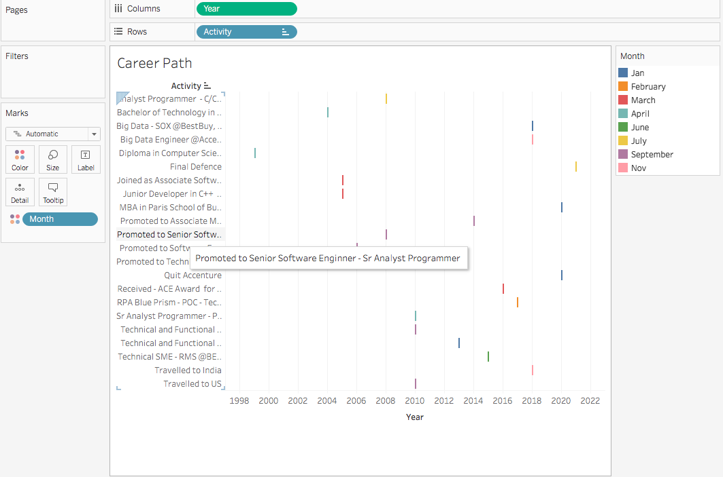
Career Journey

Slide 3
SDLC Model
Role
Big DATA Engineer, Data Analyst & RPA Technical Architect
Requirement collection
Discussion with RA, Product Manager, Business Owner
Documentations using EA tools , IPA Process Analysis, FRQ, PDD (Process Definition Document),
Reviews
Design
Architectural Changes
Risk mitigations
POC
High Level Design (SDD –Solution Design Document), TDD, PDI , ODI
Low level Design
Implementations
Big Data Hadoop, Yarn Map Reduce, Scala, Hive, Kafka
RPA Automation Technical Architect (SOX Application) @BESTBUY
Pro*C, Oracle Retail Functional & Technical Architect (Oracle ReSA, ReIM, RMS) @BESTBUY
Data Analytics using python (Audit System)@BestBuy
C,C++ Development @ Bank of America and AT&T
SIT(System Integration Testing)
RPA Delivery & Test execution (Verification Test)
Semi/Fully Automated
Bot Testing (ID, Security, Roles, Test cases execution etc),
Deployment
DevOps
Ops Handbook

Slide 4
Skills
Big Data Eco System
Hadoop, Yarn Map reduce, Hive, Scala
Data Analyst
Tableau Designer & Data Visualization
RPA Technologies
Blue Prism Certifications Developer, Solution Designer, Technical Architect, ROM Architect
Blue Prism (Advanced), UiPath (Beginner), Automation Anywhere (Trained)
C/C++, Java
Pro*C , C, C++, Java, Node Js, Unix, Linux, MySQL, Oracle PL/SQL Core Development
Python
Python Programming, Python API, Flask, Django, open-source Libraries/ Packages
Threading, Multiprocessing
Project Management
Project Libre
Excel Client Implementations
Ribbons, Macros
Import and Export
Repository
GIT, CVS, Harvest, PVCS,
SVN, VSS, Azure

Slide 5
Tools
Requirements
EA
Design
EA, UML
VISIO
Implementations
MS Visual Studio
Visual Code
SIT(System Integration Testing)
Big Data Testing, RPA Blue prism, Cpp Unit, Selenium
Debugging Tools
GDD, Code Quality
Deployment
IIS
Cloud Hosting/Azure
VMs

Slide 6
Other Regular activities
Trainings
New joiners
Technical support with in / across team (Accenture Traininings)
Leadership
Big Data Engineer – Technology Architect
RPA Centre of Excellence @ BestBuy – Retail Client
Delivery Lead for the Oracle Retail/Retek systems
Scrum Management
Agile meetings
Task identification, distributions and implementations
Stack holders Discussion
Tech Support to identify the RCAs
Functional flow explanations
Team Building Activities
Trainings
Award nominations
Birthday Celebrations
Assessment review meetings (Quarter, Semi, Annual)
Conducted Monthly review meetings ( Innovative Ideas/Solutions )
Sports
Cricket
Badminton Plays

Slide 7
Thank you

