Slide 1
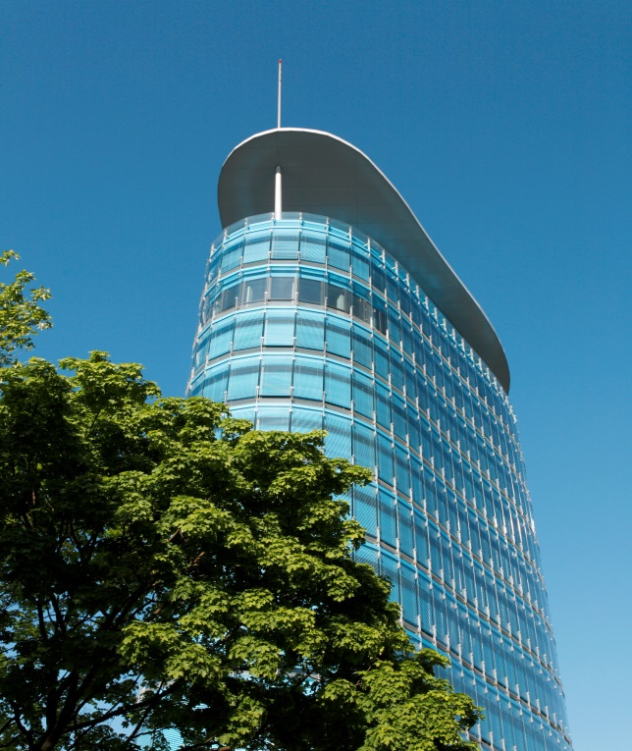



Master Thesis Presentation An analysis of Physiological Data with ML/AI/DL in the context of Flow and Immersion 21.04.2021 By Sankar Chinna SHANMugam Matriculation Number: 11012443 Supervisors Prof. Dr. Barbara Sprick M.Sc. Ehm Kannegieser
Notes:
Once again, Good Morning Professor and Ehm.
Thank you for joining me today and allowing me to present Master's thesis with you.
The title of thesis is “An Analysis of Physiological Data with Machine Leaning, Artificial Intelligence, Deep Learning in the Context of Flow and Immersion”

Slide 2
Agenda
Introduction
Data Sources
Design Approach
Implementation Details
Results
Future
Work
Evaluation
Conclusion
Related Work
Notes:
Today’s Agenda is as follows:
In the introduction, the motivation factors for choosing this subject will be discussed. Then thesis context and problem statement are accompanied by contributions to this research are described.
In the related study provides a summary of Ehm’s flow and immersion research.
Next Data Sources section, Information regarding the input data sources that were used in this thesis analysis can be found.
In Design approach, The architectural design and data pipeline are defined.
In the implementation section, the input data used in the study algorithms are described. In addition to preprocessed data preparation, later how the model will be sent to correspond with physiological data groups and emotional states are described.
In the result section, based on the input data source available as part of this study, we can see if the association between physiological data and emotional states in the public of relevant features occurs.
The assessment section discusses the manual survey that was performed as part of the research on human emotion recognition versus ML defined correlations, as well as the model accuracy measurement that was done to prove the accuracy of our study.
After that, conclusion of thesis study.
Finally in the future scope, this thesis study potential reach is useful in ensuring Ehm's research contribution further.

Slide 3
Introduction
Motivation
Flow and Immersion are phases of intense focus on a particular task[4]
Context
Questionnaires are used to achieve Flow and Immersion[4]
Problem Statement
When assessing flow state, students are unable to focus on both survey questions and game play in order to achieve flow
Contribution
Identify correlations between physiological data and flow/immersion
Notes:
I would like to start with definition of Flow and Immersion: Flow is a psychological condition that aims to characterize and justify the ideal experience, which is generally referred to as happiness or enjoyment. Whereas Immersion is defined as a deep involvement in the psychological state's flow.
Well the motivation is: how the high Flow and Immersion during gameplay will help increase learning effects in Serious Games, games that concentrate on achieving learning effects in players.
About the context: currently, the only way to calculate Flow and Immersion is through questionnaires, which are both time-consuming and arbitrary. The base study aimed at improving our understanding of how Flow and Immersion are related, as well as facilitating future work on a new measurement method based on physiological data.
Coming to Problem Statement: while evaluating the flow, students are unable to concentrate on both survey questions and game play in order to achieve flow when determining flow condition. The subsequent metric is unreliable due to the time lag between the occurrence and the measurement of any flow or attention effect. This study examines a variety of modern machine learning algorithms that aid in achieving our goal of evaluating the output estimation of states of flow, immersion and physiological data.
The contributions of my work here lies an analysis model implementation is presented and the results of a correlation analysis of physiological data relating to flow and immersion states are evaluated.

Slide 4
Related work
Ehm’s Team at Fraunhofer IOSB
Experimenting with the combined model of immersion and flow to validate it [3]
Study to develop a better understanding of the relationship between immersion and flow [4]
Notes:
The related work talks about, there are many experiments involving physiological data, flow, and immersion are still ongoing. Ehm's team is continuing research in a variety of directions relating to flow and immersion in a series of game studies. Here are few base studies..
First Study: The theoretical model of Flow is improved by the introduction of a more fine-grained model of immersion, as well as the design and execution of an experiment to validate model. In Simulations and Serious Games, detecting high intrinsic motivation and Flow states is critical for effective adaptation processes that can be used to enhance learning outcomes.
Second Study: A study that aims to improve our understanding of how Flow and Immersion are related, as well as facilitate future research into a new measurement method based on physiological data.
And so on..

Slide 5
Data source
Video/Image
+
Physiological
Data
40 Participants
10 Samples
27 Subjects
Video + CSV Data
Notes:
While coming to data sources, there were a total of 40 players who volunteered for the base research program, with no clear criteria for volunteer selection.
After filtering the data from the subjects, 27 subjects were identified, each of which included physiological data as well as video captures taken while playing the series of games.
To obtain better research results, this thesis study used ten samples with a gender ratio of 50/50 male and female subjects.
After filtering the data, our models were trained, validated, and tested using images and physiological data.

Slide 6
Design Approach
Notes:
This portion of the analysis explains the design methodology that was used.

Slide 7
Architectural Design
Analytics Results
ML Model Manager
Apply Algorithm
Train Model
Result
Data Source
Connection Manager
Meta Data Manager
(Data Preprocessing)
ML Data Manager
Data Sets
Notes:
The architectural diagram depicts the high-level structure that was created for the thesis implementation research.
Data Source: As previously mentioned, the model's input data is divided into two groups. The first is a video file form, while the second is comma-separated time-series sensor data.
Connection Manager: This subsystem connects the physical path's input data sources and transfers them to the Data Manager components for processing. Either framework has a provision for linking the CSV file directly.
The input data is prepossessed in this component, and it follows the ETL pipeline methodologies. For more details about this section is explained in coming slide.
ML Data Manager: This section breaks down the pre-existing data into a variety of input files and sends them to the model inputs. To determine the association between these classes, divide video files into images and CSV files into grouped sets of features.
ML Model Manager: This section is explained in detail in implementation slide.
Analytical Results: This is the final aspect of the design framework. This part discusses the relationship between the flow and immersion in the case of physiological data analysis, as well as the connection between the results obtained from various types of input.

Slide 8
Data pipeline
Image Flow/ Immersion
Webcam Data
Emotion Recognition from Model
Preprocessed
Data
Star Schema
Dimensions
Trained Model
Dimension Data1
Physiological Data
Dimension Data2
Analytics Results
Dimension Data3
Notes:
The Data Pipeline describes how raw input data is preprocessed before being sent to the model to be trained.
The Physiological Data unit: Physiological characteristics are divided into three separate schemas in order to better understand the relationship between physiological data and flow and immersions.
Video files from webcams are used for two different purposes. The first is to extract the emotions from the video file using the algorithm, and the second is to break the video file into several images.
The Emotion Recognition unit: The model is applied to images in this section, and the emotions are extracted.
The Image Immersion/Flow unit: To process through the model, the extracted emotions are labeled with a "onehotencoding" mechanism.
The Preprocessed Data unit: To send input to train the model, combined the data from both star schema physiological data and emotional recognized data.
The Preprocessed data is used as an input to algorithms in a trained model.
The analytics results : Determines the relationship between emotional states and physiological types.

Slide 9
Implementation Approach
Notes:
This section of the study describes how the research goals were solved using the implementation methods described earlier.
The presentation for this chapter is divided into two parts: The first part presents the results of emotion recognition from video and image files, and the second part presents the physiological data and emotion states correlation.

Slide 10
Algorithm design
ML Models
ML Algorithms
DBN
CNN
RNN/LSTM
Video Data
Image Data
Sensor Time series Data
Train Model
Train Model
Train Model
Output
Output
Output
Results
Analyze correlation between emotional and Flow/Immersion
Evaluation
Notes:
The machine learning models used in this study are explained by the low-level system design. It primarily focuses on three types of neural network algorithms.
ML Model Unit: After the input data source has been pre-processed, the next step is to apply the machine learning models. The model selects neural network algorithms in this section based on the type of data that enters the system.
ML Algorithms Unit: This part attempts to deduce the logical behavior of input data sent from the model. If the model sends a video file, the input is forwarded to the deep belief network (DBN) algorithm; if the model sends an image file, the input is forwarded to the Convolution Neural Network(CNN) algorithm; and finally, if the model sends a CSV file, the input is forwarded to the Recurrent Neural Network(RNN) algorithms.
Algorithms unit: These algorithms all take data, construct a model, and identify the physiological state outcomes. The model's behavior varies depending on which use-case it is applied to. Due to accuracy concerns, the output of the training data and test data differs. Model generation running time is also affected by device load and processor performance.
Evaluation Unit: After the results are generated, the evaluation part computes the results correctly and performs the performance analysis. The inputs are then correlated, and the outputs are submitted to the hybrid model. The hybrid model uses processed data as input and performs analysis as a consequence of the analysis.
The study analysis concludes the performance and accuracy of physiological data from the emotional states of flow and immersion in this portion. In addition, it provides comprehensive details on the relationship between the input and the analysis conducted using the built model.

Slide 11
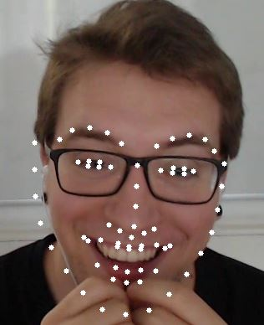
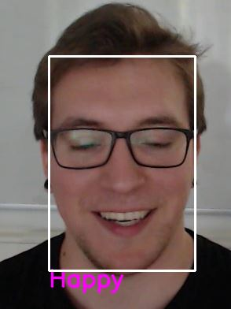
Video input to DBN
Notes:
Here, the video file was used as the data, and the DBN model produced an emotion recognition result. Here is one sample frame from the video clip.

Slide 12
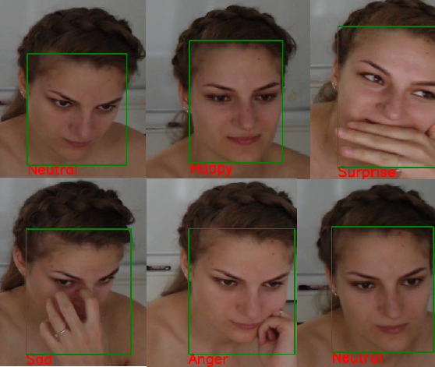
Image input to CNN
Notes:
Here, the input was a list of image files, and the CNN model returned a result for emotion recognition. Here are a few frame samples from the files.

Slide 13
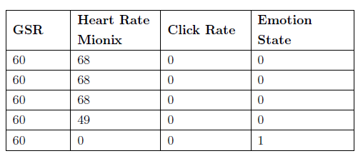
input to RNN
Image and Physiological Data merging
Images are labeled and Identified Emotions for the Images
Merged with Physiological Data
Transformed Emotions using “OneHotEncoder” method
Dived into multiple data schemas
Sample Data Set
Notes:
The algorithm used the combined dataset of physiological data sets and image frames to recognize emotions and move it on to the algorithm to find correlations. The table shows an example sample data collection.
Here Emotion State: Neutral, Happy, Surprise, Sad, Anger, Disgust and Fear are numbered as 0, 1, to 7

Slide 14
Results
Notes:
The research findings from one of the sample subjects5 are described in this section of the report.
The “Pearson” correlation approach was used to determine the relationship between physiological data and emotional states.

Slide 15
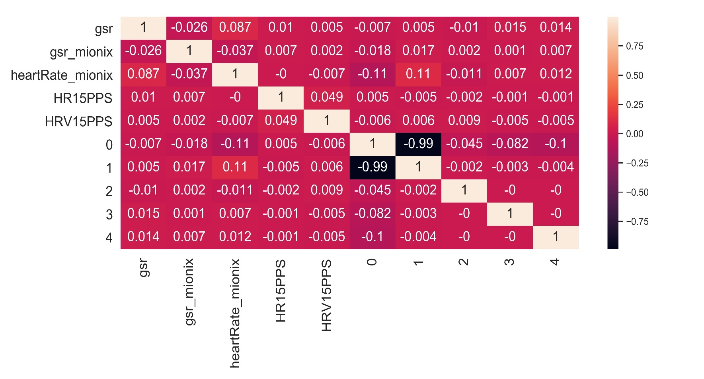
GRoup1 Correlation
Notes:
Group1 Result: The correlation matrix depicts the relationship between emotions and physiological data group1 features. From the physiological data features Electrocardiogram Left Leg and Right Arm and Electrocardiogram Left Arm and Right Arm., the Heartrate15PulsePerSeocnd and HeartrateVariability15PulsePerSeocnd are derived.
In result: the weak, null, and weak negative correlation among features is evident.

Slide 16
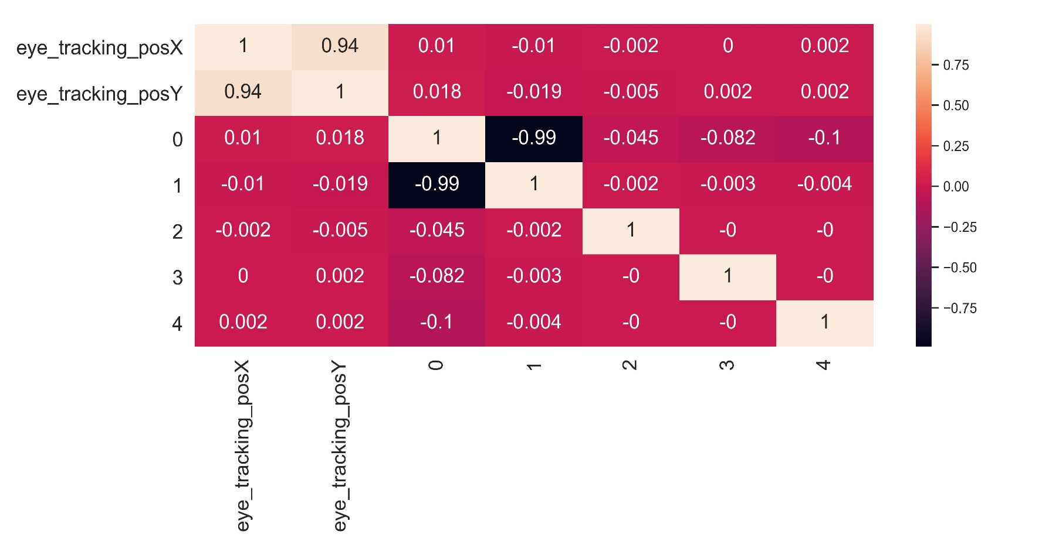
GRoup2 Correlation
Notes:
Similar to group1 here is Group2 Result: The correlation matrix depicts the relationship between emotions and physiological data for group2 features.

Slide 17
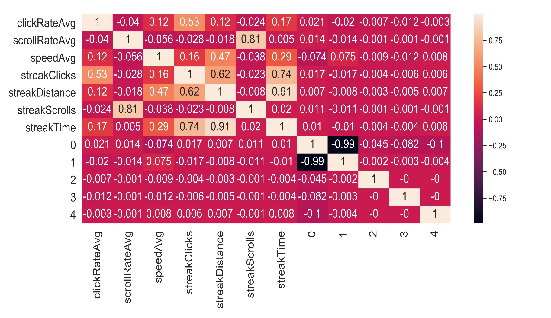
GRoup3 Correlation
Notes:
Similar to group2 here is Group3 Result: The correlation matrix depicts the relationship between emotions and physiological data for group3 features.

Slide 18
Evaluation
Notes:
This portion then moves on to the model evaluation.

Slide 19
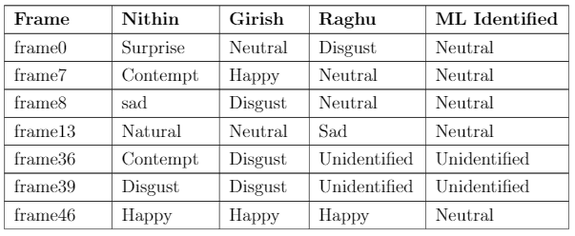
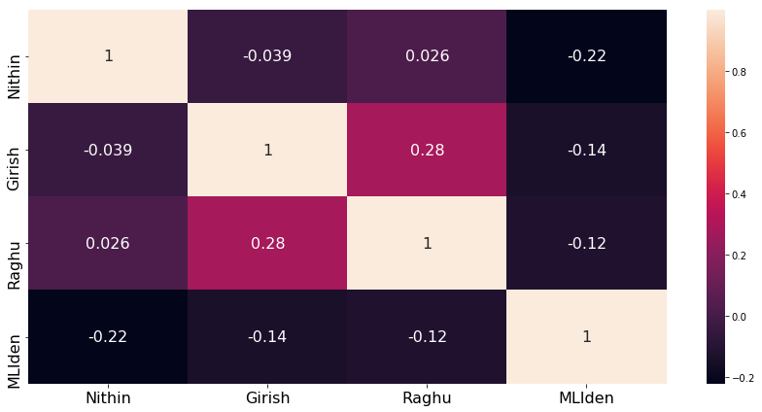
Manual Survey Correlation
Manual Survey vs ML
Survey conducted with Friends
Collected the data
Correlation
Not matched within the friends and among the ML Identified
Weak Correlation
Notes:
I have a concern about whether to use a machine learning model or a human prediction? The photos are polled with friends as cross-validation. Unfortunately, the expected association between friends and ML has not been proven.
As a result, this system was constructed with ML as a base assumption or accurate estimation, and it completed the association between the physiological data with states the flow and immersion.

Slide 20
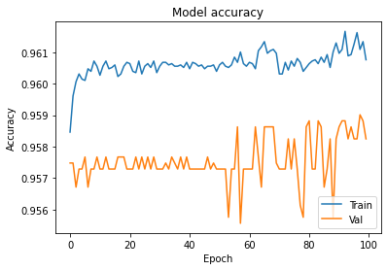
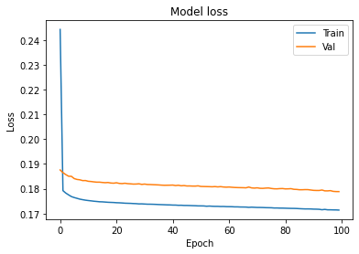
Model Accuracy
Validation Results
With 2 hidden layers
Model Accuracy in Training 96.2% and validation 95.7%
Model Loss: 0.01
More than two hidden layers also not much change in accuracy and loss
Notes:
Here is the evidence for evaluating the qualified model or the outcomes of the algorithms. On the training and validation data sets that the system considered, the model accuracy was 96.2%, followed by 95.7% on validation data with a loss of 1%.

Slide 21
CONCLUSION
“The thesis used two types of input data sources to combine physiological features with flow, and immersion to quantify the correlation between them using neural network models and generated the correlation matrix as a result”
Notes:
To conclude the Thesis,
This thesis study combined physiological data with emotional states of flow and immersion, then used statistical calculations to show that the values vary from high to low and positive to negative discrimination.
The quality and quantity metrics were used in the thesis analysis to measure the massive amount of data points used to qualify the model. The combined model of physiological data and flow, immersion states demonstrated a sufficient connection between the different emotional states.
This thesis study adds to the body of knowledge about future studies in this area. In addition, the discriminated outcomes evaluation will be carried forward, and the outcome correlations will bring more importance to future studies.

Slide 22
Future Work
With in scope
Timestamp on sensor data have time series analysis
Fine-tuning of algorithms
Other optional scope
Voice based analysis on flow and immersion studies
Notes:
Well the future scope are as follows:
The use of time stamps in physiological data as time series analysis is a more important aspect, since it allows for predictions based on the input variables in both the dependent and independent variables.
The machine learning algorithm derived emotions from the images that have been identified are not as reliable as human predictions. More chances of finetuning the algorithm would aid future research.
Another line of inquiry may be to conduct voice-based while participants are playing the game sequence. This would be useful in furthering the study of flow immersion analysis in multidimensional function extractions, which would provide more space for characteristic emotions states from physiological data.

Slide 23
Acknowledgement
Many thanks to Ehm, Professor and friends
Notes:
I would like give my acknowledgement: It is honor to working under the supervision of Ehm and Professor and completing the experiments during the master thesis. I'd like to express my gratitude to my friends who participated in the study survey and have continued to help me in this endeavor.

Slide 24
Thank you
Sankar Chinna Shanmugam
SRH University Heidelberg
Email:11012443@stud.hochschule-Heidelberg.de
H:+49 176 73 50 56 24
Notes:
That bring us to the end of my presentation.
Thank you for listening.

Slide 25
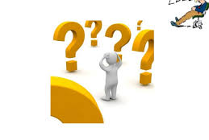
Q & A’s
Notes:
Now its time for Q and A’s?

Slide 26
Reference
[1] Daniel Atorf, Ehm Kannegieser, and Josua Meier. 2019
“Conducting an Experiment for validating the combined model of Immersion and Flow”
https://www.scitepress.org/Papers/2019/76889/76889.pdf
[2] Daniel Atorf, Ehm Kannegieser, and Lennart Hensler. 2016
“Towards a Concept on Measuring the Flow State During Gameplay of Serious Games”
[3] Daniel Atorf and Ehm Kannegieser. 2018
“Surveying games with a combined model of immersion and flow”
[4] Daniel Atorf and Ehm Kannegieser. 2019
“A study to further understand the link between immersion and flow”

Slide 27
Appendix

Slide 28
Key Factors
Learning
Algorithm provides different functionalities and fitting the appropriate feature is takes major factor
Data analysis takes place on critical role while tuning the algorithms
Challenges
Data storage in our server is bit expensive in case of data volume and memory consumption to train the model

Slide 29
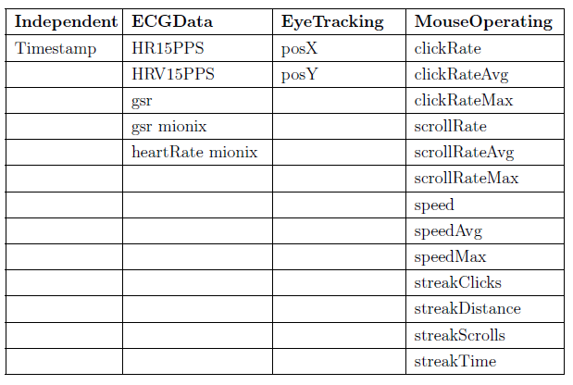
Physiological Data Features

Slide 30
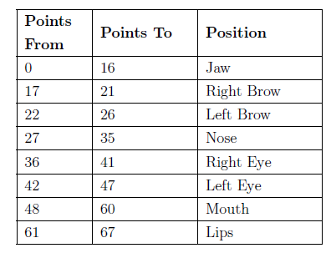
Face features extractions Points indications

Slide 31
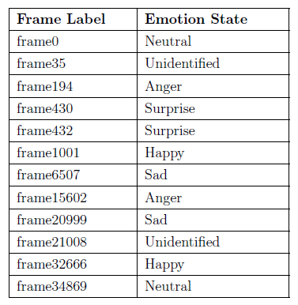
Naming OF Emotions

Slide 32
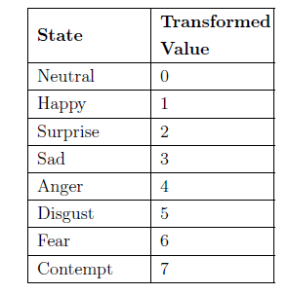
Conversion OF Emotions States

Slide 33
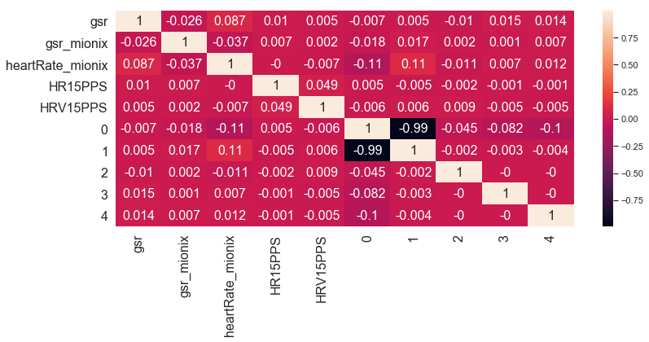
spearman Correlation Method

