Slide 1

Last-Mile Delivery Operations Analytics

Slide 2


About Us
GURUGUBELLI SURESH
PAVAN MANIKANTA BELLAM
DOKI SRIKAR
B.Tech - EEE
B.Tech - CSE, specializing in Artificial Intelligence (AI)
MBA – Business Analysis
To extract meaningful insights from data and support decisions.
To apply AI and statistical techniques to solve real-world problems.
To develop strong analytical and problem-solving skills.
Experience: Fresher
Experience: Fresher
Experience: Fresher

Slide 3
Table of contents
Project Overview
Business Scenario
Business Objectives
Dataset & Database Overview
ER Diagram & Database Structure
Analysis of the Objectives
Overall Key Findings
Business Recommendations
Conclusion

Slide 4
Project Overview
QuickRoute Logistics is a last-mile delivery service provider operating across multiple delivery zones, supported by a dedicated fleet of vehicles and a team of drivers to fulfil customer orders efficiently.
This project focuses on MySQL-based Business Analytics, leveraging data from five core entities — Customers, Orders, Deliveries, Drivers, and Vehicles — to examine operational trends, understand customer ordering behaviour, evaluate delivery performance, and assess resource utilization. The analysis aims to transform operational data into meaningful business insights that support informed decision-making and identify opportunities for operational improvement.

Slide 5
Business Scenario
QuickRoute Logistics operates a last-mile delivery network, serving customers across multiple delivery zones through a fleet of vehicles and a dedicated team of drivers.
With delivery operations spanning multiple zones, the company requires better visibility into its operational activities to understand delivery patterns, assess performance, identify inefficiencies, and recognize areas requiring improvement. The goal is to leverage data-driven insights to enhance operational efficiency and overall business performance.

Slide 6
Business Objectives
Delivery Demand Analysis
Understand order distribution across zones, service types, priorities, and time.
Customer Behaviour Analysis
Examine customer ordering patterns, spending, and segment differences.
Delivery Performance Evaluation
Assess delivery outcomes, success rates, durations, and zone-wise performance.
Driver & Vehicle Performance
Evaluate driver productivity, resource utilization, and vehicle performance.
Delivery Problem Identification
Identify delivery failures, repeated attempts, and operational bottlenecks.

Slide 7
Dataset & Database Overview
The database consists of five tables, each representing a dataset:
Customers: 400 records across 7 columns, covering customer details, location, delivery zone, preferred time slot, customer type, and registration date.
Orders: 3,000 records across 8 columns, covering customer and order details, delivery zone, package weight, service type, priority, and order value.
Deliveries: 3,500 records across 10 columns, covering order, driver and vehicle assignments, assigned and actual delivery dates, status, attempts, distance, and duration.
Drivers: 80 records across 6 columns, covering driver details, hire date, rating, employment type, and active status.
Vehicles: 50 records across 7 columns, covering vehicle type, fuel type, payload capacity, depot, service date, and active status.
Data Observation: The actual_delivery_date field contains NULL values for Failed, Pending, and Rescheduled deliveries, as these deliveries have not been completed.

Slide 8
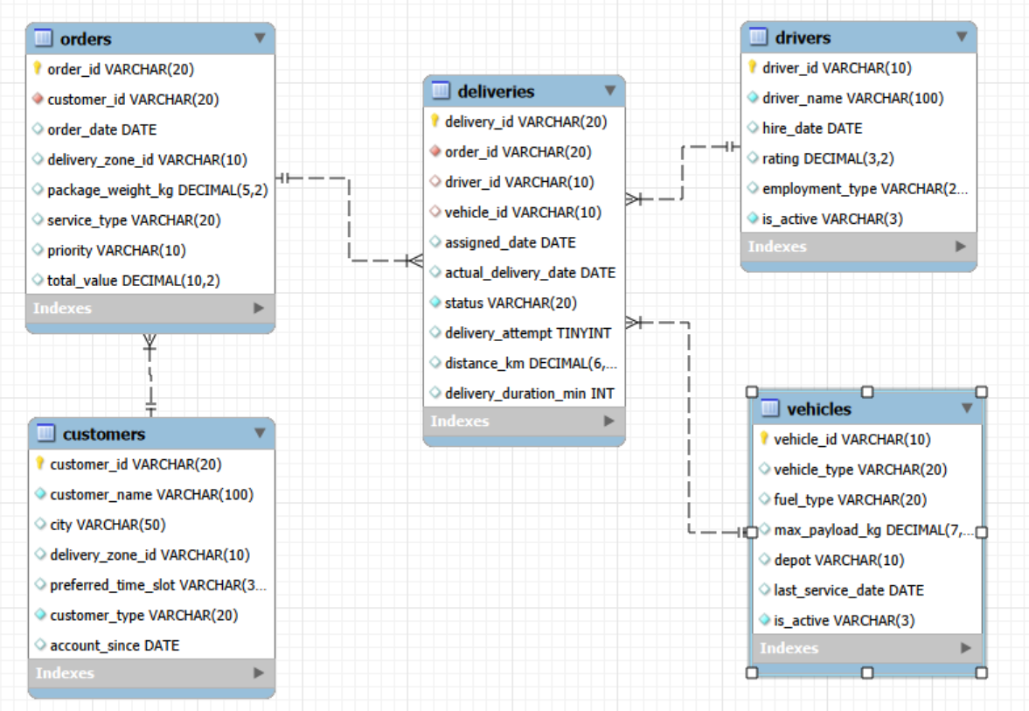
ER DIAGRAM AND DATABASE STRUCTURE

Slide 9
ER DIAGRAM AND DATABASE STRUCTURE
TABLE RELATIONSHIPS
Customers – Orders (1:M): A customer can place multiple orders, while each order belongs to one customer.
Orders – Deliveries (1:M): An order can have multiple delivery attempts, while each delivery record belongs to one order.
Orders – Drivers (M:N): An order may involve multiple drivers, and a driver can handle multiple orders through the Deliveries table.
Orders – Vehicles (M:N): An order may involve multiple vehicles, and a vehicle can serve multiple orders through the Deliveries table.
Drivers – Deliveries (1:M): A driver can handle multiple delivery records, while each delivery record is assigned to one driver.
Vehicles – Deliveries (1:M): A vehicle can be used for multiple delivery records, while each delivery record is associated with one vehicle.

Slide 10
Analysis of Objectives
Objective 1: Understand Delivery Demand
Order Distribution Across Zones
  ZONE0005 is highest: 240 orders, ₹5,89,285.70 total value
  ZONE0007 is lowest in orders: 79
  ZONE0011 is lowest in value: ₹2,10,390.88 from 86 orders
Order Distribution Across Service Types
  Standard is highest in orders (620), and Same Day is lowest (582)
  Next Day is highest in total value: ₹15,45,323.38 from 614 orders
  Express is lowest in total value: ₹14,53,427.46 from 586 orders
Order Value by Service Type
  Total value: Next Day is highest, and Express is lowest
  Average value: Same Day is highest, and Standard is lowest

Slide 11
Analysis of Objectives
Annual Order Trends
  2022 had the lowest order volume and gross value, and 2024 the highest
  Demand and order value rose overall by 2024
Half-Year and Quarterly Order Trends
  The second half of each year had more orders than the first half
  Q4 was generally the peak quarter
  In 2024, Q2 was the peak and Q4 the lowest
Order Distribution by Priority Level
  High- and Urgent-priority orders rose every year
  Normal-priority orders declined from 2023 to 2024
  Demand for priority deliveries is growing, and the order mix is shifting

Slide 12
Analysis of Objectives
Objective 2: Customer Behaviour Analysis
Customer Order Frequency
  Eric Davis (DLVCUST0000055) placed the most orders (19)
  Joseph Park, Ryan Thomas and Dorothy Brown placed the fewest (1 each)
Customer Spending Behaviour
  Eric Davis also has the highest total order value (43,779.25)
  Joseph Park has the lowest (532.50)
Geographical Distribution of Customers
  ZONE0005 has the most customers (29)
  ZONE0007 and ZONE0015 have the fewest (11 each)

Slide 13
Analysis of Objectives
Business vs. Individual Customers
  Individual customers generated 2,050 orders worth 5,078,345.15
  Business customers generated 950 orders worth 2,444,069.63
  Individuals contributed the majority of both orders and total order value
Customer Registration and Ordering Trends
  Registrations peaked in 2020 (111) and were lowest in 2021 (92)
  Distinct customers placing orders rose from 246 in 2022 to 366 in 2023 and 371 in 2024
  Customers who registered and ordered in the same year: 69 in 2022 and 83 in 2023

Slide 14
Analysis of Objectives
Objective 3: Evaluate Delivery Performance
Delivery Records by Year (3,500 Total)
  2023 recorded the highest volume (1,392; 39.77%), followed by 2024 (1,377; 39.34%), 2022 (726; 20.74%), and 2025 (5; 0.14%).
Overall Delivery Status
  2,581 deliveries (73.74%) were Delivered, while 26.26% were Pending, Failed, or Rescheduled.
Zone-wise Delivery Success
  Success rate: ZONE0010 highest (79.33%); ZONE0020 lowest (68.33%).
  Successful deliveries: ZONE0005 highest (225); ZONE0011 lowest (76).
Unsuccessful Delivery Outcomes
  Failed: ZONE0003 had the highest rate (11.89%), ZONE0008 the lowest (5.33%), while ZONE0005 recorded the most failures (25).

Slide 15
Analysis of Objectives
  Rescheduled: ZONE0016 had the highest rate (14.49%; 31 records), while ZONE0009 had the lowest (5.73%).
  Pending: ZONE0008 had the highest rate (15.15%; 20 records), while ZONE0011 had the lowest (6.12%; 6 records).
Delivery Duration by Status
  Duration ranged from 5 to 90 minutes, averaging 47.19 minutes.
  Failed deliveries had the highest average duration (49.67 minutes), compared with 46.92 minutes for Delivered records.
Delivery Duration Across Zones
  Average duration ranged from 43.90 minutes (ZONE0017) to 49.74 minutes (ZONE0012).
Annual Delivery Duration Trend
  Average duration declined from 48.40 minutes (2022) to 47.14 (2023) and 46.59 (2024), an overall improvement of approximately 3.75%.

Slide 16
Analysis of Objectives
Annual Delivery Success Trend
  Success rate increased from 74.79% (2022) to 75.72% (2023), before declining to 71.24% (2024).
Changes in Unsuccessful Delivery Outcomes
  Between 2023 and 2024, Failed, Pending, and Rescheduled rates all increased.
  Rescheduled increased from 8.19% to 10.17%, while Pending rose from 7.76% to 9.66%.

Slide 17
Analysis of Objectives
Objective 4: Driver & Vehicle Performance
Employment Type
  Full-time employees handled the most deliveries (1,384; 39.54%), and part-time employees the fewest (1,050; 30%)
  Full-time employees had the highest success rate (74.21%), and all employment types ranged between 73% and 75%
  Part-time employees had the lowest failure rate (7.14%)
Deliveries Handled by Drivers
  Highest: Rachel Roberts (DRV00073), with 68 deliveries
  Lowest: Yan Lewis (DRV00066), with 13 deliveries
  Average: 44 deliveries per driver

Slide 18
Analysis of Objectives
Performance Across Delivery Outcomes
  Highest success rate: Pooja Traoré (DRV00001), 89.66%, the strongest performer
  Lowest success rate: Vijay Sharma (DRV00034), 55.32%, which calls for a closer look at the contributing factors
  Lowest failure rate: Yan Lewis (DRV00066), 0%, with no failed deliveries
  Highest failure rate: Barbara Koné (DRV00008), 21.88%
Delivery Duration Across Drivers
  Longest average duration: Frank Osei (DRV00027), 55.97 min over 18.03 km, with 86.49% success and 13.51% failure
  Shortest average duration: Laura Lee (DRV00048), 40.38 min over 14.22 km, with 73.58% success and 3.77% failure
  Lowest delivery count: Yan Lewis (DRV00066), 13 deliveries, averaging 40.85 min over 14.47 km
  Highest delivery count: Rachel Roberts (DRV00073), 68 deliveries, averaging 48.46 min over 15.48 km

Slide 19
Analysis of Objectives
Vehicle Usage by Type
  Cargo Bikes had the most deliveries (717 records), averaging 26.20 kg per delivery
  Electric Vans had the fewest (448 records), averaging 24.72 kg per delivery
Performance by Vehicle Type
  Success rate: Electric Vans are highest (75.00%) and Motorbikes lowest (71.51%)
  Failure rate: Trucks are lowest (6.42%) and Electric Vans highest (9.82%)
Performance by Fuel Type
  Electric vehicles had the highest success rate (74.57%)
  Petrol vehicles had the lowest success rate (72.10%) and the highest failure rate (9.54%)
Individual Vehicles
  Success rate: VEH0010 is highest (82.19%) and VEH0027 lowest (61.04%)
  Failure rate: VEH0044 is lowest (1.54%) and VEH0050 highest (17.46%)

Slide 20
Analysis of Objectives
Objective 5: Delivery Problem Identification
Delivery Status Distribution (3,500 records)
  Delivered: 2,581 (73.74%), the most common status
  Rescheduled: 318 (9.09%)
  Pending: 306 (8.74%)
  Failed: 295 (8.43%)
Delivery Attempts
  Of the 2,581 successful deliveries, 2,457 (95.20%) were on the first attempt
  The other 124 (4.80%) needed multiple attempts
Factors Associated with Delivery Attempts
  Average distance, duration and package weight were lowest for the first attempt and highest for the third
  This shows an association between these factors and the number of attempts

Slide 21
Analysis of Objectives
Problematic Delivery Records Across Zones
  Highest percentage: ZONE0020, with 31.67% problematic records (38 records)
  Highest count: ZONE0005, with 69 of 294 records (23.47%)
Delivery Problems by Time Slot
  Failure rates varied by preferred time slot
  Morning (8-12) was highest at 10.31% (87 of 844 records), then Any (8.76%), Evening (7.83%) and Afternoon (6.78%, 55 of 811 records)

Slide 22
Overall Key Findings
Demand and Customers
Growing Demand & Priority Shift
  Orders and value peaked in 2024, with H2 leading every year.
  High- and Urgent-priority orders increased annually, while Normal declined from 2023.
  ZONE0005 led (240 orders; ₹5,89,285.70), while ZONE0007 had the fewest (79).
Service Type: Volume vs. Value
  Standard led in orders (620) but had the lowest average value.
  Next Day generated the highest total value (₹15,45,323.38).
  Same Day had the highest average value despite the fewest orders (582).
Individual Customer Contribution
  Individuals led with 2,050 orders (₹50.78 lakh), versus businesses with 950 (₹24.44 lakh).
  Ordering customers grew from 246 (2022) to 371 (2024).
  Eric Davis led in order frequency (19) and value (₹43,779.25).

Slide 23
Overall Key Findings
Delivery Reliability and Zones
Delivery success is moderate and declined in 2024
  Only 73.74% of deliveries succeeded, and 26.26% were Pending, Failed or Rescheduled
  Success went 74.79% (2022), 75.72% (2023), 71.24% (2024), with Failed, Pending and Rescheduled rates all rising
  Duration improved about 3.75% (48.40 to 46.59 min), so faster delivery did not mean better success
Zone performance varies widely
  ZONE0010 had the best success (79.33%), and ZONE0020 the lowest (68.33%) and the highest problematic share (31.67%)
  Each outcome has its own hotspot: failures in ZONE0003 (11.89%), rescheduling in ZONE0016 (14.49%), pending in ZONE0008 (15.15%)
  High-volume ZONE0005 had the most successful deliveries (225) and the most failed ones (25)

Slide 24
Overall Key Findings
Driver performance, not employment type, drives variation
  Employment types were similar (73–75% success), but drivers ranged from 55.32% (Vijay Sharma) to 89.66% (Pooja Traoré)
  Failure ranged from 0% (Yan Lewis) to 21.88% (Barbara Koné)
  Workload ranged from 13 to 68 deliveries per driver, against an average of 44
  Longer time did not mean lower success: Frank Osei averaged 55.97 min with 86.49% success
Vehicles, Problem Drivers and Data Note
Vehicle choice has a modest but measurable impact
  Electric Vans had the highest success (75.00%) and the highest failure rate (9.82%)
  Motorbikes had the lowest success (71.51%), and Petrol trailed Electric (72.10% vs 74.57%)
  Individual vehicles varied more than types: VEH0010 (82.19%) to VEH0027 (61.04%), with VEH0050 the highest failure rate (17.46%)

Slide 25
Overall Key Findings
Delivery problems are linked to distance, duration and weight
  These were lowest for first-attempt deliveries and highest for third attempts
  95.20% of successful deliveries were first-attempt, so repeats are rare but costly
  Failed deliveries took longer (49.67 min) than successful ones (46.92 min)
Data coverage note
  Only 5 records (0.14%) fall in 2025, so the analysis rests mainly on 2022–2024

Slide 26
Business Recommendations
Fix Delivery Reliability
Target the weakest zones
  Review ZONE0020 (68.33% success) first, then fix failures in ZONE0003, rescheduling in ZONE0016 and pending in ZONE0008
  Copy ZONE0010’s practices (79.33% success), and watch ZONE0005 (25 failures)
Reverse the 2024 decline in success
  Target at least 75.72% (the 2023 level), tracked monthly by zone
  Add an SMS or app confirmation before dispatch
Manage drivers actively
  Coach Vijay Sharma (55.32% success) and Barbara Koné (21.88% failure), and train on Pooja Traoré’s practices (89.66%)
  Balance workloads (13 to 68 deliveries)

Slide 27
Business Recommendations
Optimise vehicle allocation
  Review VEH0027 and VEH0050, and shift suitable routes to Electric (74.57% vs 72.10% Petrol)
  Investigate Electric Vans’ high failure rate (9.82%)
Grow Demand and Strengthen Operations
Handle long-distance and heavy orders better
  Flag them at dispatch, and assign suitable vehicles, experienced drivers and realistic time windows
Align capacity with demand
  Add capacity for H2, Q4 and growing High and Urgent orders
  Promote Same Day (highest average value) and review Standard pricing

Slide 28
Business Recommendations
Retain and grow customers
  Offer loyalty programmes for high-value customers such as Eric Davis (₹43,779.25)
  Grow business customers, target low-customer zones (ZONE0007, ZONE0015) and convert new registrations into repeat buyers
Strengthen monitoring
  Build a dashboard for success, failure, rescheduling and duration by zone, driver and vehicle
  Make success the main KPI and speed secondary

Slide 29
Conclusions
The business has growing demand but inconsistent delivery reliability
Orders and value peaked in 2024, and priority orders grew every year
Only 73.74% of deliveries succeeded, and success fell from 75.72% (2023) to 71.24% (2024)
Gaps sit in specific zones, drivers and vehicles, not in service or employment types
Targeted action in the weakest areas, better handling of high-risk orders and success rate as the main KPI will let growth be matched by reliable service
Growth in demand must be matched by reliable delivery, and the data points the way.
Data note: 2025 has only 5 records, so the conclusions rest mainly on 2022 to 2024.

Slide 30

THANK YOU

