Slide 1
Suresh Jada
Portfolio Website
8 pages • Home, About, Education, Skills, Projects, Achievements, Gallery, Contact
Title
Suresh Jada — Portfolio Website

Slide 2
Introduction
The website is built using plain HTML only.
No CSS is used anywhere in the site.
In place of CSS, the font, bgcolor, and table tags are used for color and layout.
Introduction
Suresh Jada — Portfolio Website

Slide 3
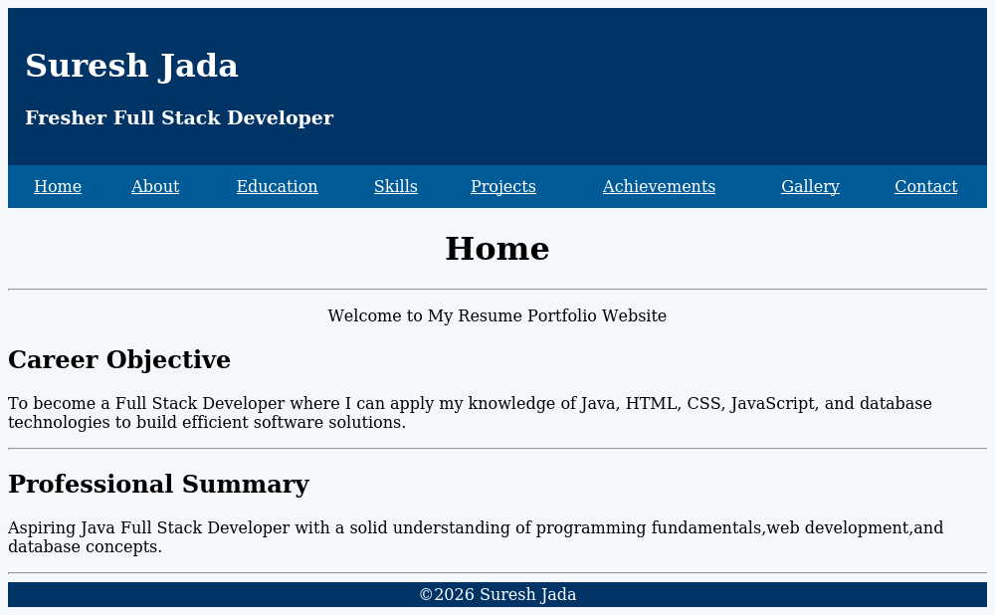
Home Page
index.html — the welcome page with a career objective
The page itself
Tags used for this layout
▪ <table> — Builds the header, menu bar, and footer.
▪ bgcolor — Fills the header and menu bar with color.
▪ <font color> — Colors text, like the white header text.
▪ <center> — Centers the page title.
▪ <hr> — Draws a line between sections.
▪ <h1>, <h2> — Show the big and small headings.
Page 1 of 8 — Home
Suresh Jada — Portfolio Website

Slide 4
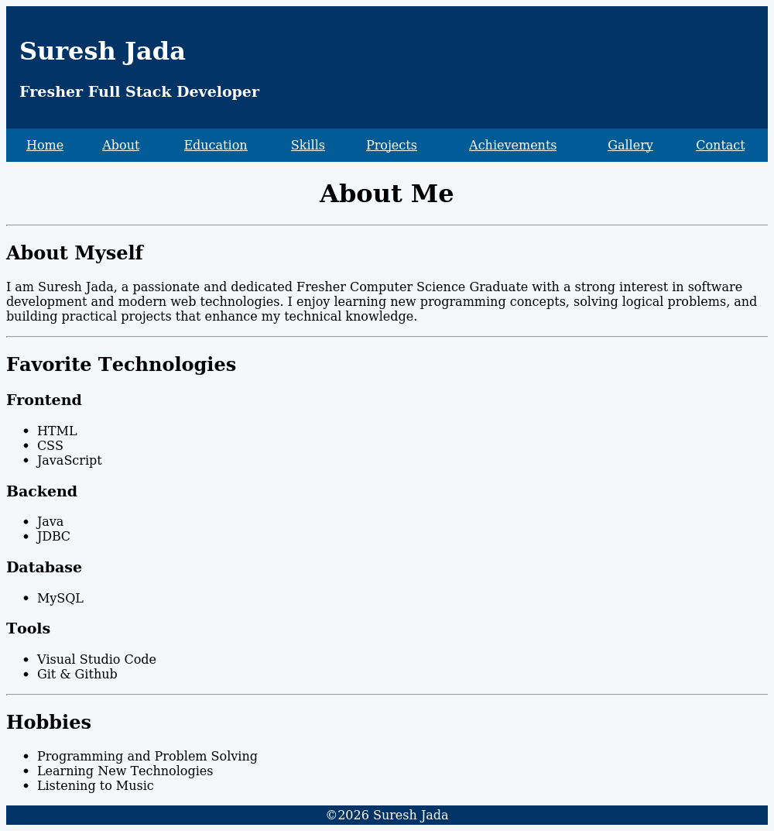
About Page
about.html — a short bio and a list of favorite tools
The page itself
Tags used for this layout
▪ <h3> — Shows small group headings like Frontend.
▪ <ul>, <li> — Creates the bullet lists of skills.
▪ <hr> — Separates each section.
▪ <p> — Holds the bio paragraph.
Page 2 of 8 — About
Suresh Jada — Portfolio Website

Slide 5
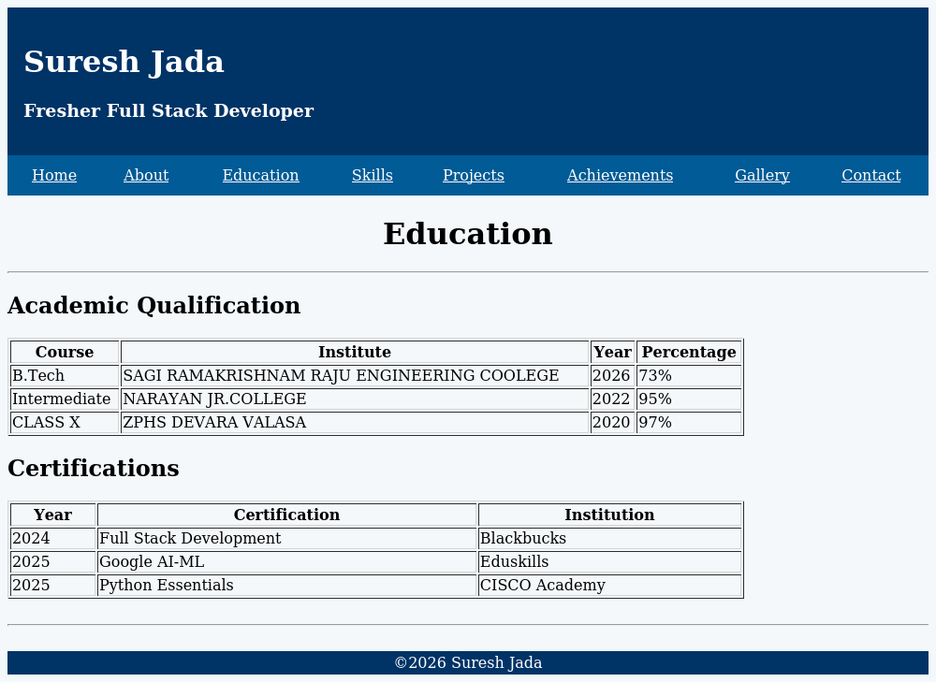
Education Page
education.html — degrees and certificates shown as tables
The page itself
Tags used for this layout
▪ <table border> — Draws a grid with visible lines.
▪ <th> — Bold header cell, like "Year".
▪ <tr> — One row of the table.
▪ <td> — One cell inside a row.
▪ width — Sets how wide the table is.
Page 3 of 8 — Education
Suresh Jada — Portfolio Website

Slide 6
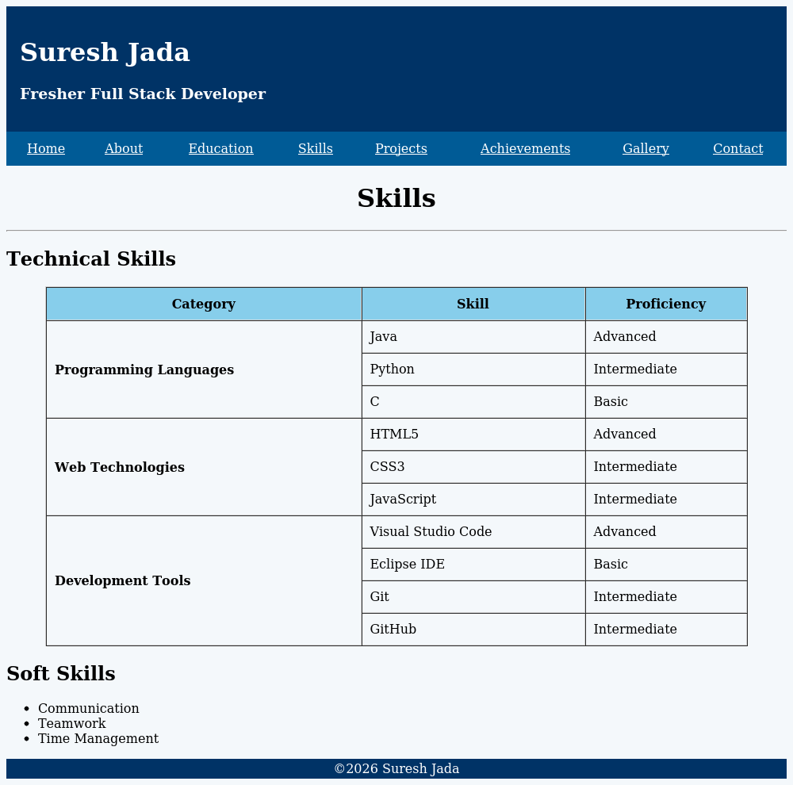
Skills Page
skills.html — technical skills in a grouped table, plus soft skills
The page itself
Tags used for this layout
▪ rowspan — Joins rows under one category name.
▪ bgcolor (on <tr>) — Colors just the header row.
▪ cellpadding — Adds space inside each cell.
▪ <b> — Makes the category names bold.
▪ <ul>, <li> — Lists the soft skills.
Page 4 of 8 — Skills
Suresh Jada — Portfolio Website

Slide 7
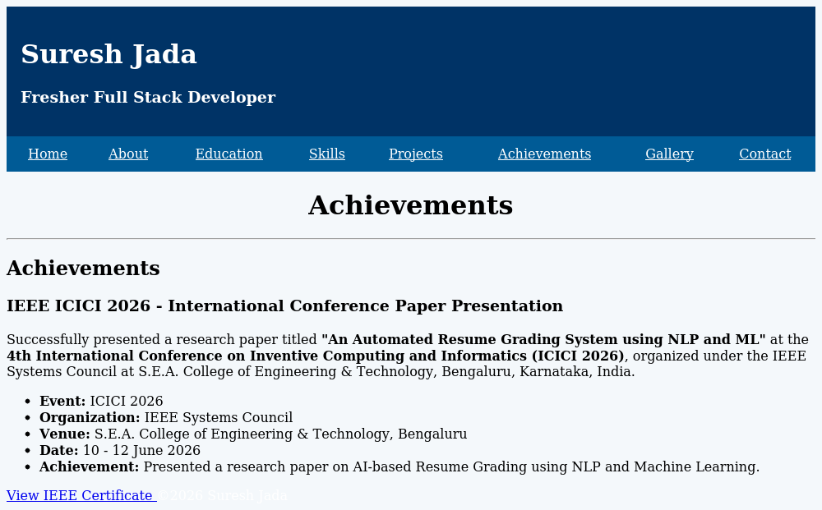
Achievements Page
achievements.html — a conference paper presentation, with proof
The page itself
Tags used for this layout
▪ <div> — Groups the heading, text, and list together.
▪ <strong> — Bolds important words.
▪ <ul>, <li> — Lists quick facts like date and venue.
▪ target="_blank" — Opens the certificate in a new tab.
Page 5 of 8 — Achievements
Suresh Jada — Portfolio Website

Slide 8
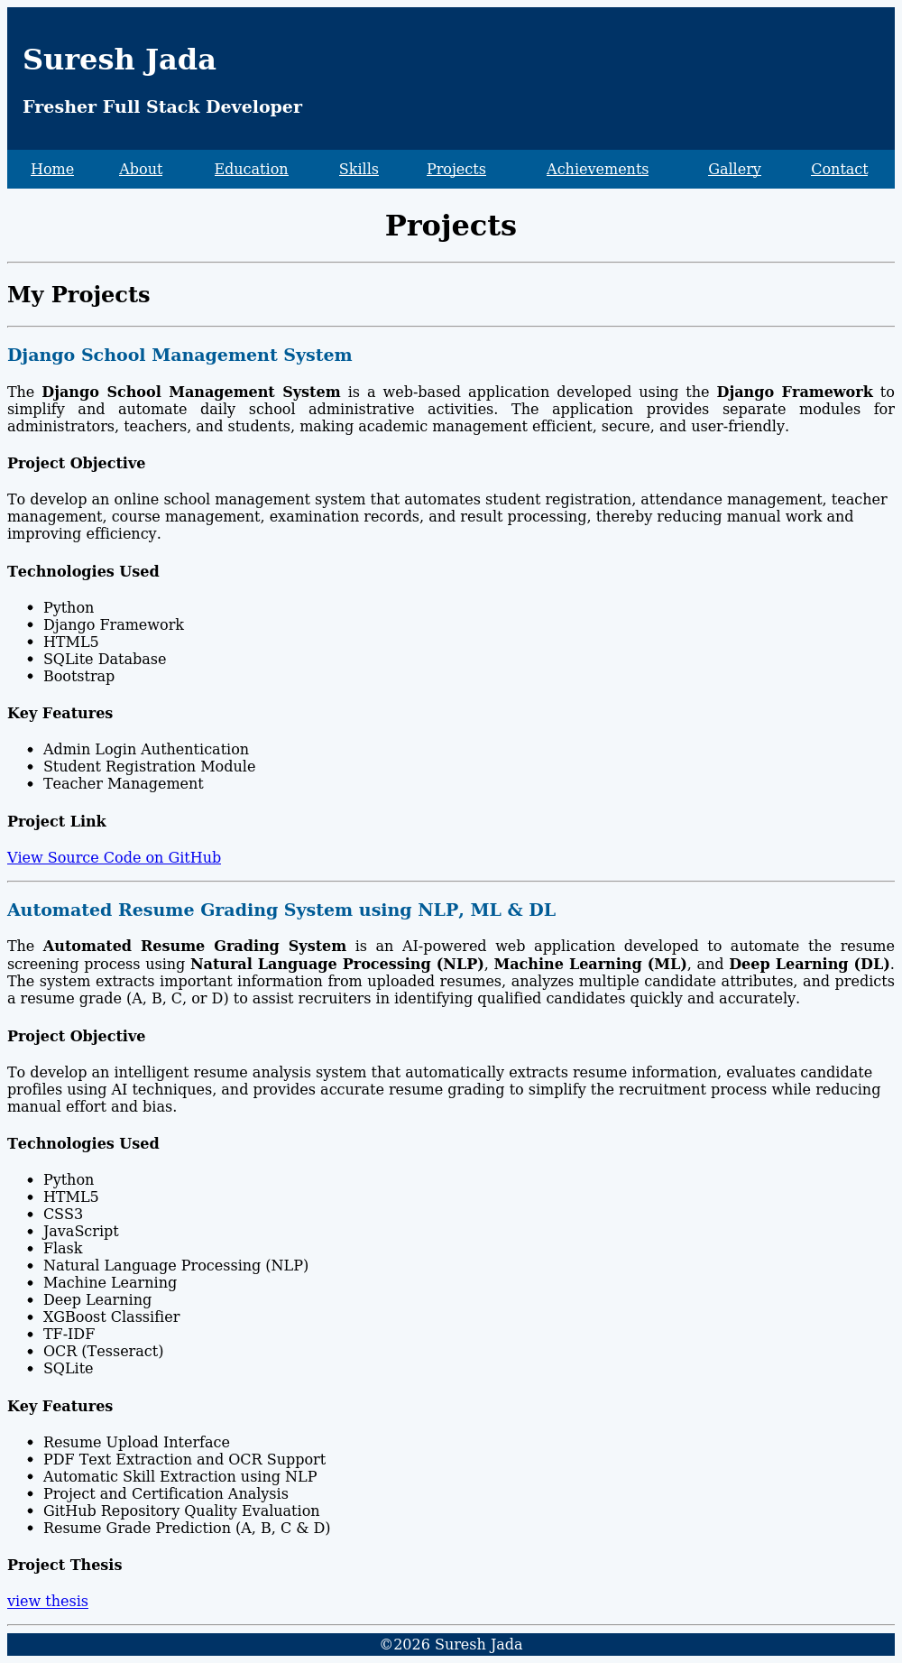
Projects Page
projects.html — two projects, each with details and a link
The page itself
Tags used for this layout
▪ <font color> — Colors each project heading blue.
▪ align="justify" — Lines up both edges of the paragraph.
▪ <h4> — Small heading, like "Key Features".
▪ <b> — Bolds key words in a sentence.
▪ <a target="_blank"> — Opens the GitHub or thesis link in a new tab.
Page 6 of 8 — Projects
Suresh Jada — Portfolio Website

Slide 9
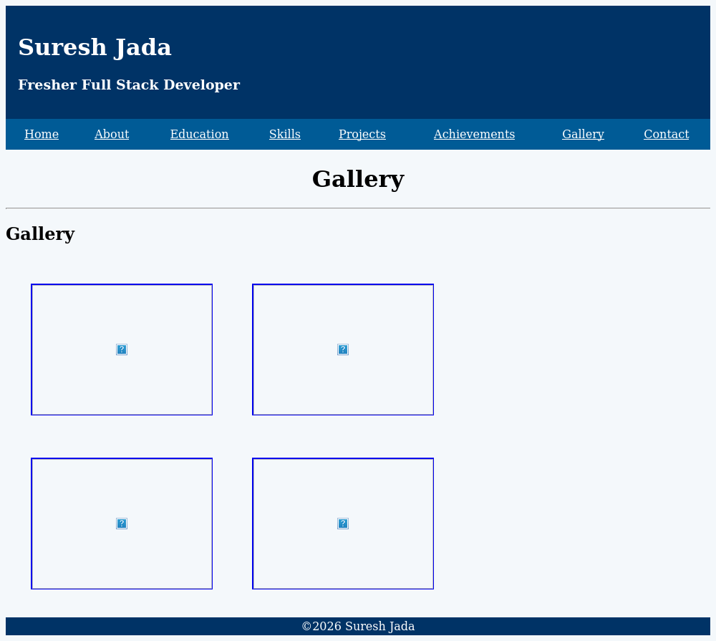
Gallery Page
gallery.html — a 2 by 2 grid of clickable certificate photos
The page itself
Tags used for this layout
▪ <table> (no border) — Arranges the 4 photos in a grid.
▪ <img> — Shows each photo with a set width and height.
▪ <a> around <img> — Makes each photo clickable.
▪ cellpadding / cellspacing — Adds space between photos.
▪ align="center" — Centers each photo in its cell.
Page 7 of 8 — Gallery
Suresh Jada — Portfolio Website

Slide 10
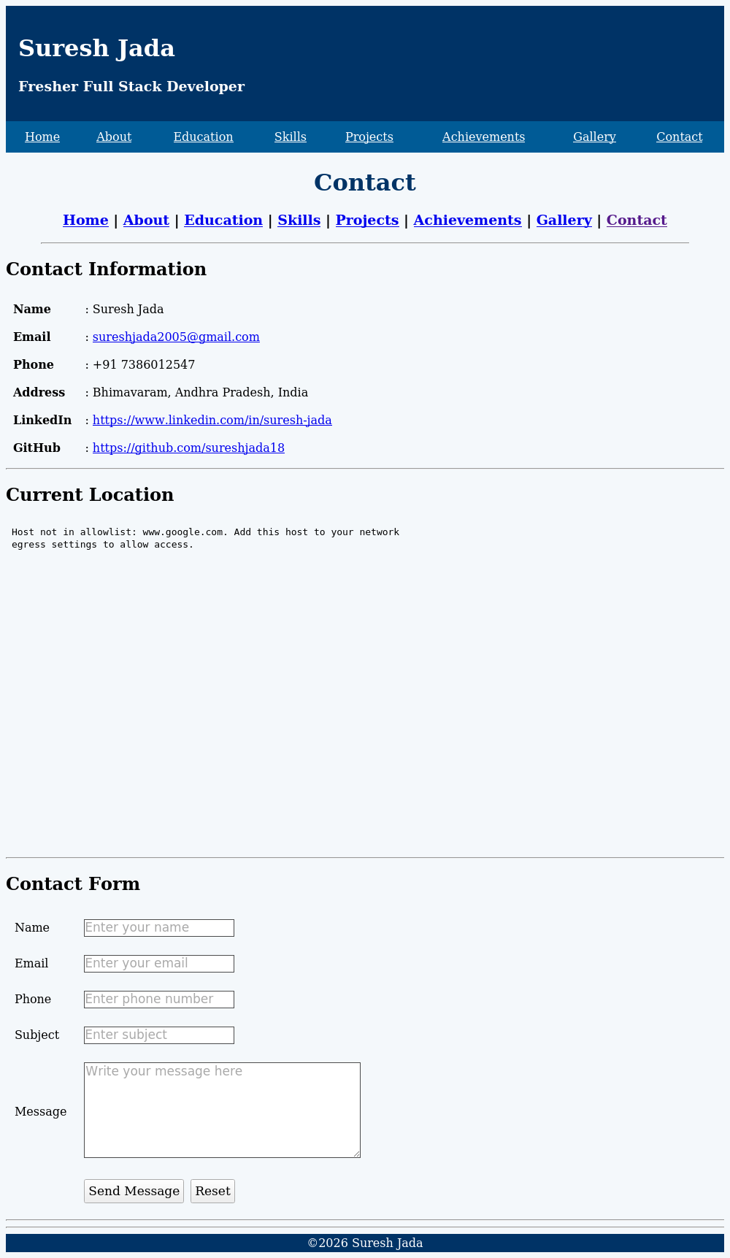
Contact Page
contact.html — contact details, a map, and a message form
The page itself
Tags used for this layout
▪ <table> — Lines up each label with its value.
▪ <a href="mailto:"> — Opens the visitor's email app.
▪ <iframe> — Embeds the Google Map.
▪ <form> — Groups all the input fields together.
▪ <input>, <textarea> — Collect name, email, phone, and message.
Page 8 of 8 — Contact
Suresh Jada — Portfolio Website

Slide 11
Thank You
Questions and feedback are welcome.
sureshjada2005@gmail.com | github.com/sureshjada18 | linkedin.com/in/suresh-jada
Thank You
Suresh Jada — Portfolio Website

