Slide 1
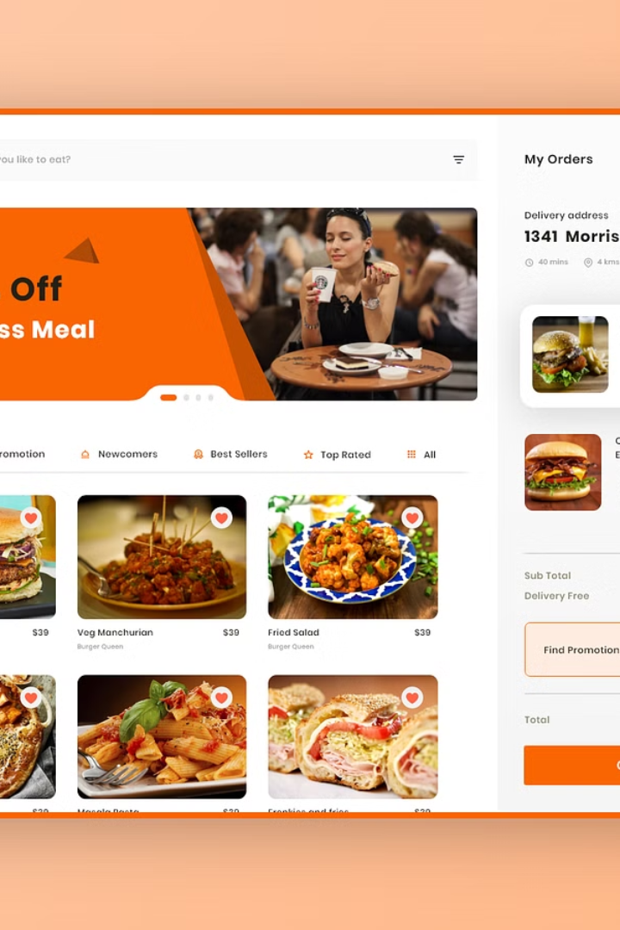


Online Food Ordering System
Explore the benefits and features of our intuitive online food ordering system.
by Suresh K

Slide 2
Benefits of an Online Food Ordering System
1
Convenience and Efficiency
2
Cost-Effective
Customers can place orders anytime, anywhere, leading to increased sales.
Reduces the need for phone support, saving time and money.
3
Improved Accuracy
4
Enhanced Customer Loyalty
Eliminates errors due to miscommunication during phone orders.
Easy access and personalized experiences result in repeat business.

Slide 3
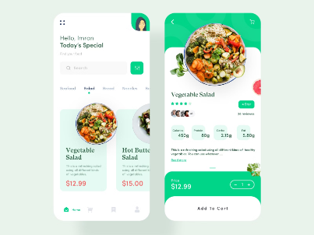
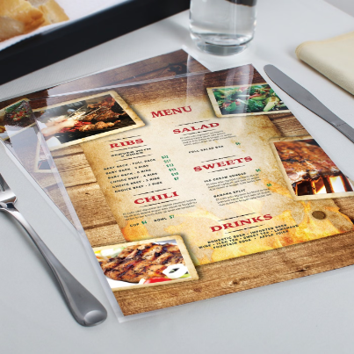
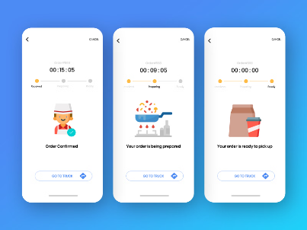
Features of Our Online Food Ordering System
User-Friendly Interface
Customizable Menus
Real-Time Order Tracking
Intuitive and seamless experience for both customers and restaurant staff.
Restaurants can easily update and modify their menus as per their needs.
Customers can track the status of their orders in real time for added convenience.

Slide 4
How Our System Works
1
Order Placement
Customers browse the menu, select items, and place their orders seamlessly.
2
Confirmation & Payment
Orders are confirmed, and secure payment options ensure a smooth transaction.
3
Preparation & Delivery
Restaurants prepare the order and ensure timely and hassle-free delivery.

Slide 5
Integration with Existing Restaurant Systems
POS Integration
Inventory Management
Reporting & Analytics
The system seamlessly integrates with existing Point of Sale (POS) software.
Generates detailed reports and analytics for informed business decisions.
Automates inventory updates and synchronizes menu changes in real time.

Slide 6
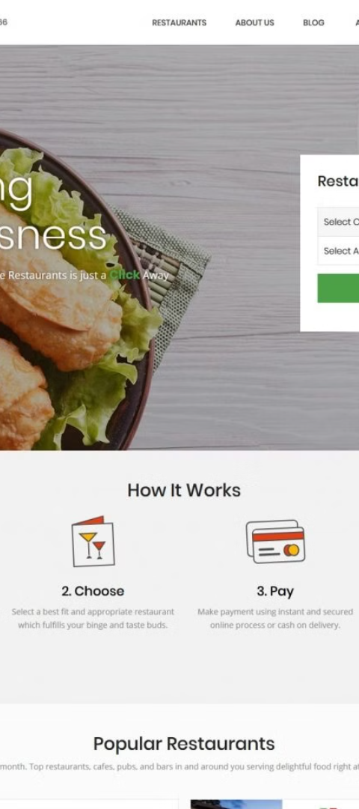



Customer Experience and Convenience
Seamless Ordering
Customers experience a hassle-free ordering process from start to finish.
Personalized Recommendations
AI-driven recommendations enhance the user experience and satisfaction.
Feedback & Ratings
Allows customers to provide feedback and rate their dining experience.

Slide 7


Case Studies and Success Stories
Growth Stories
Customer Satisfaction
Real examples of restaurants that have achieved growth and success using our system.
Positive experiences and testimonials from satisfied customers.

Slide 8
Conclusion and Next Steps
Take the next step toward enhancing the restaurant experience for both your business and your customers with our comprehensive online food ordering system.

