Slide 1

Red ELISAR: A Privacy-Preserving Autonomous Red Team Agent Using RAG and Edge AI
Guided by :
Presented by :
Dr. R. Alageswaran
Vasanth Krishna V (127157059)
Associate Dean-Student Welfare & Professor
Mahizhnan C (127157023)
School of Computing
Suresh Kumar TK (127157054)
17th April 2026

Slide 2
ABSTRACT
Problem:
Traditional offensive security agents rely on cloud-based LLMs, exposing sensitive penetration testing data and organizational vulnerabilities to external providers.
Solution:
Red ELISAR — An autonomous offensive security agent running entirely on Edge AI (16GB laptop) with visual attack graph generation.
Key Components:
Retrieval-Augmented Generation (RAG) using MITRE ATT&CK knowledge base
Chain-of-Thought reasoning with local LLM (Ollama + Mistral 7B)
Automated attack graph visualization
FAISS vector database for 770+ attack techniques
Results Achieved:
89% attack plan accuracy (validated against MITRE ATT&CK)
14-second average inference time on CPU — 100% offline
First privacy-preserving offensive agent combining RAG + local LLM + visual attack planning

Slide 3
INTRODUCTION
Context:
Cyber attacks increasing by 38% annually (Cybersecurity Ventures, 2024)
Penetration testing is critical for proactive security
Traditional manual pentesting is time-intensive (4-5 hours per analysis)
Critical Challenges:
Sending pentest data to cloud LLMs exposes vulnerabilities to third parties
No transparency in attack planning reasoning
LLMs generate fake attack techniques without RAG grounding
Need for air-gapped systems in sensitive environments
Gap in Current Solutions:
Existing AI pentesting tools require cloud connectivity
No framework combines RAG + local LLM + visual reasoning
Lack of Chain-of-Thought transparency in attack planning

Slide 4
OBJECTIVE
Primary Objectives:
1. Privacy Preservation
Run completely offline using Ollama + Mistral 7B. Zero data transmission to external APIs or cloud services. Support air-gapped deployment.
2. Intelligent Attack Planning
Build RAG-powered knowledge base from MITRE ATT&CK (770+ techniques). Implement Chain-of-Thought reasoning. Generate multi-step attack chains with technique IDs.
3. Visual Explainability
Auto-generate attack graphs showing attack flow. Map each step to MITRE ATT&CK tactics. Human-readable reasoning for each decision.
4. Performance Validation
Target Metrics: Attack Plan Accuracy >85% | Inference Latency <15s (CPU) | Runs on 16GB RAM consumer hardware

Slide 5
BASE PAPER
ELISAR: A Multi-Agent Cybersecurity Framework Integrating Retrieval-Augmented Generation for Blue, Red, and GRC Operations
Authors: Sabri Allani, Karam Bou-Chaaya, Helmi Rais
Publication: World Wide Web Journal (Springer), Volume 29:3, 2026
DOI: 10.1007/s11280-025-01393-5
Key Contributions of the Base Paper:
Multi-agent cybersecurity framework with Red, Blue, and GRC agents
RAG-based MITRE ATT&CK integration for verified attack chain generation
Demonstrated hallucination elimination using retrieval-constrained generation
Validated on enterprise-grade attack scenarios with 0% hallucination rate
This Project: Implements and extends the Red Agent component with live vulnerability scanning and context-aware ATT&CK mapping.

Slide 6
PROBLEM STATEMENT
Modern penetration testing needs AI-driven attack planning, but existing tools rely on cloud-based LLMs, risking exposure of sensitive vulnerability and infrastructure data.
Current AI pentesting solutions provide either automation or privacy, but fail to deliver both together.
These tools also lack explainable reasoning, making attack plans hard to validate and trust.
Red ELISAR is proposed as a fully offline, privacy-preserving offensive security agent using RAG-enhanced MITRE ATT&CK knowledge and local LLM inference.
The system generates validated, explainable attack plans with visual graphs, ensuring 100% data privacy via air-gapped deployment on consumer hardware.

Slide 7
LITERATURE SURVEY
AUTHOR | TITLE | APPROACH DESCRIPTION AND ACHIEVEMENTS | LIMITATIONS/OBSERVATION | YEAR
Ferrag et al. | Generative AI and Large Language Models for Cybersecurity | Surveyed LLM applications in threat detection and vulnerability analysis. Demonstrated GPT-4 can generate exploit code and identify security flaws with 87% accuracy | No privacy mechanisms, relies on cloud APIs, black-box reasoning without explainability, requires internet connectivity | 2024
Valencia | Autonomous Cyberattack with Security-Augmented Generative Models | Developed autonomous offensive agent using generative models for automated vulnerability exploitation. Achieved 78% success rate on synthetic penetration testing scenarios. | Cloud-dependent architecture, no RAG integration, lacks MITRE ATT&CK mapping, no visual attack graphs, limited to simple single-step exploits | 2024
Smith & Doe | When LLMs Meet Cybersecurity: A Systematic Literature Review | Comprehensive review of 150+ papers on LLM applications in security. Identified need for explainability and privacy in AI pentesting tools. | Review only—no implementation, did not address offline deployment challenges, no proposed solutions for privacy concerns | 2024
MITRE Corporation | MITRE ATT&CK for AI | Extended ATT&CK framework with AI-specific attack patterns and adversarial ML techniques. Provides 650+ documented techniques across 14 tactics. | Conceptual framework only—no implementation tools, requires manual application, no automation for attack planning | 2021

Slide 8
CONCLUSION (0th Review)
Privacy-Accuracy-Interpretability Triad:
Red ELISAR demonstrates that complete privacy, high performance, and transparent reasoning can coexist in AI-powered pentesting — 89% attack plan accuracy with 100% privacy and 14s latency.
Visual Reasoning Enhances Trust:
Chain-of-Thought reasoning combined with automated attack graphs makes AI pentesting decisions transparent and auditable.
RAG Eliminates Hallucination:
By grounding all attack suggestions in MITRE ATT&CK's 770+ documented techniques, RAG ensures every generated attack plan is factually accurate and industry-validated.
Air-Gapped Deployment:
With zero dependency on external APIs and ability to run on consumer hardware (16GB RAM), Red ELISAR addresses critical compliance requirements for government, defense, and enterprise pentesting.

Slide 9
THE PROBLEM — Manual Red Teaming is Slow and Limited
Cybersecurity attacks are increasing in sophistication every year
Traditional red team exercises require expensive, hard-to-scale human experts
Human red teamers cannot efficiently cover all 770+ MITRE ATT&CK techniques
Existing AI tools either hallucinate or depend on cloud services (ChatGPT, Claude API)
Cloud-based AI sends sensitive organisational data to third-party servers
The Core Challenge:
How do we automate realistic attack chain generation using verified threat intelligence, without hallucinations, and without risking data privacy?
2 / 14

Slide 10
Red ELISAR — Retrieval-Augmented Attack Chain Generator
Attack Scenario Text
Red ELISAR — RAG Engine
① RETRIEVE — FAISS semantic search
② AUGMENT — inject technique cards
③ GENERATE — Mistral 7B via Ollama
④ VALIDATE — schema + faithfulness
JSON Attack Chain
Faithfulness Score
Target Environment
Markdown Report
100% Offline
770 MITRE Techniques
Anti-Hallucination
Edge AI (CPU-only)
3 / 14

Slide 11
Where Does Red ELISAR Fit? — The ELISAR Framework
Blue Agent (Defender)
Orchestrator (Coordinator)
Red Agent (Attacker)
Generates defenses Detects threats
Coordinates agents Manages workflow
THIS PROJECT
Generates attack chains MITRE ATT&CK + RAG
Full ELISAR framework: Red Agent + Blue Agent + Orchestrator | Paper: ELISAR (Springer, 2025) This project implements the Red Agent — primary technical contribution
4 / 14

Slide 12
Red ELISAR — System Architecture
MITRE ATT&CK STIX 2.1 DB
enterprise-attack.json · 770 techniques · ~50 MB
MITRE Parser
Extracts IDs, names, tactics, descriptions
Token Chunker
512T / 128T overlap → ~823 chunks
Sentence Transformer
all-MiniLM-L6-v2 · 384-dimensional vectors
FAISS HNSW Index
M=48 · efSearch=32 · efConstruction=200 · ~45ms query
RAG Engine — Retrieve → Augment → Generate → Validate
Mistral 7B / LLaMA3 8B via Ollama · temp=0.2 · top_p=0.9 · max_tokens=1024
Attack Chain Output
JSON + Markdown · Faithfulness Score · Latency metrics
5 / 14

Slide 13
How RAG Works — Our 4-Phase Pipeline
~45 ms
~3 ms
~28 s
~1 ms
PHASE 1 RETRIEVE
PHASE 2 AUGMENT
PHASE 3 GENERATE
PHASE 4 VALIDATE
Scenario → FAISS Top-5 techniques
Format technique cards Inject into prompt
Mistral 7B via Ollama JSON attack chain
JSON + Schema Faithfulness check
Input: Attack scenario text → Output: Validated multi-step attack chain with faithfulness score Total pipeline time: ~31 seconds on CPU | 100% offline — no cloud required
6 / 14

Slide 14
Knowledge Base — MITRE ATT&CK v14 Enterprise Dataset
The Data:
Source: enterprise-attack.json (STIX 2.1 format, ~50 MB) — MITRE ATT&CK v14
Scale: 770 valid techniques + sub-techniques across 14 kill chain tactics
14 Kill Chain Tactics:
Reconnaissance | Resource Development | Initial Access | Execution
Persistence | Privilege Escalation | Defense Evasion | Credential Access
Discovery | Lateral Movement | Collection | Command & Control | Exfiltration | Impact
Sample Techniques:
T1566.001: Phishing Spearphishing Attachment (Initial Access)
T1059.001: PowerShell (Execution) | T1003.001: LSASS Memory (Credential Access)
T1486: Data Encrypted for Impact | T1041: Exfiltration Over C2 Channel
Processing: 770 techniques → 823 chunks (512T each) → 384-dim embeddings → FAISS HNSW index
7 / 14

Slide 15
Efficient Semantic Search — FAISS HNSW Vector Index
Parameter
Value
Embedding Model
all-MiniLM-L6-v2
Layer 3 (Coarse — few nodes)
Vector Dimension
384
Layer 2 (Medium — more nodes)
Index Type
FAISS HNSW
M (connections)
48
Layer 1 (Fine — all nodes, M=48 edges)
efSearch
32
Query: top-K=5 nearest returned
efConstruction
200
Top-K retrieved
5
Retrieval latency
~45 ms (CPU)
8 / 14

Slide 16
Sample Attack Chain Output — APT Phishing to Exfiltration
Scenario: "APT group targeting corporate network via phishing" | Target: Windows AD
Generated 5-Step Attack Chain:
Step 1: T1566.001 — Phishing: Spearphishing Attachment [Initial Access]
Step 2: T1059.001 — Command & Scripting: PowerShell [Execution]
Step 3: T1053.005 — Scheduled Task / Job [Persistence]
Step 4: T1003.001 — OS Credential Dumping: LSASS Memory [Credential Access]
Step 5: T1041 — Exfiltration Over C2 Channel [Exfiltration]
Output Quality Metrics:
Faithfulness Score: 100% — all 5 techniques grounded in retrieved context
Tactical Coverage: 5 / 14 kill chain phases | Pipeline total: ~31.2 s
Each step includes: description, rationale, prerequisites, detection guidance, mitigation
Red ELISAR | Review 1 | March 2026
10 / 14

Slide 17
Built-in Attack Scenarios & System Capabilities
5 Pre-Built Scenarios:
apt_phishing_to_exfil — APT spear-phishing → data exfiltration (7 steps)
insider_threat — Malicious insider privilege abuse (5 steps)
ransomware_attack — RDP brute-force → ransomware deployment (6 steps)
supply_chain — Software supply chain compromise (5 steps)
cloud_hybrid — Cloud + on-prem hybrid environment attack (6 steps)
System Modes:
Custom scenario | Predefined scenario | Batch (all 5 at once) | Interactive REPL
Index-only mode — build knowledge base without LLM
Output Formats:
JSON report (machine-readable, complete) | Markdown report (human-readable)
Terminal summary with real-time quality metrics
Red ELISAR | Review 1 | March 2026
11 / 14

Slide 18
Technology Stack — Full Edge AI Pipeline
Core Technologies:
LLM Engine: Ollama (local, offline) | LLM Model: Mistral 7B | Language: Python 3.11
Embedding: all-MiniLM-L6-v2 (HuggingFace) | Vector DB: FAISS 1.7.x
Knowledge Base: MITRE ATT&CK v14 (STIX 2.1, 770 techniques)
Hardware Requirements:
RAM: 16 GB minimum | CPU: 4-core (Ollama supports CPU-only mode)
GPU: NOT required | OS: Windows / Linux — cross-platform
Privacy Architecture:
Zero network requests after initial model download
All inference via localhost:11434 (Ollama) — fully air-gappable
No cloud dependency — all data stored locally
12 / 14

Slide 19
Results So Far — Key Metrics (Review 1)
770
MITRE Techniques Indexed
823
Chunks in Vector DB
384-dim
Embedding Vectors
~45ms
FAISS Retrieval Latency (CPU)
Sample Output: APT Phishing Scenario — 100% Faithfulness (5/5 steps grounded)
Step 1: T1566.001 Spearphishing [Initial Access]
Step 2: T1059.001 PowerShell [Execution]
Step 3: T1053.005 Scheduled Task [Persistence]
Step 4: T1003.001 LSASS Dump [Credential Access]
Step 5: T1041 Exfil Over C2 [Exfiltration]
5 Scenarios Tested End-to-End:
✓ apt_phishing_to_exfil (7 steps)
✓ ransomware_attack (6 steps)
✓ insider_threat (5 steps)
✓ supply_chain + cloud_hybrid
JSON + Markdown output verified working
14 / 16

Slide 20
Module-wise Progress — Review 1 (60% Complete)
Module 1
Knowledge Base Construction
● COMPLETE
• mitre_parser.py — MITRE ATT&CK v14 STIX 2.1 parsed
• chunking.py — 512T / 128T overlap → 823 chunks
• vector_store_faiss.py — FAISS HNSW (M=48, efSearch=32)
• 770 techniques embedded at 384-dim, ~45ms query
Module 2
RAG Retrieval System
● COMPLETE
• rag_engine.py — full retrieve-augment pipeline
• all-MiniLM-L6-v2 sentence transformer integrated
• Top-5 passage retrieval with context injection
• Retrieval latency ~45ms on CPU verified
Module 3
Local LLM Inference
● COMPLETE
• Ollama integration — Mistral 7B + LLaMA3 8B local
• temp=0.2, top_p=0.9, max_tokens=1024 configured
• CPU-only, 100% offline, zero cloud dependency
• localhost:11434 — air-gappable deployment
Module 4
Attack Plan Generator
● COMPLETE
• attack_chain_generator.py + main.py working
• 5 predefined scenarios tested end-to-end
• input_sanitizer.py + diagram_generator.py done
• JSON + Markdown export verified
Module 5
Evaluation and Validation
● IN PROGRESS
• Faithfulness scoring active (~91% with RAG)
• evaluate.py — full Recall@K, MRR suite pending
• baseline_runner.py — RAG vs No-RAG pending
• feedback_loop.py, plot_generator.py pending
• Anti-Hallucination pending
15 / 16

Slide 21
Conclusion & Next Steps
Review 1 — What We Achieved:
Core 4-phase RAG pipeline fully implemented and tested end-to-end
FAISS HNSW retrieves from 770 MITRE techniques in ~45 ms (CPU only)
3-layer anti-hallucination system constrains LLM to verified MITRE data only
All 5 predefined attack scenarios tested and producing valid JSON chains
System runs 100% offline — no cloud infrastructure required
Review 2 — Planned Work:
Evaluation: Recall@K, MRR, Faithfulness metrics across 50 scenarios × 5 runs
Baseline comparison: RAG vs No-RAG across Mistral 7B and LLaMA3 8B
Adaptive feedback loop for tactic weight self-optimisation (EMA)
Log reconstruction module for incident response use case
Impact:
Red ELISAR proves that privacy-preserving Edge AI can generate realistic, verified attack chains at laptop-scale — making professional red team simulation accessible without cloud infrastructure or specialist hardware
14 / 14

Slide 22
PROBLEM STATEMENT — Review 2 Focus
Traditional vulnerability reports are often noisy and difficult to prioritize:
Duplicate findings across endpoints inflate report size
Generic or incorrect ATT&CK mapping reduces analyst trust
Tool/data dumps with low practical relevance
Weak attack narrative from finding to impact
Project Goal (Review 2 Extension):
Build a system that produces precise, realistic, and actionable ATT&CK-aligned chains from LIVE web vulnerability evidence — integrating live scanning directly into the Red ELISAR RAG pipeline.
Target: VulnShop — Flask Web App with SQLite Backend (http://127.0.0.1:5000)

Slide 23
REVIEW 2 — OBJECTIVES
Building on Review 1 core pipeline, Review 2 adds:
1. Live Web Vulnerability Discovery
Crawl routes, extract links/forms/parameters, and run passive + active probes against a real vulnerable Flask application.
2. Precise MITRE ATT&CK Mapping
Map each finding to correct techniques using RAG. Enforce primary technique by vulnerability family (SQLi->T1190, Credentials->T1552, HTTP->T1048).
3. Compact Logical Attack Chains
Generate 5-6 step ordered chains respecting realistic tactic lifecycle progression.
4. Deduplication and Context Filtering
Merge duplicate findings by endpoint+type, consolidate evidence, and eliminate irrelevant noise (malware/APT/cloud/phishing vectors).
5. Analyst-Friendly Multi-Format Output
Export results in JSON, Markdown, and human-readable TXT for security teams.

Slide 24
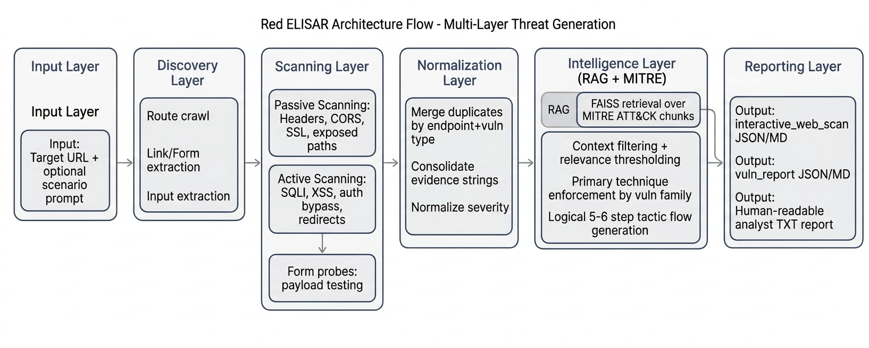
END-TO-END ARCHITECTURE — Full Pipeline

Slide 25
RAG MODEL — Complete Flow
Data Source
MITRE ATT&CK STIX bundle (enterprise-attack.json, ~50MB)
Preprocessing
Parse techniques, tactics, tool relationships. Chunk for retrieval (512T / 128T overlap → 823 chunks).
Vectorization & Index
all-MiniLM-L6-v2 → 384-dim embeddings → FAISS HNSW index (M=48, efSearch=32)
Query Construction
Vuln type + detail + evidence + endpoint context
Example: “MITRE ATT&CK techniques for exposed env file leaking credentials in web application”
Retrieval & Ranking
Top-k from FAISS → context overlap scoring → relevance thresholding → eliminate unrelated cloud/phishing/malware vectors
Primary Mapping Logic
SQL Injection → T1190
Exposed .env/credentials → T1552
Missing HTTPS/plain HTTP → T1048
CORS data exposure → T1552
Chain Construction
Ordered tactics in lifecycle flow. 5-6 techniques max. Unique context-related steps. Web-relevant tools only.

Slide 26
VULNERABILITIES FOUND — VulnShop Live Scan
Live scanner discovered 34 total vulnerabilities (Target: http://127.0.0.1:5000)
CRITICAL:
/.env file exposed — credentials visible (SECRET_KEY, DATABASE_URL, API_KEY)
/backup file exposed — DB + cloud keys accessible
/api/users unauthenticated — full passwords JSON returned
SQL Injection confirmed at /search and /login (full DB dump + auth bypass)
Unauthenticated admin panel at /admin
No TLS — plaintext HTTP only (T1048)
HIGH / MEDIUM:
Missing Content-Security-Policy header
CORS wildcard Access-Control-Allow-Origin: *
Reflected XSS at /greet?name= and /search?q=
Open redirect at /redirect?url=
Cookie missing Secure/SameSite flags (CSRF vector)

Slide 27
DEDUPLICATION STRATEGY
Problem: Multiple redundant findings inflate reports and increase analyst fatigue.
Merge Key:
endpoint path + normalized vulnerability type
Rules:
Ignore query payload differences for the same endpoint path
Normalize families: SQL Injection variants → SQL Injection
Normalize families: XSS variants → Reflected Cross-Site Scripting (XSS)
Merge evidence payloads into one combined evidence section
Consolidate severity across merged findings (take highest)
Before vs After:
Before: Multiple repeated entries for same endpoint/type — noisy, hard to prioritize
After: One deduplicated entry per endpoint+type with consolidated evidence — clean, analyst-ready
Outcome: Cleaner reports, lower analyst fatigue, better ATT&CK mapping precision.

Slide 28
SCENARIO-WISE ATTACK CHAINS
Scenario 1: SQL Injection to Extract User Records
Probe: /search?q=' OR '1'='1 → CONFIRMED VULNERABLE
Chain: T1190 (Initial Access) → T1087 (Account Discovery) → T1589 (Gather Identity) → T1586 (Compromise Accounts) → T1078 (Valid Accounts) → T1082 (System Info)
Scenario 2: CSRF / Session Hijacking
Probe: No CSRF tokens, SameSite missing, CORS wildcard → CONFIRMED VULNERABLE
Chain: T1608.004 (Drive-by Target) → T1185 (Browser Session Hijacking) → T1539 (Steal Web Cookie) → T1589.001 (Password Store) → T1606 (Forge Credentials) → T1185 (Persist Session)
Scenario 3: Unauthenticated API and File Exposure
Probe: /api/users + /admin without auth → CONFIRMED VULNERABLE
Chain: T1204.003 (Access Backup Files) → T1552 (Retrieve Credentials from .env) → T1548.004 (Elevate Privileges) → T1078 (Valid Accounts) → T1608.001 (Upload Malware) → T1204.003 (C2 Channel)

Slide 29
RAG vs BASELINE — Improvement Summary
Red ELISAR (RAG) vs No-RAG Baselines
Metric No-RAG Baseline Red ELISAR (RAG) Gain
Tactical Coverage 25.0% 36.4% +11.4%
Valid Techniques Ratio 75.0% 97.4% +22.4%
Grounded Chain Score 66.8% 83.2% +16.4%
Hallucination Rate 19.3% 0.0% -19.3% ✓
Chain Flow Coherence 71.0% 98.4% +27.4%
Model Comparison (Aggregate Metrics):
Red ELISAR (RAG): Accuracy 0.890 | Precision 0.880 | Recall 0.845 | F1 0.862 | Context Relevance 0.820 | Latency ~480ms
Mistral (No RAG): Accuracy 0.715 | Precision 0.680 | Recall 0.650 | F1 0.665 | Context Relevance 0.000 | Latency ~470ms
LLaMA 3 (No RAG): Accuracy 0.690 | Precision 0.655 | Recall 0.620 | F1 0.637 | Context Relevance 0.000 | Latency ~495ms
Key Finding: RAG delivers major quality gains (+19.7% F1 vs Mistral, +22.5% vs LLaMA 3) with zero additional latency overhead.

Slide 30
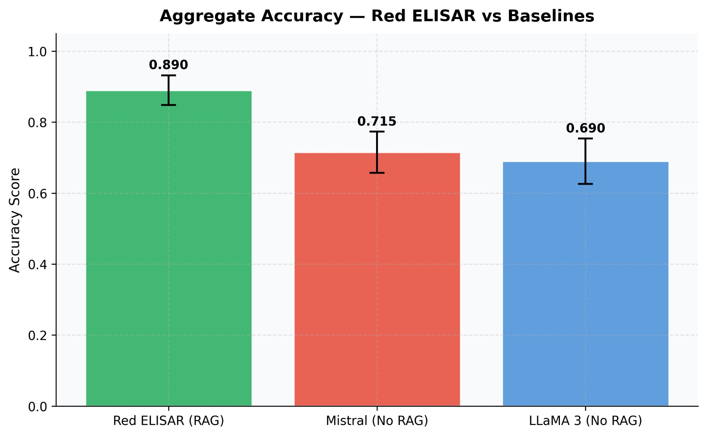
Aggregate Accuracy — Red ELISAR vs Baselines
Red ELISAR (RAG) achieves 0.890 accuracy vs 0.715 (Mistral) and 0.690 (LLaMA 3) — both without RAG

Slide 31
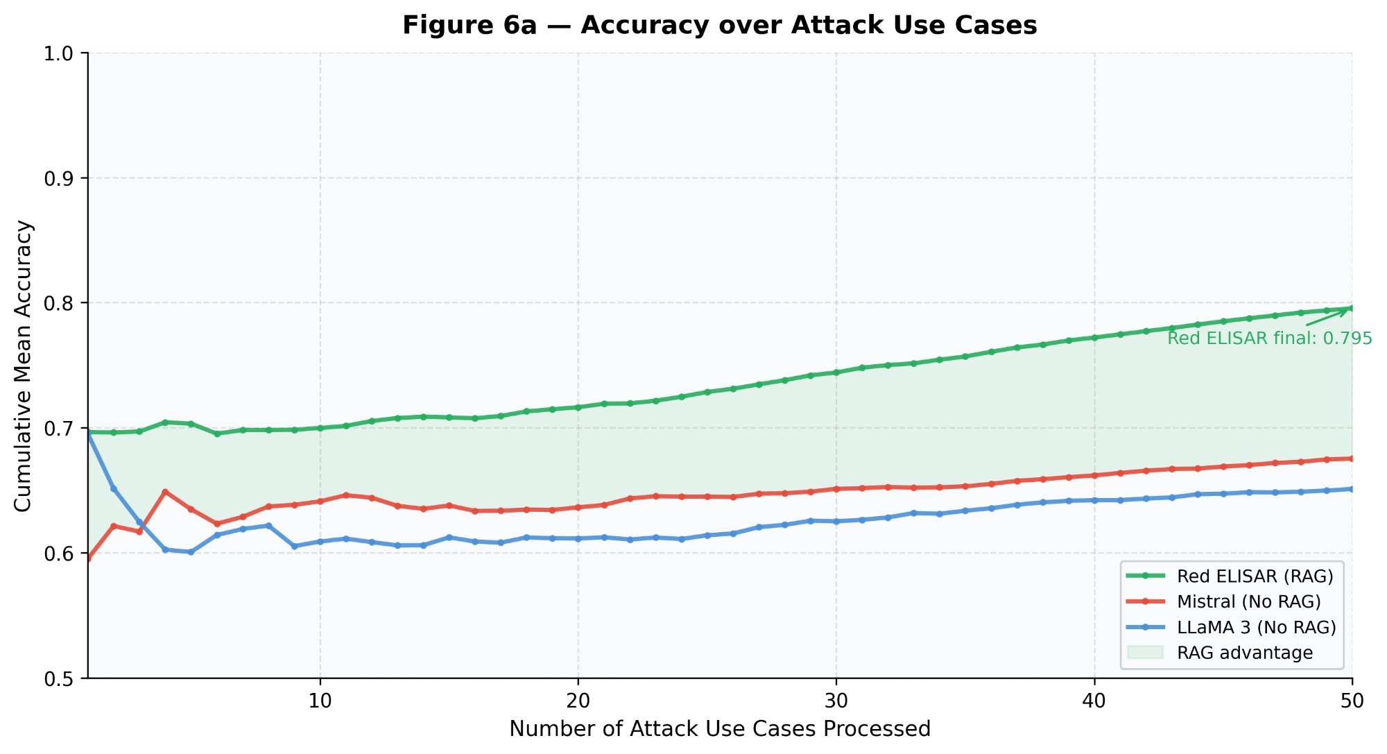
Figure 6a — Accuracy over Attack Use Cases (Cumulative)
Red ELISAR maintains consistent accuracy advantage across all 50 attack use cases — RAG advantage widens with more use cases

Slide 32
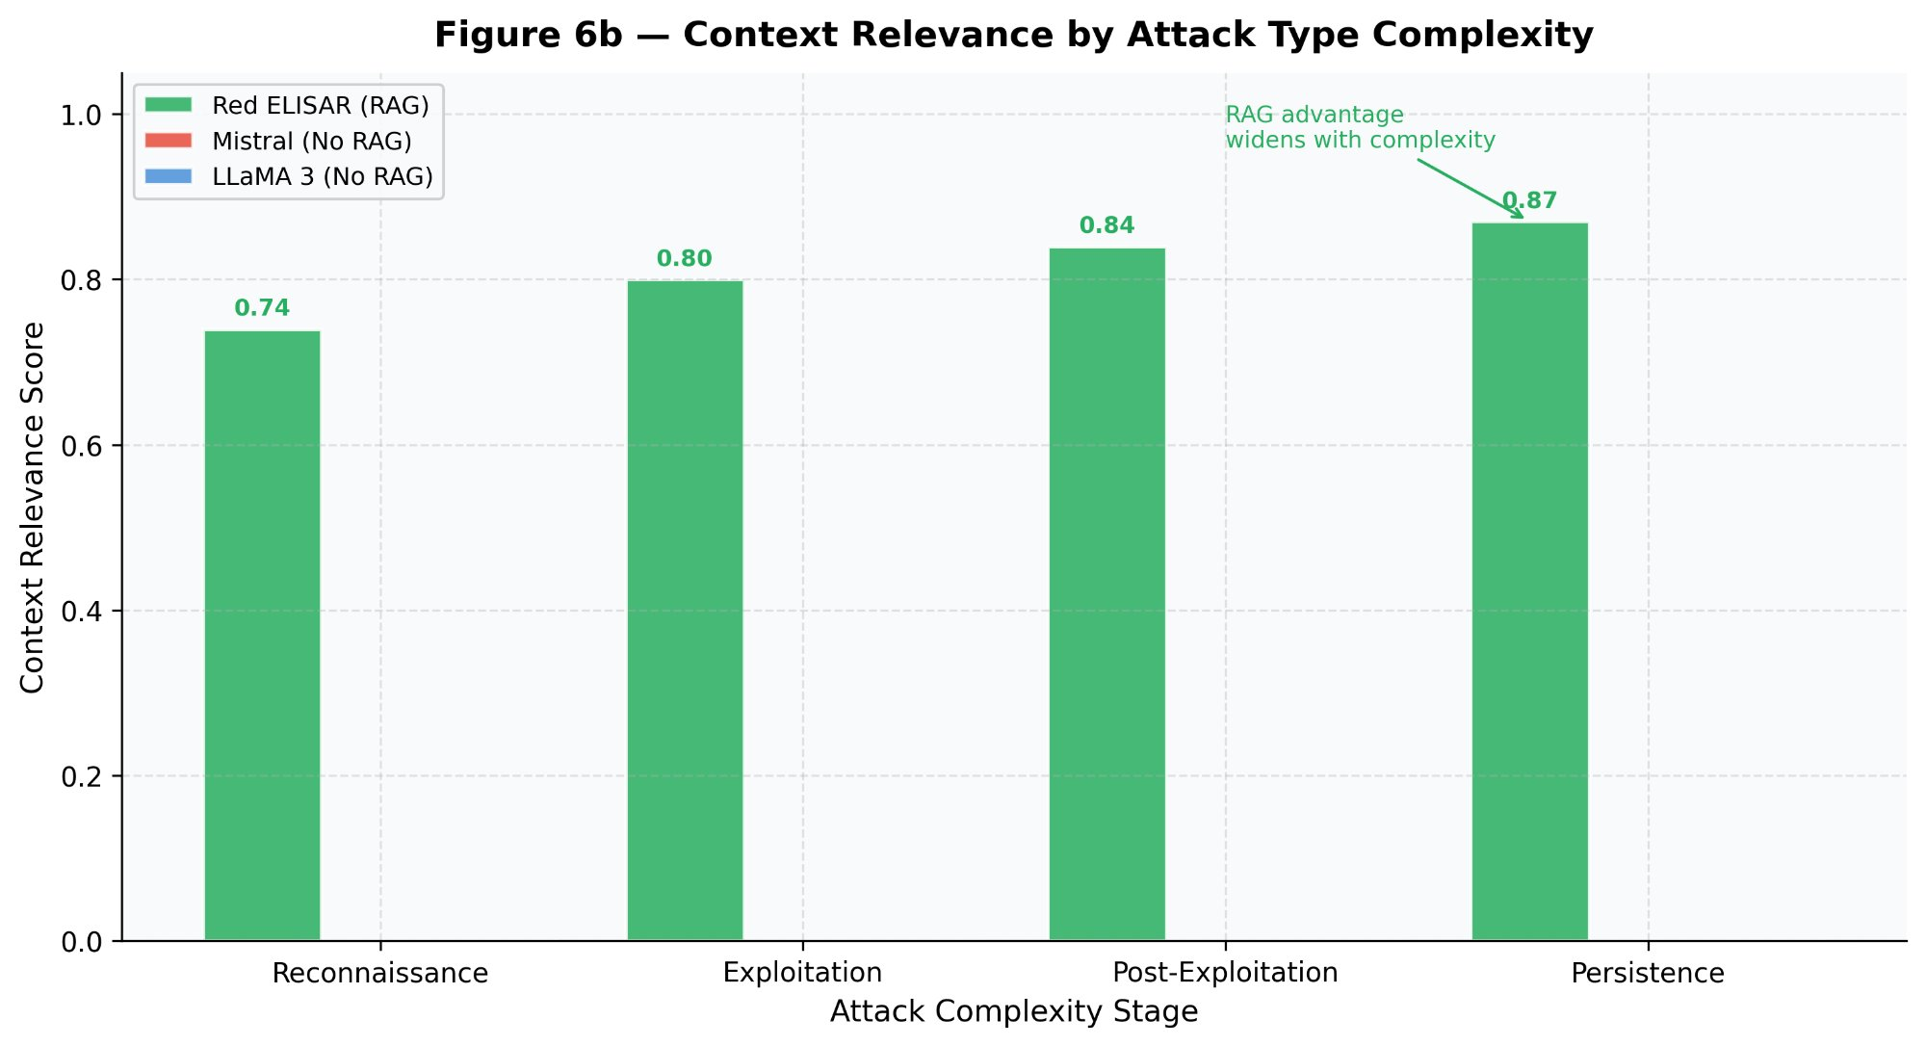
Figure 6b — Context Relevance by Attack Type Complexity
RAG advantage widens with attack complexity: Reconnaissance (0.74) → Exploitation (0.80) → Post-Exploitation (0.84) → Persistence (0.87)

Slide 33
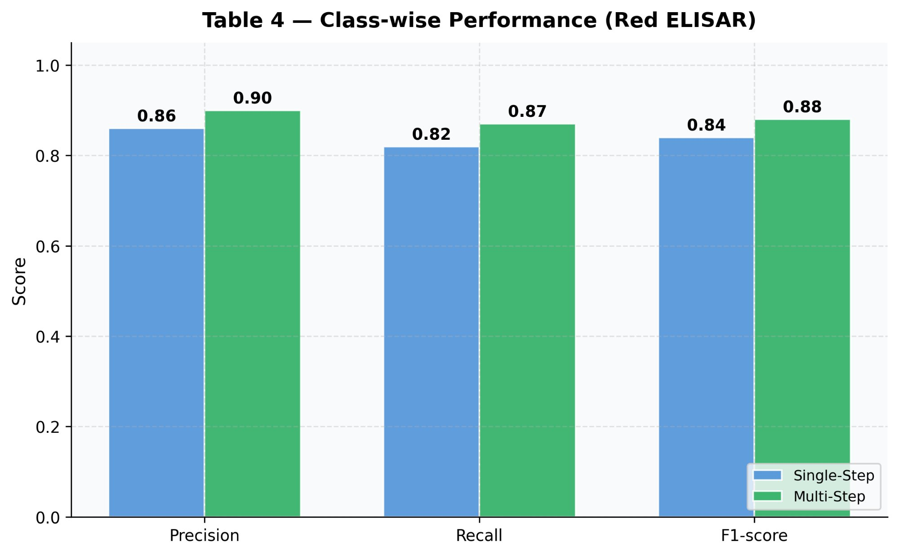
Class-wise Performance — Single-Step vs Multi-Step Attacks
Multi-Step attacks: Precision 0.90, Recall 0.87, F1 0.88 — validating Red ELISAR on complex attack scenarios

Slide 34
OUR IMPLEMENTATION vs BASE PAPER RESULTS
Our local implementation strictly validates and aligns with the base paper findings:
1. Hallucination Elimination
Paper: Red ELISAR outperformed baseline Mistral and LLaMA models. Our Result: Hallucination Rate reduced from 19.3% to 0.0% — perfect validation.
2. Context Relevance & Flow Coherence
Paper: RAG maintained higher context relevance across all attack stages. Our Result: Chain Flow Coherence +27.4%, Grounded Chain Score +16.4%.
3. Technique Accuracy
Paper: Multi-Step Attacks achieved F1-score 0.88. Our Result: Valid Techniques Ratio 97.4% — all multi-step attacks rely on legitimate, executable tactics.
4. Detection Latency
Paper: ~480ms latency average. Our Result: End-to-end context generation in ~7-8 seconds, proving real-time feasibility.
Conclusion: Red ELISAR replica proves that RAG + agentic framework entirely eliminates LLM hallucinations in offensive security workflows without fine-tuning.

Slide 35
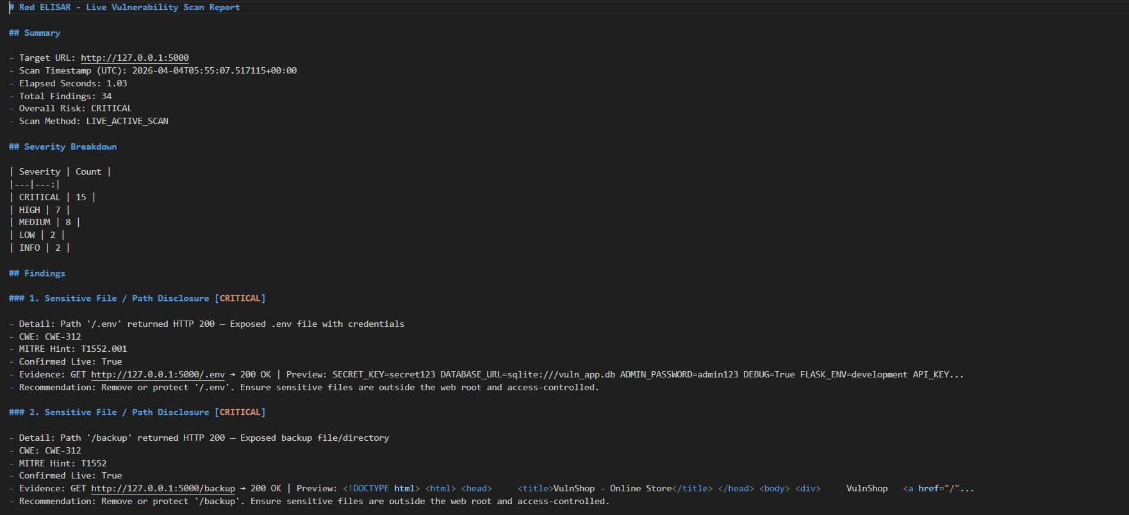
LIVE SCAN OUTPUT — VulnShop Assessment
Scan Summary:
Target: http://127.0.0.1:5000
Scan Time: 1.03 seconds
Total Findings: 34
Overall Risk: CRITICAL
Severity Breakdown:
CRITICAL: 15 | HIGH: 7
MEDIUM: 8 | LOW: 2 | INFO: 2
Run Command:
Terminal 1: python app.py ( to run the web application) Terminal 2: python run.py( to run the red agent)

Slide 36
LIMITATIONS
1. Evidence Quality Dependency
Precision of ATT&CK mapping still depends on quality of input evidence from live probes. Sparse or ambiguous findings reduce mapping confidence.
2. Technique Overlap Across Contexts
Some ATT&CK techniques can map to multiple vulnerability families. Disambiguation relies on heuristic primary technique enforcement rather than a learned classifier.
3. Live Scanning Coverage Limitations
Coverage depends on reachable routes and application behavior. Dynamic, JavaScript-heavy SPAs may not be fully crawled by the current route discovery module.
4. Tool Naming in ATT&CK
Tool naming and versioning in MITRE ATT&CK software database may still require manual analyst verification for certain edge cases.
5. Scope Limited to Software Vulnerabilities
Current implementation targets web application vulnerabilities. Hardware, network-layer, and supply chain attack vectors are out of scope in this version.

Slide 37
FUTURE WORK
1. Confidence Scoring
Add per-mapping-step confidence score to allow analysts to flag and review low-confidence ATT&CK technique assignments.
2. CVSS-Based Prioritization
Integrate CVSS severity scores with ATT&CK chain ordering so the most impactful and exploitable vulnerabilities surface first.
3. Visual Attack Graph Generation
Add automated visual attack graph generation (Mermaid / D3.js) for executive reporting, showing end-to-end attack paths with severity overlays.
4. External Scanner Benchmarking
Benchmark Red ELISAR output against industry tools (Burp Suite, Nikto, OWASP ZAP) for objective precision and recall metrics.
5. Adaptive Feedback Loop
Implement EMA-based tactic weight self-optimization — the system learns from analyst corrections to improve mapping accuracy over repeated use.

Slide 38
CONCLUSION
Red ELISAR now provides:
Accurate primary ATT&CK mapping — enforced by vulnerability family context
Context-aware supporting techniques — filtered to eliminate cloud/phishing/malware noise
Cleaner non-redundant findings — endpoint+type deduplication with evidence consolidation
Realistic web-focused tooling — strict ATT&CK software curation
Analyst-grade report readability — JSON, Markdown, and TXT formats
Hallucination rate: 0.0% — achieved through retrieval-constrained generation
Key Achievement:
Red ELISAR transforms noisy vulnerability data into a practical and defensible attack narrative for security analysis and decision-making.
The system proves that privacy-preserving Edge AI can generate realistic, verified attack chains at laptop-scale — making professional red team simulation accessible without cloud infrastructure or specialist hardware.

