Slide 1
UAV OPERATION
BRICS FUTURE Hi-Tech Skill Championship – Ekaterinburg, Russia
Presented by
SureshKumar Balasubramanian

Slide 2
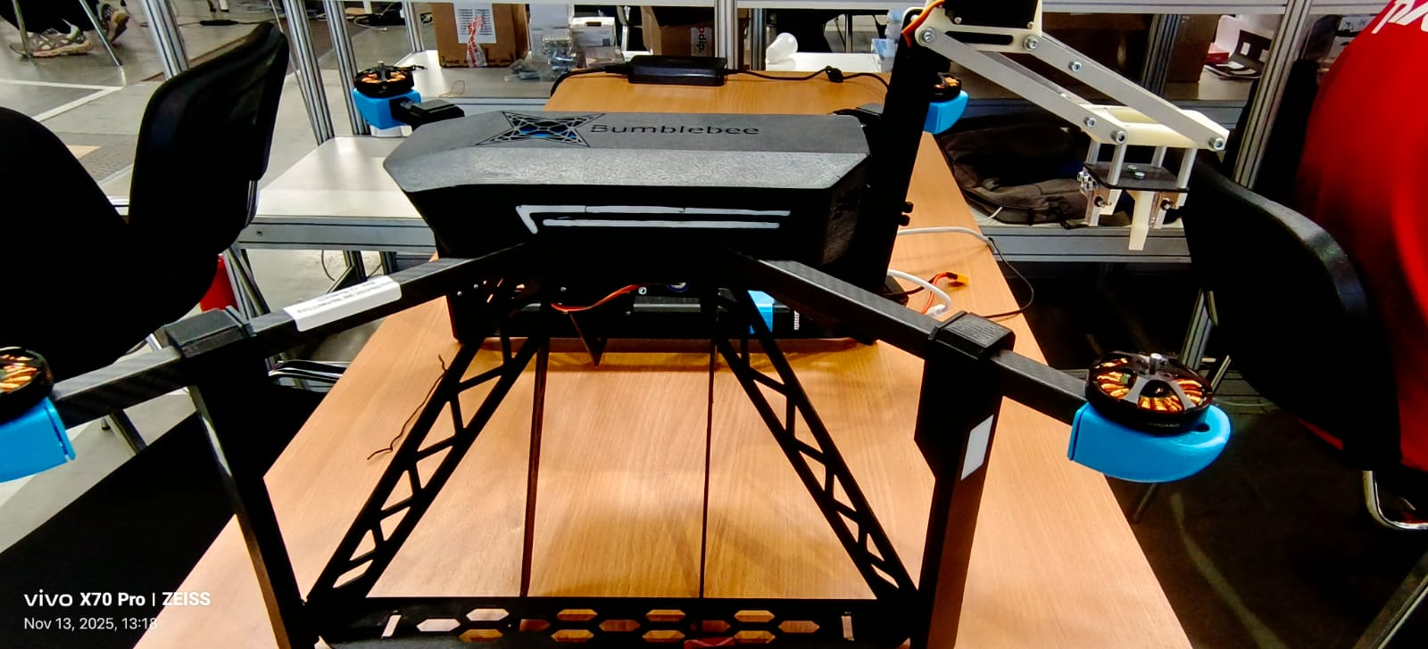
MODULE A
Farmers face difficulties in transporting produce and materials across large fields.
Manual transport is time-consuming and labor-intensive.
Objective: Design and development of a cargo transportation unit for agriculture

Slide 3
Component Details
Flight Controller: Pixracer
Receiver: ELRS
Transmitter: Radiomaster TX12 ELRS
Motors: 2300KV BLDC (x4)
Propellers: 5-inch Triblade
Servo: 5V Metal Gear Servo
Gripper: 3D Printed

Slide 4
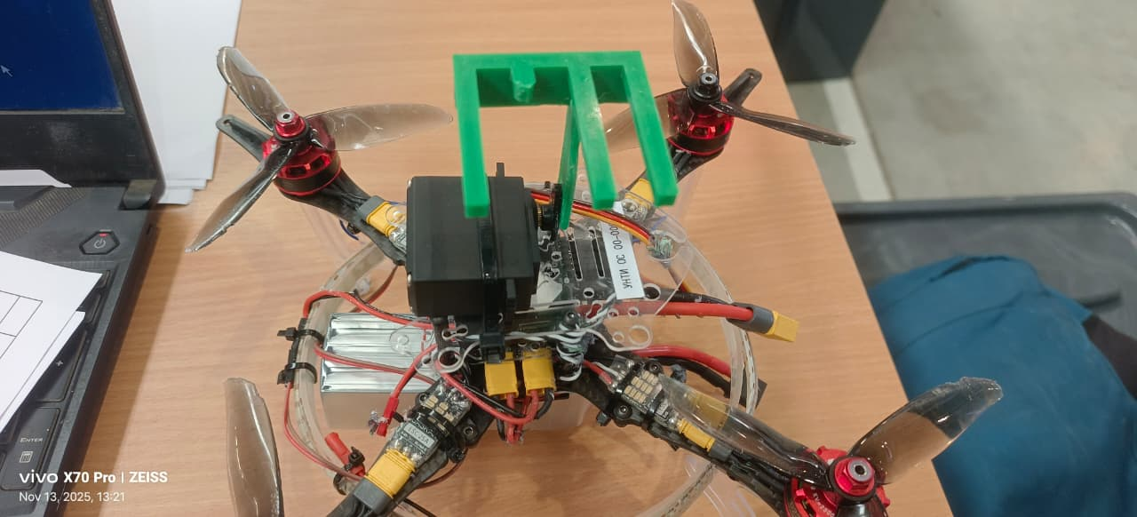
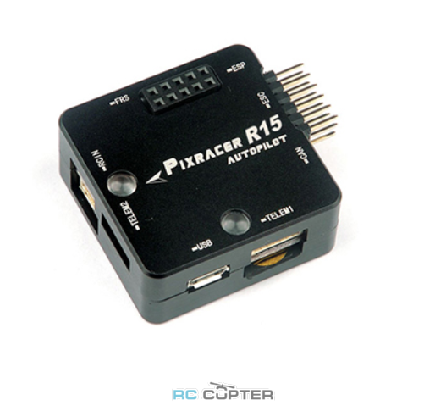
Electrical Schematic
Electrical schematic diagram(showing connections for FC, motors, ESCs, servo, and power).
SERVO OUT AUX 5
MAIN OUT FOR MOTORS
Aux 1 - Aux 4
ELRS RECIVER IN
POWER INPUT
USB FOR CONNECTION AND CALIBRATION

Slide 5
Working Principle
•Drone hovers over cargo location.
Servo gripper closes to pick up payload via AUX channel 5 control.
Drone navigates to drop point.
Servo opens to release payload.
Demonstrates remote-controlled precision and stability.

Slide 6
Flight Controller Setup – Pixracer
Configured through Mission Planner.
AUX 5 output assigned to servo channel.
Servo end-points calibrated.
ELRS Receiver paired with Radiomaster TX12 for reliable signal control.

Slide 7
Servo Gripper Mechanism
3D printed mechanical hook attached to drone base.
5V Metal Gear Servo provides actuation.
Controlled via transmitter switch mapped to Channel 5.
Lightweight and efficient design to handle moderate payloads.

Slide 8
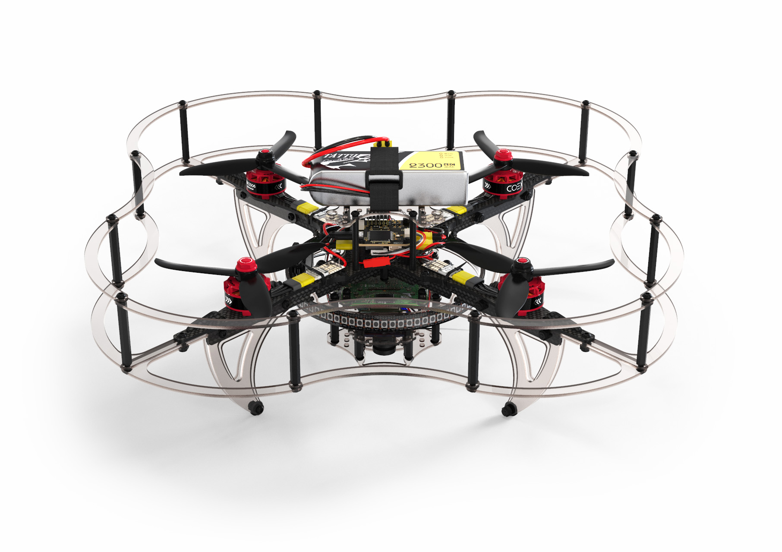
MODULE B
The powerlines are huge source of electricity us so for the maintance of the powerlines we are using drones for it
Objective : Maintance of powerlines using UAV

Slide 9
Project Objective
Design and build a UAV for power line inspection and light maintenance tasks.
Integrate a servo-controlled manipulator for simple mechanical repairs or cleaning.
Optimize flight stability using Pixracer FC and ELRS control system.
Enable safe remote operation near high-voltage environments.

Slide 10
Component Details
Flight Controller: Pixracer
Receiver: ELRS
Transmitter: Radiomaster TX12 ELRS
Motors: 2300KV BLDC (x4)
Propellers: 5-inch Triblade
Servo: 5V Metal Gear Servo
Drone Arm: 3D Printed

Slide 11
Servo Arm Mechanism
3D-printed lightweight servo arm mounted under UAV.
Controlled via transmitter switch mapped to Channel 5.
Designed for minor maintenance like brushing insulators or placing sensors.
Metal gear servo provides precision and strength.

Slide 12
Demonstration Summary
Demonstration includes lifting and dropping a payload within the farm field.
Showcases control, stability, and payload handling.
Smooth servo operation and safe Landing on the powerlines with removal of obstacles are demonstrated.

Slide 13
Safety & Maintenance
• Pre-flight check: Verify all connections and propellers.
• Maintain 10-meter safety zone during operation.
• Regular calibration of flight controller.
• Inspect gripper mechanism before each flight.

Slide 14
Documentation Overview
User manual for operation and maintenance.
3D model of the servo Arm
Wiring schematic and assembly steps documented.
Test results recorded.
Data to be used for further system optimization.

Slide 15
Future Development
Integrate GPS for Position Hold.
Enable autonomous waypoint missions.
Develop lightweight frame for improved efficiency.
Add telemetry for real-time monitoring.
Increase payload capacity.

Slide 16
Conclusion
The cargo transport drone provides a practical, efficient, and scalable solution for farm logistics.
The project demonstrates the integration of mechatronic systems with UAV technology for Powerline Inspection.
Further advancements in automation and GPS control will enhance operational reliability.

Slide 17
REFERENCES
https://px4.io/
https://qgroundcontrol.com/
https://github.com/mavlink/qgroundcontrol
https://github.com/ArduPilot/ardupilot

Slide 18
Acknowledgment
Presented by: SureshKumarBalasubramanian
Representing: India
Event: Hi-Tech Skill Championship, Ekaterinburg, Russia
Special thanks to mentors, organizers, and supporting institutions.
https://github.com/sureshkumarbalasubramanianin/-BRICS-Hi---Tech-Future-Skill-Competetion_UAV-Operation_Team-INDIA

