Slide 1









COREVIA
VELLORE INSTITUTE OF TECHNOLOGY,VELLORE
INOHAC26000127
HACK ID

Slide 2

Solar Panel Efficiency optimizer –AI Powered Smart Monitoring System
PROBLEM STATEMENT CODE:- PS13
TRACK:- ARTIFICIAL INTELLIGENCE/MACHINE LEARNING (AIML)
Problem:
Solar plants lose efficiency due to dust, weather, and delayed maintenance
Manual inspection is costly and unreliable in large or remote farms
Most systems depend on continuous internet and expensive hardware
Gap Identified:
Lack of a low-cost, low-internet, intelligent system that can
Deduct dust and performance
loss automatically
Make smart decision
Work in rural area

Slide 3
PROPOSED SOLUTION & WORKING
Problem
An Edge AI-powered solar monitoring system that combines:
Numerical ML for expected power prediction
Vision AI for dust classification using daily panel images
Weather intelligence for rain-aware maintenance decisions
A mobile-friendly dashboard for real-time remote monitoring
Gaps
Enable Smart, Low-cost, And Scalable Solar Plant Maintenance In Low-connectivity Areas

Slide 4
PROPOSED SOLUTION & WORKING
1. Edge Data Acquisition
• Sensors capture irradiance, temperature, and power output
• Camera captures panel images (3 per day)
2. Parallel Intelligence Engines
Numerical ML Engine
• Predicts expected power output
• Computes power loss % and health score
Vision AI Engine
• Classifies panel condition:
Clean | Dusty | Heavily Dusty
3. Decision Intelligence
• Weather data integrated via Open-Meteo API
• Decision Engine fuses ML, Vision, and Weather inputs
• Final action generated:
Clean Now | Postpone (Rain Expected) | System Healthy
4. Cloud & Dashboard
• Insights sent via REST API
• Real-time status and alerts shown on mobile dashboard

Slide 5
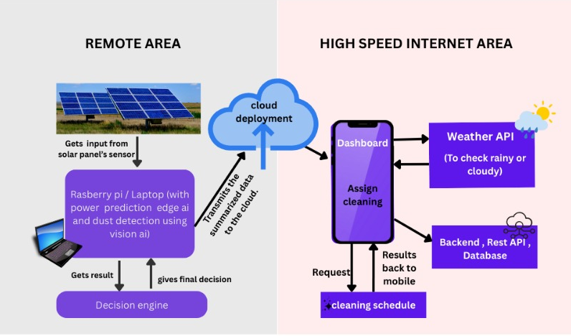
Technical workflow

Slide 6
FEATURES & TECH STACK
Features
Teck Stack
1.Edge AI && Vision AI:
Python, Scikit-learn, TensorFlow Lite
2.Backend:
Node.js, Express (REST API)
3.Frontend:
Streamlit (Mobile Web UI)
3.Weather API:
Open-Meteo
4.Deployment:
Raspberry Pi / Laptop (Edge Simulation)
Expected Power Prediction (ML)
Power Loss & Health Score Generation
Vision-Based Dust Classification
Multi-Model Decision Engine
Weather-Aware Cleaning Recommendation
Rain-Based Cleaning Skip
Daily Energy Forecast
Mobile-Friendly Dashboard

Slide 7


Novelty and USPs
NOVELTY
Multi-Modal AI combining Numerical ML + Vision AI for unified decisions
True Edge Intelligence with no cloud dependency for core logic
Camera-based dust detection without manual inspection
Weather-aware automated maintenance decision engine
Fusion-based intelligence instead of rule-based monitoring
UNIQUE SELLING POINT
Designed for low-internet and rural environments
Low-cost hardware and minimal sensor requirements
Scalable architecture for single or multi-plant deployment
Explainable AI decisions with clear action reasoning
Mobile-first monitoring for real-time remote access
Novelty:
Multi-Modal AI combining Numerical ML + Vision AI for unified decisions
True Edge Intelligence with cloud dependency for core lo
Camera-based dust detection without manual inspection
Weather-aware automated maintenance decision engine
Fusion-based intelligence instead of rule-based monitoring

Slide 8




SDGs
Improves solar efficiency and energy output
Uses Edge AI for smart renewable infrastructure
Supports intelligent energy systems for rural and urban areas
Maximizes clean energy generation and reduces carbon footprint

