Slide 1
“Is Organic food Worth It?”
CMPS 184 Final Project
Spring 2019
Alex Williamson (alswilli@ucsc.edu)
Carlos Del Rey (cdelreyg@ucsc.edu)
Matthew Krone (makrone@ucsc.edu)

Slide 2
Questions Explored
HEALTH
Does eating organic food provide any health benefits over eating conventional (non-organic) food?
Fatty Acid Ratios in Milk
Flavonoid and Antioxidant Counts
Deaths from Strengthened Bacterial Infections
Is the amount of pesticides used on conventional food harmful to us?
EPA Harmful Level Detections for Pesticides in Produce
Which types of food products have the most/least pesticides used on them in the U.S.? Which types of pesticides are most/least prevalent?
Pesticide Detection in Produce: Top-10 Pesticides and Top-10 Crops (Individual and Cumulative Years
COST
How do the prices for organic and conventional foods compare in the U.S.?
Price of Organic v.s. Conventional Produce from Retail Sellers
SUSTAINABILITY
Is organic farming more sustainable than conventional farming?
Comparative analysis of environmental impacts of agricultural production systems, agricultural input efficiency, and food choice

Slide 3
Data Sources
Fatty Acid Ratios in Milk
https://onlinelibrary.wiley.com/doi/full/10.1002/fsn3.610
PDF data converted to Excel
Flavonoid and Antioxidant Counts
https://www.cambridge.org/core/journals/british-journal-of-nutrition/article/higher-antioxidant-and-lower-cadmium-concentrations-and-lower-incidence-of-pesticide-residues-in-organically-grown-crops-a-systematic-literature-review-and-metaanalyses/33F09637EAE6C4ED119E0C4BFFE2D5B1/core-reader
PDF data converted to Excel
Deaths from Strengthened Bacterial Infections
https://www.cdc.gov/drugresistance/threat-report-2013/pdf/ar-threats-2013-508.pdf
PDF data converted to Excel
EPA Harmful Level Detections for Pesticides in Produce
https://apps.ams.usda.gov/pdp
CSV data
Pesticide Detection in Produce: Top-10 Pesticides and Top-10 Crops (Individual and Cumulative Years)
https://apps.ams.usda.gov/pdp
CSV data
Price of Organic v.s. Conventional Produce from Retail Sellers
https://www.consumerreports.org/cro/news/2015/03/cost-of-organic-food/index.htm#table1
PDF data converted to Excel
Comparative analysis of environmental impacts of agricultural production systems, agricultural input efficiency, and food choice
https://iopscience.iop.org/article/10.1088/1748-9326/aa6cd5/data
Excel sheet data

Slide 4
Code/Visualization References + Libraries
Is organic really better for the environment than conventional agriculture?
https://ourworldindata.org/is-organic-agriculture-better-for-the-environment
Presents similar data/questions to things we observed in Sustainability section
Titanic Kaggle Machine Learning Project
https://nbviewer.jupyter.org/github/agconti/kaggle-titanic/blob/master/Titanic.ipynb#Data-Handling
Presents similar ipynb file structure to our project
Libraries Used
Xlrd
Os
Numpy
Pandas
Matplotlib

Slide 5
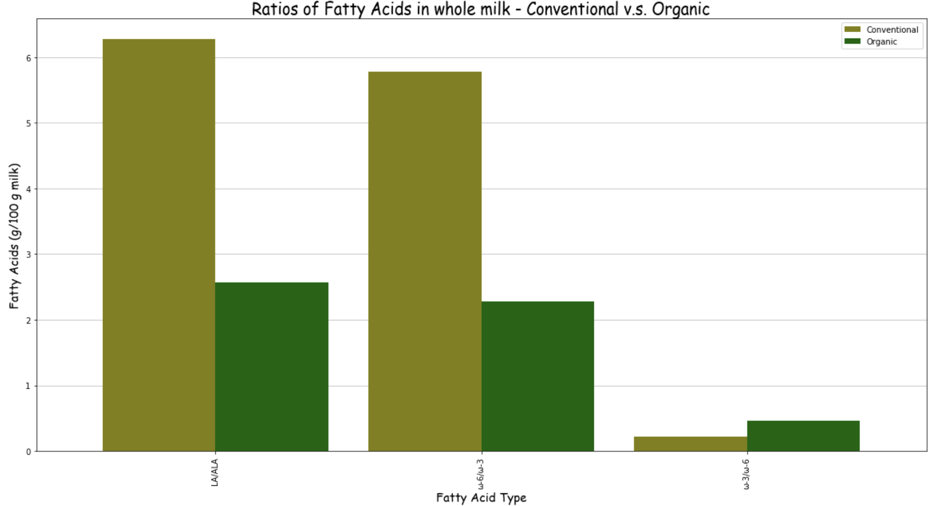
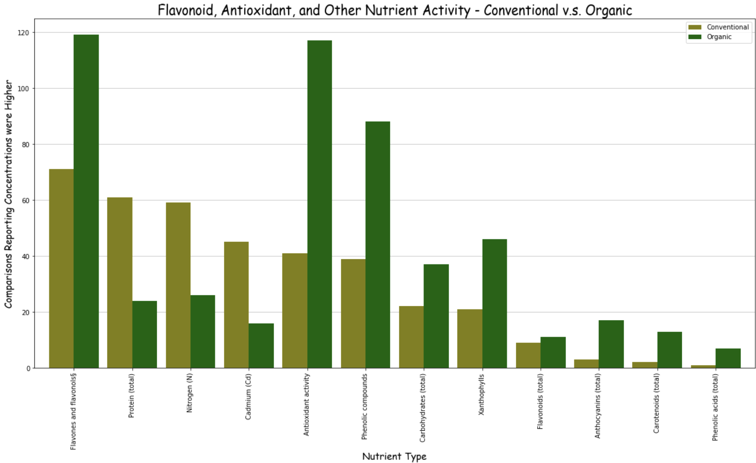
Results - Health
Section 1.1
Section 1.2

Slide 6
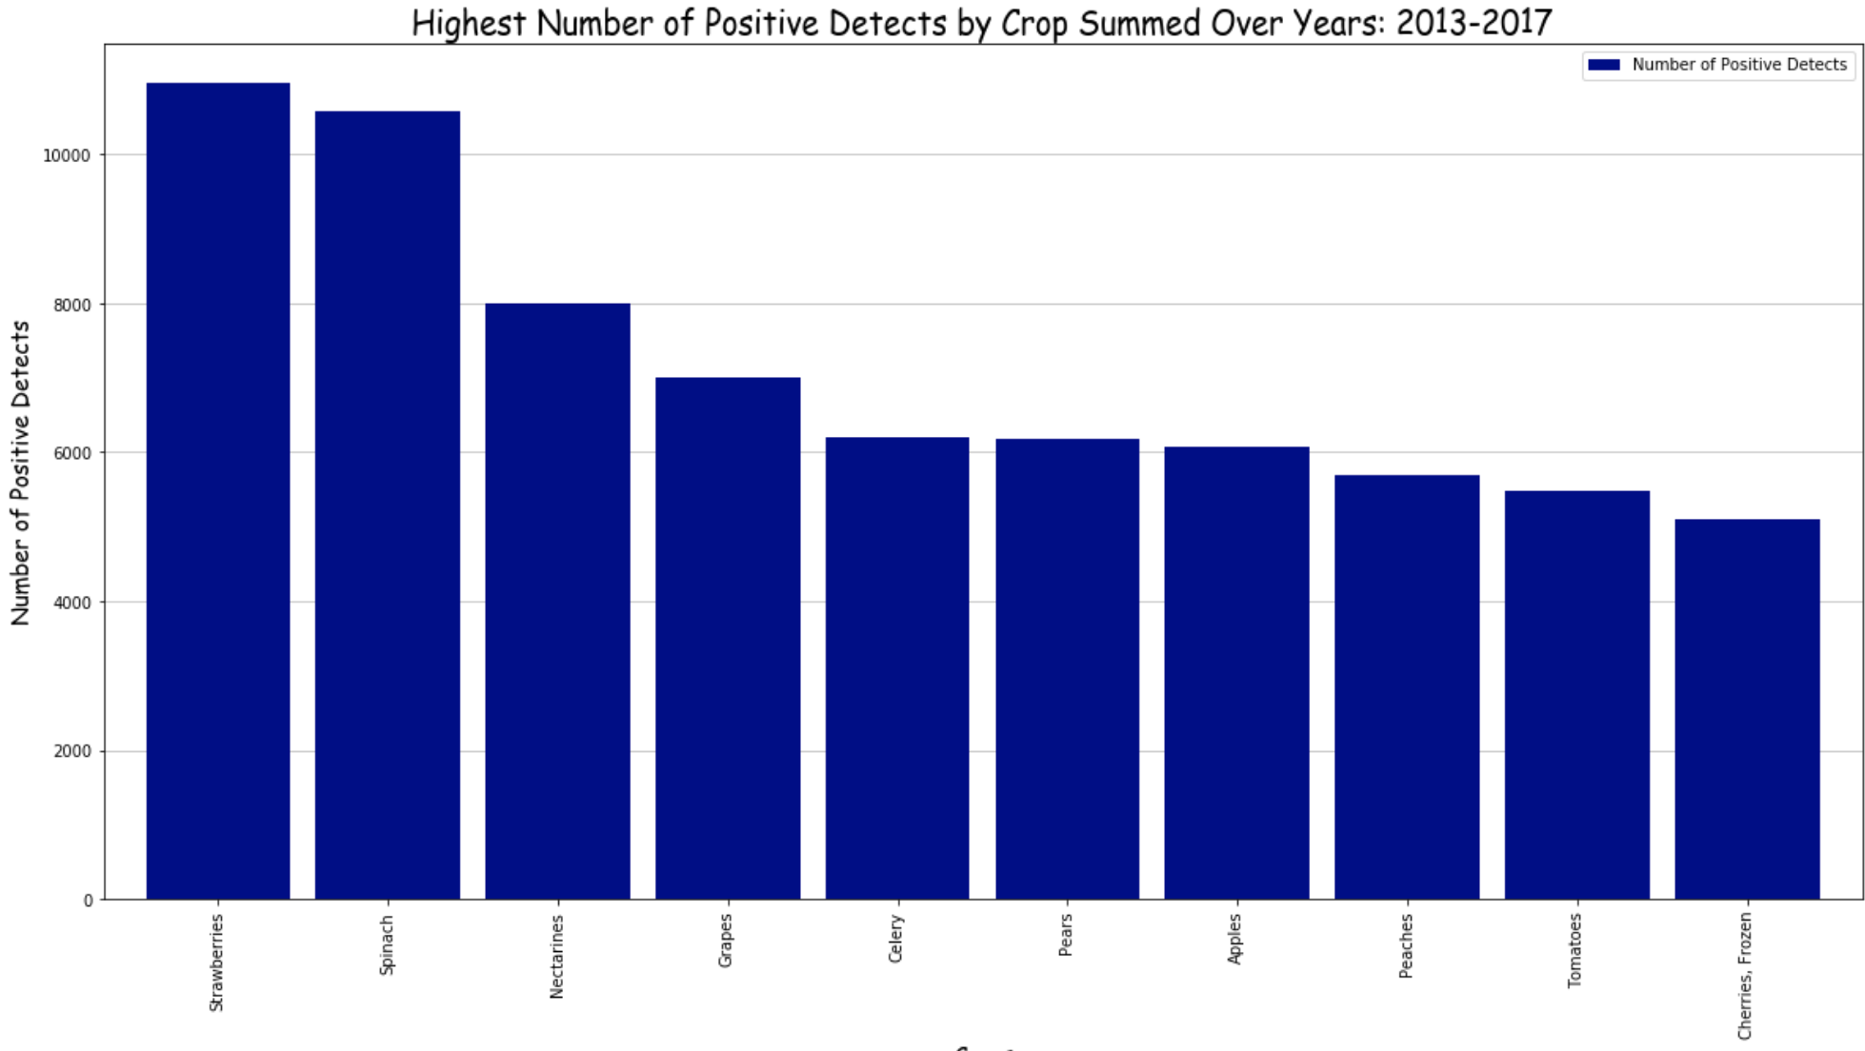
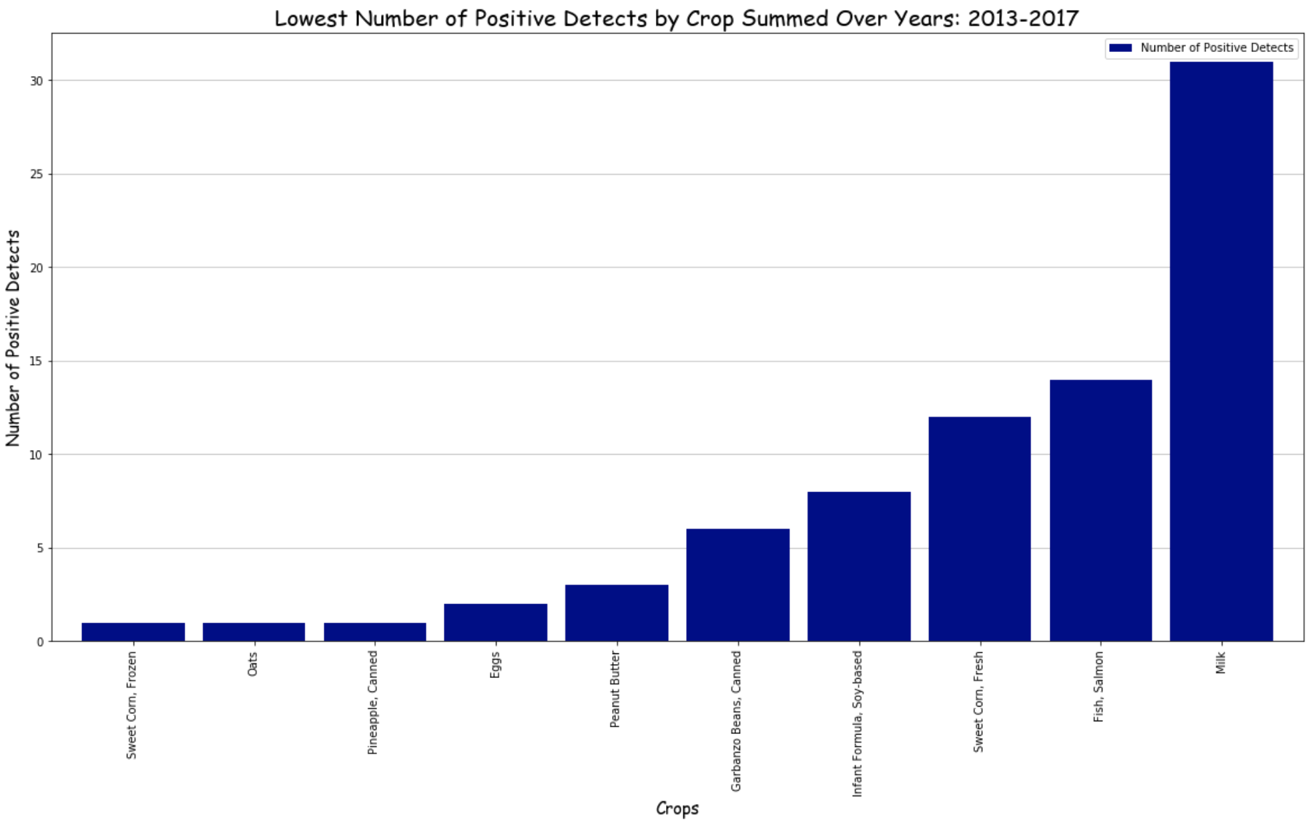
Results - Health(cont.)
Section 2
Section 3

Slide 7
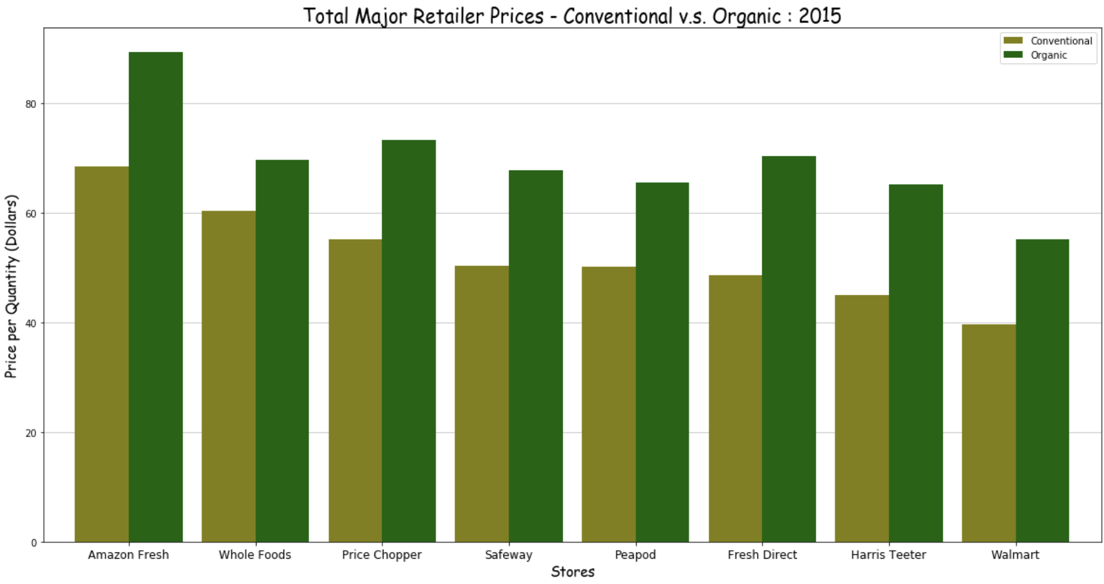
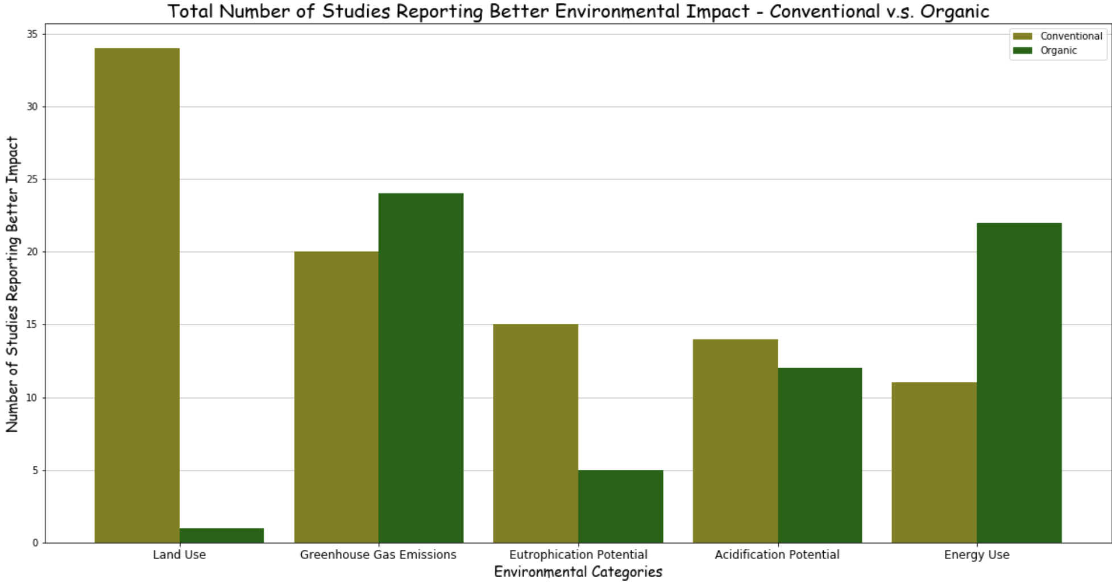
Results - Costs and Sustainability
Costs
Sustainability

Slide 8
Tasks/Challenges + Conclusion
Tasks/ Challenges
Finding appropriate data for each question + researching the topics for analysis sections
Converting PDF data to Excel and cleaning any errors from transformation (using Adobe software)
Cleaning the rows of Excel file data so that there contained no unnecessary characters (“”, “$”, “NaN”, etc.)
Separating the data for specific graphs into arrays and data frames (ex: Produce data for each retail seller)
Representing multiple data points using complex graphs (stacked bar and line charts)
Writing the analysis for each section
Small edits for a professional look (graph color coordination, graph sorting, header comments, etc.)
Conclusion
Organic food shows evidence of being more healthy, but the evidence is limited and not general enough in all cases
Organic food is much more expensive than Conventional food in most cases, but less in other cases
Depends on the store and produce item
Organic food production is better with energy use and gas emissions, but worse with land use/eutrophication potential
Overall, the jury is still out on whether Organic food is worth it, based on these scenarios

