Slide 1
Endangered Languages
Pardis Moridian
Danny Kim
Moises Martinez
Ruiwen Liang

Slide 2
Questions
Data
What languages are endangered?
Where are those languages spoken?
How endangered are those languages? (based on UNESCO scale)
How many speakers of each language?
What languages are replacing those endangered languages?
Which language families have the most endangered languages?
Which countries have the most endangered languages?
UNESCO (2722 languages in the data)
Endangered Languages Project Dataset (3422 languages in the data)
Both datasets include information on language name, level of endangerment, number of speakers, coordinates, etc.
The final combined dataset have over 5000 language data.

Slide 3
References
Ruiwen Liang
Interactive map plots with Plotly
Changed the dataset
Customized layout, different colors for data analysis and visualization
Added different ways of interaction
Mapbox Choropleth Maps in Python: Adapted layers from the code
Pardis Moridian
Interactive map plots with Plotly
Applied to new dataset which I merged myself
Adapted pie chart tutorial
Added subplot views for all language families
Pandas Documentation: Wrangled most of the data myself but this was helpful

Slide 4
References
Moises
Interactive map plot with Folium
Changed the dataset
Customized layout, different radii for data analysis and visualization
Added interaction with each circle marker
Pandas
Python Regex Documentation
Danny Kim
Interactive grouped-bar plot with Plotly
Reshaped the dataset by countries
Scraped Language Family data from Wikipedia using BeautifulSoup

Slide 5
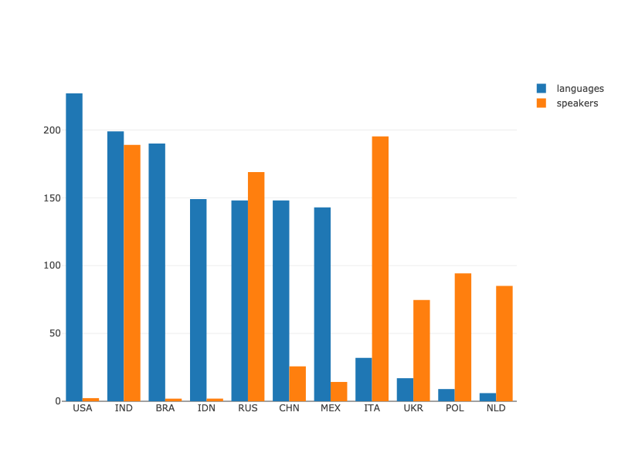
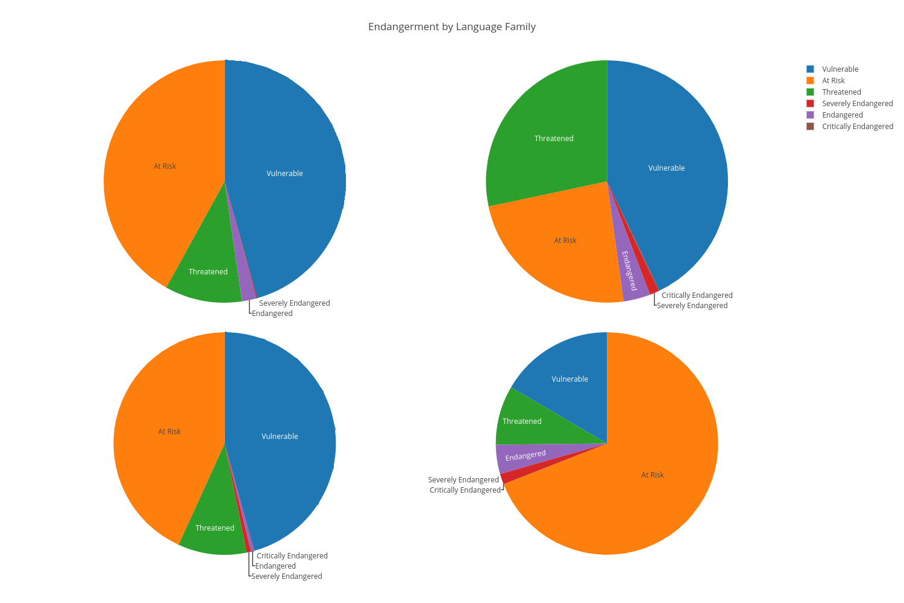
Final Results

Slide 6
Libraries and Tools
Pandas
Plotly
Mapbox
Folium
Beautiful Soup
Gsuite (Google Colab) and Jupyter

Slide 7
Tasks
Data wrangling
Clean the Endangered Languages Project dataset
Combine two data sets
Web scraping
Scraping language family data from Wikipedia
Data analysis / visualization
Analysis and visualize the distribution of languages on the map
Visualize location of endangered languages with color coded map by degree of endangerment
Visualize number of speakers of each language with bubble map
Creating stacked bar chart for top five language families with the most endangered languages
Creating grouped bar chart to visualize which countries have the most endangered languages and the most number of speakers

