Slide 1
World Airports Voronoi
John Leckrone
CSE 163 Enhancement Project
Spring 2020

Slide 2
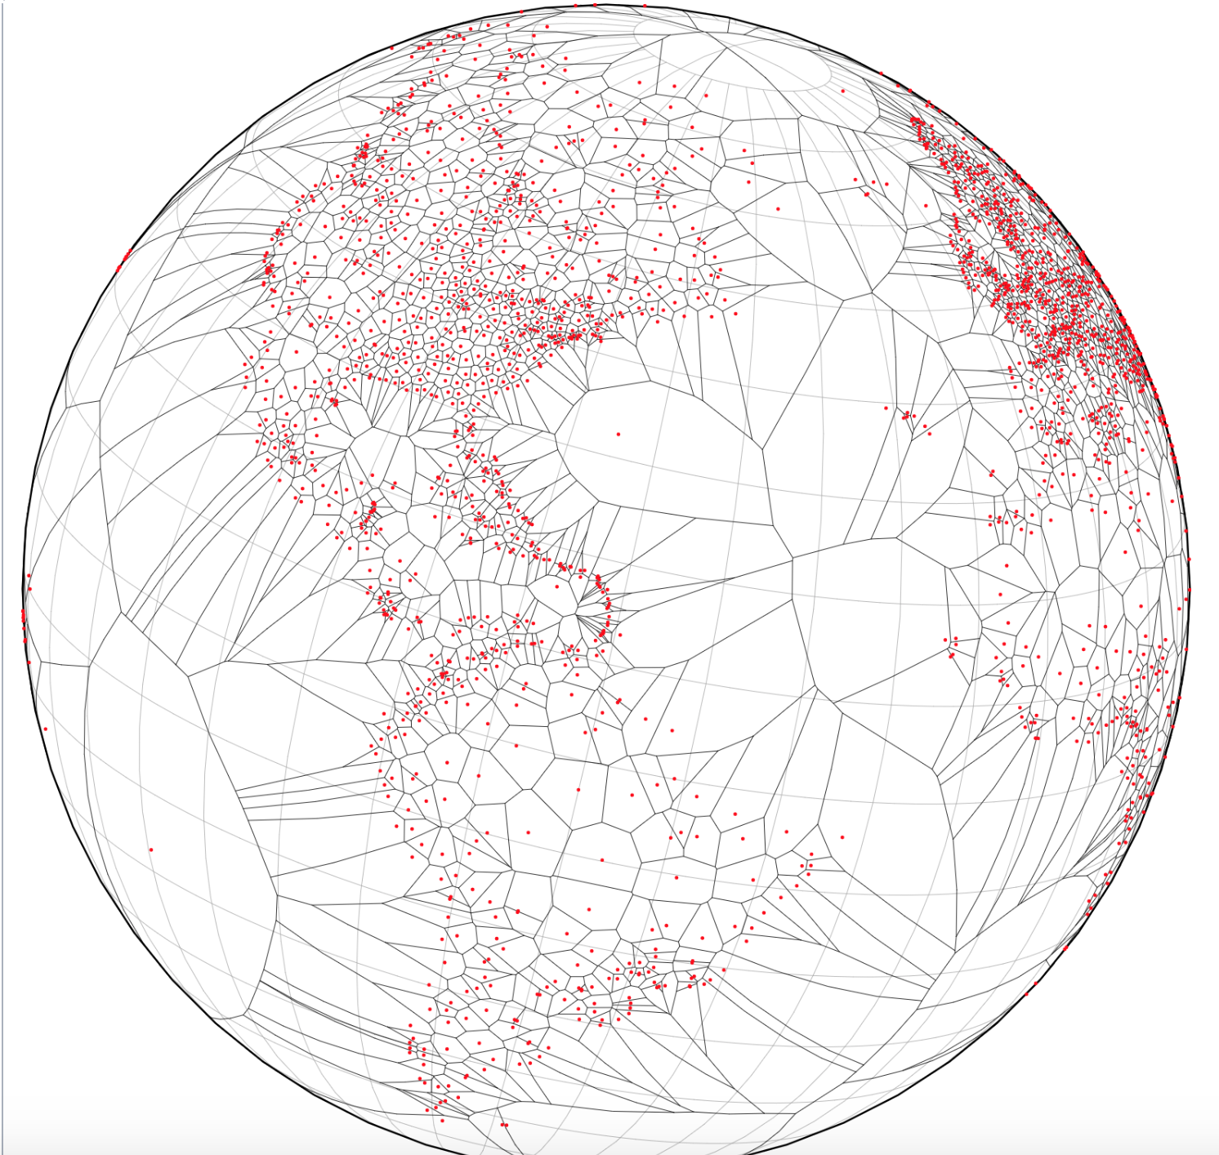
Inspiration
https://observablehq.com/@mbostock/world-airports-voronoi

Slide 3

https://observablehq.com/@d3/versor-dragging

Slide 4
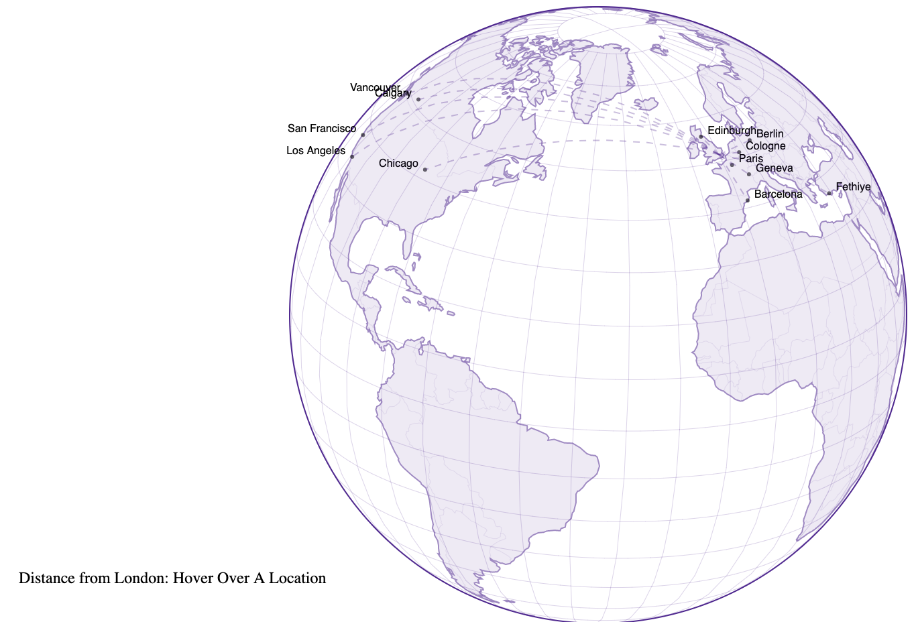
http://bl.ocks.org/tlfrd/df1f1f705c7940a6a7c0dca47041fec8

Slide 5
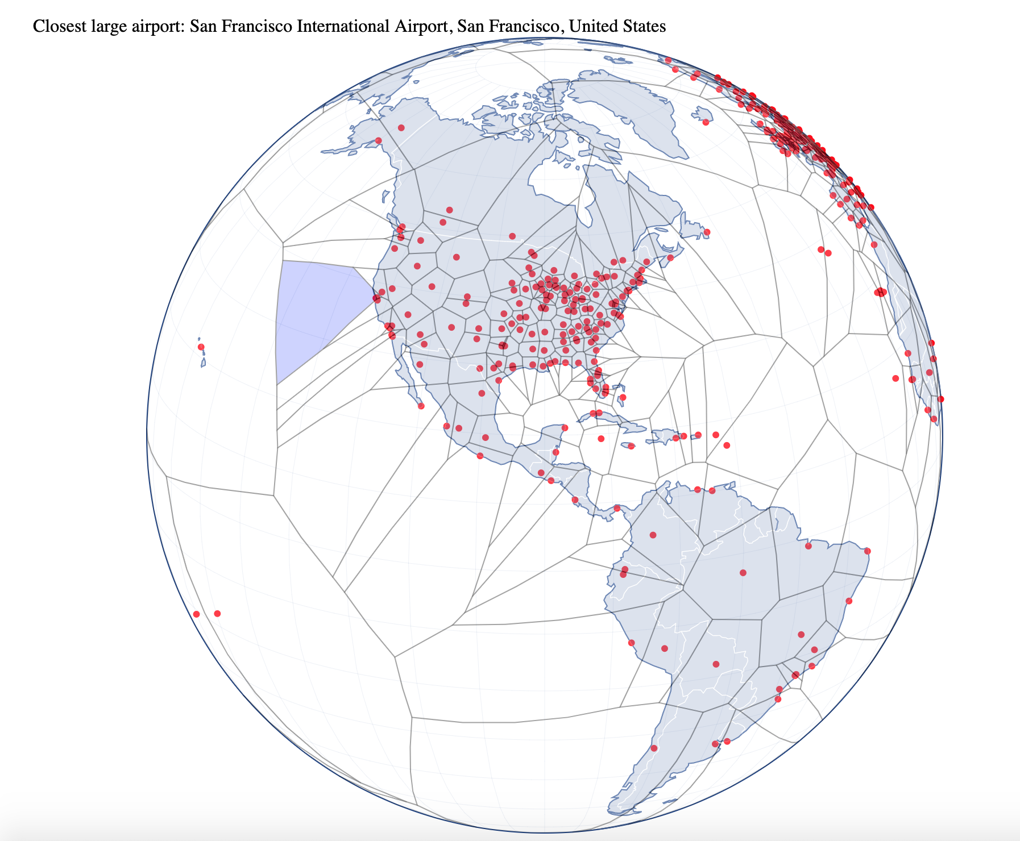
Result
https://jleckron.github.io/WorldAirportsVoronoi/

