Slide 1
Fake Tweets
By Will Presti, Danyal Mohammad, Michael Bassous

Slide 2
Questions
How do FAKE tweets compare to REAL tweets
Grade Level
Readability
Sentiment
What are the top 10 most common words (over all years) for Trump and Modi?
Does Zipf’s Law pertain to both the fake tweets and the real tweets?
How does Modi’s tweets compare to Trump’s tweets
Does readability have any correlation with grade level

Slide 3
Overview
Two datasets
Modi tweets provided by Kaggle
https://www.kaggle.com/reach2ashish/all-narendra-modi-tweets
CSV file
Trump tweets provided by Trump Twitter Archive
http://www.trumptwitterarchive.com/archive
TXT file
Created fake tweet TXT files using provided datasets (fine-tuned) and GPT-2

Slide 4
Code References/Contributions
Danyal Mohammad
Sentiment Analysis from TextBlob: https://textblob.readthedocs.io/en/dev/quickstart.html
Grade Level/Readability from TextStat: https://pypi.org/project/textstat/
Scraped Modi tweets into TXT files. Ran analysis on all tweets. Assisted Zipf’s law figure generation.
Michael Bassous
Counter for finding top words and hashtags https://pymotw.com/2/collections/counter.html
Created all visuals https://matplotlib.org/3.1.1/api/_as_gen/matplotlib.pyplot.plot.html
Scraped Trump Tweets. Created visualizations for analysis and Zipf’s law. generated data for Zipf’s law.
Will Presti
GPT-2 from GitHub: https://github.com/ak9250/gpt-2-colab
Set up GPT-2 on Google collab. Fine tuned models by approximation, and generated fake tweets based off those models.

Slide 5
GPT-2
Generalized Pretrained Transformer 2
Developed by OpenAI
GPT-2 is a pretrained model that can be used to generate coherent text based off of little data (we use transfer learning to fine tune the model with the scraped tweets)
It surprisingly worked very well to generate fake tweets!

Slide 6
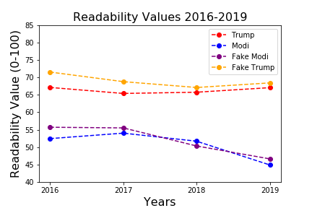
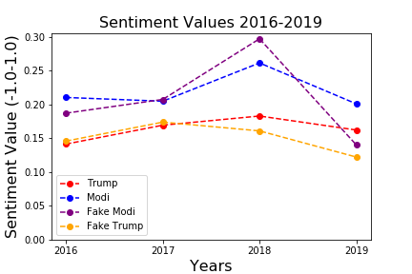
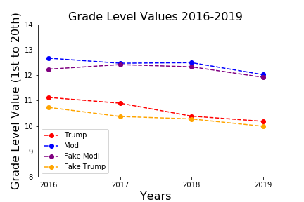
Analysis Results

Slide 7
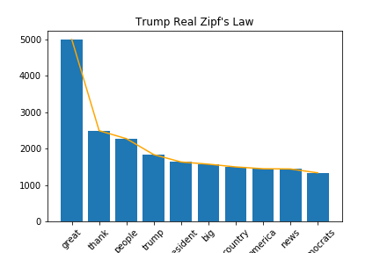
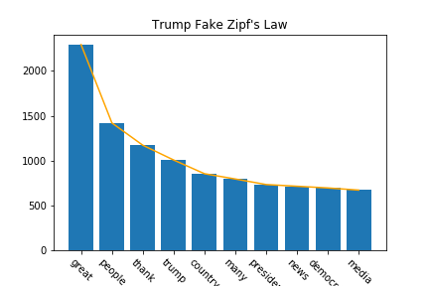
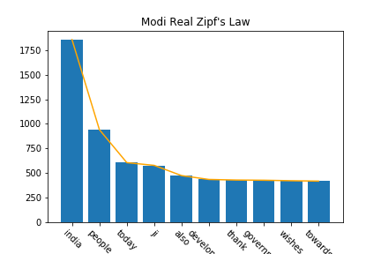
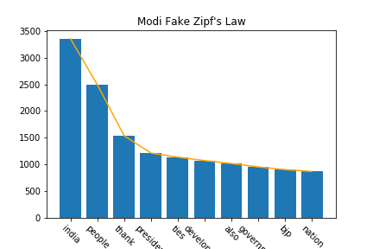
Zipf’s Law Results

Slide 8
Top 5 Hashtags
Modi Real: 1. #MannKiBaat 2. #Gandi150 3. #AsianGames2018 4. #TirangaYatra 5. #YogaDay
Modi Fake: 1. #MannKiBaat 2. #TirangaYatra 3. #MainBhiChowkidar 4. #TransformingIndia 5. #Rio2016
Trump Real: 1. #Trump2016 2. #Maga 3. #AmericaFirst 4. #VoteTrump 5. #DrainTheSwamp
Trump Fake: 1. #Trump2016 2. #MakeAmericaGreatAgain 3. #VoteTrump 4. #MAGA 5. #ImWithYou

