Slide 1
Streaming Effects on Music Industry
By Brandon Yan, Gus Person, Khang Tran, William Whelan

Slide 2
Overview
Goals & Questions:
Is the popularization of streaming services decreasing the length of songs?
How are the single track lengths changing compared to album lengths? Have the number of tracks per album fluctuated?
How does this trend affect different genres?
How has music chart diversity changed before and after the popularization of streaming (where diversity is the number of unique artists appearing on the chart for that year)?
How are audio features of charting songs correlated, and how has streaming affected these correlations?
Code and Visualization References:
Spotify Web API, Is Spotify Making Songs Shorter?
Data Sources:
Billboard
Spotify
Notes:
https://github.com/khangvttran/CSE184-Final

Slide 3
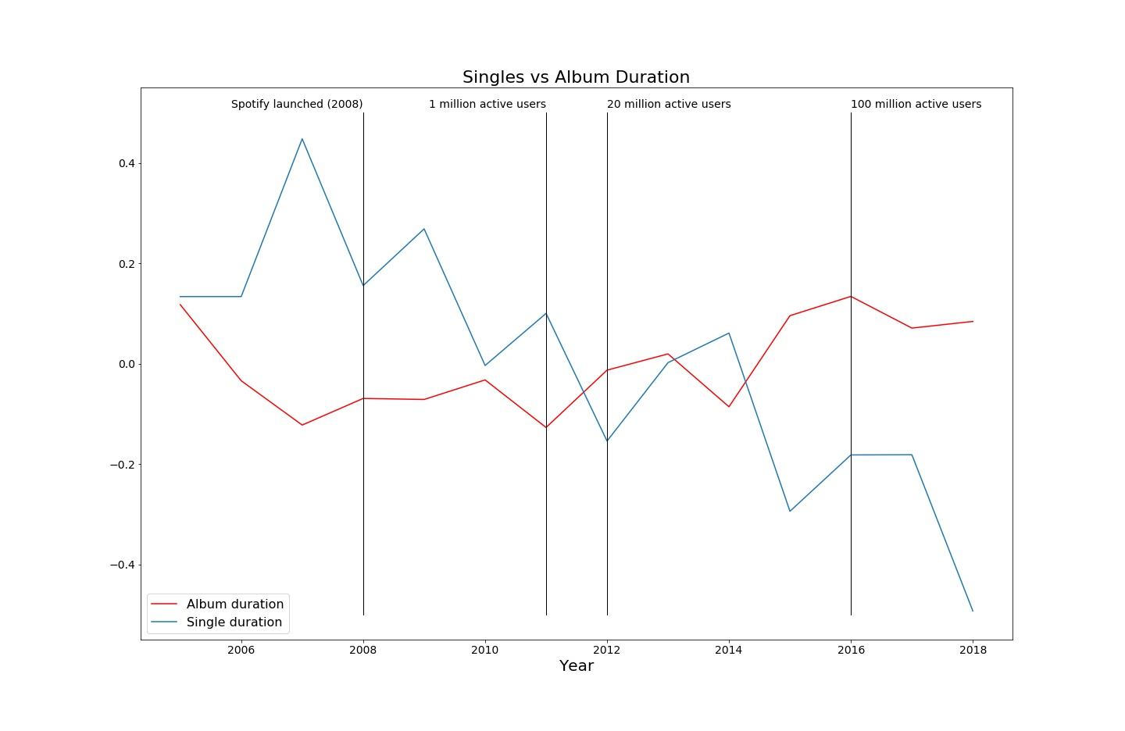

Slide 4
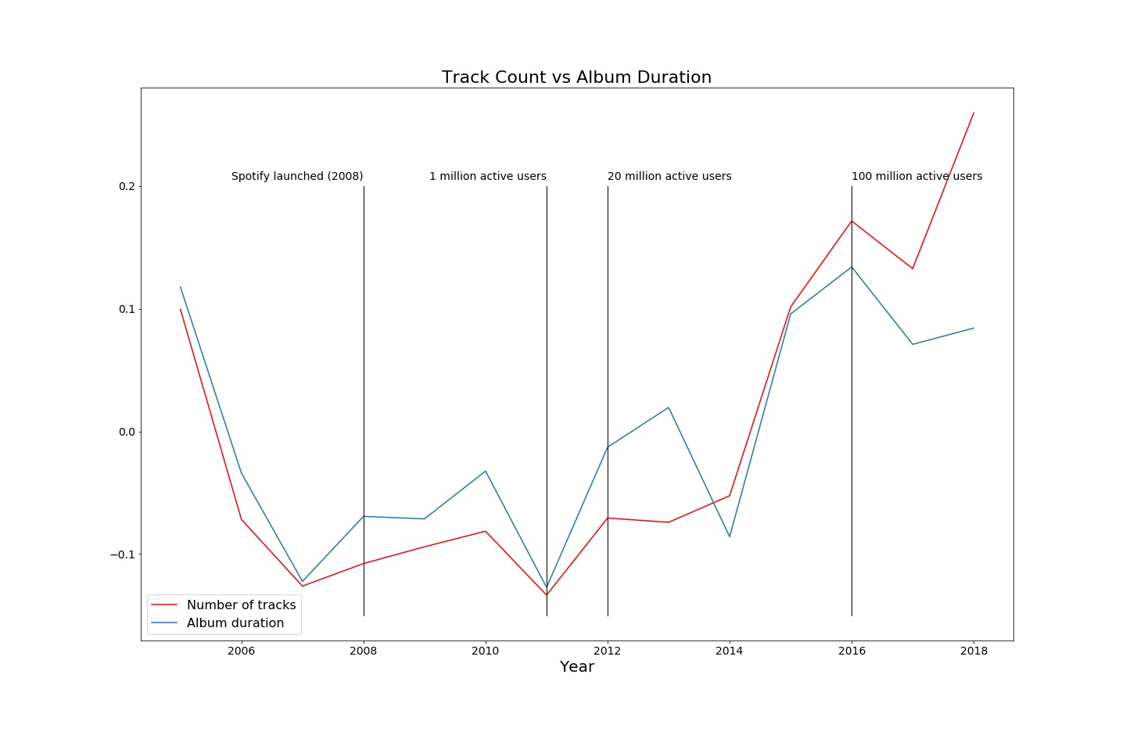

Slide 5
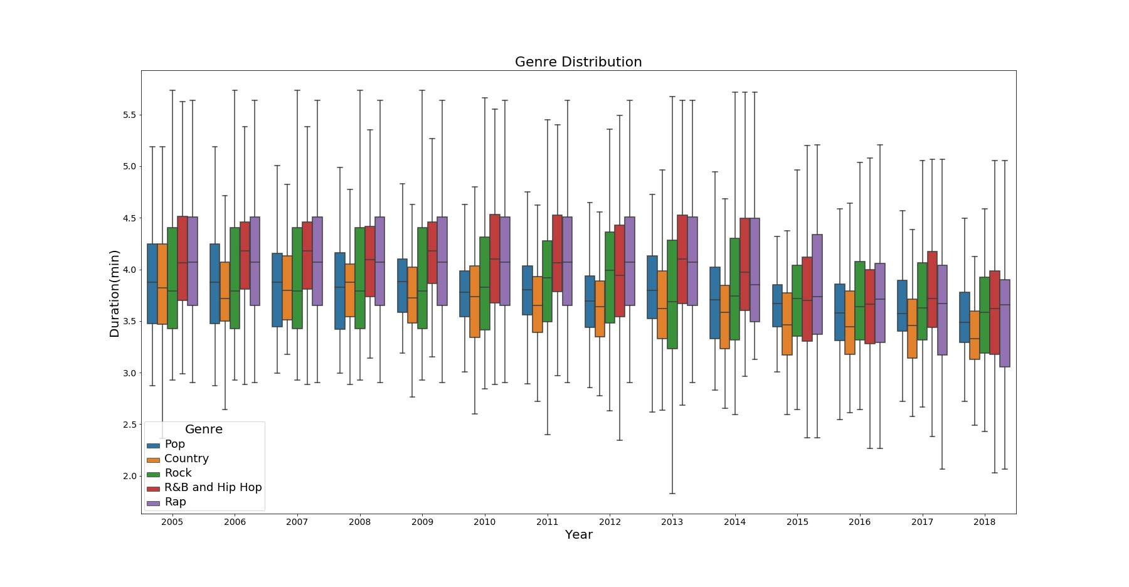

Slide 6
Spotify Audio Features Definitions
Energy - measure of intensity and activity. High energy = fast, loud, and noisy
Danceability - suitability for dancing ie. tempo, rhythm stability, beat strength, and overall regularity
Loudness - loudness in decibels
Valence - musical positivity. High valence sounds happy, low valence sounds sadder
Tempo - beats per minute (BPM)

Slide 7
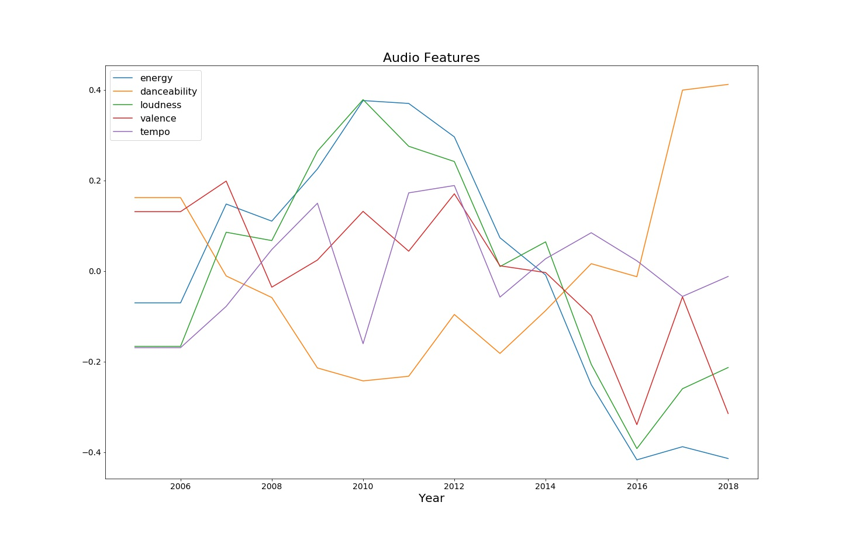

Slide 8
