Slide 1
Patents
Samuel Woolledge
Thomas Pappas

Slide 2
Questions And Data
What are the most innovative countries, according to patent output?
What are the most innovative fields, according to patent output?
What are the top patent assignees for the past 40 Years?
Who owns the most patents and how has this changed over time?
Scraped paft.uspto.gov
Government patent database covering every patent filed since 1980
Used a modified PyPatent Library
Extracted data from html into multiple csv files and compiled all into one big csv file

Slide 3
References
Python Libraries
Pypatent (slightly modified)
Pandas
Numpy
Visualization tools
Datawrapper
Flourish

Slide 4
Answers
Patents related to technology and computers (CPC categories Physics and Electricity) have overtaken patents related to motor vehicles (the previous dominant field).
Companies related to computers and technology have overtaken companies related to vehicles in number of patents owned.
The rise of tech and computer patents preceded (though only slightly) the .com boom - we may be able to look at patent trends in the future as indicators of future fields on interest.
US and Japan were and are the biggest source of patents.

Slide 5
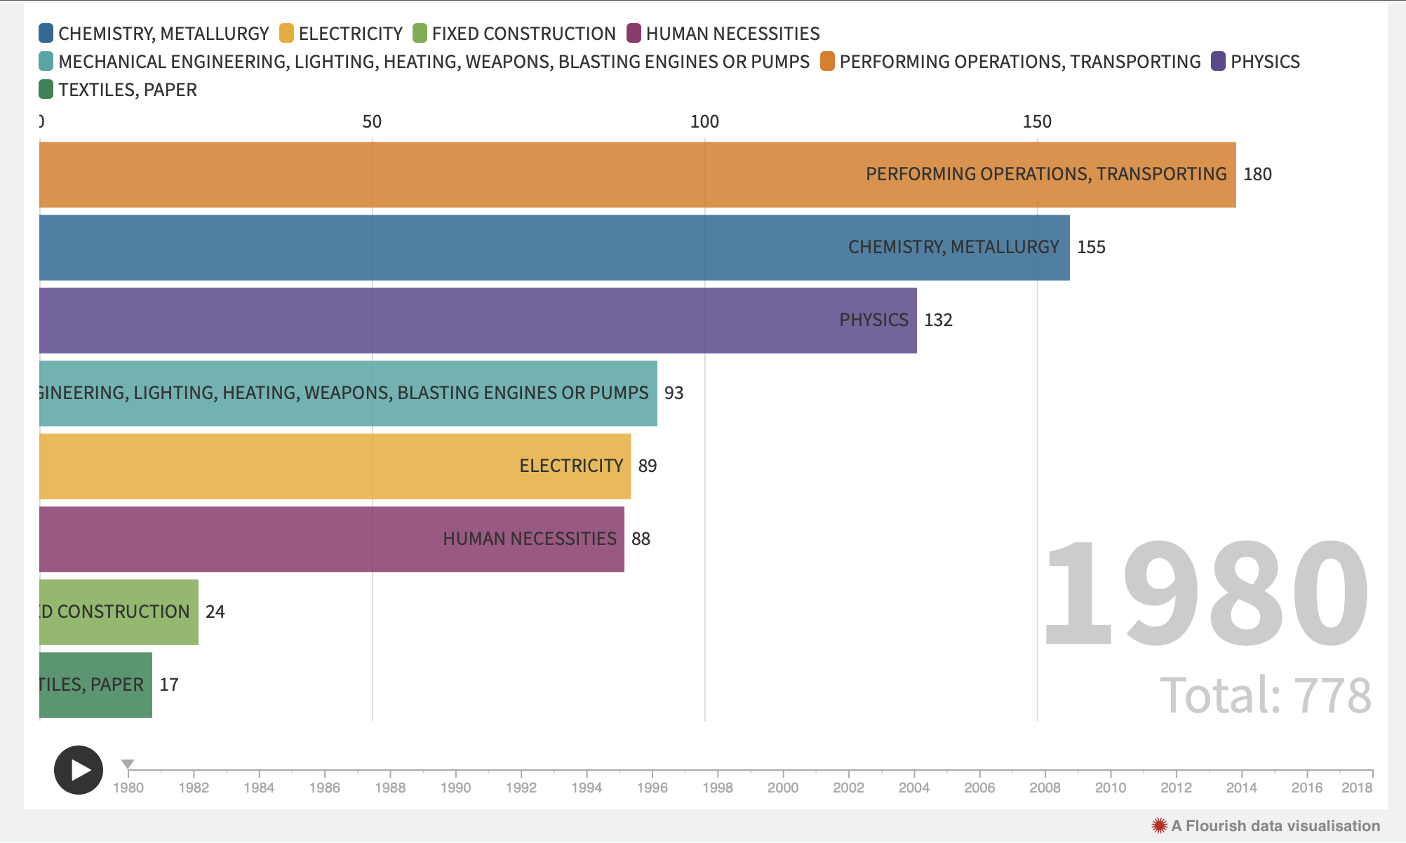
Fields - 1980

Slide 6
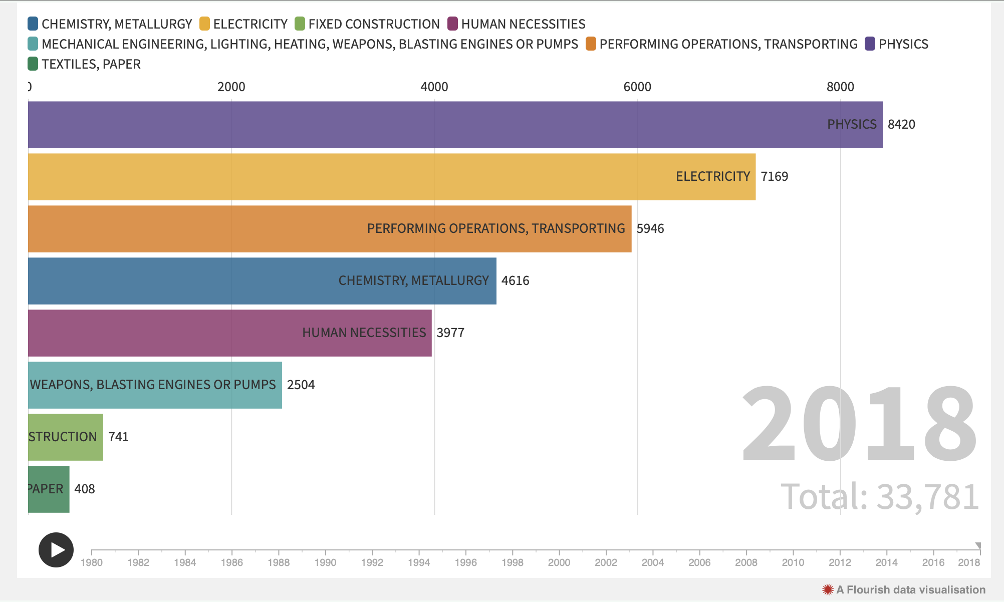
Fields - 2018

Slide 7
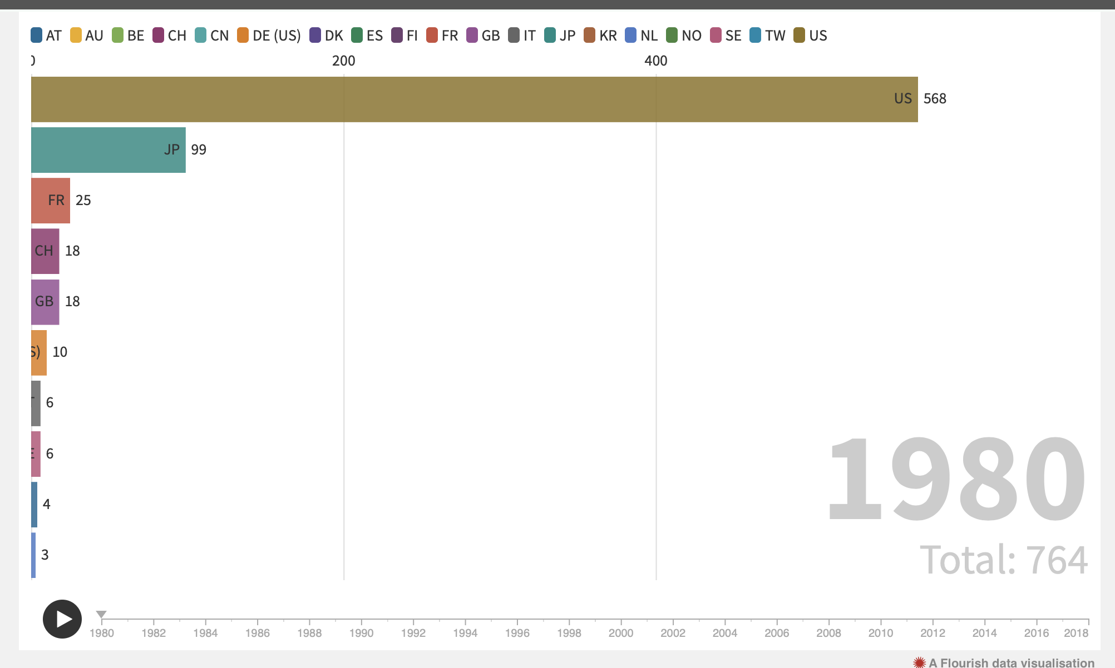
Countries - 1980

Slide 8
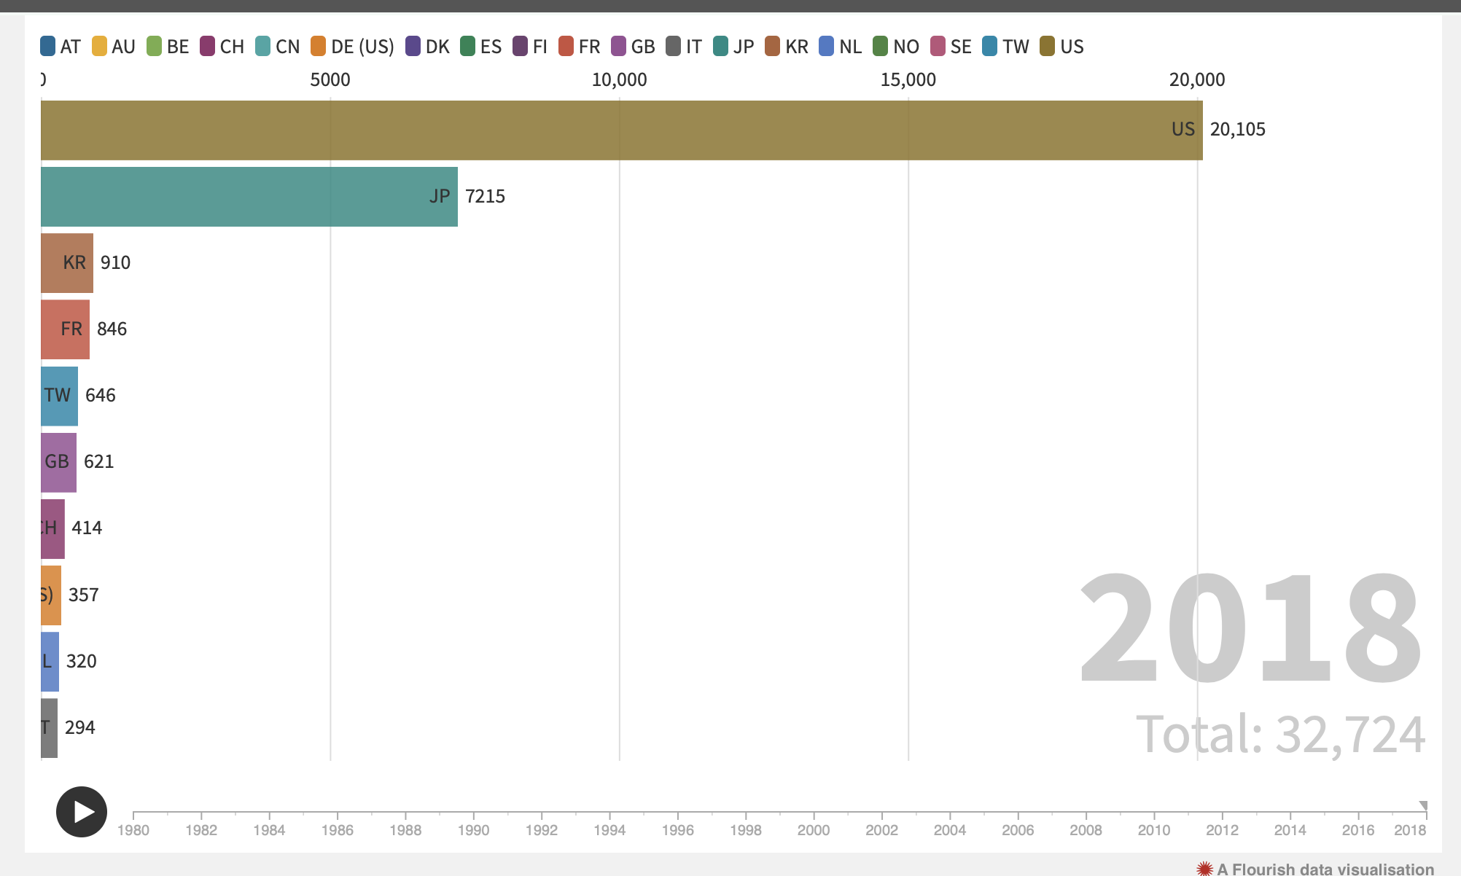
Countries - 2018

Slide 9
